Slide 1
Crazy8s Connect Brainstorming
Participant: Jaoyi, Jeremie, Anthony, Joseph,
New member
2017/02/08

Slide 2
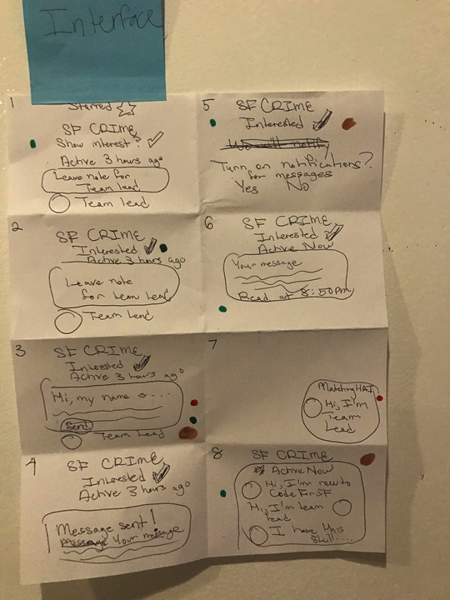
Interface - Anthony
What people liked
Show interests
Messaging with self introduction
A nice way to open conversations at the hacknight

Slide 3
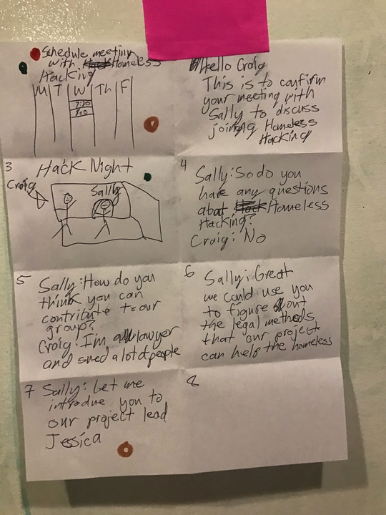
Scheduler -Joseph
What people liked
Scheduled meetings with the core team/ team leads
Be able to actually talk with someone at the hack night

Slide 4
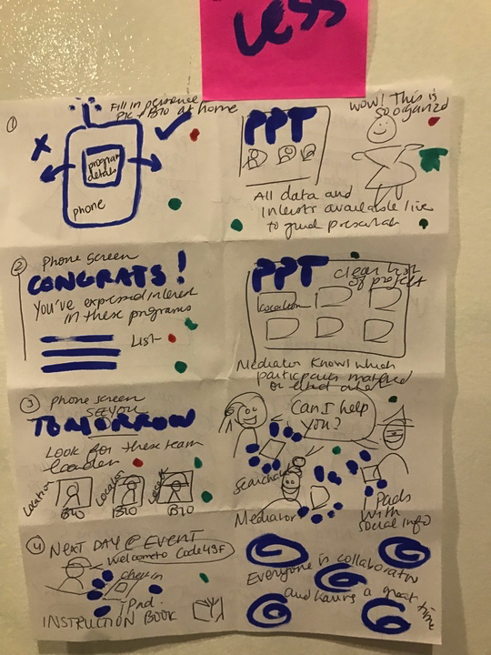
Seamless -Jeremie
What people liked
Be able to fill out the form at home
A list of matches
Pictures of the team leads
Leave the impression that all data and information are ‘well-organized’
A way to start conversations at the hack night

Slide 5
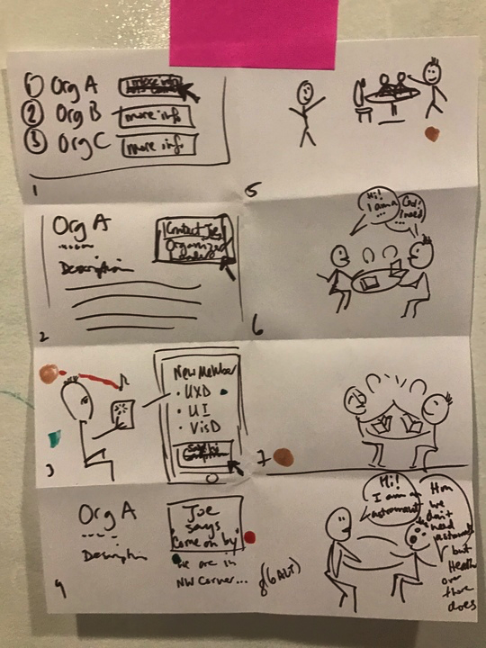
The Match
What people liked
Pleaseant sound/music when matched
Information about locations
Conversation starters at the hacknight

Slide 6
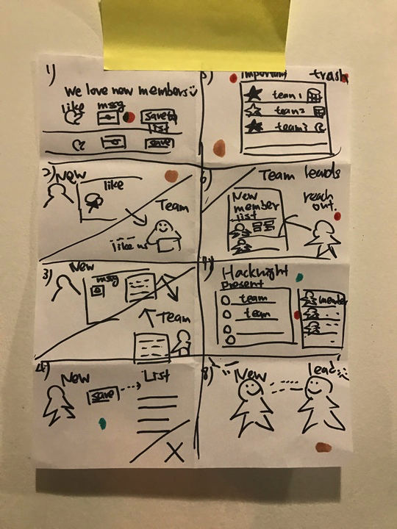
Multi-Connects -Jaoyi
What people liked
A way to message team leads
Be able to save matches
Be able to organize matches, such as marking some as important, or unimportant
Having team leads reach out to new members
Present lists of project teams and new members

Slide 7
Summary
Design
Be able to fill out the form at home
Pleaseant sound/music when matched
A list of matches
Mark as “interested”
Be able to save matches
Be able to organize matches, e.g marked as important, or delete, etc
Message team leads, possibly with self introduction
Pictures of the team leads
Information about locations
Having team leads reach out to new members
Hacknight structure
Serves as conversation opener at the hacknight x3
Be able to talk with a scheduler/core team athack night
Scheduled meetings with the core team/ team leads
Leave the impression that all data and information are ‘well-organized’ (ppt?)
Present lists of project teams and new members that are presentat the hacknight

