Slide 1
Turbofan Engine Remaining-Useful-Life Prediction
NASA C-MAPSS FD001 — 100 run-to-failure engines, 21 sensors
Question: how many cycles until this engine fails?
Answer: HistGradientBoosting, test RMSE 12.74 cycles
Honest band from repeated CV: ~14–15 cycles
Independent portfolio project — public data only
Mukesh Sharma · github.com/designmukesh/turbofan-rul-prediction

Slide 2
The business problem
Unplanned engine removals cost 3–10× a planned shop visit
Fixed-interval overhauls waste healthy life; surprises risk failure
The decision to improve: WHEN to pull an engine
Users: reliability engineers, maintenance planners, fleet managers
Late predictions (saying 'healthy' when it's not) are the dangerous error

Slide 3
The dataset — and what it isn't
NASA C-MAPSS FD001 (Saxena & Goebel, 2008), PHM Society mirror
100 train engines (20,631 cycles) + 100 truncated test engines
21 sensors + 3 operating settings per cycle
SIMULATED data — thermodynamic model, not field data
One operating condition, one fault mode (HPC degradation)
Every claim in this deck is conditional on that

Slide 4
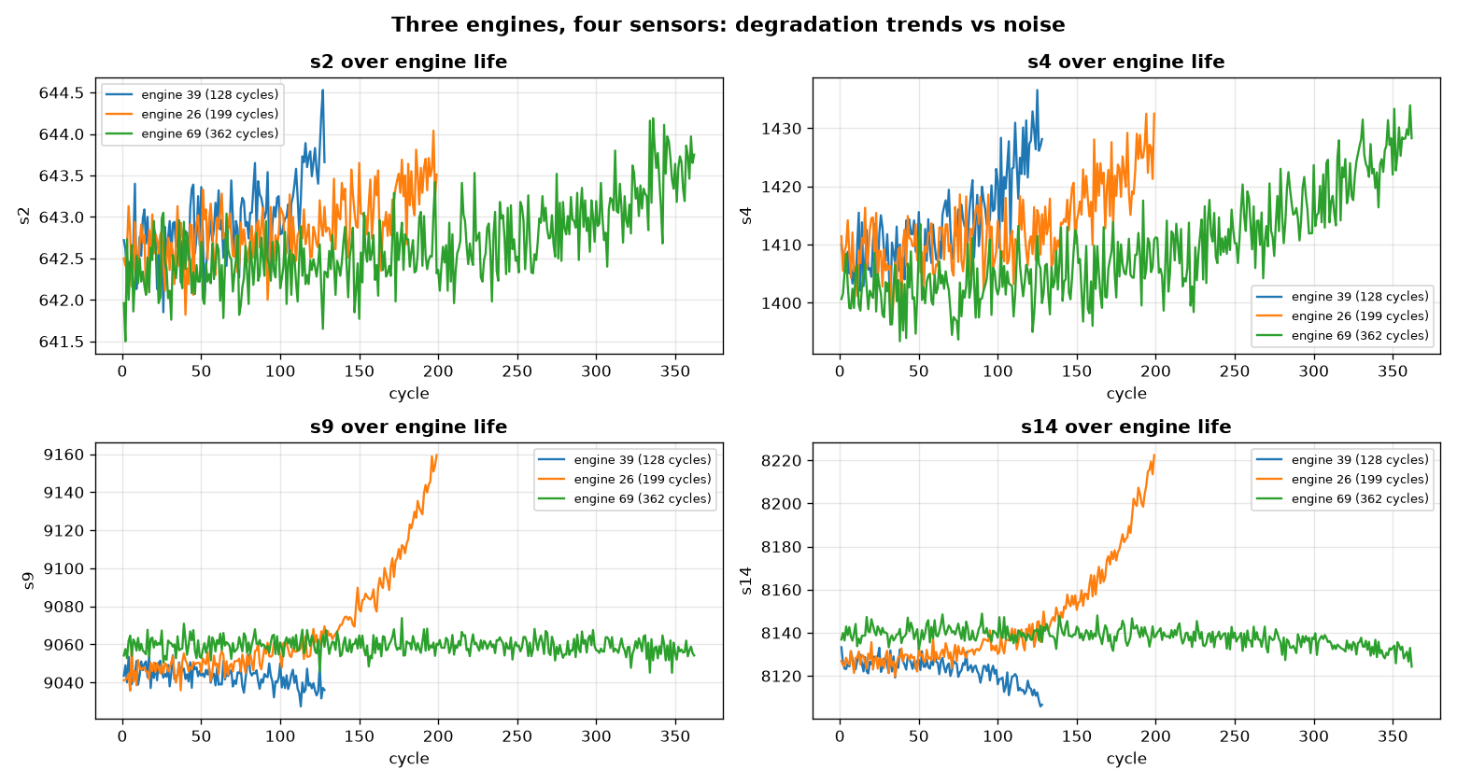
EDA: the signal is visible before any model
7 of 21 sensors never move → dropped; 14 carry degradation trend
Temperatures rise, speeds shift in the last ~100 cycles
Lifespans vary 128–362 cycles — age alone predicts nothing

Slide 5
Solution architecture
per-cycle sensors → 30-cycle sliding windows
→ 84 statistical features (mean/std/min/max/last/slope × 14 sensors)
→ HistGradientBoosting → predicted RUL + trend
→ risk band → illustrative action → HUMAN review → work order
→ outcome feedback → retrain
The model advises; certified processes decide.
Batch scoring daily is enough — RUL moves slowly.

Slide 6
Feature engineering: transparent by design
One cycle has no trend — windows give the model history
Six statistics per sensor: distribution (mean/std/min/max),
recency (last), and within-window slope (the trend)
All 84 features are physics-readable: a rising s3 slope
means the HPC outlet is actively getting hotter
No black-box embeddings; nothing the domain can't interrogate

Slide 7
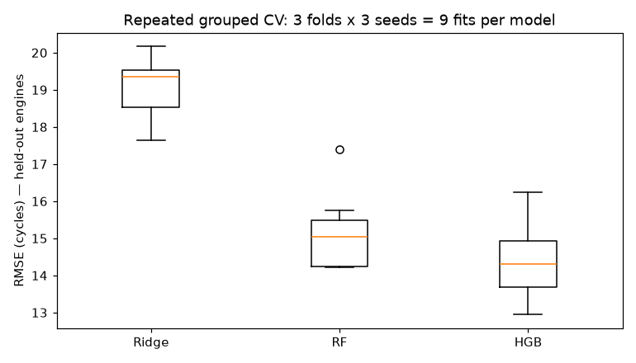
Validation: designed to be hard to fool
Split by ENGINE, never by window (overlaps would leak)
Model selection on 20 validation engines; test set scored ONCE
Repeated grouped CV: 3 folds × 3 seeds = 9 fits per model
Unit tests for windowing, labels, and metrics (pytest, 10 tests)

Slide 8
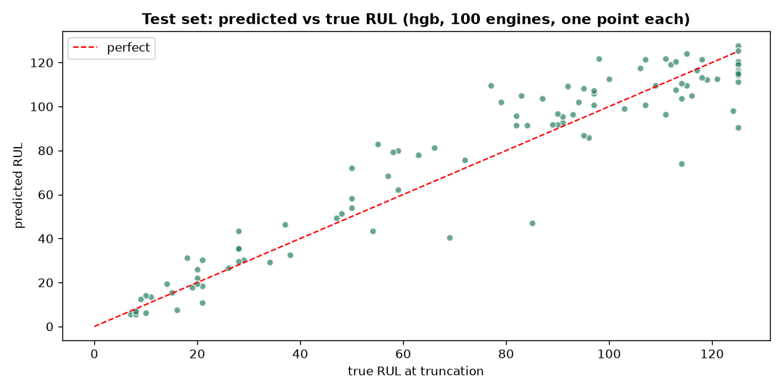
Results
HGB: test RMSE 12.74 · PHM 247 · CV 14.40 ± 0.93
RF: 13.48 / 307 · Ridge baseline: 17.43 / 484
Ranking HGB > RF > Ridge holds across all 9 CV fits
Honest expectation for new engines: ~14–15, not 12.7
Most precise near failure: 4.83 RMSE in the 0–30 cycle band

Slide 9
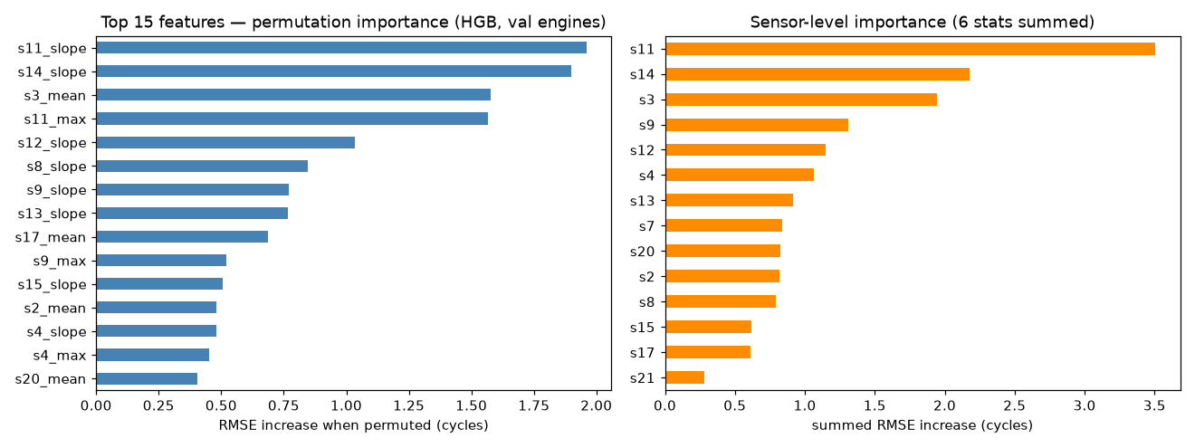
Explainability: the model watches change, not levels
7 of top 8 features are _slope — it learned degradation as a process
Top channels: HPC outlet pressure/temp, core speeds
— exactly what HPC-degradation thermodynamics predicts
Ablation: worst single-sensor loss +0.64 RMSE → no sensor is load-bearing
Permutation and ablation disagree on rankings — so neither is trusted alone

Slide 10
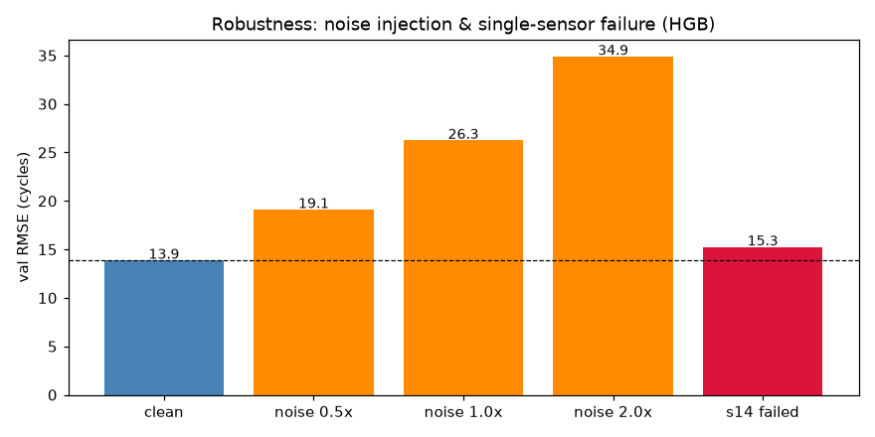
Robustness: what's fragile
Seed-stable: 13.49–14.18 over 5 seeds — not luck
Noise-sensitive: +5.2 RMSE at 0.5× sensor noise — TOP RISK
(field sensors are noisier than sim sensors → harden with noise-augmented training)
Survives worst-sensor failure via imputation (+1.37) — graceful
Leans optimistic: late errors dominate PHM 2.6× → needs conservative margin

Slide 11
From prediction to product
Streamlit demo: pick an engine → traces, RUL curve, risk band, action
Decision flow, not just 'RUL = 42': who sees it, what threshold
triggers what, who signs off, what a false alarm costs
Rollout: shadow mode → advisory → constrained automation
KPIs that matter: false alarms/100 cycles, warning lead time,
unplanned removals avoided — not just RMSE

Slide 12
Limitations — volunteered, each with a next experiment
Simulated, single condition/fault → FD002–FD004 next
100-point test set is a noisy ruler → wider CV already reported
Point predictions only → quantile intervals for planners
Noise-sensitive → noise-augmented training
Never validated prospectively → shadow-mode protocol
Nothing here claims savings, deployment, or field accuracy.
The limitations section is a feature: it's what makes the rest believable.

