Slide 1
AI/ML Threat Modeling

Slide 2
What is ML
Linear Regression
Use Case: Predicting housing prices based on features like size, location, and age of the property.
Logistic Regression
Use Case: Classifying emails as spam or non-spam.
Decision Trees
Use Case: Diagnosing patients based on symptoms for medical decision-making.
Random Forest
Use Case: Credit scoring to determine the creditworthiness of loan applicants.
Support Vector Machines (SVM)
Use Case: Image classification in computer vision applications.
Gradient Boosting Machines (GBM)
Use Case: Improving weather forecasting by combining multiple weak prediction models.
Deep Learning (Neural Networks)
Use Case: Voice recognition in virtual assistant devices, LLMs, etc.

Slide 3
Neural network

Slide 4
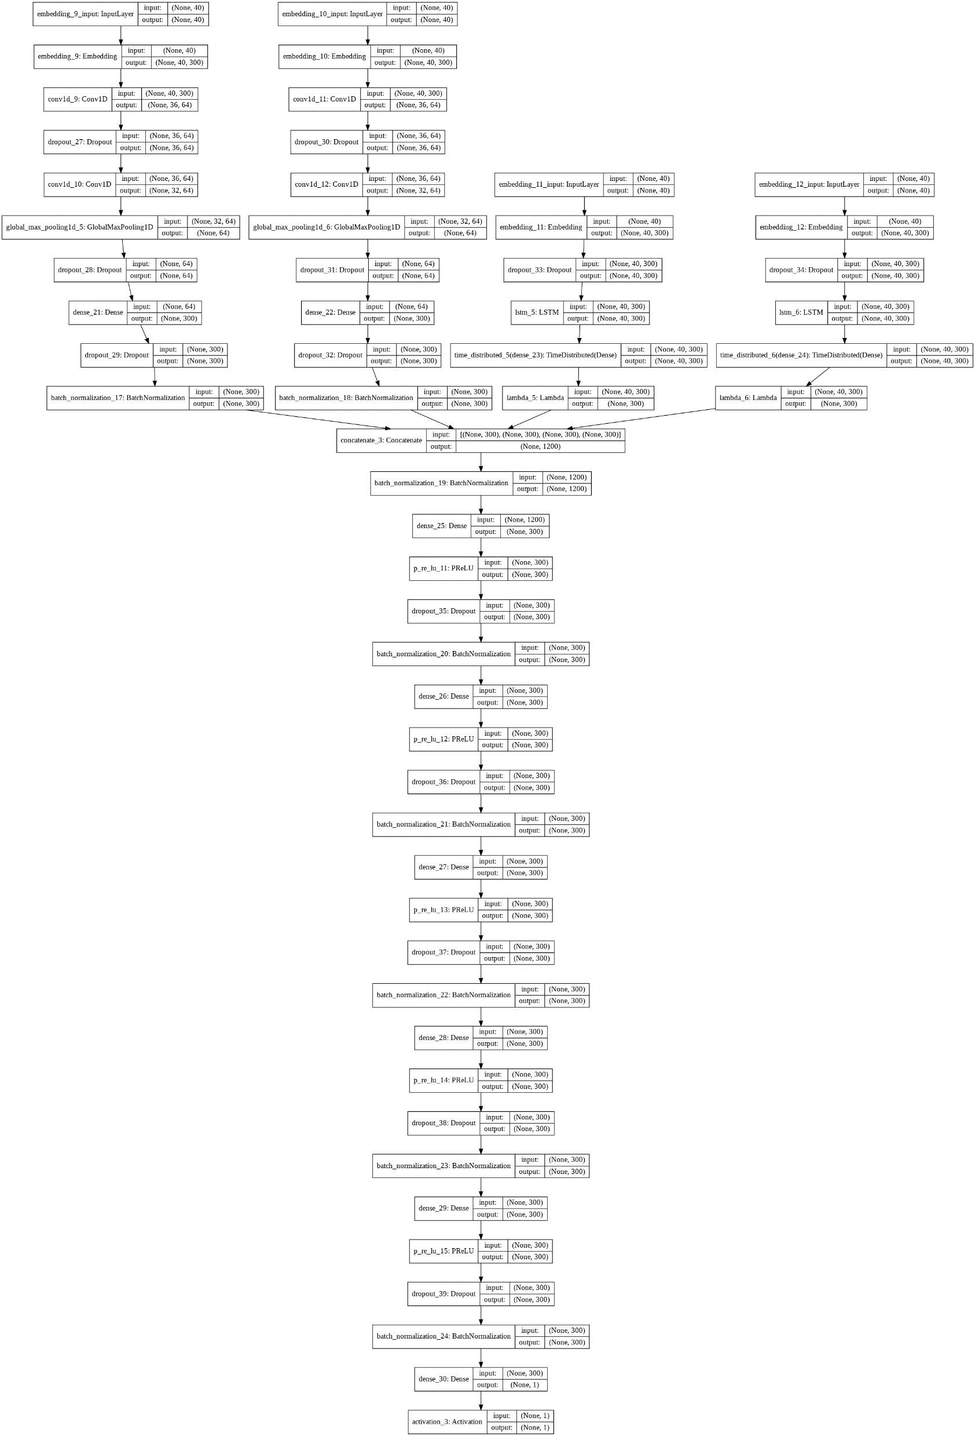
How it actually looks like

Slide 5
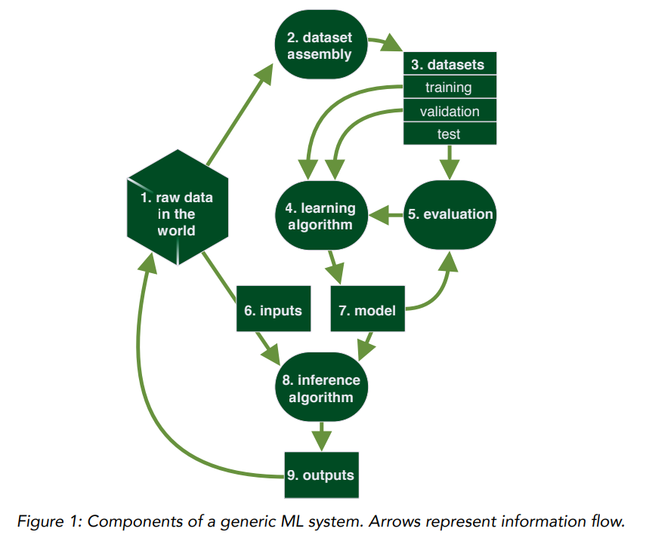
Generic ML Workflow

Slide 6
Some terms
Neuron: The basic unit of computation in a neural network, modeled after biological neurons. It receives input, processes it, and generates output.
Activation Function: A function used in a neuron to introduce non-linearity into the output of a neuron. Common examples include ReLU (Rectified Linear Unit), sigmoid, and tanh.
Layer: A collection of neurons in a neural network. There are different types of layers, including input, hidden, and output layers.
Input Layer: The first layer in a neural network that receives the input data.
Hidden Layer: Layers between the input and output layers. They are not exposed to the input or output directly but play a crucial role in learning complex patterns in data.

Slide 7
Some more terms
Output Layer: The final layer in a neural network that produces the output for the given problem.
Backpropagation: A method used for training neural networks, where the error is propagated backward through the network to update the weights.
Dropout: A regularization technique where randomly selected neurons are ignored during training. It helps prevent overfitting.
Learning Rate: A hyperparameter that controls how much to change the model in response to the estimated error each time the model weights are updated.
Epoch: One complete presentation of the entire dataset to be learned to a learning machine. Training a neural network typically involves multiple epochs.
Batch Size: The number of training examples used in one iteration of model training.

Slide 8
And some more…
Loss Function: A function that measures the difference between the actual output and the predicted output of the model. Common examples include mean squared error and cross-entropy.
Optimizer: An algorithm or method used to change the attributes of the neural network, such as weights and learning rate, to reduce losses. Examples include SGD (Stochastic Gradient Descent), Adam, and RMSprop.
Regularization: Techniques used to prevent overfitting, which include methods like L1 and L2 regularization, dropout, and early stopping.
Hyperparameters: These are the settings or configurations that govern the overall behavior of a machine learning model. Unlike model parameters, which are learned from the data, hyperparameters are set prior to the training process. Examples include the learning rate in neural networks or the number of trees in a random forest.
Overfitting: This occurs when a machine learning model learns not only the underlying patterns in the training data but also the noise and random fluctuations. As a result, it performs very well on the training data but poorly on new, unseen data.
Underfitting: Opposite to overfitting, underfitting happens when a model is too simple to capture the complexity of the data. It doesn't learn the underlying patterns well enough, leading to poor performance on both the training data and new data.
Backtracking: In the context of algorithms and programming, backtracking is a strategy for finding solutions to problems incrementally, one step at a time, and removing those steps that fail to satisfy the conditions of the problem at any point.

Slide 9
Last ones
Bias: Bias in the data or model predictions, where certain groups or types of data are unfairly favored or ignored, leading to less accurate or equitable outcomes.
Weights: In the context of machine learning models, weights are the parameters that are learned during training. They determine the importance of different features in making predictions. For instance, in a neural network, weights are adjusted during training to minimize the prediction error.
Embeddings: In machine learning, especially in natural language processing, embeddings are dense representations of words, sentences, or other entities in a continuous vector space. They capture semantic meanings and relationships, making them useful for various tasks like text classification or sentiment analysis.
Metrics
Accuracy: (TP + TN) / (TP + TN + FP + FN). This is the proportion of total cases that were correctly classified.
Precision: TP / (TP + FP). This is the proportion of predicted positive cases that were correct.
Recall (Sensitivity): TP / (TP + FN). This measures the proportion of actual positive cases that were identified correctly.
Specificity: TN / (TN + FP). This measures the proportion of actual negative cases that were identified correctly.
F1 Score: 2 * (Precision * Recall) / (Precision + Recall). This is the harmonic mean of precision and recall, providing a balance between them.

Slide 10
Factors affecting ML Security
Dataset Risks
Learning Risks
Evaluation/Testing Risks
Inputs
ML Model Risks
Inference Risks
Output

Slide 11
Dataset Risks
Data Confidentiality
Storage
Legal
Data Encoding
Data Feature Risk
Latency for Inputs
Data Annotation
Data Similarity/Disimilarity

Slide 12
Learning Risks
Reproducibility
Algorithm
Features
Noise
Hyperparameters

Slide 13
Evaluation Risks
Underfitting/Overfitting
Evaluation Data Quality
Evaluation Metrics

Slide 14
Inputs
Malicious Input
Looped Input
Reinforcement Learning

Slide 15
ML Model Risks
Improper Re-use
Trojan Models
Training Set Reveal
Reverse Engineering

Slide 16
Inference Risks
Confidence Scores
Inscrutability
Reinforcement Learning Risk

Slide 17
Output
Unverified/Unsanitised Output
Provenance
Reinforcement Learning Risk

