Slide 1
NOSQL for the SQL dev
Santosh Hari

Slide 2
Agenda
NoSQL concepts
Families of NoSQL
Decisions
NoSQLDB-as-a-service

Slide 3
Some NoSQL basics
Why?
CAP Theorem
Consistency, Availability and Parititioning
3Vs
Volume, Velocity and Variety

Slide 4
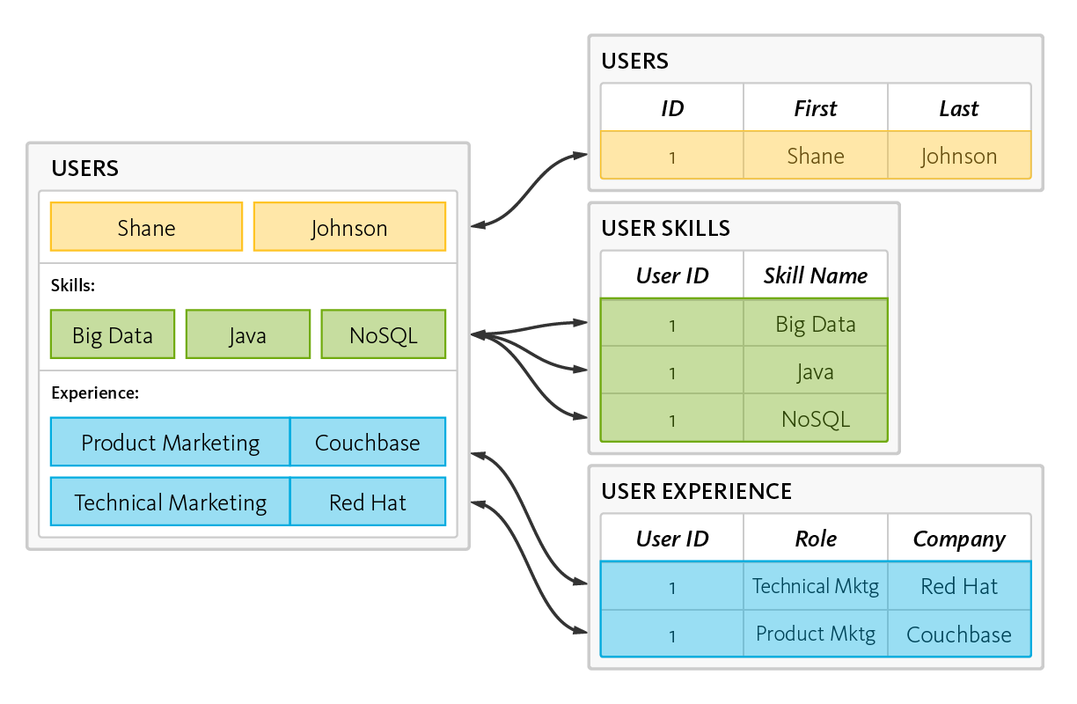
RDBMS – Reads, Writes, data shredding and reassembling
Notes:
data is read and written by disassembling, or “shredding,” and reassembling objects
This is the object-relational “impedance mismatch.”
The workaround is object-relational mapping frameworks, which are inefficient at best, problematic at worst.

Slide 5
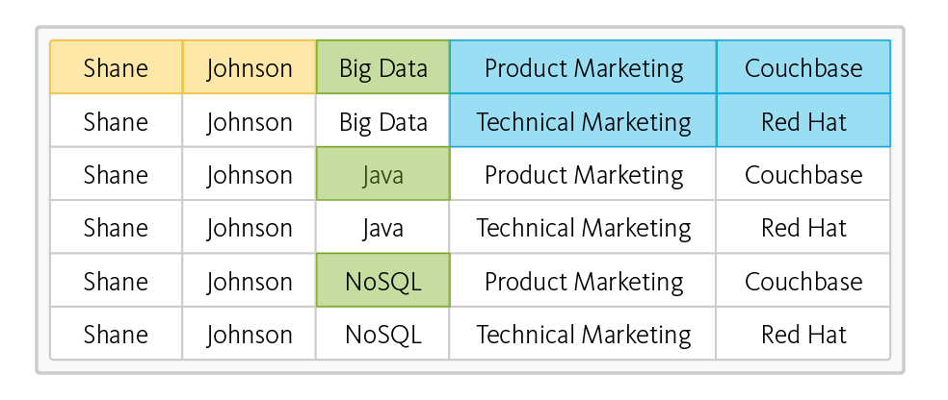
RDBMS – read operation – takes six rows from three tables
Impedance Mismatch
Notes:
This is the object-relational “impedance mismatch.”
The workaround is object-relational mapping frameworks, which are inefficient at best, problematic at worst.

Slide 6
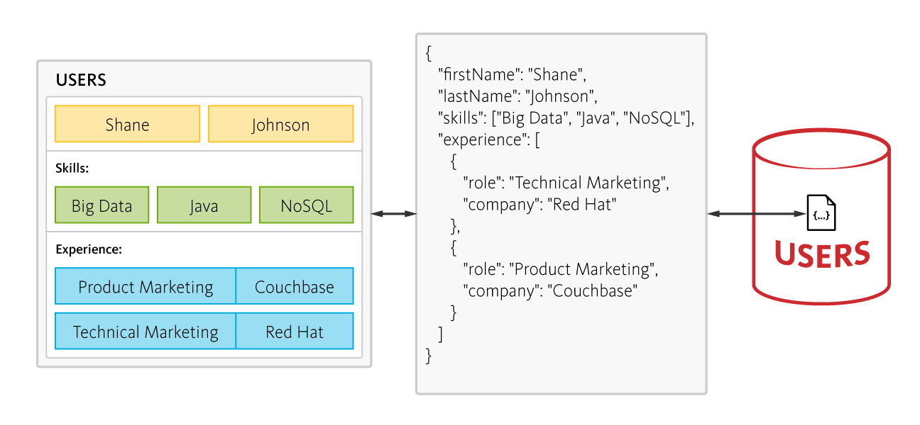
NoSQL – 6 rows of data, no joins, one fetch
Notes:
In contrast, a document-oriented NoSQL database reads and writes data formatted in JSON –
which is the de facto standard for consuming and producing data for web, mobile, and IoT applications.
It not only eliminates the object-relational impedance mismatch,
it eliminates the overhead of ORM frameworks and simplifies application development
because objects are read and written without “shredding” them – i.e., a single object can be read or written as a single document, as illustrated here:
DO NOT SWITCH SOLELY FOR THIS REASON!!!

Slide 7
RDBMS – Scale Vertical Single Server
Application
Concurrent Connections
L
Server load
M
S
Increase in Users
Notes:
Database has to be able to scale reads, writes, and storage
Several years ago, building performance into a software system was simple –
you either increased your hardware resources (scale up) or modified your application to run more efficiently (performance tuning).
Today, there’s a third option: horizontal scaling (scale out).

Slide 8
RDBMS – Scale Vertical Single Server
Concurrent Connections
Negative User Experience
Server efficiency
Postive User Experience
Server load
Unused
Capacity
Increase in Users
Notes:
Scaling up on single machine
User experience good until server efficiency reached
After exceeding server efficiency, user experience sucks
Almost half of capacity unused
Horizontal scaling – positives – unlimited scaling – negative – complexity
Data records vary across clients/nodes in different locations. Single points of failure destroy system up-time, and intermittent network issues creep up at the worst possible time

Slide 9
Scale horizontal many servers
Application
NoSQLDB
NoSQLDB
NoSQLDB
Notes:
As application usage increases keep adding nodes
Even if nodes fail, system is able to keep responding
NoSQL scale out – run on commodity hardware on multiple nodes
Easy to add and remove nodes to handle loads
No single PoF
Flexibility in handling trade offs (CAP Theorem)

Slide 10
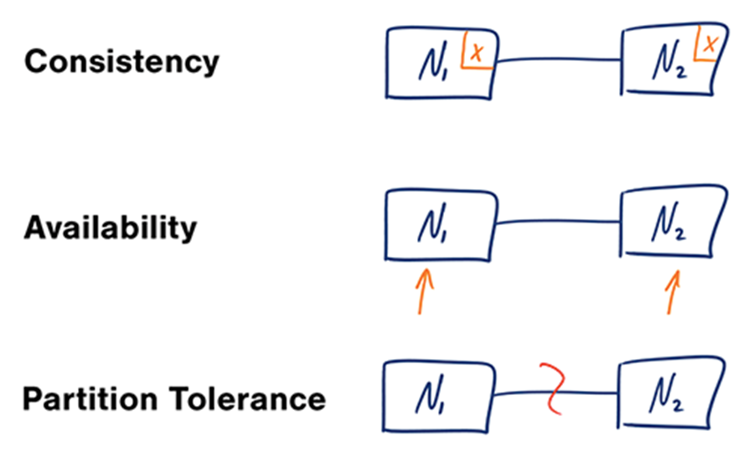
CAP Theorem
Notes:
Applies for distributed systems in general
Consistency - A read is guaranteed to return the most recent write for a given client.
Availability - A non-failing node will return a reasonable response within a reasonable amount of time (no error or timeout).
Partition Tolerance - The system will continue to function when network partitions occur.
Widely distributed aka networking factors comes into play. Object Oriented Programming != Network Programming.
One such fallacy of distributed computing is that networks are reliable. They aren’t. Networks and parts of networks go down frequently and unexpectedly. Network failures happen to your system and you don’t get to choose when they occur.

Slide 11
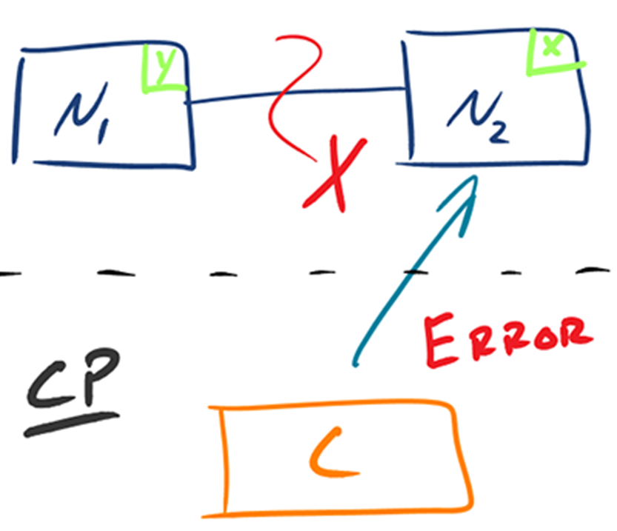
CAP Reality 1 – Consistent+Partition Tolerant
Notes:
Given that networks aren’t completely reliable, you must tolerate partitions in a distributed system, period.
Fortunately, though, you get to choose what to do when a partition does occur.
Wait for a response from the partitioned node which could result in a timeout error
OR
The system can also choose to return an error, depending on the scenario you desire.
Choose Consistency over Availability when your business requirements dictate atomic reads and writes.

Slide 12
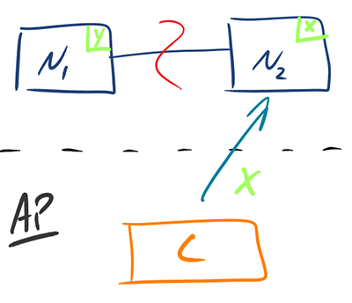
CAP Reality 2 – Availability + Partition Tolerant
Notes:
Return the most recent version of the data you have, which could be stale.
This system state will also accept writes that can be processed later when the partition is resolved.
Choose Availability over Consistency when your business requirements allow for some flexibility around when the data in the system synchronizes.
Availability is also a compelling option when the system needs to continue to function in spite of external errors (shopping carts, etc.)

Slide 13
ACID becomes BASE
Atomic Consistent Isolated Durable – relational – RDBMS
Basically Available Soft state Eventually consistent – NoSQL
Notes:
Basically available - Guarantees availability aka a response will get a request even if error
Soft State – changes over time and could even change when no incoming data because catching up
Eventual consistency – when writes stop for a while, system becomes consistent with time

Slide 14
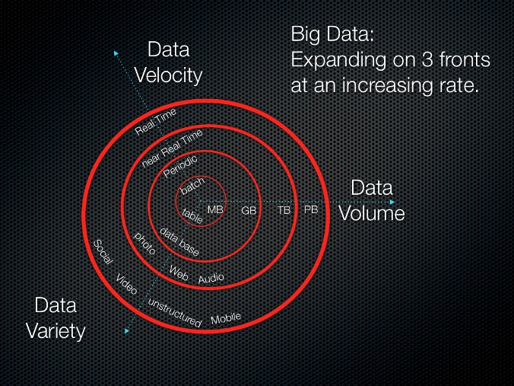
3Vs
Notes:
Volume: Facebook has over 250 billion images in 2015, ToDoList has 10 million installs
Velocity: Facebook has over 900 million photos/day.
Variety: Some large company CRMs have data in spreadsheets, docs, pdfs, audio, video, emails and so on

Slide 15
Families of NoSQL
Document Store NoSQL Database – MongoDB, Cosmos SQL API
Graph Base NoSQL Database - Neo4J, Gremlin
Key Value Store NoSQL Database – Redis
Column Store NoSQL Database – Cassandra, Hbase

Slide 16
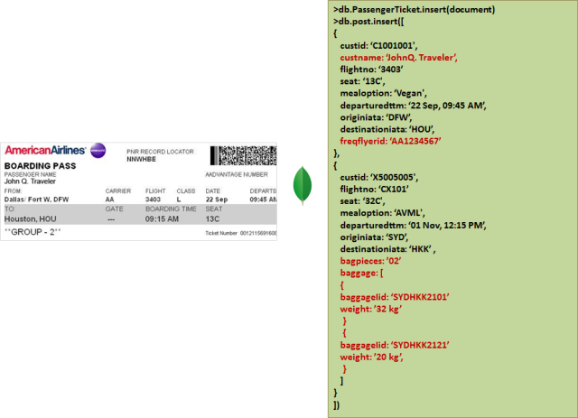
Document
Notes:
Document databases pair each key with a complex data structure known as a document.
Documents can contain many different key-value pairs, or key-array pairs, or even nested documents. Mongo, CosmosDB SQL

Slide 17
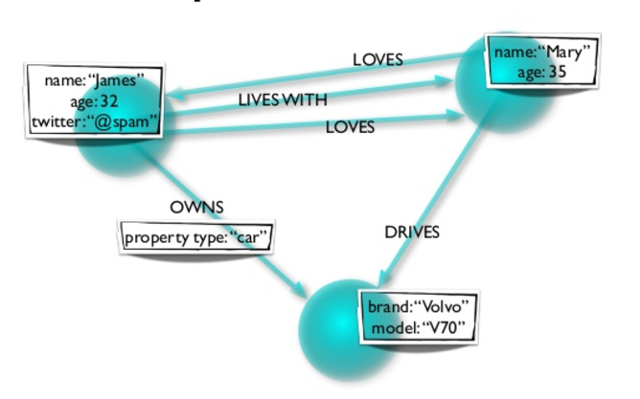
Graph
Notes:
Data in real world is naturally connected. Traditional data modeling focuses on entities.
model the rich relationships between entities.
Graphs allow you to model both entities and relationships naturally.
composed of vertices and edges.
Vertices denote discrete objects such as a person, a place, or an event.
Edges denote relationships between vertices

Slide 18
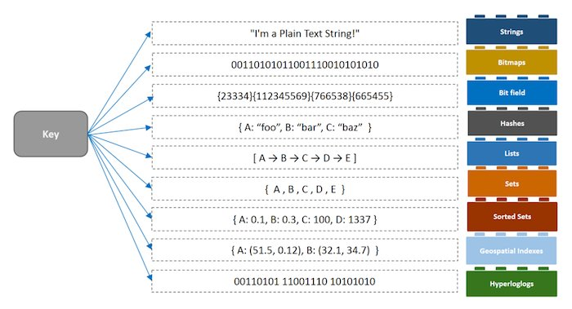
Key-Value
Notes:
Key-value stores are the simplest NoSQL databases.
Every single item in the database is stored as an attribute name (or 'key'), together with its value.
Examples of key-value stores are Riak and Berkeley DB.
Some key-value stores, such as Redis, allow each value to have a type, such as 'integer', which adds functionality.

Slide 19
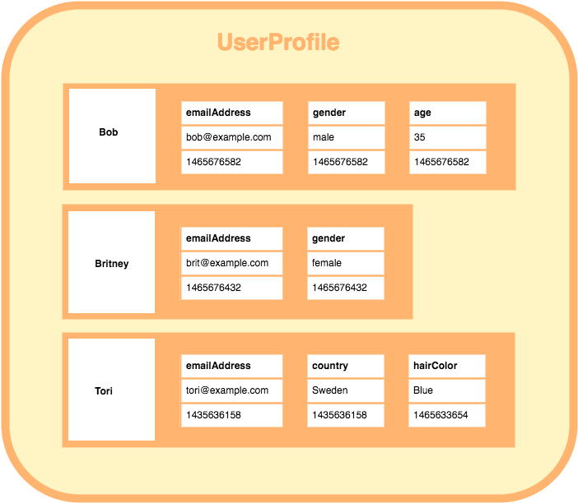
Wide Column
Notes:
Wide-column stores such as Cassandra and HBase are optimized for queries over large datasets,
store columns of data together, instead of rows.
Based on the theory that certain columns or group of columns are more likely to be requested together than entire row
well-suited for OLAP-like workloads (e.g., data warehouses)
Pre-processing needed

Slide 20
Decision Time!!!
Should I switch from SQL to NoSQL?
(spoiler alert: NO!! Go Polyglot)
Should I use NoSQL DBaaS?
(spoiler alert: *bleeping* yes)

Slide 21
Should I switch from SQL to NoSQL?
 | SQL | NoSQL
Model | Relational | Non-relational
Storage | Tables | JSON docs, Key-value pairs, column stores, graphs
Data Properties | Every record in table has same properties | Flexibility in properties varies across records
Relationships | Uses joins | Uses denormalization
Schema | Strict | Flexible
ACID transactions | Supports | Varies by solution
Data Consistency | Strong | Variable
Scale | Vertical | Horizontal
Notes:
Does it meet 3Vs?
Are you ok flexible on consistency
Do you want to host it yourself or as a managed service
Design for polyglot persistence – SQL and different families of NoSQL depending on data and use case

Slide 22
NoSQL Database-as-a-service
Factors to consider
TCO
Consistency
Throughput
Latency
Availability
Partitioning
Global Distribution

Slide 23
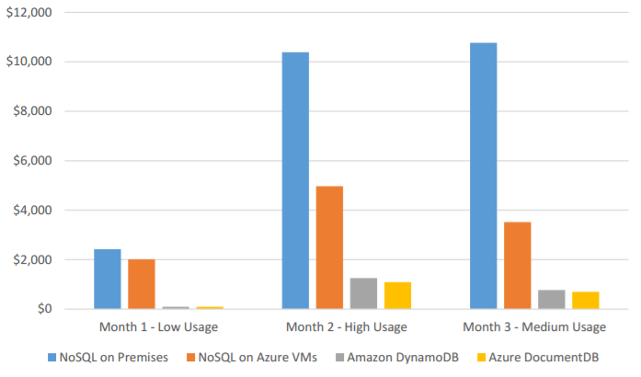
Total Cost of Ownership

Slide 24

Consistency
Strong
Eventual
Notes:
Most systems make you pick between strong and eventual consistency.
Pick systems that creatively allow for middle ground

Slide 25
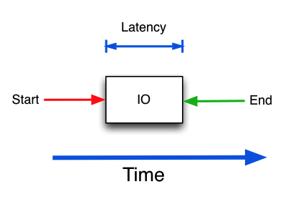
Latency
How long do reads and writes take? Single or low double digit milliseconds is ideal
What percentile (50? 90? 99?) of read-writes?
When you scale how long does it take for new instances to catch up?
Notes:
How long do reads and writes take? Single or low double digit milliseconds is ideal
What percentile (50? 90? 99?) of read-writes?
When you scale how long does it take for new instances to catch up?

Slide 26
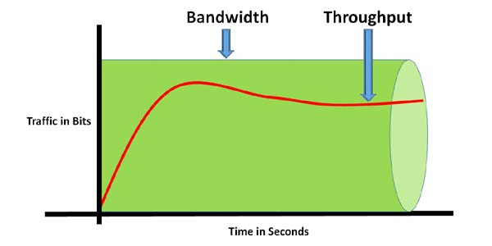
Throughput
Throughput = amount of items passing through a system (in and out)
Throughput for CRUD operations?
Currency of database systems
Should be adjustable
Notes:
Provisioning throughput for a DBaaS
Throughput = amount of items passing through a system (in and out)
Throughput for CRUD operations?
Currency of database systems
Should be adjustable

Slide 27
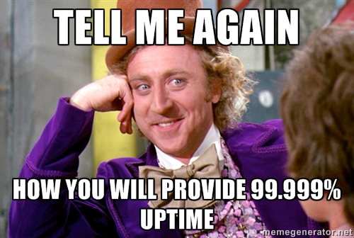
Availability

Slide 28
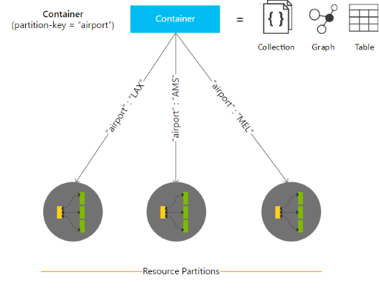
Partitioning
Notes:
Partitioning strategy is the single most important decision you will make
UserId
DeviceId
LocationId

Slide 29
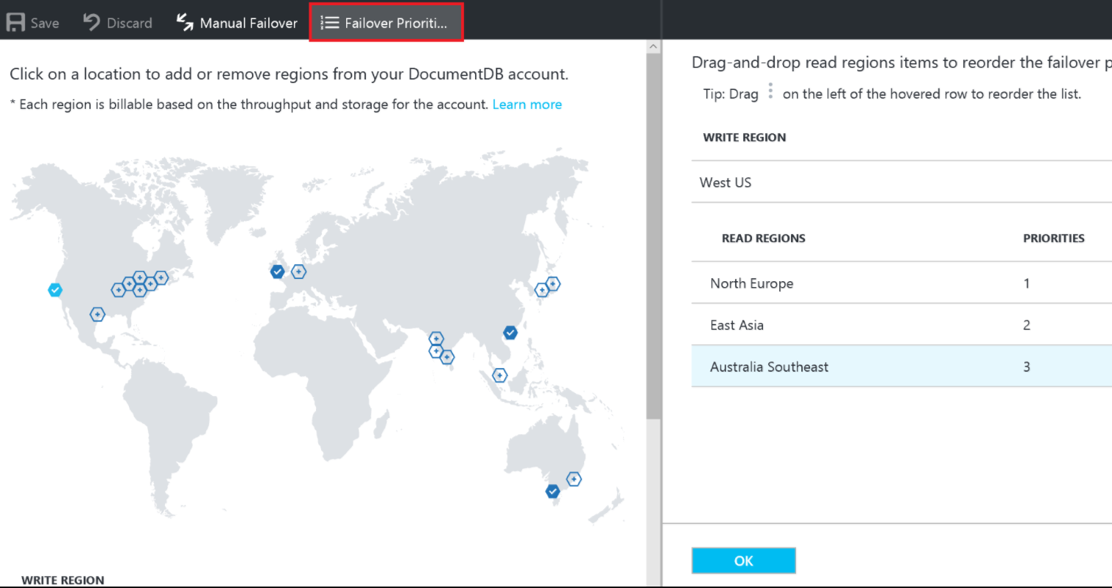
Global Distribution
Notes:
If you have a global distro how fast can you spin up instances across the globe
How fast do these instances operate at full capacity
What is the read-write strategy for multiple instances
One master or multiple masters?

Slide 30




Microsoft Azure MVP
President ONETUG
Organizer Orlando Codecamp
Director of Tech, Konacom
SME and Consultant
@santoshhari
@desinole
@_s_hari

