Slide 1
Serverless and Schema-less w/ Azure Functions and CosmosDB
Santosh Hari

Slide 2




Microsoft Azure MVP
President ONETUG
Organizer Orlando Codecamp
Director of Tech, Konacom
SME and Consultant
@santoshhari
@desinole
@_s_hari

Slide 3

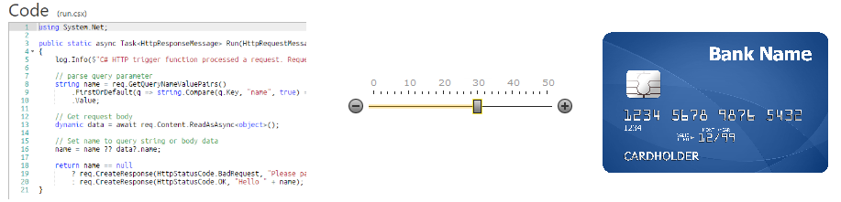
Azure Functions
*Image copied from Hanselman
Notes:
Functions is the natural evolution of WebJobs in that it takes the best things about WebJobs and improves upon them. The improvements include:
Streamlined dev, test, and run of code, directly in the browser.
Built-in integration with more Azure services and 3rd-party services like GitHub WebHooks.
Pay-per-use, no need to pay for an App Service plan.
Automatic, dynamic scaling.
For existing customers of App Service, running on App Service plan still possible (to take advantage of under-utilized resources).
Integration with Logic Apps.

Slide 4
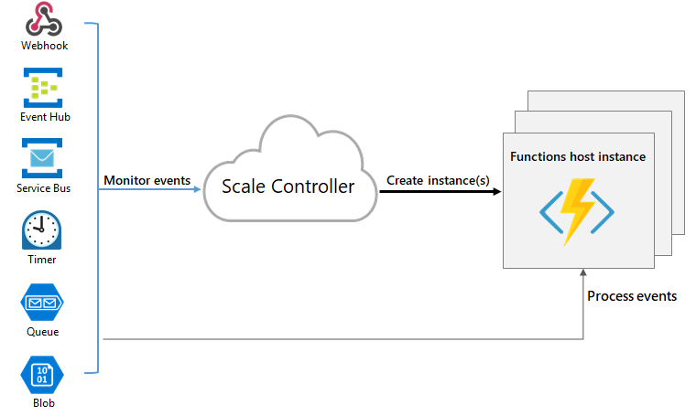
Azure Functions
Notes:
Azure Functions are “event-driven” meaning they run based on associated and configure events, or “triggers”. For example an Azure Function could be triggered by a simple timer, such as running a process once every 24-hours, or triggered by an event in a document management system, such as when a new document is uploaded to a SharePoint library. Azure Functions can also respond to Azure-specific events, such as an image added to a Storage Blob or a notification arriving in a Message Queue.

Slide 5
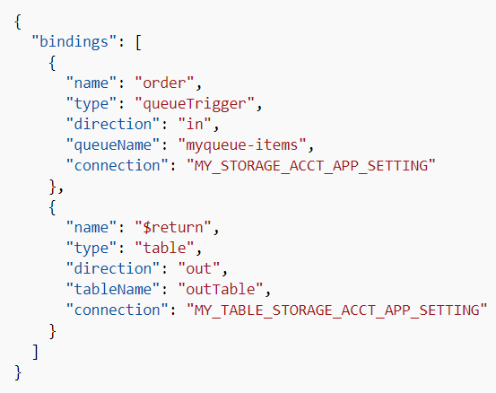
Azure Functions
bindings

Slide 6
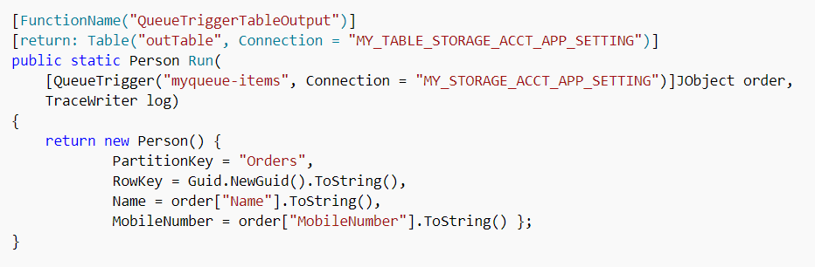
Azure Functions
C# code

Slide 7

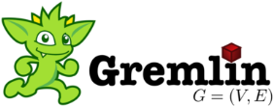




Azure Cosmos DB
Table API
MongoDB
Column-family
Document
Key-value
Graph
Elastic scale out
of storage & throughput
Guaranteed low latency at the 99th percentile
Five well-defined consistency models
Turnkey global distribution
Comprehensive SLAs
Notes:
Azure Cosmos DB offers the first globally distributed, multi-model database service for building planet scale apps. It’s been powering Microsoft’s internet-scale services for years, and now it’s ready to launch yours.
Only Azure Cosmos DB makes global distribution turn-key.
You can add Azure locations to your database anywhere across the world, at any time, with a single click. Cosmos DB will seamlessly replicate your data and make it highly available.
Cosmos DB allows you to scale throughput and storage elastically, and globally! You only pay for the throughput and storage you need – anywhere in the world, at any time.

Slide 8
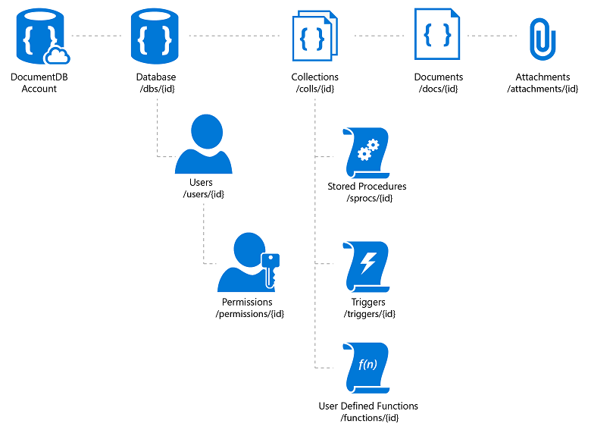
Azure Cosmos DB
Notes:
A database account consists of a set of databases, each containing multiple collections, each of which can contain stored procedures, triggers, UDFs, documents, and related attachments. A database also has associated users, each with a set of permissions to access various other collections, stored procedures, triggers, UDFs, documents, or attachments. While databases, users, permissions, and collections are system-defined resources with well-known schemas - documents, stored procedures, triggers, UDFs, and attachments contain arbitrary, user defined JSON content.
Documents – managed (upload blob) unmanaged (link)

Slide 9
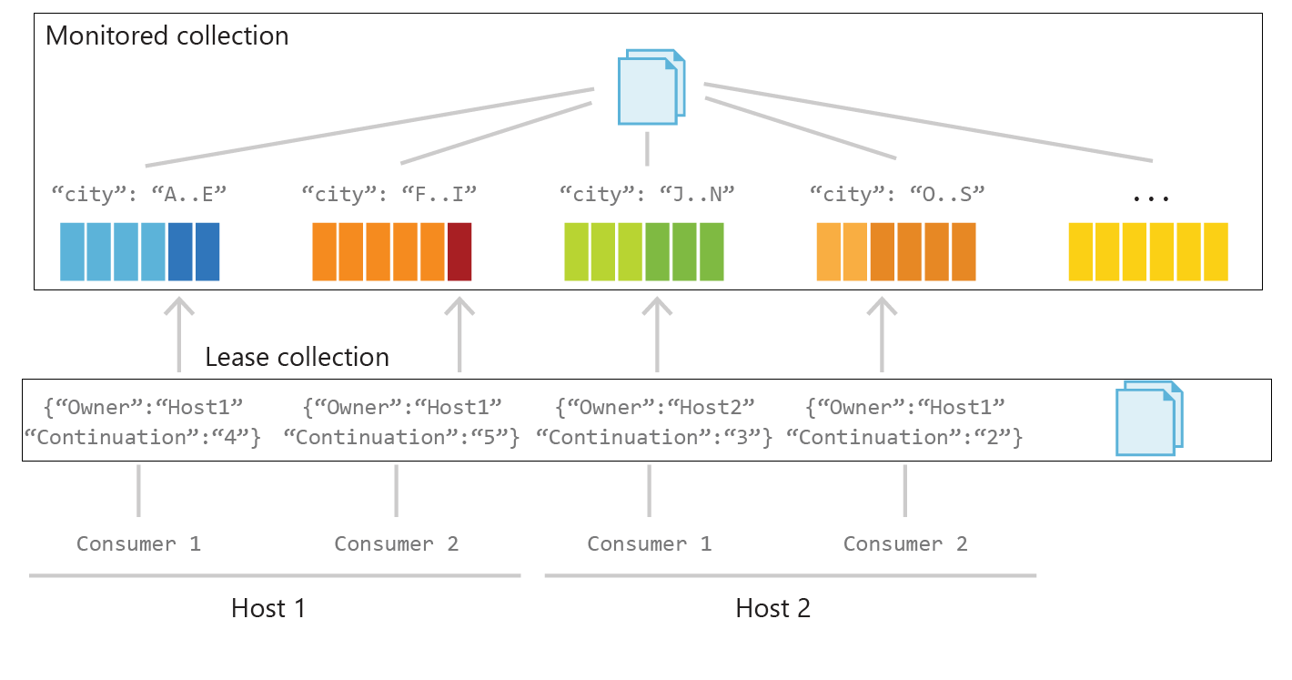
Azure Cosmos DB
Change Feed
Notes:
Monitored Collection: data from which the change feed is generated.
inserts and changes reflected in the change feed of the collection.
Lease Collection: coordinates processing the change feed across multiple workers.
separate collection stores leases with one lease per partition. contains the following attributes:
Owner: Specifies the host that owns the lease
Continuation: Specifies the position (continuation token) in the change feed for a particular partition
Timestamp: Last time lease was updated; the timestamp can be used to check whether the lease is considered expired
Processor Host: Each host determines how many partitions to process based on how many other instances of hosts have active leases.
When a host starts up, it acquires leases to balance the workload across all hosts. A host periodically renews leases, so leases remain active.
Host checkpoints the last continuation token to its lease for each read. To ensure concurrency safety, a host checks the ETag for each lease update. Other checkpoint strategies are also supported.
Upon shutdown, a host releases all leases but keeps the continuation information, so it can resume reading from the stored checkpoint later.
At this time the number of hosts cannot be greater than the number of partitions (leases).
Consumers: Consumers, or workers, are threads that perform the change feed processing initiated by each host. Each processor host can have multiple consumers. Each consumer reads the change feed from the partition it is assigned to and notifies its host of changes and expired leases.

Slide 10
Serverless and Schema-less
Why?
Scale easily – computing and data storage
Microservices-friendly
Minimize custom integration code
Handle 3Vs of data – variety, velocity, volume

Slide 11
Serverless and Schema-less
Serverless computing with Azure Functions
Serverless Schema-less data storage with CosmosDB
Read from CosmosDB with input binding for Azure Function
Save to CosmosDB with output binding for Azure Function
Monitor CosmosDB data changes with Azure Functions Change Feed
Notes:
native integration between Azure Cosmos DB and Azure Functions.
you can create database triggers, input bindings, and output bindings directly from your Azure Cosmos DB account

Slide 12
Serverless and Schema-less
Dev environment
Visual Studio 2017
Install Azure storage emulator
Install CosmosDB emulator
Visual Studio Azure Development Workload
Install latest version of Azure Functions tools
Install cosmos support for functions v1.x

Slide 13
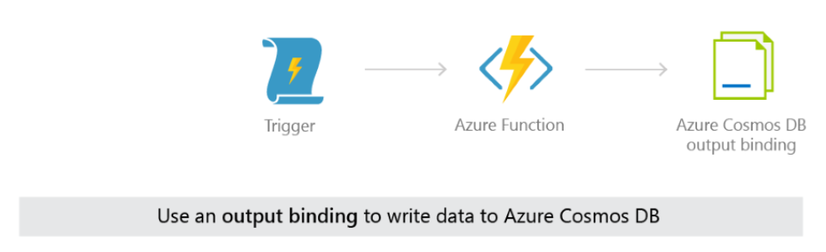
Serverless and Schema-less
Notes:
An input binding to an Azure Cosmos DB container can be used in the same function as an Azure Cosmos DB trigger, and can be used with or without an output binding as well. You could use this combination to apply up-to-date currency exchange information (pulled in with an input binding to an exchange container) to the change feed of new orders in your shopping cart service. The updated shopping cart total, with the current currency conversion applied, can be written to a third container using an output binding.

Slide 14
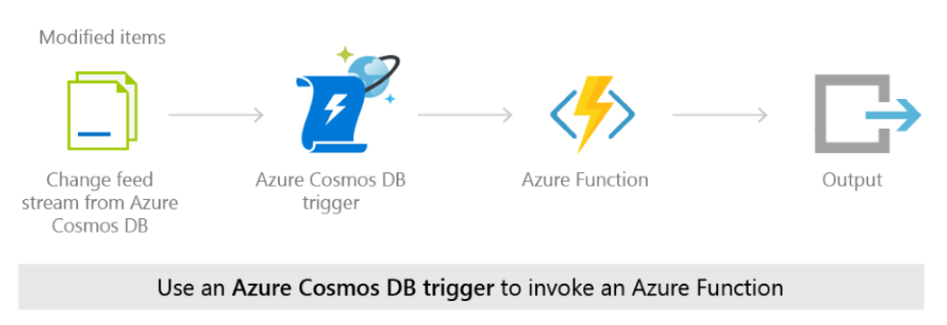
Serverless and Schema-less
Notes:
An Azure Cosmos DB trigger can be used with an output binding to a different Azure Cosmos DB container.
After a function performs an action on an item in the change feed you can write it to another container
(writing it to the same container it came from would effectively create a recursive loop).
Or, you can use an Azure Cosmos DB trigger to effectively migrate all changed items from one container to a different container, with the use of an output binding.

Slide 15
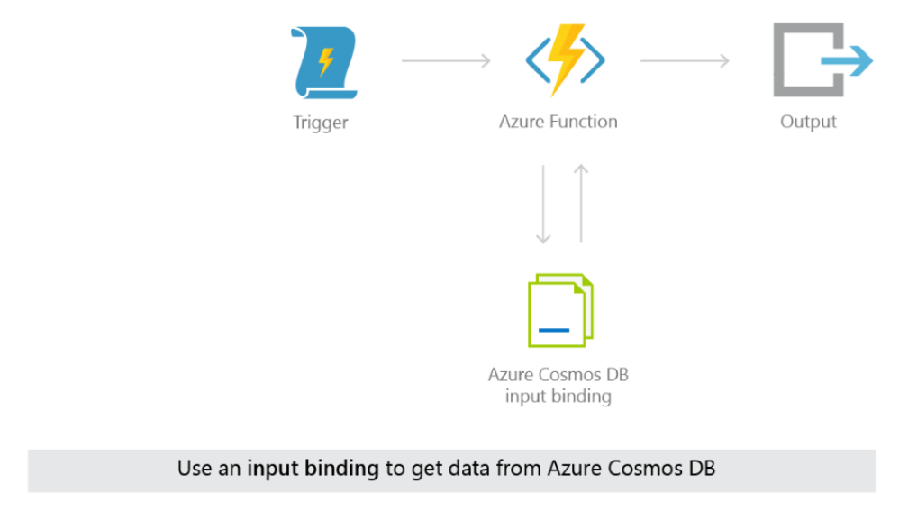
Serverless and Schema-less
Notes:
Input bindings and output bindings for Azure Cosmos DB can be used in the same Azure Function.
This works well in cases when you want to find certain data with the input binding, modify it in the Azure Function,
and then save it to the same container or a different container, after the modification.

Slide 16
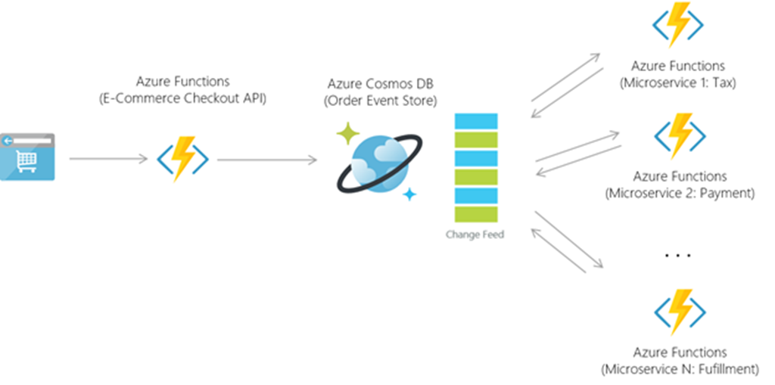
Serverless and Schema-less

Slide 17
Demo
Serverless and Schema-less

Slide 18
Resources
Serverless and Schema-less
https://azure.microsoft.com/en-us/blog/azure-cosmosdb-database-for-serverless-era/
https://docs.microsoft.com/en-us/azure/cosmos-db/serverless-computing-database
http://www.bradygaster.com/posts/azure-cosmosdb-with-functions
http://www.bradygaster.com/azure-cosmosdb-with-functions-and-nodejs

