Slide 1
Lambda Architecture
Santosh Hari

Slide 2



Santosh Hari
Azure Consultant @ Nebbia Tech
Azure MVP
President, Orlando .NET UG
Organizer, Orlando Codecamp
santoshhari.wordpress.com
santosh.hari@newsignature.com
@_s_hari
/in/santoshhari

Slide 3
Agenda
Intro to Lambda Architecture (LA)
Intro to Cosmos DB
Discussion on building blocks
Materialized View
Event Sourcing
CQRS
Big picture view
Discussion on how Cosmos DB simplifies LA
Criticisms of LA and short discussion on Kappa Architecture
Heavy on concepts, no code or demo

Slide 4

Intro to Lambda Architecture

Slide 5
Modern data system scale horizontal
Application
Server
Server
Server
Notes:
As application usage increases keep adding nodes
Even if nodes fail, system is able to keep responding
NoSQL scale out – run on commodity hardware on multiple nodes
Easy to add and remove nodes to handle loads
No single PoF
Flexibility in handling trade offs (CAP Theorem)

Slide 6
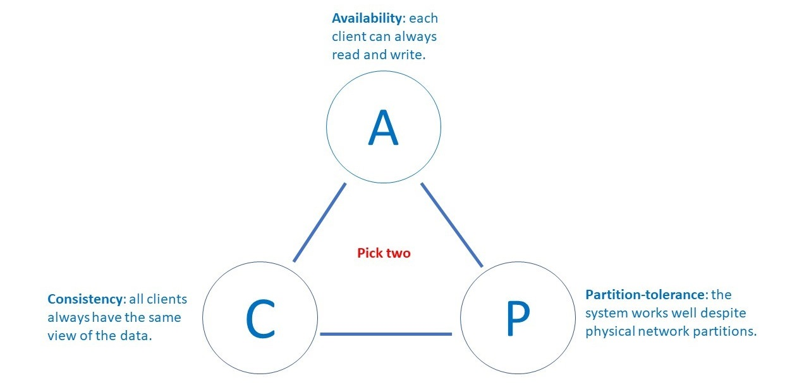
CAP Theorem
Notes:
Applies for distributed systems in general
Consistency - A read is guaranteed to return the most recent write for a given client.
Availability - A non-failing node will return a reasonable response within a reasonable amount of time (no error or timeout).
Partition Tolerance - The system will continue to function when network partitions occur.
Widely distributed aka networking factors comes into play. Object Oriented Programming != Network Programming.
One such fallacy of distributed computing is that networks are reliable. They aren’t. Networks and parts of networks go down frequently and unexpectedly. Network failures happen to your system and you don’t get to choose when they occur.

Slide 7
Challenge of data processing in distributed systems
High latency
Unable to read latest writes
Keep data in it’s original form
Low latency
Issues querying large amounts of historical data
Fault tolerance
Not very scalable

Slide 8
What is Lambda Architecture?
Term coined by Nathan Marz in 2012
Distributed data processing architecture
Generic, scalable
Robust, fault tolerant against system and human failure
Enables low latency reads and updates
Scales horizontally
Notes:
Nathan Marz came up with the term Lambda Architecture (LA) for a
generic, scalable and fault-tolerant data processing architecture,
based on his experience working on distributed data processing systems at Backtype and Twitter.
The LA aims to satisfy the needs for a robust system
that is fault-tolerant, both against hardware failures and human mistakes,
being able to serve a wide range of workloads and use cases,
and in which low-latency reads and updates are required.
The resulting system should be linearly scalable, and it should scale out rather than up.

Slide 9
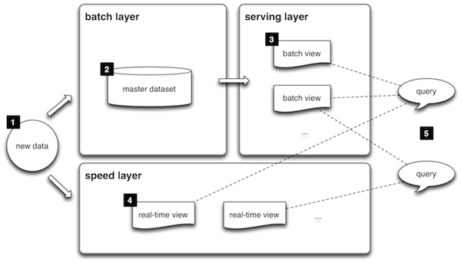
Lambda Architecture Overview
Notes:
All data entering the system is dispatched to both the batch layer and the speed layer for processing.
The batch layer has two functions: (i) managing the master dataset (an immutable, append-only set of raw data), and (ii) to pre-compute the batch views.
The serving layer indexes the batch views so that they can be queried in low-latency, ad-hoc way.
The speed layer compensates for the high latency of updates to the serving layer and deals with recent data only.
Any incoming query can be answered by merging results from batch views and real-time views.

Slide 10
Use Case Scenarios
Ad-hoc user queries on master dataset
Quick responses to incoming data
Capable of handling updates
No data erased
Notes:
Lambda architecture can be deployed for those data processing enterprise models where:
User queries are required to be served on ad-hoc basis using the immutable data storage.
Quick responses are required and system should be capable of handling various updates in the form of new data streams.
None of the stored records shall be erased and it should allow addition of updates and new data to the database.
Lambda architecture can be considered as near real-time data processing architecture.
As mentioned above, it can withstand the faults as well as allows scalability.
It uses the functions of batch layer and stream layer
and keeps adding new data to the main storage while ensuring that the existing data will remain intact.
Companies like Twitter, Netflix, and Yahoo are using this architecture to meet the quality of service standards.

Slide 11
Pros and Cons
CONS
Complex
Re-processes every batch cycle
Difficult to migrate / reorganize
PROS
History
Less errors
Speed and reliability.
Fault tolerant
Scalable
Notes:
Pros
Batch layer of Lambda architecture manages historical data with the fault tolerant distributed storage which ensures low possibility of errors even if the system crashes.
It is a good balance of speed and reliability.
Fault tolerant and scalable architecture for data processing
Cons
It can result in coding overhead due to involvement of comprehensive processing.
Re-processes every batch cycle which is not beneficial in certain scenarios.
A data modeled with Lambda architecture is difficult to migrate or reorganize

Slide 12
Cosmos DB

Slide 13
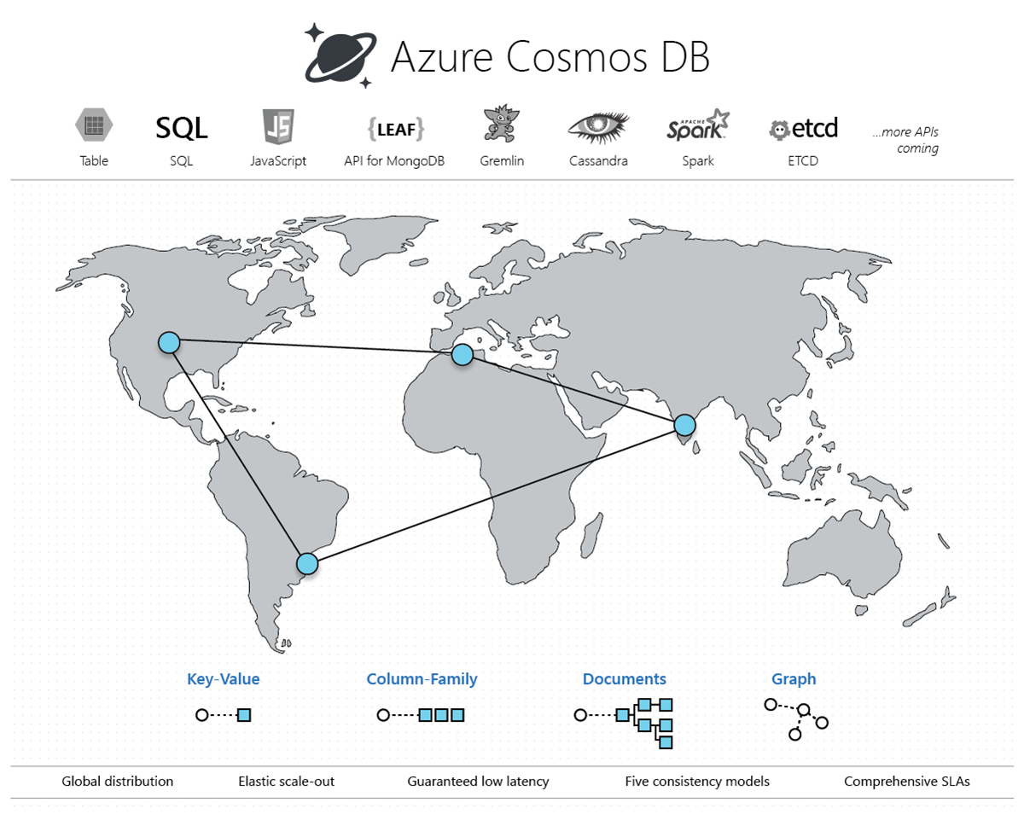
Enter Cosmos DB
Notes:
Azure Cosmos DB is Microsoft's globally distributed, multi-model NoSQL database-as-a-service.
With the click of a button, Cosmos DB enables you to elastically and independently scale throughput
and storage across any number of Azure's geographic regions.
You can elastically scale throughput and storage,
and take advantage of fast, single-digit-millisecond data access using your favorite API among
SQL, MongoDB, Cassandra, Tables, or Gremlin.
Cosmos DB provides comprehensive service level agreements (SLAs) for
throughput, latency, availability, and consistency guarantees

Slide 14
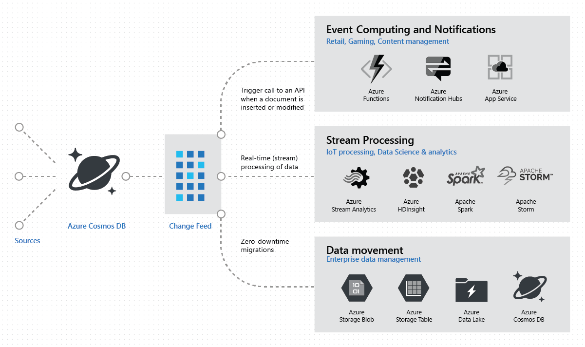
Cosmos DB Change Feed
Notes:
Change feed support in Azure Cosmos DB
works by listening to an Azure Cosmos DB container for any changes.
outputs Sorted list of documents in the order in which they were modified.
The changes are persisted,
can be processed asynchronously and incrementally,
and output distributed across one or more consumers for parallel processing.

Slide 15
Relevant Patterns

Slide 16
Patterns to know
Materialized View
Event sourcing
CQRS

Slide 17
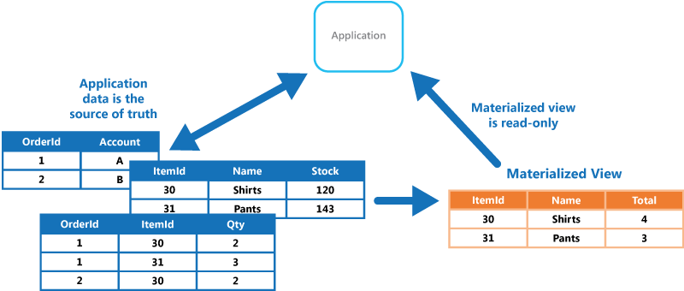
Materialized View
Notes:
Generate prepopulated views over the data in one or more data stores
when the data isn't ideally formatted for required query operations.
This can help support efficient querying and data extraction,
and improve application performance.

Slide 18
What problems does Materialized View solve
Data optimized for storing or reading
Negative effect on queries
Notes:
When storing data, the priority for developers and data administrators
focused on how the data is stored, as opposed to how it's read.
chosen storage format is usually closely related to format of the data,
requirements for managing data size and data integrity, and the kind of store in use.
For example, when using NoSQL document store, the data is often represented as a series of aggregates,
each containing all of the information for that entity.
However, this can have a negative effect on queries.
When a query only needs a subset of the data from some entities,
such as a summary of orders for several customers without all of the order details,
it must extract all of the data for the relevant entities in order to obtain the required information.

Slide 19
How does Materialized View solve these problems
Contain only read data
Subset
Disposable
Easy re-generation
Cache
Notes:
Solution:
Mat Views only contain data required by query, great for querying
Contains subsection of columns, calculated data, transforms
Data is disposable and can be entirely rebuilt from source
When source changes, view should be updated
Never updated directly by app, more like a cache

Slide 20
Materialized View considerations
Handling updates
Eventual consistency
Storage
Index and partitioning
Notes:
Considerations:
Updates – when, how (response to an event?), overhead if rapid change, scheduled
Great in cases like event sourcing, maybe overkill in other cases
Data consistency – what happens when you read at the moment source changes
Storage – should be disposable and easy to rebuild
Index and partition – for performance

Slide 21
Materialized View use cases - good
Handles difficult to query data
Perf
Local cache
Separate query from source
Bridging data sources
Notes:
Use Cases (good):
Difficult to query data directly or complex queries (semi structured or unstructured data)
Dramatically improves performance
Connection intermittent or disconnected issues like local cache
Separate queries from source data – security, privacy, obscure data source knowledge
Bridging data sources – NoSQL (writes) and Relational (Queries)

Slide 22
Materialized View use cases - bad
Simple to query data
Rapidly changing data
Consistency needed
Notes:
Use cases (bad):
Source data easy and simple to query
Source data changes quickly
High consistency needed

Slide 23
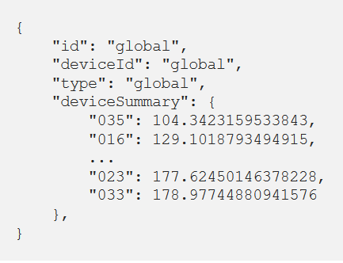
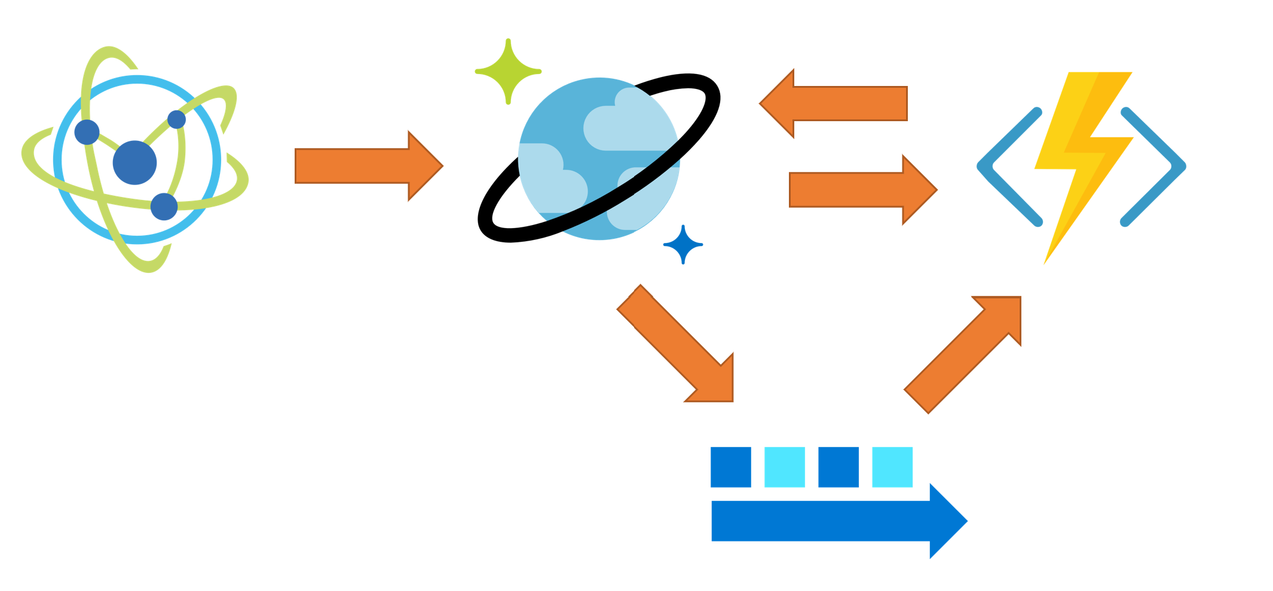
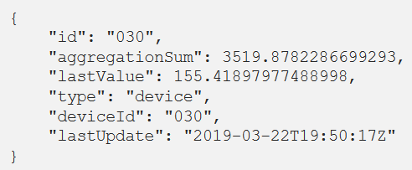
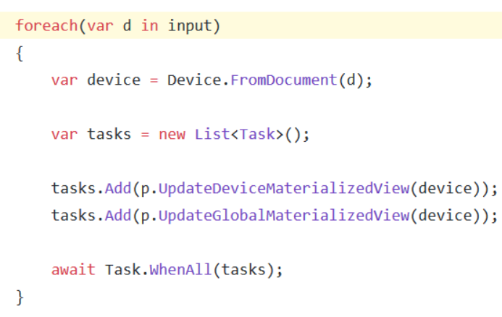
Materialized View with Cosmos DB
{
“deviceId”:”030”,
“currentValue”: 155.4189
}
https://medium.com/@mauridb/real-time-materialized-views-with-cosmos-db-90ecea84f650
Notes:
Data generated by a simulator and written directly to Cosmos DB.
Ensures that we will always capture and preserve the raw data

Slide 24
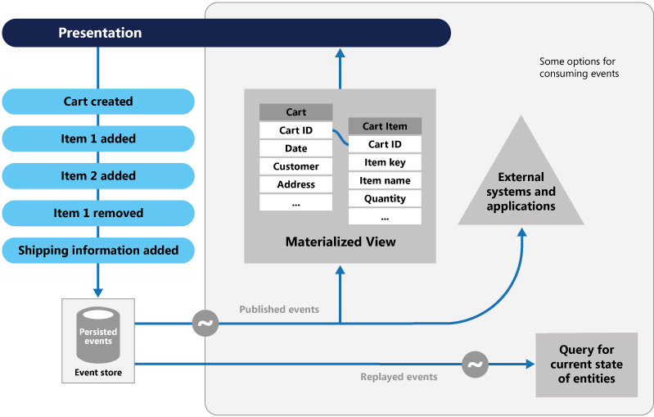
Event Sourcing
Notes:
Instead of storing just the current state of the data in a domain,
use an append-only store to record the full series of actions taken on that data.
The store acts as the system of record and can be used to materialize the domain objects.
This can simplify tasks in complex domains,
by avoiding the need to synchronize the data model and the business domain,
while improving performance, scalability, and responsiveness.
It can also provide consistency for transactional data,
maintain full audit trails and history that can enable compensating actions.

Slide 25
What problems does Event Sourcing solve?
Current state only
Locking
Data loss
Audit??
Notes:
Most apps work with only current state of data. For instance, customer status
Transaction often lock the data leading to data storage during transaction lock
Data conflicts can cause data state loss during conflict resolution
Needs separate audit mechanism

Slide 26
How Event Sourcing solves these problems
Data-as-events-sequence
Append-only store
Store is authoritative
Store publishes events
Materialized View
Replay events
Notes:
Approach centers around handling operations on data that's driven by a sequence of events,
each of which is recorded in an append-only store.
Stores acts as authoritative about current state also
Stored publishes events for consumers – publishing code decoupled from subscribing code
Events published can be used to maintain Mat Views which are updated with new data
Apps also read history of events to materialize current state

Slide 27
Event Sourcing advantages
Immutable events
Simple objects
Domain experts friendly
No direct DB updates
Audit trail
Decouple events from tasks
Notes:
1 Events are immutable changed using append-only ops.
Updating UI/Workflow can continue and event handlers backgrounded. Superior perf & scalability
2 Simple objects describing action with associated data.
Data store not directly updated. Simplifies implementation and management
3 Events have meaning for domain experts
Whereas OR impedance mismatch in databases are complex.
Also tables are often current state, not all events
4 No direct datastore updates, prevent concurrency
5 Append only allows audit trail – allows monitoring updates, replaying events, regenerating current state
6 Events decoupled from tasks that handle them provide scalability and flexibility
Tasks know about type of event and data but not what op triggered event
One event can have multiple tasks

Slide 28
Event Sourcing considerations
Eventual Consistency
No out-of-band updates to event store
Event format vital
Order of events vital
Current State = sum all
Use snapshots
Reduces data conflicts
Consumers idempotent
Notes:
When materializing views, system will be eventually consistent
Event store should not be updated with anything else since it’s source of truth
If format of event changes, difficult to combine events before and after
Consistency and order of events in store is vital
Timestamping events is a must
Current state can only be determined by reading all events in history
If event stream is large, consider creating snapshots at intervals – current state from snapshot + replaying events
Data conflicts reduced by eventual consistency and lack of transactions need to be handled by app
Consumers idempotent – same ops same results, so event updates should not be reapplied

Slide 29
Event Sourcing use cases - good
Capture intent, purpose, reason
Avoiding conflicts
Restore / rollback
Decouple I/P O/P
Great with CQRS
Notes:
capture intent, purpose, or reason in the data
When avoiding conflicts is vital
Record and replay event to restore state of a system and rollback or history/audit
Need to decouple input/updates from tasks that respond to these
In conjunction with CQRS, for systems that are ok with eventual consistency

Slide 30
Event Sourcing use cases - bad
Simple domain
CRUD
Consistent systems
Real-time systems
Non-audit non-historical systems
Low conflict systems
Notes:
Small or simple domains, systems that have little or no business logic
nondomain systems that naturally work well with traditional CRUD data management mechanisms.
Systems where consistency and real-time updates to the views of the data are required.
Systems where audit trails, history, and capabilities to roll back and replay actions are not required.
Systems where there's only a very low occurrence of conflicting updates to the underlying data. For example, systems that predominantly add data rather than updating it.

Slide 31
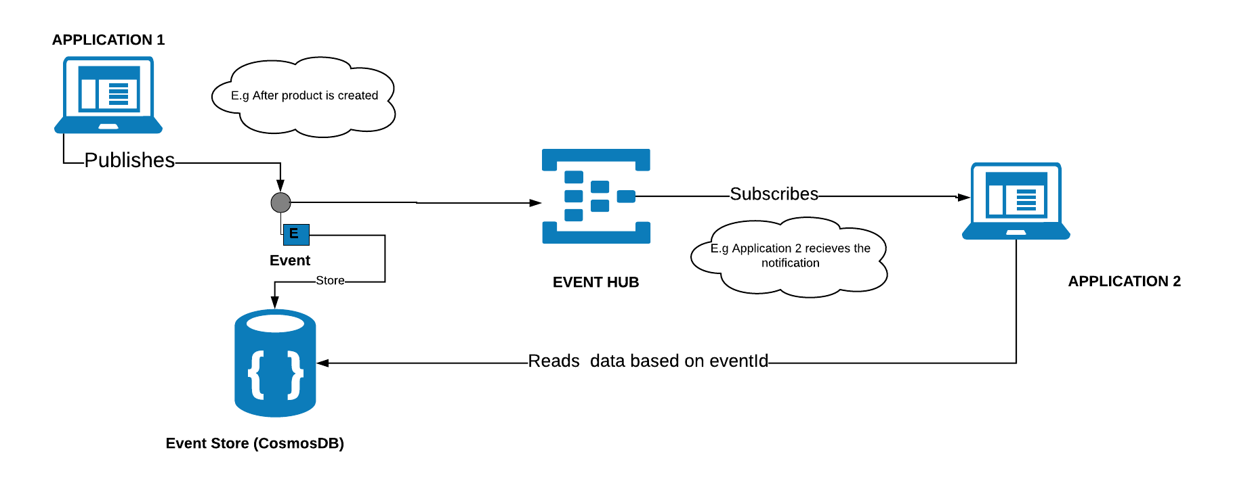
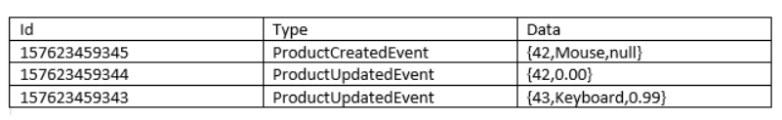
Event Sourcing with Cosmos DB
{“MessageId”:1547632386819}
val events = eventStore.findAllById('1547632386819');
val product = Product().applyAll(events)
https://sajeetharan.com/2019/02/03/event-sourcing-with-azure-eventhub-and-cosmosdb/
Notes:
Whenever user updates an object in the application1, there will be notification message sent to the EventHub with an ID (unique id for each message) that something has happened on application. We could make use of epoch timestamp with 8 digits to make sure it is a unique one. A sample payload would look like,
Once the notification is sent, the state of the object is stored in the eventstore(cosmosdb).
Application 2 will have an EventHub receiver which runs on the background which will subscribe to the EventHub and get the latest message. Once the id is retrieved by the receiver, it can request the eventstore with the id and get all the changes prior to the id as follows,
which will create the documents in Cosmosdb as,

Slide 32
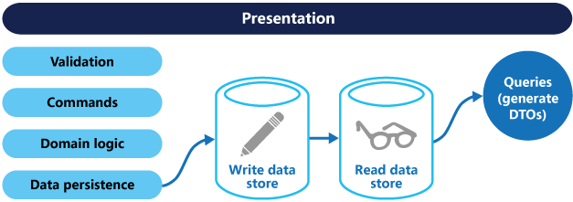
CQRS
Notes:
architecture style that separates read operations from write operations.
Segregate operations that read data from operations that update data by using separate interfaces.
This can maximize performance, scalability, and security.
Supports the evolution of the system over time through higher flexibility,
prevents update commands from causing merge conflicts at the domain level.

Slide 33
What problems does CQRS solve
CRUD against same entities
Scaffolding tools optimize for commands
Columns with diff update frequencies
Data contention
Diff Security /Perms
Notes:
Traditional DBMS both command (CUD) and query (R) against same entities
In case of ORM type scaffold tools, optimized for command, not query
Frequently updated columns (timestamp) in same record as infrequently updated columns (full name) for read
Data contention risks when records are locked for writing and need to be read
Security/perms complex because read (often lower security) right next to write (often high security)

Slide 34
How does CQRS solve these problems?
Segregate Reads and Commands
Diff data models
Separate R/W stores
Notes:
segregates read (queries) from updates (commands) by using separate interfaces
data models used for querying and updates are different. models can then be isolated
use of separate query and update models simplifies design and implementation
Best to separate write and read data stores:
Read can be read-only replica or read-write can be completely different
IN distributed scenarios, multiple read-only replicas for scaling
Read and write stores can scale according to load

Slide 35
CQRS Considerations
No Scaffolding
Increase perf+security
More complex
Model change mgmt.
Limited scope
Task not data
Eventual Consistency
Notes:
Considerations:
Can’t use scaffolding mechanisms like entity frameworks
Increase performance and security,
also increases complexity in terms of resiliency and consistency
Changes to write model, require corresponding changes to read model
Apply to limited parts of your system
Commands should be task based, rather than data centric.
("Book hotel room," not "set ReservationStatus to Reserved.")

Slide 36
CQRS Use Cases - Good
Collaborative domain
DDD
R to W ratios high
Separation of concerns
Different read models
Evolving BL
Notes:
Use cases (good):
1 Collaborative domain – multiple ops on same data
Command domain handles merge conflict
2 Great in DDD – write model handles BL, i/p validation, b/l validation
No validation for read model, only returns DTO
3 Great when either read or write ratios are really high and separate scaling needed
4 When one team focuses on writes (ETL people) and another on reads (Report devs)
5 When multiple versions of read model needed (diff customers, versions of software)
6 Business rules change a lot

Slide 37
CQRS Use Cases - Bad
Simple domains
Less Data
Whole systems
Notes:
Use cases (bad):
Simple domain and/or business rules
Simple system with less data and/or simple structure
Whole systems – too complex

Slide 38
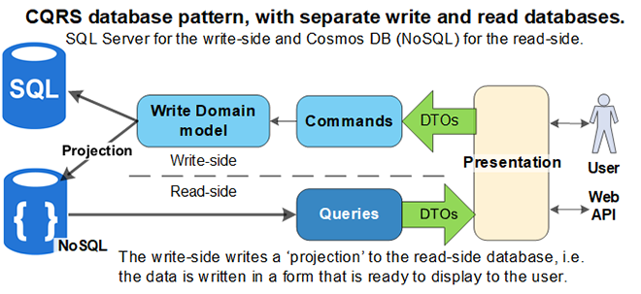
CQRS with Cosmos DB
https://www.thereformedprogrammer.net/building-a-robust-cqrs-database-with-ef-core-and-cosmos-db/

Slide 39
How it all ties together

Slide 40
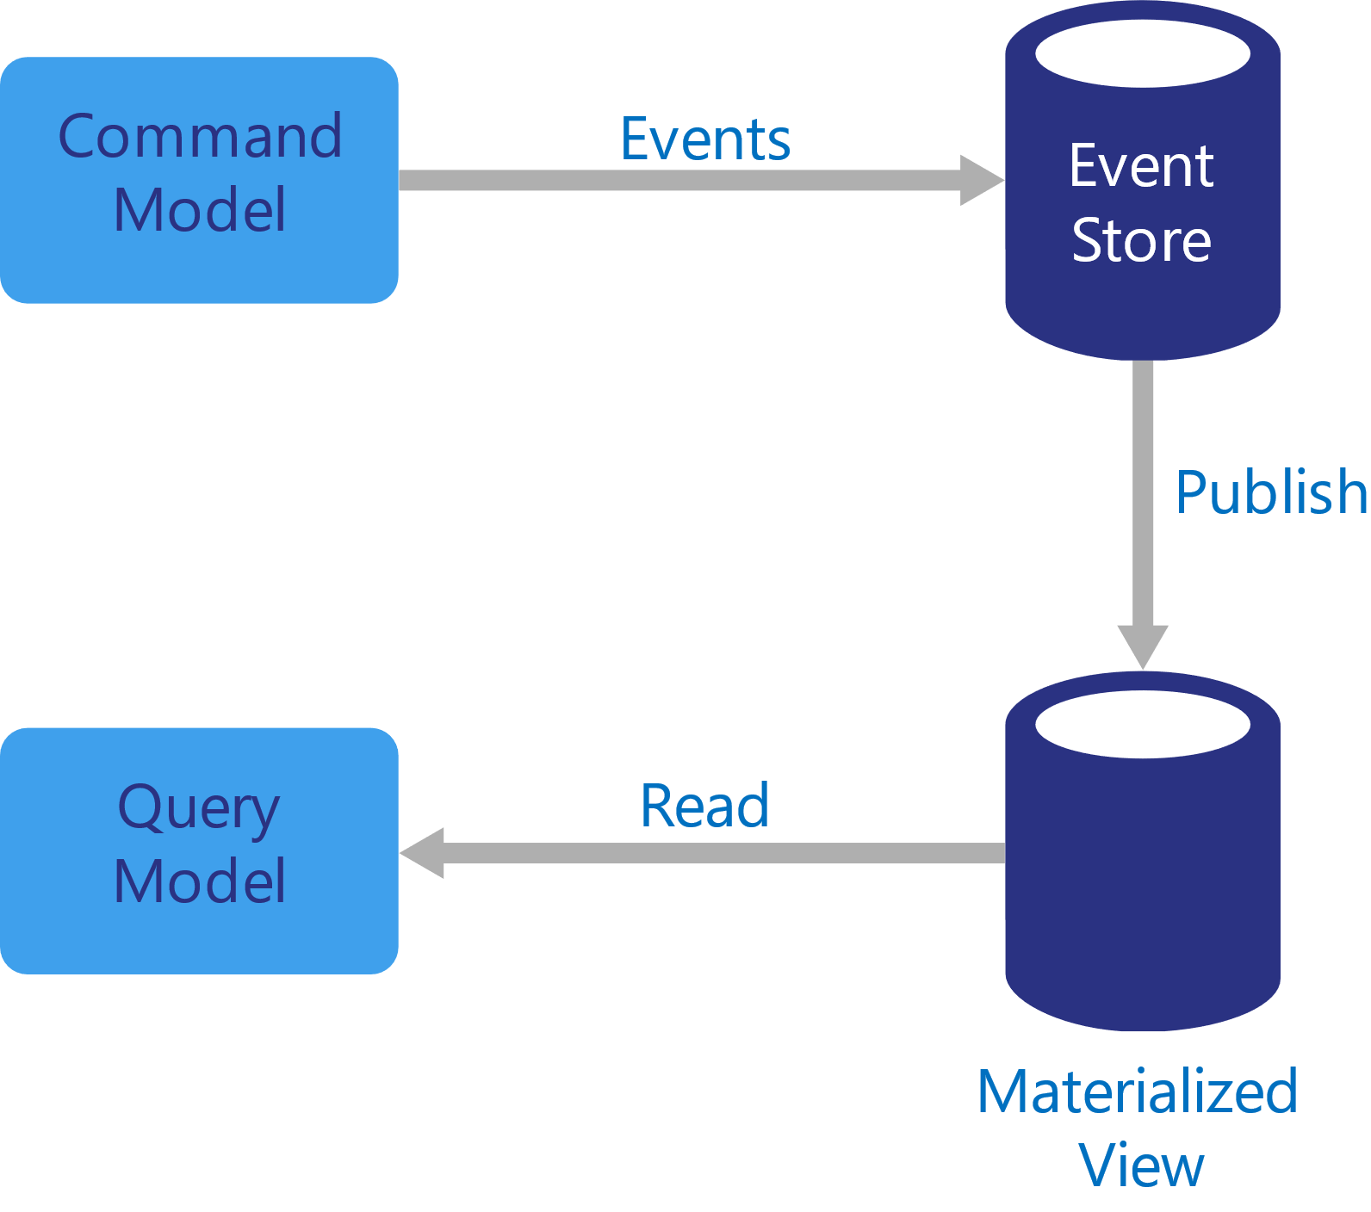
Event sourcing + CQRS + Materialized views
Still Eventually Consistent
Notes:
Store of events is the write model and official source of information
Storing data as event stream instead of current state avoid conflicts and max perf and scale
Read model is a materialized view tailored to interfaces and displays reqs of app
Maximize both display and query performance of app
Easy to delete and recreate materialized view from event store to get current state
Pattern adds complexity because event handling and view maintenance are separate
Mat Views require significant processing and resource usage, aggregation calculations are even worse
Fix this by snapshotting data at intervals
System still has to be eventually consistent

Slide 41
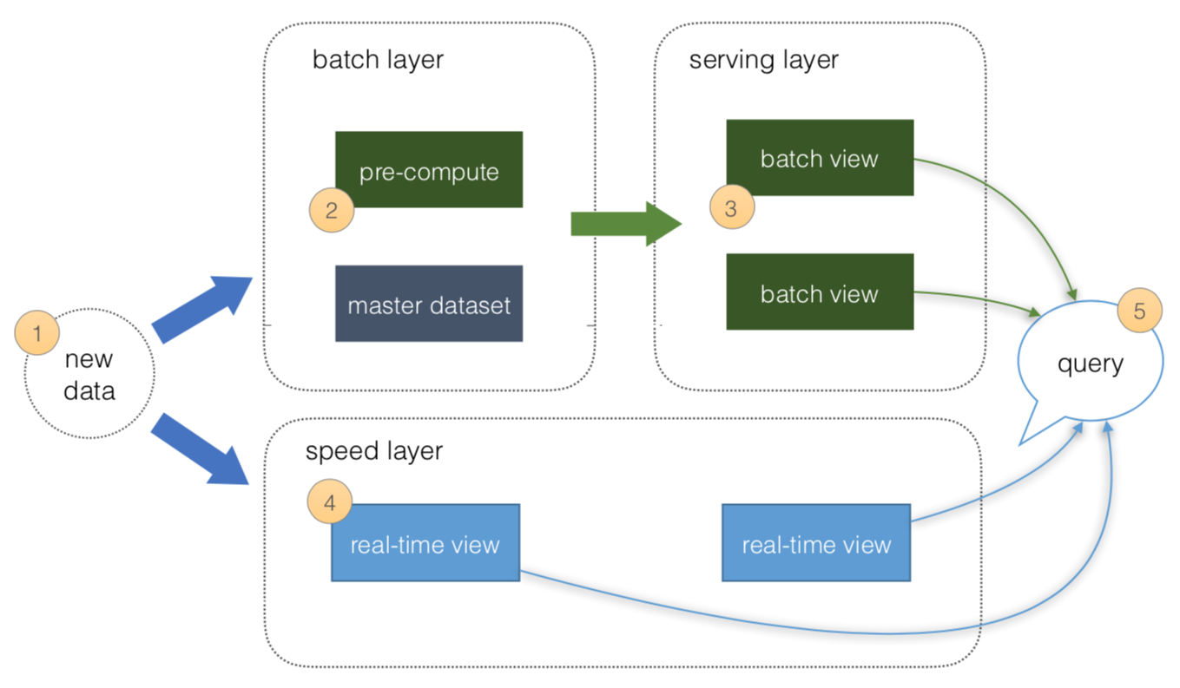
Lambda Architecture
Event store
Materialized View
Query
Command
Speed layer – solves latency
Notes:
1. All data is pushed into both the batch layer and speed layer.
2. The batch layer has a master dataset (immutable, append-only set of raw data) and pre-compute the batch views.
3. The serving layer has batch views so data for fast queries.
4. The speed layer compensates for processing time (to serving layer) and deals with recent data only.
5. All queries can be answered by merging results from batch views and real-time views or pinging them individually.

Slide 42
How Cosmos DB simplifies things

Slide 43
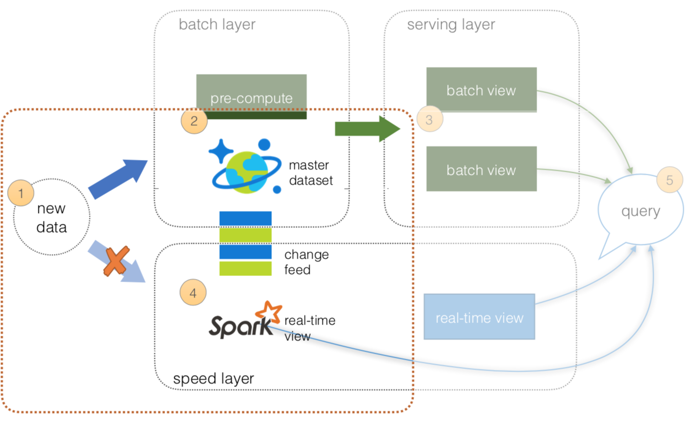
Simplify Lambda Architecture with Cosmos DB
Notes:
From an operations perspective, maintaining two streams of data
while ensuring correct state for the data can be a complicated endeavor.
To simplify this, we can utilize Azure Cosmos DB to keep state for the batch layer
While revealing the Azure Cosmos DB Change log via the Change Feed API for your speed layer.
All data is pushed only into Azure Cosmos DB thus you can avoid multi-casting issues.
The batch layer has a master dataset (immutable, append-only set of raw data) and pre-compute the batch views.
The serving layer will be discussed in the next section.
The speed layer utilizes Apache Spark that will read the Azure Cosmos DB Change Feed.
This allows you to persist your data as well as to query and process it concurrently.
All queries can be answered by merging results from batch views and real-time views or pinging them individually.

Slide 44
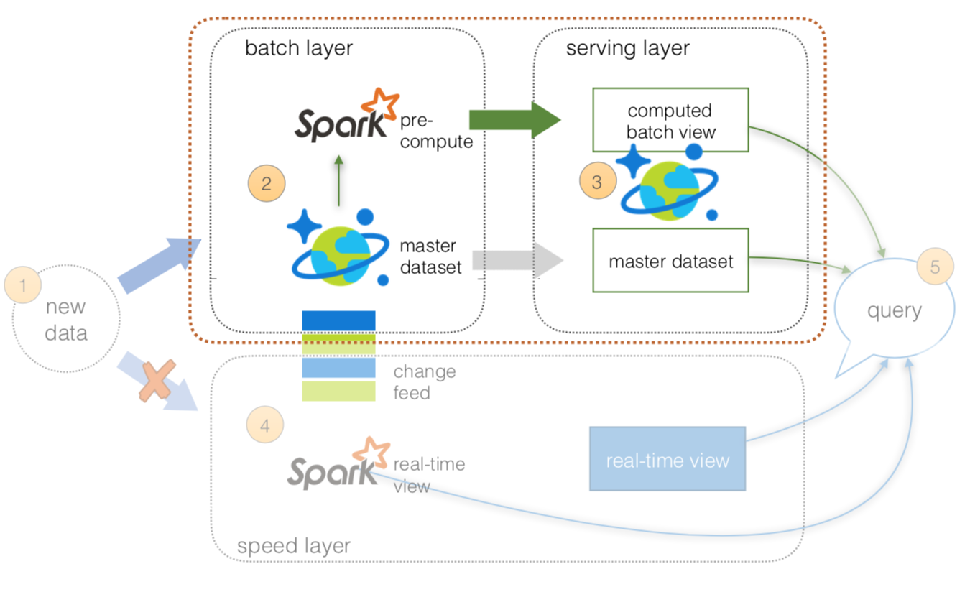
Lambda Architecture Cosmos DB – Batch and Serving Layers
Notes:
Since the data is loaded into Azure Cosmos DB where the master dataset
(an immutable, append-only set of raw data) resides.
From this point onwards, we can use Apache Spark to perform our pre-compute from batch layer to serving layer.
All data pushed into only Azure Cosmos DB (avoid multi-cast issues)
The batch layer has a master dataset (immutable, append-only set of raw data) stored in Azure Cosmos DB.
Using Spark, you can pre-compute your aggregations to be stored in your computed batch views.
The serving layer is an Azure Cosmos DB database with collections for master dataset and computed batch view.
The speed layer will be discussed next slide.
All queries can be answered by merging results from batch views and real-time views or pinging them individually.

Slide 45
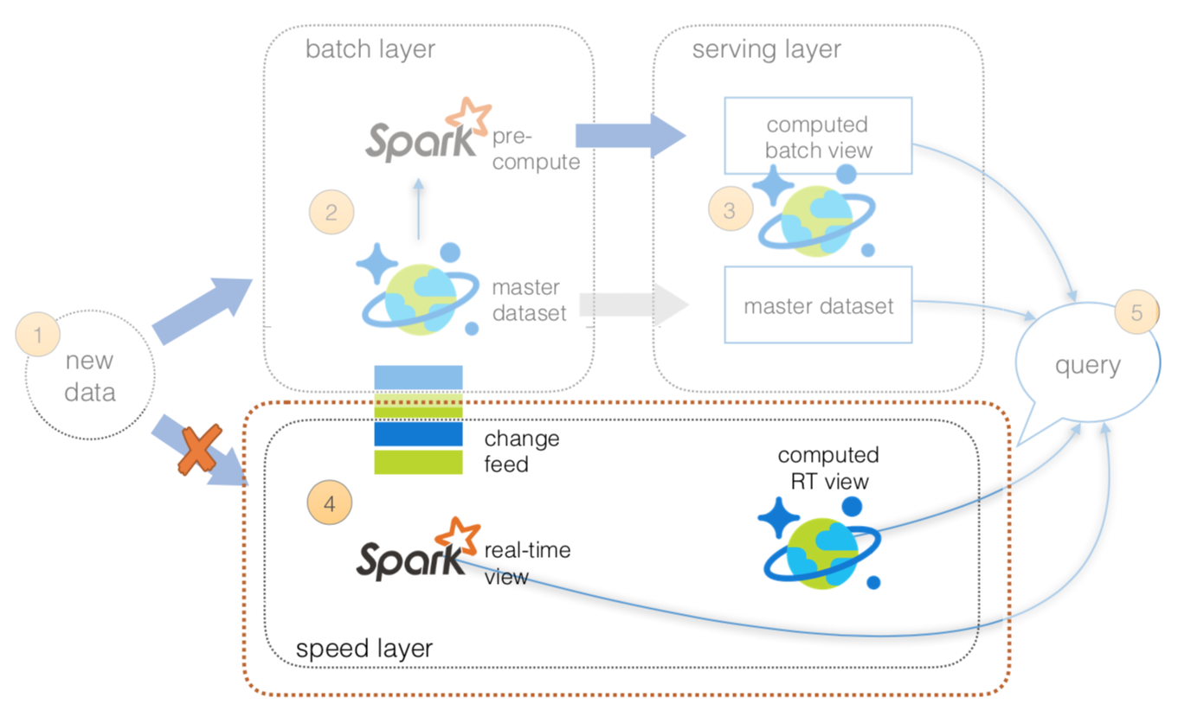
Lambda Architecture Cosmos DB – Speed Layer
Notes:
Azure Cosmos DB Change Feed allows us to simplify the operations between the batch and speed layers.
Use Apache Spark (via HD Insight) to perform our structured streaming queries against the data.
But you may also want to temporarily persist the results of your structured streaming queries so other systems can access this data.
To do this, create a separate Cosmos DB collection to save the results of your structured streaming queries.
This allows you to have other systems access this information not just Apache Spark.
As well with the Cosmos DB Time-to-Live (TTL) feature,
you can configure your documents to be automatically deleted after a set duration.

Slide 46
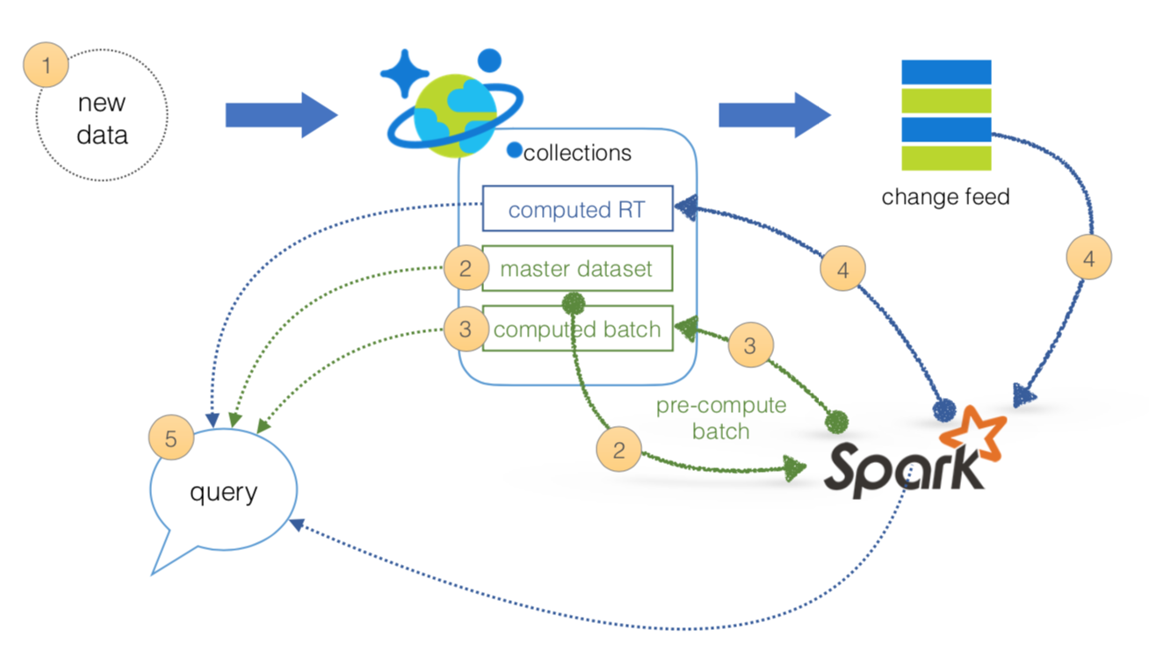
Lambda Architecture Cosmos DB - Re-architected
Notes:
we can simplify our Lambda Architecture by using Azure Cosmos DB,
the Cosmos DB Change Feed to avoid the need to multi-cast your data between the batch and speed layers,
Apache Spark, and the Spark Connector for Azure Cosmos DB.
only two managed services that together will address the batch, serving, and speed layers
of our Lambda Architecture simplifying not only the operations but also the data flow.
1 All data pushed into Cosmos DB layer for processing
2 The batch layer has a master dataset (immutable, append-only set of raw data) and pre-compute the batch views
3 The serving layer has batch views so data for fast queries.
4 The speed layer compensates for processing time (to serving layer) and deals with recent data only.
5 All queries can be answered by merging results from batch views and real-time views.

Slide 47
Lambda Architecture - Criticism

Slide 48
Lambda Architecture - downside
Notes:
maintaining code that needs to produce the same result in two complex distributed systems is painful
Programming in distributed frameworks like Spark, Storm, Hadoop is complex.
Inevitably, code ends up being specifically engineered toward the framework it runs on.
Resulting in operational complexity of systems implementing the Lambda Architecture
Debugging two systems is even tougher
We wanted to build a processing system with low latency
We have a layer with high latency that can reprocess results and one with low latency that cannot reprocess

Slide 49
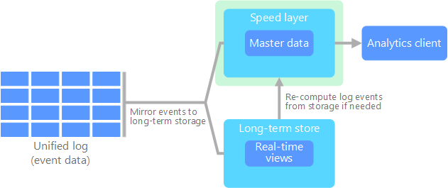
Kappa Architecture
Notes:
proposed by Jay Kreps as an alternative to the lambda architecture.
same basic goals but with an important distinction:
All data flows through a single path, using a stream processing system.
similarities to the lambda architecture's batch layer,
in that the event data is immutable and all of it is collected, instead of a subset.
The data is ingested as a stream of events into a distributed and fault tolerant unified log.
These events are ordered, and the current state of an event is changed only by a new event being appended.
Similar to a lambda architecture's speed layer, all event processing is performed on the input stream and persisted as a real-time view.
If you need to recompute the entire data set,
you simply replay the stream, typically using parallelism to complete the computation in a timely fashion.

Slide 50
Pros and Cons
CONS
Re-processing costly
Speed layer always busy
Less robust
PROS
No batch layer, less complex
Re-processing infrequent
Runs on fixed memory
Horizontally scalable
Fewer resources
Notes:
Pros:
Kappa architecture can be used to develop data systems that are online learners and therefore don’t need the batch layer.
Re-processing is required only when the code changes.
It can be deployed with fixed memory.
It can be used for horizontally scalable systems.
Fewer resources are required as the machine learning is being done on the real time basis.
Cons:
Re-processing is costly
Reusing speed layer for recomputing old events makes it unavailable for live logs
Lambda is considered more robust because it reduces errors

Slide 51
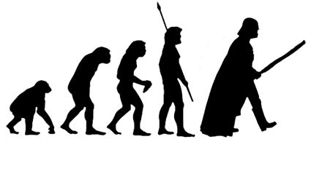
Evolution
Materialized View
Event Sourcing
CQRS
Kappa/Lambda Architecture
????????

Slide 52
Santosh Hari
Azure Consultant @ Nebbia Tech
Azure MVP
President, Orlando .NET UG
Organizer, Orlando Codecamp
santoshhari.wordpress.com
santosh.hari@newsignature.com
@_s_hari
/in/santoshhari

