Slide 1
SQL is not an excuse to avoid DevOps
Santosh Hari

Slide 2
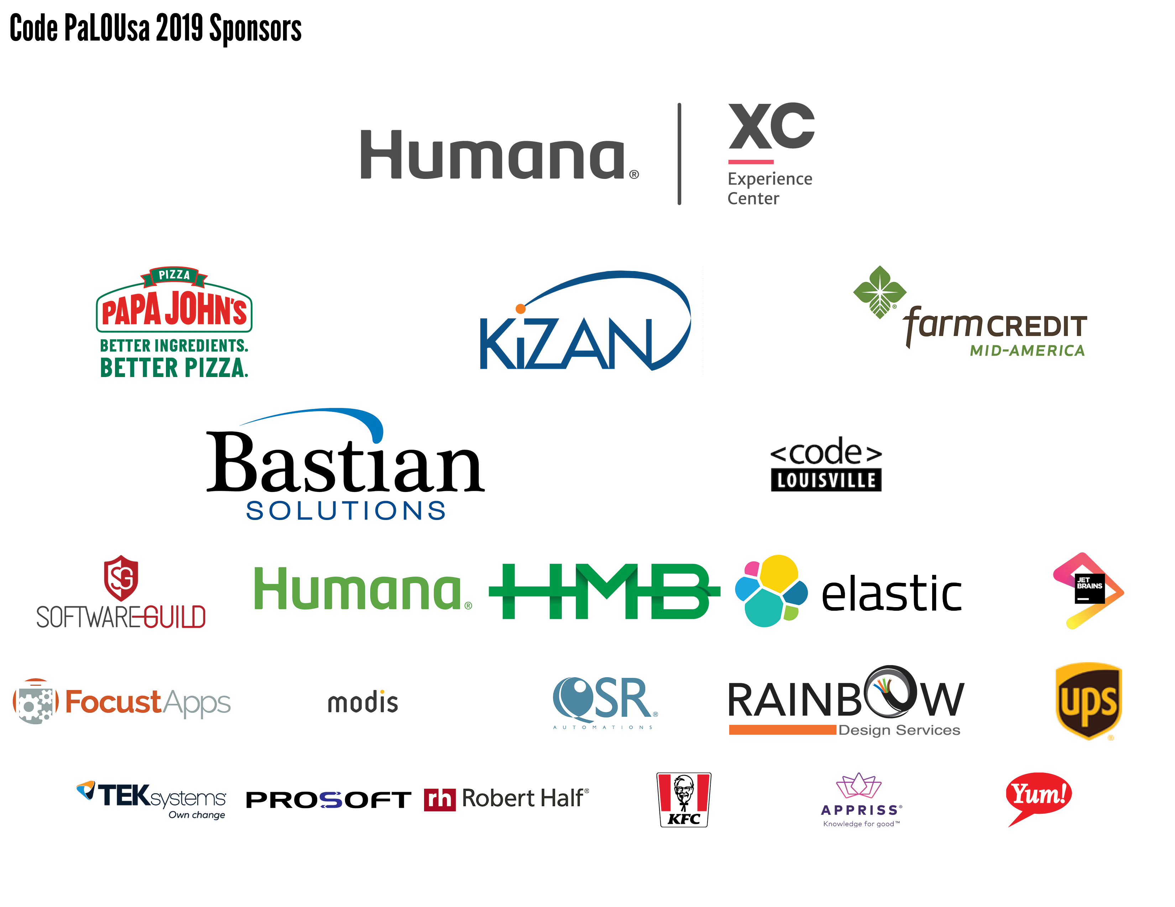

Slide 3



Santosh Hari
Azure Consultant @ Nebbia Tech
Azure MVP
President, Orlando .NET UG
Organizer, Orlando Codecamp
santoshhari.wordpress.com
santosh.hari@newsignature.com
@_s_hari
/in/santoshhari

Slide 4
Agenda
Problems database professionals experience during deployments
Concerns about DevOps
Why risk avoidance is bad
How DevOps addresses and minimizes risk
Basics of database DevOps
Demo
Parting thoughts

Slide 5
The factory of the future will have only two employees, a man and a dog. The man will be there to feed the dog. The dog will be there to keep the man from touching the equipment.
Warren Bennis - scholar, organizational consultant and author

Slide 6
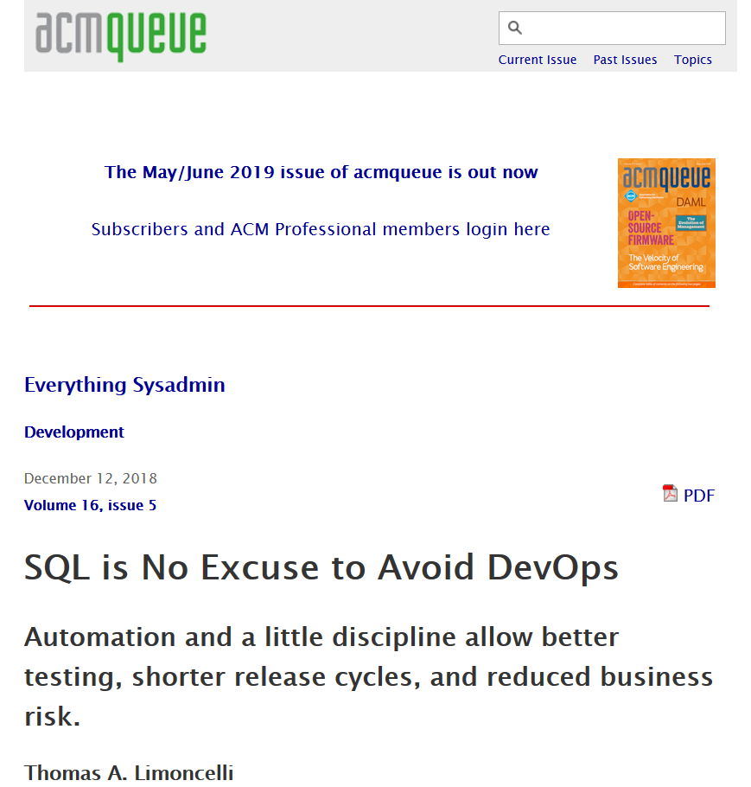
The title and some content inspired by

Slide 7
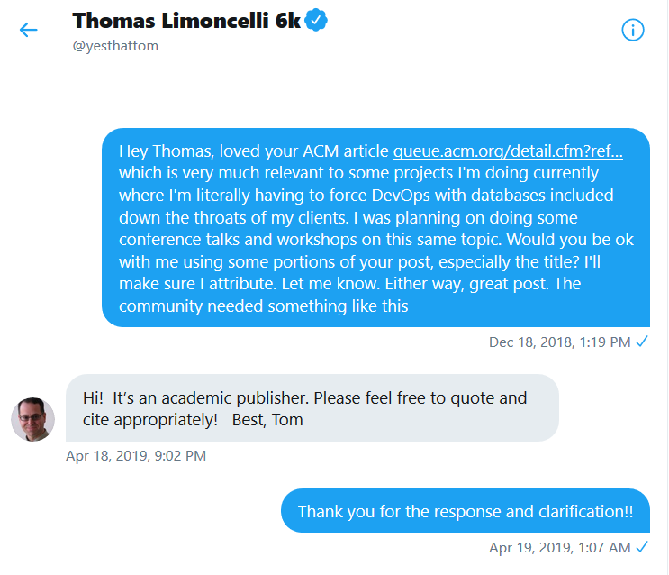
Yes, I got permission

Slide 8
Current state of database deployments
Deployments take hours if not days
Weeks of negotiation with moving codebases
Infrequent aka big bang
Often performed on weekends
No control over when to deploy your changes

Slide 9
Jumping through hoops for database deployments
Have to perform gymnastics
Lock out users/apps
Take Offline
Disable data writes
Run in parallel and sync up data

Slide 10
Concerns with DevOps
Deployments take time
Deployments are risky
Notes:
Take days to do mine currently. Since DevOps more deployments then we will be basically doing it full time and system will always be down
Deployments risky. Every time risk system downtime and data loss. Doing it multiple times increases risk

Slide 11
Risk avoidance causes fragility
Changes are risky
Less frequent
Out of practice
Surrounding environment changes
Unknown side effects increase
Failure nearly guaranteed.
Notes:
when something is risky there is a natural inclination to seek to do it less.
Counterintuitively, this actually increases risk.
The next time you do the risky thing, you'll be even more out of practice
the accumulated changes to the surrounding environment become larger and larger
failure-by-unknown-side-effect nearly guaranteed.
Vicious cycle

Slide 12

DevOps is the union of people, process, and products to enable continuous delivery of value to our end users
Donovan Brown, Cloud Advocate Manager of the Methods and Practices Org, Microsoft
Notes:
In this definition, he uses value not software
End Users instead of dev, test or prod
Something that does not reach end user does not provide value
DevOps not a product
Cannot buy, cannot install DevOps
Not solely restricted to pipelines, automation or IaC
People following process enabled by products to deliver value to end user
I will be talking about the process and products

Slide 13
How to DevOps
Continuous Integration (CI)
Continuous Delivery (CD)
Version Control (VC), mostly Git
Agile planning and lean project management
Monitoring and Logging
Public and Hybrid Clouds
Infrastructure-as-Code (IaC)
Microservices
Containers
Shift Left philosophy
Notes:
CI ongoing merging and testing of code, finding defects early. less time wasted on merge issues. rapid feedback for development teams.
Continuous Delivery of software solutions to production and testing environments helps fix bugs and respond to ever-changing business requirements.
VC enables sharing of code, effective comms in teams, integrating with s/w monitoring tools for activities like deployment
Agile and PM plan and isolate work, manage team capacity, adapt to changing biz needs. Done = s/w collecting telemetry against biz objectives
Monitoring Logging = app health, customer usage, hypothesis to validate/invalidate strategies
Public + Hybrid – mixed workloads for versatility
IaC = automation and validation of creation and teardown of environments
Microservices = isolate business use cases into small reusable services
Containers = easy to create and configure from config and code files
Shift Left philosophy = everything moves left – security, infrastructure, deployments

Slide 14
DevOps is anti-fragile
Deployments more frequent
Deployment batch size is smaller
Exposes issues
Forces automation
Forces testing
Frequency provides more practice
Drives down fixed cost of deployment
Process smoother
Reduced risk
Notes:
risky things should be done more frequently and in smaller quantities
higher frequency exposes the minor (and major) issues that have been swept under the rug
forces us to automate the process, automate the testing of the process
gives the people involved more practice
driving down the fixed cost of deployment toward zero.
make the process so smooth that risk is reduced
Virtuous cycle

Slide 15
DevOps for databases
Everything is automated
Schema change management - State-based or migration-based?
Unit tests
Schema validation
Data (Lookup tables, for instance)
Security – firewall, usernames/passwords
Infrastructure and config
Logging and monitoring
Feature Flags
Above all, work closely with the rest of the team

Slide 16
Demo
Deploy database from scratch
Manage subsequent schema changes
Infrastructure create/change

Slide 17
Parting thoughts

Slide 18
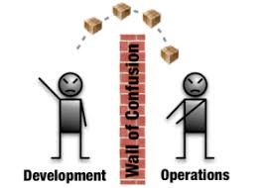
Don’t throw stuff over the wall
Notes:
No throwing stuff over a wall to a different team
Don’t boil the ocean
Everything is pipelined all the way through prod
Reduce environmental config drift
Log and monitor everything
Painful at first like starting exercise regimen
DevOps is a journey, don’t stop believing

Slide 19

Don’t attempt to boil the ocean
Notes:
No throwing stuff over a wall to a different team
Don’t boil the ocean
Everything is pipelined all the way through prod
Reduce environmental config drift
Log and monitor everything
Painful at first like starting exercise regimen
DevOps is a journey, don’t stop believing

Slide 20
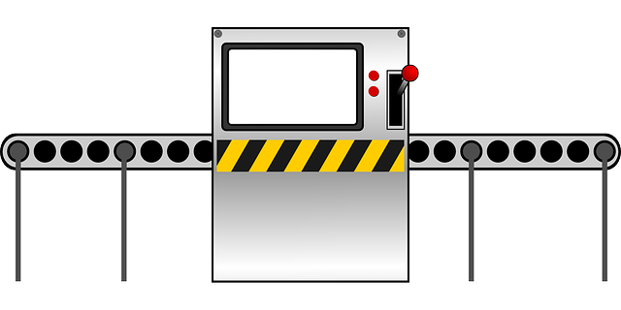
Pipeline and automate everything
Notes:
No throwing stuff over a wall to a different team
Don’t boil the ocean
Everything is pipelined all the way through prod
Reduce environmental config drift
Log and monitor everything
Painful at first like starting exercise regimen
DevOps is a journey, don’t stop believing

Slide 21

Reduce drift between environments
Notes:
No throwing stuff over a wall to a different team
Don’t boil the ocean
Everything is pipelined all the way through prod
Reduce environmental config drift
Log and monitor everything
Painful at first like starting exercise regimen
DevOps is a journey, don’t stop believing

Slide 22

Log and monitor everything
Notes:
No throwing stuff over a wall to a different team
Don’t boil the ocean
Everything is pipelined all the way through prod
Reduce environmental config drift
Log and monitor everything
Painful at first like starting exercise regimen
DevOps is a journey, don’t stop believing

Slide 23
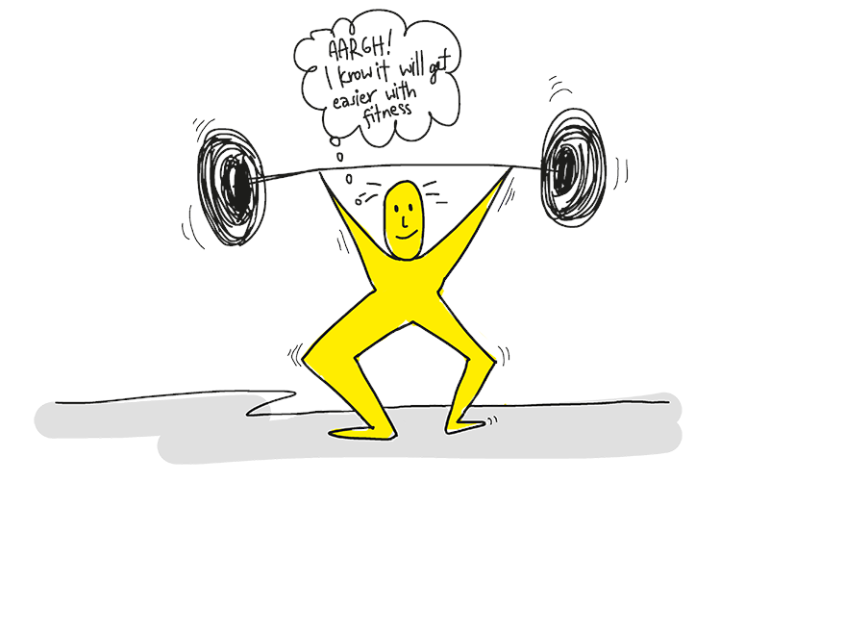
DevOps *will* hurt at first
Notes:
No throwing stuff over a wall to a different team
Don’t boil the ocean
Everything is pipelined all the way through prod
Reduce environmental config drift
Log and monitor everything
Painful at first like starting exercise regimen
DevOps is a journey, don’t stop believing

Slide 24

DevOps is a journey
Notes:
No throwing stuff over a wall to a different team
Don’t boil the ocean
Everything is pipelined all the way through prod
Reduce environmental config drift
Log and monitor everything
Painful at first like starting exercise regimen
DevOps is a journey, don’t stop believing

Slide 25
Resources
SQL is no excuse to avoid DevOps – ACM – Thomas Limoncelli https://queue.acm.org/detail.cfm?ref=rss&id=3300018
Official Microsoft SQL Server DevOps https://www.microsoft.com/en-us/sql-server/developer-get-started/sql-devops/
What is DevOps? https://docs.microsoft.com/en-us/azure/devops/learn/what-is-devops
Redgate – State based or migration based https://www.red-gate.com/library/state-or-migrations-based-database-development
The Phoenix Project - https://www.amazon.com/Phoenix-Project-DevOps-Helping-Business/dp/1942788290
Accelerate - https://www.amazon.com/Accelerate-Software-Performing-Technology-Organizations/dp/1942788339

Slide 26
Santosh Hari
Azure Consultant @ Nebbia Tech
Azure MVP
President, Orlando .NET UG
Organizer, Orlando Codecamp
santoshhari.wordpress.com
santosh.hari@newsignature.com
@_s_hari
/in/santoshhari

Slide 27
State-based database change management
SSDT or Redgate SQL Source Control (supports hybrid)
Single step between current and desired state
Mostly CREATE statements
Easy workflow for large teams and complicated databases
Scripts generated at deployment time using comparison
Developer involvement minimal
UI based and automated options available
Bad for scenarios like column-split or datatype/constraint changes because context is lost

Slide 28
Migration-based database change management
Migration-first: EF, DbUp, Redgate SQL Change Migration (supports hybrid)
Captures individual change scripts during dev to effect larger iterative migrations
Numerically ordered migrations
Mostly ALTER commands
Works well with simple data stores for table refactoring or data migration
Dev and DBA collaborate early in dev cycle to define deployment steps
Can be executed as code/scripts both manual and through automation
Last check-in would dominate

Slide 29
Automated Schema Updates
Automated Schema Updates

Slide 30
Coding for Multiple Schemas
Coding for Multiple Schemas

Slide 31
Infrastructure and environments

Slide 32
Generate Test Data
Generate Test Data

Slide 33
Log and monitor everything

Slide 34
Multi-phase schema commit
Propose New Schema: checkin new schema, contains both old (primary) and new (backup) fields, no field deletes/renames, DAO abstracts column type changes, make app new schema, write to both old and new columns, migrate old data as needed, easy to rollback
Flip source of truth: new fields should be primary, old fields will still be valid. Previous release will still work
Remove old references: Once you're certain you're not going to roll back, stop reading/writing the old data. This is your hard flip.
requires at least two periods of schema change and one period that involves multiple software rollouts
requires that your application is well formed. Your application needs to be properly modularized, use reasonable DAOs or otherwise have complete understanding of how the data is accessed

Slide 35
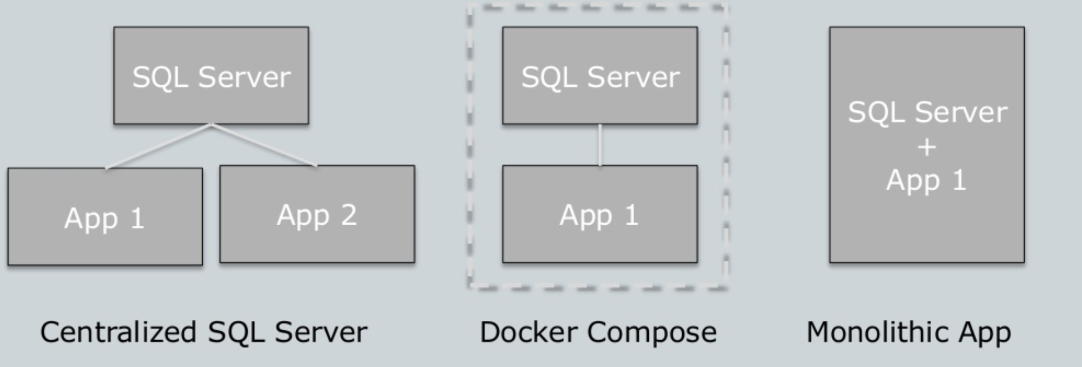
App Deployments with Containers
Notes:
SQL Server is coming to Linux in the next major version of SQL Server.
Having SQL Server in Linux containers makes it much easier for dev/test, CI/CD, and build automation pipelines

Slide 36
Santosh Hari
Azure Consultant @ Nebbia Tech
Azure MVP
President, Orlando .NET UG
Organizer, Orlando Codecamp
santoshhari.wordpress.com
santosh@nebbiatech.com
@_s_hari
/in/santoshhari

