Slide 1
Serverless and Schema-less w/ Azure Functions and CosmosDB
Santosh Hari

Slide 2



Santosh Hari
Azure Consultant
Azure MVP
President, Orlando .NET UG
Organizer, Orlando Codecamp
santoshhari.wordpress.com
santosh@nebbiatech.com
@_s_hari
/in/santoshhari

Slide 3
Agenda
Discuss Serverless – Azure Functions as context
Discuss Schema-less – Cosmos DB as context
Store schema-less data in Cosmo DB and process it with minimal code using serverless concepts with Azure Functions

Slide 4
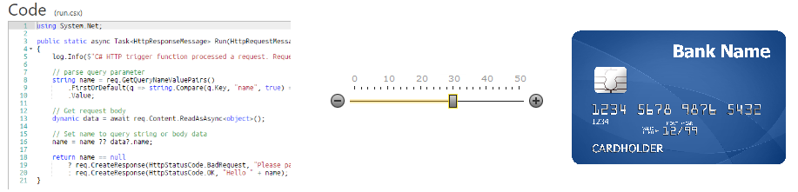
What is Serverless?
*Image copied from Hanselman
Notes:
Serverless computing is the abstraction of servers, infrastructure, and operating systems.
don’t need to provision and manage any servers, so you can take your mind off infrastructure concerns
driven by the reaction to events and triggers happening in near-real-time—in the cloud.
fully managed service - server management and capacity planning are invisible to the developer
billing is based just on resources consumed or the actual time your code is running.

Slide 5
What I like about Serverless
Eliminates most plumbing code
Reacts to events/conditions
Low TCO
Focused short snippets of code
Easy to test
Easy to reuse

Slide 6
What is a Schema-less database?
Does not require conformation to a rigid schema
No data type limitations
Can store structured and unstructured data.
Eliminates the need for ORM
Stores data as Key-Value pair or JSON document
Notes:
SQL = Schema enforced by a RDBMS on Write
NoSQL = Partial Schema enforced by the DBMS on Write, PLUS schema fully enforced by the Application on Read (Externalised schema)

Slide 7
Why Schema-less?
Context: Document Oriented NoSQL databases
Great for similar but not identical data
Models real world data
Less NULL columns

Slide 8

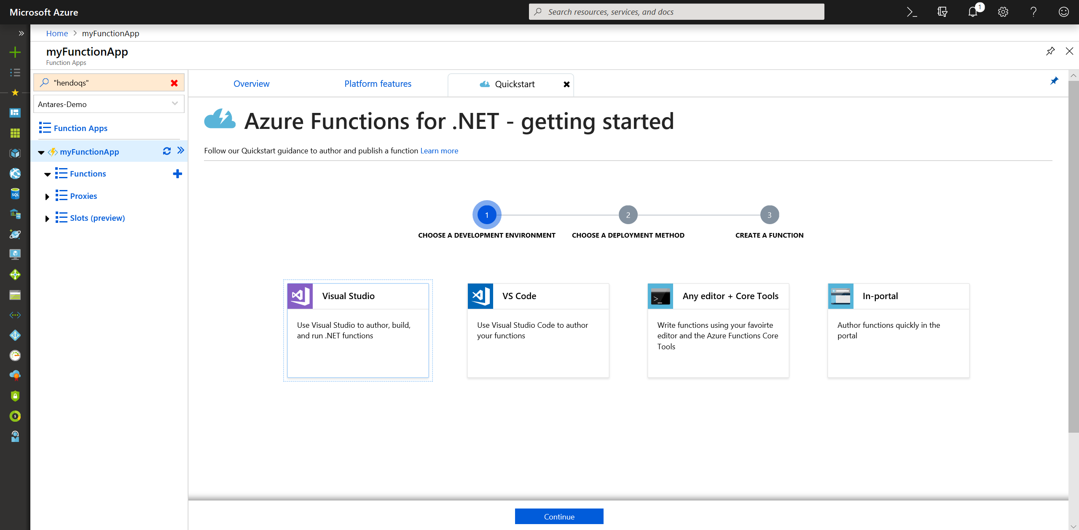
Serverless with Azure Functions
Notes:
Functions is the natural evolution of WebJobs in that it takes the best things about WebJobs and improves upon them. The improvements include:
Streamlined dev, test, and run of code, directly in the browser.
Built-in integration with more Azure services and 3rd-party services like GitHub WebHooks.
Pay-per-use, no need to pay for an App Service plan.
Automatic, dynamic scaling.
For existing customers of App Service, running on App Service plan still possible (to take advantage of under-utilized resources).
Integration with Logic Apps.

Slide 9
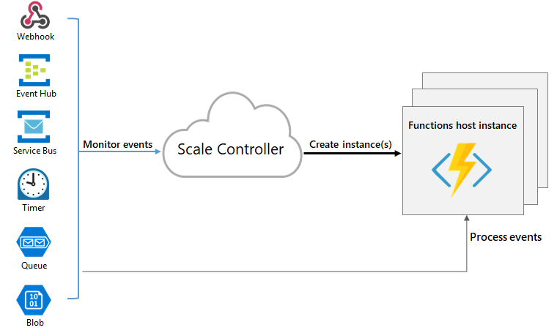
Azure Functions - Trigger
Notes:
Azure Functions are “event-driven” meaning they run based on associated and configure events, or “triggers”.
For example an Azure Function could be triggered by a simple timer, such as running a process once every 24-hours,
or triggered by an event in a document management system, such as when a new document is uploaded to a SharePoint library.
Azure Functions can also respond to Azure-specific events, such as an image added to a Storage Blob or a notification arriving in a Message Queue.
Automagically handles scaling

Slide 10
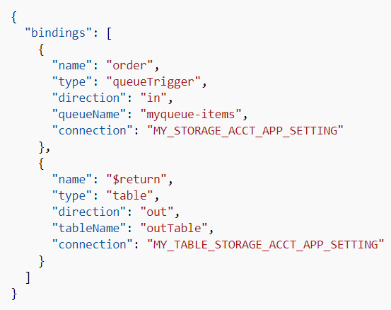
Azure Functions - Binding
bindings
Notes:
Binding is how you connect the function code to infrastructure
Done properly no additional plumbing code needed

Slide 11
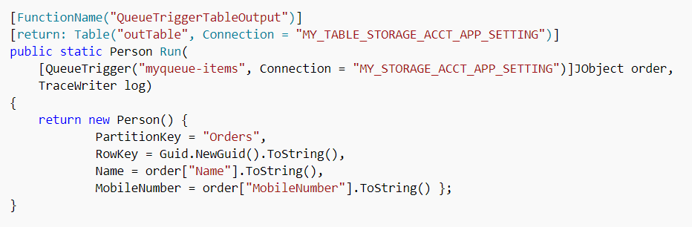
Azure Functions
Binding in C# code

Slide 12

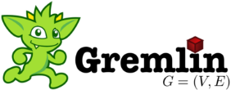




Schema-less with Azure Cosmos DB
Table API
MongoDB
Column-family
Document
Key-value
Graph
Elastic scale out
of storage & throughput
Guaranteed low latency at the 99th percentile
Five well-defined consistency models
Turnkey global distribution
Comprehensive SLAs
Notes:
Azure Cosmos DB offers the first globally distributed, multi-model database service for building planet scale apps. It’s been powering Microsoft’s internet-scale services for years, and now it’s ready to launch yours.
Only Azure Cosmos DB makes global distribution turn-key.
You can add Azure locations to your database anywhere across the world, at any time, with a single click. Cosmos DB will seamlessly replicate your data and make it highly available.
Cosmos DB allows you to scale throughput and storage elastically, and globally! You only pay for the throughput and storage you need – anywhere in the world, at any time.

Slide 13
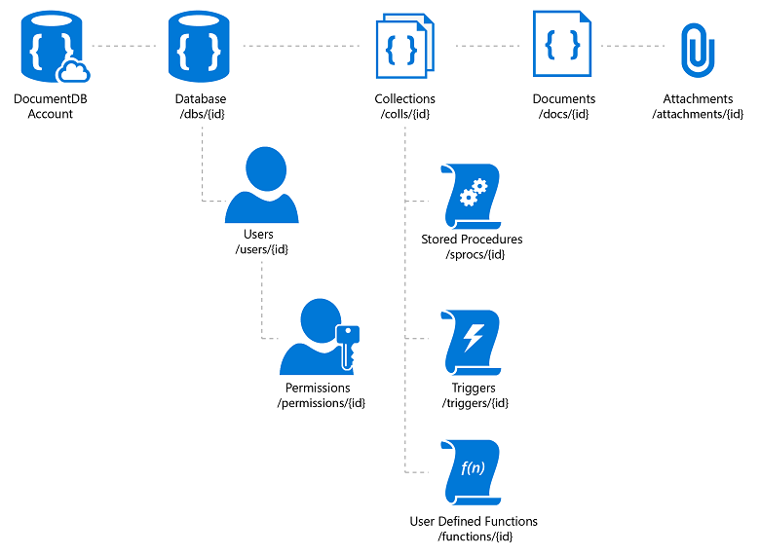
Azure Cosmos DB – SQL API (DocumentDB)
Notes:
We will use SQL API aka DocumentDB for our demo purposes
A database account consists of a set of databases, each containing multiple collections, each of which can contain stored procedures, triggers, UDFs, documents, and related attachments. A database also has associated users, each with a set of permissions to access various other collections, stored procedures, triggers, UDFs, documents, or attachments. While databases, users, permissions, and collections are system-defined resources with well-known schemas - documents, stored procedures, triggers, UDFs, and attachments contain arbitrary, user defined JSON content.
Documents – managed (upload blob) unmanaged (link)

Slide 14
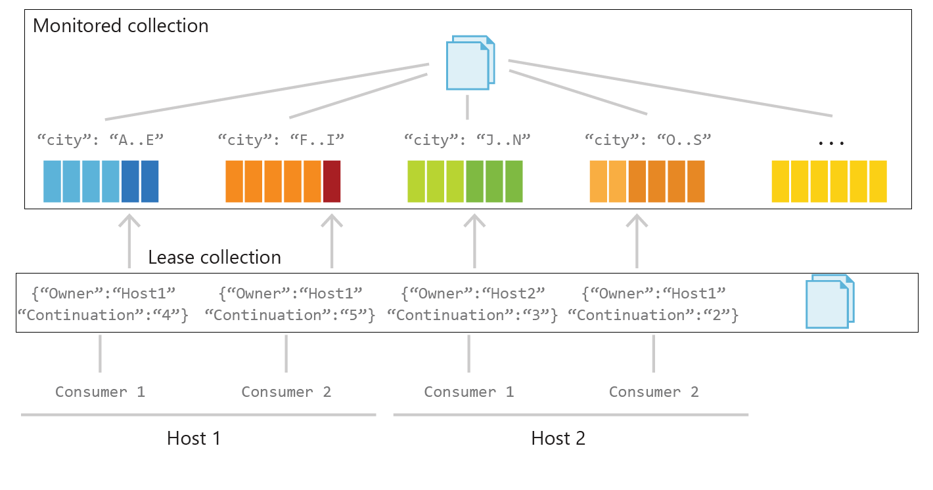
Cosmos DB – Change Feed
Partitions, Partition Ranges, Monitored Collection,
Notes:
Monitored Collection: data from which the change feed is generated.
inserts and changes reflected in the change feed of the collection.
Lease Collection: coordinates processing the change feed across multiple workers.
separate collection stores leases with one lease per partition. contains the following attributes:
Owner: Specifies the host that owns the lease
Continuation: Specifies the position (continuation token) in the change feed for a particular partition
Timestamp: Last time lease was updated; the timestamp can be used to check whether the lease is considered expired
Processor Host: Each host determines how many partitions to process based on how many other instances of hosts have active leases.
When a host starts up, it acquires leases to balance the workload across all hosts. A host periodically renews leases, so leases remain active.
Host checkpoints the last continuation token to its lease for each read. To ensure concurrency safety, a host checks the ETag for each lease update.
Other checkpoint strategies are also supported.
Upon shutdown, a host releases all leases but keeps the continuation information, so it can resume reading from the stored checkpoint later.
At this time the number of hosts cannot be greater than the number of partitions (leases).
Consumers: Consumers, or workers, are threads that perform the change feed processing initiated by each host. Each processor host can have multiple consumers.
Each consumer reads the change feed from the partition it is assigned to and notifies its host of changes and expired leases.

Slide 15
Serverless and Schema-less
Why?
Scale easily – computing and data storage
Microservices-friendly
Minimize custom integration code
Handle 3Vs of data – variety, velocity, volume

Slide 16
Serverless and Schema-less
Serverless computing with Azure Functions
Serverless Schema-less data storage with CosmosDB
Read from CosmosDB with input binding for Azure Function
Save to CosmosDB with output binding for Azure Function
Monitor CosmosDB data changes with Azure Functions Change Feed
Notes:
native integration between Azure Cosmos DB and Azure Functions.
you can create database triggers, input bindings, and output bindings directly from your Azure Cosmos DB account

Slide 17
Serverless and Schema-less
Dev environment
Visual Studio 2017
Install Azure storage emulator
Install CosmosDB emulator
Visual Studio Azure Development Workload
Install latest version of Azure Functions tools for v2
Install cosmos support for functions

Slide 18
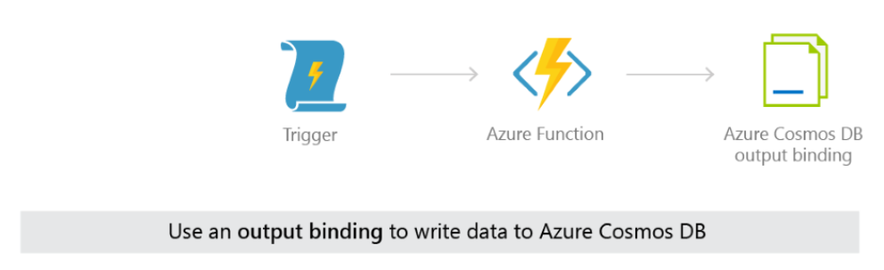
Store Schema-less data
Notes:
An input binding to an Azure Cosmos DB container can be used in the same function as an Azure Cosmos DB trigger, and can be used with or without an output binding as well. You could use this combination to apply up-to-date currency exchange information (pulled in with an input binding to an exchange container) to the change feed of new orders in your shopping cart service. The updated shopping cart total, with the current currency conversion applied, can be written to a third container using an output binding.

Slide 19
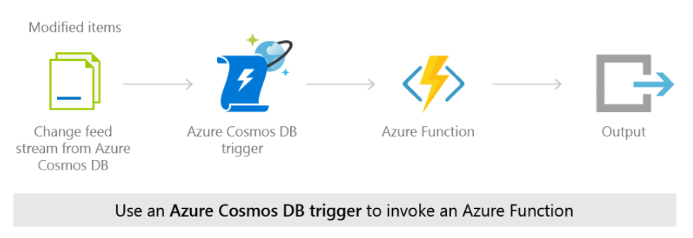
React to changing Schema-less with Serverless code
Notes:
An Azure Cosmos DB trigger can be used with an output binding to a different Azure Cosmos DB container.
After a function performs an action on an item in the change feed you can write it to another container
(writing it to the same container it came from would effectively create a recursive loop).
Or, you can use an Azure Cosmos DB trigger to effectively migrate all changed items from one container to a different container, with the use of an output binding.

Slide 20
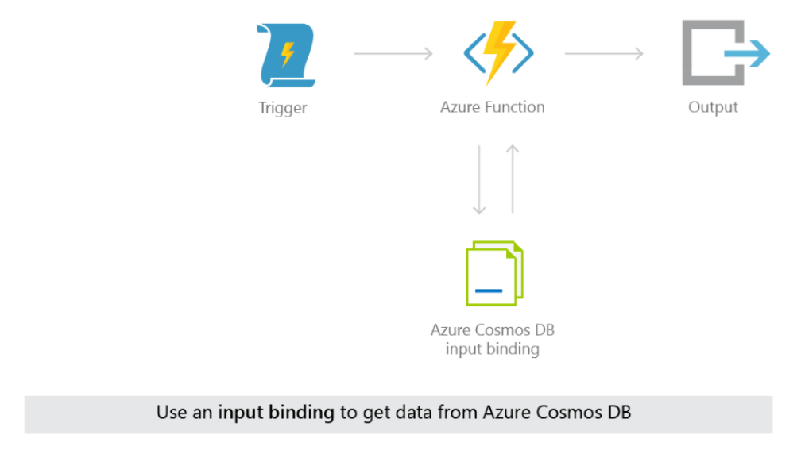
Serverless and Schema-less
Notes:
Input bindings and output bindings for Azure Cosmos DB can be used in the same Azure Function.
This works well in cases when you want to find certain data with the input binding, modify it in the Azure Function,
and then save it to the same container or a different container, after the modification.

Slide 21
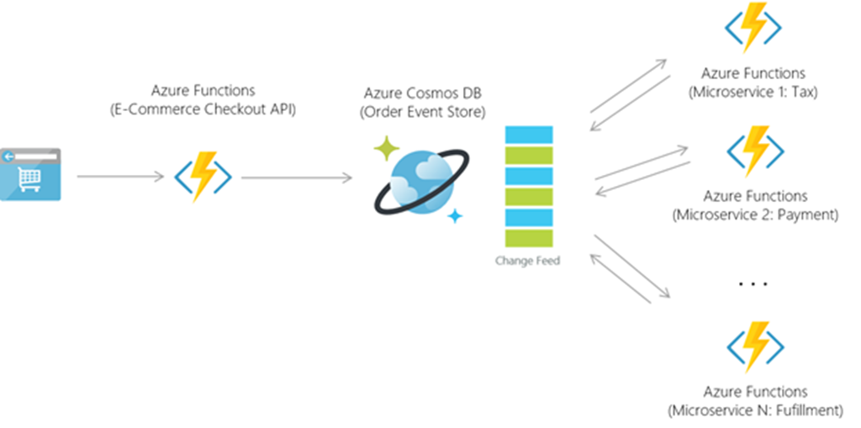
Serverless and Schema-less implementation

Slide 22
Demo
Serverless and Schema-less

Slide 23
Resources
Serverless and Schema-less
https://azure.microsoft.com/en-us/blog/azure-cosmosdb-database-for-serverless-era/
https://docs.microsoft.com/en-us/azure/cosmos-db/serverless-computing-database
http://www.bradygaster.com/posts/azure-cosmosdb-with-functions
http://www.bradygaster.com/azure-cosmosdb-with-functions-and-nodejs

Slide 24
Santosh Hari
Azure Consultant
Azure MVP
President, Orlando .NET UG
Organizer, Orlando Codecamp
santoshhari.wordpress.com
santosh@nebbiatech.com
@_s_hari
/in/santoshhari

