Slide 1
2015 ONC Certification Testing Approach Overview: Using the HL7 V2 Immunization Validation Tool for Testing an HIT Module
§170.315(f)(1) Transmission to Immunization Registries Testing Process Supplement
Robert Snelick, NIST (rsnelick@nist.gov)
October 26, 2016

Slide 2
Purpose
Provide an additional resource to explain the process of certification testing of a Health IT Module related to HL7 V2 Immunization Messaging
Describe the National Institute of Standards and Technology (NIST) approach for assessing and validating the test messages created by Health IT Modules and for validating the ability of Health IT Modules to consume acknowledgement and response messages
Provide an overview of the testing requirements

Slide 3
Table of Contents
List of Resources
ONC Immunization Criterion
Referenced Standards
Test Tool Overview
Scope of NIST Immunization Messaging Testing
Testing Process and Testing Workflow Diagrams
Explanation of Test Cases and Test Steps
Example Test Case Documents
Explanation of Test Data Categorization/Validation
Test Tool Overview and Example Test Tool Screen
Additional Resources

Slide 4
Resources
ONC Test Procedure
(http://confluence.oncprojectracking.org/display/ONCCERT2015/ONC+Health+IT+Certification+Program+2015+Edition+Test+Methods+Home)
Test Tool Web Site (http://hl7v2-iz-r1.5-testing.nist.gov/iztool )
Validation Tools
User Documentation
HL7 Implementation Guide for Immunization Messaging, Release 1.5 (http://www.cdc.gov/vaccines/programs/iis/technical-guidance/downloads/hl7guide-1-5-2014-11.pdf)
HL7 Implementation Guide for Immunization Messaging, Release 1.5, Addendum
(http://www.cdc.gov/vaccines/programs/iis/technical-guidance/downloads/hl7guide-addendum-7-2015.pdf)
On Test Tool Documentation Tab
NIST Immunization Messaging Testing Process
Immunization Tool Quick Reference Guide
Immunization Tool Tutorial
Release Notes for each version of Test Tool
Known Issues
Immunization Test Tool Google Group for submitting questions to the Test Tool developers
(https://groups.google.com/d/forum/hl7v2-immunization-testing)

Slide 5
ONC Final Rule Criterion - Immunizations
§170.315(f)(1) Transmission to immunization registries
Evaluates the capability for a Health IT Module to electronically create immunization information for electronic transmission using the Immunization Messaging Guide and associated Addendum, with CVX codes for historical vaccines and National Drug Code Directory codes for administered vaccines
Evaluates the capability for a Health IT Module to enable a user to request, access, and display a patient’s evaluated immunization history and forecast from an immunization registry with information from the Health IT Module, if applicable, using the Immunization Messaging Guide and associated Addendum
Note: The ONC certification criterion does not specify use of a transport standard; therefore, testing for this criterion does not require Health IT Modules to be certified to any transport standards

Slide 6
Referenced Standards - Immunizations
§170.205 Content exchange and implementation specifications for exchanging electronic health information
(e)(4) Standard. HL7 2.5.1 Implementation specifications.
HL7 2.5.1 Implementation Guide for Immunization Messaging, Release 1.5
HL7 Version 2.5.1 Implementation Guide for Immunization Messaging (Release 1.5)—Addendum, July 2015
§170.207 Vocabulary standards for representing electronic health information
(e)(2) Standard. HL7 Standard Code Set CVX -- Vaccines Administered, updates through August 17, 2015
(e)(4) Standard. National Drug Code Directory– Vaccine Codes, updates through August 17, 2015

Slide 7
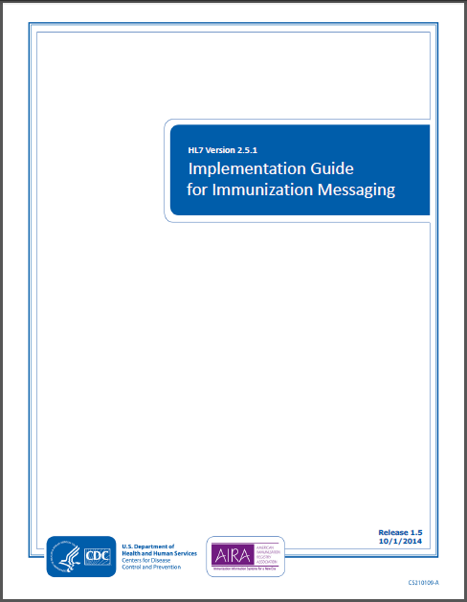
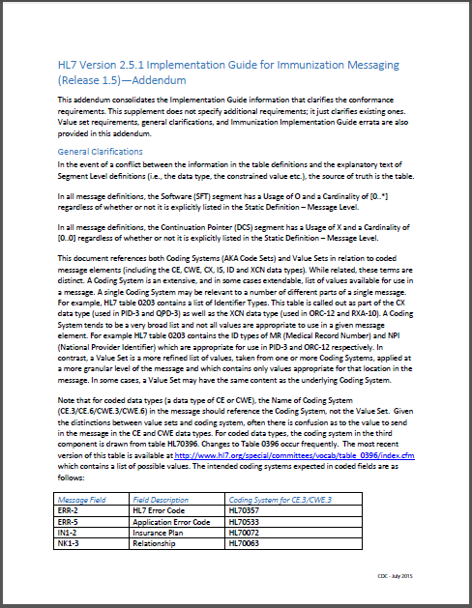
Referenced Content Exchange Standards Documents
HL7 2.5.1 Immunization Implementation Guide Release 1.5
HL7 2.5.1 Immunization Implementation Guide Release 1.5, Addendum
http://www.cdc.gov/vaccines/programs/iis/technical-guidance/downloads/hl7guide-1-5-2014-11.pdf
http://www.cdc.gov/vaccines/programs/iis/technical-guidance/downloads/hl7guide-addendum-7-2015.pdf

Slide 8
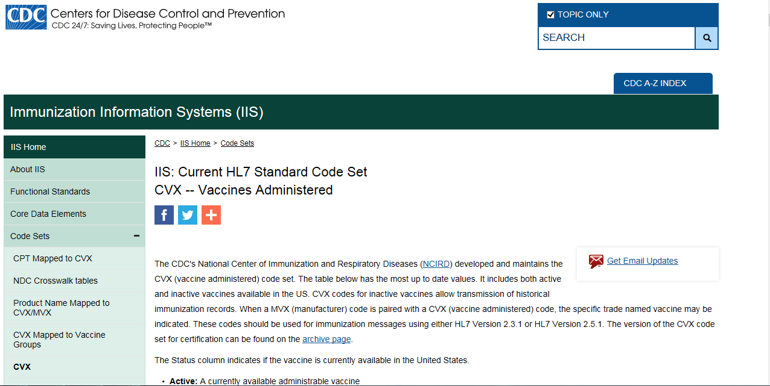
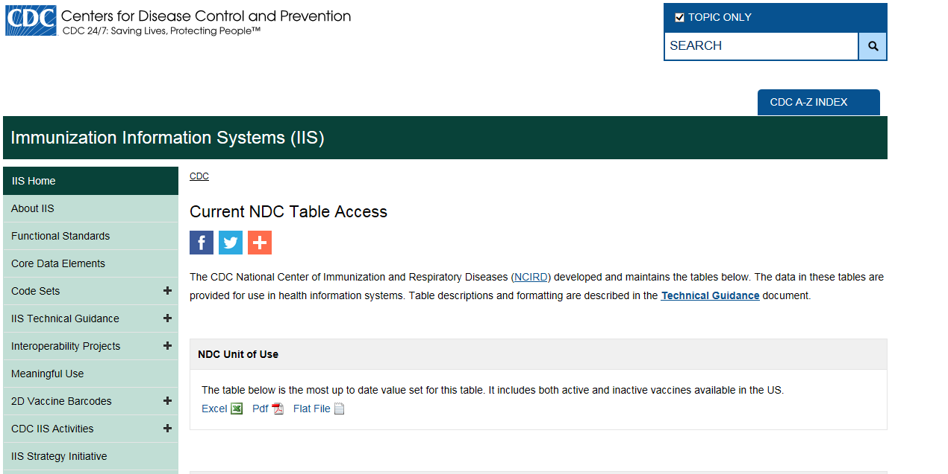
Referenced Vocabulary Standards Web Sites
CDC CVX Codes
http://www2a.cdc.gov/vaccines/IIS/IISStandards/vaccines.asp?rpt=cvx
CDC NDC (Unit of Use)
http://www2a.cdc.gov/vaccines/iis/iisstandards/ndc_tableaccess.asp

Slide 9
Use of MVX Codes for Immunization Messages
ONC did not adopt MVX (Manufacturers of Vaccines) codes for vaccine manufacturers in the 2015 Edition Health IT Certification Criteria Final Rule and did not include MVX codes in their list of code sets. For the purposes of administered vaccines, ONC requires that the NDC (National Drug Code) be sent in the VXU message [RXA-5] when an immunization is reported at the time it is administered when the actual product is known; and states that CVX (Vaccines Administered) codes are to be sent [RXA-5] when reporting historical vaccines. The NIST HL7 Context-based validation in the 2015 Edition Immunization Test Suite used for ONC certification testing will verify that the Health IT Module supports NDC for new immunization records and CVX for historical immunization records in HL7 immunization messages, and the Test Cases in the Test Suite (ONC 2015 Test Plan) will reflect this requirement.
A question has arisen regarding whether the MVX code should be included in the VXU message [RXA-17] when an immunization is reported at the time it is administered, since the NDC is required to be sent and an NDC typically includes the identification of the vaccine manufacturer (Note: if the NDC identifies the re-packager of the vaccine, the identification of the actual vaccine manufacturer may not be readily available or apparent via that NDC).
The Implementation Guide for Immunization Messaging, Release 1.5, requires the MVX code be sent conditionally in RXA-17 of the VXU. The Condition Predicate that triggers populating RXA-17 with the MVX code is the first occurrence of RXA-9.1 (Administration Notes-Identifier) being valued "00" (New Immunization Record, i.e., newly administered vaccine) and RXA-20 (Completion Status) being valued "CP" (Complete) or "PA" (Partially Administered).
Though ONC does not require use of MVX codes in the VXU messages created by certified Health IT Modules, the Immunization Messaging Guide does require use of MVX codes if the Condition Predicate is met. Immunization registries (IIS), which are not included in CMS Meaningful Use and are not incented to conform to the ONC health IT certification requirements, are likely to be following the Guide rather than the ONC 2015 Edition Final Rule regarding use of MVX codes. To facilitate interoperability, the NIST test cases include MVX codes in accordance with the requirement in the Implementation Guide for Immunization Messaging, Release 1.5; therefore, the NIST Immunization Test Suite verifies that the health IT being tested supports MVX codes for RXA-17 as well as NDC for RXA-5 (for New Immunization Records) even though certain data available via the NDC and MVX code may be redundant.

Slide 10
Vaccine Codes Required for Immunization Messages
2015 ONC Certification Testing Only
Codes from the NDC Directory are required for vaccines in new vaccine administered records in
Z22 VXU (send unsolicited immunization update message)
CVX codes are required for vaccines in vaccine historical records in
Z22 VXU (send unsolicited immunization update message)
Z42 RSP (return evaluated history and forecast message)
Example Scenario
A Z22 VXU message is transmitted from an EHR to an IIS with an NDC for a new vaccine administered
A query for an Evaluated Immunization History and Forecast (Z44 QBP message) is performed via the EHR the next day
The response for the Evaluated Immunization History and Forecast (Z42 RSP message) is transmitted from the IIS with a CVX code for the vaccine sent with an NDC in the Z22 VXU the day before, as this vaccine now exists as a historical record in the IIS

Slide 11
NDC Format
NDC has various formats for representing a concept
Published NDC codes are 10 digits with dashes (can be groups of 4-5, 3-4, 1-2, digits but always 10 total)
CMS created 11 digit unformatted (padded without dashes, always with 5-4-2, groups of digits with one of the 1st, 2nd, or 3rd component padded with a 0)
The problem of the 10 digit format is that they don’t often have the dashes and so can’t reliably be determined to match a given vaccine. This motivated the “normalization” to 11 characters.
11 digit format with dashes and padded. E.g., “CDC Vaccine Price List”
much of the vaccine used in the US is federally funded and ordering uses the 11 character with dash—this format was determine to be the most appropriate choice
The link in the ONC rule points to files that contain the 11 digit format with dashes and padded.
Bar codes are created that map to the NDC codes (Today’s NDC bar codes are unique). Bar codes contain a prefix, 10 digit NDC (no dashes), and a check digit
There are crosswalk tables to keep all of this straight and to be able to go from one format to another (Implementers may need to do this to meet their implementation choices)
Certification Requirements are to use the 11 digit format with dashes and padded
RXA-5.1 Example: 00006-4047-20^RotaTeq^NDC
Note 10 digit NDC code is 0006-4047-20 with the leading 0 added to the first component.
No other formats are acceptable for certification
If vendors wish to send an alternative code they may do so in the 2nd triplet of RXA-5
e.g., 00006-4047-20^RotaTeq^NDC^00006404720^RotaTeq^NDC
In this case the 11 digit padded without dashes format is used
Vendors can represent the NDC codes internally in their HIT system in any manner they choose

Slide 12
Immunization Validation Tool Overview
Tool Key Capabilities
SOAP Envelope Testing | The SOAP Envelop Testing ensures SOAP envelopes are correctly formed, validating the conformance of the messages to the requirements in the SOAP and Transport specifications.
SOAP Connectivity Testing | The SOAP Connectivity Testing evaluates valid SOAP connectivity, the ability to send and receive SOAP messages, validating the conformance of the messages to the requirements in the SOAP and Transport specifications.
Context-Free Testing | Provides a simple and convenient method for testing immunization messages structure and most vocabulary. Validation is perform on messages with or without a SOAP wrapper.
Context-Based Testing | Context-based testing provides, in addition to HL7 Context-free validation, message validation associated with a given test script that includes data for a specific test scenario where the context is known by the validation tool. It also validate messages with a SOAP wrapper.
Isolated Testing | Isolated testing provides a simulated operational environment that allows validation at the functional level in addition to content and context-free testing, where Test Agents simulates the functions of IZ EHR-S or IIS.
Environment: NIST Immunization Test Suite is accessible as a web application.
Supported Browsers: Firefox, Chrome, Safari, and Internet Explorer (Version 10 and 11)
URL: http://hl7v2-iz-r1.5-testing.nist.gov
NOTE: The Test Tool (.war file) can also be downloaded and installed locally. See Documentation tab in Test Tool

Slide 13
http://hl7v2-iz-r1.5-testing.nist.gov/iztool
Immunization Messaging Test Tool Overview
Purpose: The tool validates Immunization messages created by Health IT Modules, and Context-based Testing is intended for ONC 2015 Edition certification testing.
.
Tool Key Capabilities
Context-free Testing | (No Test Cases - Test any Immunization message created by Health IT Module) Context is unknown to validation tool Provides a simple and convenient method for testing message structure and most vocabulary
Context-based Testing | (Test Cases - Test Immunization message associated with a specific test scenario) Context is known to validation tool All conformance requirements of the Immunization implementation guide can be assessed Used for certifying ONC 2015 Edition Health IT Modules
Profile Viewer | Allows user to look up component of message that generated an error and view the related conformance data (such as if Required, format, value, etc.) to correct message.
Value Set Browser | Allows user to look up table value that generated an error and view valid values to correct message.
Documentation | Provides access to documents which will assist in using the tool (including test procedure, test cases, profile descriptions, vocabulary descriptions and validation tool download).
No registration or log-in credentials are needed. Simply click on the link below and send/paste/load message into tool to obtain a Validation report.
NOTE: The Test Tool (.war file) can also be downloaded and installed locally. See Documentation tab in Test Tool
NOTE: Web Application is compatible with Firefox, Chrome, and Safari.
Register to Google Group at https://groups.google.com/d/forum/hl7v2-immunization-testing to ask questions and provide feedback.
13

Slide 14
Scope of ONC Final Rule Criteria and Testing
Per the ONC Edition 2015 Final Rule, capabilities of each Health IT Module are tested rather than specific installed instances of a Health IT Module
The ONC certification criterion specifies testing the capability of a Health IT Module to create immunization information and query messages for electronic transmission and to receive electronic responses
Receiving systems, such as immunization information systems (IIS), are not being certified; however, a receiving system should be capable of processing the data specified in the ONC criterion
Testing focus and scope are narrow
Testing encompasses only the specific use case indicated in the Final Rule
Testing does not attempt to address the entire spectrum of use cases found in the production setting or specified in implementation guides
Health IT Module certification testing is driven by the test data
The NIST test tool assesses the capability of a Health IT Module to use specific data to create and consume immunization messages for transmission to/from public health agencies
The testing will not demonstrate complete conformance to the Implementation Guide as it is not practical for ONC certification testing to be exhaustive
Transmission of the messages is not being tested
The Test Cases provided do not cover the full extent of use cases specified in the Implementation Guide; through consultation with CDC Immunization experts, a set of scenarios were created for testing
The Centers for Disease Control and Prevention (CDC), in collaboration with the American Immunization Registries Association (AIRA) and NIST, provided the Test Cases and Test Data for the Immunization Messaging testing process

Slide 15
Derived Conformance Statements / Requirements
The NIST HL7 v2 Immunization Test Suite performs certain conformance testing that is not directly related to any conformance statement in the Immunization Messaging Guide
These “derived statements” are based on requirements from the HL7 v2.5.1 Base Standard, as well as statements that NIST has determined should be included in the validation (e.g., evaluating the format of a code for conformance to the Code System’s format, or testing for conformance to a specific Time Stamp format)

Slide 16
Immunizations to Public Health Testing Process
Immunization IG, Release 1.5, and Addendum
Immunization Data Entry
VXU Message & Direct Data Entry
HIT Module
(System under Test)
NIST Validation Tool (acting as IIS)
VXU Message
ACK Message
ACK Message Imported
ONC Certification Testing Scope
VXU Message
Imported
Test Step 1
Test Step 2
The HIT Module is the system being tested. The HIT Module is required to create VXU messages and consume ACK messages that conform to the referenced standards (see previous slides).
Test data can be entered into the HIT Module directly via the Module’s user interface or can be imported via an incoming message.
The HIT Module is expected to process the test data to create a VXU message. This message is imported into the testing tool for validation (Test Step 1 – Z22 VXU). The HIT Module is expected to consume an ACK message. This message is imported from the testing tool into the HIT Module (Test Step 2 – Z23 ACK).
Test data are available through the Test Tool via the Test Steps in the Test Cases. Each Test Step includes a Test Story that provides the context, a Test Data Specification that lists the test data, a Message Content Data Sheet that shows the conformant message (in a table format), and a Juror Document (for ACK Test Steps).

Slide 17
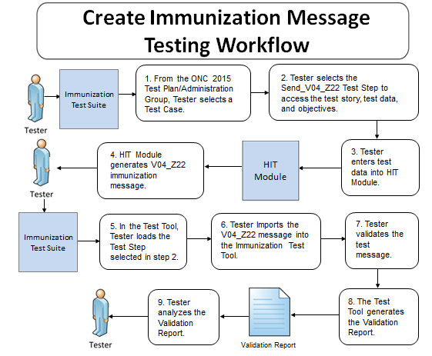
Testing Workflow Diagram (Test Step 1 – Z22 VXU)
This diagram shows
How the major steps of the create VXU message test are sequenced
When the Test Tool is to be used

Slide 18
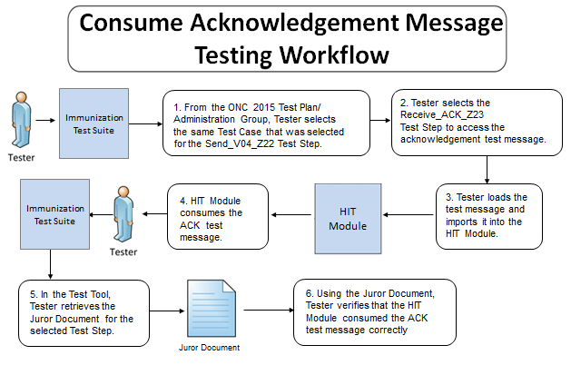
Testing Workflow Diagram (Test Step 2 – Z23 ACK)
This diagram shows
How the major steps of the consume ACK message test are sequenced
When the Test Tool is to be used

Slide 19
Request for Evaluated Immunization History & Immunization Forecast Testing Process
Immunization IG, Release 1.5, and Addendum
Patient Data Entry
ADT Message & Direct Data Entry
HIT Module
(System under Test)
NIST Validation Tool (acting as IIS)
QBP Message
RSP Message
QBP Message Imported
ONC Certification Testing Scope
RSP Message
Imported
Test Step 1
Test Step 2
The HIT Module is the system being tested. The HIT Module is required to create QBP messages and consume RSP messages that conform to the referenced standards (see previous slides).
Test data can be entered into HIT Module directly via the Module’s user interface or can be imported via an incoming message.
The HIT Module is expected to process the test data to create a QBP message. This message is imported into the testing tool for validation (Test Step 1 – Z44 QBP). The HIT Module is expected to process an RSP message and display the Evaluated Immunization History & Forecast if received. The RSP message is imported from the testing tool into the HIT Module (Tests Step 2 – Z42 or Z33 RSP).
Test data are available through the Test Tool via the Test Steps in the Test Cases. Each Test Step includes a Test Story that provides the context, a Test Data Specification that lists the test data, a Message Content Data Sheet that shows the conformant message (in a table format), and a Juror Document (for RSP Test Steps).

Slide 20
Display of IIS Evaluated History and Forecast
Work Flow and Pre-conditions
HIT Module has a test patient for the Test Case
Tester verifies that this patient has no current immunization administration information in their electronic record
Tester causes Module to create a Query for Evaluated History and Forecast
Module must display the Evaluated History and Forecast Response information returned by the IIS (IIS simulated by NIST Test Tool)
Scope
ONC requirement is for the HIT Module to receive and display Evaluated History and Forecast from IIS
Test environment is set up so this information sent in the RSP message from the Test Tool is the only available immunization administration information in the patient’s electronic record
This information must be displayed, and only display of this information for the Evaluated History and Forecast is valid for ONC certification testing
HIT Modules can be designed to display the immunization Forecast based on data stored in the Module, but this capability is out-of-scope for ONC certification testing
Scope of ONC certification testing is focused on verifying that the HIT Module is able to display the Evaluated History and Forecast from the IIS
Substitution of a Forecast produced from patient immunization data stored in the HIT Module is not acceptable for the ONC certification testing; the Testers will check to make sure the electronic record for the test patient has no immunization information prior creation of the Evaluated History and Forecast Query
The Juror Document used for assessing the Evaluated History and Forecast Response step indicates what information from the RSP message must be displayed, not how this information is to be displayed

Slide 21
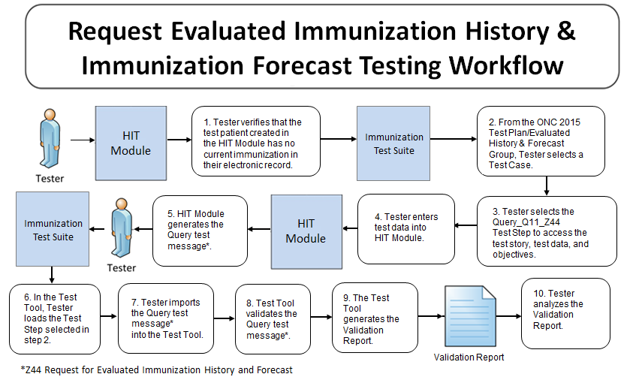
Testing Workflow Diagram (Test Step 1 – Z44 QBP)
This diagram shows
How the major steps of the create QBP message test are sequenced
When the Test Tool is to be used

Slide 22
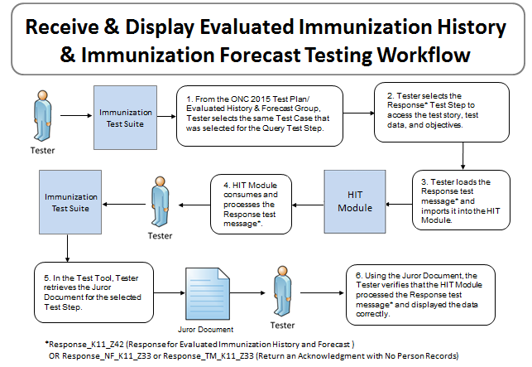
Testing Workflow Diagram (Test Step 2 – Z42 or Z33 RSP)
This diagram shows
How the major steps of the process RSP message test are sequenced
When the Test Tool is to be used

Slide 23
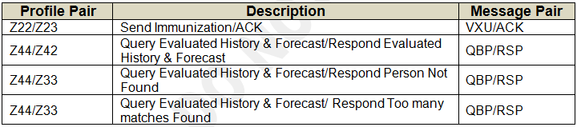
Test Cases and Associated Test Steps
The immunization test data are used for both ambulatory and inpatient settings
The ONC 2015 Test Plan in the Test Tool
Consists of two Groups of Test Cases
10 Administration Test Cases
4 Evaluated History and Forecast Test Cases
Provides Test Steps containing the test data for certification testing
Five of the profiles defined in the Immunization Messaging Guide are in-scope and are paired for ONC certification testing

Slide 24
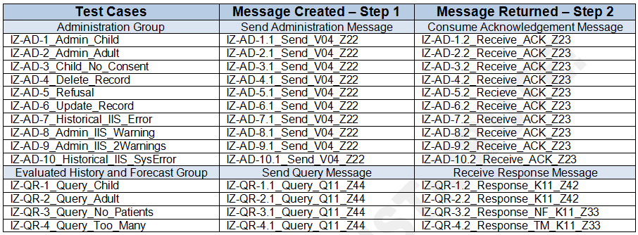
Test Cases and Associated Test Steps (cont’d)
Each Test Case consists of two Test Steps
First Test Step involves creation of a test message by the HIT
Second Test Step involves return of a test message by the IIS
First Test Step includes a Test Data Specification
Second Test Step includes a Juror Document
Both Test Steps include a Test Story, Message Content Data Sheet, and Example Message

Slide 25
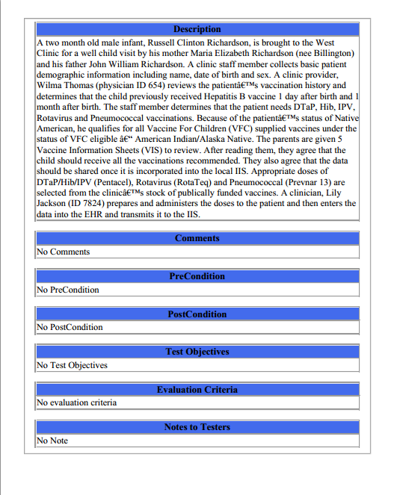
Test Data Documents for the Test Cases
Each Test Case includes a narrative Test Story that describes a real world situation and provides context for each Test Step
Example Test Data document: Test Case: IZ-AD-1_Admin_Child – 1.IZ-AD-1.1_Send_V04_Z22

Slide 26
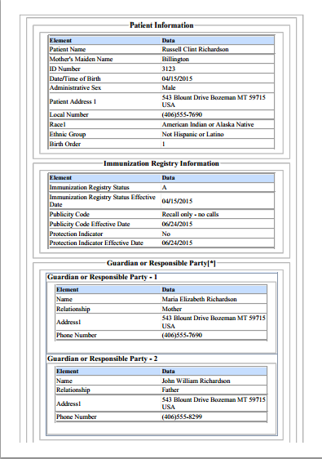
Test Data Documents for the Test Cases (cont’d)
Each Test Case includes a Test Data Specification for each Test Step for which test data are expected to be entered into the HIT Module
Lists data associated with the Test Story
Consists of typical information found in the clinical setting
Along with the Test Story, provides sufficient information to be entered into the HIT Module for the Test Step
A test message is generated using these data and the HIT Module functions
Example Test Data document: Test Case: IZ-AD-1_Admin_Child – 1.IZ-AD-1.1_Send_V04_Z22
26
Notes:
26

Slide 27
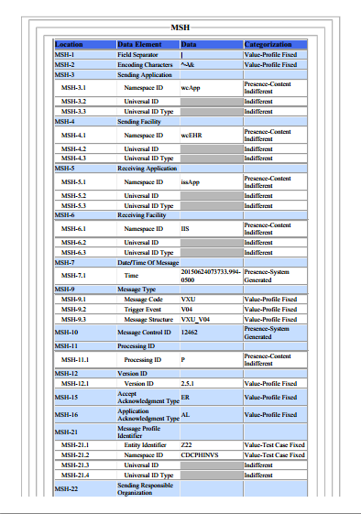
Test Data Documents for the Test Cases (cont’d)
Each Test Case includes a Message Content Data Sheet that shows a conformant message instance for each Test Step
The Category of the test data is listed in the Categorization column for each Data Element Location
Example Test Data document: Test Case: IZ-AD-1_Admin_Child – 1.IZ-AD-1.1_Send_V04_Z22
27
Notes:
27

Slide 28
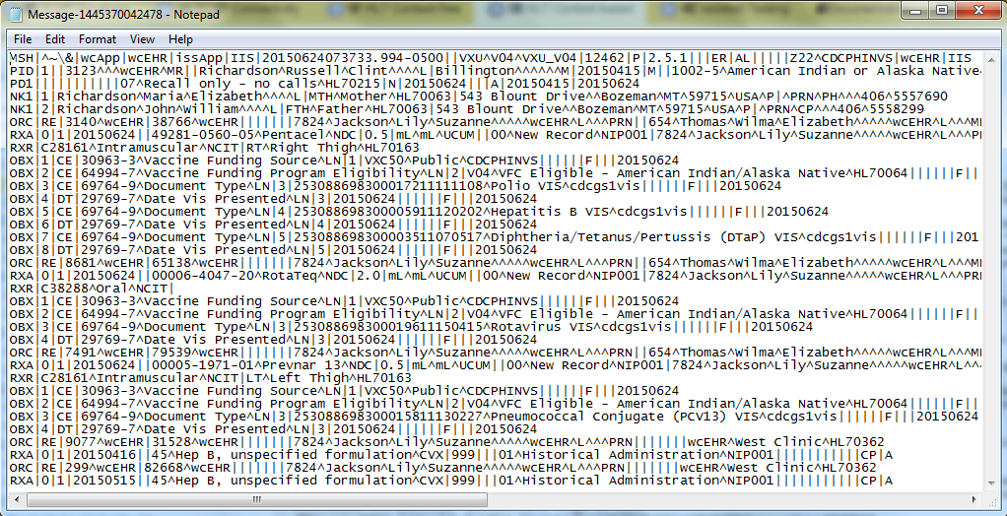
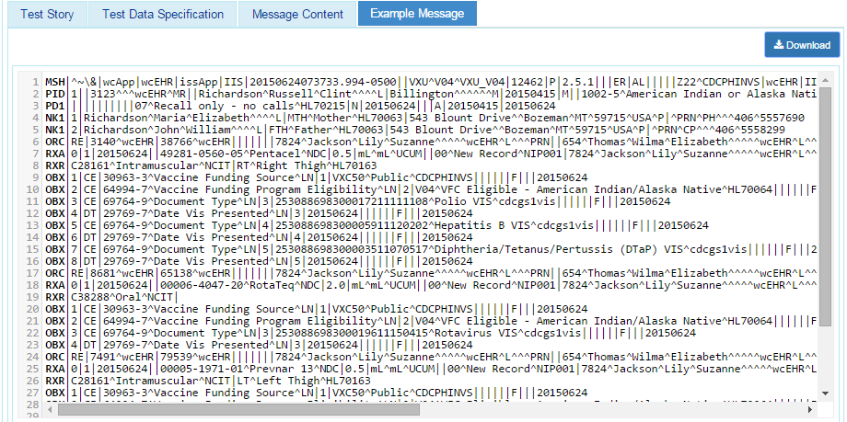
Test Data Documents for the Test Cases (cont’d)
Each Test Case includes an Example Message instance for each Test Step
These example messages demonstrate use and interpretation of the standards
Example Test Data document: Test Case: IZ-AD-1_Admin_Child – 1.IZ-AD-1.1_Send_V04_Z22
28
Notes:
28

Slide 29
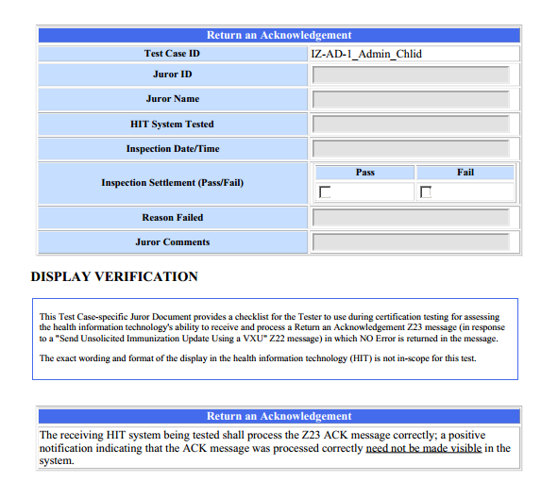
Test Data Documents for the Test Cases (cont’d)
Each Test Case includes a Juror Document for the Receive or Response Test Step
Example Test Data document: Test Case: IZ-AD-1_Admin_Child – 2.IZ-AD-1.2_Receive_ACK_Z23
29
Notes:
29

Slide 30
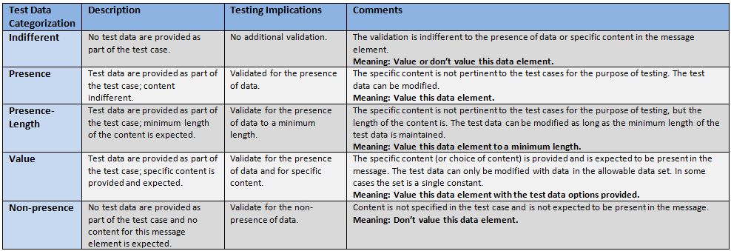
Test Data Categorization and Validation
The Message Content Data Sheet shows the Categorization of the test data that are provided for each Location
Each Test Data Category
Defines the criteria that are used by the test tool to assess the test data that populate each field in a message
Tells the Tester if the test data in a specific field can be changed, the source of the test data, and to what level of precision the validation tool will assess the data

Slide 31
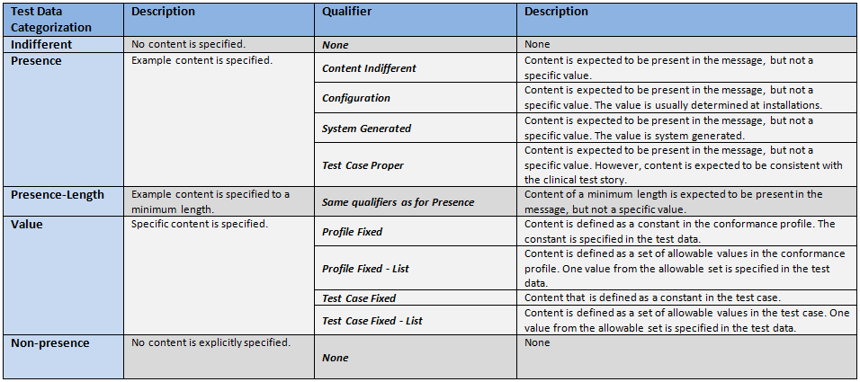
Test Data Categorization and Validation (cont’d)
Qualifiers enable refinement of the Test Data Category, providing additional information to the Tester about the source of the data and the expectations of the data element
The Qualifier does not impact the validation of the data element

Slide 32
Test Category Assessment Table (Examples)
Element | Usage | Test Data | Test Category | Conformity Assessment | Data in Message | Validation Result
PID-5.3 (Middle Name)* | RE | Donna | Presence-Content-Indifferent | Required | <Empty> | Fail
PID-5.3 (Middle Name) | RE | Donna | Presence-Content-Indifferent | Required | Donna | Pass
PID-5.3 (Middle Name) | RE | Donna | Presence-Content-Indifferent | Required | Sue | Pass
PID-5.3 (Middle Name) | RE | Donna | Presence-Length-Content-Indifferent | Required Min Length = 5 | Victoria | Pass
PID-5.3 (Middle Name) | RE | Donna | Presence-Length-Content-Indifferent | Required Min Length = 5 | Sue | Fail
PID-5.3 (Middle Name) | RE | Donna | Value-Test Case Fixed | Required Value = Donna | Donna | Pass
PID-5.3 (Middle Name) | RE | Donna | Value-Test Case Fixed | Required Value = Donna | Sue | Fail
MSH-9.2 (Trigger Event) | R | V04 | Value-Profile Fixed | Required Value = V04 | V04 | Pass
* Actual description is “Second and Further Given Names or Initials Thereof”

Slide 33
Coded Element Examples
Example Message Segment:
RXA|0|1|20150624||49281-0560-05^Pentacel^NDC|0.5|mL^mL^UCUM||00^New Record^NIP001|7824^Jackson^Lily^Suzanne^^^^^wcEHR^L^^^PRN|^^^wcEHR||||526434|20150722|SKB^GlaxoSmithKline^MVX|||CP|A
Element | Test Data | Test Category | Conformity Assessment
RXA.5.1 | 49281-0560-05 | Value-Test Case Fixed | Content must be present and exactly “49281-0560-05”
RXA.5.2 | Pentacel | Presence-Test Case Proper | Content must be present and indicate a value equivalent to Pentacel
RXA.5.3 | NDC | Value-Test Case Fixed | Content must be present and exactly “NDC”
Example Message Segment:
RXR|C28161^Intramuscular^NCIT|RT^Right Thigh^HL70163
Element | Test Data | Test Category | Conformity Assessment
RXR-1.1 | C28161 | Presence-Content Indifferent | Content is expected to be present in the message, but not a specific value
RXR-1.2 | Intramuscular | Presence-Test Case Proper | Content must be present and indicate a value equivalent to the code in RXR-1.1
RXR-1.3 | NCIT | Value-Profile Fixed | Content is defined as a constant in the profile. The constant is specified in the test data; value must be present and exactly “NCIT”

Slide 34
Test Data Validation – Sequencing of Segments
Previously, in order to perform Context-based validation using the Category/Qualifier combination assigned to the Data Elements in the message, the NIST Tool expected the repeatable fields/segments/segment groups in the message to be sequenced in a certain order.
This sequencing requirement has been changed. The Tool now has the ability to validate repeatable fields/segments/segment groups in a given message in any sequence.
In addition, segments and segment groups that are not accounted for in the test data can be added to the message in any sequence (as long as the segment sequence is conformant to the standard), and the Tool will validate these elements without generating a content error.
Note: For repeatable fields – such as PID-13 (Phone Number) – the Tool will still generate a content error if a field that is not accounted for in the test data is inserted before a field that is populated with data that are provided in the test data.

Slide 35
http://hl7v2-iz-r1.5-testing.nist.gov/iztool
Immunization Messaging Test Tool Overview
Purpose: The tool validates Immunization messages created by Health IT Modules, and Context-based Testing is intended for ONC 2015 Edition certification testing.
.
Tool Key Capabilities
Context-free Testing | (No Test Cases - Test any Immunization message created by Health IT Module) Context is unknown to validation tool Provides a simple and convenient method for testing message structure and most vocabulary
Context-based Testing | (Test Cases - Test Immunization message associated with a specific test scenario) Context is known to validation tool All conformance requirements of the Immunization implementation guide can be assessed Used for certifying ONC 2015 Edition Health IT Modules
Profile Viewer | Allows user to look up component of message that generated an error and view the related conformance data (such as if Required, format, value, etc.) to correct message.
Value Set Browser | Allows user to look up table value that generated an error and view valid values to correct message.
Documentation | Provides access to documents which will assist in using the tool (including test procedure, test cases, profile descriptions, vocabulary descriptions and validation tool download).
No registration or log-in credentials are needed. Simply click on the link below and send/paste/load message into tool to obtain a Validation report.
NOTE: The Test Tool (.war file) can also be downloaded and installed locally. See Documentation tab in Test Tool
NOTE: Web Application is compatible with Firefox, Chrome, and Safari.
Register to Google Group at https://groups.google.com/d/forum/hl7v2-immunization-testing to ask questions and provide feedback.
35

Slide 36
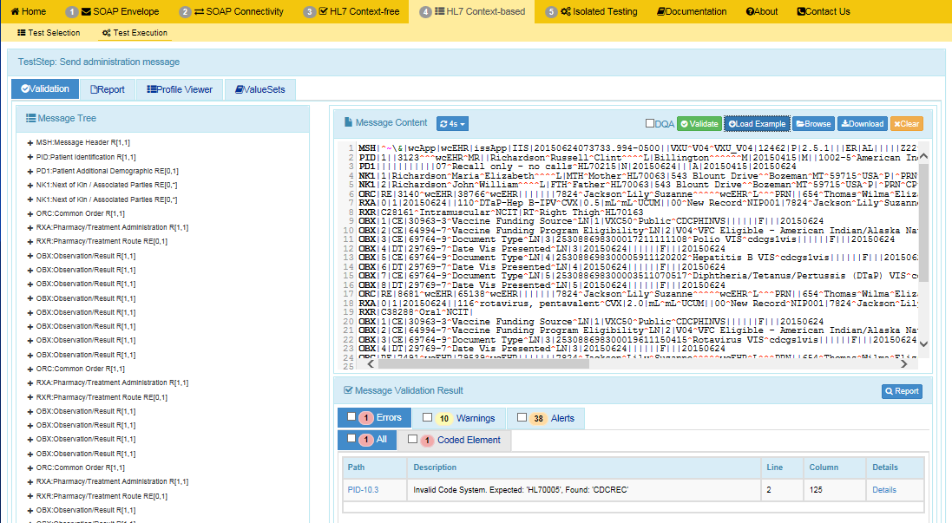
Example Immunization Test Tool Screen
See Immunization Tool Tutorial on Documentation Tab for full guide
1
Uploaded test message displays.
2
If message fails validation, errors will display.
3
Click on Path link to highlight within the Message and Message Tree
the data element causing the error

Slide 37
Resources
ONC Test Procedure
(http://confluence.oncprojectracking.org/display/ONCCERT2015/ONC+Health+IT+Certification+Program+2015+Edition+Test+Methods+Home)
Test Suite Web Site (http://hl7v2-iz-r1.5-testing.nist.gov/iztool ) provides
Test Tool (API, Web Application, and Desktop)
Test Cases / Test Steps / Test Stories / Message Content Details / Test Data / Juror Document / User Documentation
Example messages
Testing Artifacts
Message Profiles
Value Sets
Contact
Rob Snelick (rsnelick@nist.gov)

