Slide 1
Citibike June 2018-March 2019 Analysis
By
Desiree Ferrer

Slide 2
Analysis - Findings
Overall ridership has decreased by 3.62%, from June 2018 to March 2019, this can be due to decrease usage during winter months.
Citibike has effectively tackled the intensity of reliability: subscriber base has increased through the years (from 253,443 in 2017 to 300,904 in 2019)
Female ridership has decreased by %5.08 for the timeline analyzed, which can also be explained by the percentage of male customers in relation to female customers
Top popular stations pursue busiest NYC spots; strikingly, top begin and end stations are nearly the equivalent.
Summer and Winter hour dispersion are genuinely comparable, with tops at the 08hrs and the 17/18hrs, which are normal business tasks begin and end time spans
Average mileage per rider varies and can be related to weather changes, with summer rides at an average of >2 and winter rides at an average of <2, predominately by age groups 16-24 and 25-34
Utilization Rate per bike varies from 28% to 2%. It was very striking to notice such a low utilization rate and lack of bike rotations among stations.

Slide 3
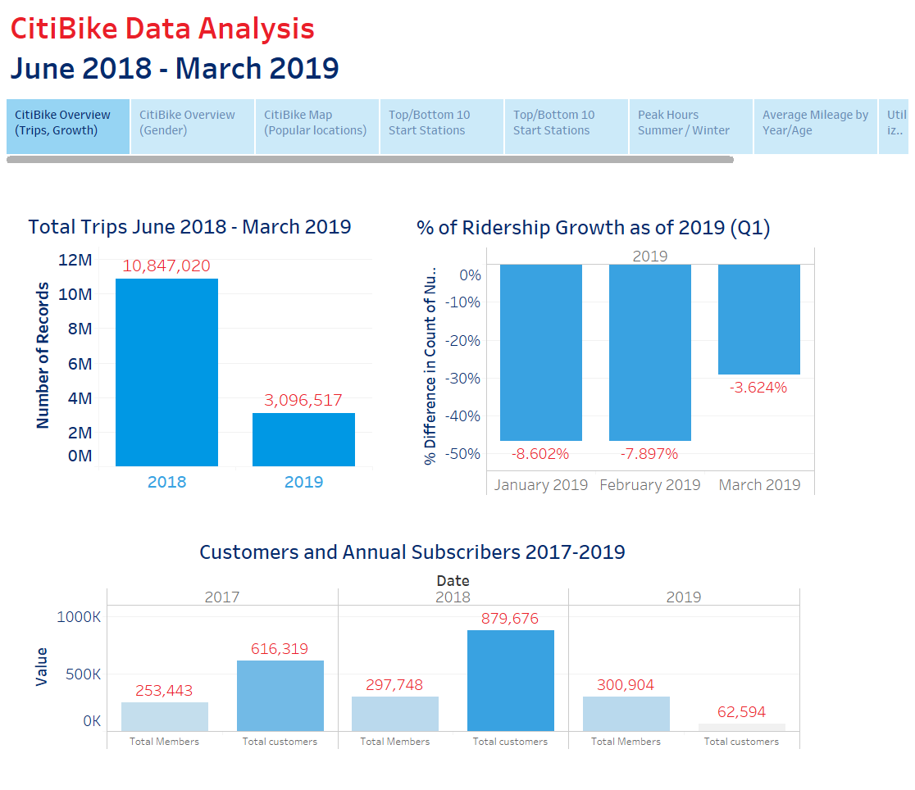

Slide 4
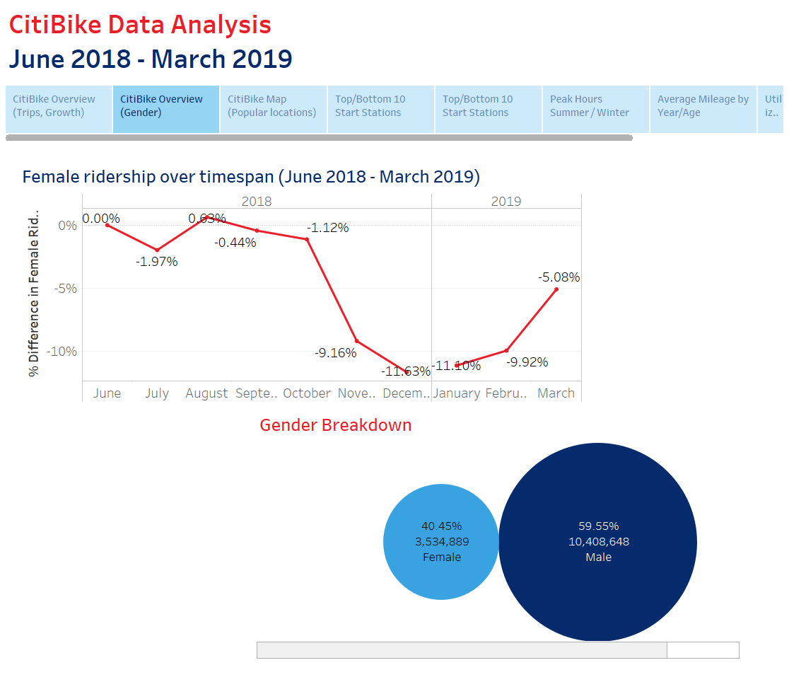

Slide 5
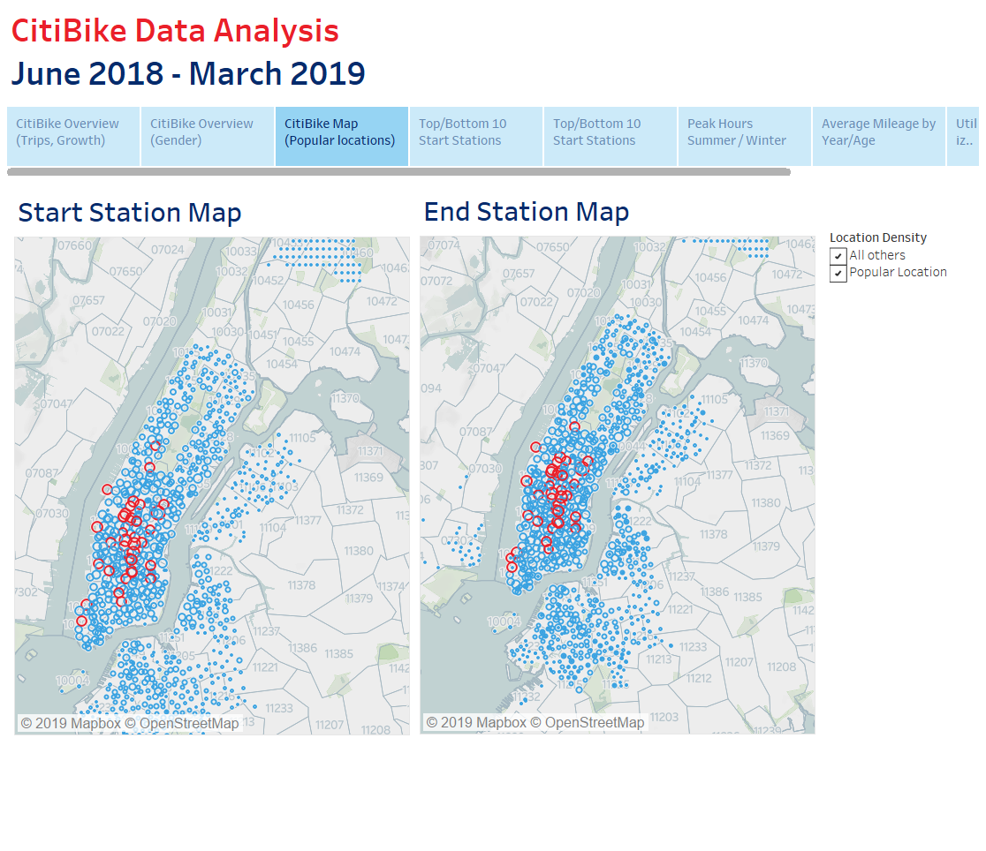

Slide 6
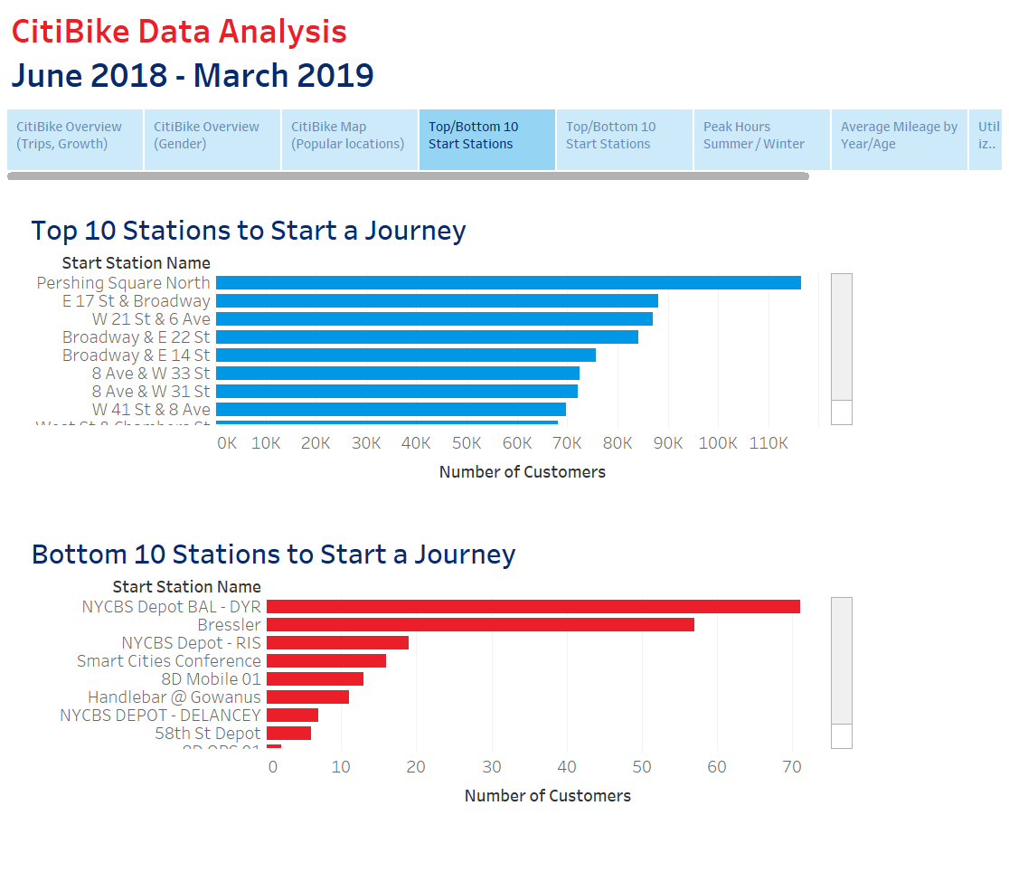

Slide 7
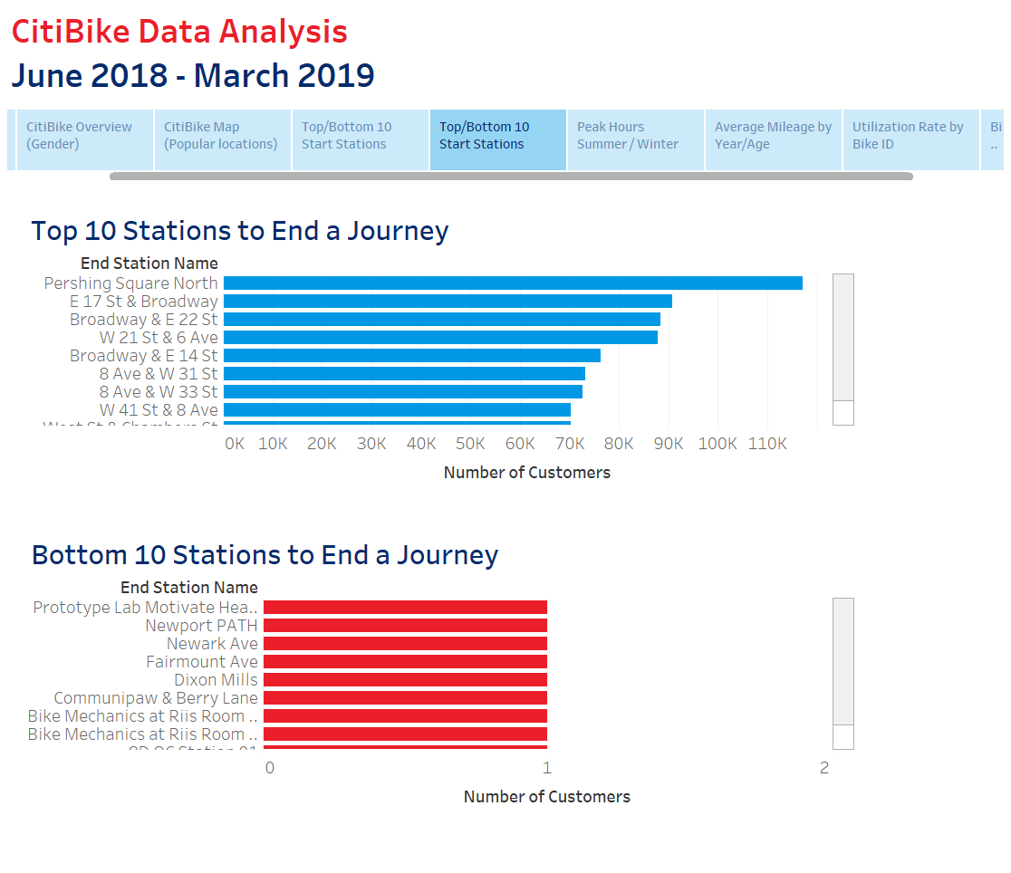

Slide 8
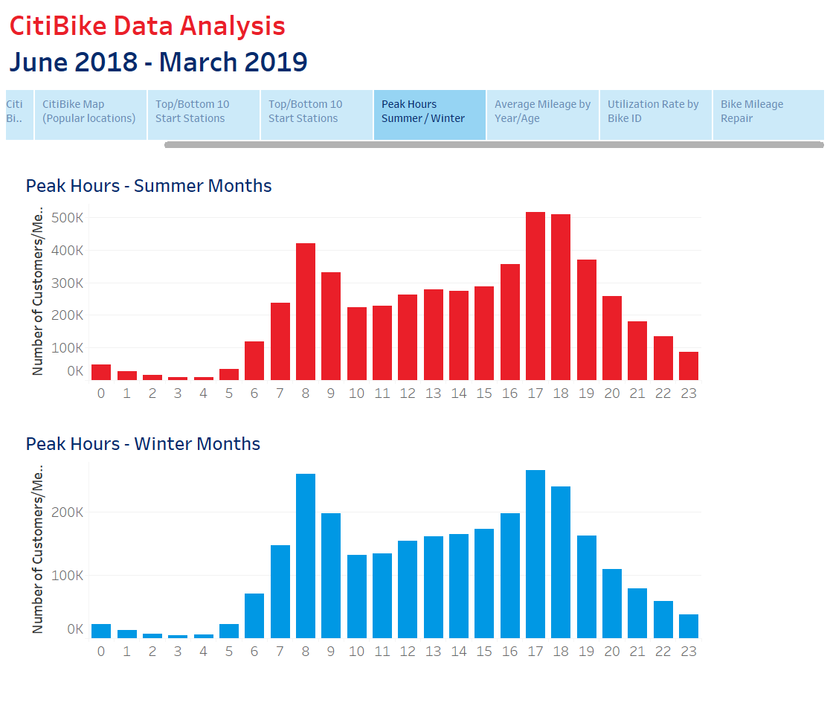

Slide 9
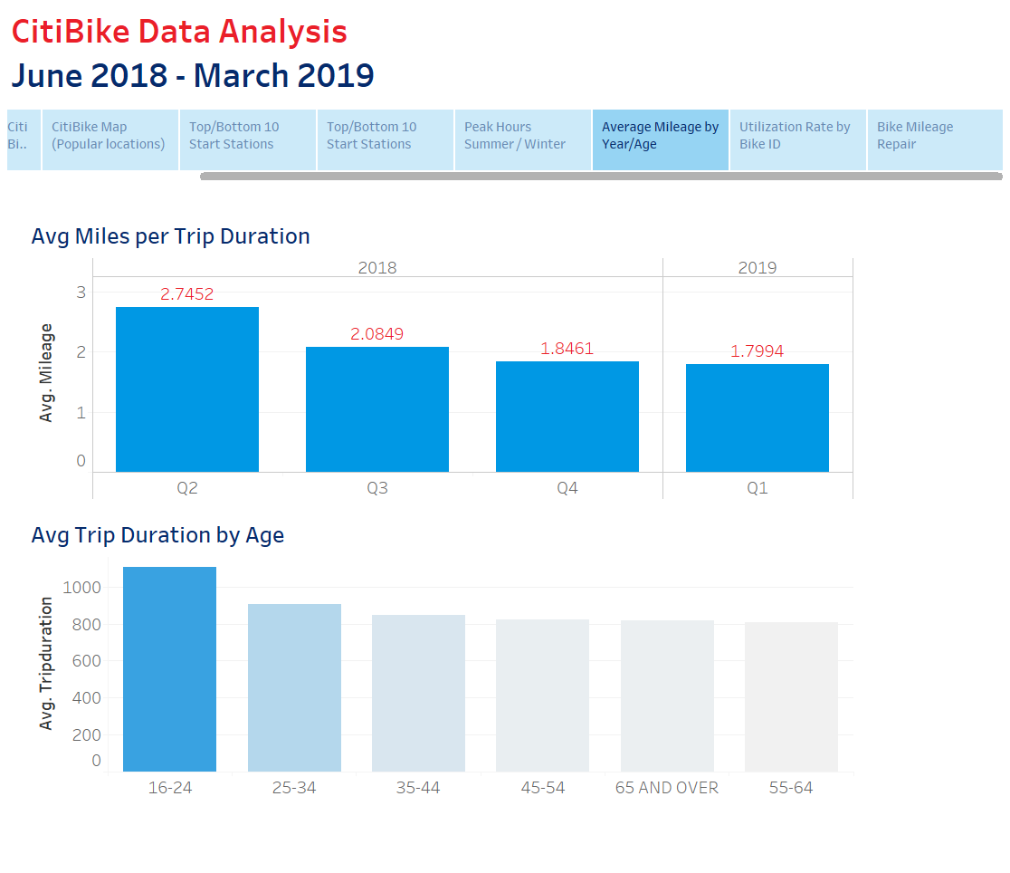

Slide 10
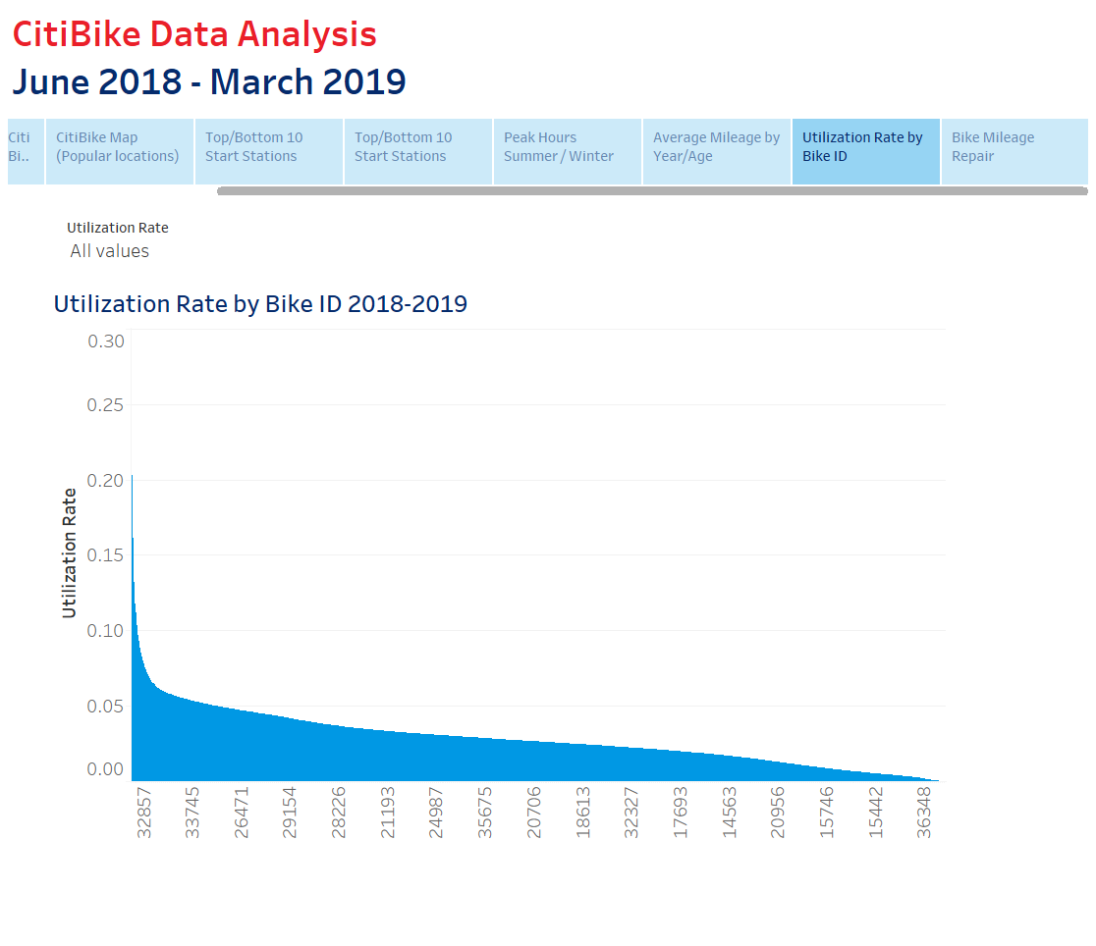

Slide 11
