Slide 1
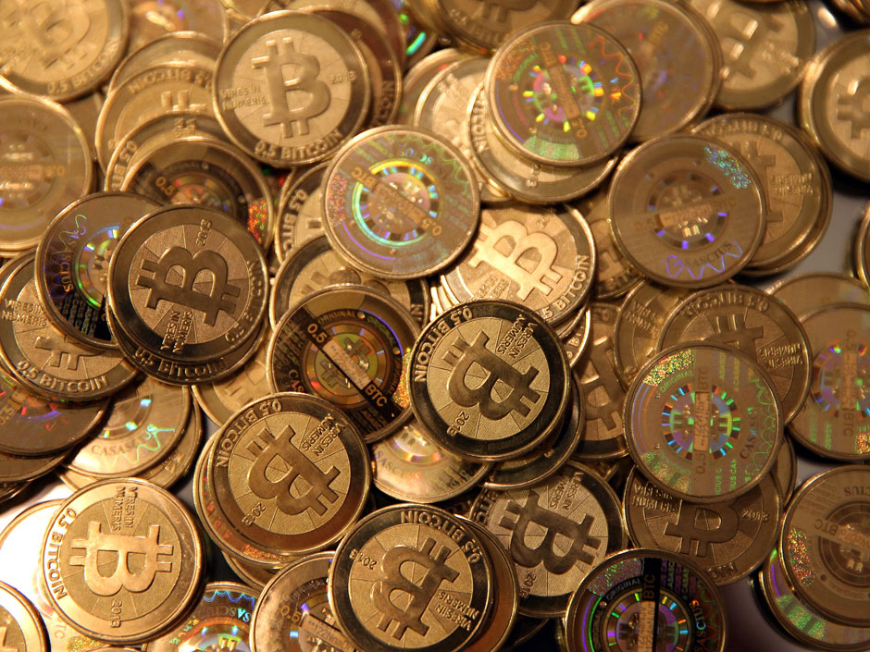
Data Analysis Project: Bitcoin
General Assembly, Summer 2015 – Desiree Sylvester

Slide 2
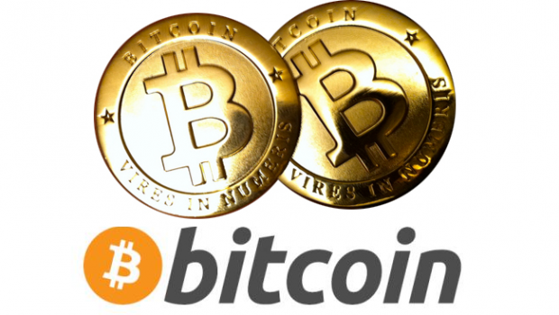
Introduction
Why Bitcoin?
Data sources
Questions to explore
Challenges

Slide 3
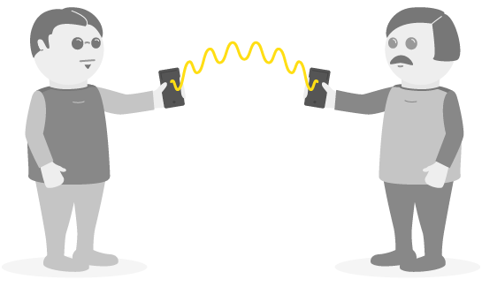
Data sources
Coin Center survey
StockTwits
Average daily Bitcoin price
Notes:
Randomized mobile survey with ~8k responses
Data cleaning required, merged data
StockTwits
Selected over Twitter mentions because users may have a better understanding of financial markets/impact
Index of positive/negative mentions for a given day
Average daily price
Varies over the course of a day, calculated from total sales for a given day

Slide 4
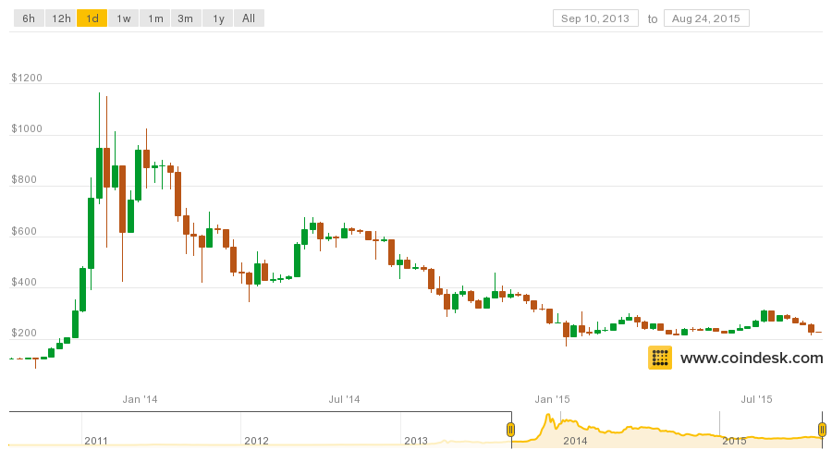
Questions to explore
Are there strong predictors of positive/negative opinion about Bitcoin?
Can social media mentions predict price change?

Slide 5
Word association
Token | Frequency
Scam | 434
Money | 301
Fraud | 214
Coin | 108
Internet | 96
Digital currency | 77
Fake money | 71
Risky | 52
Internet money | 50
Notes:
9 out of ~3000 unique tokens

Slide 6
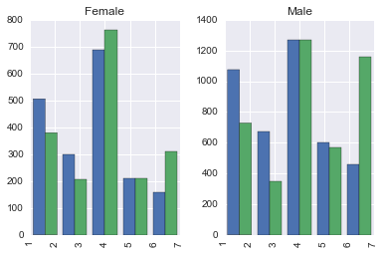
Demographics
Are transactions mostly legal (1) or fraudulent (7)? Should governments regulate (1) or ban(7) Bitcoin?
Notes:
Blue: whether Bitcoin transactions are legal or fraudulent
Green: whether Bitcoin should be regulated or banned

Slide 7
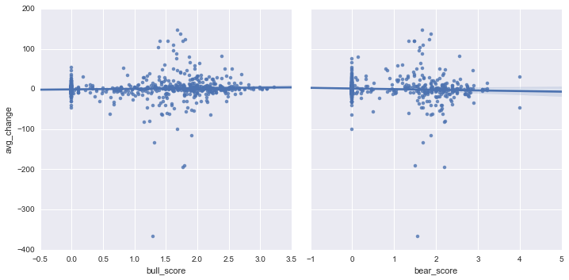
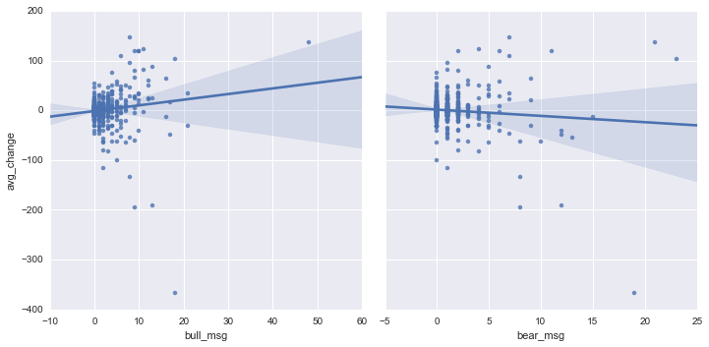
Sentiment index vs. Total messages
RMSE
$37.38
Current price
~$213
Notes:
Chose a linear regression model to gauge degree of change based on number of messages.

Slide 8
Challenges
Cleaning the data
Model requirements
Framing the problem
Future work

