Slide 1

Why we cannot ignore functional programming
              Massimiliano Dessì & Mario Fusco
@desmax74 @mariofusco

Slide 2





speakers
Max
Mario
JugSardegna, SpringFramework UG, Google Technology UG Sardegna,
Senior Software Engineer in Energeya
Author of Spring 2.5 AOP
Creator of lambdaj and hammurabi projects
Senior Software Engineer in
Red Hat working on the core
of the drools rule engine

Slide 3
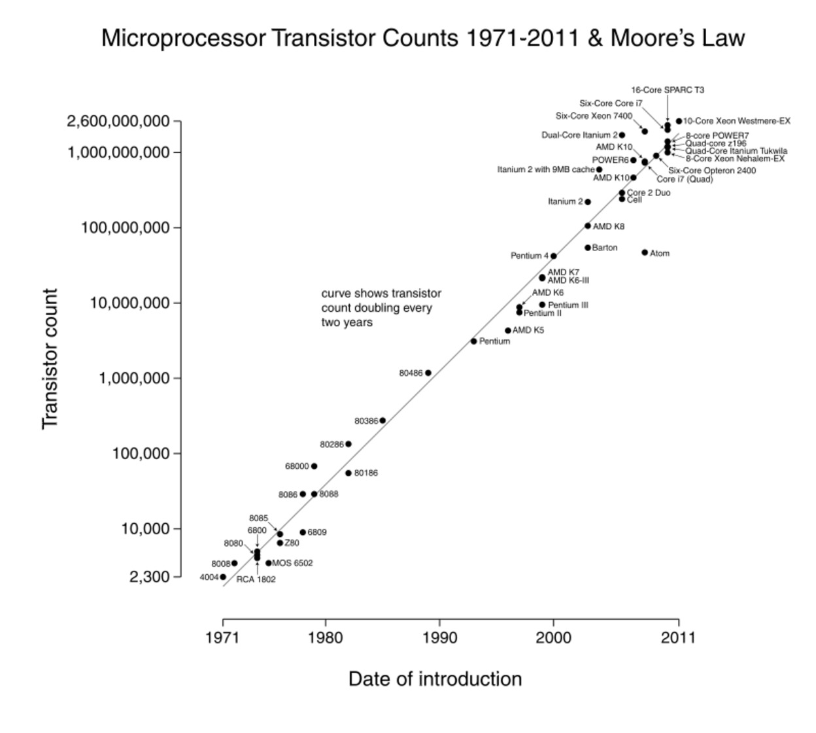
Moore's law
The number of transistors on integrated circuits doubles approximately every two years

Slide 4
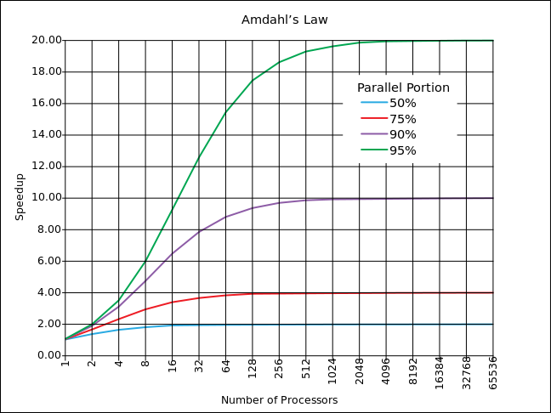
Amdahl's law
The speedup of a program using multiple processors in parallel computing is limited by the time needed for the sequential fraction of the program

Slide 5
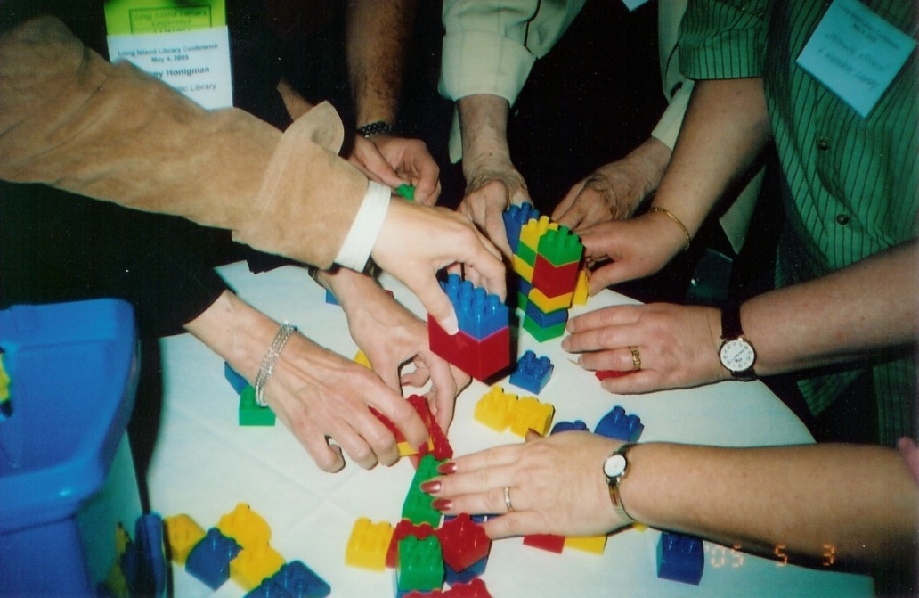
Concurrent programming
Managing concurrent requests

Slide 6

Parallel programming
Running multiple tasks at the same time

Slide 7
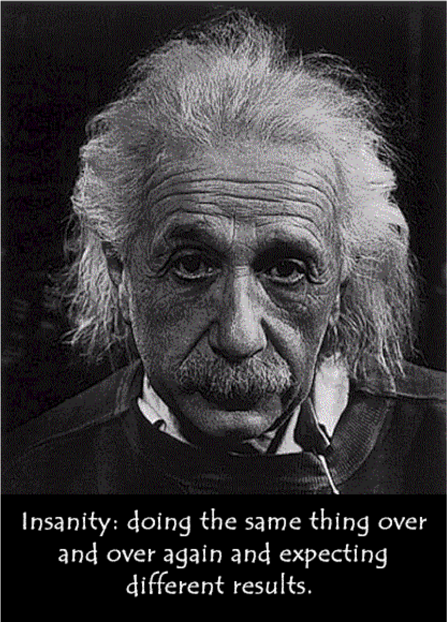
The root of the problem
Mutable state +
Parallel processing =
Non-determinism
Functional
Programming

Slide 8

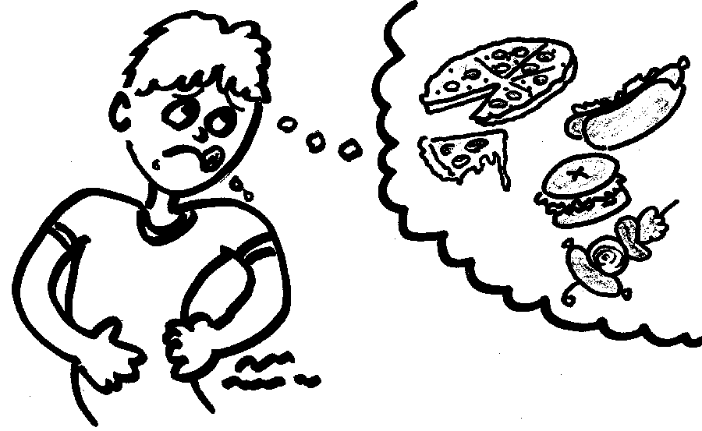
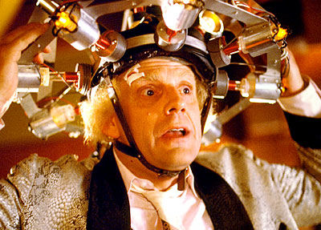
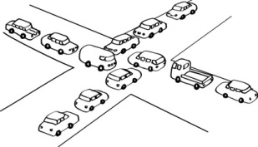

… and its effects
Race conditions
Starvation
Deadlocks
Livelocks

Slide 9
Epic data race failure
Data races is not a multiuser system's feature,
the Therac-25 was a radiation therapy machine
http://en.wikipedia.org/wiki/Therac-25
It was involved in at least six accidents between 1985 and 1987, in which patients were given massive overdoses of radiation, approximately 100 times the intended dose.
These accidents highlighted the dangers of software control of safety-critical systems.
Therac-25 killed three patients and injured several others

Slide 10
Epic data race failure
http://en.wikipedia.org/wiki/Northeast_blackout_of_2003
The blackout affected an estimated 10 million people in Ontario and 45 million people in eight U.S. States.
A software bug known as a race condition existed in General Electric Energy's Unix-based XA/21 energy management system. Once triggered, the bug stalled FirstEnergy's control room alarm system for over an hour.
On Thursday, August 14, 2003, just before 4:10 p.m. While some power was restored by 11 p.m.,
many did not get power back until two days later

Slide 11
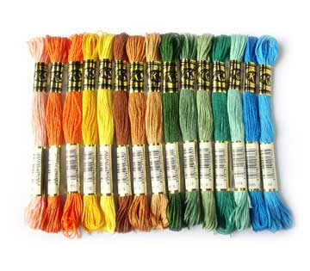


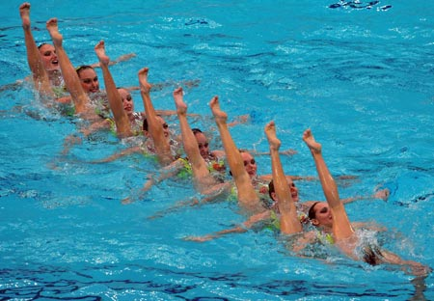
Java concurrency model
Threads
Threads
Semaphores
Locks
Synchronization
They are sometimes plain evil …
… and sometimes a necessary pain …
… but always the wrong default

Slide 12


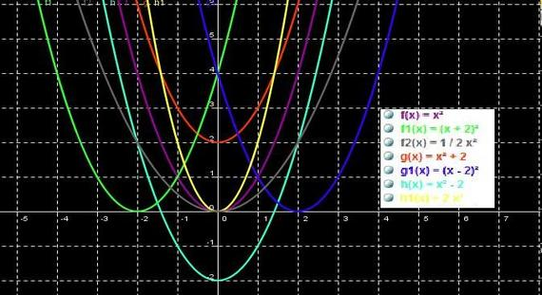

Different concurrency
models
Shared mutable state
(threads + locks)
Isolated mutable state (actors)
Purely immutable (pure functions)

Slide 13
Summing attendants ages
Threads
class Blackboard {
int sum = 0;
int read() { return sum; }
void write(int value) {
sum = value; }
}
}
class Attendant implements Runnable {
int age;
Blackboard blackboard;
public void run() {
synchronized(blackboard) {
int oldSum = blackboard.read();
int newSum = oldSum + age;
blackboard.write(newSum);
}
}
}

Slide 14

Summing attendants ages
Actors
class Blackboard extends UntypedActors {
int sum = 0;
public void onReceive(Object message) {
if (message instanceof Integer) {
sum += (Integer)message;
}
}
}
class Attendant {
int age;
Blackboard blackboard;
public void sendAge() {
blackboard.sendOneWay(age);
}
}

Slide 15
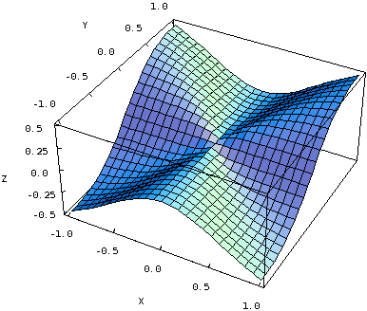
Summing attendants ages
functional
class Blackboard {
final int sum;
Blackboard(int sum) { this.sum = sum; }
}
class Attendant {
int age;
Attendant next;
public Blackboard addMyAge(Blackboard blackboard) {
final Blackboard b = new Blackboard(blackboard.sum + age);
return next == null ? b : next.myAge(b);
}
}
attendants.foldLeft(
new Blackboard(0),(att, b) -> new Blackboard(b.sum + att.age)
);

Slide 16

functional program
NO

Slide 17
functional program
Avoidable Side effects
Reassigning a variable
Modifying a data structure in place
Setting a field on an object
Throwing an exception or halting with an error

Slide 18
functional program
Deferrable Side effects
Printing to the console
Reading user input
Reading from or writing to a file
Drawing on the screen

Slide 19
functional program
Functional programming
is a restriction on
how
we write programs, but not on
what
they can do

Slide 20
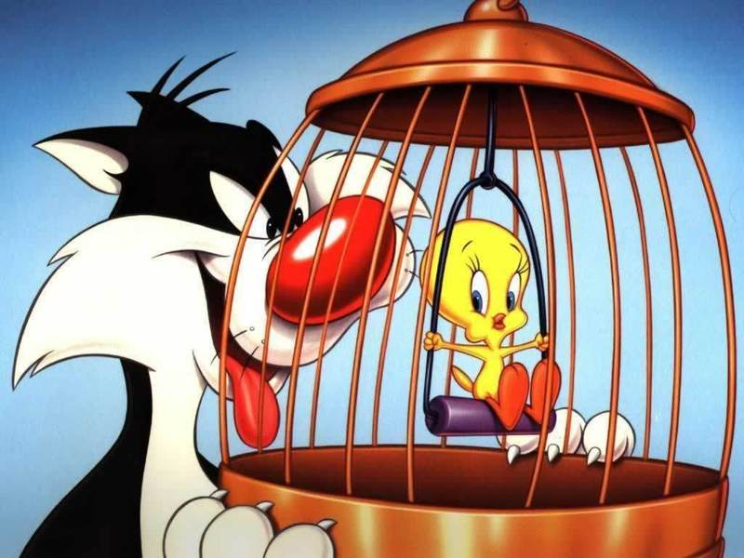
The OOP/FP dualism
class Bird
class Cat {
def capture(b: Bird): Unit = ...
def eat(): Unit = ...
}
val cat = new Cat
val bird = new Bird
cat.capture(bird)
cat.eat()
class Cat
class Bird
trait Catch
trait FullStomach
def capture(prey: Bird, hunter: Cat): Cat with Catch
def eat(consumer: Cat with Catch): Cat with FullStomach
val story = (capture _) andThen (eat _)
story(new Bird, new Cat)

Slide 21
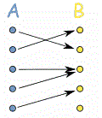
Pure function
A function with input type A and output type B is a computation which relates every value a of type A to exactly one value b of type B such that b is determined solely by the value of a

Slide 22

Pure function
But, if it really
is a function,
it will
do nothing
else

Slide 23

Referential transparency
An expression e
is referentially transparent
if for all programs p,
all occurrences of e in p
can be
replaced
by the result of evaluating e, without affecting
the observable behavior of p

Slide 24
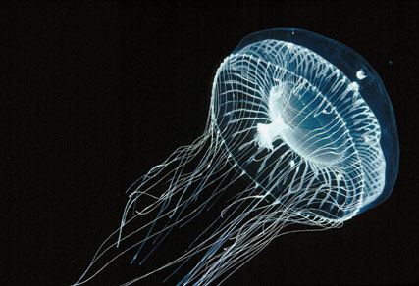
Referential transparency
A function f
is pure
if the expression f(x)
is referentially transparent
for all
referentially transparent x

Slide 25

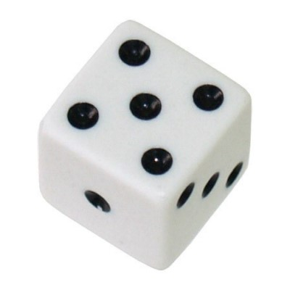
Referential transparency
Referencial transparency
String x = "purple";
String r1 = x.replace('p', 't');
String r2 = x.replace('p', 't');
String r1 = "purple".replace('p', 't'); r1: "turtle"
String r2 = "purple".replace('p', 't'); r2: "turtle"
Not Referencial transparency
StringBuilder x = new StringBuilder("Hi");
StringBuilder y = x.append(", mom");
String r1 = y.toString();
String r2 = y.toString();
String r1 = x.append(", mom").toString(); r1: "Hi, mom"
String r2 = x.append(", mom").toString(); r1: "Hi, mom, mom"

Slide 26

Referential transparency
RT Wins
Under a developer point of view:
Easier to reason about
since
effects of evaluation are purely local
Use of the substitution model: it's possible
to replace
a term with an equivalent one

Slide 27

Referential transparency
RT Wins
Under a performance point of view:
The JVM is free to optimize the code by safely reordering the instructions
No need to synchronize access to shared data

Slide 28
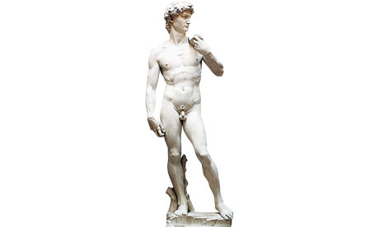
Immutability
Immutable objects
can be shared
among many threads exactly
because none of them can
modify it

Slide 29

Immutability
In the same way
immutable (persistent)
data structures
can be shared
without
any need to synchronize the different threads accessing them

Slide 30
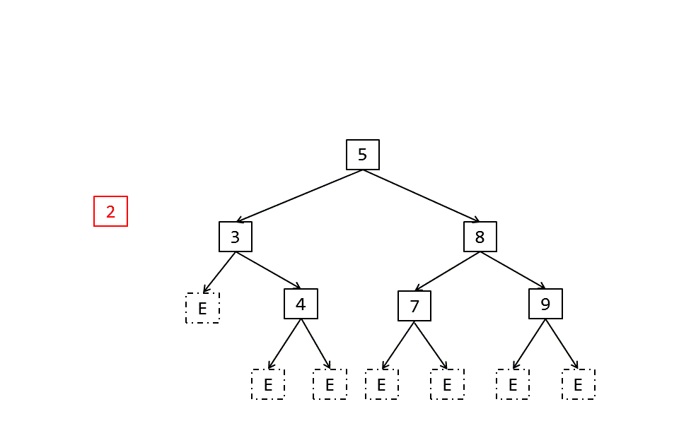
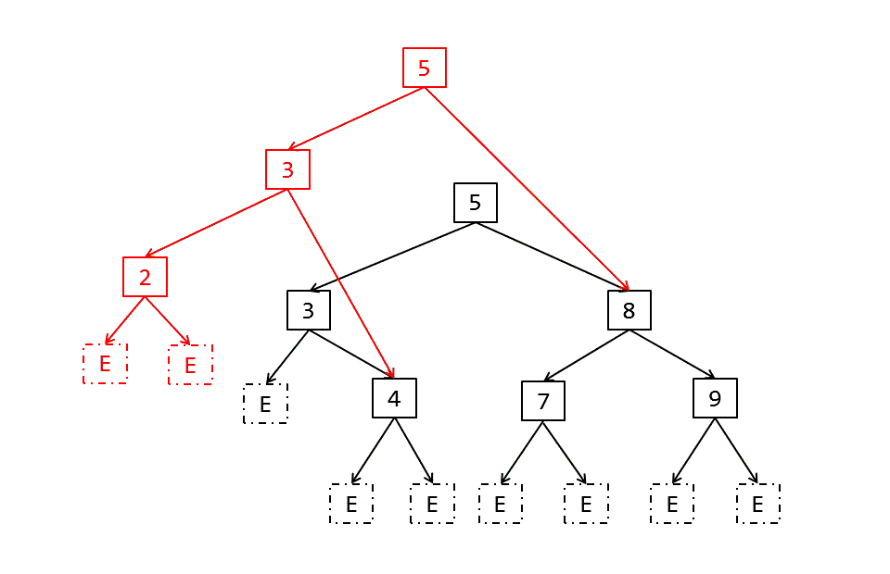
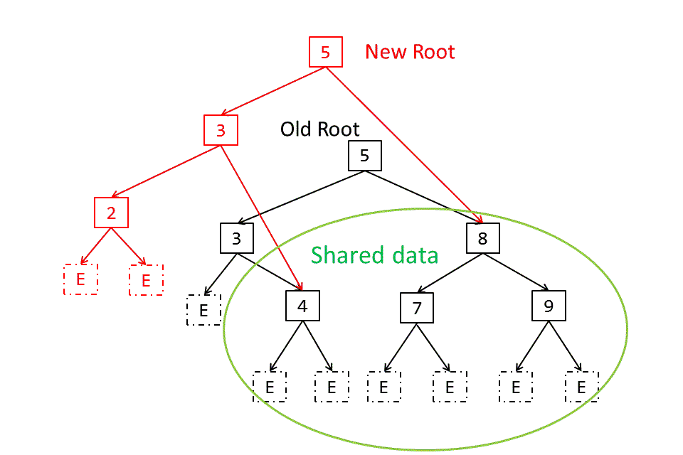
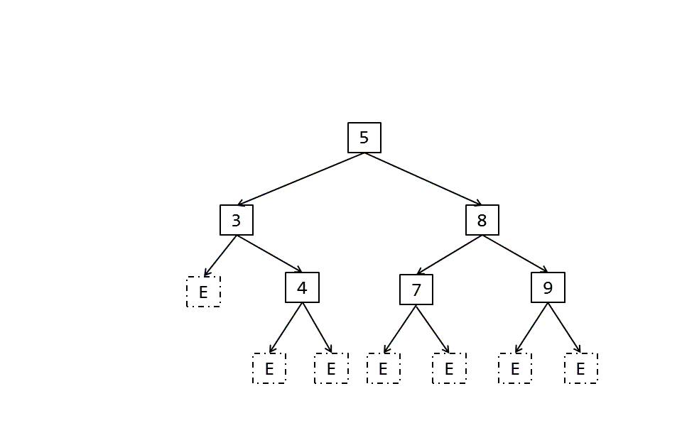
Persistent Collections

Slide 31
Persistent Collections
Tree with high branching factor (at least 32 per node)
reduce the time for operations on the tries.
High branching factor require four levels to hold up a million of elements.
Phil Bagwell (EPFL) Rich Hickey (Clojure)
http://lampwww.epfl.ch/papers/idealhashtrees.pdf
http://infoscience.epfl.ch/record/169879/files/RMTrees.pdf
http://infoscience.epfl.ch/record/169879/files/RMTrees.pdf?version=1

Slide 32

Modularity
class Player { String name; int score; }
Separate computational logic from side effects
public void declareWinner(Player p) {
System.out.println(p.name + " wins!");
}
public void winner(Player p1, Player p2) {
if (p1.score > p2.score) declareWinner(p1)
else declareWinner(p2);
}
public Player maxScore(Player p1, Player p2) {
return p1.score > p2.score ? p1 : p2;
}
public void winner(Player p1, Player p2) {
declareWinner(maxScore(p1, p2));
}
public Player maxScore(Player p1, Player p2) {
return p1.score > p2.score ? p1 : p2;
}
public void winner(Player p1, Player p2) {
declareWinner(maxScore(p1, p2));
}
public Player maxScore(Player p1, Player p2) {
return p1.score > p2.score ? p1 : p2;
}
public void winner(Player p1, Player p2) {
declareWinner(maxScore(p1, p2));
}
public Player maxScore(Player p1, Player p2) {
return p1.score > p2.score ? p1 : p2;
}
public void winner(Player p1, Player p2) {
declareWinner(maxScore(p1, p2));
}
declareWinner(players.reduceLeft(maxScore))
reuse maxScore to compute the winner among a list of players

Slide 33
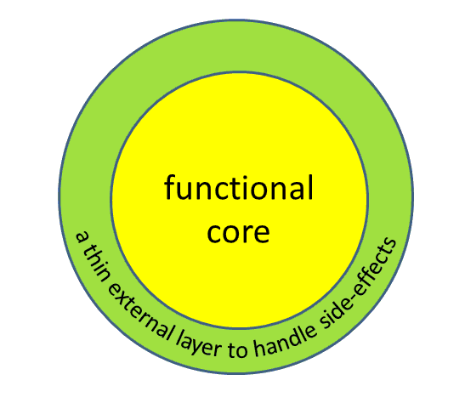
Functional core
a thin external layer to handle side-effects
Any function with side-effects can be split into a pure function at the core and a pair of functions with side-effect. This transformation can be repeated to push side-effects to the outer layers of the program.

Slide 34

Q & A

Slide 35

Thank you for your attention !

