Slide 1


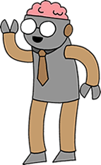
Notes:
Good morning everyone!
My name’s xxx and I want to tell you about Code Club.

Slide 2

Who owns a computer?
Notes:
So… who owns a computer?

Slide 3
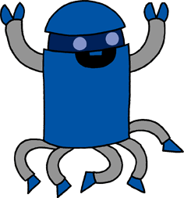
Who likes to play computer games?
Notes:
And… who likes to play computer games?

Slide 4
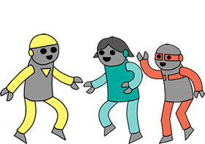
What’s your favourite game?
Notes:
Okay… what’s your favourite game?
I like xxx and xxx

Slide 5

How was it made?
Notes:
Do you know how those games were made?
That’s right they were coded by people like you and me…
But how do you code a game?

Slide 6


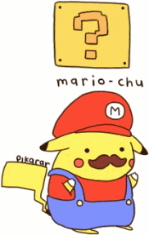
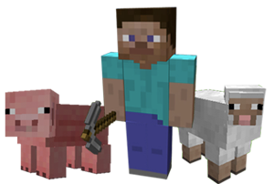
Notes:
Well, you take all ingredients… the goodies and the baddies and the graphics and the sounds…
Then you tell the computer what to do with them

Slide 7


Hey computer!
Hi…
make me a pizza!
Okay!
Notes:
Coding is really just telling computers what to do…

Slide 8


Notes:
We’re going to learn in Scratch
Scratch is a really fun way to learn to code

Slide 9
See you at
Code Club!

