Slide 1
Problem
The setter thinks of a number between 1 and 100
The guesser has a guess at this number
Is this guess the same as the setter’s number?
YES then the game ends
NO then setter tells the guesser if it is too high or too low

Slide 2
Conditions, loops and data structures
Workshop 2
25/02/2016

Slide 3
Workshop objectives
Understand iterations
Apply different type of conditions
Compare and contrast different data structures (array, list)

Slide 4

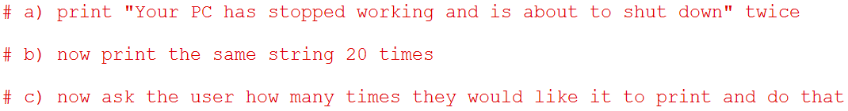
Answer these 3 questions

Slide 5
Iteration
known and small
known and large
unknown

Slide 6
Iteration
known and small
FOR
known and large
unknown
FOR
WHILE

Slide 7
Iterations
How can we continue the game until the guesser guesses the number?
The setter thinks of a number between 1 and 100
The guesser has a guess at this number
Is this guess the same as the setter’s number?
YES then the game ends
NO then setter tells the guesser if it is too high or too low

Slide 8
Iterations
How can we continue the game until the guesser guesses the number?
The setter thinks of a number between 1 and 100
The guesser has a guess at this number
Is this guess the same as the setter’s number?
YES then the game ends
NO then setter tells the guesser if it is too high or too low
Go back to step 2

Slide 9
Iterations - while
while it is raining stay indoors
while you are asleep you cannot play badminton
while you are less than 1 metre tall you are not allowed on a ride

Slide 10
Iterations - while
The condition is evaluated at the beginning of the loop and, if it is true, the code in the loop executes.
The program then loops back and the condition is evaluated again.
At the point where the Boolean condition evaluates to False, the code in the loop is skipped and the program executes from after the ENDWHILE.
is_it_raining ← USERINPUT
WHILE is_it_raining = 'yes'
# stay indoors
is_it_raining ← USERINPUT
ENDWHILE
# go outdoors

Slide 11
Iterations - while
Guesser game
While the guess is not the same as the number then the guesser has another go and this will continue until the guess is correct.
setters_number ← USERINPUT
guess ← USERINPUT
WHILE setters_number ≠ guess
# tell the guesser whether it is too high or too low
guess ← USERINPUT
ENDWHILE

Slide 12
Iterations - while
setters_number = input()
guess = input()
while setters_number != guess:
# tell the guesser whether it is too high or too low
guess = input()

Slide 13
Iterations - for
The two previous examples are loops that are controlled by a Boolean expression and are known as indefinite iteration because they can continue looping an indefinite number of times.
In contrast to this, you can also use a loop that iterates for a specific number of times which we will call a FOR loop.
For example, this short program will output the string 'hello' ten times:
FOR i ← 1 TO 10
OUTPUT 'hello'
ENDFOR

Slide 14
Iterations - for
If we wanted to create a program that outputs the 3 times table from 1x3 to 12x3 we could make good use of the variable in the FOR loop by studying the pattern in the expressions. Without a loop, our program would look something like this:
OUTPUT 1*3
OUTPUT 2*3
OUTPUT 3*3
# etc for 4*3 to 11*3
OUTPUT 12*3

Slide 15
Iterations - for
If we wanted to create a program that outputs the 3 times table from 1x3 to 12x3 we could make good use of the variable in the FOR loop by studying the pattern in the expressions. Without a loop, our program would look something like this:
OUTPUT 1*3
OUTPUT 2*3
OUTPUT 3*3
# etc for 4*3 to 11*3
OUTPUT 12*3
FOR i ← 1 TO 12
OUTPUT i*3
ENDFOR

Slide 16
Iterations - for
How could this program be extended so that instead of just printing the three times table, it prints all of the times tables from one to ten?

Slide 17
Iterations - for
How could this program be extended so that instead of just printing the three times table, it prints all of the times tables from one to ten?
FOR i ← 1 TO 10
FOR j ← 1 TO 12
OUTPUT j*i
ENDFOR
ENDFOR

Slide 18
Iterations - for
FOR i ← 1 TO 3
FOR j ← 1 TO 5
OUTPUT j*i
ENDFOR
ENDFOR

Slide 19
Selection - if
Selection means selecting (or choosing) what to do next. Should I cycle to school, or ask for a lift? If it’s a sunny day I might cycle. If it’s raining, I’ll ask for a lift.
Let’s take a new variation on the guessing game from earlier where the guesser only has one go at guessing the number and if they get it correct then they get a ‘well done’ message.
setters_number ← USERINPUT
guess ← USERINPUT
IF setters_number = guess THEN
OUTPUT ꞌwell done!ꞌ
ENDIF

Slide 20
Selection - if
IF guess < setters_number THEN
OUTPUT ꞌguess was too lowꞌ
ENDIF
IF guess > setters_number THEN
OUTPUT ꞌguess was too highꞌ
ENDIF

Slide 21
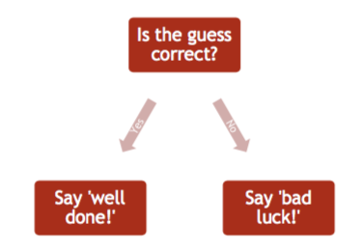
Selection - if

Slide 22
Selection -if
setters_number = input()
guess = input()
number_of_guesses = 1
while setters_number != guess:
if guess < setters_number:
print('guess too low')
else:
print('guess too high')
guess = input()
number_of_guesses = number_of_guesses + 1
print(number_of_guesses)

Slide 23
Problem Set
Write a program that prints ‘Hello World’ to the screen.
Write a program that asks the user for her name and greets her with her name.
Modify the previous program such that only the users Alice and Bob are greeted with their names.
Write a program that asks the user for a number n and prints the sum of the numbers 1 to n
Modify the previous program such that only multiples of three or five are considered in the sum, e.g. 3, 5, 6, 9, 10, 12, 15 if you enter 17

Slide 24
Data structures
A data structure is a specialized format for organizing and storing data.

Slide 25
Data structures
Any data structure is designed to organize data to suit a specific purpose so that it can be accessed and worked with in appropriate ways.

Slide 26
Data structures
Array: An array is a series of memory locations which holds a series of items of data. All data in an array must be of the same data type.
List: A list is a series of memory location which can hold a series of items of data. All data in an array can be of different data types.

Slide 27
Data structures - array
If you flip a coin it is either heads or tails and, if you flip it often enough, the number of times you get a head and the number of times you get a tail will probably be similar.
If we wanted to check this with a coin we might flip it 6 times and record the result each time:
flip1 ← True
flip2 ← False
flip3 ← False
flip4 ← True
flip5 ← True
flip6 ← True

Slide 28
Data structures - array
We can create an array in a very similar way to declaring a variable but the assignment of values uses new syntax.
This is our 6 coin flips rewritten in an array called coin_flips:
coin_flips ← [True, False, False, True, True, True]
Each element in our array can be thought of as an individual variable – it can be assigned a
value, accessed and updated in the same way – but instead of having its own individual
identifier it instead has a combination of the array identifier and an integer location.

Slide 29
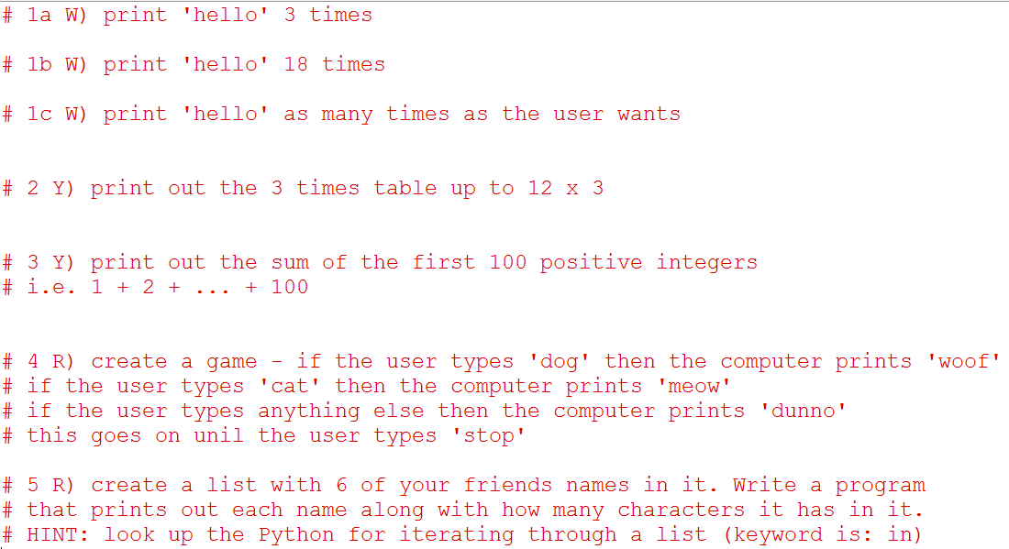
Problem Set

Slide 30
Investigation
Find out the Python code to read a text file then...
Read in the text file sample_text.txt saved in the Coding Problems folder.
Count the number of times the word ‘the’ is used.
Print this number out.

Slide 34
Title and Content Layout with Chart

Slide 35
Two Content Layout with Table
First bullet point here
Second bullet point here
Third bullet point here
 | Group A | Group B
Class 1 | 82 | 95
Class 2 | 76 | 88
Class 3 | 84 | 90

Slide 36
Two Content Layout with SmartArt
Group A
Task 1
Task 2
Group B
Task 1
Task 2
Group C
Task 1
First bullet point here
Second bullet point here
Third bullet point here

