Slide 1
AQA GCSE Computer Science Workshop
12/02/2016

Slide 2
Data and Information
Data can consist of facts or statistics out of the context and used for analysis. It can be numbers, characters, symbols or images that are processed by a computer.
Information can be a sentence of words, a sequence of number or a series of images that have been put into a context, which is what gives the data meaning.

Slide 3
Constant and Variables
Variables are used in computer programming to store specific values within a program. They are assigned both a data type and a value.
Some values are stored permanently; the data is constant.
Other things are always changing; the data is variable.
Variables are data entities whose values can be altered.
Constants are data entities whose values cannot be altered.

Slide 4

Constant and Variables
When we create a variable we call it ‘declaring’ a variable.
When we give the variable its first value we call it ‘initialising’ a variable.
age = 12

Slide 5
Assignment
print(3+4)
answer = 3 + 4
numberOne = 3
numberTwo = 4
answer = numberOne + numberTwo
score = 112
score = score + 1
print(score)

Slide 6
Data Types
All programming is fundamentally taking data and doing something with it. It is a good ambition to have your programs process data as quickly and safely as possible. To help in this, data can be put into different categories or types.
Integer (whole number both positive or negative)
Real (any number that can be found on the number line)
Boolean (only two values either True or False)
Character (a symbol)
String (a series of characters)

Slide 7
Data Types
All programming is fundamentally taking data and doing something with it. It is a good ambition to have your programs process data as quickly and safely as possible. To help in this, data can be put into different categories or types.
Integer (whole number both positive or negative)
Real (any number that can be found on the number line)
Boolean (only two values either True or False)
Character (a symbol)
String (a series of characters)
There are arithmetic tests that can be used to create Boolean values. They are <, <=, ==, !=, >= and >

Slide 8
Data Types
Integers
We can force Python to make something a whole number by saying int(number)
number = 3.7 newNumber = int(number) print(newNumber)

Slide 9
Data Types
Integers
We can force Python to make something a whole number by saying int(number)
number = 3.7 newNumber = int(number) print(newNumber)
Check the type of your data with the type() function

Slide 10
Data Types
Floats
The second main type is a floating point, or just “float” for short (a decimal). We can force Python to make something a float by saying float(number).
number = 3 print(number)
newNumber = float(number) print(newNumber)

Slide 11
Data Types
Floats
The second main type is a floating point, or just “float” for short (a decimal). We can force Python to make something a float by saying float(number).
number = 3 print(number)
newNumber = float(number) print(newNumber)
This is called “casting”

Slide 12
Data Types
Floats
The second main type is a floating point, or just “float” for short (a decimal). We can force Python to make something a float by saying float(number).
x = int(22) y = int(7) z = x/y print(z)

Slide 13
Data Types
Long
Another number type you might need occasionally is long, or a long integer.
Integers in Python can only hold numbers from -2billion to +2billion (actually from -2,147,483,646 to +2,147,483,647).
If your number is going to be outside that range then you will have to use a long to keep count.

Slide 14
Data Types
A boolean (bool for short) can store one of only two possible values - True or False. (NB: Note the capital letters!)
This is useful for logical tests (e.g. is 22/7 bigger than 3?) or to check if something has been completed
The main advantage of booleans is that they are very small and simple.
bigger = False
print(bigger)

Slide 15
Data Types
Long
Another number type you might need occasionally is long, or a long integer.
Integers in Python can only hold numbers from -2billion to +2billion (actually from -2,147,483,646 to +2,147,483,647).
If your number is going to be outside that range then you will have to use a long to keep count.

Slide 16
Data Types
String
A string is a block of text. It could be a single word, a sentence or an entire paragraph. In Python we use the term “str” to mean a string.
start = "Hello, "
name = input("What is your name? ") end = ". How are you today?" sentence = start + name + end print(sentence)

Slide 17
Data Types
Combining Strings and Numbers
start = "2 + 2 ="
number = 4
print(start,number)
print("Two plus two = ",number)

Slide 18
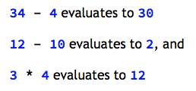

Arithmetic Operations

Slide 19
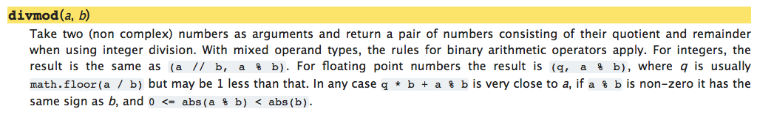
Arithmetic Operations

Slide 20
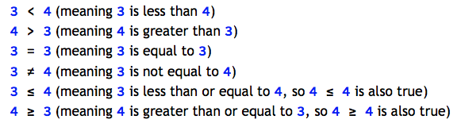
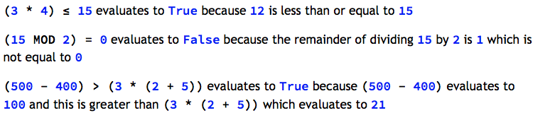
Relational Operations

Slide 21





Boolean Operations
AND, OR, NOT
1. I am 14 years old 2. I am under 1.5 metres tall

Slide 22



Boolean Operators

Slide 23
Problem
Write a program that calculates the area of three rectangles where one of the sides increases by 1 every time.
The setter thinks of a number between 1 and 100
The guesser has a guess at this number
Is this guess the same as the setter’s number?
YES then the game ends
NO then setter tells the guesser if it is too high or too low

Slide 24
Selection
Selection means selecting (or choosing) what to do next. Should I cycle to school, or ask for a lift? If it’s a sunny day I might cycle. If it’s raining, I’ll ask for a lift.
Let’s take a new variation on the guessing game from earlier where the guesser only has one go at guessing the number and if they get it correct then they get a ‘well done’ message.

Slide 25
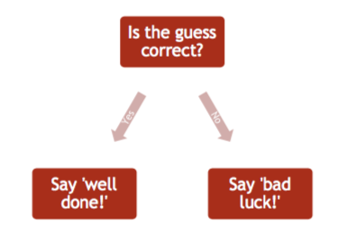
Selection

