Slide 1
Chapter 3-5
How to Describe a Component in the Business
These next 3 chapters will cover how to describe a Component in the context of the Business.
It covers:
What we will model in a business architecture
Basic modeling techniques
Integrated modeling techniques
Business View of a System

Slide 2
MAp Viewpoints
Information supports goals, process
Need shared domain
vocabulary
Process supports goals
Domain / Biz
Architecture
Need shared domain
vocabulary
Goal
1
sub-goal
sub-goal
Outside
Domain: Information
Goals
Biz.Process
Goals – success criteria
Traceability
Black box assembly includes S
Black-boxes use cases and info
models support business model
Black box Assembly (including S)
Three primary viewpoints
Component Architecture
Black box view (of S)
S
1
S
1
S
2
E
D
S: Information / Attributes
Boundary
Black-box Specification (of S)
4
S: Behavior
Architecture Styles: Principles, Patterns, Guidelines, Rules, Transforms
3
White box view of S
sub-component s1…s3
Black box view of S
Styles across viewpoints, projects:
workflow partitioning style
MQ series configuration style
Black-box behavior and info model
partitioned into sub-components
1
2
S
S
Component Architecture
White box view (of S)
s1
s2
Inside
s2
3b
s1
s3
3a
s3
4
Information
Behavior
Each sub-component could be existing separately specified black box, or new spec for next level of drill-down.

Slide 3

What Questions Does MAp Ask?
3. What are the properties of the box visible at its boundary?
functionality: services offered and
required, events handled,
information handled
others: volumes, performance,
location, security, tech platform
1. What is the bigger
goal being achieved outside?
How is our box combined with other parts to solve it?
Are there better approaches?
2. What is the boundary of the “box”
we are describing?
Workers
Policies
Our Box
Resources
4. What internal “boxes” can be combined to do the job?
Existing? New?
How to partition behavior and information responsibility to meet end-to-end needs?
6. What are properties of each internal box?
functionality: services offered and
required, events or information handled
others: volumes, performance,
location, security, tech platform
5. What consistent principles, patterns, or styles guide our design and are shared across components?
How to document these?

Slide 4
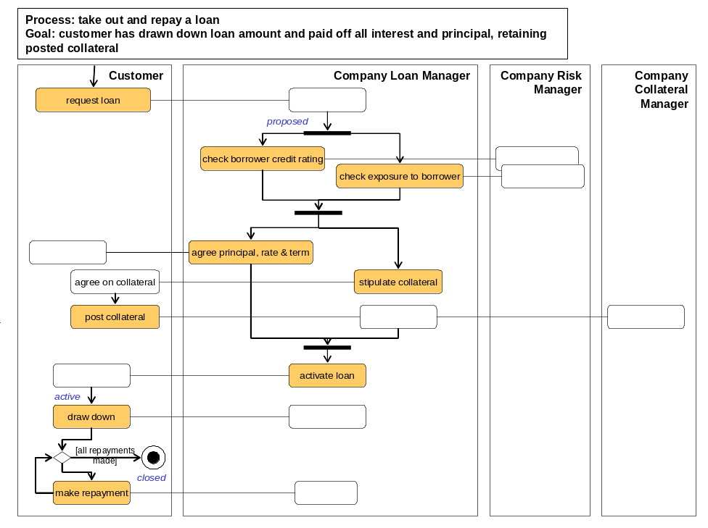
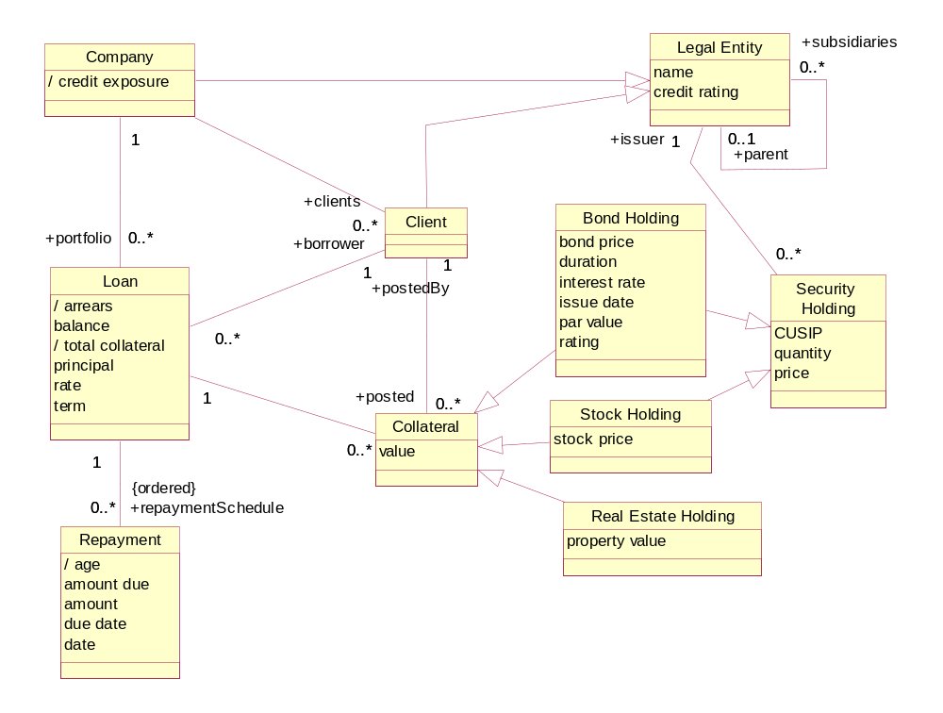
Example – Goals, Domain Model, Biz Process Model
Clear Information Terms
Convenient Derivation Rules
Goals + Process use Information Terms
<<goal>>
Minimize Risk
<<goal>>
Maximize Return
Predict Risk
….
Adjust Risk Exposure Factors
…..
Track Risk Prediction History
Learn Over Time

Slide 5
Example – Top Level Black Boxes Info Partition
Loans
Reference Data
Collateral

Slide 6
How we will learn to build these models
Basic modeling techniques: information and behavior
Consistent modeling between information and behavior
Using the above to define goals, processes, and information models

