Slide 1
RADs and Use Cases

Slide 2
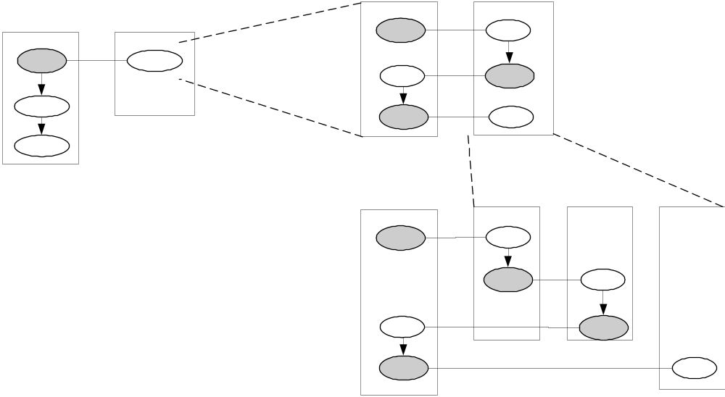
Granularity in RADs
Dental
Practice
Patient
visit
Expand activity or
interaction
Make appointment,
Change it,
Sign in,
…
Expand role
Patient Assistance,
Dentist,
Billing
Any interaction (or other activity) can be expanded into finer grained dialog
Any role can be expanded into a more granular set of roles
An entire process can be treated as a single action

Slide 3
RAD Interaction = Use Case
An “Interaction” on a RAD is an activity between 2 or more roles
  Diagram shows end states of interaction
  Drilled down diagram shows sequence and interactions between roles
A “Use Case” is an interaction between actors and “system”
  Diagram just shows participants
  Text spec defines end state
  Text design defines sequence and interactions between roles
Hence, text use case form is roughly interchangeable with RAD

Slide 4
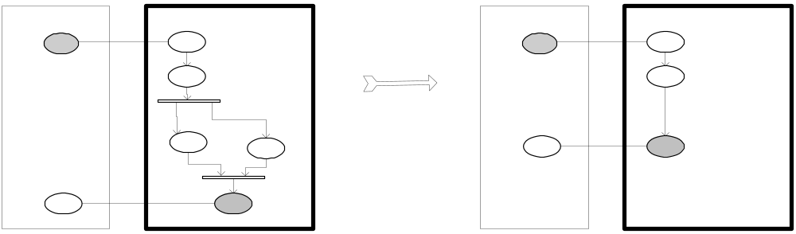
Bad Vs. Good Black Box RADs
Black Box RAD need not show design of internal process, roles, activities
Black box focus is helpful when identifying external user goals, CTQs

Slide 5
End-to-End Scenarios

Slide 6
Two Aspects Scope “End-to-End”
Where does the scenario start and end, in a “spatial” sense
  Which software, hardware, people are within scope
When does the scenario start and end, in a “temporal” sense
  Is the biggest lifecycle “make insurance claim” or “execute insurance policy”?
space
event 1 ??
event 2 ??
time
event 3 ??

Slide 7
Abstracting Objects and Actions
Within an “end-to-end” scope we can further control the level of abstraction
  One box vs. many
  One action vs. many
space
time

Slide 8



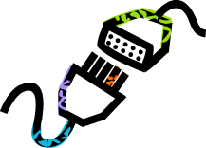

“End-To-End”: Requirements →
Software Specification → Internal Design
Weather Stations
The ‘Machine’
Connections
Software
spec
Weather
Sensors
SW + HW
The Software
Requirement:
Keep Watchers informed
of Current Weather
Further Outside
UI
Internal
Design
Watchers
A domain is some (part of the world) with “connections” to other domains
  Weather, weather stations, users, the machine, other machines, etc.
Problem domain is different from Machine domain and intermediate “connection” domains
  The problem to be solved is outside the machine; the machine + connections help solve it
“Requirements” prescribe what the machine must cause in the Problem domain
  It depends on descriptions of all relevant aspects of the problem domain(s)
“Software Specification” defines all interfaces of the software, including technical and UI
  It depends upon descriptions of other domains + prescriptions of operational procedures

Slide 9
Steps to Black Box Architecture (1)
Weather Stations
Connections
The ‘Machine’
Weather
Sensors
Software
spec
Electronics
The Software
Requirement:
Keep Watchers informed
of Current Weather
Further Outside
UI
Internal
Design
Watchers
Identify the scope of the problem
Using interviews and end-to-end scenarios through RADs, find the outermost scope: outer events and information that influence your requirements
  This is the fringe of what we need to investigate to understand and solve the problem
  Things left out of this are irrelevant to understanding the problem
  Consider the largest grained actions that occur at this boundary, then finer grain one
  This boundary will form the initial “end” of our “end-to-end” scenarios
    Boundary in “space”: where to start and end consideration
    Boundary in “time”: what are all the events and consequent actions within scope?
Identify and list stakeholder roles and their goals and CTQs
Find deficiencies, causes, and improvements in the business process
Prioritize and decide scope for black box definition
Validate and refine using end-to-end scenarios

Slide 10
Steps to Black Box Architecture (2)
Weather Stations
The ‘Machine’
Weather
Connections
Software
spec
Sensors
Electronics
The Software
Requirement:
Keep Watchers informed
of Current Weather
UI
Internal
Design
Watchers
Develop the black box use cases
Iteratively do the following validating with end-to-end scenarios
Brainstorm list of candidate actors interacting with the black box, and their goals
  Direct actors interact with the system
  Include indirect participation up to the outermost scope identified for the problem
Define the Black Box Use Cases and Operations
  Use Goals as starters for Use Cases, draft the use case specification, and design the steps of the use case based on the end-to-end scenarios
  Identify the Black Box Operations that will be invoked in those use case steps
  Link each Use Case to the RAD activity which might start that use case
  Note: there will be a many-many relationship between operations and RAD activities
Define the Black Box Information Model
  Use the Business Information Model as a starting point, remove parts that are out of scope for the black box, add software-specific types (sessions, preferences, etc.), and add input / output information types
  Validate that the information model supports the use cases and operations

Slide 11
Included Use Cases and Internal Actions
A use case is a unit of external interaction
  It can <<include>> smaller use cases
  But these also have to be units of external interaction
Sometimes we need to name behaviors that are not external interactions
  Use general action for these
  They are useful to separate definition of complex bits of internal behavior
  They can also represent some intended allocation of behavior in the internal design
Minimize using actions to define black box computations with no side effects
  Use derived attributes instead
  The white box view will allocate it and can decide about computation vs. storage
A use case can refer to an action in
  Its postcondition (preferred usage)
  Its steps (but be careful not to describe internal algorithms unnecessarily)
Simple convention in text: include underline-italics to refer to use case or action

Slide 12
Note: One vs. Many Black Boxes
Your model must include every external actor of your system of interest
But should the system itself be modeled as one or many black boxes?
For more moderate scale systems
  Model one black box, specify and design use cases and system operations
For larger scale systems, either
  Model as one black box, and only draft its use cases and operations
    Then move into the white box architecture
  Or, Model as several (sub) components, and analyze across all of them
    Interactions across all the sub-component in scenarios and interaction diagrams
    This is really just a form of white box architecture

Slide 13
Exactly Which Black Box?
External view of X: all actors view
Insides hidden
CAM: Black Box
X
External view of X: one actor’s view
Insides and other actors hidden
CAM: Interface or Port
An “object” X
with its internal and external parts and interactions
One actor external view = Port Specification
  Usage contract with list of operations
  Simple postcondition on single information model
External view with all actors = Component Spec
  Realization or Assembly contract with list of Ports
  Defines how (in) port attributes correspond to (out) port attributes i.e. information sources
  Defines operation that call other operations
Internal view = Component Implementation
  White box assembly (of other black boxes)
Internal view of X
CAM: White Box

Slide 14
Use Cases, Operations, and RADs
In moderate sized systems with well-structured RADs
  A use case represents a RAD interaction between actor and System
  Add a role for the System into the RAD
  For each use case, add an interaction between system and appropriate actor roles
  Operating procedures for the system can be defined from these
In large systems, or without well-structured RADs
  The top level activities might be too coarse-grain to correspond to use cases
  The next level activities might be too fine-grain to correspond to use cases
    Particularly if RADs degenerate to flowcharts, without focus on important states
  Simply refer from each use case to all RAD processes/activities that initiate it
  use case: …..
  Initiating processes: list of processes or activities
In both cases
  System operations have a many-many relation to RAD activities
  The use cases must be validated with end-to-end scenarios

