Slide 1
Chapter 2 - Addendum
Relation to CIB-Tech SDLC
In this addendum we discuss how MAp complements the CIB-Tech software development lifecycle (SDLC).
The SDLC provides a framework for planning and executing a multi-phased project.
MAp is not an SDLC, but provides a framework for architecture definition that fits within the SDLC.
MAp adds specific ways to describe architectures. In this section we discuss where these may be useful.
MAp can be used at business strategy level, service-oriented architecture, component design and implementation.
MAp prefers, but does not require, an iterative lifecycle.
This addendum contains excerpts from descriptions of the SDLC and SDLC Workspace.

Slide 2
SDLC Terminology
Business Case
Engagements
Activities
Tasks
PTS
Project Types
Route Maps
AWS – Architecture Workspace
SQA Workspace – Software Quality Assurance
Function Point Workspace
All fine with MAp
Routes through MAp architecture framework
MAp guidelines and consistency and completeness

Slide 3
SDLC Roles and Organization
Engagement Level Roles
  Client Manager
  Senior Client Manager
  Chief Systems Officer
  Engagement Manager
  Engagement Team Admin
Project Level Roles
  Project Manager
  Project Team Admin
  Project Leader
  SQM
  Function Point Coordinator
MAp focus is more on architecture roles

Slide 4
SDLC Approval/Escalation Process
PM Submits
Document/
Request
1
MAp
does not prescribe such controls
provides specific completeness and consistency guidelines
should fit into process
SQM
Approval
Task
Complete
Yes
No
PM Accept
Task Must be
Completed/
Corrected
Yes
1
No
CSO
Override
Task
Complete
Yes
No
Task Must be
Completed/
Corrected
1

Slide 5
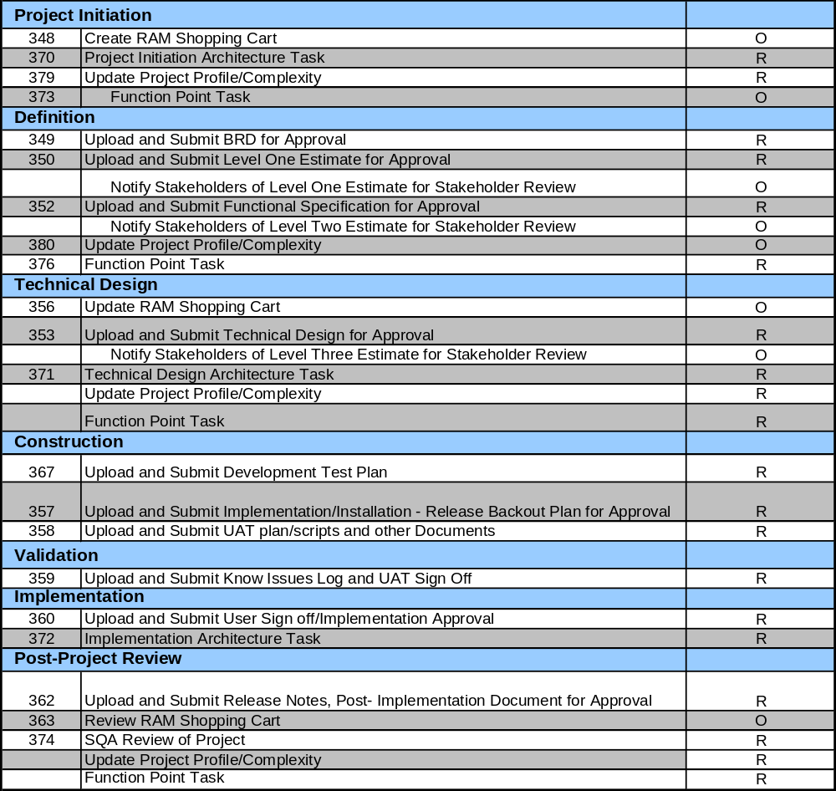
Phases
MAp Business, Black-Box, and White-Box (including Technical) provides specific architecture descriptions and separations
Initiation
Definition
Technical Design
Construction
Validation
Implementation
Post-Project Review
QTS
Different “Routes”
“Full Development”
route shown here
MAp prefers (does not require) an iterative lifecycle

Slide 6
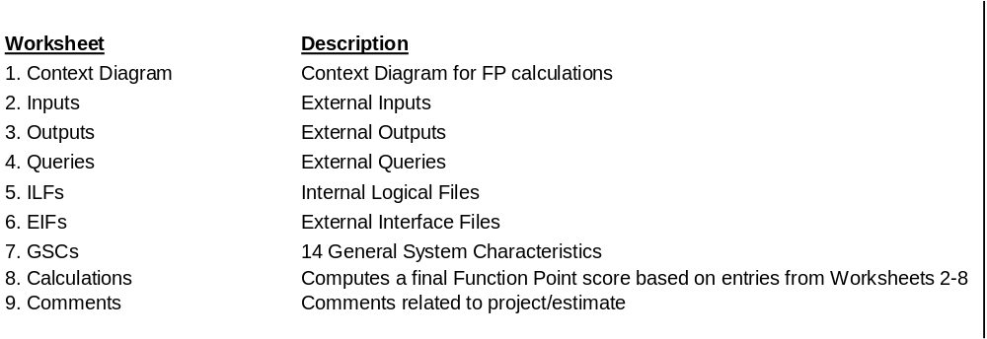
“Initiation” – Function Point Worksheet
GSCs
data communication
distributed processing
performance
transaction rate
reusability
operational ease
multiple sites installation
…
Could use as input an early “list” version of MAp black-box specification, including non-functional concerns

Slide 7
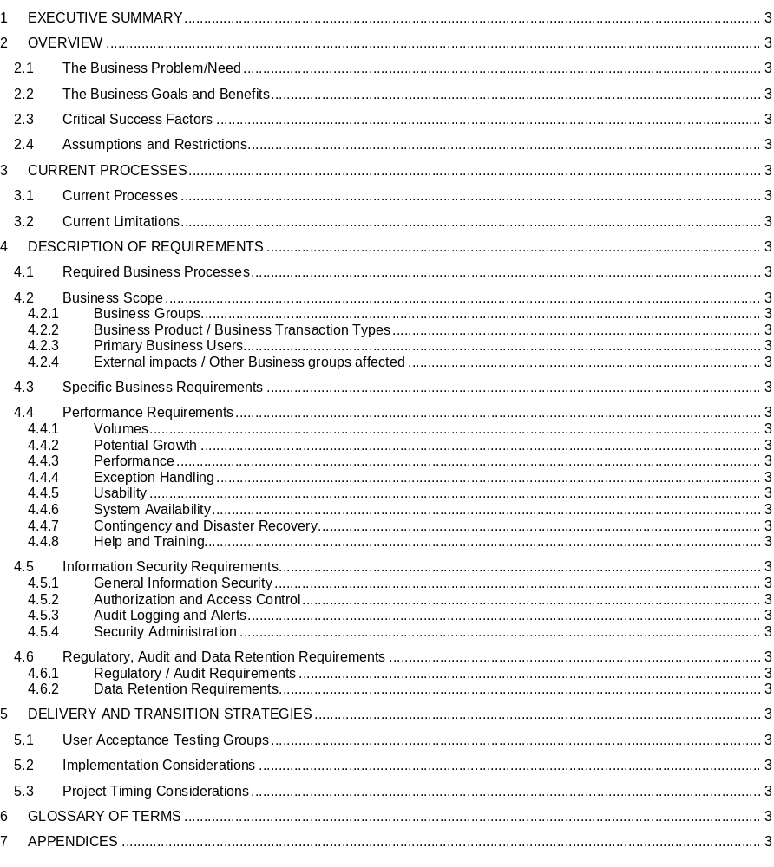
“Definition” –
Business
Requirements
Document
The Business Requirements Document represents the customer’s requirements for a project. It does not anticipate what the solution to these requirements may be – this is the purpose of the Functional Requirements and Technical Design documents. The Business Requirements documents ‘what’ needs to be done, and the Functional Requirements and Technical Design document ‘how’ it will be done. The other key function of the Business Requirements is to document the current state of affairs in terms of business processes and existing systems.
MAp top-level goals and domain
MAp current-state with problems/opps
MAp goals (including functional, security, performance) refined and scoped
MAp deployment, migration

Slide 8
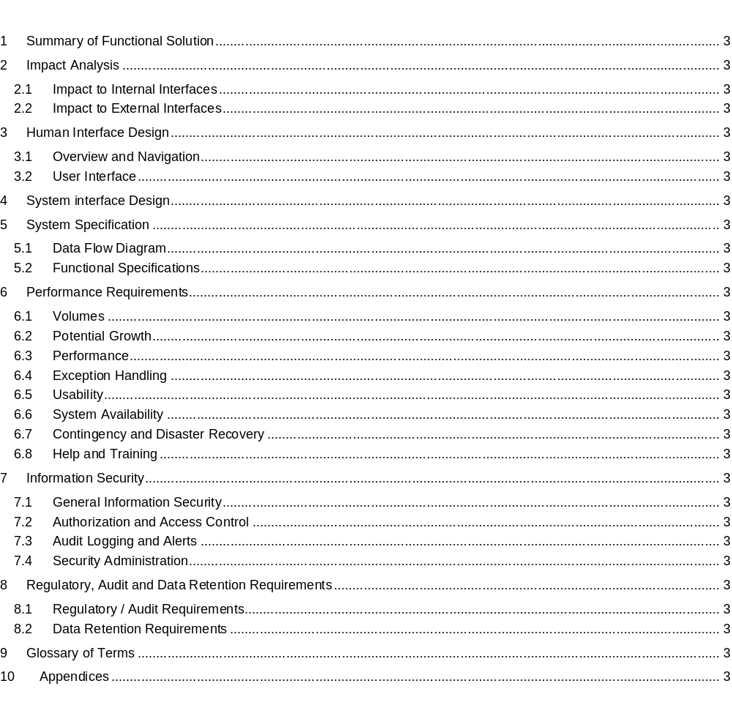
“Definition”:
Functional
Requirements
Document
The Functional Requirements Document represents CIB Tech’s approach to meeting the customer’s Business Requirements. It details the logic and processing aspects of the proposed system, but will not necessarily cover any elements of the implementation. The detailed design of the proposed system will be covered in the Technical Design phase of the project.
MAp external interfaces and connected systems
MAp Black-Box Specification (refined from goals)

Slide 9
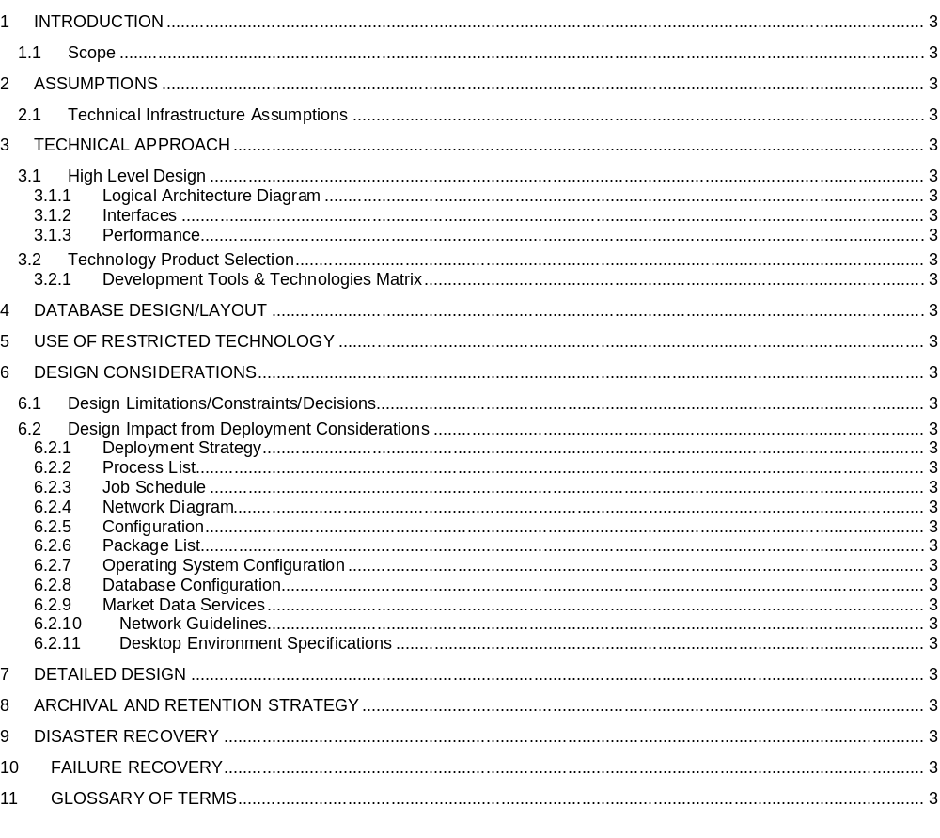
TSD –
Technical
Specification
Document
The Technical Specifications Document translates the Functional Requirements into high-level software requirements and detailed design. In addition, it describes the process flow and the impact on other groups, systems, and applications. This document is the basis for development activities during the construction phase.
MAp white-box
logical + technical architecture
Partly covered in MAp deployment

Slide 10
Route Map – Different Routes for Different Project Type
Create Business
Case
Create Work
Order
Exploratory
Exploratory
Feasibility
Feasibility
Stakeholder
Approval
Stakeholder
Approval
PTS DV
Project
PTS DV
Project
PTS MD
Project –
Enhancement Tasks
PTS MD
Project –
Enhancement Tasks
PTS MD
Project –
Enhancement Tasks
Full Development
Route Map
Vendor Route
Route Map
Minor Dev
Route Map
Support Minor Dev
Route Map
Work Order
Route Map
Initiation
Initiation
Definition
Validation
Validation
Definition
Definition
Construction
MAp project types and routes
Technical Design
Technical Design
Validation
Construction
Construction
Validation
Validation
Note: Depending upon the route map selected there will be different tasks required for each phase.
Implementation
Implementation
Post Project Review
Post Project Review

