Slide 1
Chapter 5
How to Describe a Component to the Business
Business View of <System X>
This chapter introduces techniques for modeling business processes with roles, activities, and interactions.
It covers:
Business Goals Model
Domain / Information Model
Business Behavior Model
  Activity diagrams
  State diagrams
[Optional] Defining a reference business process architecture

Slide 2
MAp Viewpoints
Information supports goals, process
Process supports goals
Domain / Biz
Architecture
1
Outside
Domain: Information
Goals
Biz. Process
Goals – success criteria
Black box assembly includes S,
Supports business model
Traceability
Mapped Black box Assembly (including S)
1
S
Component Architecture
Black box Spec (of S)
S
E
D
S
1
2
S: Information
Boundary
Black-box Specification (of S)
4
S: Behavior
Architecture Styles: Principles, Patterns, Guidelines, Rules
3
Black box view of S
Architecture styles, patterns: across viewpoints, projects
White box view of S
sub-component s1…s3
Partitions behavior & information
1
2
S
S
Component Architecture
White box design (of S)
s2
Inside
s2
s1
3b
s1
s3
3a
s3
4
Information
Behavior
Each sub-component could be drilled-down if needed

Slide 3
Preview of Business Architecture
Domain Subject Matter Expertise
Domain descriptions and standards
Knowledge of (and in) existing systems
Operating procedures
2
3
Goals Model
Subject area 1
Domain / Information Model
Behavior Model
g1
g2
g3
Roles
User
Business
Architect
Application
Architect
Goals, sub-goals,
Obstacles, assumptions
Patterns
Patterns
Types, attributes and associations
(No real focus on “operations”)
Events in the domain
Business Architecture Styles
Activity or State diagrams
Roles, activities, interactions, state transitions
Dictionary, Snapshots, End-to-end scenarios, textual specification
Optional: description relating attributes, actions, events across multiple process or subject areas
Why do a Business Architecture?
To get a clear definition of business goals, domain, rules and target business model, define the ultimate requirements for the project, and document that model in a form that serves downstream work.

Slide 4

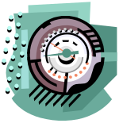
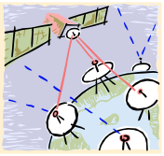

Outside (Goal), Boundary (Spec), and Inside (Design)
Properties of stations, connection: speed, errors, …
Properties of weather: range, changes, movement,
Spec should be based on the properties of the domain
Weather
Stations,
Sensors &
Electronics
Connections
Software
spec
Weather
The Software
Goal: Keep Watchers
informed of Current Weather
Further “Outside”
Internal
Design
Device
Properties of watchers: location, mobile, environment, senses
Watchers
A domain is a part of the world with some shared state or interactions with other domains
  Weather, weather stations, watchers, the machine
Problem domain is different from Machine domain and intermediate “connection” domains
  The problem to be solved may be outside the machine; the machine + connections help solve it
Goals define what the machine must cause in the Problem Domain
  It is expressed in terms of all relevant aspects of the problem domain(s): weather, watchers
Software Specification defines all interfaces of the software, including technical and UI
  It is part of the solution, along with other domains, machines, human operating procedures

Slide 5
Steps Toward Business Architecture
Frame the Problem
  Describe the Domain: Describe relevant properties of the domain that is the subject of goals
    Things that exist – object and attributes
    Things that happen – events and actions affecting objects and attributes
  Define Goals: Prescribe desired relationships between domain elements that we want to achieve
    Define stakeholders
    Explore why of goals to get higher-level goals
    Explore how of goals to get more complete sub-goals, assumptions about domain, system-specs
    Refine domain model and refine goals
  Validate with Scenarios: Use goals as problem boundary for end-to-end scenarios
    Use these to validate business goals and process models
  Identify Essential Process Architecture: Use domain model and scenarios to identify essential processes
    Case, case-coordination processes
[Optional] Current state analysis for domain knowledge, problems & opportunities
Design target-state process model: using the above goals and as-is models
  If you design multiple processes, also include an overview of how they interrelate
  Ensure Information Model supports activities in process and goals model
  You do not need to decide specific automation or system boundaries
Why?
  Use goals and understanding of current-state to design future-state business process

Slide 6
Domain Model and Goals
Describe the Domain: Relevant properties of the domain that is the subject of goals
Define Goals: Prescribe desired relationships about domain elements
Validate with Scenarios: Use goals as problem boundary for end-to-end scenarios

Slide 7
Domain Properties  Support Goal Refinements
● Maximize sustainable revenue from individual patients
  ● Maximize perceived value to each patient by providing treatments to meet needs
  ● Maximize realized value from patients commensurate with perceived value
■ Assumption: Sustainable revenue needs perceived & realized value & payment ability
    ■ Fact: Custom treatments cannot be developed from scratch per patient
Why does this subgoal help get revenue from customers?
    ● Have Treatment Portfolio that covers typical Patient Segment Needs
    ● Understand Individual Patient Needs
    ● Maximize coverage of Individual Needs with Custom Treatments created From Portfolio
    ● Keep Patients aware of provided value of treatments
    ■ Fact: Different patients can return different value, can pay different fees,…
    ● …
What are some possible subgoals, based on this domain fact?
● Ensure planned treatments can be paid for by patients and insurance

Slide 8
What is a “Good” Goal Refinement?
Formally, a set of Goals and Domain Properties {G1, ..., Gn, D1 } refines a goal G if the refinement is:
  Sufficient / Complete: G1, ..., Gn , and domain properties ➔ G
  Necessary / Minimal: No subset of G1 … Gn is sufficient to ➔ G
  Consistent: The goals and domain properties are consistent
“Everything supports everything” is not helpful
Understand “What” of each goal before refining
Decompose each goal carefully
Include domain properties as part of refinement
Build and present the goal model incrementally
Should be able to understand each goal refinement (largely) separately
Build and present the domain model incrementally

Slide 9
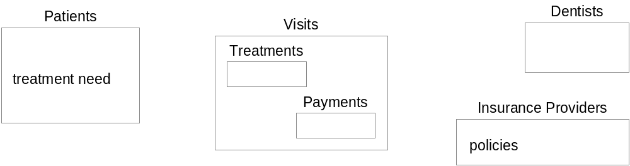
Domain – Patients, Dentists, and Visits
Patients have treatment needs based on dental conditions. They visit the Dental Practice and are treated by Dentists. Treatments are paid by the Patients and their Insurance Providers.
Sketch of the domain model
  Drawn informally for now
  Will be developed into Information Model etc. later

Slide 10
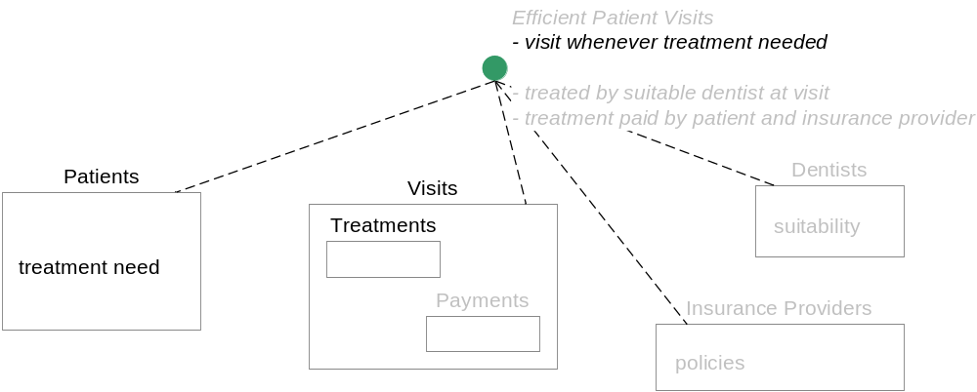
Goals – Patient Visits
Goal
Observes
Controls
Domain Property
■
Goal: Efficient Patient Visits:
  Patients visit whenever treatment is needed
  Patients are treated by suitable dentists at the visit
  Treatments are paid for by patients and their insurance providers
Model indicates which things in the domain are referenced by the goal: can distinguish observe vs. control
In order to refine and satisfy this goal we need to investigate properties of the domain …
  What domain properties causes a treatment to “be needed”? What domain properties affect visits?
    Routine, scheduled follow-ups, and symptomatic or emergency visits
    Patients forget routine appointments
    Unexpected calendar conflicts for either patients or dentists
  What makes a dentist suitable for treating a patient?
  What are the properties of patient and insurance payment?
Observes
Controls
Goal needs to observe this part of the domain (dashed, no arrow)
Goal needs to control / influence this part of the domain (dashed, arrow)

Slide 11
Domain Properties  Guide Sub-Goal Design
■ Visits are needed for routine checks, follow-up treatments, or based on current symptoms
  ● Goal: Both Patients and the Dental Practice make appointments for patient visits as needed.
■ A patient’s scheduling needs can change due to personal appointments.
  ● Goal. Change and Cancel Appointments. Patients can change and cancel their appointments.
■ Sometimes there are changes in dentist availability and the Dental Practice needs to re-schedule existing appointments.
  ● Goal. Dental Practice Re-schedules Appointments
■ Patients sometimes miss appointments.
  ● Goal. Remind Patients of Appointments
■ Dentist’s have time off and can become double booked for appointments or planned time-off.
  ● Goal. No double booking of dentists including time-off.
■ Not all dentists can perform all treatments.
  ● Goal. Only Qualified Dentists Assigned to an Appointment.
■ Patients don’t like surprises about costs or coverage.
  ● Goal. Cost and coverage estimates for appointments known to patients at appointment time.
■ Insurance often has co-payments, and actual insurance payments may not match estimates.
  ● Goal. Patient pay both co-payments and past-payments.
Note: Problem definition includes describing properties of the problem domain, and corresponding definition of goals and sub-goals, including SWOTs (Strength, Weakness, Opportunity, Threat)

Slide 12
Typical Structure of Goal Refinement
● Parent Goal: what we want to make true
■ Domain Property (Fact, Assumption): Considering this fact or making this assumption …
■ Domain Property (Fact, Assumption): And considering this other fact or making this assumption …
● Sub-Goal: If we solve the smaller problem as defined by this sub-goal
■ Domain Property (Fact, Assumption): And considering this fact or making this assumption …
● Sub-Goal: And if we solve this other smaller problem as defined by this other sub-goal
Then we have solved the original goal, where all the sub-goals are necessary (based on the domain properties) and sufficient (the sub-goals, if met, combined with the domain properties, will ensure the parent goal is met).

Slide 13
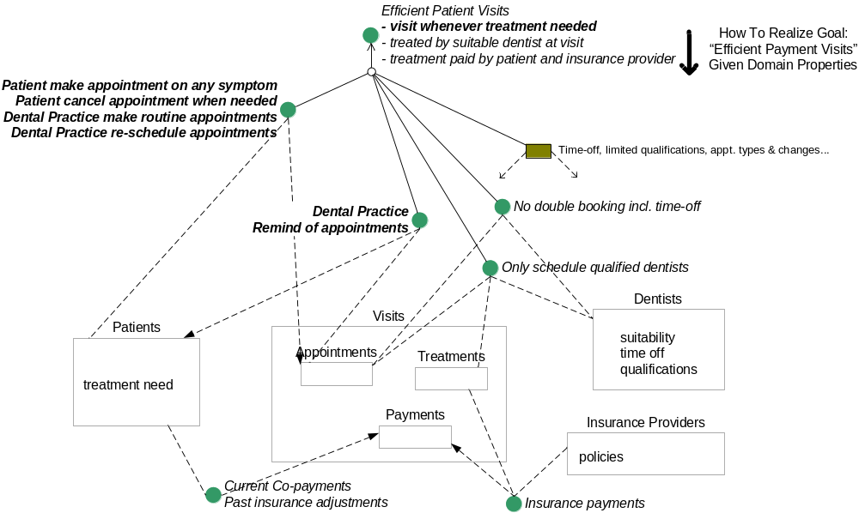
Refining Goals and Domain Model – Why? How?
Think of goals as being continuously met by some ongoing processes
Ask: Why?
Find parent
goal(s)
Goal continuously met
Ask: What?
Find Controls,
Observes
Goal continuously met
Ask: How?
Find siblings,
Assumptions,
alternatives
As part of “How”, consider other interrogatives like: Where? When? Who? Whom?

Slide 14
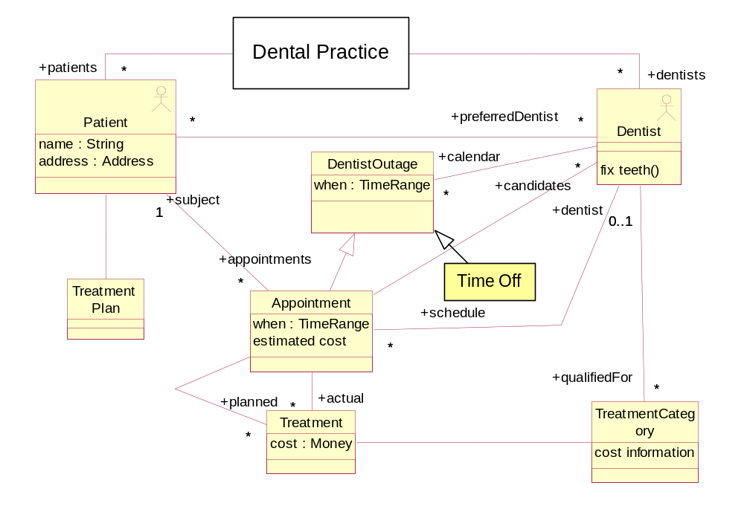
Example – Detailed Domain Information Model
Goals model gets refined
Domain model gets refined
Which do we need to add?
  time-off
  symptoms
  insurance
  patient’s personal calendar
  reminders

Slide 15
[Optional] Goal and Goal-Refinement Patterns
Where possible use one of the following forms for a goal
  Maintain [while condition maintain target-state]
  Avoid [while condition avoid target-state]
  Achieve [when condition achieve target-state]
  Cease [when condition exit target-state]
  Min / Max / Optimize / Increase / Decrease [condition to be optimized]
There are some patterns of goal refinements as well e.g.
  Simple case analysis
    Goal: Fill Customer Orders
      Domain property: Orders can be for Products or for Services
      Sub-goal: Fill Product Orders
      Sub-goal: Fill Services Orders
  Milestones towards goal
    Goal: Deliver Orders From Warehouse On Time
      Sub-goal: Package the Order for shipment
      Sub-goal: Schedule pickup of Package based on shipment time
      Domain property: Scheduled pickups will be delivered within shipment time

Slide 16
Exercise 5.1

Slide 17
Relating Roadmap to other Roadmaps
Goal (parent)
Parent
2 important kinds of relationships with a common approach
  Child roadmaps
  Peer roadmaps
Child roadmaps (e.g. Identity and Entitlement Management vs. Entitlement Review)
  Child roadmap mostly details the goals, white-box architecture, migration of parent
  Need clear consistency relationship between the two, even if not enforced 100%
  Child roadmaps may be focused on a sub-component, or a slice through all sub-components
Ownership: parent roadmap owns child’s interfaces, connections, cross-child styles
Coverage: parent must explore “architecturally significant” sub-goals scenarios
  Scenarios must begin and end at the “end-points” of the outermost parent goals
  Those that exercise new paths through the next level architecture
  Those that cannot be localized within a single child
Peer roadmaps (e.g. Identity and Entitlement Management vs. HR)
  Demands communication with different stakeholder and owner group
  Goals and information models must fit together
  Component architecture, information ownership, interaction must fit together
  Migration plans and timelines must fit
  Note: Peer roadmaps should also have a notional “parent” to own the connections

Slide 18
Other Useful Goal Model Elements
An Obstacle is a Domain Property that keeps a Goal from being met
  Obstacles must be addressed e.g. sub-goals to eliminate, mitigate effects, resolve
A Conflict is a condition under which 2 or more goals interfere
  Conflicts also need to be resolved e.g. prioritize one over the other, trade-off
A Goal has associated Metrics and Targets : how well the goal is being met
  Metrics are quite difficult to choose, and goals help design appropriate metrics
  e.g. average payment delay, Minimize, target < 0.02 hours
Goal models and refinement bring a focus on exact kinds of risks
  Incorrect parent goal, invalid assumption, refinement not necessary / sufficient

Slide 19
Domain models are potentially quite deep
A Domain Model can be much more than an information model
  Describes all properties of the problem domain relevant to meeting goals
  Includes concepts, structures, behaviors, rules, etc.
E.g. Consider the possible “layers” in a domain of rail transportation
  Intrinsic:
    Path, segment, junction
    Load (freight, passenger)
    Conveyor (train, truck, ship)
    Movement
  Supporting technologies: signals, rail track switches, communication network
  Rules (don't cross red light) + Regulations (corrective actions - issue ticket)
  Human behaviors : what drivers or policemen must do
  Management, organization : org structures, motivations, strategies and tactics

Slide 20
Essential Business Process Architecture
This section covers:
Large domains have multiple interrelated business processes
Often what is demarcated as a “process” is an arbitrarily drawn boundary
Case, Coordination, Strategy gives a clear structure to processes
It identifies the essential processes and their key dynamic relationships

Slide 21
Essential Process Architecture
Find “essential” business entities: things where each instance has a lifecycle you have to manage
  Patient, Visit, Dentist, Payment
Define a “case” process: takes each instance through entire lifecycle; focused on a single “case” instance
  Handle a Patient, Handle a Visit, Handle a Dentist, Handle a Payment
For each “case”, define a “case coordination” process to start, stop, coordinate across multiple “cases”
  Coordinate Patients, Coordinate Visits, Coordinate Dentists, Coordinate Payments
  Sometimes “coordination” folds into another “case” process e.g. Treatments are coordinated within a Visit itself.
Optionally define a “case strategy” process: measure, change, optimize the other processes themselves
Find dynamic “generate” relations from each case to other entities spawned off, with their own lifecycles
  Co-ordinate these through the case-coordination process
Process architecture relates these together with summarized interactions
case process
Patient Strategy
case coordination process
monitor, measure
optimize
Maintain Patient
Handle a Patient
onboard, retire,
balance preferred dentists
Coordinate Patients
deliver visit
<<new>>
hire, fire,
co-ordinate vacations
Maintain Patient
new visit request
Coordinate Dentists
Employ Dentist
Maintain Patient
<<new>>
re-schedule
Coordinate Visits
Handle a Patient Visit

Slide 22
Pretty Process Pictures – a Reality Check
An organization operates as a network of processes with dynamics
  a number of case processes come and go … under the control of
  case coordination processes … both of which are strategically monitored by
  some case strategy processes
Most organizational processes are not neat chains and hierarchies
Case, case-coordination (and strategy) show truer structure
  Rather than encapsulate the whole overarching provision of an account, from account opening, through a number of transactions like processing checks, through closing …
  Define a case process for opening an account and one or more case processes for multi-step operations like clearing checks, with coordination processes as needed

Slide 23
End-to-end Scenarios
Scenarios are sequences of interactions. This section briefly sketches:
How to select appropriate “size” of scenarios

Slide 24
Finding “End-to-End” scenarios
Where does the scenario start and end, in a “spatial” sense
  Which software, hardware, people are within scope: phone agent, insurance agent, or policy holder?
  Start at the outermost boundary relevant to the “true” problem i.e. top-most goals controls, observes
When does the scenario start and end, in a “temporal” sense
  Is the biggest lifecycle “make insurance claim” or “execute full insurance policy lifecycle”?
  Start with largest grained actions at or within this boundary, then finer grain ones as steps in scenarios
Leave out things that are irrelevant to understanding the problem to be solved
Once end-to-end scope is decided, choose granularity of objects and size of scenario steps to model
Explore both success cases and failure paths
Describe scenario in text, or UML sequence or collaboration diagrams – even early executable test cases!
2. c
in scope?
system 4
system 1
1. b
0. a
3. d
in scope?
6. g
5. f
4. e
7. h
system 3
in scope?
system 2

Slide 25
Example of Boundary, Stakeholders, Goals
What is the outer boundary for the Dental Practice?
  Patient? Patient’s family? Patient’s employers?
What are largest grained actions there? Finer grained ones?
  Patient lifecycle, visit the dentist, sign in / get treated / pay
  End to end scenario start from entire patient lifecycle → complete visit → make appointment
Who are all stakeholders, how to group them, what are their goals, what scenarios apply?
  Routine Patients
    Want more proactive planning of appointments for dental care and follow-up
    Would like reminders of appointments with option to change times
    Need appointments scheduled and completed efficiently, with access to medical history, cost and insurance coverage information, and suitable or preferred dentist or staff assigned
  Emergency Patients - to be seen immediately
  Insurers - justification and audit trail for each treatment
  Dental Practice – Increase patient satisfaction, faster billing, fewer questions from insurance
Failures, deficiencies, etc.
  Appointments changed or cancelled due to patient’s personal schedule
  Appointments changed or cancelled due to dentist becoming unavailable
  Appointments forgotten by patient
  Patient care suffers when pre-planned appointments not consolidated with new symptoms
  Better follow-up planning and scheduling possible
Sometimes insightful to do careful stakeholder analysis and grouping:
Emergency vs. Routine Patients

Slide 26
Business Behavior – (Role) Activity Diagrams
A scenario is a concrete story of an interaction sequence. An Activity Diagram specifies required interaction sequences, and generalizes scenarios. This section covers:
Describing Business Process with an Activity Diagram
  We will include some facilities supported by the new UML 2.0
  Alternately, we will use a variation called “Role Activity Diagrams”

Slide 27
Activity diagram Generalizes End-to-End Scenarios
Process: Patient Visit
Goal: Patient has made appointment, completed visit, and all charges have been billed
Patient
Patient Assistance
Dentist
Billing
make
<<joint>>
Scenario name: joe visits dentist for annual cleaning and checkup
Initial state: joe is already a patient at teeth’r’us.
His account is in good standing.
    He has has no pending treatment.
1: joe calls and schedules an appointment with dora for 5/1
2: At the appointment time, joe signs in at teeth’r’us
3: dora works on joe and does his cleaning and x-rays; all clear.
4: joe pays his co-payment and teeth’r’us bills his insurance
Final state: joe is treated, and his dental and account records are updated and his insurance billed
appointment
colored
appointment is confirmed
red
black
green
change
appointment
appointment
date
Note: cannot change
after appointment date
sign in
treat patient
bill
make co-
insurance
pay

Slide 28
Activity Diagram Explained
Process name and goal
Process: Patient Visit
Initial state
Goal: Patient has made appointment, completed visit, and all charges have been billed
Role
(Partition)
Interaction / Joint Activity: both pre-states must be enabled.
No arrow. Our convention: name from (shaded) initiator end
Final state
State
(can be on line ends in or out of activity)
Patient
Initiator
Patient Assistance
Dentist
Billing
make
Branch (with conditions, only one gets enabled)
appointment
<<joint>>
colored
appointment is confirmed
Decision Point or Branch
[red]
[black]
[green]
appointment
Signal/
Event
Merge (any one can enable)
change
date
raise
event
appointment
Raise event
sign in
Activity
(= Action)
Join (all ins must be enabled)
treat patient
Sequence
Sequence
(arrow)
bill
make co-
insurance
pay
Fork (all outputs enabled

Slide 29

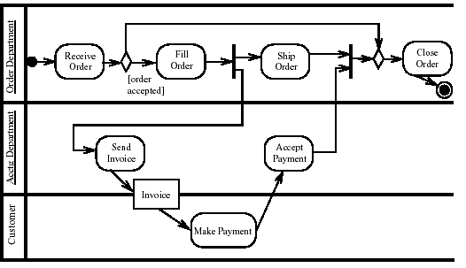

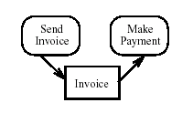
Some UML 2.0 Notes
UML 2.0 uses “Rounded Rectangle” for action and activity
UML 2.0 “Partition” can indicate role
UML 2.0 does not allow Interactions/Joint Activity on swim-lanes, but 2.0 text version allows “partition” list. Use <<joint>> annotation
This action is contained within 2 partitions e.g. jointly performed by 2 roles
UML 2.0 has “Object flows” for state, “Interruptible” regions, “pins”, and more
Object flow

Slide 30
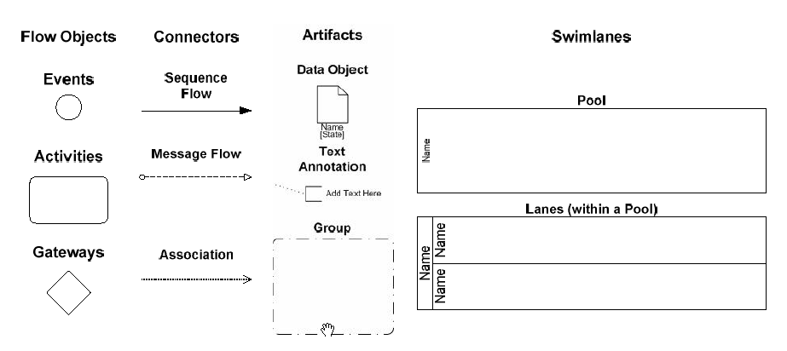
Some BPMN Notes
Business Process Modeling Notation – Standard
Constructs and approach consistent with our use of role-activity diagrams
things that “happen”
(start, stop, intermediate)
communication /
directed joint action
associated state artifacts
branch, join, fork, conditionals, …

Slide 31
Activity Diagram Pragmatics
Process: Patient Visit
Goal: Patient has made appointment, completed visit, and all charges have been billed
Patient
Patient Assistance
Dentist
Billing
Note: the patient can change the appointment anytime many times before appointment date
make
appointment
colored
appointment confirmed
red
black
green
change
appointment
appointment
date
sign in
treat patient
bill
make co-
insurance
pay
Formalizing concurrency, iteration, conditionals… can make diagram detailed
Just add informal annotations to diagram, unless you want executable models
  Let the diagram focus on being clear about the “normal case”
  Annotation on diagram, or numbered footnotes
Compress detailed conditions using names like “do xyz if appropriate”

Slide 32
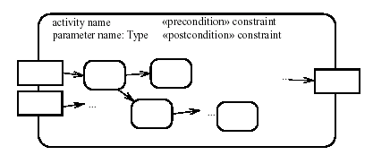
Textual Activity Specification
UML 2.0 composite activity with pre/post + explicit in/out parameters using object flows
Actions specified textually
  activity: make appointment
  roles: Patient, Patient Assistance
  inputs: symptoms: Set of Symptom [from Patient]
  outputs: appointment details: Appointment [to Patient]
  goals: references to goals that this activity supports
  Precondition: Patient account is not delinquent
  Postcondition: An appointment has been created for
  patient for date, to cover planned treatments, with dentist qualified for treatment type.
  Insurance and cost estimates recorded.
As always, this (together with state annotations on diagram) uncovers terminology and states needed in the Information Model
Dentist
Appointment
confirmed: Boolean
when: Date
qualified dentists
Treatment
cost estimate
insurance estimate
Treatment Type
plan

Slide 33
Refinement – Temporal, Spatial (Activities, Roles)
Dental
Practice
Dental
Practice
Patient
Insurance
make
appointment
Patient
Insurance
Patient
visit
Expand activity or
interaction
treat
pay
Expand role
Insurance
Patient
Patient Dentist Billing
Assistance
Any activity can be expanded into finer grained activity or interaction
Any role can be expanded into a more granular set of roles
An entire process can be treated as a single action
Start with largest grained activities and roles, be willing to zoom in and out
Typically show at most ONE internal action between interactions for an external view

Slide 34
From Goals to Activities within Processes
Once goals have been refined adequately we need
  the actions that are relevant to the goals
  the requirements on these actions so that the goals are satisfied.
Identify actions by considering state transitions relevant to those goals
Goals contribute to specification of actions
  action
    must be performed whenever …
    must not be performed unless …
    when performed, must result in … [success, failure cases]
Maintain [condition → state] goal
  need constraints on actions that make condition true
  need constraints on actions that make condition false
Achieve goal …

Slide 35
Specifications on Activities from Goals
e.g. for a Maintain [while condition then state] goal
  Op 1 to establish state must be performed whenever condition becomes true
  Any Op 2 that exits state must not be performed while condition is true
e.g. for an Achieve [when condition then state change] goal
  Op 1 to establish state change must be performed whenever condition becomes true
Finer analysis possible by making finer-grained distinction of goal types
A goal influences many actions; an action is influenced by many goals
One can check that the actions as specified meet the goals

Slide 36
Exercise 5.2

Slide 37
Business Behavior Model – Lifecycles
This section covers:
Describing Object Lifecycle using a State Diagram and State Matrices

Slide 38
State Model Describes Lifecycle of Object
Frequently, some objects in the domain have complex lifecycles
  Insurance Company: a Claim - filed, appraised, contested, in court, settled
  Pharmaceutical Company: a candidate Drug - lab trials, clinical trials, sample production, FDA approved
Question: Which of our activity diagrams represents such a “case” process?
A State Model shows states and transitions between states of such objects
  Each state is similar to a Boolean attribute (with some implied constraints)
  Each state corresponds to some combination of other attributes and associations
  The transitions correspond to the completion of actions and activities

Slide 39
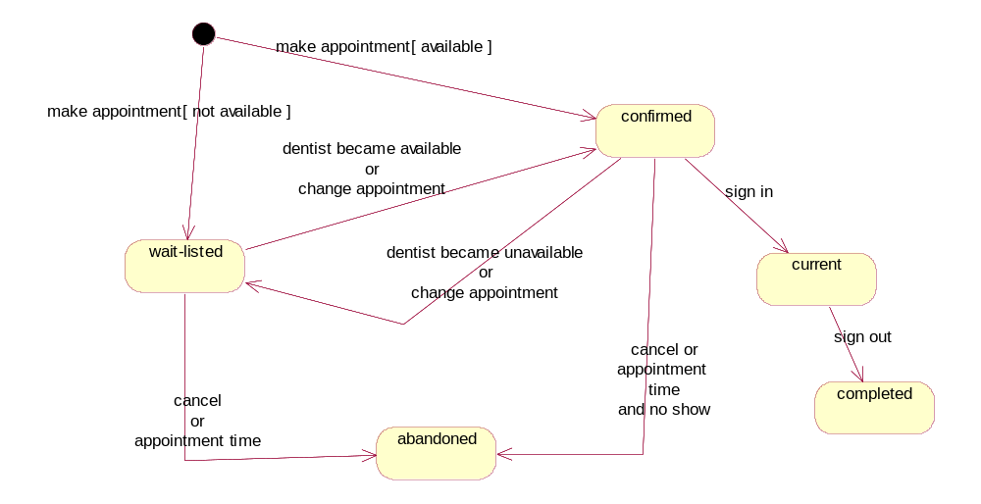
State Diagram of Dentist Appointment
Note: activity diagram is roughly a dual of a state diagram: bubbles as actions Vs. bubbles as states
event = action (completion)
guard = condition
Object not yet existing
(“initial state”)
state
States: confirmed, wait-listed, current, abandoned, completed
Events: make appointment, change appointment, sign in, …

Slide 40
State Definition Table and State-Event Table
Each state is similar to a Boolean attribute (or some “status” attribute, with implied constraints)
Each state should be derived from other attributes and associations
  A simple table (matrix) of states vs. other attributes and associations can be helpful
States should be distinguishable by the other attributes (otherwise why make them different states?)
State | Derivation Expression
confirmed | time > now and dentist <> null
wait-listed | time > now and dentist = null
current | time = now and signedIn
Each transition event should correspond, directly or indirectly, to some action
Consider all events in all states, even “non”-events e.g. not responded in 3 days (timeout)
A simple table of states vs. possible events helps find missing cases
State → Event ↓ | confirmed | wait-listed | current
Change appointment | Confirmed, wait-listed | Confirmed, wait-listed | NA
Dentist available | Confirmed | Confirmed | NA
Dentist unavailable | Wait-listed | Wait-listed | NA
Time out | Abandoned | Abandoned | NA

Slide 41
Exercise 5.3

Slide 42
Business Architecture – Some Guidelines
Structure business goals by asking Why and How
Always consider relevant domain properties influencing goal refinement
Focus on end goal and state change for every process or activity
Focus on states and transitions using state diagram
Support process behaviors, goals, and states with information model
Zoom in and out of roles, processes, activities, and goals
[Optional] Define reference process architecture from object lifecycles

Slide 43
Summary
This chapter has shown that:
Modeling business goals uncovers assumptions, alternatives, rationale
A reference business process can be systematically derived
Activity diagrams and state diagrams provide complementary views

