Slide 1
Chapter 6
How to Specify a Component’s External Properties
Black Box View of <System X>
This chapter describes how to specify an application or component from the “black-box” perspective i.e. the boundary of the box and any properties as seen from the outside.
It covers:
Defining the top-level Mapped Black-Box Assembly
Specifying Use Cases
  Identifying Use Cases from end-to-end scenarios and activity diagrams
  Building a Black Box Information Model: persistent state and inputs, outputs
Designing Use Case Steps
  Defining steps within a Use Case
Defining System Operations
  Operations from use case steps
  Specifying operations using Information Model
  Black box ports and connectors

Slide 2
MAp Viewpoints
Information supports goals, process
Process supports goals
Domain / Biz
Architecture
1
Outside
Domain: Information
Goals
Biz. Process
Goals – success criteria
Black box assembly includes S,
Supports business model
Traceability
Mapped Black box Assembly (including S)
1
S
Component Architecture
Black box Spec (of S)
S
E
D
S
1
2
S: Information
Boundary
Black-box Specification (of S)
4
S: Behavior
Architecture Styles: Principles, Patterns, Guidelines, Rules
3
Black box view of S
Architecture styles, patterns: across viewpoints, projects
White box view of S
sub-component s1…s3
Partitions behavior & information
1
2
S
S
Component Architecture
White box design (of S)
s2
Inside
s2
s1
3b
s1
s3
3a
s3
4
Information
Behavior
Each sub-component could be drilled-down if needed

Slide 3
Preview of Black Box Architecture
Domain Descriptions
Known standards, existing systems
All systems to interface with
Envisioned Software Boundaries
Business Architecture
(Goals, Information, Behavior,
+ End-to-end Scenarios)
Stakeholders
Sys
Mapped Black-Box assembly
Black Box Specification of <Sys>
Black Box Information Model
Black Box Behavior Model
Sys
Use cases
Use case U1
Actors …
Pre …
Post …
User does …
System does …
User does …
System does …
Sys
Use case abc
Goal …
Pre …
Post …
User does …
System does …
User does …
Roles
User
Business
Architect
Application
Architect
U1
U2
U3
Types for
system state and I/O
Operations from use case steps
Op1 (…) pre: … post
<<out>> Op2 (…) pre: … post
Use case diagram
Textual use case specs
Textual operation specs
Black box system assembly with ports
Sequence or Collaboration diagrams
Or text scenarios of system usage
Sys
Why do a Black Box Architecture?
To envisage a solution to the problem and specify the external behavior of the system in terms of how it interacts with its environment, so as to rationalize its internal architecture.

Slide 4



Steps to Black Box Architecture
Weather Stations
The ‘Machine’
Weather
Connections
Software
spec
Sensors
Electronics
The Software
Requirement:
Keep Watchers informed
of Current Weather
UI
Internal
Design
Watchers
Iteratively do the following validating with end-to-end scenarios
Define and validate Mapped Black Box Assembly
  Identify large-grained boxes – new and existing
  Assign responsibilities and needs by ownership of domain model
  Derive Black-Box assembly
  Validate with Scenarios and Snapshots
Black Box Specification (of one box)
  Define (for your black-box of interest) the Use Cases and Operations
    Derive use cases and actors (direct and indirect) from business process, goals, or brainstorm
    Specify each use case at level of pre/post condition as a single action
    Design the steps of the use case as lower-level actions
    Identify the Black Box Operations that will be invoked in those use case steps
    Define all the black box ports and connectors to outside actors
    Link use cases, actors from use case to activity and roles from business process
  Define the Black Box Information Model
    Use the Domain / Business Information Model as a starting point
    Decide parts in scope for the black box Vs. parts that are managed by other systems
    Include persistent and I/O types, software-specific types (sessions, preferences, etc.)
    Validate that the information model supports the use cases and operations

Slide 5
Black Box as Contract
Contract Name
The Development Agreement between Joe Inc. and Fred Ltd.
server
Interface
client
(b) Interface
Terms and Definitions
tested = …
correct = …
product = …
extension = …
horrible thing = …
Deal Making <<Interface>>
notional amount = …
total draw = …
total draw can never exceed ..
Information
Model
Body of Contract
…Joe Inc shall deliver a tested and correctly functioning product to Fred Ltd by the delivery date, subject to extensions. If he should fail to do so, then Fred Ltd can do many and various horrible things to Joe...
Amend Deal (amendment)
Pre: amendment leaves notional amount > draw total
Post: amendment done
Behavior
Model
Draw Down
Pre: provided draw total will not exceed notional amount
Post: the draw is completed
(a) Legal Contract
(c) Interface Contract

Slide 6
Define and Validate Mapped Black Box Assembly
This section covers:
Defining a Mapped Black Box Assembly
We will build a Dental System that will work with
  Insurance System
  Vacation Calendar application
  Dentists, Patients, Schedule Operator

Slide 7
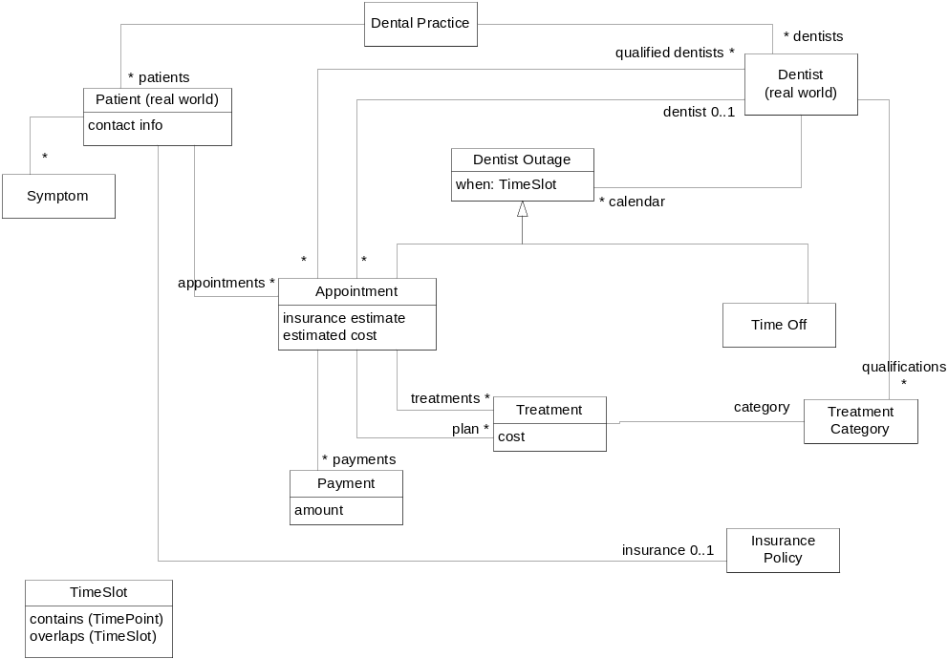
Mapped Black-Box Assembly
(Work out example on next slide)
Which elements of the domain model are owned by (i.e. authoritative source)
  Patient (real-world)
  Dentists (real-world)
  Vacation Calendar
  Dental System
  Insurance System
  (You may need to refine domain model to show ownership)
If ownership is split at the type or attribute level, split the element and introduce new finer-grained ones
Mark <<cross-system>> associations
  Ultimately we will want clear ownership of these as well: indicate by arrow
Which external elements have copies explicitly represented in the Dental System
  Add accuracy goal between software elements and domain counterparts if needed
Do not use subtype relations across system boundaries – replace by associations
System-1
Intended Ownership
System-2
A
C
D
B
UML notation
System-2
System-1
A
C
B
<<cross-system>>
D
Text / Tabular notation …

Slide 8

Students – Mark Up Notes With Instructor
Patient (SW)
Insurance System

Slide 9
Exercise 6.1

Slide 10
Specifying Use Cases
This section covers:
Building an Actor/Use-Case Diagram
Specifying a Use Case

Slide 11
Use Cases
Use case from activity
Actor from Role in Activity Diagram
Actor
Dental System
Use Case spec
Patient
remind appointment
browse schedule
Dentist_
Use case
Spec
Use case: make appointment
Trigger..prohibit..pre..post
Use case: make appointment
pre … post …
Use case: make appointment
pre … post …
make appointment
schedule time off
System
as focus
System does …
Scheduler does …
System does …
Patient does …
Schedule does …
System does …
Design
Patient does …
Schedule does …
System does …
plan treatment
make appointment
Use Case design
Billing System
Scheduler
do payment
Indirect participation in make appointment
Patient does not directly interact with system
but is within “outer” scope of problem / goals
InsuranceCo
do payment
Use case diagram: name, primary and other actors participating in each, included use cases
Use case textual specification adds
  Inputs and outputs, precondition and postcondition (successful outcome), other information
Use case step design adds (still at the black-box level, and still deferring UI specifics)
  Steps of use case, alternate and exception paths

Slide 12
Link from Black Box to Business Model
Preferably
  One use case corresponds to one business activity or interaction
    Use case <<include>> (later) can be used to show multiple activities if needed
  Use case actors include the business roles in that activity or interaction
  Simply name the use case and actors based directly on the business model
If not, document in a table
  For each use case, all business activities that it supports
  For each actor, how it corresponds to the business roles

Slide 13
Use Case Spec – Expanded
Dental System
Use case: make appointment (on Dental System)
Actors: Patient, Scheduler, Billing System, InsuranceCo
Inputs: patient info,dates,symptoms (from Patient→Scheduler)
insurance info (from InsuranceCo via Billing System)
Outputs: treatments (to InsuranceCo via Billing System)
appointment info, cost, dentist (to Patient via Scheduler)
Goals: Which goals this use case supports
Trigger: Patient calls for appointment
Precondition: None
Postcondition:
  System recorded new appointment on date for patient, suitable dentist for planned treatment and patient preferences. System requested insurance coverage for patient and planned treatment from Billing System and recorded estimated costs based on it. All appointment info was returned to Scheduler.
Spec
Patient
remind appointment
browse schedule
Dentist_
make appointment
schedule time off
make appointment
plan treatment
Billing System
Scheduler
do payment
make appointment
InsuranceCo
do payment
Steps:
…
…
Specification of post-condition should include:
change of state of the “system”
any requests made by system to outside actors
any returned information from the system

Slide 14
Use Case Specification abstracts step details
d: Dental System
Defers interaction dialog of steps
  Detailed effect of each step deferred
  Abstracted and rolled-up into overall use case pre/post
Defers protocol of information exchange
  Each step information exchange deferred
  Abstracted and rolled-up into use case ins/outs
Discuss: What are the ins/outs of the editor “Cut” use-case? What is the detailed protocol of information exchange?
Patient
Scheduler
make appt (p,d,s)
lookup patient
check calendar
create appt
get coverage(p,t)
validate (p)
lookup policy(p)
coverage(p,t)

Slide 15
Granularity of Black-Box Application Use Case
Define lowest level use-cases at the granularity of
  An interaction which meets a meaningful goal of the initiating actor
  A single short session with the black-box application (minutes to hours)
  An interaction which is a meaningful business transaction (in that domain)
  Place an order: good use-case granularity
  Login to system: not good granularity
    OK to define it as a use case, but …
    Include a meaningful higher level use case that includes login
  Add line item: not good granularity for use case, OK for a step
But … Use case spec, step, and system operation are just relative terms
Explore the steps and alternate paths of the use case, but …
  Step back and specify the net inputs, outputs, and pre/post conditions
Typical reasonable range of use case steps is 3 - 12 steps

Slide 16
Formalizing a Use Case Specification
Dental System <<type>>
Persistent attributes of Black Box
+ Input/Output Types
Use case specification
(+ Design + System Operations)
The use case specification should be expressed using the terms of the Black Box Information Model
  This is a model of the Black Box System, its persistent attributes, and I/O types
  The starting point for this is the Domain Model (Information)
OK to elide some specifics of input/output types at this point
  Specification of system operations from use case design can be more precise

Slide 17
Focus the Information Model for Use Case Specs
Focus is the black box system
Dental System
+patients
*
*
*
*
+dentists
Patient
*
+preferredDentist
*
*
*
Dentist
name : String
+calendar
State of the system
(driven by use case spec)
address : Address
DentistOutage
*
when : TimeRange
+candidates
*
fix teeth()
*
1
+subject
*
+dentist
1
0..1
0..1
+appointments
*
Treatment
*
Plan
Appointment
+schedule
when : TimeRange
estimated cost
*
*
PatientRec
+qualifiedFor
*
+planned
*
+actual
*
*
TreatmentCateg
AppointmentRec
*
Treatment
ory
*
cost : Money
cost information
Use case: make appointment (on Dental System)
Actors: Patient, Scheduler, Billing System
Inputs: patient info, date, treatments
Outputs: appointment info with cost and dentist
Precondition: None
Postcondition: An appointment on date created for patient
with suitable dentist for planned treatment and patient preferences.
Insurance and cost estimates agreed with patient and recorded in system.

Slide 18
Exercise 6.2

Slide 19
Designing Use Case Steps
This section covers:
Defining use case steps
Exception and alternate paths

Slide 20
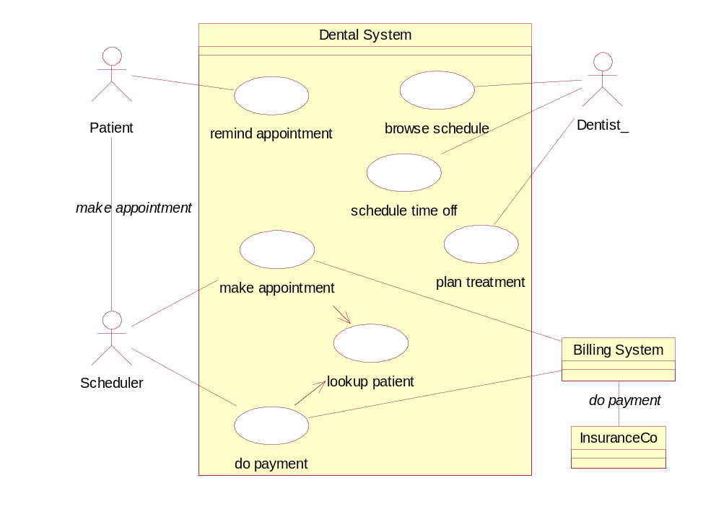
Use Case Design – Expanded
Use case: make appointment (on Dental System)
Actors: Patient, Scheduler, Billing System
Inputs: patient info,date,symptoms (from Patient via Scheduler)
insurance info (from InsuranceCo via Billing System)
Outputs: treatments (to InsuranceCo via Billing System)
appointment info, cost, dentist (to Patient via Scheduler)
Trigger: Patient calls for appointment
Precondition: None
Postcondition: An appointment created on date for
patient, suitable dentist for planned treatment
and patient preferences. Insurance and cost
estimates agreed and recorded in system.
Spec
Main (success) steps:
Patient calls Scheduler for appointment
Scheduler: include look up patient
Scheduler enters symptoms and date
System queries insurance info from Billing System
System: include estimate patient cost
System provides appointment, plan, staff, insurance, cost
Scheduler discusses with patient and confirms
Alternate paths:
2. Patient not found: …
Design
one use case “includes” another in its steps (or its “spec”)
use case lookup patient
Actors: Scheduler
…
use case estimate patient cost
post: …
Included use cases also have specs and/or step-level designs.

Slide 21
Step Details: Iteration, Alternatives, Exceptions
Use case: make appointment
Patient calls Scheduler for appointment
Scheduler: Include look up patient
Scheduler enters symptoms and date
System queries insurance info from Billing System
System provides appointment with plan, staff, cost
Scheduler discusses with patient and confirms
Main use case steps focuses on primary “success path”
  Iteration, grouping, concurrency … described informally with steps using step numbers:
  … Scheduler repeats steps 3-5 until satisfactory dates are found
Alternate paths are named and refer to step numbers in main path
  Alternate paths:
  #2. Patient not found:
  1. Scheduler: include setup new patient before continuing
  #4. Billing System not available:
  1. System detects and signals failure to communicate with Billing System
  2. Scheduler informs patient and manually estimates cost
  *: System Failure (At any time the System fails):
  1. Scheduler: include restart system, log in, and recover prior state

Slide 22
Elaborate Information Model from Steps
Dental System
+patients
*
*
*
*
+dentists
Patient
*
+preferredDentist
*
*
*
Dentist
name : String
+calendar
address : Address
DentistOutage
*
when : TimeRange
+candidates
*
fix teeth()
*
1
+subject
*
+dentist
1
0..1
0..1
+appointments
*
Treatment
*
Plan
Appointment
+schedule
when : TimeRange
estimated cost
*
*
Steps will further
clarify input and
output types
(UI or API
will go further)
PatientRec
+qualifiedFor
*
+planned
*
+actual
*
*
TreatmentCateg
AppointmentRec
*
Treatment
ory
*
cost : Money
cost information
Patient calls Scheduler for appointment
Scheduler does lookup patient with System
Scheduler enters symptoms and date
System queries insurance info from Billing System
System provides appointment,plan,candidates,cost
Scheduler discusses with patient and confirms
Alternate paths:
2. Patient not found:

Slide 23
Overall Use Case Writing Guidelines
Use case specification
  Name a use case by the goal of the primary actor, or the outermost trigger
    Make appointment
  List all actors involved
    Scheduler, Billing System
  Summarize effective inputs and outputs to/from each actor to the System
    Patient Info, Dates
  Write the precondition for this use case to happen (and trigger, prohibition)
    Order Agent is already logged in
  Write down the postcondition for on successful use case completion
    A new Appointment has been …
Use case steps
  Write each step as actor … action … [with actor | other phrase]
    System queries insurance information from Billing System
  Avoid too detailed or intra-actor sequencing
    Avoid: “System prompts for name, user enters name, system prompts…”
  Avoid UI specifics
    User clicks on OK button → User confirms selection

Slide 24
Exercise 6.3

Slide 25
Defining Black Box System Operations
This section covers:
Finding System Operations
Specifying System Operations

Slide 26
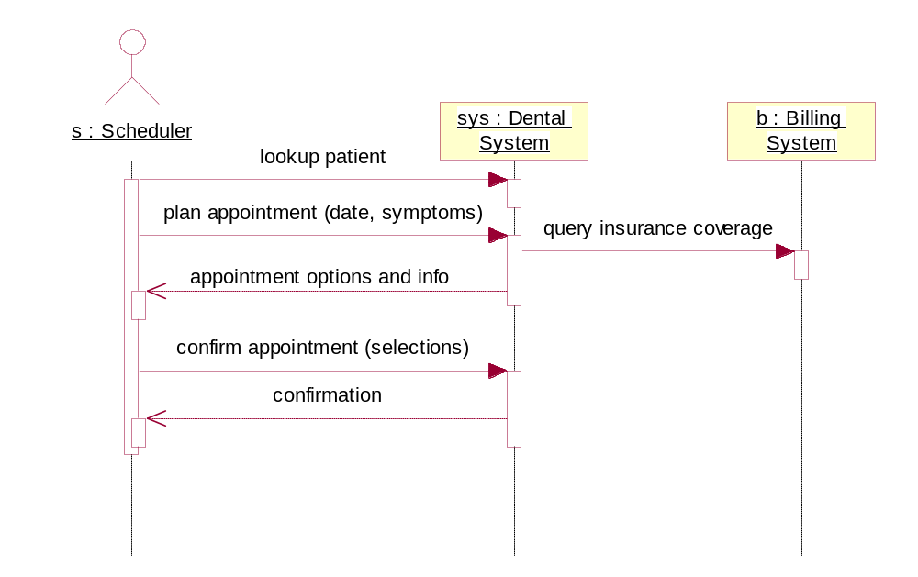
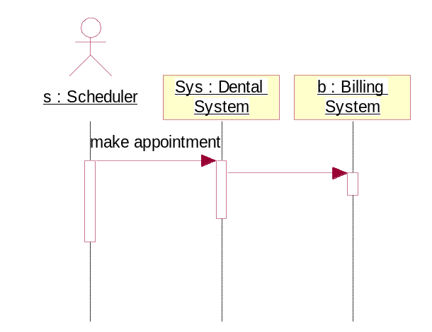
From Use Case to System Operations
Use case: make appointment
Patient calls Scheduler for appointment
Scheduler includes look up patient with System
Scheduler enters symptoms and date
System queries insurance info from Billing System
System provides appointment with plan, staff, cost
Scheduler discusses with patient and confirms
Make
appointment
A use case defines a complete unit of interaction with the system
The use case steps hint at “operations” called on the system or by the system
  Operations can be API level, or can still abstract more detailed interaction protocol
Scenarios and sequence diagrams can be explored at either or both levels
A use case or a use case step could correspond to several system operations

Slide 27
Finding System Operations
For each step in a use case
  Identify any operation(s) invoked on the system
    With any input data provided as parameters and any returned values
  Identify any <<out>> or <<event>> interactions out of the system to other actors
    With any data provided and returned from those calls out
    A <<out>> method call is a service requested, with some expected response
    An <<event>> is an outgoing notification, without any expected response or handling
  Check that the information model defines the types and attributes required
Summarize as
  All operations the system must support: operation (…)
  All operations required from other actors: <<out>> operation (…)
  All events raised by the system to other actors: <<event>> event (…)
Write out the specification of each non-trivial operation
  Name, Input parameters, Return values
  Precondition: what should have been true at the start of this operation was invoked
  Postcondition: what should be the resulting state and any outputs upon completion
    State-changing <<out>> operations might need a model of state of the external actor
    e.g. <<out>> put(x) followed by <<out>> get():x requires model of state of putter/getter
  [Exceptions]

Slide 28
Operations Example
Make appointment
System Operations:
Lookup patient ()
Plan appointment ()
Confirm appointment ()
lookup patient (id: Patient Identification): Patient Info
find the patient based on patient identification
post: returns the patient whose identification matches id
plan appointment (p: PatientID, symptoms: Set(Symptom), dates: Date Range)
: Set (Appointment)
return set of Appointment options which meet patient treatment plan, symptoms, and desired dates, with a suitable dentist and cost estimate
post: returns multiple appointment options
  with time within dates
  with a treatment plan based on symptoms and existing treatment for that patient
  with a dentist who is a candidate for that appointment and is available at that time
  with cost estimate based on insurance information from the billing system

Slide 29
Exercise 6.4

Slide 30
Finding Supporting or Missing Use Cases
It is easy to overlook some use cases and actors if domain model and black-box assembly map is not well done
For each type in the Information Model, ask
  What event in the domain would cause a new instance of that type to exist?
  What use case creates a new instance of that type?
  What use cases remove it?
  Dental System: what creates patient, dentist, treatment category?
    Sometimes “hardcoded” into code or configuration files, with no run-time use cases
For each attribute or association, ask
  What event in the external world would correspond to a change in that attribute or association?
  What use cases could set or modify that attribute or association?
For each use case, ask – What if the use case was abandoned somewhere in between?
For each actor, ask – What sequence of its use cases would make sense? What would they accomplish?
What this uncovers
  missing use cases: there should be a use-case for managing that type, or different use-case path
  external shared “reference data”: that type ownership belongs elsewhere, we may cache the info
  initialization or other lifecycle requirements: that type is instantiated at startup
Do not document purely CRUD use cases in detail
  If you must mention, simply annotate information model types with <<crud>>

Slide 31
[Optional] Exercise 6.5

Slide 32
Black Box Assembly with Ports and Connectors
Each connection to an external actor can be summarized as
  a “Port” on the black box
    With a list of incoming operations, <<out>> outgoing operations, <<event>> events, etc.
  a “Connector” to the corresponding external actor
    If another system, connector actually connects to a particular port on that system
Port is like an Interface
  Generalizes UML1.x “Interface”; more directly supported in UML 2.0
  Specified like a Type
Could have been called ~P3 if it is exact dual of P3
P1 <<port>>
op1 (x, y)
op2 (a, b)
<<comp spec>> Comp Name
<<comp spec>>
Actor
P1
P2
P2 <<port>>
<<out>> m(x)
<<out>> n()
<<event>> e(t)
P3
Abbreviated form of ports
Expanded form of ports

Slide 33
Dentist Black Box Assembly
Make appointment
Change appointment
Cancel appointment
Make payment
<<out>> Check availability
Manage vacations
Check availability
<<comp spec>>
Dental System
Patient
Scheduler
Appt
<<comp spec>>
Vacation Calendar
Dentist
<<comp spec>>
Insurance System
<<out>> Estimated Coverage
<<out>> Submit Claim
Pay Claim
Estimated Coverage
Submit Claim
<<out>> Pay Claim

Slide 34
Defining “Other Properties” of the Black Box
There are other properties (including non-functional and technical) that are visible from the outside of the black-box
MAp allows such other properties to be described on the black box
  Technical properties of ports and connectors
    Communication, data formats, specific technical infrastructure elements used and how configured
  Performance properties
    Expected timeliness of information and timeliness guarantees
    Response times, throughputs, transaction rates (see Transactions below) under different load conditions
  Transactions
    Transaction scope – existing transaction expected with operation requests? new transaction guaranteed?
    Isolation levels – visibility of uncommitted data: lost updates, dirty reads, etc.
  Security
    Roles, identities, entitlements and access control: information expected, guarantees made
  Deployment / Location
    Relevant geographic or network regions and properties for components and actors
    Relevant properties of connectors

Slide 35
Exercise 6.6

Slide 36
Black Box Architecture – Some Guidelines
Black-box assembly: include context to end-points of goals
  E.g. Source of information being entered by Scheduler is the Patient
  “Real” requirement is to make appointment for patient
  “End-to-end” scenarios should span the entire assembly
For a use cases, include at least immediate context of target black-box system
  E.g. Scheduler entering information into system, other external systems
Consider longest-lifecycle business activity and then finer-grained ones
  E.g. Patient does a complete visit, from appointment to final payment
Define clear responsibilities of system and external actors
  Include information exchanged, change of state, external communications
Focus business information to black box information model
  What information does it provide, require, and remember?
Validate with selective scenarios

Slide 37
Summary
This chapter has shown that:
The definition of software boundary and services is a creative process
Black box specification is based on use cases and underlying operations
  Use cases are derived from business architecture – goals, processes
  Use cases are specified by end result, designed as sequence of steps
  More detailed system operations emerge from the steps of a use case
All behavior is described in terms of the Black Box Information Model
  Includes persistent attributes of the system and input/output types
The Business Information Model forms the basis for the Black Box Info Model
The Business Goals & Process Model is basis for the Use Cases

