Slide 1
Chapter 7
How to Design a Component’s Internal Architecture
White box View of <System X>
This chapter describes how to design an assembly of smaller black box sub-components to meet a larger black box component specification, while managing dependencies between the sub-components.
It covers:
Draft a partition into sub-components
Design sub-component collaborations
Define sub-component assembly
Specify each sub-component

Slide 2
MAp Viewpoints
Information supports goals, process
Process supports goals
Domain / Biz
Architecture
1
Outside
Domain: Information
Goals
Biz. Process
Goals – success criteria
Black box assembly includes S,
Supports business model
Traceability
Mapped Black box Assembly (including S)
1
S
Component Architecture
Black box Spec (of S)
S
E
D
S
1
2
S: Information
Boundary
Black-box Specification (of S)
4
S: Behavior
Architecture Styles: Principles, Patterns, Guidelines, Rules
3
Black box view of S
Architecture styles, patterns: across viewpoints, projects
White box view of S
sub-component s1…s3
Partitions behavior & information
1
2
S
S
Component Architecture
White box design (of S)
s2
Inside
s2
s1
3b
s1
s3
3a
s3
4
Information
Behavior
Each sub-component could be drilled-down if needed

Slide 3
Preview of White Box Architecture
Black Box Architecture
(Use cases, scenarios,
operations, Information Model)
Creative design partition
Architectural styles and patterns
Design trade-offs and considerations
Decoupling and maintainability
Sub-Component Specs
Sub-Component Assembly
For each sub-component
B
A
A
C
B
A
<<ev>>
<<ev>>
C
Roles
Business
Architect
Application
Architect
Technical
Architect
Sub-components with ports, connectors
Types for sub-component state + I/O
Patterns
Sub-Component Collaborations
Patterns
White Box Styles (Including Connectors Types)
Port 1
Op1 () …
Event 2() …
1: x()
For each black-box operation or use case
Port 2
Op1 () …
Event 2() …
m()
:A
Port 1
Op1 () …
Event 2() …
1: x()
1.1: y()
2: z()
1: x()
:B
1.1: y()
op1
1: x()
1.1: y()
m
:A
Specification of every operation,
event, etc. on each port
m
2.1: x()
2.1: x()
2: z()
2.1: x()
2: z()
:C
2: z()
2.2: w()
2.2: w()
2.2: w()
Collaboration or sequence diagrams
Why do a White Box Architecture?
To design sub-components that collaborate to provide required behaviors
To separate logical components and interactions from technical ones

Slide 4
WARNING !! Black-Box and White-Box Dangers!
The terms Black-Box and White-Box sometimes lead to confusion
  Should I deliver the white-box?
  Should I demand the black-box?
Always be explicit in all usage of the terms
  This is the Black-Box View of Component-A
    Consisting of these ports with behavior specs and information model
  This is the White-Box View of Component-A
    Consisting of these sub-components A1, A2, A3
    With these (black-box view) specifications of A1, A2, A3
    With these connectors between them
A
a1
a2

Slide 5
Note: Architecture = Non-Local Decisions
A
a1
a2
What constitutes “architecture” at any level of black boxes?
Any decision which is “Non-Local” is architecture at that level
  It concerns interfaces, connections, rules, scenarios that span a1, a2, …
  Expanding the boundary of A requires re-validating that decision
Any decision which is “Local” is not architecture at that level
  If satisfied by a1, it cannot then become “unsatisfied”
  Expanding the boundary of A does not affect it

Slide 6
Steps to White Box Architecture
Choose applicable architecture styles for white box
  Including connector styles (we assume simple call and event connectors here)
Draft a partition into candidate sub-components
  Partition black box information model to get information-cluster components
  Introduce behavior centric coordination components for use cases
  For existing components or vendor packages to be used build “just-enough” models of them
Design collaborations across sub-components
  Use the Black Box operations as a starting point
  Design collaboration between sub-components to meet spec and maintain invariants
  Validate with scenarios (including performance concerns) and re-factor the partition
  Use executable tests with stubs where possible
Define Sub-Component Information Model
  Derive the information that is managed and exchanged by each component
Define Sub-Component Assembly
  Show all sub-components, named ports with operations, events, connectors
[Optional] Specify each sub-components and connector used in assembly
  All operations, events, etc. at all ports of each sub-component

Slide 7
Draft Sub-Component Partition
This section covers:
Information-cluster components with core type analysis
Behavior/coordinator components from use cases
Other heuristics
Note:
  There are many different styles of partitioning sub-components
    Workflow, n-tiered, co-ordinator based, federated vs. centralized information, …
  Each is applicable in different situations
    Nature of problem, non-functional requirements, existing components … all have an impact
  This course teaches a few specific heuristics and styles, and mentions others

Slide 8
Information Cluster Partition based on “Core” types
Identify “core” types – they typically satisfy these heuristics
  Can easily be uniquely identified in business terms and business identifiers
  Have associations to (owned) detailing types, with constant “1” at core end
  Often need an association from the “top” type which has just one instance
  Do not have mandatory (always 1) associations to other types
    unless they are classifying types: classifying types serve primarily to categorize or group objects of another type e.g. Book Title vs. Book Copy
    but be prepared to bend this heuristic to further partition and de-couple e.g. distinct lifecycles
Ignore derived associations and attributes and ignore the “top” system type
  separately consider whether derived attributes merit a calculation-centric component
Consider further separating objects that have distinct and complex lifecycles (with their dependent types) and also treat a “core” types
Consider finer-grained ownership at the attribute level rather than type, if needed
Mark such types as «core»
Treat types whose existence is dependent on a core type as ‘detailing’
  Will typically have a constant “1” association to owning type from dependent type
  Sometimes might need to break a tie and assign to one core type

Slide 9
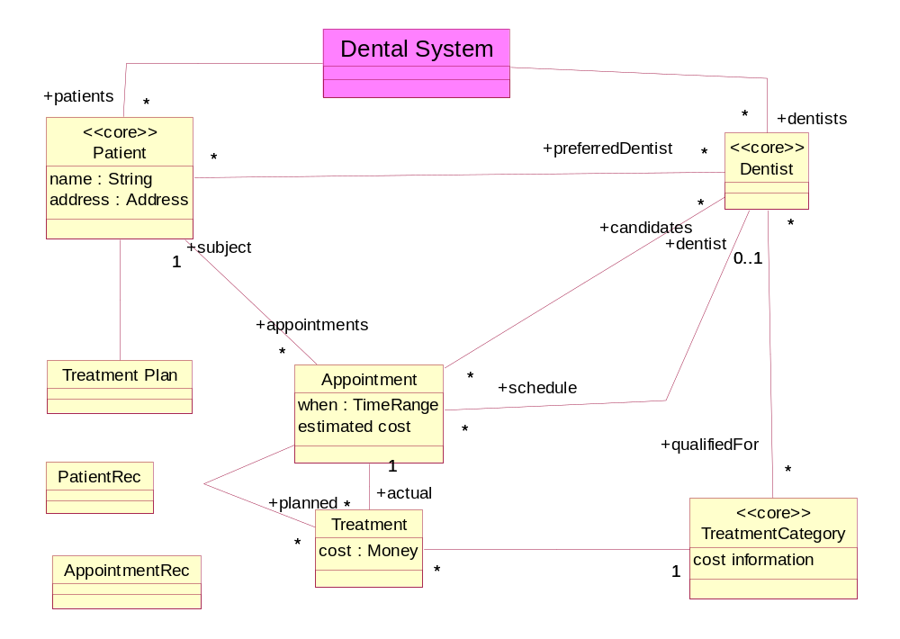
Core Type Analysis - Example
*
We have simplified the black box model somewhat e.g. removed time off and Dentist Outage supertype

Slide 10
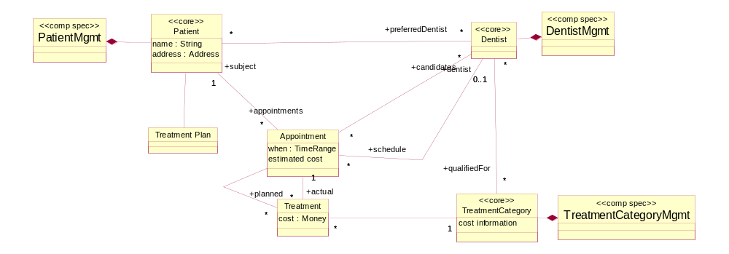
Assign Core Types to Initial Components
Introduce a component to manage each “core” type (and its detailing types)
  Components marked with «comp spec» for component specification
  More advanced: analyze cross-component invariants, split attributes across components
Show assignment by UML “composition”
*
*
*

Slide 11
Assign Initial Direction to Associations
When types managed by separate components have cross-component associations
  We need to decide which side will be the golden source of the links
  Bi-directional dependencies, particularly without clear master, are not encouraged
  Replication & caching is treated separately, once there is a clear golden source
Select one side to be the owner of the relationship
  Anticipate likely direction of frequent navigation (validate later by collaborations)
    e.g. Derived attributes may need navigate assoc. to “push” changes or to “pull” and re-compute on demand
  Indicated by putting a “navigability” direction on the association
*
*
Directionality equally useful at black-box assembly
*

Slide 12
Result of Initial Core Type Partition
A set of initial components
The information model managed by each component
  Core types, detailing types, cross-component association direction

Slide 13

Other partitioning heuristics for Sub-Components
Introduce component to co-ordinate the interactions for each use case
Introduce a sub-component for each black box port to adapt to that port view, format, etc.
Finer-grained partition by analysis of the life-cycle of objects
  If one object lifecycle spawns others with loosely-coupled lifecycles, use separate components
  E.g. Appointment lifecycle within Patient lifecycle?
Partition to depend more on stable components than unstable ones
Introduce computational component e.g. compute derived attributes, associations
If you find variability in behavior, encapsulate variability within a stable interface
  Add a component which hides that variability behind an unchanging interface
Invent generic reusable business service components – tax calculator, calendar
Goals model: align components with sub-goals and with corresponding domain ownership
Informal, intuition, experience, educated guesswork

Slide 14
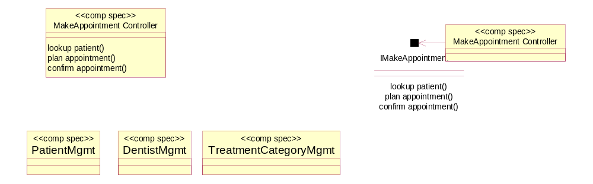
Add Use-Case Supporting Components
Introduce a component to support system operations of each use case <U>
  If too many use cases, use a «port» per use case on one single «comp spec»
  Typically name that component something like <U>Controller, <U>Coordinator
These components will be the “receivers” of the external requests
  Via some GUI or other connection to the outside actors …
  Result in some interaction with and between the other components, internal & external
use case controller

Slide 15
Component Tiers
operations of use case
Black box
UI
dialog
“Core” type
(Entity)
Services
Use case
Ctrlr 1
“Core” type
(Entity)
Services
UI
dialog
Use case
Ctrlr 2
Make appointment
Dialog
Make appointment window and dialog state with current patient, dates selected, etc.
Steps:
System does …
Scheduler does …
System does …
Operations of use case:
Lookup patient ()
Plan appointment ()
Confirm appointment ()
Use cases steps, interim state, and transactions map to white-box tiers
  User Interface and dialog state for use case steps, invoking …
  … System operations required by the steps of the use case, realized by utilizing …
  … … Further partitioned clusters of business types

Slide 16
Exercise 7.1

Slide 17
[Optional] Workflow Based Component Architecture
When you have one <<core>> type cluster where many instances of the core type go concurrently through phases of a lifecycle
  an Appointment goes through a lifecycle
It can be useful to design the insides of the <<core>> type component with sub-components to perform processes in a workflow, if “flow” is highly variable
  Ports acts as sources and sinks for stream of uniform data type
  New connector type represents queue of instances awaiting processing
  A workflow manager who co-ordinates the flows based on events and state conditions
One component for each major state transition on the core type
  Components AppointmentMaker, AppointmentChanger, AppointmentCloser
This architecture style can be applied recursively
Coordinator
Appointment Manager
Coordinator

Slide 18
Design Collaborations across Sub-Components
This section covers:
Designing collaborations across sub-components
Collaboration Vs. Sequence Diagrams

Slide 19
White Box Collaborations – Starting Point
Dental System
Make
appointment
Billing
System
Operations:
lookup patient
plan appointment
confirm appointment
Start with a use case and all the operations from its steps
For the significant operations
  study the operation specification
  design end-to-end interactions across sub-components so that
    operation post-condition is met
    all external interactions are completed
Cover use case normal and exception paths
Validate end-to-end scenarios from business and black box architectures
Re-factor partitions and responsibility, making interfaces generic

Slide 20
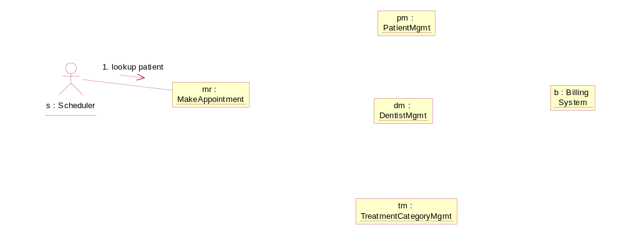
Make Appointment: Lookup Patient
(UML Collaboration/Communication Diagram)
parameter name
2. r1 := lookup patient (pi): Patient
r :=
(pi: PatientInfo)
same pi
returns r1
returns r
(derived from r1, pi, persistent state)

Slide 21
[Optional] UML Collaboration/Communication Diagrams
* Means repeated; *|| means repeated concurrently
formal or informal definition of repetition
R := M (x,y)
C :Sub Component 1
1*:[for all I] r1 := M1 (p, q)
:Sub Component 3
2 A: [condition] B := M2 (r, s)
:Sub Component 2
1.1: r2 := M11 (t,u)
<<new>> is
dynamically
created by
“Create” msg
<<new>>
:Sub Component 4
[ ] Means conditional
A is thread name; 2 A, 2 B, 2C … done in parallel
Called after 1, must complete before 3
Nested numbering for sequence of operation invocations
Each operation M (x, y) on a sub-component C specified by:
  Sequence of invocations from C in response to operation invocation M
  Relationship between x, y, and initial state of C → p, q, r, s
  Final state + final returned values of C in terms of x, y, initial state, A, B
Note: MAp Interpretation shows sequence, not hard-coded method calls
  We will separately choose types of connectors and ports on components

Slide 22
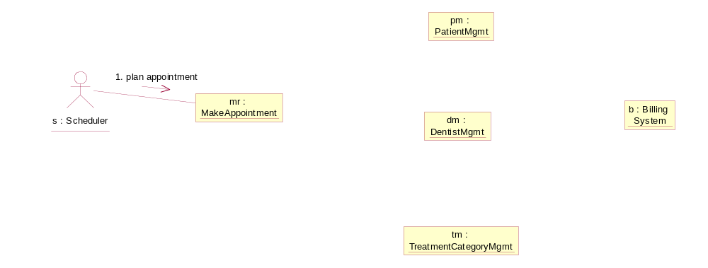
Make Appointment: Plan Appointment
plan appointment (p: PatientID, symptoms: Set(Symptom), dates: Date Range)
: Set (Appointment)
return set of Appointment options which meet patient treatment plan, symptoms, and desired dates, with a suitable dentist and cost estimate
post: returns multiple appointment options
  with time within dates
  with a treatment plan based on symptoms and existing treatment for that patient
  with a dentist who is a candidate for that appointment and is available at that time
  with cost estimate based on insurance information from the billing system
2: treatment := next treatment (patient, symptoms)
options :=
(patient, symptoms, dates)
3 A. coverage := get coverage (patient, treatment)
3 B: set of dentist-dates := get available & qualified dentists (treatment, dates)
sc: Scheduler
May add these for availability, qualification, vacation, etc.

Slide 23
Exercise 7.2

Slide 24
Collaboration versus Sequence Diagrams
Collaboration and sequence diagrams are alternate diagrams of interactions
Collaboration style helps build up “overlays” to get to the assembly definition
1.1 …
Collaboration
:Sub-2
1: y := a(p,q)
Confirm
appointment (sel)
:Sub-1
:Sub-4
:Sub-3
2: z := a(y)
2.1:…
3: record(z)
2.2:…
:Sub-1
:Sub-2
:Sub-3
:Sub-4
Confirm
appointment (sel)
y := a(p,q)
…
z := a(y)
etc.
Sequence
…
…
record(z)

Slide 25
[Optional] Active Objects and Asynchronous Messages
UML supports asynchronous messaging
  Does not wait for a return
  Shown in interactions with one-sided arrowhead (1.x) or stick arrow (2.0)
  Both passive and active objects can send asynchronous messages
UML has “active objects” with dark borders (1.x) or double bars (2.0)
  Maintain their own thread of control
  Only active objects can receive asynchronous messages
Ob-1:
Ob-2:
Ob-2:
asynch(a)
asynch
synch

Slide 26
Cross-Component Invariants and Interaction State
Consider invariants or consistency goals that cut across sub-component boundaries at the white-box level e.g. consistency constraints desired at the black-box level that are now partitioned across sub-components
Handle with care to ensure consistency across multi-step updates, specially in the presence of failures. Consider a range of potential solution approaches:
  Distributed cross-component transactions – transaction coordinator with 2-phase commit of local atomic transactions
  Retry of failed portions of transactions, or retry-all semantics (assuming duplicate of a previously successful request are harmless)
  Compensating transactions – simple local transactions with compensating (“undo”) transactions
  Acceptable tolerances for incomplete or imperfect ACID guarantees
  Consistent creation and propagation of transaction context on all calls, including nested calls
A state model (or activity or sequence diagram) of the interaction as a unit and/or each participant, with state changes and invariants for key states, can help to understand the interactions and failure modes and to design an appropriate protocol.
update 1
update 2
update 3

Slide 27
Modeling Interaction Transaction State – Example
Coordinator / Interaction
Participant
sent update request to all
receive update request /
log & send confirm
receive update request /
send failure
can do
(with state invariant)
receive abort request /
rollback
received confirm from all /
send commit to all
received failure from any /
send abort to all
receive commit request /
commit
failed
(with state invariant)
succeeded
(with state invariant)
failed
(with state invariant)
succeeded
(with state invariant)
With suitable state changes and state invariants = 2-phase commit protocol
Other variants might include re-try, compensating (‘undo’) transactions, etc.

Slide 28
Define Sub-Component Assembly
This section covers:
Basic Connectors
Building an Assembly Model

Slide 29
Assembly Combines Collaborations
One collaboration shows the interaction resulting from one trigger
An assembly is a summary of component interconnections
Combines all collaborations into ports and connectors, elides sequencing
Sub-2
Connector
Sub-1
Sub-3
Sub-4
Port A
Sub-2
Sub-2
Sub-1
Sub-4
Sub-1
Sub-3
Sub-4
Sub-3
Sub-2
Component
Port
Sub-1
Sub-3
Sub-4
Why do we need “connectors”?
  Each component need be specified only from port to port i.e. it is encapsulated
  For collaboration, we rely on at least a basic “call” connector for communication
  We ultimately would like a library of connectors: call, events, adapting, replication, …

Slide 30
Connectors and their Specifications
To use a connector in the white box assembly, we must know it’s spec
  Documented in a connector specification and used as a stereotype or pattern`
if no annotation, assume simple “call”
P1
P2
call connector
spec (trivial)
“<<out>> m1() call at P1 become in m1() call at P2”
«event-method»
P1
P2
event-method
connector
spec
“When P1 <<event>> e raised, the corresponding P2 method m() is executed
with event attributes mapped to method parameters
Using a connector means:
  connecting it to appropriate ports
  configuring it if necessary: e.g. which events to which methods, how to map attributes to parameters
It is possible to have richer connector types: synchronizing, replicating, etc.
Each connector type could have many different platform realizations
Platform realizations are described in Technical Architecture

Slide 31
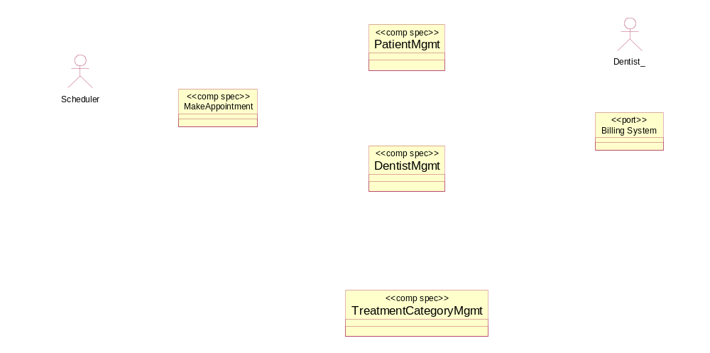
Assembly Example
Assembly shows
  External actors / ports
  Internal sub-components
  All connectors between them
<<event>>
visitDone (treatment)
lookup patient (…)
next treatment (…)
<<event-method>>
charge insurance (..)
get_coverage (..)
get available & qualified dentists (…)

Slide 32
Exercise 7.3

Slide 33
Specify Sub-Components
This section covers:
Specifying each sub-component

Slide 34
[Optional] Sub-Component Specifications
Port A
Sub-2
Sub-1
Sub-4
Sub-3
Port B
A sub-component spec does not refer to other sub-components
  It just refers to its ports
For each sub-component
  What is all information exchanged [at each port]
  What is all information remembered [at each port]
  What are logical specs for all behaviors [at each port]
    Include required interfaces/ports for operations required
    Include inputs, outputs, state changes, exceptions
Sub-1

Slide 35
[Optional] Operations and Event Specifications
Operations
Simple operations – change component state and return result
  Specified by operation signature and pre-condition / post-condition
Complex operations – require interaction sequences with other components
  Specified by
    Operation signature
    Collaboration diagram with component as main “focus”
    Pre-condition / post-condition that includes variables used in interaction sequence
  Will often require analysis of transaction properties
Both cases can include separate exception specifications
Events
Events raised: specified by
  explicitly including [raise eventName] in all applicable operation specs, or
  implicitly specifying event eventName using
    pre / post condition
    to define the state change that will raise that event
    implicitly specifying all operations that cause that state change

Slide 36
[Optional] Specifying Simple Operations
Simple operations – change component state and return result
  Operation signature and pre-condition / post-condition
A Sales Manager component with startSale, addItem, endSale
  startSale ()
  pre: there is no current sale
  post: a new Sale is created and becomes the current sale
  addItem (pc: ProductCode, qty: Integer): Money
  pre: there is a current sale, s; pc is code for catalog Product, p
  post: a new SaleItem is added to s,
  with item cost = p.costFor(qty) and product = p
  the total of s is increased by item cost -- can be replaced by invariant
  Item cost is returned
  endSale (): Money
  pre: there is a current sale
  post: …. Is returned
As always, all operations are specified in terms of a single information model including persistent state and all data exchanged
  What is the information model of Sale Manager?

Slide 37
[Optional] Specifying Complex Operations
Complex operations require sequences of interactions with others
  Operation signature, collaboration diagram centered on the component as main “focus”, post-condition only adds missing information
  Often require careful analysis of transactional properties
:Inventory
Manager
total :=
addItem (pc, qty)
:Sales Manager
2: deplete (pc, qty)
1: price := getPrice (pc, qty)
:Product
Pricer
3: recordItem (pc, qty, price)
Sales Manager::
addItem (pc: ProductCode, qty: Integer) : Money
pre: there is a current sale, s
post: 1: product pricer’s price retrieved, price
2: inventory manager’s stock has been depleted
3: a new SaleItem has been added to s
4: sale item’s total has been returned
(separately)
Inventory Manager::
deplete (…)
pre: …
post: …

Slide 38
Exercise 7.4

Slide 39
Summary
This chapter has shown that:
A black box specification can be realized by an assembly
There are useful heuristics for partitioning into sub-components
Collaborations between sub-components achieve the black-box spec
The white box assembly defines how the sub-components are connected
The sub-component specs specify each sub-component

