Slide 1
Chapter 8
How to specify a component’s external technical properties?
Technical View of <System X>
Technical architecture defines how the logical component and connector are realized in platform-specific terms.
It covers:
Defining and Using (Technical) Styles, including mappings
Technical Realization of Connectors
Technical Realization of Components

Slide 2
MAp Viewpoints
Need shared domain
vocabulary
Domain / Biz
Architecture
Goal
Need shared domain
vocabulary
1
sub-goal
sub-goal
Outside
Domain: Information
Goals
Biz.Process
Black-boxes use cases and info
models support business model
Black box Assembly (including S)
Component Architecture
Black box Spec (of S)
S
1
S
1
S
2
E
D
S: Information / Attributes
Boundary
Black-box Specification (of S)
4
S: Behavior
Architecture Styles: Principles, Patterns, Guidelines, Rules, Transforms
3
Black-box behavior and info model
partitioned into sub-components
1
2
S
S
Treat technical architecture as a platform-specific transformation of logical component-connectors, preferably as an “overlay” on black-box or white-box or business/domain views
Component Architecture
White box design (of S)
s2
s1
s2
Inside
3b
s1
s3
3a
s3
4
Information
Behavior
functionality
security
location
performance
technology

Slide 3
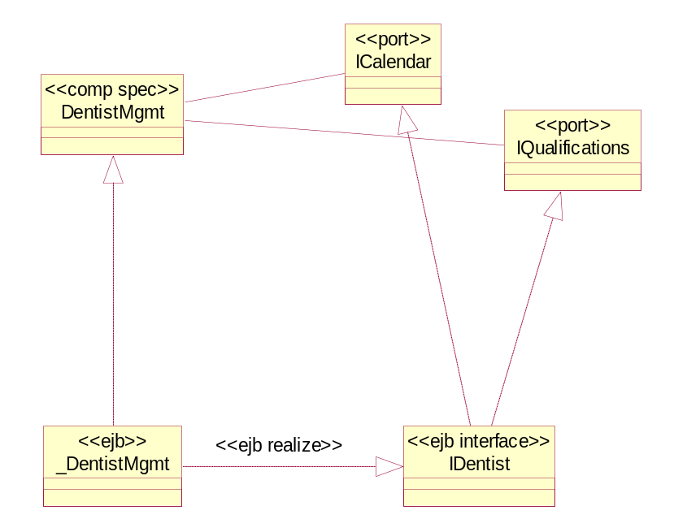
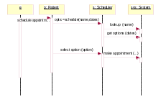
Preview of Technical Architecture
White (or black) Box Architecture
(component, ports, connectors)
Candidate patterns
Deployment architecture
Platform knowledge
Connector Realizations
Component Realizations
For each connector in white (or black) box
For each sub-component in white (or black) box
conn1
(a) Technical design of connector
(a) Data model for persistence
Roles
Application
Architect
Technical
Architect
Operations
Class and Interaction diagrams
Realization of ports, ops, events, names, exceptions, tiers, etc. to platform
Connector Realization styles
Patterns
Patterns
Or
(b) Connector styles applied
Patterns
Patterns
Component Realization styles
<<http>>
Or
(b) Patterns applied to map to component platform
Why do a Technical Architecture with connector styles?
Connectors repeatedly address similar connectivity and adaptation concerns. We want a consistent connector design and implementation. Sophisticated connectors decrease coupling between components. Consistent mappings from component specs to platforms help decrease needless variation.

Slide 4
Steps to Technical Architecture
Technical Realization of Connectors
  Choice of communication protocol
  Encoding of data formats for communication
  Adapt protocols with intermediate components
  Encourage or enforce use of standardized co-ordination infrastructure
Technical Realization of Components
  Design Database Models
  Map components, ports, methods, events, etc. to platform specifics

Slide 5
Technical Realization of Logical Components, Connectors
White Box Arch
White Box Arch Styles
An event is specified by:
event name and event information
condition for event to be raised
An event method connector:
takes a raised event e (T)
takes a corresponding method m(x,y)
takes a mapping from T to x, y
ensures m invoked when e is raised
Facility Methods
Deal Mgmt
Deal Events
Facility Mgmt
«event-method»
Technical Arch Styles
To realize event S::e (T) in Java:
method S::add_e_Listener (x)
method S::remove_e_Listener (x)
call S::notify_e (T)
To realize method A::m (x, y) in C:
procedure m (A_id, x, y)
Map ids, parameter types: …
To connect Java event to C method:
add appropriate listeners
connect Java event to Java method
call C via Java Native Interface
Technical Arch
«Java»:
Events realized in Java event model
«C»:
Methods realized in C
Connect Java events to C methods
Map component spec to platform: methods → procedures? transactions? relational data?
Map operations, parameters, failures → platform naming, parameter types, exceptions

Slide 6
Exercise 8.1

Slide 7
Technical Domains and Business Domains
Domain is about Messaging
Domain is about Trading
Messaging
Business
Black Box
White Box
Terms: Message
Topic
Subscription
Queue
…
Interfaces: …
Trading security goals use Security Model
Tr(Sec)
Trading
Business
Black Box
White Box
- technical
Business
Black Box
White Box
- technical
Security
Domain is about security
Business
Black Box
White Box
Terms: Role
Permission
Capability
Credential
…
Interfaces: ….
Trading white-boxes use Security interfaces
Infrastructure or technical domains (e.g. Security, Messaging) have their own business (or “domain”), including goals, black box, and white box models
These can be developed, to some extent, in parallel with the primary business domain (e.g. Trading)
When Trading is defined in technical or platform terms (e.g. white-box/technical), that platform itself is defined in part by the technical domains and their black-box or white-box interfaces.
A domain is some (portion of a) world usefully treated as a unit in problem solving and goal analysis and in goal dependencies. A sub-domain is a subset of a domain
A domain service is a way to offer access to the implemented technology or conceptual terminology of a domain from dependent domains. (related to a “Concern”)

Slide 8
Defining and Using Patterns
This section covers:
Concerns tangle and scatter across designs
Patterns separate design concerns
Patterns are defined by adding parameters to a package
The same pattern is applied to many parts of a design

Slide 9
[Optional] Concerns Tangle and Scatter across designs
An implementation has to deal with a myriad of different concerns
  Primary business functional logic
  Tracing and logging
  Synchronization under concurrent access
  Notification of events to unknown external parties
What happens to the design and code of simple interacting objects when you add
  Tracing
  Synchronization
  Notification
Designs and code will
  Tangle all these issues together – primary functionality is mixes with many other issues
  Scatter a given issue – no central architectural control over trace, synchronize, …
Tracing
Business function 1 (…)
synch; trace; do stuff; notify;
Business function 2 (…)
synch; trace; do stuff; notify;
Business function 3 (…)
synch; trace; do stuff; notify;

Slide 10
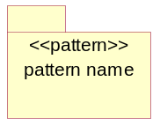
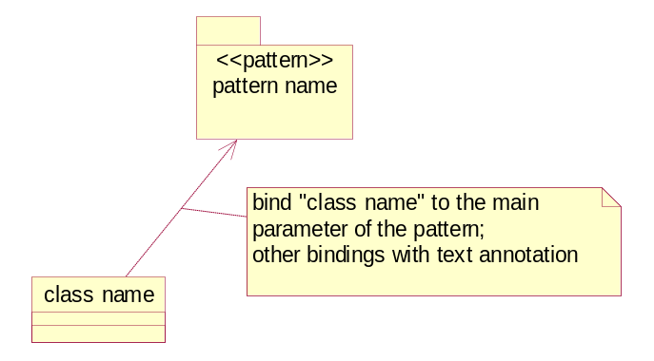
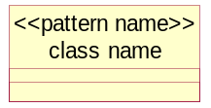
MAp Usage of Patterns
Pattern: a recurring model structure that appears in multiple places
  Defined in a package
    With parameters of the pattern
    As part of the Architectural Style
    Formally described with a model, or
    Informally described with a note, example, code fragment, etc.
Pattern application uses that pattern in a particular context
  It is shown by
    A stereotype with the pattern name: bind the element to the placeholder in pattern
    A package with an arrow for the primary parameter binding if any, text annotation for other parameter bindings
Patterns apply in all viewpoints and mappings across viewpoints
Note: UML 2.0 support for patterns is much improved
<<pattern>>
pattern name
<<Bind>> <A→ C1, B-→ C2>
my package
UML 2.0

Slide 11
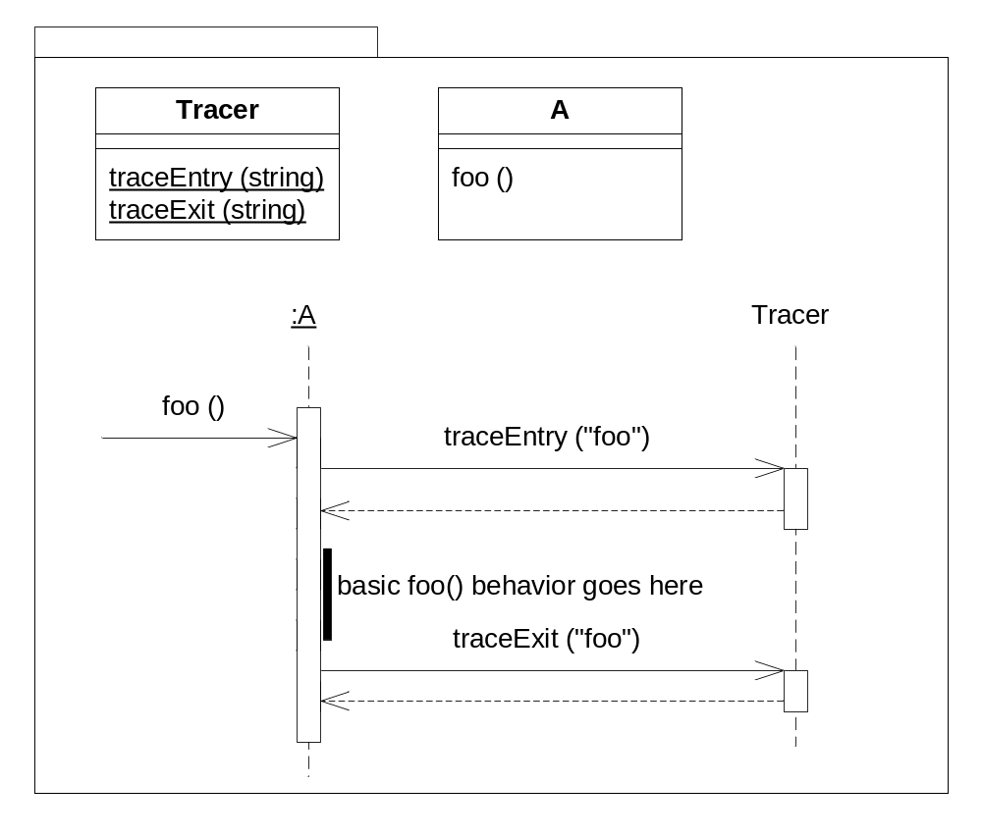
Example: Logging or Tracing in a Specific Case
A class A has a method foo that needs to be traced
A Tracer class provides the basic entry and exit calls
A::foo makes calls to do the traces

Slide 12
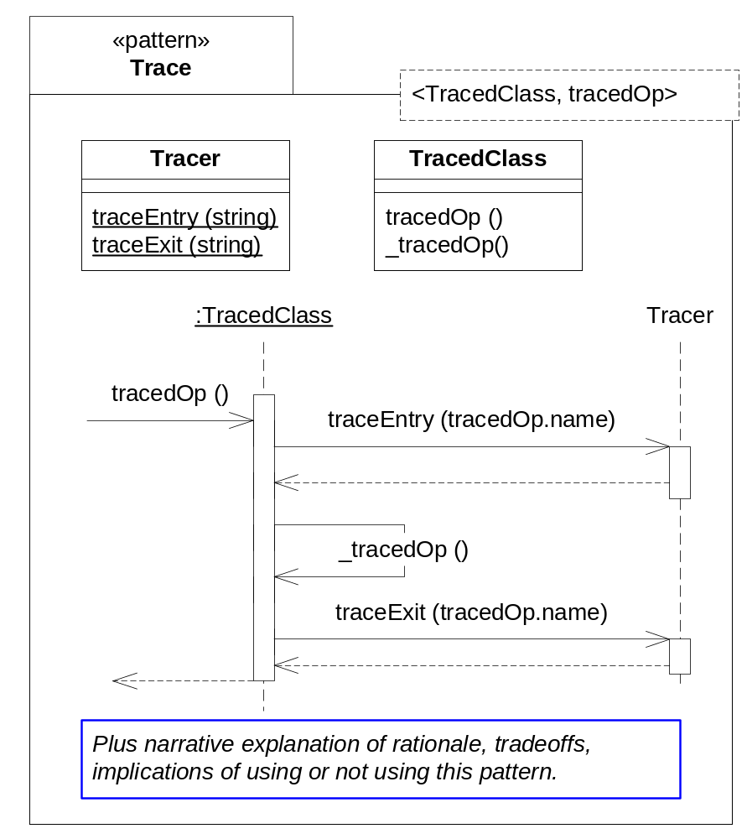
Example: Defining Trace as a Pattern
Pattern package
Define a package for the pattern
Decide “parameters” of package
<TracedClass, tracedOp(…)>
  These are pattern parameters
  Any TracedClass will do
  Any tracedOp
Define the expanded version generated by the pattern
  Just like a normal model
  Insert Tracer class
  Rename original method to _tracedOp
  Insert “wrapper” method tracedOp
    Has same name as pattern parameter
    Call _tracedOp ( )
  Access to things like tracedOp.name
Pattern Parameters

Slide 13
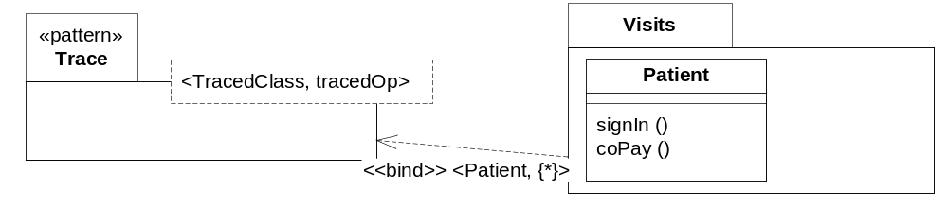
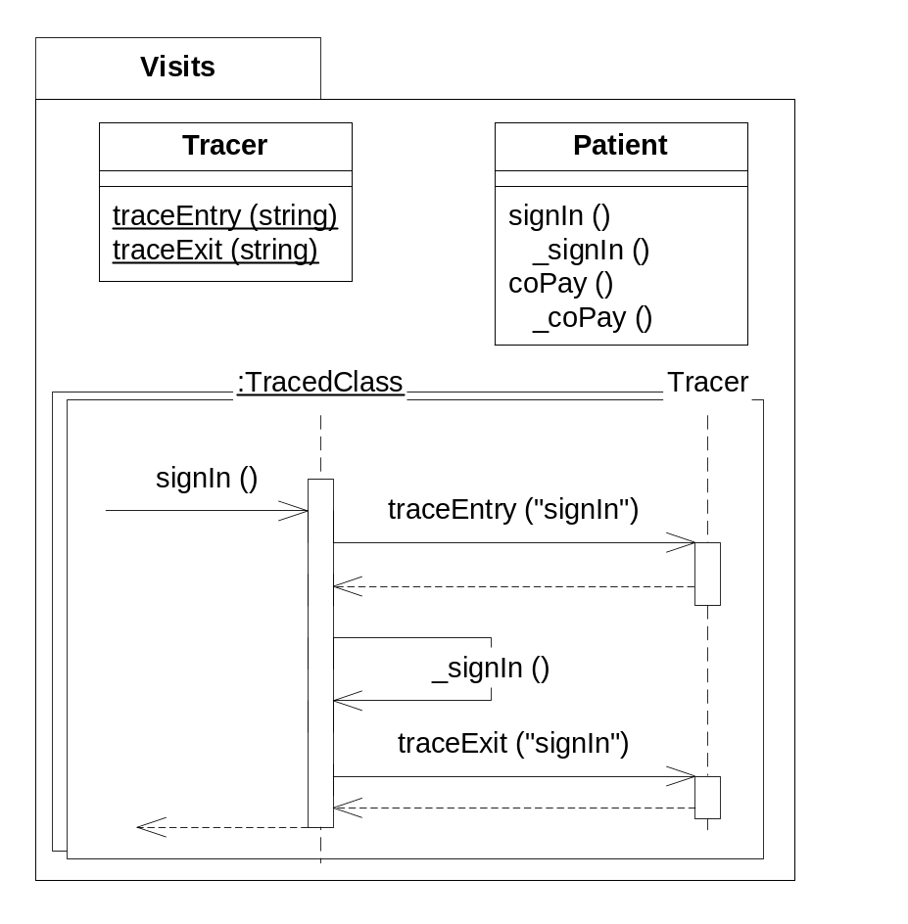
Example: Apply Pattern to all Methods of a Class
Parameter Binding
trace all methods of Patient class
Result: 2 wrapper methods
around renamed original methods
Apply the pattern by “binding” its parameters
  Can include one or several bindings
  This example binds all methods of Patient
This needs an extension to UML patterns
  UML permits just 1-to-1 substitution
The resulting design has all the right traces in the right methods

Slide 14
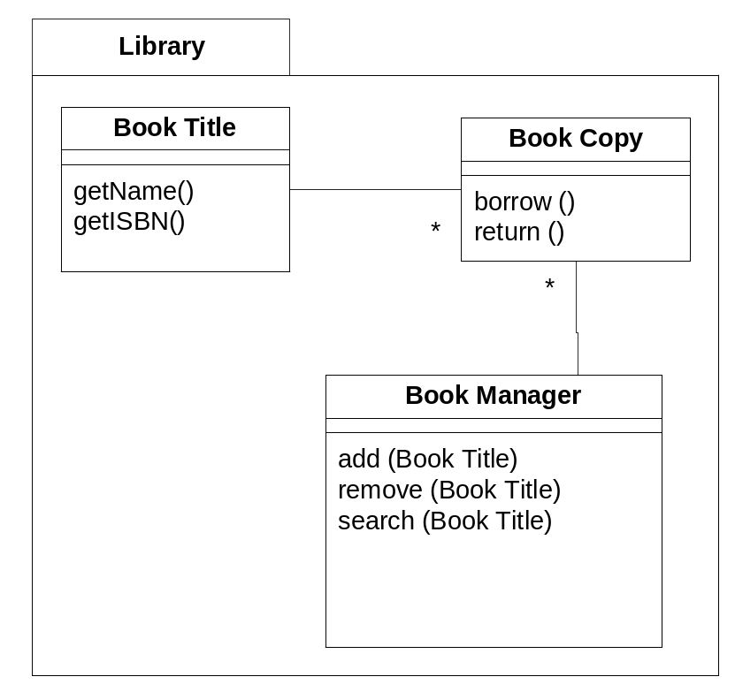
Designs Apply Multiple Patterns
This is an example of a basic design model
Its focus is main functionality
  Borrow and Return Book Copies
  Add, Remove, Search Book Titles
But it will also need
  Observation/Notification of Copy changes
  Synchronization of concurrent access
These could tangle up the design
  Unless defined separately as patterns
  And applied to the basic design model

Slide 15
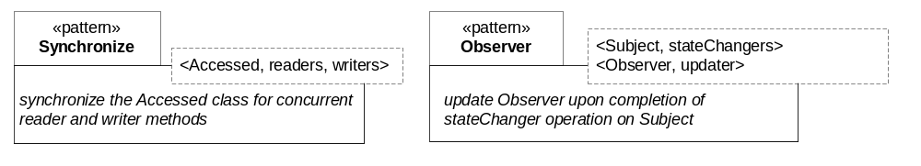
Patterns: Synchronization, Notification
Each pattern is defined with its parameters
Synchronize: protect reader and writer methods from each other
Observer: generate notifications of state changes

Slide 16
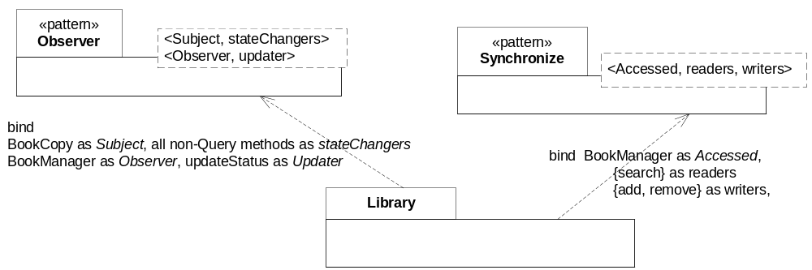
Apply Observer and Notification Pattern
Apply Observer Pattern
  Subject = BookCopy
    stateChangers = { all BookCopy methods without a “read-only” tag }
  Observer = BookManager
    updater = updateStatus
Apply Synchronize pattern
  Accessed = BookManager
    readers = { search }
    writers = { add, remove }

Slide 17
Other Examples of Patterns
Composite
  An composite object contains other objects that can themselves be either composites or simple; both offer similar interfaces
Publisher-Subscriber Hub
  Keep the state of cooperating components synchronized by enabling one-way propagation of changes. One publisher notifies the hub of changes; the hub propagates changes to all active subscribers
Adaptive Propagator
  Define a network of objects so that when one changes state, dependent objects are marked as affected but actual update can be dealt with separately
Sliding Window
  A set of types for dealing with sliding windows of time and how various properties change across those windows
Lazy Object Merge
  Sometimes two distinct objects are discovered to be the same. Mark the first as superseded, link it to the second, and have the first behave by delegating to the second
MQ Series Queue Local Naming
  For a source S of events and a destination D that will be co-located on a single machine, use an MQ Series queue named <S><D><…>, configured as <….>, and set up the S and D ends of the queue as <….>

Slide 18
Exercise 8.2

Slide 19
Technical Architecture for Connectors
This section covers
Connector specification Vs. realization
Example of Event → Method Connector
Example of Simple and Sophisticated Batch Connector
Connectors and Integration Style
User-Interfaces as Connectors

Slide 20
Connectors Assemble Components
Deal Origination
Foreign Exchange Monitoring
Event-method
connector
Same
Connector
Type
~manage deal
Fx events
“Simple” connector
Transaction Management
Deal Management
Event-method
connector
manage
transactions
manage deal
Architecture Styles
deal events
1-Way Property Connector
e.g. FX_rate_change event calls Recalc_portfolio_value
Propagate source property change
- to the destination property
Event-Method Connector
Given a source port
  with a set of events and event data
And given some number of destination port
  with methods, input args, data mappings
“Connect” the events to the methods
  Logical view: business protocol
  Technical view: platform protocol
Change Veto Connector Type
e.g. MQSeries.Send() operation is invoked, which puts a msg in…
Given a source port property
Require a “propose-change” event
Add veto protocol from listeners

Slide 21
Connectors Have Specification and Realization
Each connector is specified as follows
  Set of ports
  Properties, guarantees, and protocols between ports
Each connector has one or more realizations
  Realization of properties, guarantees, protocols on some platform
Connector definition can be layered
  One specification
  Multiple realizations
Example: Different ways to update destination attribute with source attribute changes
  Loosely coupled publish / subscribe mechanism
  Direct update calls from source to destination
1-way prop Connector
Spec
Propagate source attribute
to destination attribute
Realization 1
Use events with pub/sub
Realization 2
Use direct update calls

Slide 22
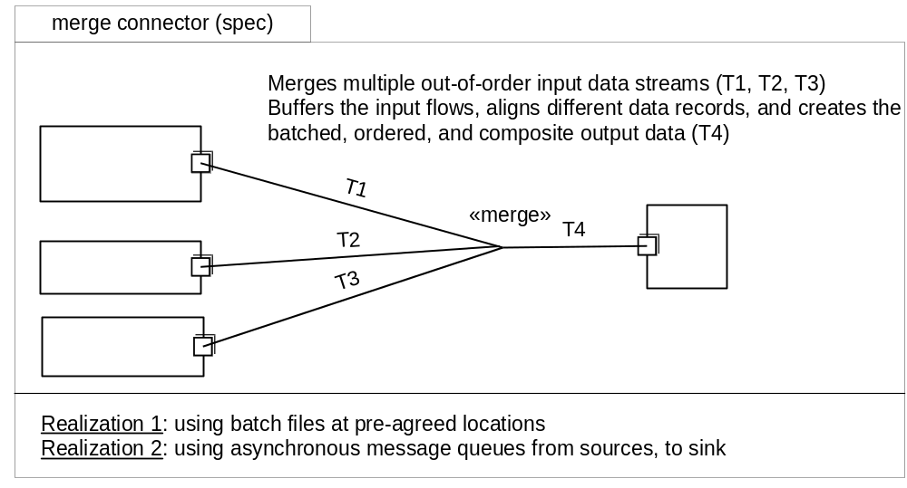
Sophisticated Connectors – Data Merge (Informal)
Note: sophisticated connectors enable us to use simpler approaches in white-box architecture e.g.
  Equality invariants across components → use property synchronization connectors
  Merge relationships across data collections or streams → use merge connector
  Event-trigger relationships across components → use event-method connector

Slide 23
Exercise 8.3

Slide 24
Technical Architecture for Components
This section covers
Component Realization
Mapping to Platform Architecture
Information Model to Data Models
Patterns for object-relational mapping

Slide 25
Component Realization
Logical component must be designed to full technical detail
  Platform
    OS, data base, language, …
  Platform-specific data model
    Typically expressed as relational model
      Data model, degree of (de)normalization, indices, etc.
  Nested levels of sub-components if needed
    Platform may offer specific approaches to sub-components in different tiers
    Optionally just done in code without explicit models
  Platform implementation code
    Exploit platform facilities e.g. synchronization, notification, …
Again we prefer to define uniform rules or policies to map to the platform

Slide 26
Component Realizations Examples
Mapping patterns for components include
  Mapping of ports: single interface per component? Map ports accordingly
    E.g. Java allows multiple inheritance of interfaces; EJB has no outgoing ports
  Operation, parameters, and errors names and types
    e.g. Java exceptions
  Standard platform patterns
    e.g. home interfaces in EJB
  Component managers vs. Objects
    EJB requires a home interface which can serve some manager functions

Slide 27
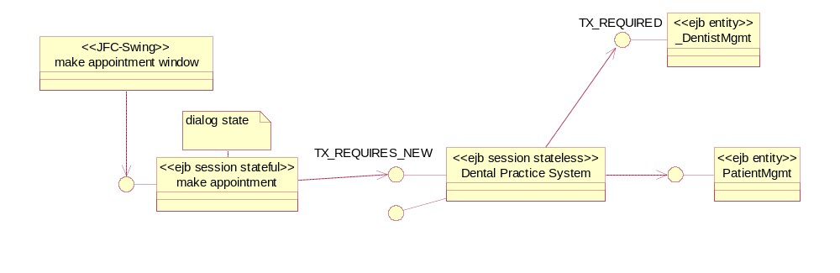
Mapping to Platform Architecture
use case operations
UI/dialog
Co-
ordinator
«core»
type
component
Guidance or rules of which elements of UI/dialog map to Swing and which to Session
UI/dialog
Co-
ordinator
Mapping of transaction properties to platform TX_REQUIRES_NEW
Can define patterns to map to platform supported architecture
  EJB Session beans (stateful for dialog; preferably stateless for server)
  EJB Entity beans
  Servelets and JSPs

Slide 28
Information Model to Data Models
Persistent information must be mapped to selected data model
Information model has
  implicit object identities
  platform neutral attribute types
  collections, sequences permitted
  parameterized attributes
  derived attributes
  Invariants
Data model might have
  Tables
  Columns with pre-defined types
  Primary keys
  Foreign keys
  Indices

Slide 29
Patterns for object-relational mapping
1-Many Association Mapping
<A>, <B>, <r>
given 1-N between A and B
A
B
1
r
*
define two tables, a primary key on A, one foreign key on B
<A>Table
<B>Table
id : <A>Id
r : <A>Id
Many other object-relational mapping patterns apply
  Subtypes → single table vs. multiple tables
  Identities → generate and lookup identifiers
  Rows → Active Objects: wrap object smarts around individual row data structure
  Tables → Table Gateway: provide access to an entire table and encapsulate SQL

Slide 30
Exercise 8.4

Slide 31
Summary
This chapter has shown that:
Separation of white box logical from technical views has good benefits
Systematic mapping between white box and technical based on
  Patterns: many of which can be defined as parameterized packages
  Pattern application: binding selected parts of your design using patterns
  Separation: specification vs. realization for connectors and components
Connectors
  Specifications define logical dependency between ports of components
  Realizations define protocols, data formats, and adaptors
Components
  Specifications define logical behavior at all ports
  Realizations map to platform architecture, appropriate data models, etc.

