Slide 1
Chapter 9
Deployment View of <System X>
Deployment Architecture describes the system topology needed to install, configure, and support the system. It describes locations (geographic and network), types of hardware nodes, network connections, and the application and platform software that is deployed on them, and constraints on all of the above. It can be considered early in the lifecycle.
This chapter covers:
Specify node types
Identify deployment locations and constraints
Map nodes and devices to locations
Specify connections between nodes or locations
Specify software and network configuration

Slide 2
MAp Viewpoints
Need shared domain
vocabulary
Domain / Biz
Architecture
Goal
Need shared domain
vocabulary
1
sub-goal
sub-goal
Outside
Domain: Information
Goals
Biz.Process
Black-boxes use cases and info
models support business model
Black box Assembly (including S)
Component Architecture
Black box spec (of S)
S
1
S
1
S
2
E
D
S: Information / Attributes
Boundary
Black-box Specification (of S)
4
S: Behavior
Architecture Styles: Principles, Patterns, Guidelines, Rules, Transforms
3
Black-box behavior and info model
partitioned into sub-components
1
2
S
S
Treat deployment architecture as an overlay on business or logical components and connectors + platform-specific technical components, adding information about locations e.g. geography, or network topology.
Component Architecture
White box design (of S)
s2
s1
s2
Inside
3b
s1
s3
3a
s3
4
Information
Behavior
functionality
security
deployment / location
performance
technology

Slide 3
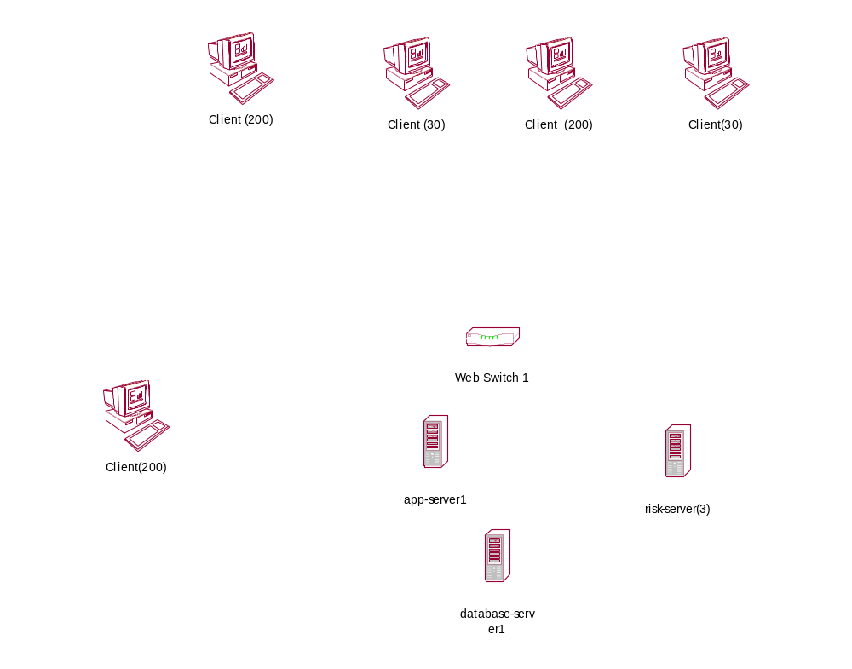
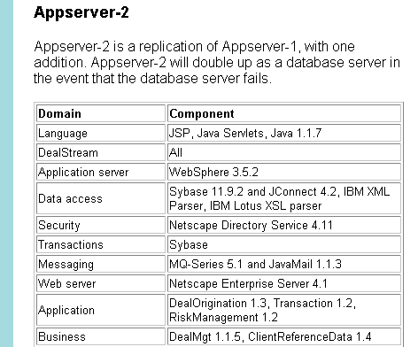
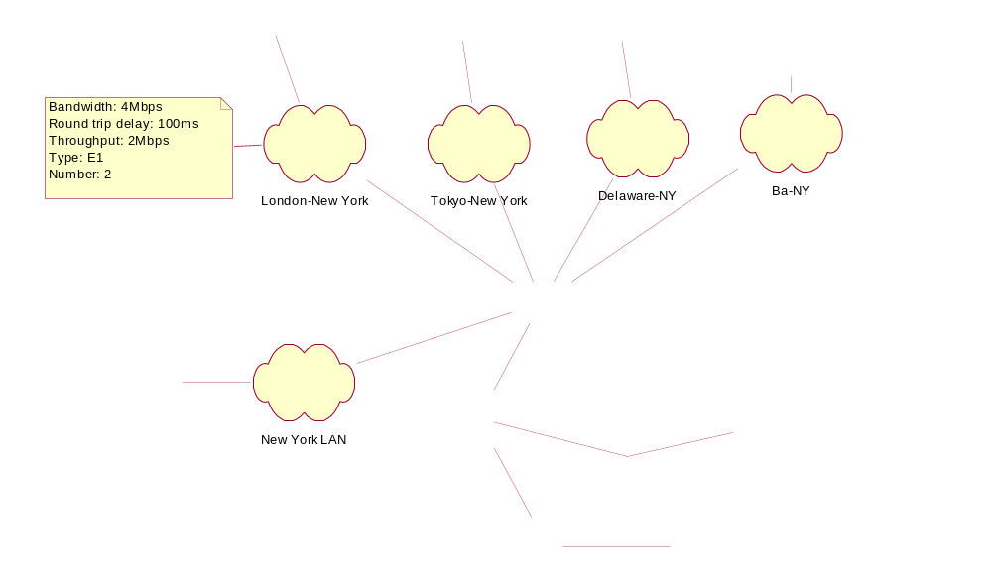
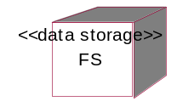

Preview of Deployment Architecture
Early white box and technical architecture
Module architecture summary
Architecture patterns
Deployment concerns: failure, security, ..
Hardware Topology
Software Deployment
Location, node and network topology
Mapping of software to nodes
Roles
Application
Architect
Technical
Architect
Operations
Hardware Topology Styles
Patterns
Patterns
Patterns
Patterns
Software Distribution Styles
Properties of node and network types
Mainframe
Model: z800+
OS: Linux 2.4
RAM: 4G
Disk: 16T
Web Server
Model: Dell PE 66
OS: Linux 2.4
RAM: 1G
Disk: 400G
Scenarios: failure, security, etc.
Why do a Deployment Architecture?
Deployment decisions impact availability, reliability, performance, scalability, manageability, operations, and more. We want to leverage deployment patterns consistent with the application and technical architectures, and to define deployable software modules to be built.

Slide 4
Many Concerns Influence Deployment Decisions
What existing infrastructure do we have?
What guidelines or policies exist for deployment?
What are security risks for the nature of information and connections?
How available must the system be in the presence of failures?
Where are the other systems we need to interact with?
How will you monitor and manage the system once you deploy it?
What hardware, network, software, and configurations need to be deployed?
MAp currently describes the resulting deployment model, not all the analysis.

Slide 5
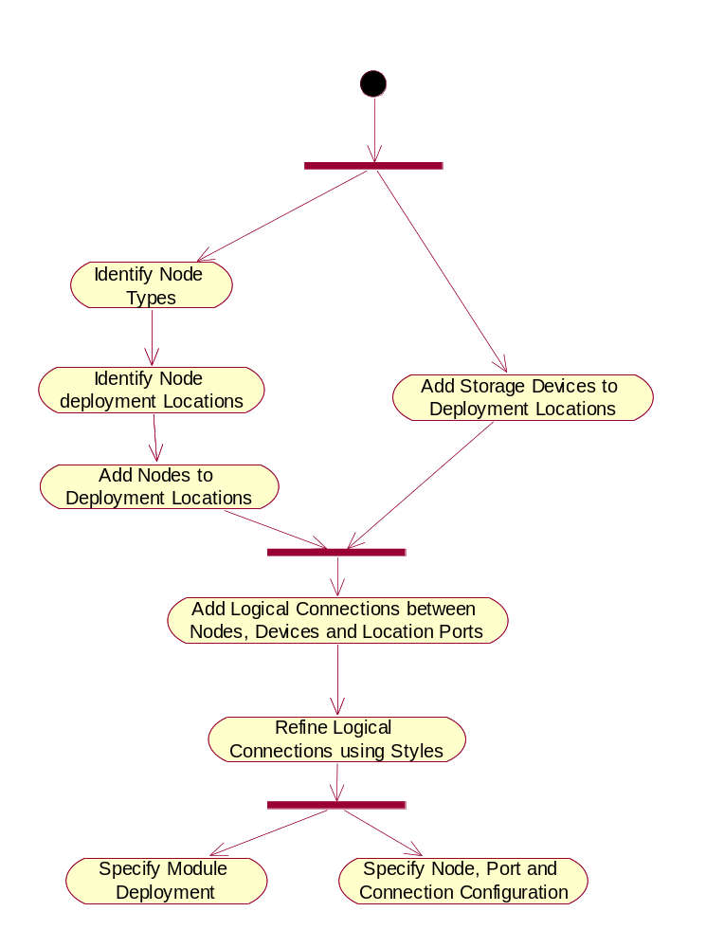
Steps to Deployment Architecture
The following are not a strict sequence
Specify node types
Identify deployment locations and constraints
Add nodes to locations
Specify logical connections between nodes
Add additional devices: network, storage, etc.
Map deployment units to network
Iterate with scenarios: failures, intrusions, load spikes, etc.
Alternatively, specify all relevant visible properties in an SLA

Slide 6
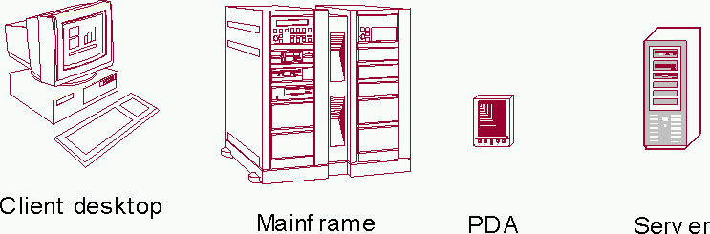
Specify Node Types
Define the types of processing nodes and their key characteristics
  Thin clients: OS, processor, memory, disk space, …
  Servers: OS, processors, memory, disk space, …
Find or introduce icons or stereotypes for these nodes
Client desktop | Mainframe | PDA | Server
Model: Any | z800 + | Any | Sunfire 12K
OS: Any browser | Linux | Palm 3.5 + | Solaris 8 OE
RAM: 128M + | 2 GB | 8M + | 1 GB
Disk: 40G + | 4TB + | N/A | 1 TB
Not an exhaustive attribute list

Slide 7
Identify Deployment Locations
Name (and define if needed) the locations where nodes will be located
  A location can be geographical or physical area, network location, or both
  Chosen at granularity appropriate to need, and to define connectivity
  Define constraints on nodes and locations
Examples
  Toronto Teeth’R’Us
  New York Dental Schedulers’ desks
  New York Dental Data Center at 45 Tooth Tower
  New York Dental Security Zone 3
    Definition: the network zone between the internet firewall and the database servers

Slide 8
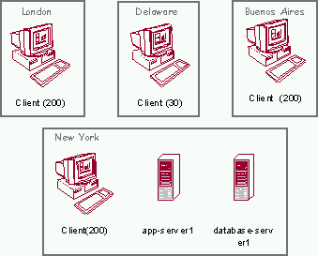
Add Nodes and other Devices
Place appropriate node types and numbers at each location
Add other devices such as web-switches, firewalls, storage devices, etc.

Slide 9
Add Connections and Connection Attributes
Network connections support the communications needed by white box and technical architecture
Network attributes include:
  Bandwidth: Measures the total data transfer capacity of the network connection as (mega- or kilo-) bits per second, e.g. 4 Mbits/sec
  Roundtrip delay: Measures time between two nodes to queue a request at switching nodes in the network plus time to propagate data (packets). This varies by distance and bandwidth. This is measured in milliseconds, e.g. 100ms
  Throughput: Measures the available data transfer capacity of the network connection, considering connection sharing with other applications, e.g. 2Mbits/sec
  Connection type: The type of network connection, e.g. private line, metropolitan area network (MAN), local area network (LAN), E1.
  Number of connections: The number of network connections available.
Optionally name and define new types of network connections and their attributes

Slide 10
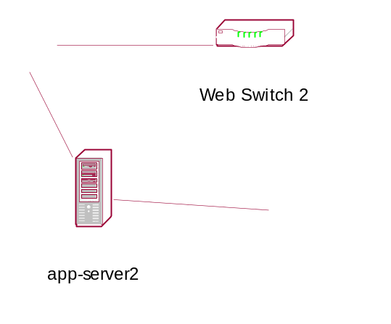
Deployment Architecture
New York
Tokyo
Delaware
Buenos Aires
Locations
Connections
New York
Nodes
Devices
Failure and Performance
Viewpoints

Slide 11
Map Software Modules to Network
Map deployable software units onto the network
  These units must be the targets of “builds” in the module architecture
Ensure all modules they depend upon are also suitably mapped
  Modules that realize other application components
  Modules that realize technical components
Can include very specific platform details and configuration settings
  Configuration of users, directories, database accounts
  Setup of communication ports on servers
  Product specific configuration e.g. for Oracle, Veritas, WebSphere, …
  Configuration of IP network usage, router and web switch programming

Slide 12
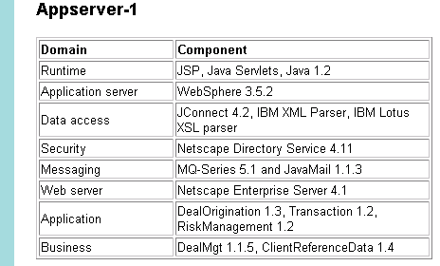
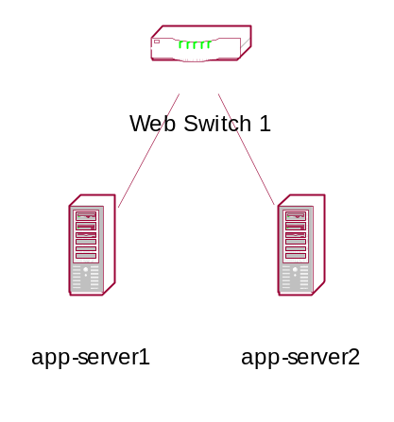
Software Deployment
Coordinators
Make Appointment Controller 3.1,
Plan Time Off Controller 1.0
Core types
Root Canals Manager 3.2
Coordinators
Make Appointment Controller 3.1,
Plan Time Off Controller 1.0
Core types
Root Canals Manager 3.2

Slide 13
Iterate with Deployment-Related Scenarios
Evaluate for load changes, failures, security scenarios
Some scenarios are best described with scenario diagrams
  The objects are deployed application and platform software components, and hardware nodes and networks
  Interactions or events correspond to load changes, failures, security breaches
server
monitor
backup server
overload
fail
ping
failover

Slide 14
Exercise 9.1

Slide 15
Summary
This chapter has shown that:
Deployment architecture defines the topology of hardware and software
It is influenced by many concerns of the deployed system
It describes
  Locations, hardware nodes and network connections
  Application and platform software that is deployed on them
  Optionally, how the architecture handles scenarios of failure, security, etc.

