Slide 1
Chapter 10
Optional: Models and Code
In addition to helping define component interfaces and architectures, MAp specification models help design the implementation code for a given component. Implementation code is a special case of white box design, and has to include aspects of technical (platform) and module (code structure).
This chapter covers:
Basic object-oriented design
Some design principles
Non object-oriented design

Slide 2
MAp Viewpoints
Information supports goals, process
Need shared domain
vocabulary
Process supports goals
Domain / Biz
Architecture
Need shared domain
vocabulary
Goal
1
sub-goal
sub-goal
Outside
Domain: Information
Goals
Biz.Process
Goals – success criteria
Traceability
Black box assembly includes S
Black-boxes use cases and info
models support business model
Black box Assembly (including S)
Three primary viewpoints
Component Architecture
Black box view (of S)
S
1
S
1
S
2
E
D
S: Information / Attributes
Boundary
Black-box Specification (of S)
4
S: Behavior
Architecture Styles: Principles, Patterns, Guidelines, Rules, Transforms
3
White box view of S
sub-component s1…s3
Black box view of S
Styles across viewpoints, projects:
workflow partitioning style
MQ series configuration style
Black-box behavior and info model
partitioned into sub-components
1
2
S
S
Component Architecture
White box view (of S)
s1
s2
Inside
s2
3b
s1
s3
3a
s3
4
Information
Behavior
Each sub-component could be existing separately specified black box, or new spec for next level of drill-down.

Slide 3
Structuring Code with Domains and Bridges
My Component
“Observes” the core to communicate electronically
Communication Domain
Connections
Messages
Packets
GUI Domain
Buttons
Windows
Menus
Selections
Clicks
“Core” Domain
Appointment
Patient
Dentist
Treatment
Persistence Domain
Tables
Columns
Keys
“Observes” core; communicates via GUI
bridge
Implementation deals with objects in “core” domain, GUI, persistence, communication, …
Objects in one domain frequently have counterparts in the other domains
Good practice to keep these separated in code via a separate “bridge” layer of objects

Slide 4
Basic Object-Oriented Design – The “Core”
To develop an object-oriented design for the “Core” domain:
Develop an initial class diagram
  Turn each black box information model Type into a Class
Develop object-level collaboration for each black-box operation
  Draw before snapshot for operation
  Select receiver for the operation request
  Design collaboration between objects
  Check against the black box operation specification
Consolidate class operations from all collaborations
  A class must support all operation requests its objects receive
Define class instance variables and directed associations
  An object must “remember” certain things at start/end of each operation
  All attributes and associations from the black box specification get stored or computed somewhere

Slide 5
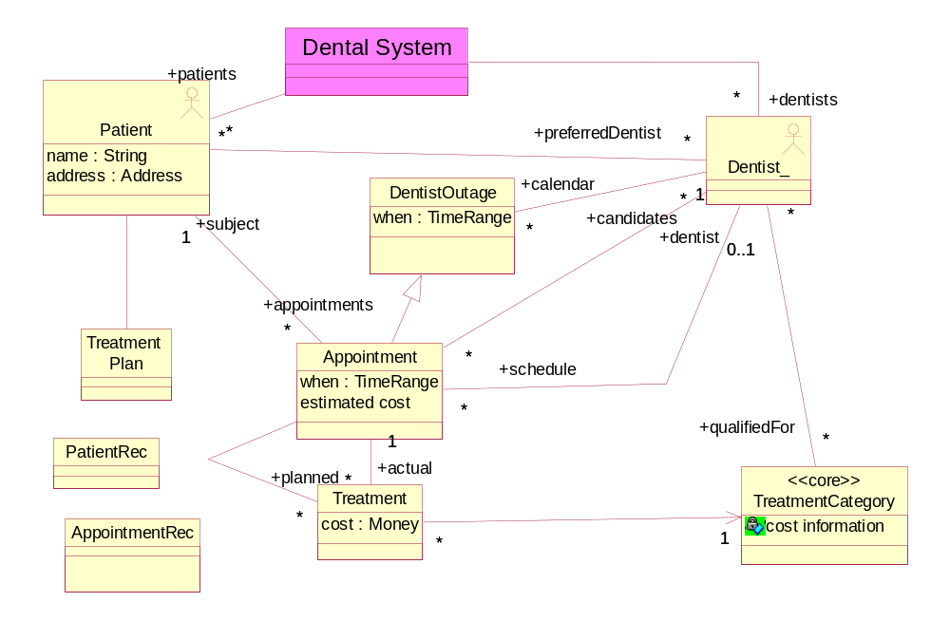
An Initial Class Diagram
Turn each type in the black-box information model into a class
  We will use a simplified version of the model below

Slide 6
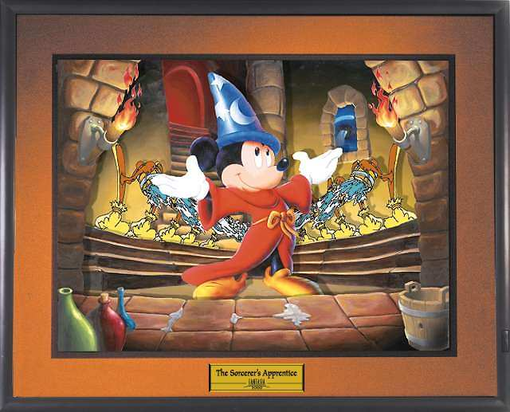
The “Smiley Face” Principle ☺
Treat an object as though it was alive (intelligent) and had a smiley face
Design how a group of such objects would collaborate
Remember Walt Disney’s mops, pails, and sinks in Fantasia
… but temper this with design heuristics (later) and patterns
t: TreatmentPlan ☺
: Dentist ☺
a8: Appointment ☺

Slide 7
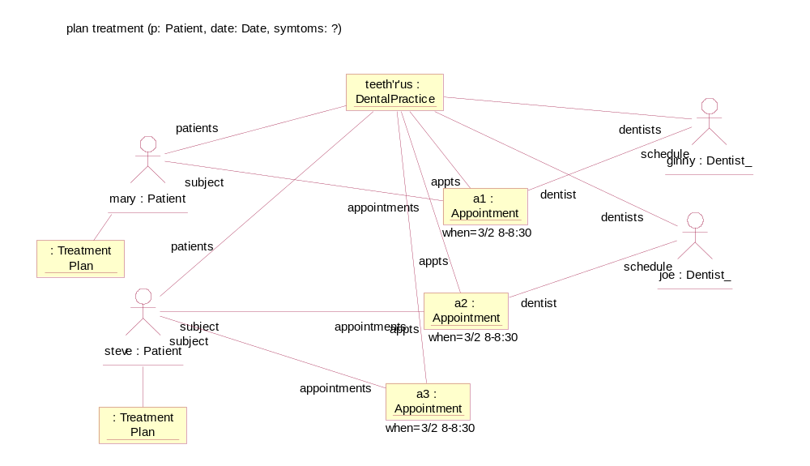
Design collaboration for each black box operation
Select black box operation
  plan appointment (patient, date, symptoms): appointment options
    returns available times and some treatment plan information for that appointment
Draw before snapshot for operation, including the “top level” object
  Remember, these are now all objects in the running software
Select receiver for the operation request
Design collaboration between objects
?

Slide 8
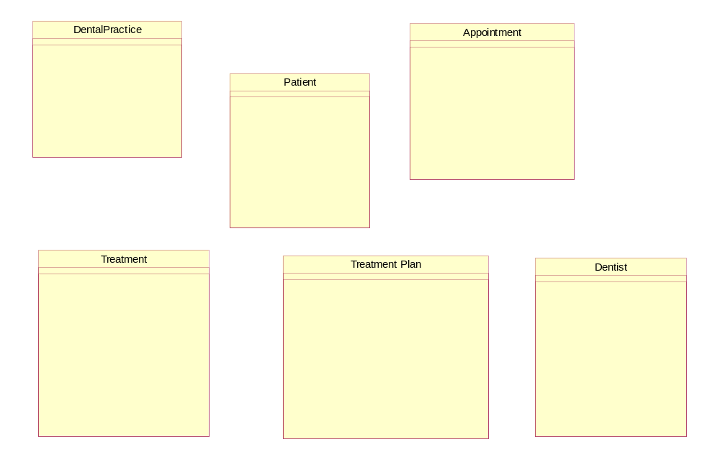
Define Class Operations
Collect all incoming requests on an object into operations on its class
Formalize operation signature: parameters, return types
?

Slide 9
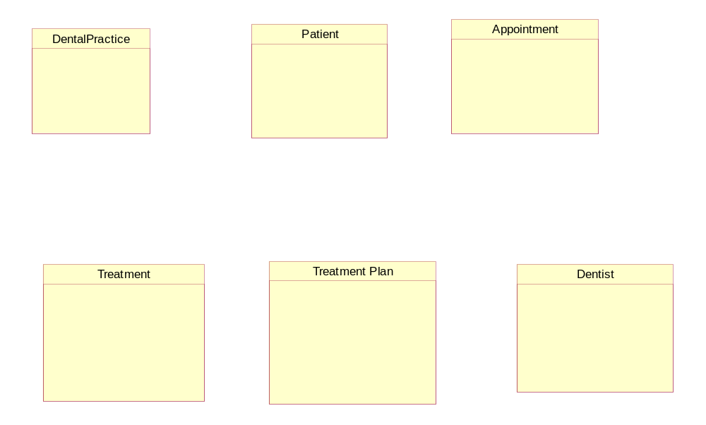
Define Class Persistent State
Design instance variables and directed associations “remembered” by objects
All attributes and associations from the specification model can be determined
?

Slide 10
Exercise 10.1

Slide 11
Some Design Heuristics
Heuristics for good object-oriented design include:
Intelligent Information
  If some behavior requires information, assign the behavior to the object with the information
Avoid the “God” object
  A global “controller” with all other objects being dumb data accessors
Delegate where you can
  Too many Y:= a . get Y (…) followed by do stuff with (Y)
  Should be turned into a command like a . do stuff with (…)
Type using Interfaces, not Classes
  Parameters and return values should be typed more by interfaces than classes
  The only place where a class has to be referred to is to create a new object
Creation
  Be quite careful about who directly instantiates an object of some class
  A should create B if A will “own” B, or has all initializing data for B
  If no clear choice, then invent a separate Factory object
Consider replacing case statements with polymorphism
  Y := a . get Y (…) followed by case (Y=a) ..Do 1 ; case (Y=b) ..Do 2 …
  Should be turned into a . Do (), with multiple implementations of Do

Slide 12
More Heuristics …
Classes can have more than one interface
  An Order class supports some interface to appear on a UI Table
Adapters can be used to realize some interfaces
  TableModelAdaptor adapts Order to the needs of UI Table
Minimize circular dependencies across classes
  Separate out interfaces to break class-level dependencies

Slide 13
Non Object-Oriented Designs
This section covers:
Some design decisions for non object-oriented designs

Slide 14
Components without Object-Oriented Languages
A non-object oriented implementation still faces common basic decisions
Decide how the set of operations of a component will be invoked
  Procedure calls, one procedure per operation e.g. in C
  Using operating system mailboxes per process
  Program activation, one program per operation
Decide how the data that must persist across operations will be stored
  In a database
  Linked structures that are held on to by a few global variables e.g. in C
  Files that are read into, then written out by each program
Decide how to decompose the processing and the data
  Can use basic object design conservatively as an underlying approach
  Each class becomes some collection of procedures and data definitions
  Each object becomes an identifier for a set of data values
  Uses patterns to map the design model to the implementation language

Slide 15
Summary
This chapter has shown:
A systematic way from component specs to simple object-oriented design
Using models, with suitable mappings, to non-OO implementations
How patterns help separate and maintain different design aspects

