Slide 1
Chapter 11
Optional: Advanced Topics
This chapter covers:
Architecture Styles and Patterns
Pilot Projects
Module Architecture
Security, Performance, and Transactions
Integration Projects
Migration Planning
Method Scaling and Simplifications
Agile Methods

Slide 2
Architecture, Architecture Style, and Patterns
This section covers:
Architecture as limiting “needless creativity”
The role of patterns as a part of an ever-present Architecture Style

Slide 3
What is the intent of “Architecture”
Strong vs. loose architectures vary in the consistency of their solutions.
Architecture is about the set of design rules, patterns, principles about any system that keep its designers from exercising needless creativity
Architecture is not just about any specific size, scale, domain, or infrastructure
Architectural thinking can include any of the following
  Let’s use 3-tier Client-Server
  We should not use an Object Transaction Service
  Follow this distributed notification protocol
  Use the following convention for get/set method names

Slide 4
Architecture Styles – Spectrum of Creativity
Full defined rules
No ad-hoc at all
Only one solution “conforms”
A “design compiler”
No Rules
Fully Ad-Hoc
Any solution “conforms”
0%
100%
Creativity
Most common: guidelines, standard patterns, some rules, design language

Slide 5
Architecture and “Style” in MAp
Architecture Style
(patterns, rules, constraints)
Style
context
My architecture
Pattern 1
Pattern 1
Pattern 1
Rule 1
Apply Pattern 1 to every … when …
Pattern 1
Pattern 1
All architecture work is done in the context in some architecture style
An architecture style defines what set of architectures is acceptable
Style includes patterns, principles, constructs, usage rules, transforms, constraints
Developing and maintaining the elements of style is a key part of architecture

Slide 6
Example Projects
This section covers:
Example project characteristics

Slide 7
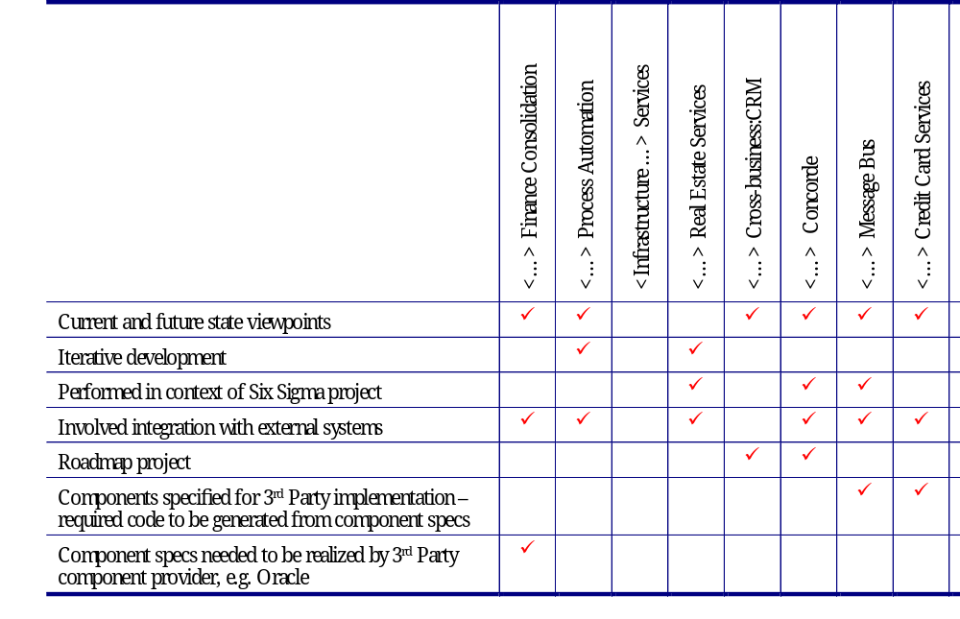
Example Project Characteristics

Slide 8
Module Architecture
This section covers:
Describing a build-time view of the system

Slide 9
What it is
Some viewpoints are about “run-time”
  Business, black box, white box, technical
Some viewpoints include “deployment-time”
  Deployment architecture
  Deployable software units are deployed onto suitable hardware + platforms
  Can have separate development / testing / production versions
Module architecture is about “build-time”
  How deployable code units are “built”
  Compile/build dependencies across code units and tools (compilers etc.)
  Structure of large/small units of code
  Permitted dependency rules across “layer” units of code
  Patterns to map logical and technical architecture to code, modules, libraries, …
  Patterns and rules on directories, module naming, etc.

Slide 10
Modules, Subsystems, Layers
Module
  an implementation unit that provides services via an interface of callable functions, and requires services via a similar interface
  may contain other modules
Subsystem
  a grouping of modules and other subsystems
Layer
  a grouping and structuring of modules into a partially-ordered hierarchy, where services of lower layers are only usable from higher layers
Note: Layers <> Tiers:
  tiers represent boundaries of potential distribution

Slide 11
Some relationships in Module architecture
Modules within Subsystems
Subsystems within other subsystems
Layers, and the “can use” relationship between them
Modules within layers (in conformance with “can use”)
Mapping from components, ports, and connectors in the Application and Technical Architecture to modules and subsystems in the Module Architecture
Imports between code units
Mapping source code units to directories
Intermediate code unit mapping (code units and generators, e.g., compiler, linker, resource compiler…)
…

Slide 12
Security, Performance, and Transactions
MAp provides some support for modeling:
Transactional requirements and its technical realization
Security requirements
Performance requirements

Slide 13
Integration Projects
Almost all projects have an element of integration with existing systems
MAp allows us to
  Describe the integration requirements at a logical or technical level
    Black or white box vs. Technical
  Have separate legacy models with a mapping to the business model
    Separated sub-component specifications from black box or business model
  Use connectors to simplify specification and implementation of integration
    Logical replication connector can have very specific legacy implementation

Slide 14

Migration Planning
Most large scale architecture projects have a major migration element
MAp can describe architectures at a variable level of precision
MAp viewpoints can clarify descriptions
  Two stages can share the same logical assembly, different technical or manual realization
Stage Name | Current State | Interim Mido | Mido | Ideal State
Stage Date | Feb 2002 | Nov 2002 | Sep 2003
Stage Description | … | … | … | … including ideal architecture style
Logical Assembly Connected components, optional key interactions
Technical Architecture
Costs, benefits, risks, rationale
Conformance to ideal state architecture style

Slide 15
Method Scaling – towards MAp Lite
Use separate viewpoints and suitable level of abstraction
  Model behavior or information at different levels of granularity
Use variable precision; MAp prefers but does not demand precision
  Information model can be considered a stylized glossary of terms
  Patterns can be described with just an example, or full parameterized model
  Precision and consistency is achievable even in very high levels views
MAp deliverables do not have to produced waterfall, or all at once
  “List” version might be list of names with 1-sentence descriptions
  “Draft” version might have fleshed out but still informal or textual models
  “Dressed” version might be fully dressed for particular areas of the system
  Project planning benefits from naming and defining such versions
MAp surfaces misunderstandings and issues earlier than normal

Slide 16
Discussion
Discuss what one kind of project profile might produce in terms of evolving versions of MAp deliverables

Slide 17
MAp for “Roadmap” Projects
Road-map projects focus on migration plan from as-is to ideal
A current-state architecture in MAp for such a project might have
  Business:
    Current processes: sketchy, informal
    Current information: glossary of types and attributes for terms used in the process
  Application:
    Current application assembly: what apps are connected to what others?
    Information: main types managed by a component vs. needed from others
  Technical:
    What are technical platforms for components and connectors
An analysis of the current-state architecture in MAp might have
  Gaps, deficiencies, or opportunities identified in current-state
An ideal target architecture might have
  Guiding architecture principles and styles defined explicitly
  “List” version of black box use cases
  White box with collaboration diagrams
  “List” version of technical architecture

Slide 18
MAp and XP-like Agile Methods
XP: Do the simplest thing that works
  MAp: Describe in simplest most natural way, validate with scenarios and snapshots
XP: Say it in the code; if you cannot say it in the code, then don’t say it
  MAp: Don’t draw pictures of code unless guaranteed sync; create models that are useful abstractions
XP: Write user-stories, keep customer involved
  MAp: Write “end-to-end” scenarios, customer validated, keeping a written glossary for consistent terms
XP: Programming in Pairs
  MAp: Develop models in teams of 2 or more
XP: Do prioritizing and planning
  MAp: Always a good practice
XP: Do Test and Code cycle
  XP: Write the test first without any code to compile or run against
    MAp: Write operation specs or invariants: refer to attributes and operations that are not yet declared or defined
  XP: Write stub code to compile the test
    MAp: declare all attributes, types, operations needed to support the spec
  XP: Implement the bodies of the stub code and do supporting implementation
    MAp: add definition of derivation invariants or other operation specs
  XP: Run the test
    MAp: exercise with scenario
XP: Define everything important once, and only once
  MAp: Define every important term once, and only once. Refer to it many times
XP: System as Metaphor
  MAp: Architecture Styles help reduce “needless creativity”
XP: No BUFD (Big Up-Front Design)
  MAp: Clear goals with evolving models from List → Draft → Dressed, code early where appropriate

Slide 19
XP Characteristics and Where We Need More
Characteristics of XP
  Well defined
  Specifications are encoded as executable unit tests
  Minimal non-code descriptions
  Everyone owns the code
  Very tight customer-developer loop: Cust stories → Dev incrs → Cust
Where we need more
  Describing and communicating an architecture and how it works
  Shared discussion using abstractions: code is not sufficient
  Larger projects: code + user stories not sufficient means of discussion
  Separate organization roles of customer facing analyst vs. development
  Component interfaces vs. component implementations
  Outsourced development based on requirements
  When code-level incremental changes or re-factorings are not enough
  Exposure of gaps, inconsistencies, high level views, requirements swings
  Better Customer-Architect-Developer loop covering broad sketch to detailed descriptions
    Cust ideas, stories → Architect questions, definitions, examples → Cust
    Architect reqs → Developer iterative testing → Architect , Cust
    Architect func tests → Developed software
Distinction between test case generation and test specification
  Particularly for functional and acceptance tests, as opposed to unit test

