Slide 1
Chapter 12
How to map current-state components to business needs from Problem Definition
This chapter provides a short overview of mapping existing IT systems against the business needs.
It covers:
Mapping to Domain Model
Mapping to Essential Processes
Mapping to Goals
Conformance to Desired Architecture Styles

Slide 2
Roadmap
Route
Initial issues, objectives, stakeholders, etc.
buried business knowledge
refine goals and obstacles
for target state work
Frame the Problem: formalize problem, syndicate with stakeholders
Goals model Key domain terms
known reference architectures,
best practices, etc.
top-level problem definition,
domain terms to map,
priorities, focus areas
Analyze The Current State
Define The Target State
Business architecture
scenarios and process sketches
key information terms
problems and opportunities
Business architecture
principles and styles
processes, roles, activities
validation vs. goals and obstacles
problems and opportunities
Component architecture:
principles and styles
[black-box] top-level assembly
[black-box] context: ports, use cases
[white-box] sub-component assembly
[white-box] end-to-end collaborations
technical properties, mapping styles
validation vs. goals and obstacles
target reference architecture
e.g. components, functions,
information … for inventory
Component architecture
application inventory and map
(against domain, target reference)
non-functional and technical props
problems and opportunities
Plan The Migration
relationship to other roadmaps and projects
goals, constraints, architectural sequencing dependencies
migration principles, stages: evolving architecture snapshot with gaps, cost
cross-project
“program” conformance
project funding
project requirements
project funding
project requirements
project funding
project requirements

Slide 3
Mapping Against Domain Information
 | Owns Is authoritative source for: type attribute event | Needs or Accepts Should use authoritative source for:
Application 1 | Type 1 (owns all information of type 1)
Application 2 | Type 2 attribute 1 attribute 2 state 1 Event 1: via these current state events … (owns listed items)
Application 3 | Type 2 attribute 1
In simple cases, ownership will be at type level
Sometimes ownership will be at attribute or state level
Sometimes mapping may not be straightforward
Duplicate ownership claim often means (a) conflict, or (b) finer-grained model of domain needed

Slide 4
Mapping Against Essential Processes
Essential
Processes
Appointment
More details about:
All entity lifecycle events
Goals of Process
Process
Provisioned By
Handle
an
Appointment
System 1 [except cancel]
Other aspects by system 2
Inventory
Coordinate
Flow of
Appointments
Goal: no double
booking
Some aspects by system 1
Other aspects by system 2
Manage
Appointment
Strategy
Some aspects by system 1
Other aspects by system 2

Slide 5
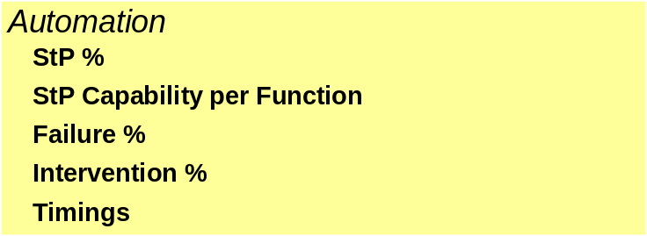
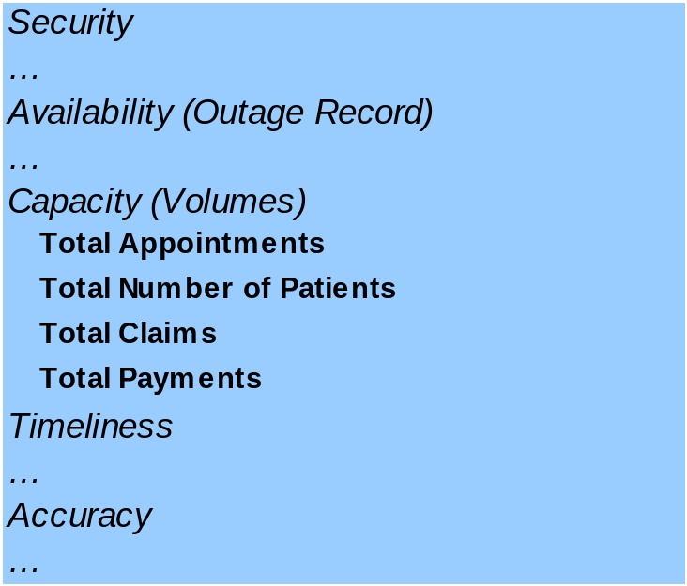
Mapping Against Goals
Application 1
Application 2
Application 3

Slide 6
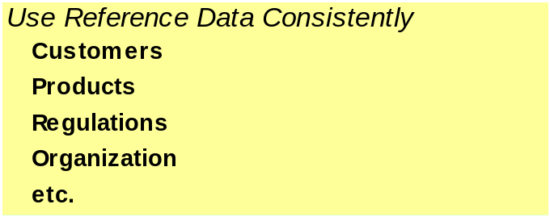
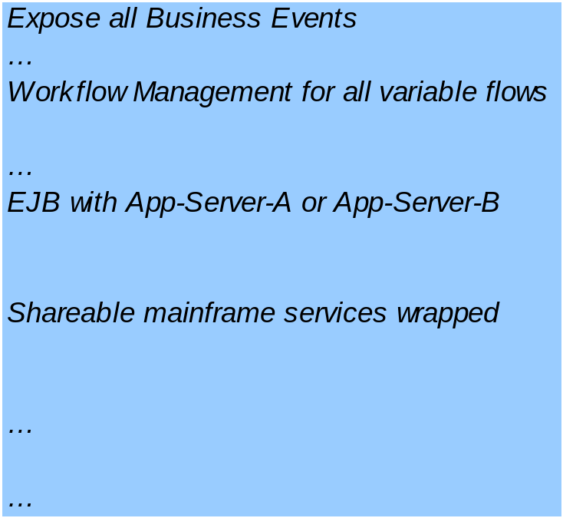
Conformance To Desired Architecture Styles
Application 1
Application 2
Application 3

Slide 7
Comparing Options
Do mapping against the Problem Definition as a starting point
Optionally make these comparisons quantitative using:
  Priorities or Weights for different needs: use these to derive weighted ranks
    Pair-wise relative weighting a bit more reliable
    e.g. Security weight = 2/3, Performance weight = 1/3
    Assign numeric “matching” scores e.g. Application-1
  Analyze domain properties to determine “value” of a match
    e.g. Biometric Security typically prevents N security breaches
    In our domain, a security breach typically could result in $X of estimated cost
    Hence presence / absence of Biometric Security will be “valued” at …

