Slide 1
Appendix: Key Points

Slide 2
MAp Viewpoints
Information supports goals, process
Need shared domain
vocabulary
Process supports goals
Domain / Biz
Architecture
Need shared domain
vocabulary
Goal
1
sub-goal
sub-goal
Outside
Domain: Information
Goals
Biz.Process
Goals – success criteria
Traceability
Black box assembly includes S
Black-boxes use cases and info
models support business model
Black box Assembly (including S)
Three primary viewpoints
Component Architecture
Black box view (of S)
S
1
S
1
S
2
E
D
S: Information / Attributes
Boundary
Black-box Specification (of S)
4
S: Behavior
Architecture Styles: Principles, Patterns, Guidelines, Rules, Transforms
3
White box view of S
sub-component s1…s3
Black box view of S
Styles across viewpoints, projects:
workflow partitioning style
MQ series configuration style
Black-box behavior and info model
partitioned into sub-components
1
2
S
S
Component Architecture
White box view (of S)
s1
s2
Inside
s2
3b
s1
s3
3a
s3
4
Information
Behavior
Each sub-component could be existing separately specified black box, or new spec for next level of drill-down.

Slide 3
Concrete Example to Abstract Model
Concrete Example | Abstract Model
Object | Type
Snapshot | Information Model
Snapshot Pair | Action
Scenario | Role-Activity-Diagram (RAD) / Use Case
Henry : Person
age = 10
Person
age: integer
Information
Spot : Pet
Henry : Person
age = 10
Person
Pet
*
Rover : Pet
age: integer
Henry : Person
age = 10
action adopt pet ( person, pet )
Precondition: …
Postcondition: …
Rover : Pet
adopt pet
Henry : Person
age = 10
Rover : Pet
Behavior
Scenario name: Veterinary care
Initial state: …
Henry makes appointment for Rover
Vet immunizes Rover
Henry rewards Rover
Appt.
Immun.
Reward

Slide 4
Objects and Actions
Distinguish
  Actions: things that happen and cause state change
  Attributes: state that undergoes change
Define the effect of every action on every attribute
  Directly in the pre / post condition of the action
  Indirectly via invariants that
    “propagate” changes from attributes to derived attributes
    “constrain” permissible values of attributes

Slide 5
Concrete Before, During, and After Abstract
Snapshots illustrate concrete situations
Scenarios illustrate concrete interactions
Concrete validates abstract
2 Minute Rule: re-focus wandering discussions to a concrete snapshot or scenario within 2 minutes

Slide 6
Model Attribute is NOT necessarily stored data
Think of attribute as Query – stored or computed
“Convenience” attributes available “for free”
Convenience attribute is short-hand name with definition
Static invariants define legal attributes
Association = pair of inverse attributes
“Parameterized” queries are like maps / tables
Contain complexity in the Information Model

Slide 7
A Model Type is NOT a Class
Type is closer to Interface
A class is an implementation template
Client only cares about types
Type defined by behavior + information
  We focus on behavior of large-grained components
  Behavior is use cases through port specifications
  Information includes inputs / outputs + state

Slide 8

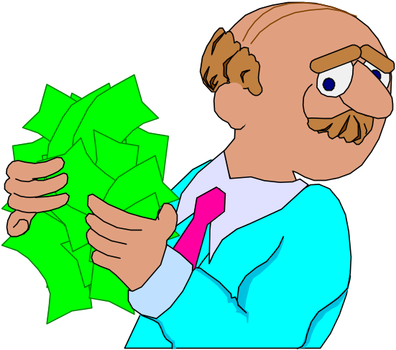
Object – Different Roles, Different Types
Guest
Passenger
Each Type has Behavior + Information
Object masquerades via adaptors if needed
A Component has multiple Ports

Slide 9
A Primary Goal is Clarity
Abstract ≠ Fuzzy Clear ≠ Detailed
Clear terms give clear specifications
Terms should be natural and simple
Say anything important Exactly Once
Good Information Model is the key
Avoid using terms not declared in the model

Slide 10
Black-Box and White-Box Views
Any “System” interacts with its “Environment”
Black-box – focus on externally visible behavior
White-box – focus on internal structure
Component specification: black-box
Component implementation: white-box
Sub-components specs and Connector specs

Slide 11

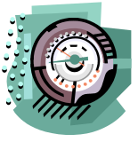
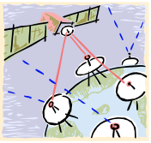

The “Problem” is Outside your Software
Properties of stations, connection: speed, errors, …
Properties of weather: range, changes, movement,
Spec should be based on the properties of the domain
Weather
Stations,
Sensors &
Electronics
Connections
Software
spec
Weather
The Software
Goal: Keep Watchers
informed of Current Weather
Further “Outside”
Internal
Design
Device
Properties of watchers: location, mobile, environment, senses
Watchers
A domain is a part of the world with some shared state or interactions with other domains
  Weather, weather stations, watchers, the machine
Problem domain is different from Machine domain and intermediate “connection” domains
  The problem to be solved may be outside the machine; the machine + connections help solve it
Goals define what the machine must cause in the Problem Domain
  It is expressed in terms of all relevant aspects of the problem domain(s): weather, watchers
Software Specification defines all interfaces of the software, including technical and UI
  It is part of the solution, along with other domains, machines, human operating procedures

Slide 12
Architecture defines Acceptable Designs
Reduce “needless creativity” in design
Architecture described by model
Architecture style = patterns, terms, rules
Architecture style could boil down to
  A Y/N test for whether a given model is conformant
  A constructive set of design elements and rules to build a model

