Slide 1
Model-Driven Engineering, Testing, Deployment
A Light Weight Approach desmond.dsouza@kinetium.com

Slide 2
Most engineering descriptions – code, test cases, configurations, builds, deployment descriptors, schema – can be usefully treated as models. There are some simple and light-weight approaches to this that can be very useful, based on a simple observation:
Code can be a model, too.
We will cover:
  What is MDE
  What makes Code a Model?
  Dynamic and reflective languages, with a focus on Ruby
  Examples of domain-specific languages and models in Ruby
  Agile methods and DSLs

Slide 3
Outline
An Overview of Model-Driven Engineering
  Models and Languages
  Traditional MDA and MDE
  Code can be a Model, provided …
  Domain-Specific Languages
  Preview: DSL in Engineering
Dynamic Languages – with a focus on Ruby
  Overview of Dynamic Languages
  Using a DSL in Ruby
  Building a DSL in Ruby
  Project Builds with Rake
  Executable Tests with R-Spec
  Web Apps with Ruby on Rails
Enterprise Software
  Enterprise Integration and Ruby
  Ruby with Java
Agile Model-Driven Engineering – with a focus on Testing and Scrum
  Scrum (and others)
  Testing and Agility
  Data modeling and agility

Slide 4
AN OVERVIEW OF MDA / MDE
Model Driven Engineering is about
  centering engineering activities
  around models of various kinds
  each expressed in an appropriate language
  with consistency and transformation between models
We outline the bigger context of MDE and explore a smaller slice in detail
  Our smaller slice is about exploiting code as models
domain
requirements
components
tests
db-schema
deployment
deltas

Slide 5
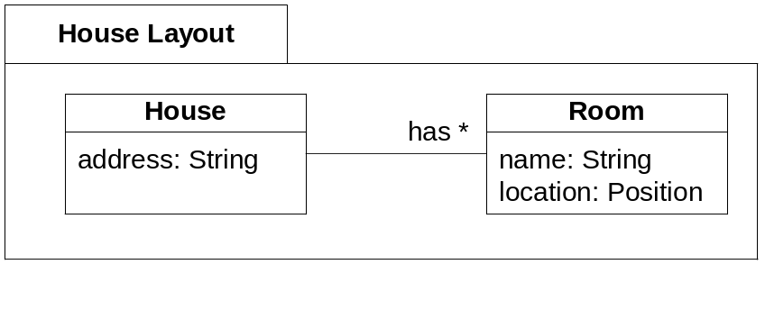
What is a Model?
Model: A structured description of selected properties of a domain or system, using some combination of formal modeling language and informal or natural language
house_layout.dtd
<!ELEMENT House (address, (Room)*)>
<!ELEMENT address (#PCDATA)>
<!ELEMENT Room (name, location)>
<!ELEMENT name (#PCDATA)>
<!ELEMENT location …>
Model ≠ Picture
Models include formal, semi-formal, and informal pictures, text, …
There are many useful models of one system
A model is expressed in a suitable modeling language

Slide 6
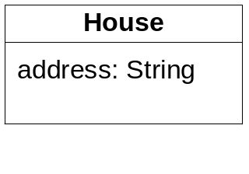
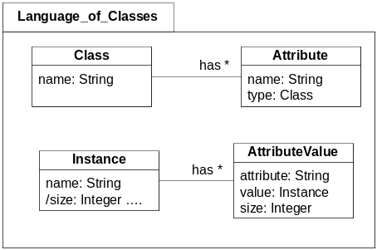
What is a Modeling Language?
Language: A collection of constructs (textual, graphical, etc.), rules to combine them into useful models, and rules to infer from those models.
Class
Noun
Verb
Noun
class name
Attribute
“People drive cars.”
predicate
object
subject
attribute name
attribute type
Sentence
Language: UML class model
Classes have a name and attributes.
Each attribute has a name and a type.
All class instances have values for those attributes.
An object’s data size is the sum of its attributes sizes.
Language: English
Nouns, verbs, rules…
Language: Java …
Language: ANT …

Slide 7
Example – Models and Languages
slider
Button
position
pressed
<<prop>>
<<prop>>
limit
<<event>>
start
temp <<prop>> in
value
in
Thermometer
Threshold
<<event>>
stop
value
out
toggled
<<prop>>
in1
out
in
reactor
OR
Alarm
Switch
in
in2
gradient
out
Differentiator
in
Threshold
Components
Java
This is a model – an abstract description of a running system
  it focuses on logical structure, interconnection, and functionality
  it uses a language of components, properties, events, methods, and connectors between “ports”
Some things are explicitly answered by the model – what is Button/pressed connected to?
Some things can be inferred by the model – how does Button/pressed trigger alarm?
Java language implementation of this would be different e.g. using Java Beans patterns

Slide 8
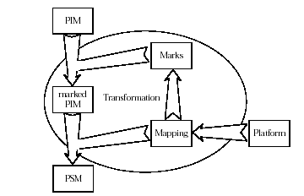
Traditional MDA / MDE
Two main players in this space
  the OMG: with IBM, Rational, others: UML-centered story
  Microsoft: a multiple Domain-Specific Languages approach
Both espouse multiple different models of the domain
Both make a largely static separation of language, model, and instance
  Both downplay behaviors and don’t leverage programming languages
OMG MDA
  A stack of objects, models, meta-models, …
  CIM: Computation Independent Model
  PIM: Platform Independent Model
  PSM: Platform Specific Model
  Annotations / Marks, Mappings, etc.
M3
meta-meta model
M2
meta-models
M1
models
M0
objects

Slide 9
The DRY Principle
Don’t Repeat Yourself
Every important fact or property should be only stated once across all models, code, and other descriptions (unless mechanically generated)
In theory, MDA / MDE is supposed to be totally DRY

Slide 10
MDA / MDE – some Pros, some Cons
Raise level of abstraction
Express in terms more natural to problem domains
Used in many different styles
  sketch UML
  architect UML
  execute UML
Multiple views, levels
“Batch” Generation
Round-tripping
Just Shift Complexity
Complex standards
Missing semantics
Picture-obsessed
Monolithic models
Heavy-weight feel
Heavy-weight tools
Code is 2nd class
Model is 2nd class

Slide 11
Code is a Model provided …
The code is clear and simple in describing its domain
  It uses terms and structures that are natural to a domain expert
  It avoids "computer geek" speak – variables, loops, database tables, etc.
  INSERT INTO queues(id, name) VALUES (1, 'Validate Customer');
  INSERT INTO queues(id, name) VALUES (2, 'Validate Books');
  INSERT INTO queues(id, name) VALUES (3, 'Charge Credit Card');
  INSERT INTO queues(id, name) VALUES (4, 'Ship Order');
  INSERT INTO queues(id, name) VALUES (5, 'Problem Resolution');
  route "EMail Order" do
  step "Validate Customer"
  step "Assemble Order"
  step "Charge Credit Card" do
  on "invalid", :recovery => "Problems/Problem Resolution“
  end
  step "Ship"
  end
The code can be mechanically consumed, generated, manipulated, executed
step
step
route
step
on
step

Slide 12
MAp in Code
MAp builds models to naturally express the architecture
MAp is strict about content and flexible about form
It is entirely feasible to apply light-weight MAp directly in code

Slide 13
Domain Specific Language
A good modeling language for a domain = a domain specific language

Slide 14
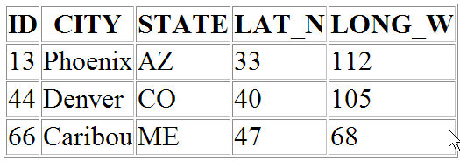
SQL
CREATE TABLE STATION (
ID INTEGER PRIMARY KEY,
CITY CHAR(20),
STATE CHAR(2),
LAT_N REAL,
LONG_W REAL
);
SELECT ID, CITY, STATE FROM STATION
WHERE LAT_N > 39.7;

Slide 15
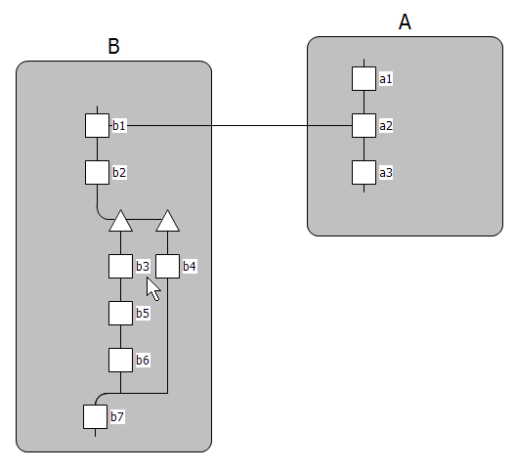
Role Activity Diagrams
Process 1

Slide 16
Steps to a DSL
Concepts: Identify concepts and relations that best express the domain
  Define classes, attributes, operations
Syntax: Choose a syntax (or graphical tooling, or web or GUI interface)
  Implement the syntax to create and connect together objects
  event_queue "airspace" do
  generate_event :every => 5.minutes + 26.seconds
  collision_radius 197.feet + 6.inches
  end
Semantics: Add additional processing logic over the objects as needed
  Execute the objects
  Generate the objects
  Transform into a different set of objects or code
generate
every
event_queue
collision_radius

Slide 17
Preview – DSLs in Engineering
A language to automate builds
  Concepts: sources, files, tasks, dependencies, …
  Syntax: make, ant, and better
  Semantics: do dependency ordering, time stamps, execute tasks, …
A language for technical deployment
  Concepts: applications, servers, server roles, repository, code updates, directories, …
  Syntax: deployment diagram, deployment descriptors, and better
  Semantics: deploy, dummy run, check deployment, reverse engineer, …
A language to define test cases
  conditions, steps, expectations, business-specific terms, …
A language to create web applications
  data model, relationships, views, input data validations, …
A language to configure applications and components
  product, function, user, entitlement → service, resource, role, user, connector, mapping

Slide 18
DYNAMIC LANGUAGES AND RUBY
Languages which are dynamic and reflective offer light-weight ways to define models and DSLs

Slide 19
Dynamic Language
There is a class of languages typically called “dynamic languages”
  Ruby
  Python
  Smalltalk
  Perl
  Groovy
  …
Incremental environments, interpreted or dynamically compiled

Slide 20
What is “Dynamic”?
Dynamic language: does more things dynamically than in a static language
  Creating an "executable“
    Static: compile / link / load activities separate from load
    Dynamic: code in a running program can create new code, load, use e.g. create new classes, methods
  Module dependencies
    Static: C/C++ #include files, Java imports both require the target to be a static constant string
    Dynamic: allow an arbitrary computation to return a target string or target module to be included
  Type checking
    Static: C++/Java require type declared at "compile" time, all variables are typed at compile time
    Dynamic: type declarations absent or optional, run-time objects are typed and dynamically checked
Far-reaching implications on flexibility, testing, evolution
Prioritize programmer convenience and productivity over machine convenience

Slide 21
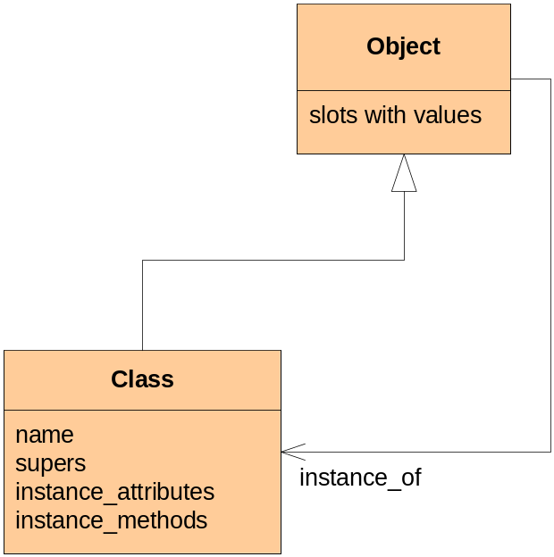
Reflective Languages – with pseudo-code
Reflective: Language constructs defined, accessible, extensible in the language itself
The language itself may define:
class Object { attribute values …. };
class Class extend Object { name ... super classes … methods … instance attributes … };
class Method extend Object { execute () …. };
The language can allow me to access these
Worker.name #
The language may allow me to extend these
class MyClass extend Class { String owner; }
The language may allow me to use my extended language constructs
class Worker ⬅ MyClass {
owner = “HR Department”
};
Reflective and dynamic go very well together
Simplifies many things
  compare/contrast to OMG strict meta-modeling tower
Classes and Methods can be manipulated like Objects

Slide 22
Ruby
Clean, intuitive, productive, practical, low-noise, and thoroughly enjoyable
Simple syntax
class Worker
trait :salary => 0
def promote (amount)
salary = salary + amount
end
end
Everything is an object
  joe joe.promote 20 joe.promote(20) # parenthesis optional
  Worker joe = Worker.new
  Class New_Worker_Class = Class.new
  26 successor = 27.next
Extensible anytime by anyone
class Numeric
def days
Days.new self # e.g. delay = 5.days + 2.hours
end
end
Functional – easy anonymous “function” objects
project_list.select { | p | p.priority > 5 }
Easily used as a procedural language
def upload_files
…do some stuff…
end
…
upload_files

Slide 23
Ruby Reflection – Code Examples

Slide 24
Using an Associations DSL in Ruby – Concepts & Syntax
class Project
# in here self is Project itself i.e. a class
has_many :tasks
# this simply calls the has_many method on Project itself
has_one :completion_date
end
And this can be done dynamically, incrementally since the DSL is straight Ruby
…
Project.has_many :a_late_addition
…

Slide 25
Build an Association DSL in Ruby (1) – syntax
class Class
trait :many_assocs => []
def has_many (name)
self.trait name => []
self.many_assocs << name
end
def has_one (name)
…
end
end

Slide 26
Build an Association DSL in Ruby (2) – semantics
class Object # any object whose class uses has_many or has_one
# add code that checks self.class for has_many X or has_one X
# and accordingly respond to
# object . X
end
class Class
def to_string
puts “class #{name}”
many_assocs.each { |n| puts “ has_many :#{n}” }
puts “end\n”
end
def to_relational_db
end
end
it’s class
many_assocs
one_assocs
object
instance_var @x
object . X

Slide 27
Using a SQL DSL in Ruby
create_table “categories” do |t|
t.column “title”, :string
t.column “image”, :text
end
create_table “items” do |t|
t.column “title”, :string
t.column “date”, :date
t.column “time”, :time
t.column “category_id”, :integer
t.column “position”, :integer
end
Do this anywhere in the code, since the DSL is straight Ruby

Slide 28
Implementing a SQL DSL in Ruby
def create_table name, &block
# create the table object
table = Table.new name
# evaluate the block of code on that table
block.call (table)
# complete the table in the database
table.create_in_database
end
class Table
def column name, type
end
create_table “categories” do |t|
t.column “title”, :string
t.column “image”, :text
end
create_table “items” do |t|
t.column “title”, :string
t.column “date”, :date
t.column “time”, :time
t.column “category_id”, :integer
t.column “position”, :integer
end

Slide 29
Using a RAD DSL in Ruby
Ordering
RAD :Ordering do
role :B do
act(:b1) >> act(:b2) >> act(:b3, :b4)
act(:b3) >> act(:b5) >> act(:b6)
act(:b4, :b6) >> act(:b7)
end
role :A do
act(:a1) >> act(:a2) >> act(:a3)
end
interaction :b1, :a2
end

Slide 30
Implementing a RAD DSL in Ruby
def RAD name &block
rad = Rad.new name
rad.instance_eval &block
rad
end
class Rad
def role name &block
role = Role.new name
role.instance_eval &block
end
end
class Role
def act …
end
RAD :Ordering do
role :B do
act(:b1) >> act(:b2) >> act(:b3, :b4)
act(:b3) >> act(:b5) >> act(:b6)
act(:b4, :b6) >> act(:b7)
end
role :A do
act(:a1) >> act(:a2) >> act(:a3)
end
interaction :b1, :a2
end

Slide 31
Notes on DSLs in Ruby
The DSL is embedded into Ruby itself
Concepts are implemented with standard Ruby objects, classes etc.
Syntax is implemented with Ruby methods, :names, parameters, blocks
Semantics are implemented with additional Ruby methods
The full power of Ruby and libraries is available to the DSL as needed
Syntax remains Ruby and (strictly speaking) is not really being extended

Slide 32
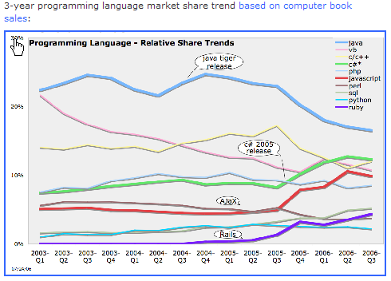
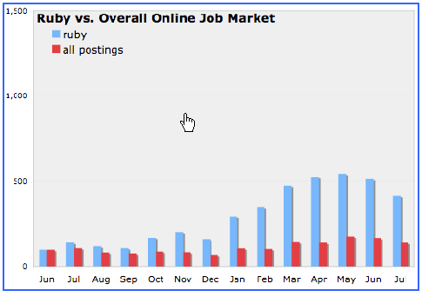
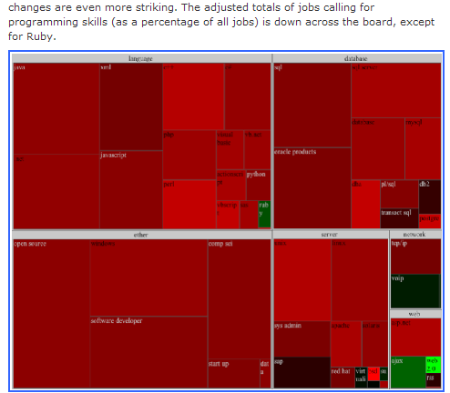
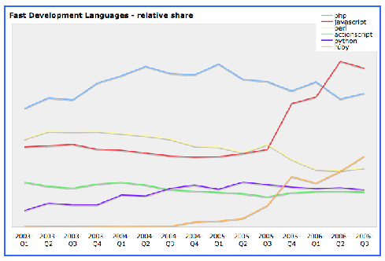
Ruby Trends 2006

Slide 33
Project Build Automation – Rake
Automating project builds is not as straightforward as it might initially appear. Effectively defining and managing builds needs
  a simple DSL for simple cases
    sources
    targets
    files with time-stamps
    compilers, linkers, etc.
  a very expressive DSL for complex cases.
    FTP transfers, SSH sessions and commands
    Conditions
    Loops
    Reporting
    Debugging
    Patterns of dependencies
    Unbounded numbers of sources and targets
    Transactions
    Time-stamped or content-based (signature-based) versioning

Slide 34
Rake
Rake files are a DSL in standard Ruby syntax with full Ruby power
Specify files with prerequisites input files / dependencies
file “begin.o” => [“begin.c”, “begin.h”] do # calls def file …
sh “cc –c begin.o begin.c”
end
file “end.o” => [“end.c”] do
sh “cc –c end.o end.c”
end
file “run” => [“begin.o”, “end.o”] do
sh “cc run begin.o greet.o”
end
What are the Concepts? Syntax? Semantics?
How can we further improve this DSL?
begin.c
begin.h
end.c
begin.o
end.o
run
Command-line invocation:
rake run
rake begin.o
etc.

Slide 35
Rake - continued
Use Ruby constants, regex, etc. to define patterns, lists of files, etc.
  SRC = FileList[‘*.c’]
Create dependencies dynamically since the DSL is straight Ruby
  SRC.each do | src_file |
  object = src_file.sub ‘.c’, ‘.o’
  file object => src_file do
  sh “cc –c #{object} #{src_file}”
  end
  end
Or use a pattern syntax to define the dependency rule
  rule ‘.o’ => ‘.c’ do |task|
  sh “cc –c #{task.name} #{task.source}”
  end
Specialize Rake::Task, extend DSL syntax, run tests, check-in/out of SVN, …

Slide 36
Rake – example mixing Ruby and DSL
desc "upload web zip via ftp"
task :upload_web do
ftp_upload PATHS.local_web, PATHS, PATHS.upload_dir
end
def ftp_upload (src_file, site, target_dir)
require 'net/ftp'
require 'pathname'
ftp = Net::FTP.new(site.server, site.user, site.pw)
ftp.chdir target_dir
FileUtils.chdir src_file.dirname
ftp.putbinaryfile( src_file.basename, src_file.basename )
end

Slide 37
Executable Tests – R-Spec, Systir, Watir
Tests clarify requirements and should be defined clearly and early
Most tests should be defined in the terms of the problem domain
Traditional approaches to Unit Testing have too high “geek” factor
Ruby and its DSLs provide more than one alternative

Slide 38
Executable Tests – R-Spec as Test Specifications
$ spec admin_spec.rb
Last Administrator Account
- should raise error on Delete
- should always have its Do_Not_Delete flag set
Login With Invalid Password
- should allow up to 3 tries
- should shut off account on 3rd failure

Slide 39
Executable Tests – R-Spec as Executable Tests
context ‘Last Administrator Account' do
setup do
@accounts.clear_all
@accounts.add “Admin”
end
specify ‘should raise error on Delete' do
proc { @accounts.delete “Admin” }.should_raise LastAdminDelete
end
specify ‘should always have its Do_Not_Delete flag set' do
@accounts.get(“Admin”).flags.should_include :Do_Not_Delete
end
end

Slide 40
Executable Tests – Mock Objects
Mock objects – intelligent monitoring/responding stubs at test boundaries
Effective and responsive automated tests demand mock objects
external_ftp_server = mock(“ftp")
external_ftp_server.should_receive(:upload).once.with(1, 2, 3)
external_ftp_server.should_receive(:upload).once.and_return(‘fail’)
external_ftp_server.should_receive(:upload).once.
and_return { |arg| dynamically_respond_to(arg) }
Mock These
Test These

Slide 41
Executable Tests – Systir for business scenarios
launch_ovsi_program
login_as_administrator
go_to_user_admin_panel
add_user {
name “Bob"
password “happy_new_year"
privileges “customer rep”
}
logout
login_as “Bob"
verify_user_can_see self_service_screen
verify_user_cannot_see access_admin_panel
logout
close_ovsi_program
What would be behind each DSL statement?
What does it take to execute this test?

Slide 42
Executable Tests – Web Interfaces test with Watir
def login_as_administrator
browser = IE.new
browser.goto “ovsi.internal.com"
browser.text_field(:name, ‘user').set(“admin")
browser.text_field(:name, ‘pw').set(“admin_pw")
browser.button(:value, ‘Login').click
end

Slide 43
Executable Tests – from 1st Class Models
Executable tests apply to 1st class models and modeling tools as well
Can support model-based specification, test generation, test execution
Example – Xactium test-based modeling and implementation

Slide 44
Web Applications – Ruby on Rails
One of the highest-profile open source initiatives around 2006-2008
Very strongly scopes certain problems in, and others out
Very productive for a substantial number of database-web applications
Leverages multiple DSLs
Implements Model-View-Controller pattern
Very DRY, ruthlessly prefers convention over configuration
Simplifies common tasks, allows “professional-grade” customization

Slide 45
Ruby on Rails Example
Grant Management System
Main entity: Grant
  Project Name
  Organization Name
  Project Goal
  Amount Requested
  Total Budget
Evolves from domain language of Grant to web language of html, AJAX, web services, etc.

Slide 46
Ruby with Java
Ruby is available on the JVM as J-Ruby
J-Ruby is integrated with Java
  use Java classes and interfaces
  subclass Java classes and override methods
  test Java code
  interactively experiment in mixed Java and Ruby setting
  run Ruby-on-Rails on Java …
Sun recently hired the leads on this project to continue the work in Sun

Slide 47
J-Ruby Example
require 'java‘
include_class 'javax.swing.JFrame‘
include_class 'javax.swing.JLabel‘
include_class 'javax.swing.JButton‘
frame = JFrame.new("JRuby panel")
frame.add JLabel.new(“A Label from JRuby”)
frame.add JButton.new("Push button from JRuby")
frame.pack
frame.show

Slide 48
ENTERPRISE SOFTWARE

Slide 49
Easy Street – made for Ruby
By Steve Vinoski
ECS – Enterprise Class Software
STRTE – Software That Runs The Enterprise
ECS: those big-company processes doing10 million transactions a minute, which span five different databases on three different hardware platforms, run on an amalgamation of equipment, from rack-mounted servers to mega-switches to specialized phones, take three years to write, and three more to get right.
STRTE: the internal HR web portal that lets employees discover the phone number of the benefit planner without having to call the CEO, does the project builds, deploys and re-configures the deployment, reaches into the 50 Word documents and Excel spreadsheets on the marketing guy's Desktop and turns them into records in his contact manager, scrapes Amazon for data about the products your company sells, and dumps the scraped data into a local LDAP store for analysis later. It is, in short, everything that anybody in the enterprise actually interacts with.

Slide 50
Integration, Utilities, and Libraries
Ruby has tons of very easy-to-use libraries in Ruby itself
  dbi, active record, og : to interface to relational data
  rexml : to manipulate XML
  csv : handle comma-separated values
  sockets : communication
  http : and many variants
  smtp :
  ldap :
  ftp :
  ssh :
  soap and wsdl :
Easily bridged to external ‘C’ libraries
Easily bridged to Java libraries

Slide 51
Comma-Separated Values
class User
inherit UniquelyNamed
attr_accessor :entitlements
def entitlements
@entitlements ||= []
end
attr_accessor :assigned_role
attr_accessor :full_name_1, :full_name_2, :geid # diff sources
def self.load
file = "cs_user_prod_func_postLoc_printer.csv"
file = "test.csv"
FasterCSV.foreach(file, :headers => :true) do |row|
user = User.new(row["Initials"])
user.full_name_1 = row["Name"]
product = Product.new(row["Product"])
function = product.add_function(row["Function"])
user.entitlements << function
end
puts "---------------\nLoaded Users file"
stats
end
end
User.load

Slide 52
The Glue That Doesn’t Set – PragDave
That's all very well, but what does writing little utility scripts have to do with real-world web programming? A whole lot, as it turns out.
As we move into a world where the network is the computer, applications change in character. Rather than writing free-standing islands of code, developers are increasingly writing programs that knit together other, existing web resources. Want to annotate a map with pictures of famous landmarks? Maybe you'll want to use the Google Maps and Flikr APIs to carry most of the load for you. Want to let your readers know when their product has shipped? Why not generate the information as RSS and let their aggregator client do all the gruntwork of displaying the result? As we move forward, more and more of our applications will be less and less like one-man bands and more like orchestra conductors.
Our applications are increasingly becoming glue code. And, if that's the case, I'd rather write them using a glue that doesn't set over time.

Slide 53
AGILITY
Waterfall is wrong
Model-driven does NOT imply waterfall at all
Early thinking about the domain, goals, etc. maps directly to DSL
Other Architecture decisions map to DSL – components, connectors
Scenarios, snapshots, etc. map directly to executable tests
Doing things iteratively maps directly to automated builds and tests
There is no need for complicated and heavy-weight metrics
Scrum is an exemplar of a very sensible, managed, agile, method

Slide 54
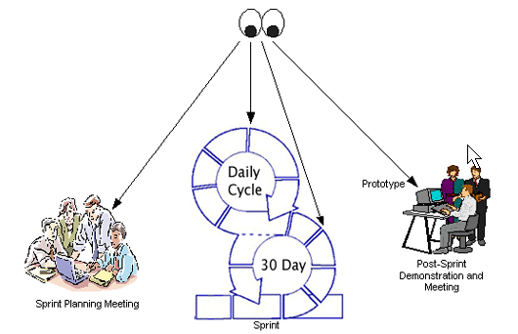
Scrum – A series of Planned Sprints delivering Software
Daily status on team progress – standing room only !
Iterative (every 30 days) reviews of product-level progress
Everything is visible - what's to be worked on, how work is progressing, and what has been built - supporting management decisions regarding cost, time, quality, and functionality
Backlogs (product, release, sprint) is current estimate of remaining work
Management is apprised daily what it can do to help the development teams - what decisions are needed, and what's getting in the way.

Slide 55
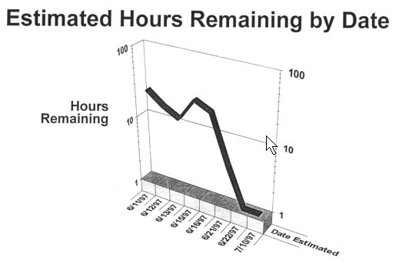
If you do a Single Metric – the Burn down Chart
It is surprising how easily you can live without most other metrics if you have this one
Built directly from backlogs
  Product
  Release
  Sprint
Optionally – supplement with test-coverage and bug-count for burn-down sanity check

Slide 56
If you use a practice from XP – Test Driven
Why is any given piece of code needed?
  Where are the tests for it?
First write the test
  Then write the code to make the test pass
  Then write the next test …
Save as automatically-run regression tests
Continuously re-factor design to eliminate duplication and get simple design
Additional scaffolding – mock objects, stubs, test automation

Slide 57
Ruby eases tests, mocks, and automation
We have seen examples of all these
Ruby can be a very useful tool in any approach, specially an agile one

Slide 58
Agility and Infrastructure
Can’t do all this without infrastructure
  Process
  Project automation and support
  Other tooling
Contrast
  Email-based sharing, editing, versioning, …
  Subversion + Trac

Slide 59
Acknowledgements & References
Used stuff from www.onestepback.org
Used Ruby examples from www.ruby-lang.org
User Ruby examples from www.rubyforge.org
For MOF, UML, etc. used www.omg.org
For Microsoft’s DSL story used msdn.microsoft.com/vstudio/dsltools

