Slide 1
Example – Intermediate Goals + Domain
Shield Info Resources
or
Limit Entitlement to
Supporting Resources
Ensure Supporting
Resource Integrity
Ensure All Paths
to Info Covered
Harden Info. Resource
Shield Supporting
Resources
Supporting
Resources
servers, clients
storage, network
people, processes
physical facilities
Resources
Entitlements
Principals
Information
Resources
Supporting Resource Available
Entitled to
Supporting Resource
Ensure Info Availability
Ensure Info Integrity

Slide 2
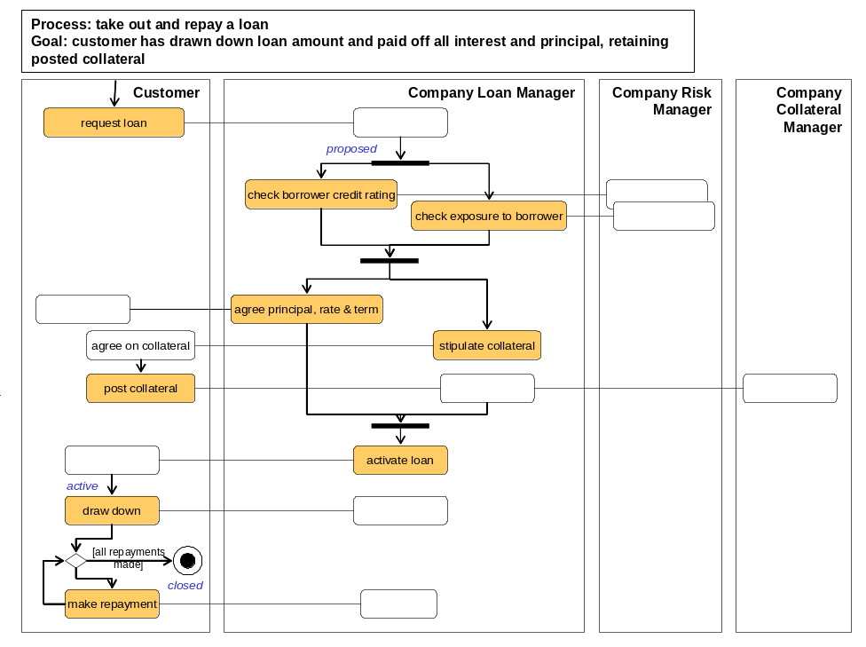
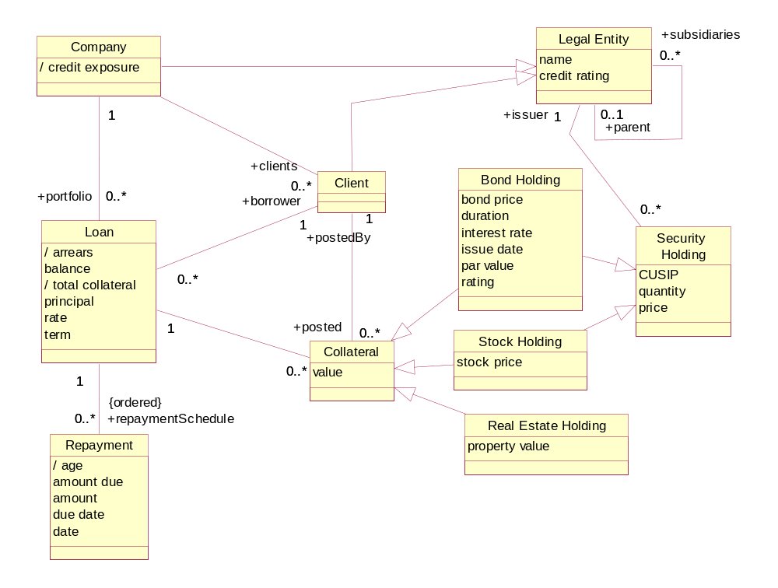
Example – Goals, Domain Model, Biz Process Model
Clear Information Terms
Convenient Derivation Rules
Goals + Process use Information Terms
<<goal>>
Minimize Risk
<<goal>>
Maximize Return
Predict Risk
….
Adjust Risk Exposure Factors
…..
Track Risk Prediction History
Learn Over Time

Slide 3
Example – Top Level Black Boxes Info Partition
Loans
Reference Data
Collateral

Slide 4
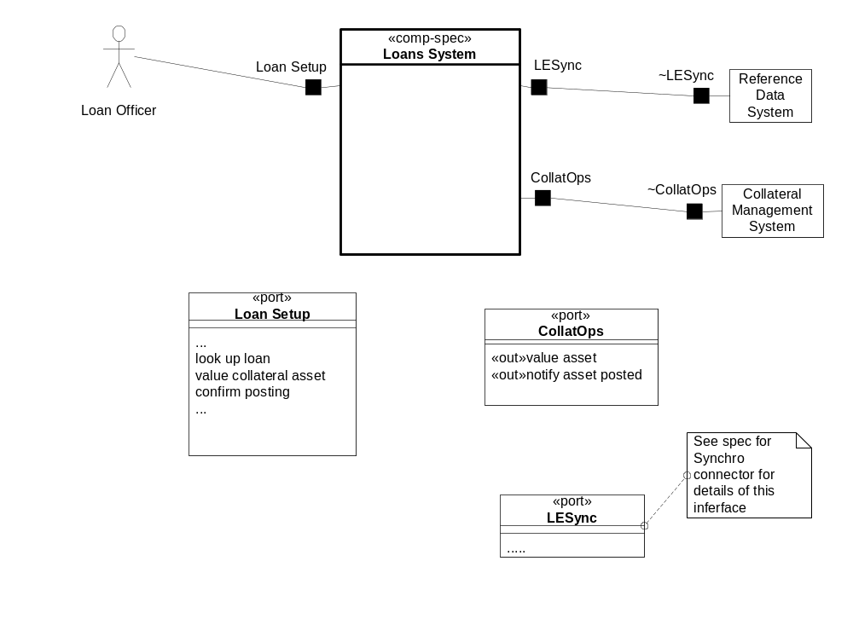
Example – Black Box Context

