Slide 1
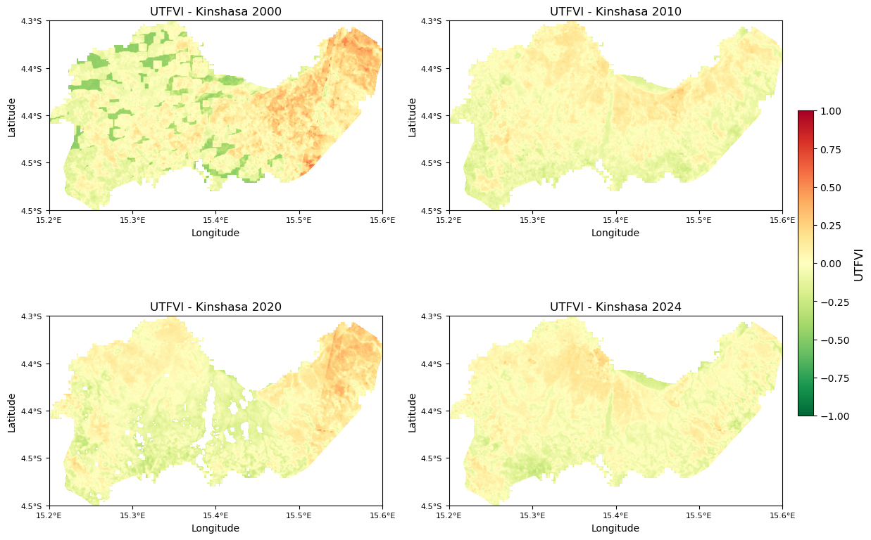
a)
b)
c)
d)

Slide 2
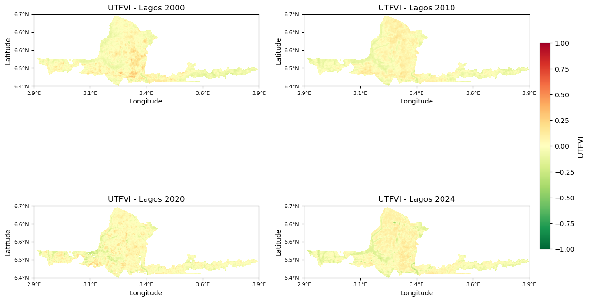
a)
b)
c)
d)

Slide 3
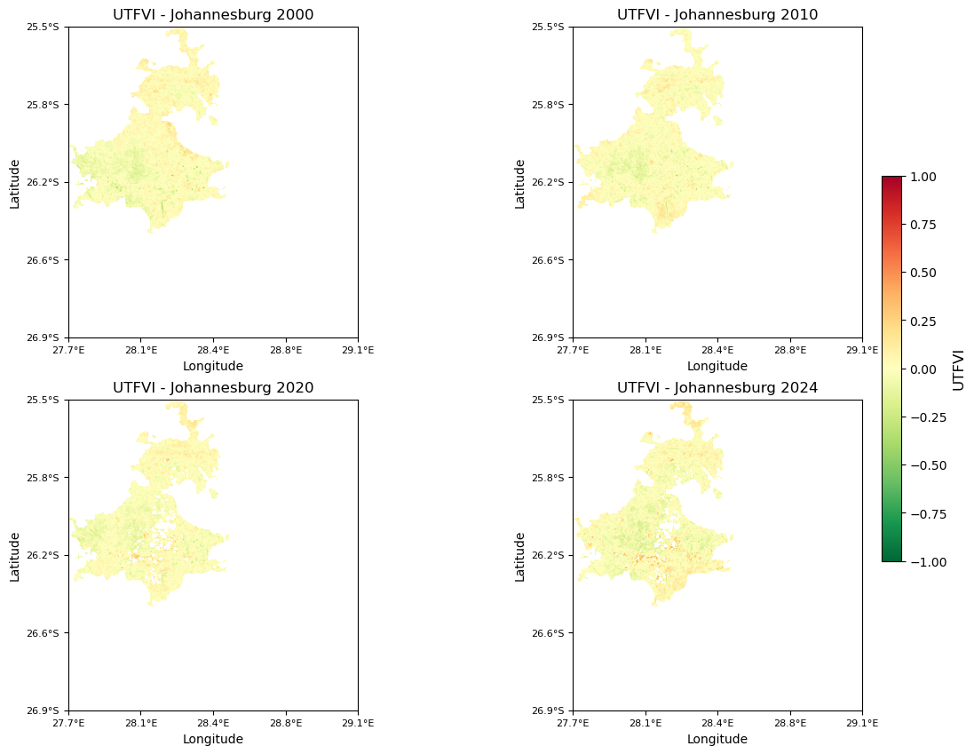
a)
b)
c)
d)

Slide 4
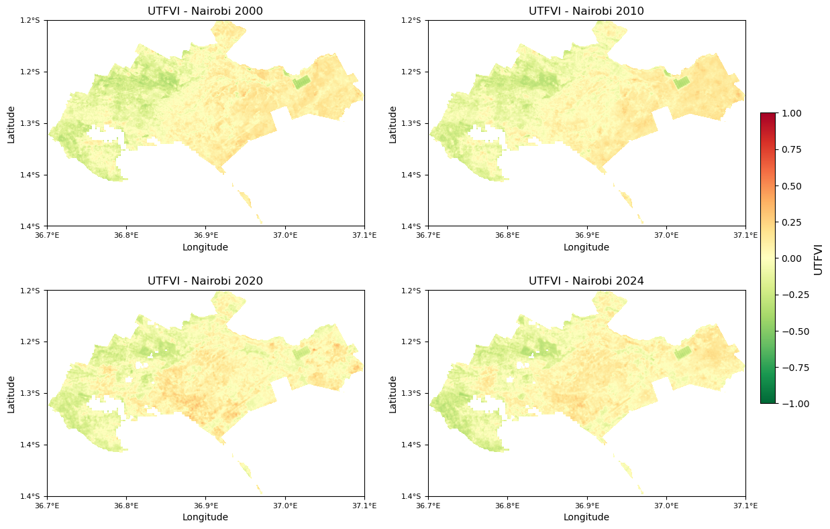
a)
b)
c)
d)
Notes:
From 2000 to 2024, Nairobi and Kinshasa exhibit significant declines in urban thermal stress as reflected in widespread cooling, while Lagos and Johannesburg show relatively stable UTFVI patterns with minimal change.
a) Nairobi (2000–2024)
Nairobi's UTFVI maps show a clear spatial shift from moderately warm zones (yellow-orange) in 2000 and 2010 toward cooler green areas by 2020 and especially in 2024, indicating widespread reduction in urban thermal stress.
b) Lagos (2000–2024)
Lagos remains relatively stable across all years, with minimal visible change in UTFVI values, suggesting consistent thermal conditions and limited expansion of heat-stressed zones.
c) Johannesburg (2000–2024)
Johannesburg shows a persistent yellow-green pattern across all years, with minor reductions in warm zones by 2024, pointing to moderate but stable urban heat levels over time.
d) Kinshasa (2000–2024)
Kinshasa’s thermal conditions improve noticeably from 2000 to 2024, with a significant decline in reddish heat-stressed areas and a rise in green, cooler zones, particularly after 2010.

Slide 5
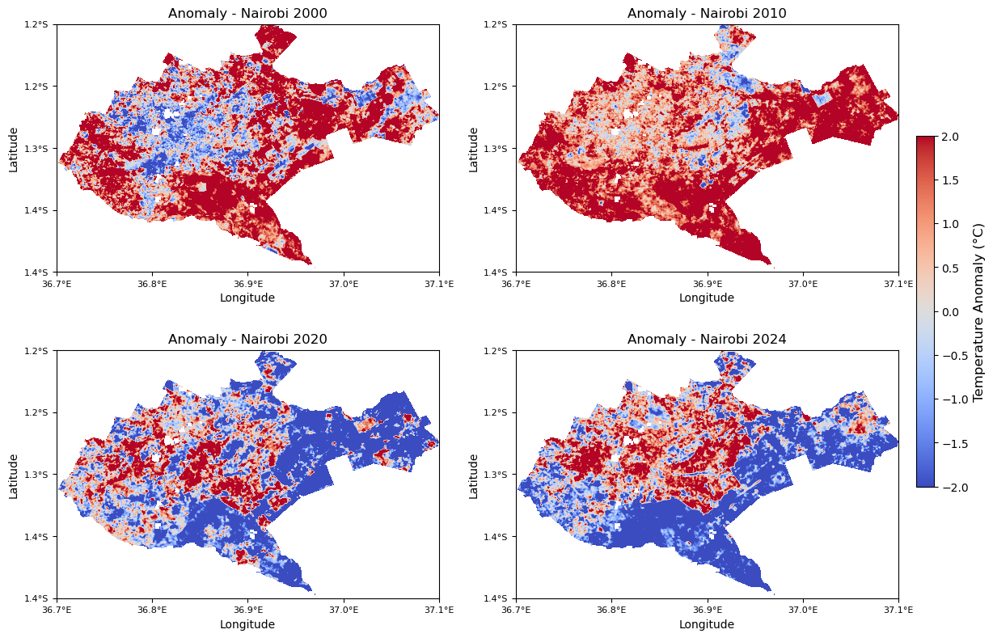
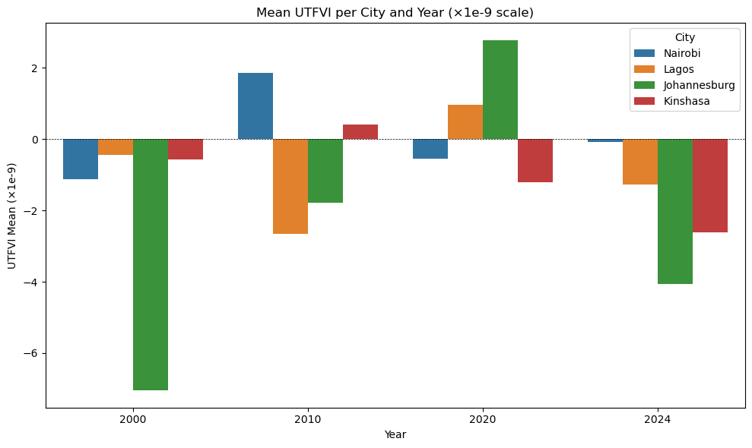
a)
b)
c)
d)

Slide 6
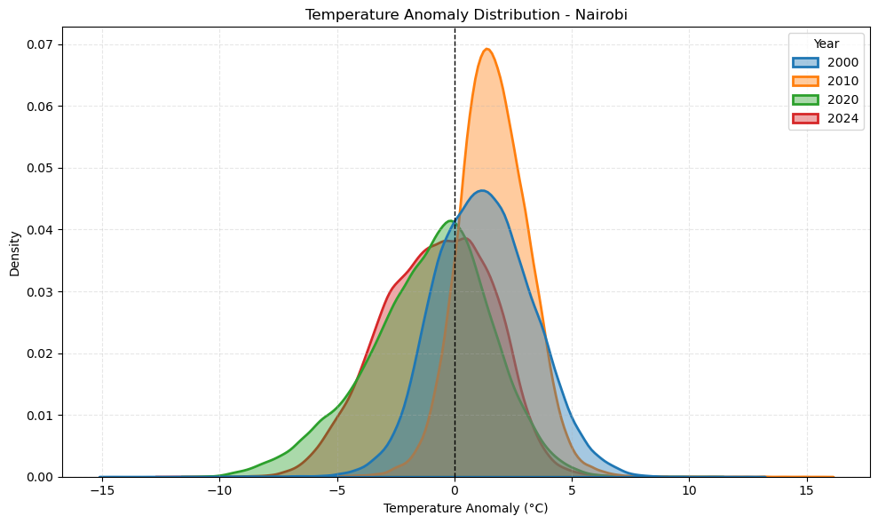
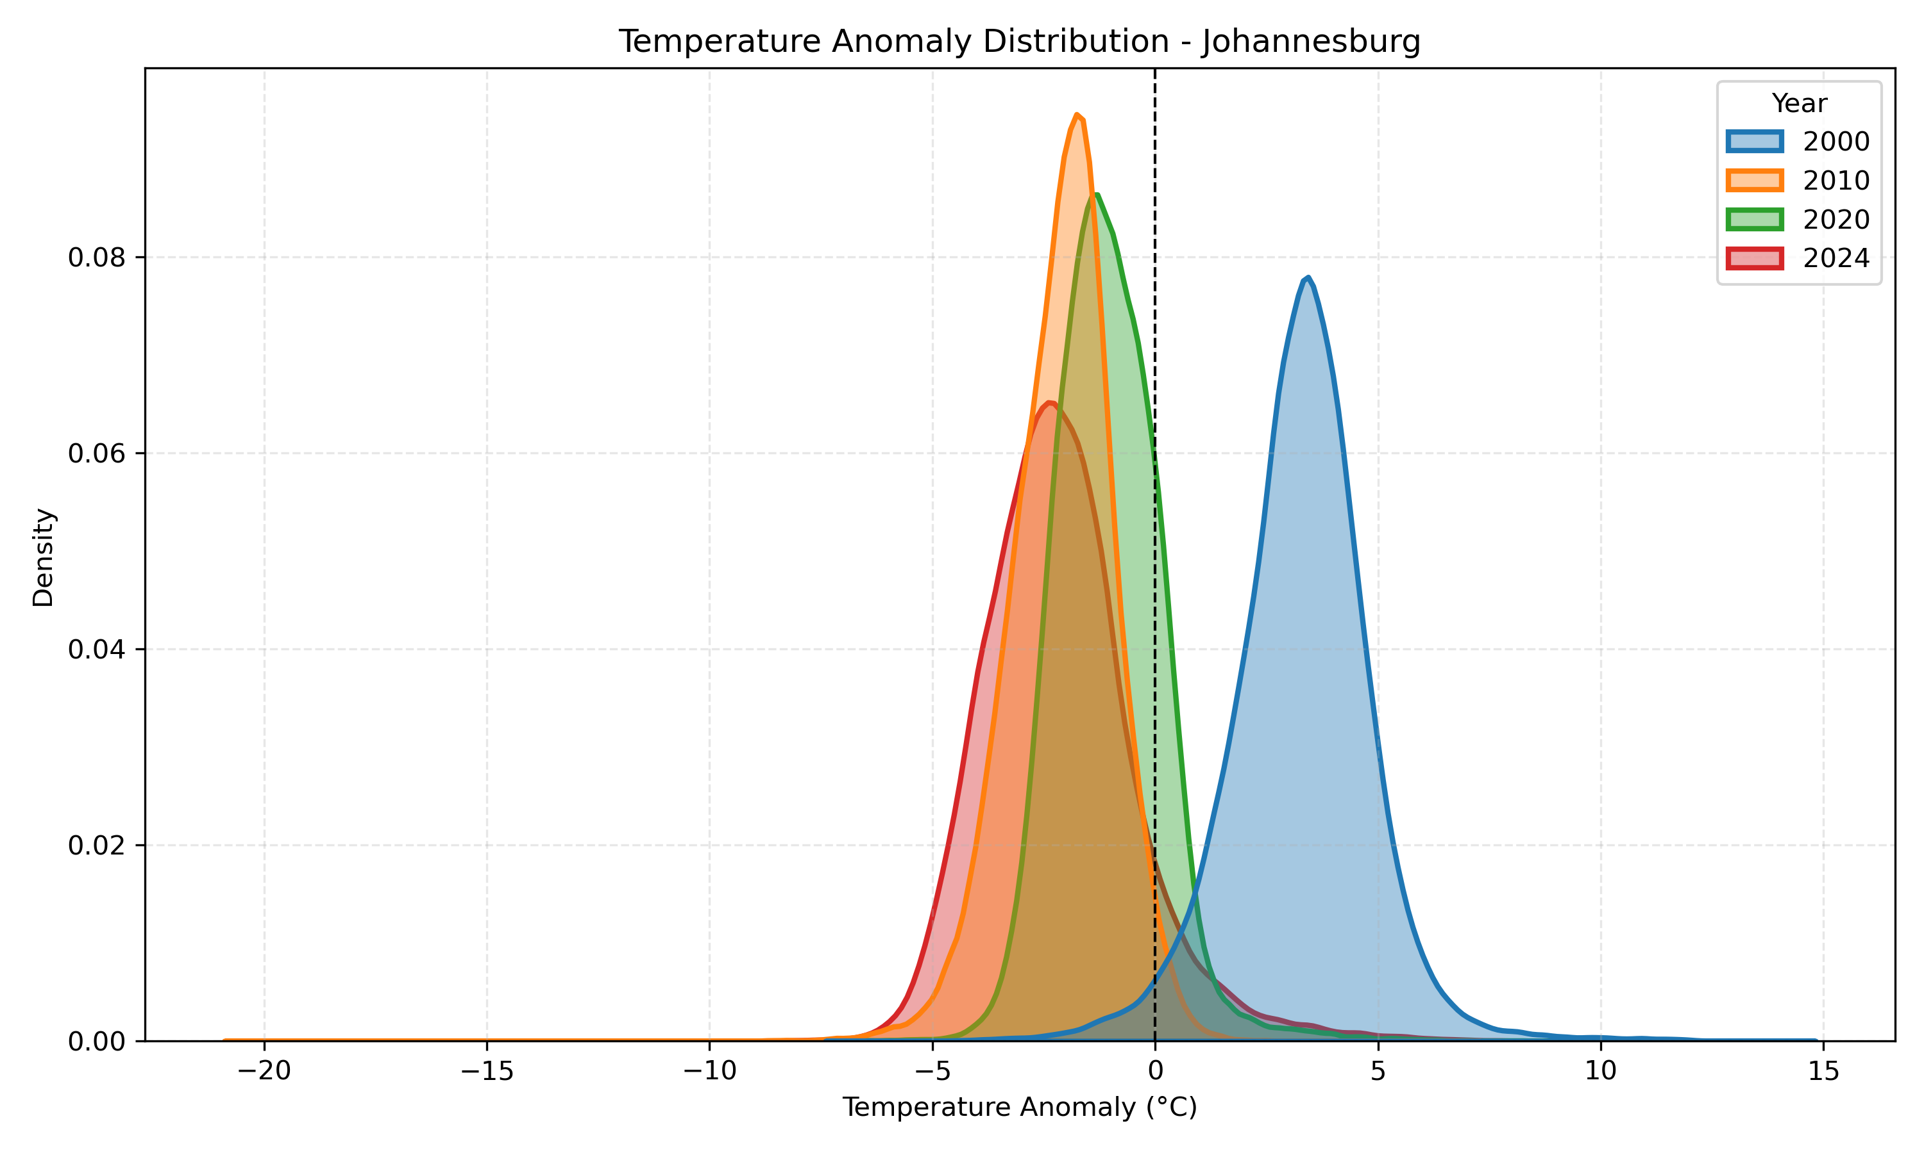
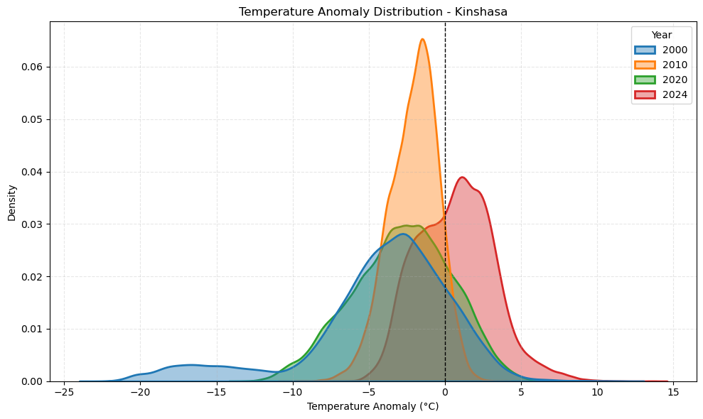
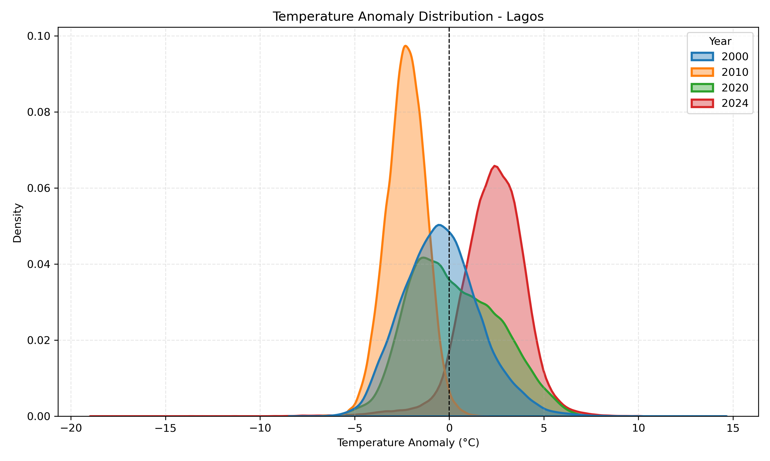
a)
b)
c)
d)
Notes:
Temperature anomalies are increasingly shifting toward cooler values in Johannesburg and Nairobi, while Kinshasa and Lagos show a clear warming trend, especially by 2024, indicating diverging climate dynamics across the cities.
a) Nairobi In Nairobi, the temperature anomaly distributions for 2000 and 2020 are relatively centered near zero, while 2010 shows a leftward shift indicating cooler conditions. By 2024, the distribution broadens and slightly shifts left again, suggesting increased variability and potential cooling compared to 2020.
b) Johannesburg Johannesburg exhibits a clear warming trend, with the 2000 distribution centered above zero, while 2010, 2020, and 2024 shift progressively leftward into negative anomalies. This indicates a transition from warm anomalies in 2000 to consistently cooler conditions over time, with 2024 showing the most pronounced cooling.
c) Kinshasa Kinshasa's temperature anomaly distribution for 2000 and 2010 remains skewed toward negative values, suggesting cooler conditions during these years. However, by 2024 the distribution shifts markedly to the right, indicating a warming trend with higher frequencies of positive temperature anomalies.
d) Lagos Lagos shows overlapping distributions from 2000 through 2020, generally centered near or slightly below zero, indicating moderate and relatively stable anomalies. In contrast, the 2024 distribution shifts distinctly to the right, reflecting a significant rise in temperature anomalies and a shift toward warmer conditions.

Slide 7
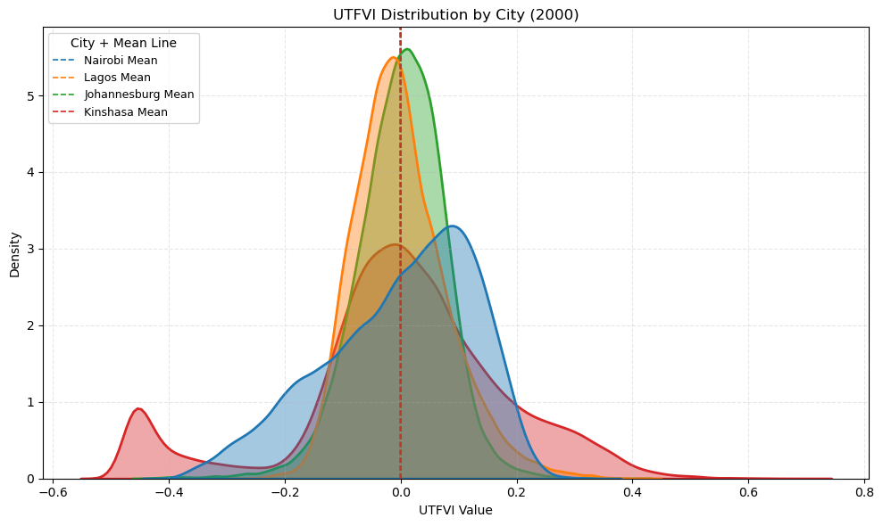
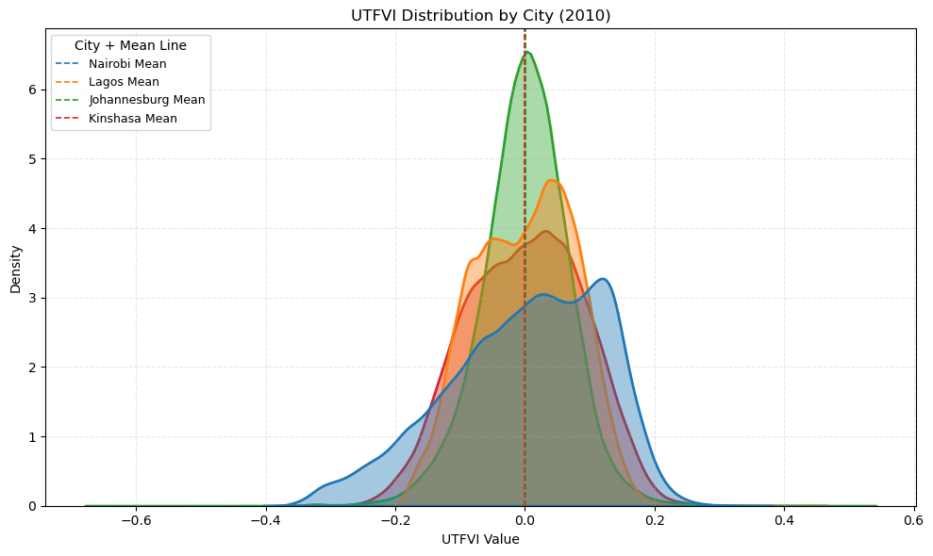
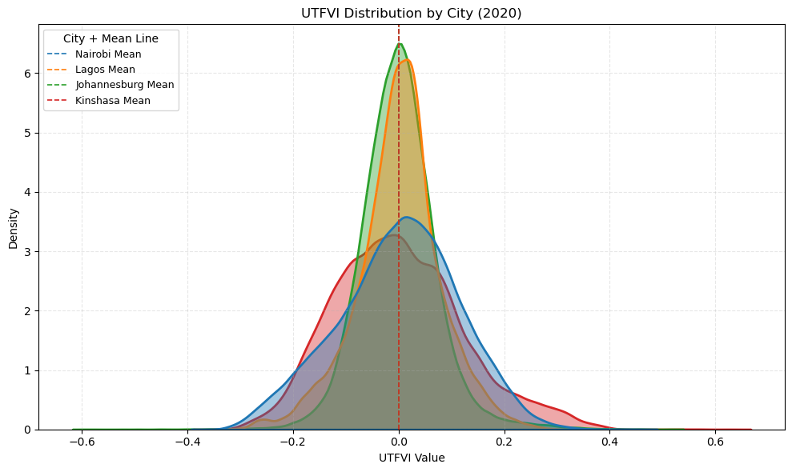
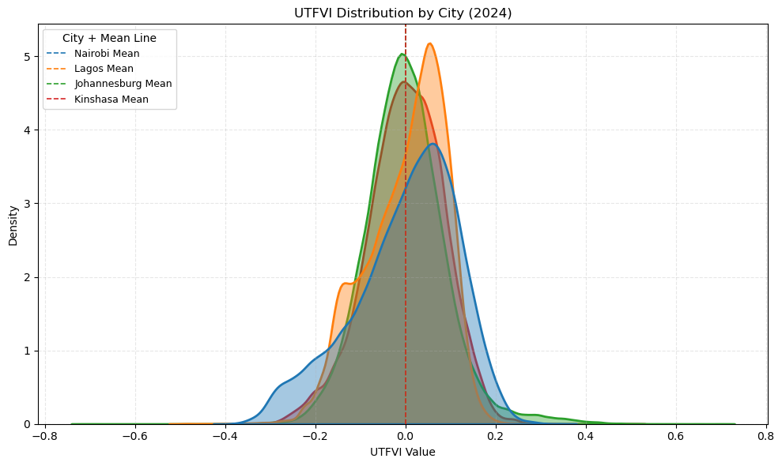
a)
b)
d)
c)
Notes:
Urban thermal stress is intensifying in Nairobi and gradually emerging in Kinshasa, while Johannesburg and Lagos remain relatively stable with minimal change in urban heat variability over time.

Slide 8
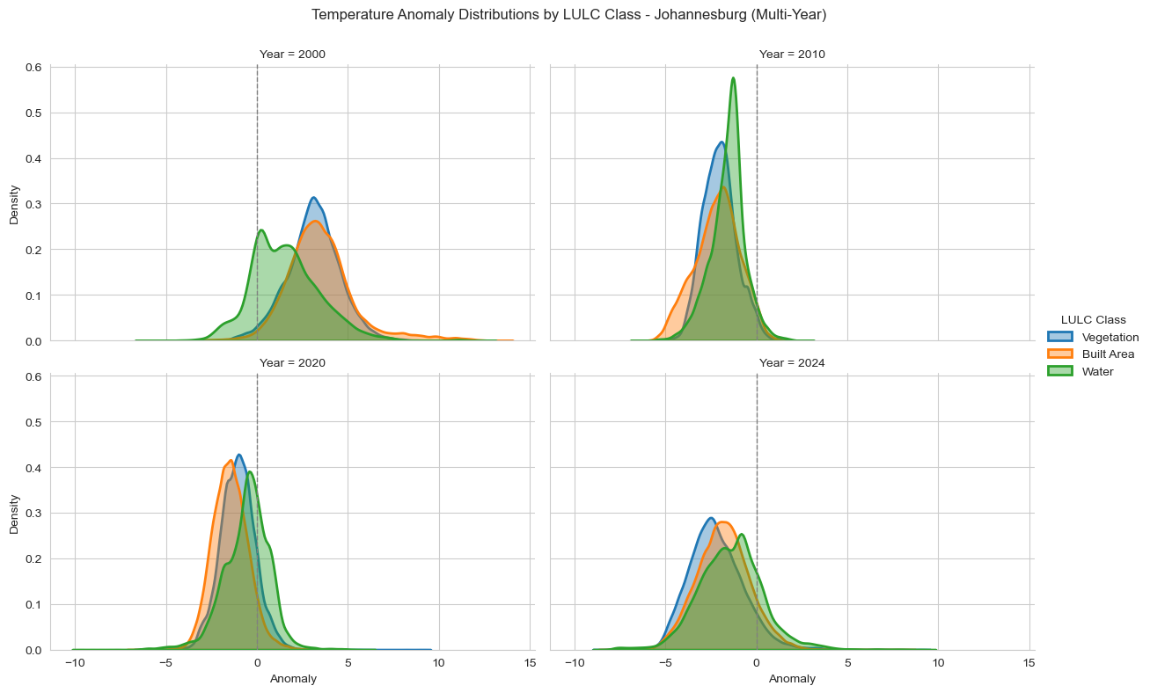
a)
b)
c)
d)
Notes:
Johannesburg is experiencing a steady and consistent shift toward surface cooling across all land cover types, especially in built-up areas, from 2000 to 2024.
a) Year 2000 In 2000, temperature anomalies in Johannesburg showed mixed distributions, with vegetation and built-up areas clustered near zero while water bodies had a slightly cooler bias.
b) Year 2010 By 2010, all three land cover classes—vegetation, built-up, and water—converged toward more compact distributions centered around slightly negative anomalies, indicating mild cooling.
c) Year 2020 In 2020, the distributions for all LULC classes shifted more clearly into negative anomalies, with built-up areas showing the highest density of cooler values.
d) Year 2024 By 2024, all land cover classes displayed consistently negative anomaly distributions, with little overlap near zero, highlighting intensified and uniform cooling across Johannesburg's surface.

Slide 9
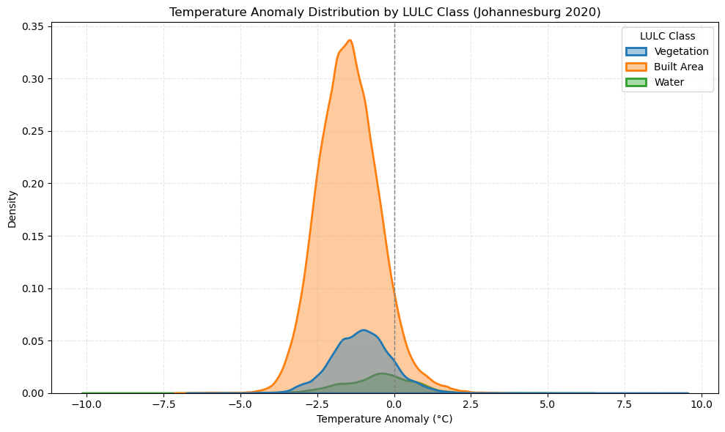
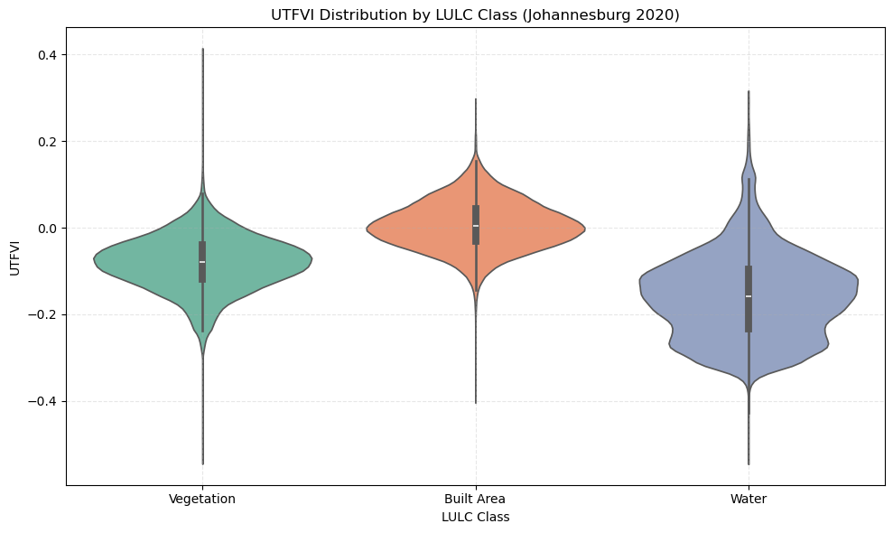
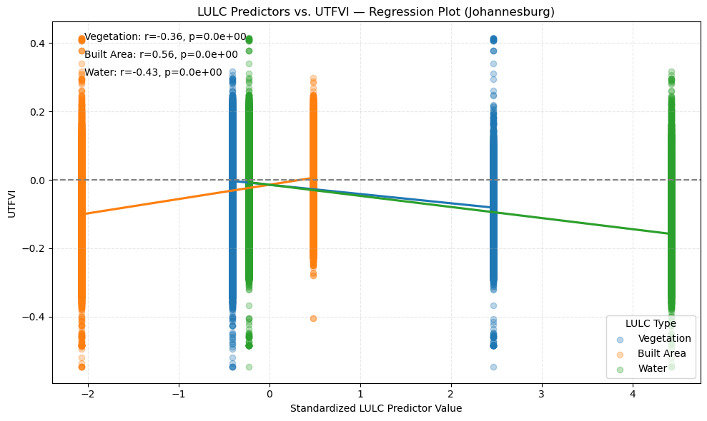
a)
b)
c)
Notes:
In Johannesburg, built-up land cover is the primary driver of urban heat, strongly associated with higher UTFVI and cooler surface anomalies, while water and vegetation consistently mitigate thermal stress.
a) Temperature Anomaly Distribution by LULC (2020) In 2020, built-up areas in Johannesburg experienced the most consistent and pronounced negative temperature anomalies, while vegetation and water showed broader and less frequent cooler anomalies.
b) UTFVI Distribution by LULC (2020) UTFVI values were highest and most positive in built-up areas, while vegetation and especially water had more negative values, indicating lower urban heat stress in natural land cover types.
c) LULC Predictors vs UTFVI – Regression Plot Built-up areas showed the strongest positive correlation with UTFVI (r = 0.56), suggesting that increased urbanization significantly raises thermal stress, whereas water (r = -0.43) and vegetation (r = -0.36) were negatively correlated, confirming their cooling effects

Slide 10
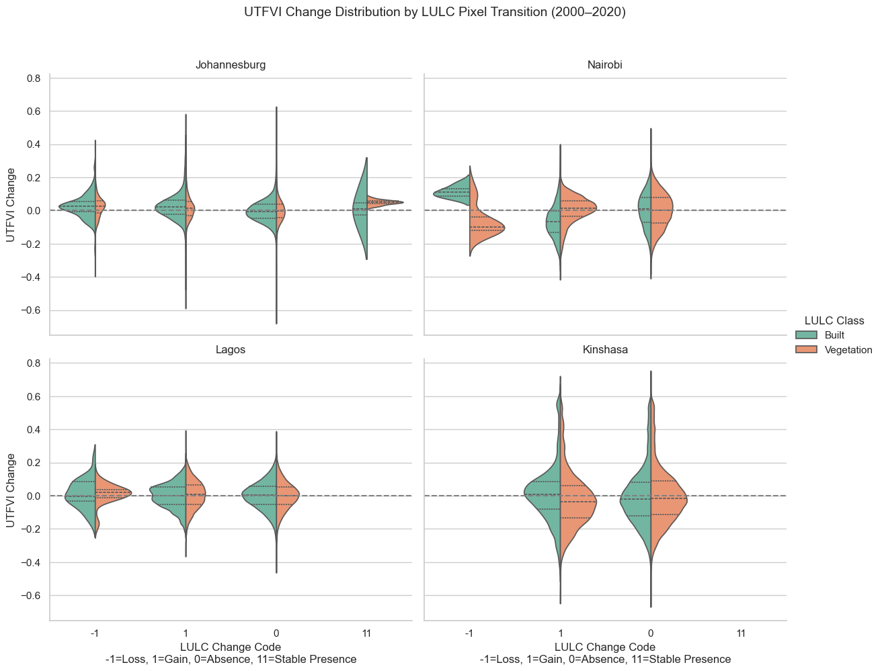
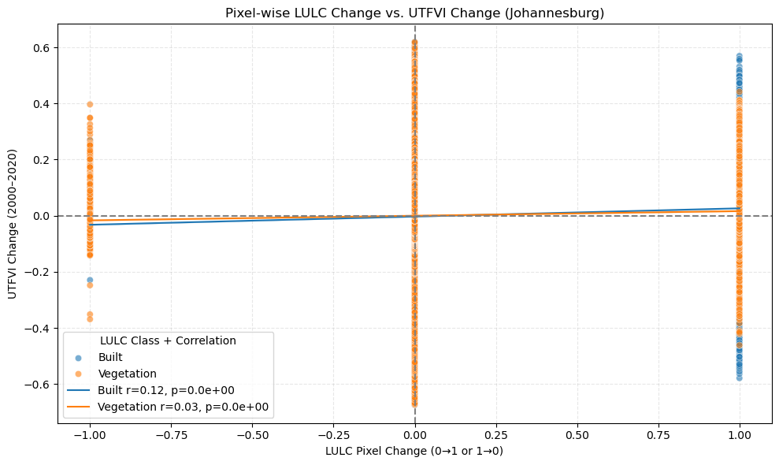
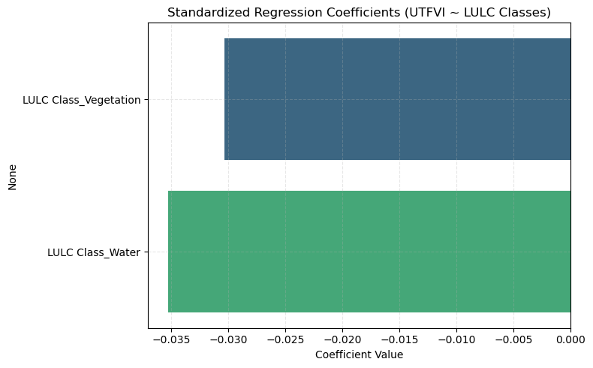
a)
b)
e)
c)
d)
f)
Notes:
Across all cities, gains or persistence in built-up areas consistently drive higher UTFVI values, while loss of vegetation contributes to thermal stress, confirming urban expansion and vegetation decline as key contributors to rising heat vulnerability.
a) Johannesburg (UTFVI Change by LULC Transition) In Johannesburg, stable built-up areas (code 11) and new gains in built land (code 1) are associated with positive UTFVI changes, suggesting increased urban heat stress.
b) Nairobi (UTFVI Change by LULC Transition) Nairobi shows a mix of positive and negative UTFVI changes, but vegetation loss (code -1) consistently leads to increased thermal stress.
c) Lagos (UTFVI Change by LULC Transition) Lagos exhibits relatively moderate UTFVI increases for both built and vegetation transitions, though built-up gains and stability (code 1 and 11) again show slight positive shifts.
d) Kinshasa (UTFVI Change by LULC Transition) Kinshasa has the most dispersed pattern, but built-up gains and vegetation loss are associated with higher UTFVI values, implying emerging heat pressure.
e) Pixel-wise Correlation (Johannesburg) In Johannesburg, built-up pixel gains are strongly positively correlated (r = 0.21) with increased UTFVI, while vegetation change has a weaker but significant negative correlation (r = -0.03).
f) Regression Coefficients (All Cities) Regression results confirm that vegetation and water have a small but consistent cooling effect on UTFVI across all cities, with vegetation having a slightly stronger influence.

Slide 11
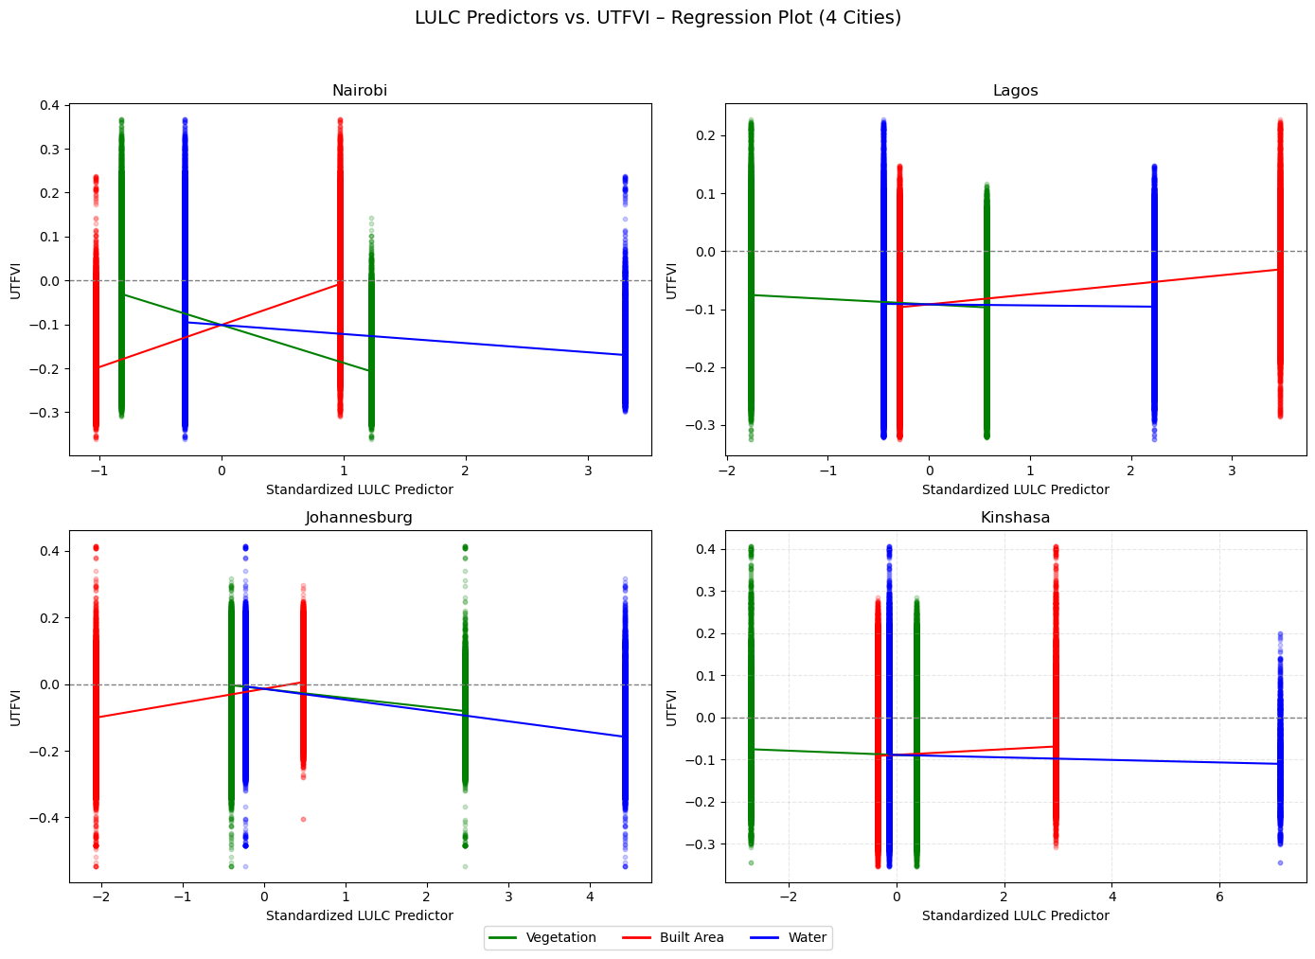
a)
b)
c)
d)
Notes:
Across all cities, built-up land consistently raises UTFVI values, while vegetation and water contribute to lowering urban thermal stress, though the strength of these effects varies by city.
a) Nairobi In Nairobi, built-up areas have a strong positive influence on UTFVI, while vegetation and water both contribute to lowering thermal stress, as indicated by their negative slopes.
b) Lagos Lagos exhibits weaker relationships, but the general trend still shows built-up areas increasing UTFVI and vegetation slightly reducing it, with minimal effect from water.
c) Johannesburg Johannesburg shows the clearest negative relationship between water and UTFVI, alongside strong positive effects from built-up areas and moderate cooling from vegetation.
d) Kinshasa Kinshasa demonstrates relatively flat trends, suggesting weaker associations overall, but built-up areas still slightly elevate UTFVI while vegetation and water have marginal cooling effects.

