Slide 1
Patients Prototype
By Desmond Wallace

Slide 2
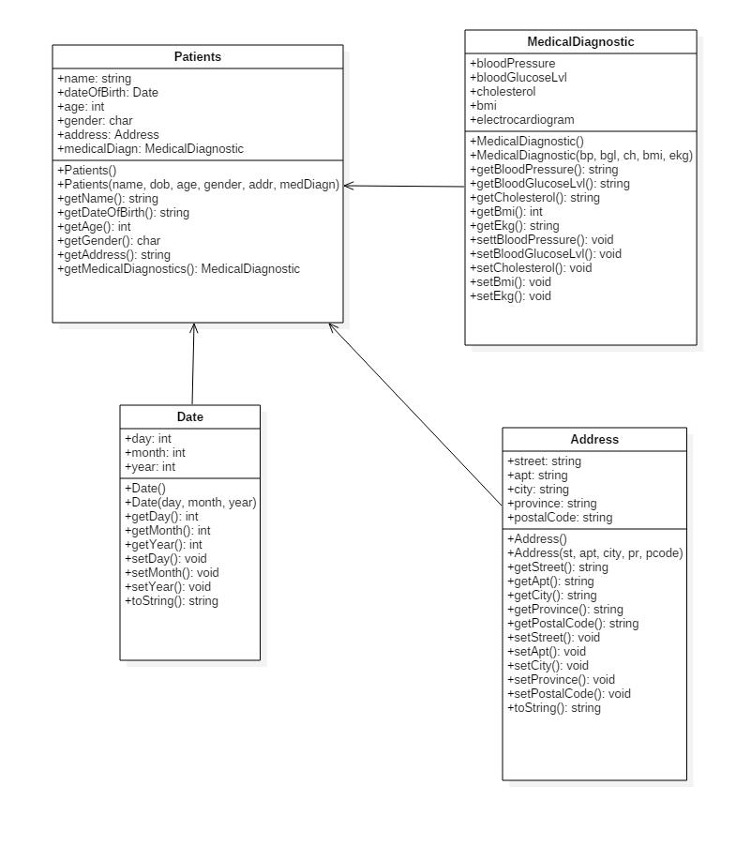
Class Diagram

Slide 3
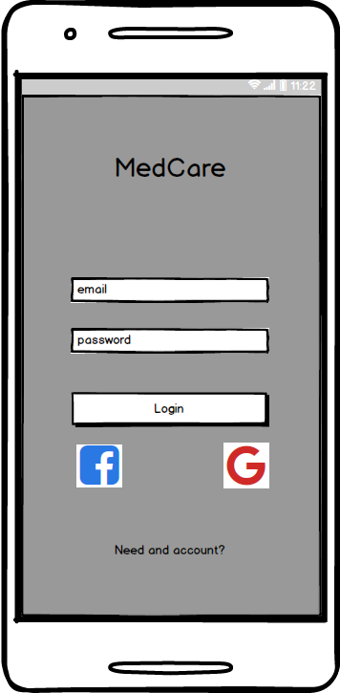
Login View

Slide 4
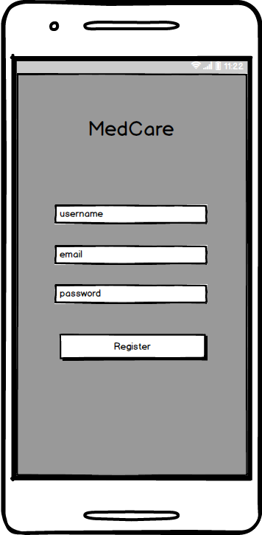
Register View

Slide 5
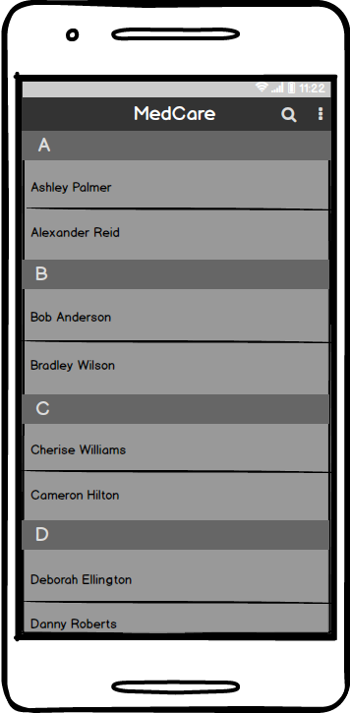
Patient list

Slide 6
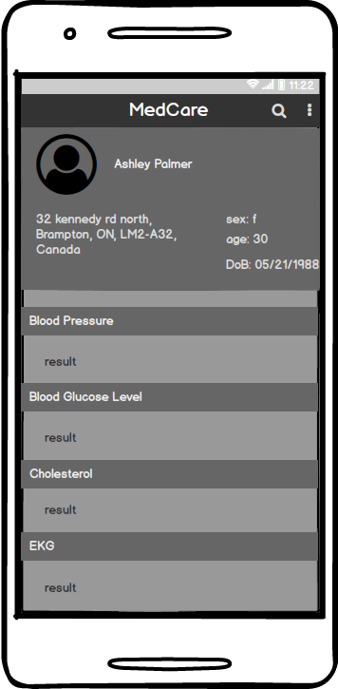
Patient info view

