Slide 1
Website Prototype
By Desmond Wallace

Slide 2
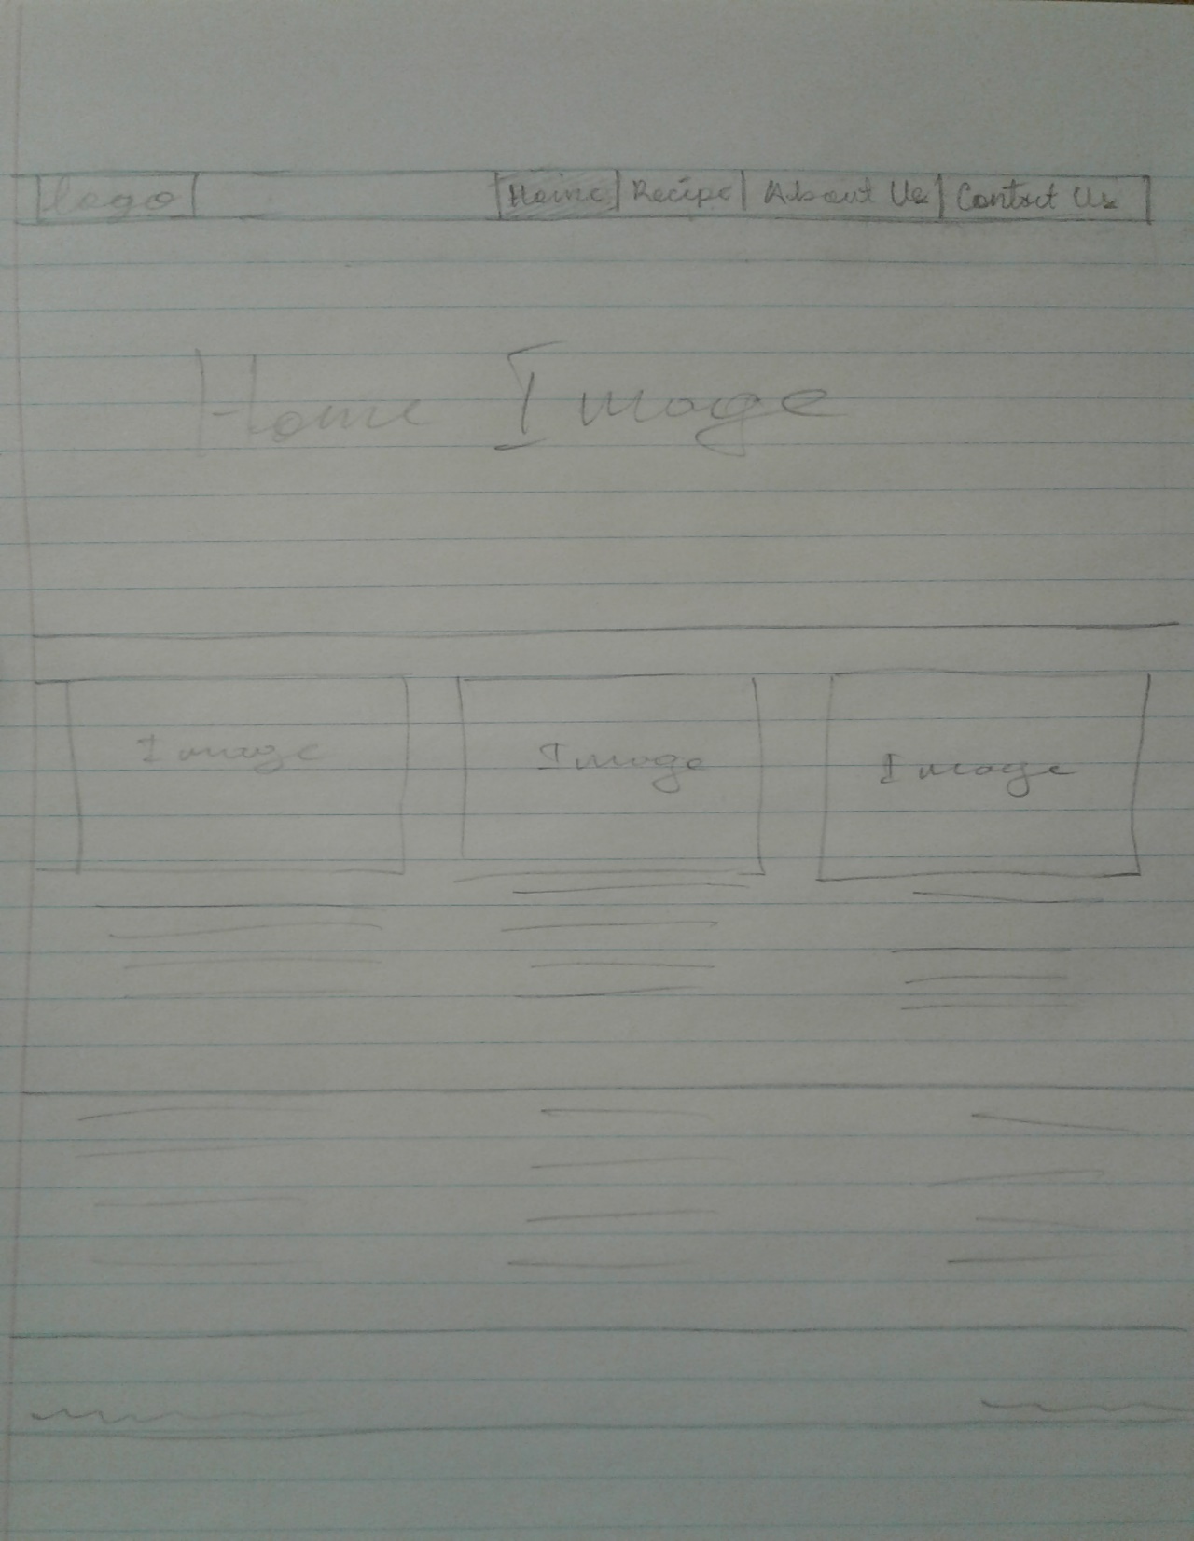

Slide 3
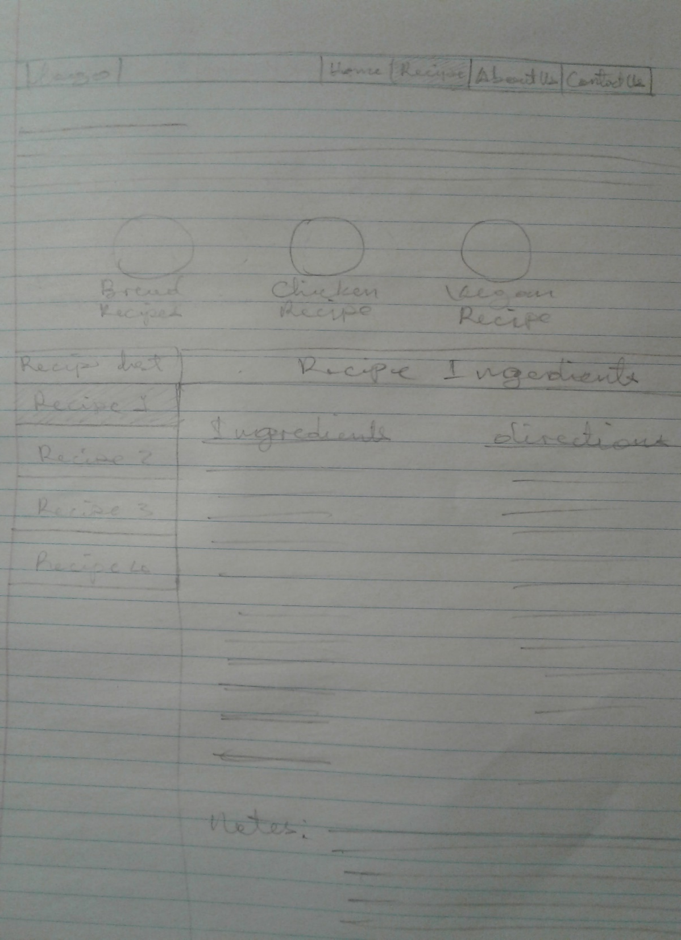

Slide 4
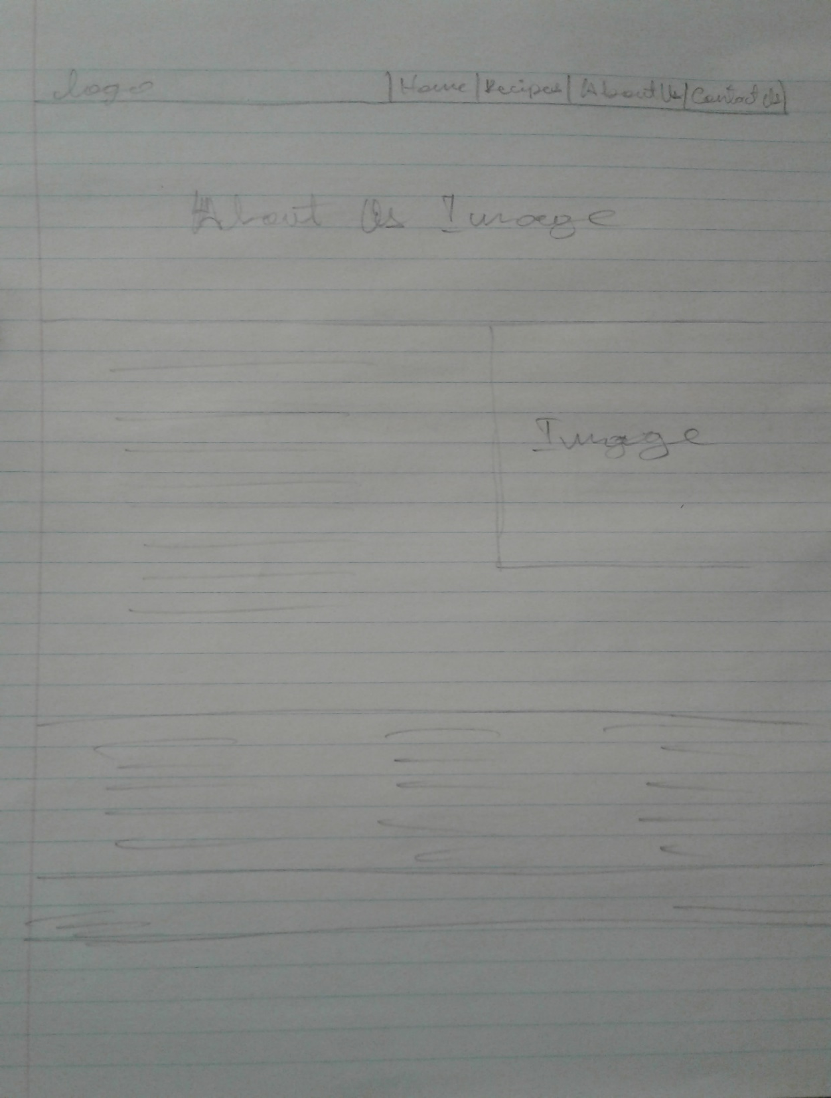

Slide 5
