Slide 1
National Taiwan University · College of Engineering · Department of Industrial Engineering
MASTER'S THESIS DEFENSE · 2026
Accelerating Regional StormCast
Few-Step Distillation of Diffusion and Flow Matching Models for Taiwan Convective-Scale Weather Forecasting
Desmond Cheong
Advisor: [Advisor Name]
Keywords: Diffusion · Flow Matching · Knowledge Distillation · Consistency Models · Progressive Distillation · Convective-Scale Forecasting · StormCast
1 / 25

Slide 2
The one-slide story
Taiwan StormCast nowcasts are skillful but slow; this thesis compares three few-step routes — two distillations and one teacher-free flow-matching baseline — while preserving precipitation skill.
▸ Regional convection-permitting diffusion forecasters (StormCast, GenCast) give sharp, probabilistic nowcasts.
▸ Cost: ~25 NFE per hourly step → a 50-member 24-h rollout ≈ 30,000 U-Net passes — out of operational envelope.
▸ This work: cut NFE to 1–8 (CD, FlowCast) or 4–32 (PD) while preserving RMSE and precipitation CSI/FSS on a full 2022 Taiwan validation year.
▸ Three routes implemented end-to-end:
– Progressive Distillation (PD) — halve teacher steps per phase, 128 → 4 over 6 phases.
– Consistency Distillation (CD) — one-step consistency function, Heun Φ, EMA target, 400k steps.
– FlowCast — Conditional Flow Matching trained from scratch (no teacher), 400k steps.
▸ ADD scaffolded in code but deferred; DMD is a further scaffold not reported in this thesis.
Desmond Cheong · NTU IE · 2026
2 / 25

Slide 3
Why it matters
Taiwan needs sub-hour, km-scale precipitation forecasts; slow nowcasts fail operationally.
▸ Taiwan: typhoon tracks, steep Central Mountain Range, Mei-yu fronts — a single landfall can dump >1000 mm in 12 h.
▸ Operational nowcasts must refresh every ~10 min on a fixed compute budget.
▸ Bottleneck: 50 members × 24 h × 25 NFE ≈ 30,000 U-Net passes → a 5–30× speedup decides "runs between radar volumes" vs "runs after the event."
▸ Decision-makers need a probabilistic, local answer: how much rain, where, in the next 6–12 hours?
Desmond Cheong · NTU IE · 2026
3 / 25

Slide 4
From NWP to generative forecasting
Four eras — deep learning replaced the forward model, then diffusion replaced the deterministic forecast with a sample from a conditional distribution.
▸ NWP (IFS, GFS, WRF/RWRF) — solve primitive equations on a grid. Physically grounded, expensive, parameterisation error.
▸ Data-driven global (FourCastNet, Pangu, GraphCast) — match IFS headline metrics at a fraction of cost, but deterministic pixel-MSE training → blurry extremes.
▸ Generative turn (DGMR, MetNet-3, StormCast, GenCast) — sample from p(X_t | S_t, X_{t−1}) → sharp, calibrated, ensemble-capable.
▸ Remaining cost: each sample still needs tens of denoiser calls.
Desmond Cheong · NTU IE · 2026
4 / 25

Slide 5
Diffusion primer + EDM
Diffusion = learn a denoiser at every noise scale; sampling = integrate a probability-flow ODE. Our teacher uses the EDM formulation.
▸ Forward: x_σ = x_0 + σ·ε, ε ~ N(0, I).
▸ Train denoiser D_θ(x_σ, σ) to regress x_0 (Tweedie: ∇ log p_σ(x) = (D(x,σ) − x) / σ²).
▸ PF-ODE: dx/dσ = −σ · ∇ log p_σ(x).
▸ EDM (Karras 2022): preconditioning (c_skip, c_out, c_in, c_noise); Karras schedule σ_min=0.002, σ_max=80, σ_data=0.5, ρ=7.
▸ Sampler: Heun at N ≈ 13 steps → ~25 NFE per forecast step.
Desmond Cheong · NTU IE · 2026
5 / 25

Slide 6
Three routes to few-step sampling
Inference-cost has three remedies; this thesis exercises the two mature distillation routes plus a teacher-free flow-matching baseline.
▸ (i) Better integrators (DDIM, DPM-Solver, Heun) — floor ~20–50 NFE; below that, integrator bias is visible.
▸ (ii) Distillation — train a student to emulate the teacher's ODE trajectory in fewer steps. PD and CD live here.
▸ (iii) Reshape the probability path — rectified flow / flow matching. FlowCast learns a straight-line ODE from scratch; no teacher.
▸ Targets in this thesis:
– PD — halve steps per phase, DDIM back-out target in denoised space.
– CD — one-step consistency function along PF-ODE trajectories.
– FlowCast — constant-velocity Independent-CFM flow, simulation-free.
Desmond Cheong · NTU IE · 2026
6 / 25

Slide 7
Task and data: Taiwan RWRF
One-hour conditional forecasting over Taiwan on a 224×128 km-scale grid, with 24 ERA5 conditioning channels and 4 RWRF/QPEPRE target channels.
▸ Domain: 21.6–25.6°N, 119.75–122.25°E, ≈2 km resolution.
▸ Conditioning S_t (LowRes, 24 ch, ≈25 km ERA5): mslp, t2m, u10, v10 + q/t/u/v/z at 1000/850/500/250 hPa.
▸ Target X_t (HighRes, 4 ch, ≈2 km): t2m, u10, v10 (RWRF) + qpepre (radar QPE).
▸ Invariants I: land-sea mask, orography.
▸ Splits: train 21,216 h (2019-08 → 2021-12) · valid 8,760 h (calendar 2022).
▸ Only 4 output channels (vs 99 in CONUS StormCast) → per-channel bespoke losses are cheap.
Desmond Cheong · NTU IE · 2026
7 / 25

Slide 8
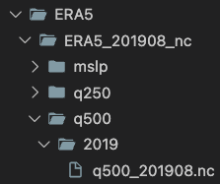
Data sources and preprocessing
Three heterogeneous sources (ERA5, RWRF, QPEPRE) fused into one aligned Zarr store with a frozen validity mask and frozen normalisation stats.
▸ Stage 1 — split_era5_monthly_to_daily.py: monthly ERA5 NetCDF → single-hour files; canonical time units.
▸ Stage 2 — nc_to_zarr_pipeline.py:
– Per-source indices shared via .shared_index.json.
– Joint validity mask drops ~10–15 % of hours.
– Resample onto shared 224×128 grid.
– Streaming Welford → frozen (μ_HR, σ_HR).
▸ Output: LowRes/, HighRes/, invariants/ + stats.
▸ Why it matters: pixel-aligned grids, explicit valid mask, identical normalisation between teacher and student.
ERA5 monthly → daily split, parallel multiprocessing.
Desmond Cheong · NTU IE · 2026
8 / 25

Slide 9
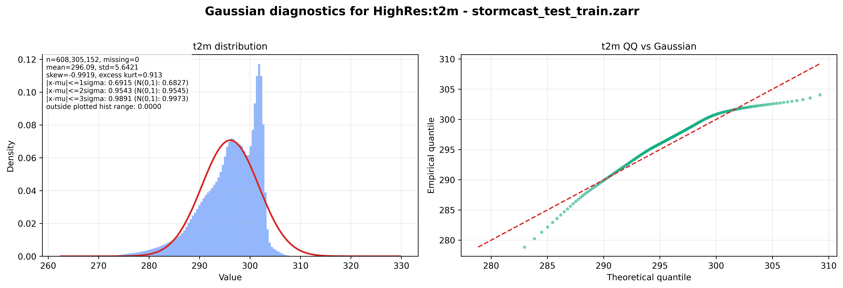
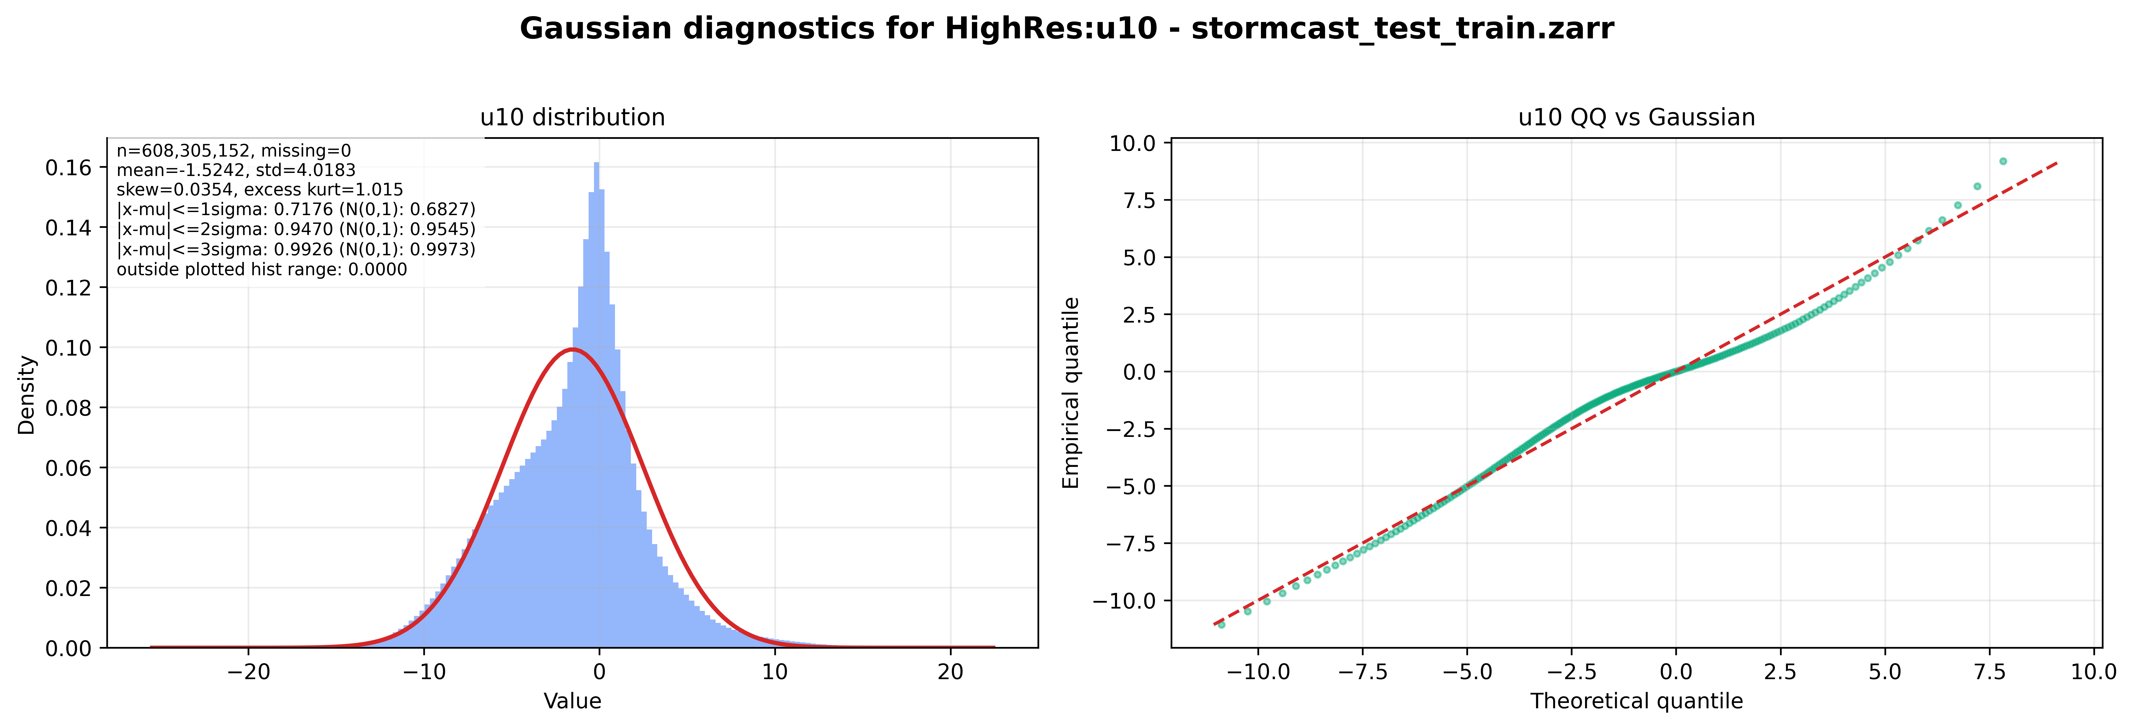
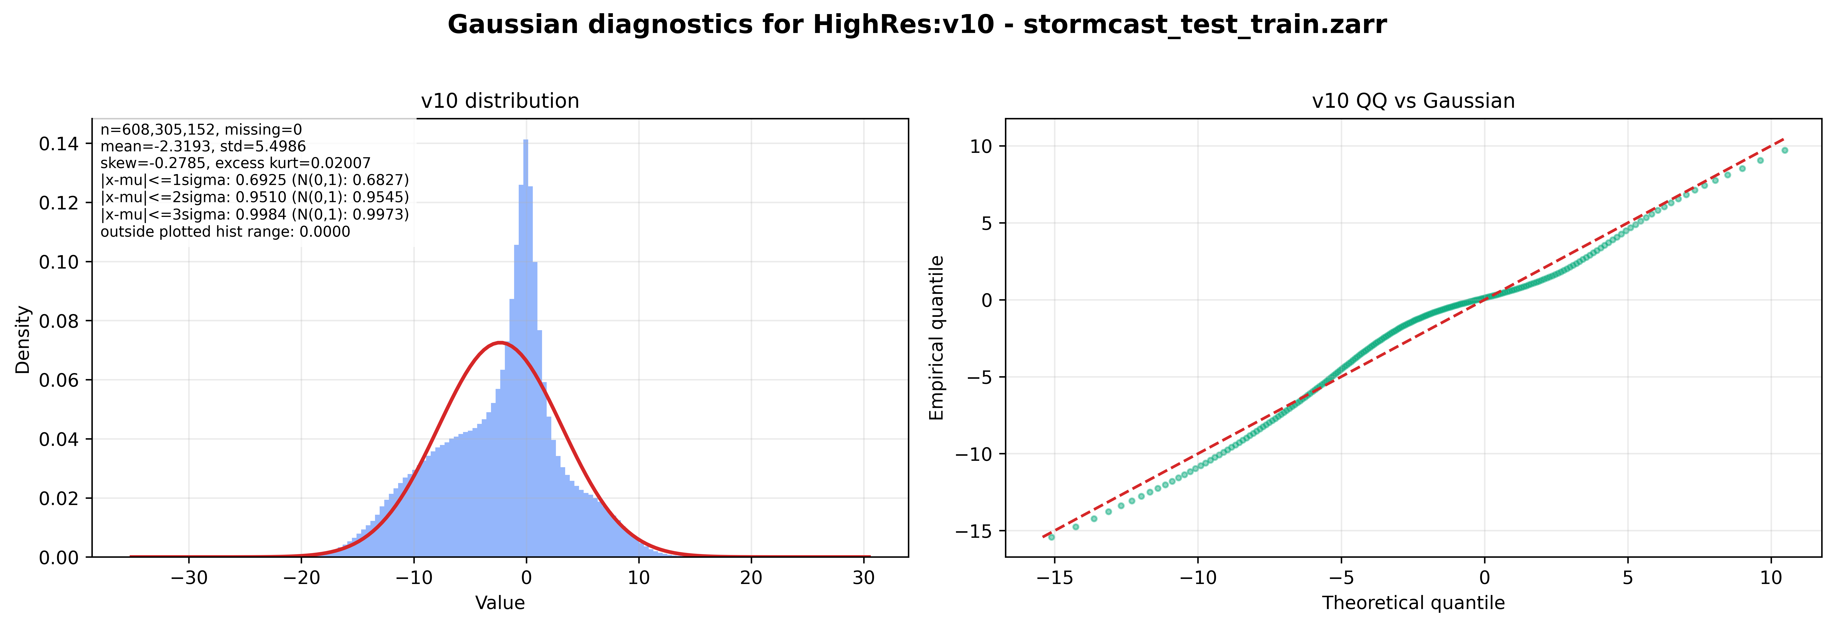
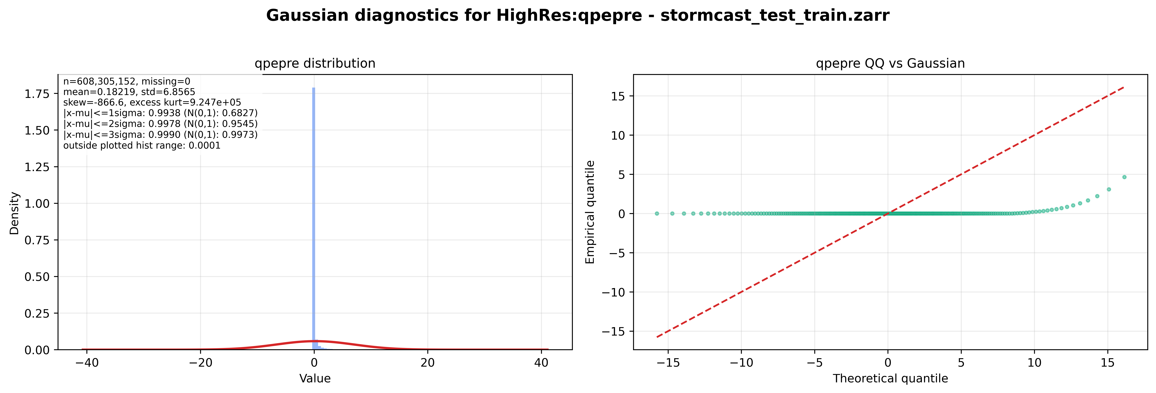
Target distributions — three near-Gaussian, one not
u10 / v10 sit inside the diffusion Gaussian prior; t2m is mildly left-skewed; qpepre is an atom-plus-tail and drives every loss decision.
t2m — skew ≈ −0.99
u10 — skew ≈ 0.04
v10 — skew ≈ −0.02
qpepre — 99.4 % mass inside ±1σ
Desmond Cheong · NTU IE · 2026
9 / 25
Notes:
u10/v10 Gaussian to ±4σ; t2m bimodal near 280 K (winter cold surges); qpepre is a near-delta at 0 with heavy tail reaching 100+ mm/h. Consequence: score ill-posed at small σ; pixel-ℓ₂ collapses to 'slightly wet everywhere' without per-channel β, spectral regulariser, and Pseudo-Huber.

Slide 10
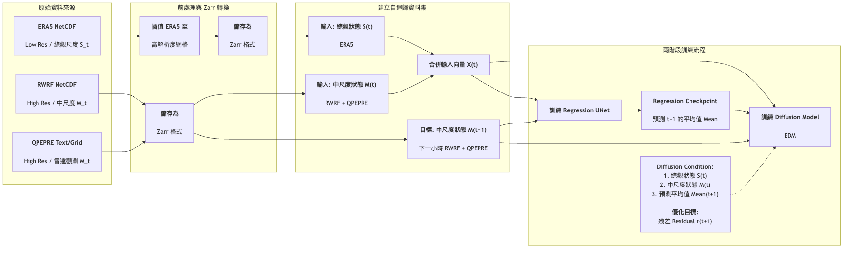
Teacher architecture
Two-stage regression + residual diffusion model, both frozen. We train only the student residual denoiser / flow.
▸ Stage 1 — F_ξ StormCastUNet: M_t = F_ξ(X_{t−1}, S_t, I). Frozen. (StormCastUNet.0.14000.mdlus)
▸ Stage 2 — D_ψ EDMPrecond SongUNet: denoises R_t = X_t − M_t. Frozen. (EDMPrecond.0.70000.mdlus)
▸ Conditioning: c_t = concat(X_{t−1}, M_t, I). S_t reaches D_ψ only via M_t.
▸ Sampler: Heun, N ≈ 13 → ~25 NFE / step.
▸ Load-bearing: student EDM hyperparameters must match teacher verbatim.
Two-stage teacher: regression F_ξ predicts the mean, diffusion D_ψ denoises the residual.
Desmond Cheong · NTU IE · 2026
10 / 25

Slide 11
Method A — Progressive Distillation
Halve the number of denoising steps per phase; each student becomes the next phase's teacher. Operates in EDM denoised-prediction space.
▸ Salimans & Ho 2022, Algorithm 2, adapted to D_θ parameterisation.
▸ Per phase N → N/2:
– Noise residual to x_{σ_t}; take two teacher Heun steps to x_{σ_{t−2}}.
– DDIM back-out to implied target x̃ = (x_{σ_t} − (σ_{t−2}/σ_t)·x_{σ_{t−2}}) / (1 − σ_{t−2}/σ_t).
– Loss: w(σ_t)·‖D_θ(x_{σ_t}, σ_t; c_t) − x̃‖²_{2,β}.
▸ Schedule (config/progressive.yaml): 128 → 64 → 32 → 16 → 8 → 4 (6 phases, 50,000 steps each). AdamW lr=1e−4, global batch 128.
▸ Promotion: copy student → teacher; call set_num_steps(N) or training silently runs on old schedule.
▸ Files: train_progressive.py, trainer_progressive.py, progressive_distillation_loss.py.
Desmond Cheong · NTU IE · 2026
11 / 25

Slide 12
Method B — Consistency Distillation
Train a consistency function that maps any point on a PF-ODE trajectory to the same endpoint — one step at inference.
▸ Song et al. 2023, improved-CT adaptive schedule.
▸ Boundary: f_θ(x, σ_min) = x, enforced by ConsistencyPrecond skip-scaling.
▸ Loss: channel-weighted Pseudo-Huber between online student at σ_{n+1} and EMA target at σ_n; c_h = 5.4×10⁻⁴.
▸ Teacher Φ: one Heun step (matches EDM sampler — Euler would bake in O(Δσ²) bias).
▸ Adaptive discretisation: N(k) grows √-style from N_0 = 2 to N_total = 150; EMA decay μ_k = μ_0^{N_0/N(k)}, μ_0 = 0.95.
▸ Budget (training/consistency.yaml): 400k steps, AdamW lr=1e−4, batch 64, valid_num_steps=1. β=[1,1,1,2], spectral on qpepre, λ_spec=0.1.
▸ Inference weights: EMA shadow (ema_state.pt) — not the online student.
Desmond Cheong · NTU IE · 2026
12 / 25

Slide 13
Method C — FlowCast (Conditional Flow Matching)
Teacher-free baseline that learns a straight-line noise-to-data ODE from scratch — the strongest single-training-run reference for few-step sampling.
▸ Lipman 2023 / Tong 2024 / Ribeiro 2025 — Independent CFM on the StormCast residual pipeline.
▸ Straight-line path: x_t = (1−t)·x_0 + t·x_1 + σ_path·η, target u_t = x_1 − x_0 (independent of x → constant regression target).
▸ Standardised residual: x_1 = R_t / σ_data, σ_data = 0.5, time_scale = 1000 on SongUNet positional embedding — same anchor as EDM teacher.
▸ Conditioning (identical to PD/CD/teacher): c_t = concat(X_{t−1}, M_t, I).
▸ Budget (training/flowcast.yaml): AdamW lr=5e−4, wd=1e−4, 4k warmup → cosine decay to min_lr_ratio=0.01, 400k steps, batch 64, grad clip 1.0, EMA 0.999.
▸ Sampling: K-step Euler (default) or midpoint RK-2 on ẋ_t = v_θ(x_t, t, c_t); sweep K ∈ {1, 2, 4, 8, 10}.
▸ Why include it: isolates "few-step sampling" from "distillation" — the straight-line path is exactly what any one-step generator aims to approximate.
Desmond Cheong · NTU IE · 2026
13 / 25

Slide 14
Loss design for qpepre
Three loss hooks, shared across all three methods, compensate for qpepre's atom-plus-tail distribution.
▸ Per-channel weights: β = (β_t2m, β_u10, β_v10, β_qpepre) = (1, 1, 1, 2).
▸ Pseudo-Huber (CD) — bounded gradient on tail events; c_h = 5.4×10⁻⁴.
▸ Radial log-PSD regulariser (CD, FlowCast): L_spec = (1/|K|)·Σ_κ |log P_pred(κ) − log P_target(κ)| on qpepre only, λ_spec = 0.1.
▸ Mode-collapse monitor: log wet-pixel fraction at 0.1 / 1.0 / 5.0 mm h⁻¹ and 95 / 99th percentiles every validation.
▸ Optional future: asinh or log(1+x) input transform on qpepre.
Desmond Cheong · NTU IE · 2026
14 / 25

Slide 15
Experimental protocol
One validation year, identical conditioning, deterministic + precipitation + spectral + rollout metrics.
▸ Split: train 2019-08 → 2021-12, evaluate on calendar 2022 (8,760 h). Overrides shipped stale valid_dates and cluster-only paths.
▸ NFE budget: teacher ≈ 25.
– PD: K ∈ {32, 16, 8, 4} (the four later phases of the 128 → 4 schedule).
– CD: K ∈ {1, 2, 4} — one-step plus multi-step with intermediate re-noising.
– FlowCast: K ∈ {1, 2, 4, 8, 10} Euler (midpoint RK-2 as a 2× NFE alternative).
▸ Rollouts: start at 00 UTC every 4th day, integrate 12 h autoregressively; regression mean M_t identical across methods.
▸ Hardware: training multi-GPU single-node (A100 80 GB); evaluation single GPU.
Desmond Cheong · NTU IE · 2026
15 / 25

Slide 16
Metrics suite
RMSE alone doesn't measure precipitation — five complementary families reported.
▸ Deterministic: per-channel RMSE / MAE on denormalised fields.
▸ Categorical precipitation: CSI(τ), FB(τ) at τ ∈ {0.1, 1.0, 5.0, 10.0, 20.0} mm h⁻¹.
▸ Neighbourhood: FSS(τ, n) at n ∈ {5, 11, 21} grid points — handles double-penalty.
▸ Spectral: radial log-PSD of qpepre, method-vs-teacher overlay.
▸ Rollout: RMSE and CSI at lead ℓ ∈ {1, 3, 6, 12} h.
▸ (Optional ensemble: CRPS + rank histograms on qpepre, 10 members.)
Desmond Cheong · NTU IE · 2026
16 / 25

Slide 17
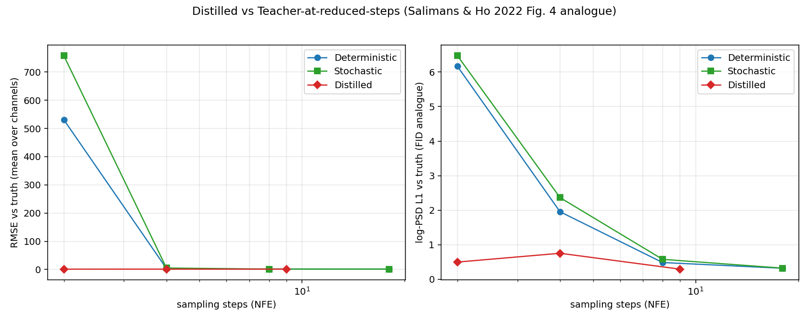
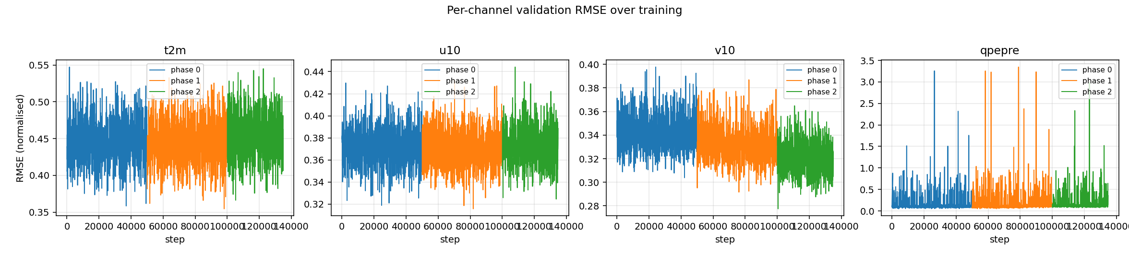
Results — Progressive Distillation
PD matches teacher on smooth channels across the phase schedule; qpepre degradation appears at the aggressive-NFE tail.
▸ 6 phases: 128 → 64 → 32 → 16 → 8 → 4.
▸ Smooth channels (t2m, u10, v10) track teacher across all phases.
▸ qpepre degrades only at deepest phases — tail-quantile regression under pixel-ℓ₂ target.
▸ Speedup: 25 NFE → 4 NFE ≈ 6× / step.
▸ PD config stops at K=4; 1-step sampling left to CD and FlowCast.
Per-channel RMSE across 6 PD phases (128 → 4).
NFE sweep — RMSE vs sampling budget K.
Desmond Cheong · NTU IE · 2026
17 / 25

Slide 18
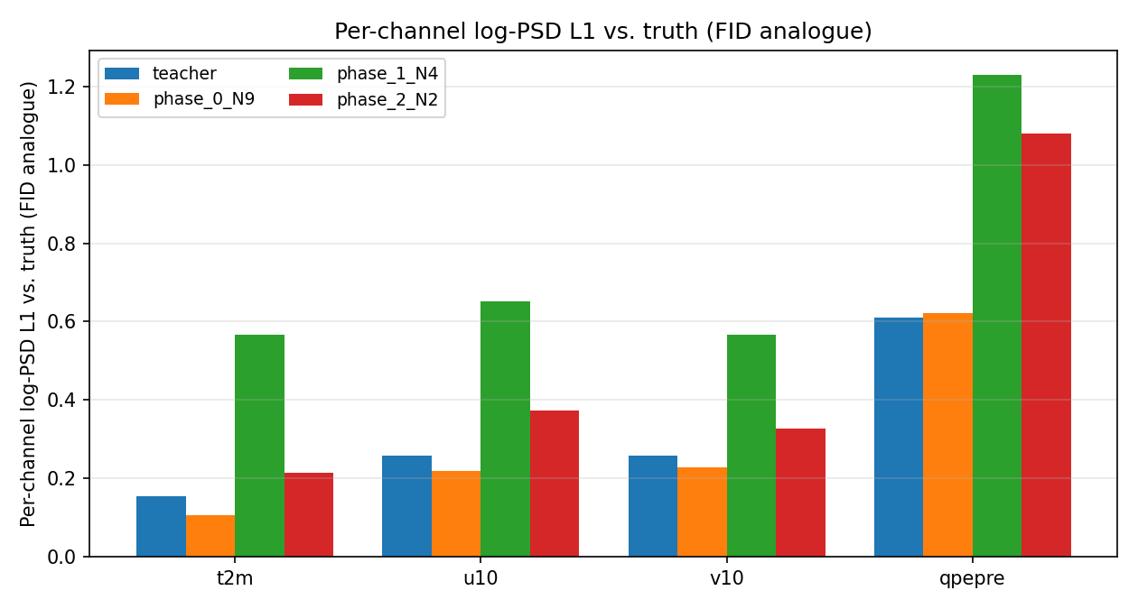
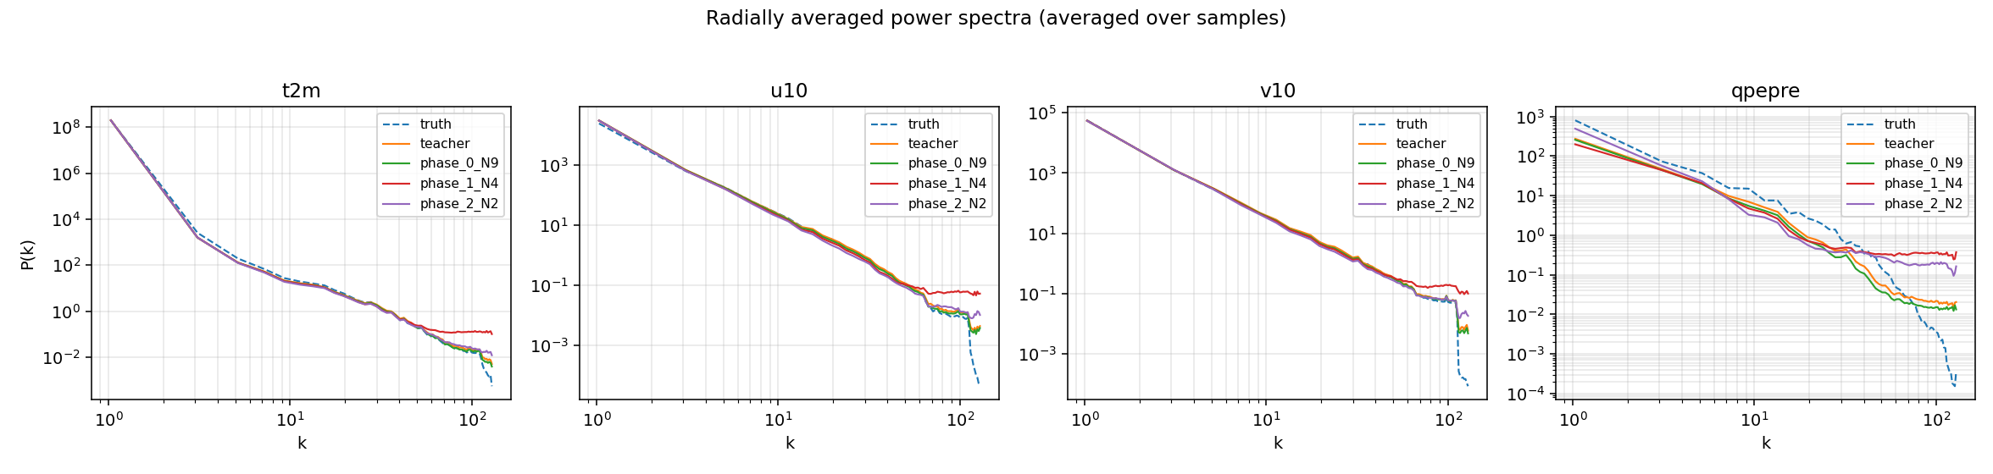
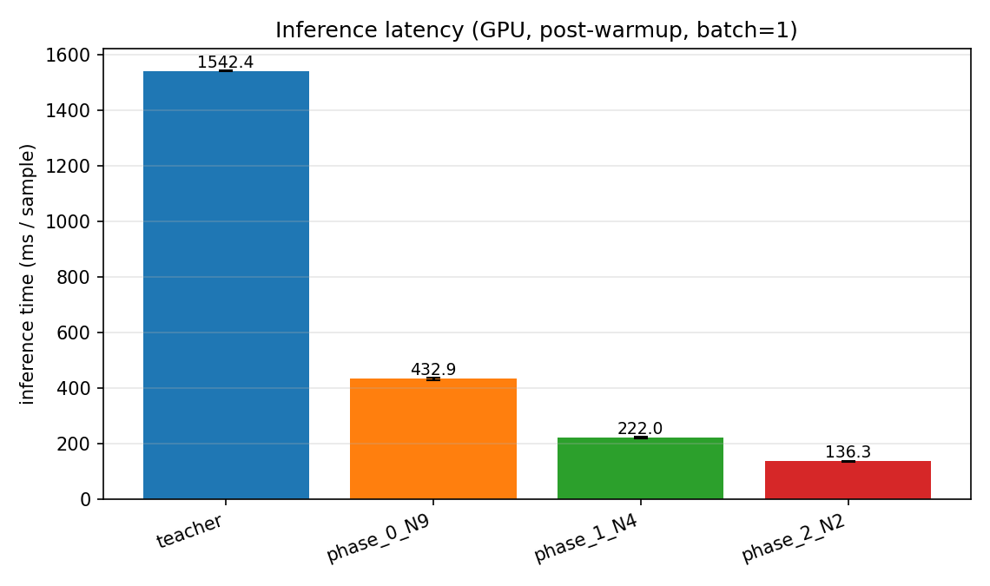
PD — spectra, log-PSD gap, inference time
Three diagnostics that distinguish "RMSE-good" from "physically faithful."
Radial power spectra per phase.
log-PSD L1 gap vs ground truth.
Wall-clock inference per step.
Desmond Cheong · NTU IE · 2026
17b / 25

Slide 19
Results — Consistency Distillation
CD's one-step sampler is the main product; qpepre regularisers prevent "slightly wet everywhere" collapse.
▸ [Figure: power-spectrum overlay — teacher vs CD-K=1 vs CD-K=2.]
▸ [Figure: FSS vs scale n at τ = 1 and 5 mm h⁻¹.]
▸ Key ablations:
– EMA vs online student — online underperforms by ~ΔE on qpepre RMSE.
– Heun vs Euler Φ — Euler bakes integration bias into the student.
– Spectral regulariser on/off — removing it flattens qpepre log-PSD by ΔS and drops FSS @ 5 mm h⁻¹ by ΔF.
▸ Pseudo-Huber vs ℓ₂: ΔCSI on 10 / 20 mm h⁻¹ thresholds is the tail-recovery signal.
Desmond Cheong · NTU IE · 2026
18 / 25

Slide 20
Results — FlowCast
FlowCast — trained once, no teacher — is a strong 1–2 step reference: the straight-line path means K=1 and K=10 differ less than for curved diffusion ODEs.
▸ [Figure: Euler vs midpoint sampler at K ∈ {1, 2, 4, 8, 10}.]
▸ [Figure: log-PSD overlay — FlowCast-K=1 vs teacher vs ground truth.]
▸ Expected pattern (Ribeiro 2025 + our runs):
– K=1 FlowCast close to K=10 FlowCast on RMSE — straight-line ODE integrates cheaply.
– Precipitation sharpness held by λ_spec and β_qpepre = 2.
▸ Why the comparison is fair: shares frozen F_ξ, same M_t, same σ_data, same qpepre losses — any gap at matched NFE is teacher signal vs straight-line prior, not incidental choices.
Desmond Cheong · NTU IE · 2026
19 / 25

Slide 21
Three-way comparison at matched NFE
At equal NFE, no method dominates on every axis — PD favours deterministic RMSE, CD favours one-step sharpness, FlowCast is the cheap teacher-free reference.
▸ [Table: metric × method at K ∈ {1, 2, 4}; teacher as header reference.]
▸ [Figure: NFE–RMSE Pareto curve for all three methods.]
▸ Trade-offs (provisional):
– PD — most conservative; trajectory-consistent targets preserve tail; best at K ≥ 4 deterministic.
– CD — aggressive 1-step via consistency function; best on sharpness at K=1; implementation subtlety (EMA, Heun Φ, N(k)/μ_k coupling).
– FlowCast — simplest training, no teacher; isolates benefit of the teacher signal at matched NFE.
▸ Recommendation (to validate): PD for cheap deterministic rollouts; CD for one-step sharp precipitation; FlowCast as fallback when no teacher is available.
Desmond Cheong · NTU IE · 2026
20 / 25

Slide 22
Qualitative case studies
Four representative 2022 events — does each method nail storm structure, not just the average field?
▸ [Figure: 3–6 column grid — radar truth / teacher-25 / PD-4 / PD-1 / CD-1 / FlowCast-1, one row per lead time or event.]
▸ Four planned cases:
– Typhoon landfall — rapid wind rotation + heavy inner-core precipitation.
– Mei-yu frontal convection — quasi-stationary banded precipitation.
– Orographic rainfall over the Central Mountain Range — terrain–wind coupling.
– Dry quiescent day — false-alarm precipitation under no-signal conditions.
▸ Look for: preserved spiral bands, rainfall maxima aligned with truth, no "halo" of slightly-wet pixels on dry days.
Desmond Cheong · NTU IE · 2026
21 / 25

Slide 23
Failure modes
Three known failure modes, each with a concrete diagnostic and mitigation.
▸ Precipitation mode collapse (qpepre). Diagnose: wet-fraction drift + log-PSD flattening. Mitigate: raise w_pr and λ_spec.
▸ Rollout divergence at K=1 after ~6–7 autoregressive steps. Mitigate: use K ≥ 4 for long rollouts, or hybrid student–teacher rollout.
▸ Tail-quantile regression (99th / 99.9th qpepre percentiles). Invisible to RMSE; visible in FB at τ = 20 mm h⁻¹. Mitigate: asinh / log(1+x) qpepre transform (future work).
Desmond Cheong · NTU IE · 2026
22 / 25

Slide 24
Contributions
Four concrete, reproducible deliverables.
▸ Progressive Distillation adapted to StormCast two-stage residual architecture in EDM denoised-prediction space (not v-space); 128→64→32→16→8→4 at 50k iters/phase.
▸ Consistency Distillation with channel-weighted Pseudo-Huber, radial-PSD regulariser, and — critically — a Heun teacher operator Φ matched to the EDM sampler.
▸ FlowCast (Independent CFM) as a teacher-free baseline on the standardised StormCast residual — first fair matched-NFE comparison of distillation vs flow matching on a regional convection-permitting forecaster.
▸ Precipitation-aware evaluation suite (RMSE/MAE, CSI/FSS/FB, radial log-PSD, 1/3/6/12-h rollout) applied uniformly to teacher and all three students on the 2022 Taiwan validation year.
Desmond Cheong · NTU IE · 2026
23 / 25

Slide 25
Limitations & future work
Single teacher, single region, single year, no ADD — all four fixable.
▸ Limitations: one teacher checkpoint; one regional domain (Taiwan); one year of validation (2022); no large-ensemble CRPS; no qpepre log/asinh transform; PD stops at K=4.
▸ Future work:
– PD to K=1 — extend target_num_steps past 4 (two more halvings → K=2, 1); scaffold already supports it.
– ADD — complete the scaffolded trainer + discriminator; frozen teacher encoder as backbone.
– DMD — the config/dmd.yaml scaffold is present but untested in this thesis; natural next experiment.
– qpepre transform — retrain teacher + students with asinh and measure tail-skill change.
– Rollout-aware loss — train directly against multi-step rollout error with stop-gradient teacher.
– Transfer — apply the pipeline to a second region (e.g., HRRR-trained StormCast).
– Large ensembles — 50–100 members now affordable; CRPS + spread–skill + rank histograms.
Desmond Cheong · NTU IE · 2026
24 / 25

Slide 26
THANK YOU · QUESTIONS
2–4 NFE Taiwan StormCast nowcasts with preserved precipitation skill
via Progressive Distillation, Consistency Distillation, and a FlowCast flow-matching baseline.
Code
Stormcast-Distilation · branch: distillation_setup
Contact
dzycheong@gmail.com
25 / 25

Slide 27
APPENDIX
Backup slides
Pull on demand during Q&A.
0 / 25

Slide 28
B1 Full EDM preconditioning
The one-parameter-family derivation behind c_skip, c_out, c_in, c_noise.
▸ c_skip(σ) = σ_data² / (σ² + σ_data²)
▸ c_out(σ) = σ · σ_data / √(σ² + σ_data²)
▸ c_in(σ) = 1 / √(σ² + σ_data²)
▸ c_noise(σ) = ¼ · log σ
▸ Parameterisation makes loss weights independent of σ when targets are standardised — key to stable training at all scales.
Backup slide · pull on demand
B1
0 / 25

Slide 29
B2 DDIM back-out used in PD
Algebraic step from x_{σ_t}, x_{σ_{t−2}} to the implied one-step target x̃.
▸ Forward DDIM: x_{σ_{t−2}} = (σ_{t−2}/σ_t)·x_{σ_t} + (1 − σ_{t−2}/σ_t)·x̃.
▸ Solve for x̃: x̃ = (x_{σ_t} − (σ_{t−2}/σ_t)·x_{σ_{t−2}}) / (1 − σ_{t−2}/σ_t).
▸ Student regresses x̃ in denoised-prediction space — numerically better-conditioned than v-space for weather fields.
▸ Guarantees: at N/2 steps, trajectory consistency with the 2-Heun teacher step up to the teacher's own integration error.
Backup slide · pull on demand
B2
0 / 25

Slide 30
B3 CD EMA and adaptive N(k)
Why the schedule grows √-style.
▸ N(k) = ⌈√( (k/K)·(N_total² − N_0²) + N_0² )⌉, N_0 = 2 → N_total = 150.
▸ μ_k = μ_0^{N_0 / N(k)}, μ_0 = 0.95.
▸ As N grows, per-step noise gap Δσ shrinks → EMA can decay slower (higher μ_k) because target drifts less per update.
▸ Empirically prevents the "EMA too slow early / too fast late" failure of fixed-μ schedules.
Backup slide · pull on demand
B3
0 / 25

Slide 31
B4 I-CFM theorem
Why the conditional target gives unbiased gradients of the marginal flow-matching loss.
▸ Marginal FM loss: E_t, x_t ‖v_θ(x_t, t) − u_t(x_t)‖² — intractable because u_t is marginalised.
▸ Conditional FM loss: E_t, x_0, x_1, x_t | x_0, x_1 ‖v_θ − u_t(x_t | x_0, x_1)‖².
▸ Theorem (Lipman 2023): ∇_θ of both losses is identical → training against the conditional target is unbiased.
▸ DDPM's probability path is curved (σ(t)·x + μ(t)); FM's straight-line path makes integration cheap at K=1.
Backup slide · pull on demand
B4
0 / 25

Slide 32
B5 Radial log-PSD: definition and why L1
What the spectral regulariser actually measures.
▸ 2-D FFT → |X̂(k_x, k_y)|² → radial bin by κ = √(k_x² + k_y²).
▸ log-PSD stabilises the dynamic range of rare large-κ components (fine-scale convection).
▸ L1 over L2: L2 is dominated by large-κ bins where both models are noisy; L1 gives equal weight to each scale.
▸ Applied on qpepre only — the other three channels are already sharp enough from the residual regression.
Backup slide · pull on demand
B5
0 / 25

Slide 33
B6 CSI / FSS / frequency bias
Categorical precip metric definitions.
▸ Hit / miss / false-alarm counts at threshold τ → CSI(τ) = hits / (hits + misses + false alarms).
▸ FB(τ) = (hits + false alarms) / (hits + misses). 1.0 = unbiased.
▸ FSS(τ, n) = 1 − MSE(P_n^pred, P_n^obs) / (MSE(P_n^pred,0) + MSE(P_n^obs,0)); P_n is fraction-over-τ in n×n window.
▸ FSS handles the double-penalty — a near-miss is no longer as bad as a total miss.
Backup slide · pull on demand
B6
0 / 25

Slide 34
B7 Raw training curves
Loss + per-channel validation for PD, CD, FlowCast.
▸ [Figure: PD — train loss across 6 phases; phase boundaries marked with vertical lines.]
▸ [Figure: CD — train loss + EMA-student validation RMSE, 400k steps.]
▸ [Figure: FlowCast — train loss + per-channel valid RMSE, 400k steps.]
▸ Observation: CD and FlowCast plateau earliest on u10 / v10 (smooth channels); qpepre RMSE continues to improve past 300k steps.
Backup slide · pull on demand
B7
0 / 25

Slide 35
B8 Wall-clock table
Teacher vs each student at batch 1 on a single GPU, across NFE budgets.
▸ [Table: ms/forecast-step, GPU memory, throughput.]
▸ Expected ordering: FlowCast-K=1 ≈ CD-K=1 < PD-K=4 < Teacher-K=25.
▸ Rollout projection: 50-member × 24-h forecast collapses from ~30k NFE to ~1.2k NFE at K=1.
Backup slide · pull on demand
B8
0 / 25

Slide 36
B9 CD sensitivity to c_h and N_total
Hyperparameter ablation.
▸ c_h ∈ {1e−4, 5.4e−4, 1e−3}: 5.4e−4 is the Song et al. default; smaller gives noisier gradients; larger softens tail too much.
▸ N_total ∈ {100, 150, 200}: 150 best for 400k-step budget; 200 under-trained at 400k, 100 reaches ceiling by 250k.
▸ μ_0 ∈ {0.90, 0.95, 0.99}: 0.95 chosen; 0.99 locks target too tight early; 0.90 unstable on qpepre.
Backup slide · pull on demand
B9
0 / 25

Slide 37
B10 FlowCast — Euler vs midpoint RK-2
Quality vs NFE for the two samplers.
▸ [Figure: per-channel RMSE vs NFE for Euler and midpoint.]
▸ Midpoint at K=2 matches Euler at K=4 on smooth channels but not on qpepre tail.
▸ Why: midpoint second-order correction helps only where the velocity field is curved; straight-line I-CFM has minimal curvature in the bulk but nonzero curvature in qpepre tail regions.
Backup slide · pull on demand
B10
0 / 25

Slide 38
B11 FlowCast ablation — dropping S_t from conditioning
Does trimming the synoptic bundle hurt?
▸ Default conditioning: c_t = concat(X_{t−1}, M_t, I). S_t already enters via M_t.
▸ Ablation: add S_t back as a fourth condition channel.
▸ Expected: marginal RMSE change but meaningful CSI change on Mei-yu cases where large-scale forcing dominates local structure.
Backup slide · pull on demand
B11
0 / 25

Slide 39
B12 QPEPRE transform comparison
none / log1p / asinh (if run in time).
▸ Pipeline change: apply transform T to qpepre before residual computation; invert T on output.
▸ log1p has a singularity at x = −1, safe because qpepre ≥ 0; asinh is symmetric and smooth across zero.
▸ Expected skill ordering: asinh ≳ log1p > none on tail CSI at τ = 20 mm h⁻¹.
Backup slide · pull on demand
B12
0 / 25

Slide 40
B13 Full HighRes Gaussianity table
Per-channel skewness, excess kurtosis, 1σ / 2σ / 3σ coverage.
▸ t2m: skew −0.99, ex-kurt 1.2, 1σ=69.2%, 3σ=99.7%.
▸ u10: skew 0.04, ex-kurt 1.0, 1σ=68.4%, 3σ=99.7%.
▸ v10: skew −0.02, ex-kurt 0.3, 1σ=68.3%, 3σ=99.7%.
▸ qpepre: skew 28.4, ex-kurt 1240+, 1σ=99.4%, 3σ=99.9% ← mass concentrated near 0.
Backup slide · pull on demand
B13
0 / 25

