Slide 1
Wiederholung

Slide 2
Agenda
Nachtrag Klassendiagramme
Analyse – VS Entwurfsklassendiagramm
Modifiable Wrapper
Storage (MM VS PM)

Slide 3
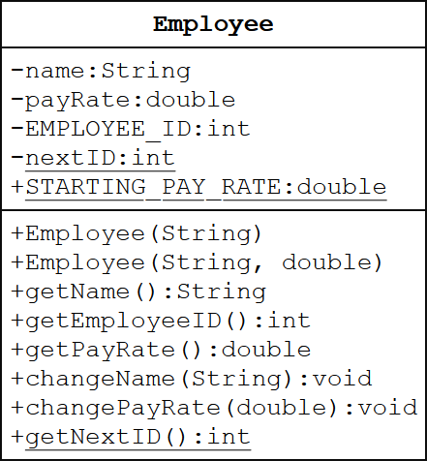
Nachtrag Klassendiagramme
final:
Constant (i.e. final) fields are indicated via naming convention: constants should be in ALL_CAPS
private String name;
private double payRate;
private final int EMPLOYEE_ID;
private static int nextID = 1000;
public static final double STARTING_PAY_RATE = 7.75;
(http://pages.cs.wisc.edu/~hasti/cs302/examples/UMLdiagram.html)

Slide 4
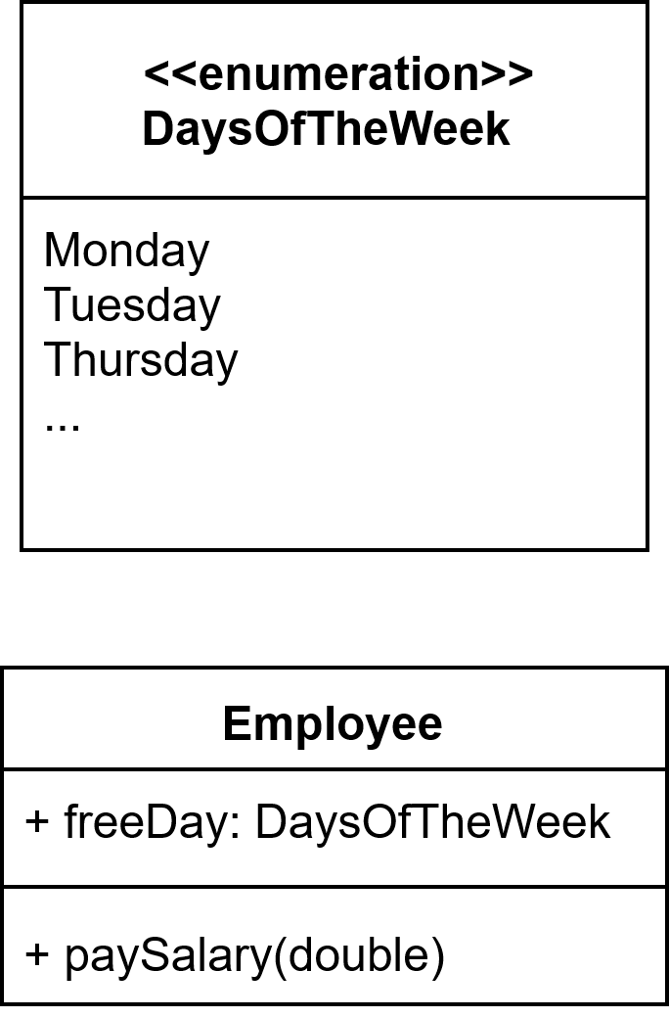
Nachtrag Klassendiagramme
ENUM:
Darstellen wie Klasse
Nutzen wie Datentyp

Slide 5
Analyse – VS Entwurfsklassendiagramm

Slide 6
Storage (MM VS PM)

