Slide 1



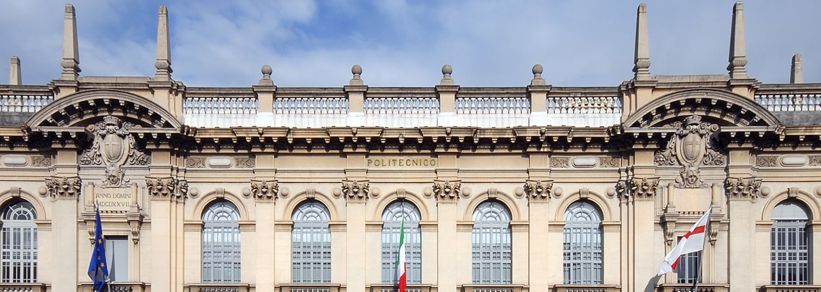

DI MILANO
POLITECNICO DI MILANO
DIMA Project
WIT
© Jacopo Rigoli Mattia Zannin 2014-2015
DIMA
© Jacopo Rigoli Mattia Zannin 2014-2015
Distributed Systems

Slide 2
DI MILANO
POLITECNICO DI MILANO
Concept
We want to focus on helping people retrieve information about turistic points of interest in the simplest way possible.
A user that wants to discover information about a place in front of him only needs to point the device to its direction and the app will automatically retrieve all relevant information.
© Jacopo Rigoli Mattia Zannin 2014-2015
DIMA
© Jacopo Rigoli Mattia Zannin 2014-2015
Distributed Systems
© Jacopo Rigoli 2014-2015
Distributed System

Slide 3
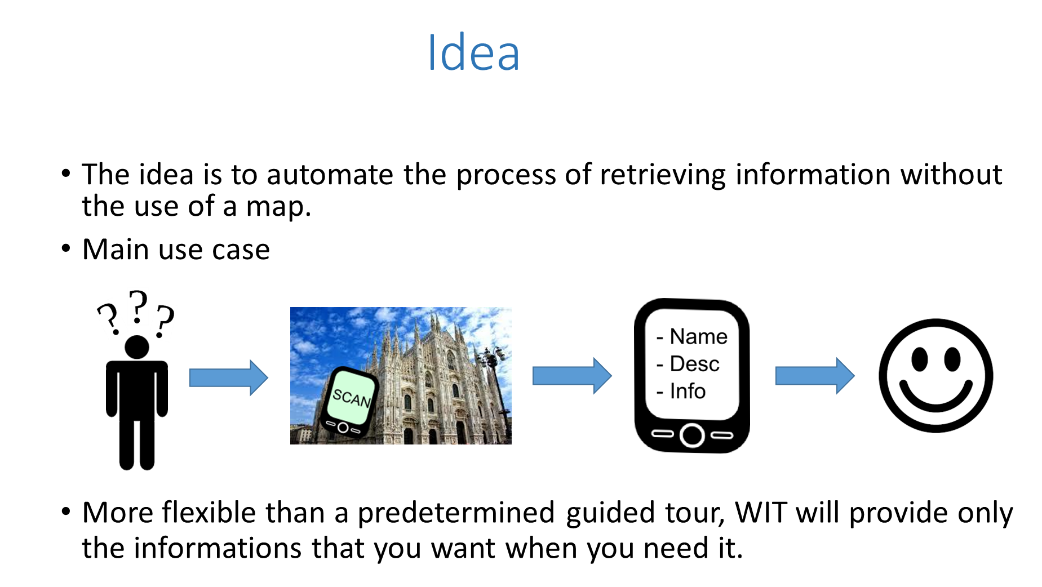
DI MILANO
POLITECNICO DI MILANO
© Jacopo Rigoli Mattia Zannin 2014-2015
DIMA
© Jacopo Rigoli Mattia Zannin 2014-2015
Distributed Systems
© Jacopo Rigoli 2014-2015
Distributed System
Notes:
Easy to use – no maps involved
Geographically indipendent
Can recognize over 2 mln touristic places all over the world
Continuously growing database

Slide 4
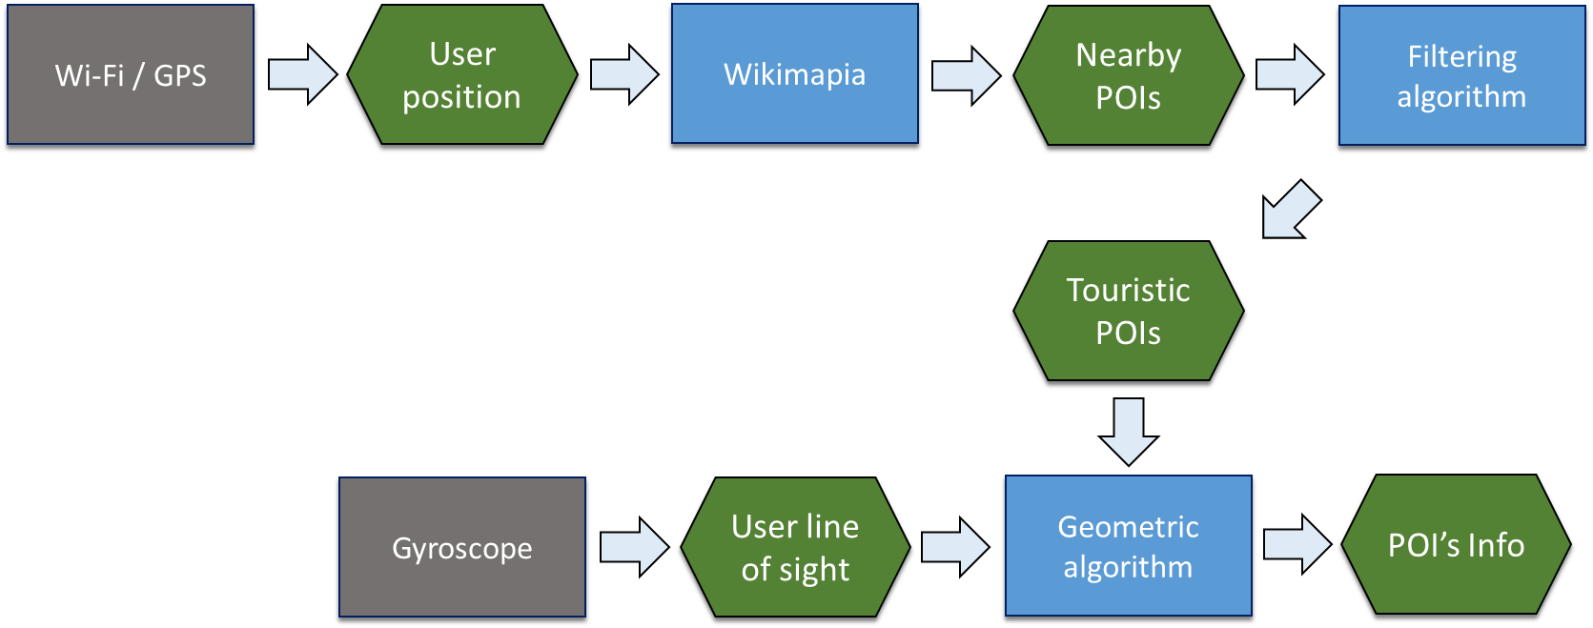
DI MILANO
POLITECNICO DI MILANO
© Jacopo Rigoli Mattia Zannin 2014-2015
DIMA
© Jacopo Rigoli Mattia Zannin 2014-2015
Distributed Systems
© Jacopo Rigoli 2014-2015
Distributed System

Slide 5
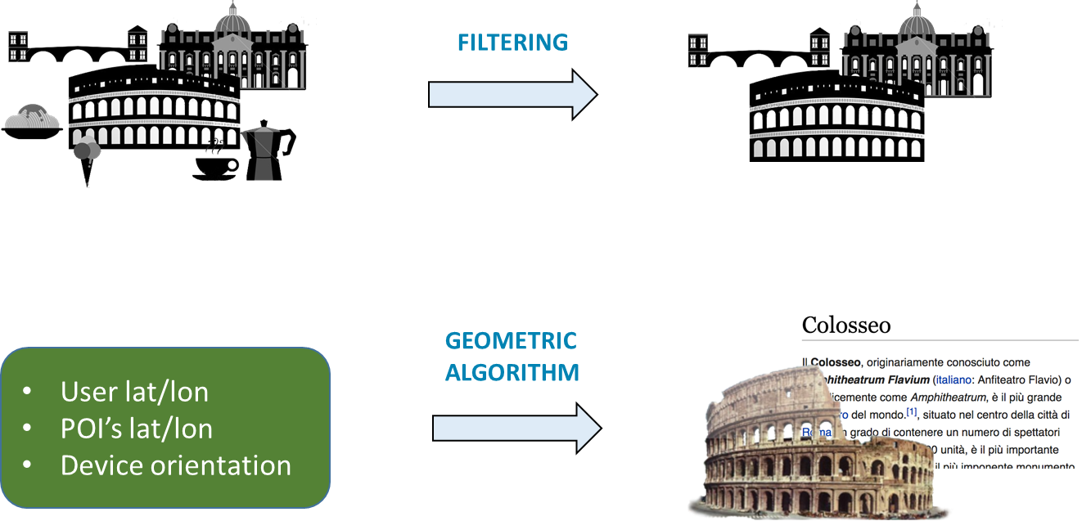
DI MILANO
POLITECNICO DI MILANO
© Jacopo Rigoli Mattia Zannin 2014-2015
DIMA
© Jacopo Rigoli Mattia Zannin 2014-2015
Distributed Systems
© Jacopo Rigoli 2014-2015
Distributed System

Slide 6
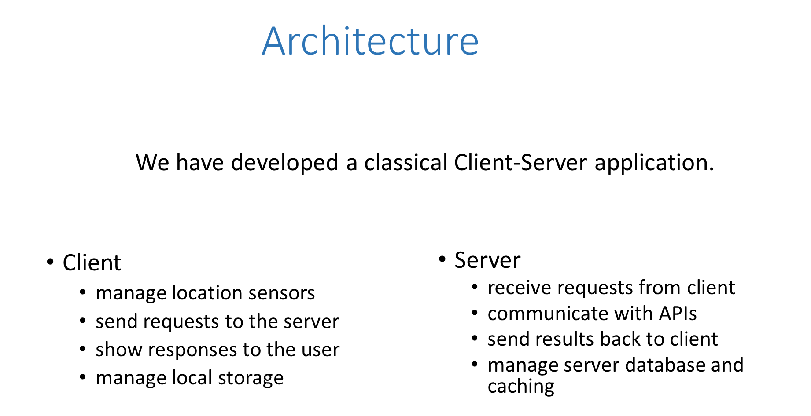
DI MILANO
POLITECNICO DI MILANO
© Jacopo Rigoli Mattia Zannin 2014-2015
DIMA
© Jacopo Rigoli Mattia Zannin 2014-2015
Distributed Systems
© Jacopo Rigoli 2014-2015
Distributed System

Slide 7
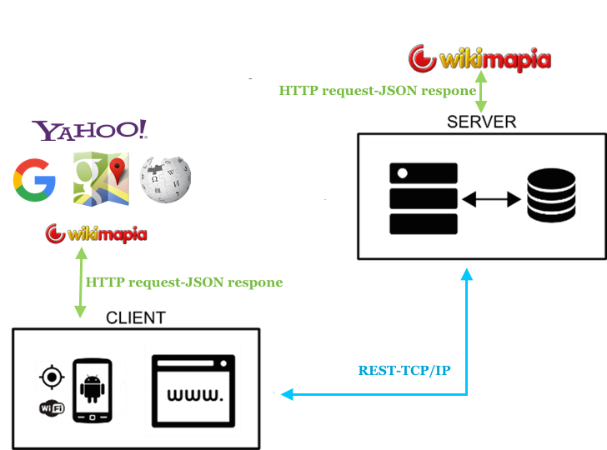
DI MILANO
POLITECNICO DI MILANO
Architecture
© Jacopo Rigoli Mattia Zannin 2014-2015
DIMA
© Jacopo Rigoli Mattia Zannin 2014-2015
Distributed Systems
© Jacopo Rigoli 2014-2015
Distributed System

Slide 8
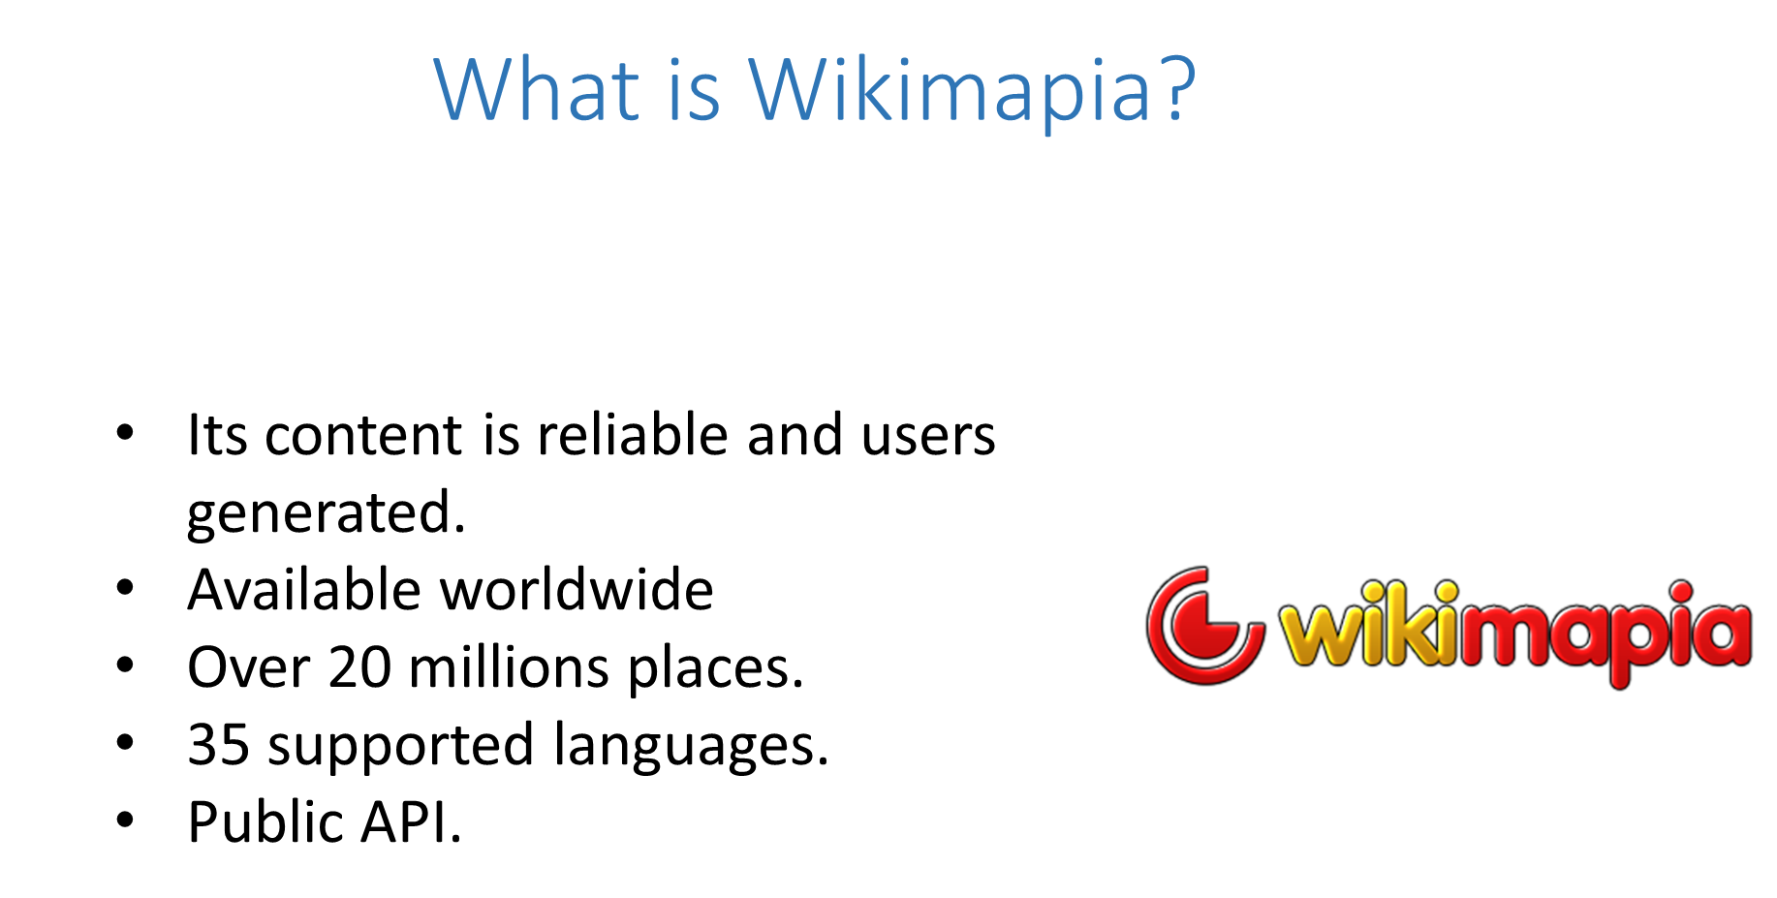
DI MILANO
POLITECNICO DI MILANO
© Jacopo Rigoli Mattia Zannin 2014-2015
DIMA
© Jacopo Rigoli Mattia Zannin 2014-2015
Distributed Systems
© Jacopo Rigoli 2014-2015
Distributed System

Slide 9
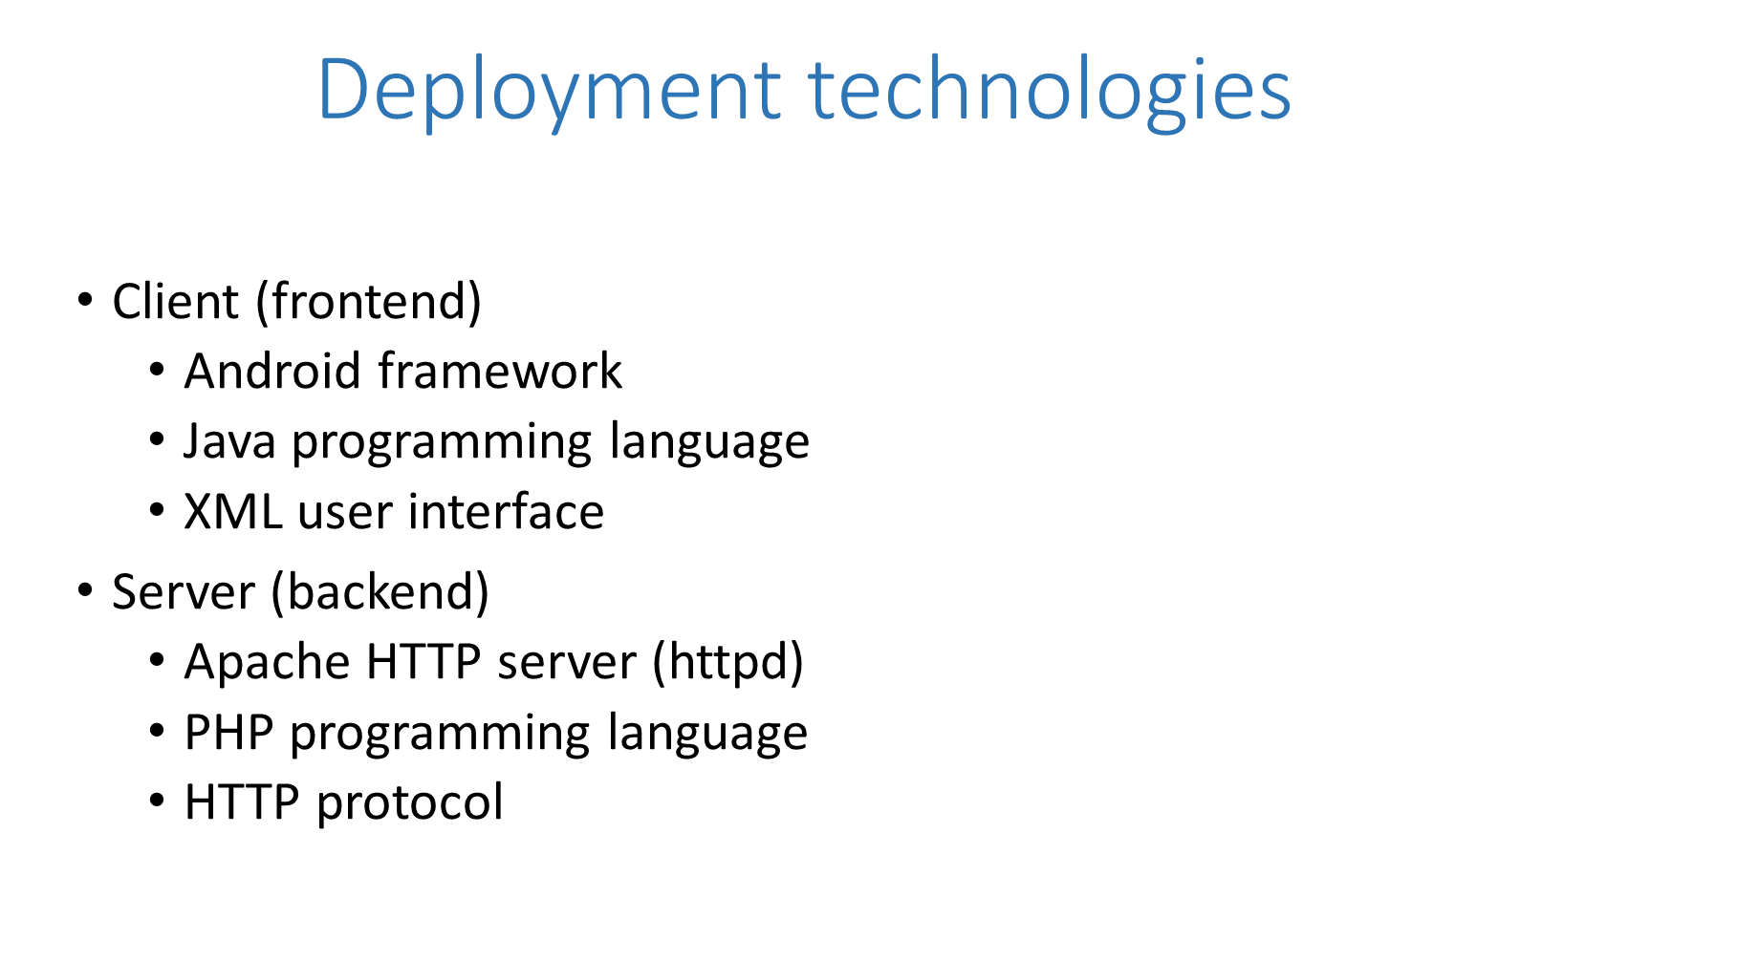

DI MILANO
POLITECNICO DI MILANO
© Jacopo Rigoli Mattia Zannin 2014-2015
DIMA
© Jacopo Rigoli Mattia Zannin 2014-2015
Distributed Systems
© Jacopo Rigoli 2014-2015
Distributed System

Slide 10
DI MILANO
POLITECNICO DI MILANO
Requirement to be implemented
Gamification:
Encourage users to collect POIs of various type to achieve trophies.
Offline mode:
Let the user to previous download from home a package with all the info of a particular city, so he can visit it without an internet connections.
Push notifications between two users when a user’s friends scan a monument that the other has recently scanned.
© Jacopo Rigoli Mattia Zannin 2014-2015
DIMA
© Jacopo Rigoli Mattia Zannin 2014-2015
Distributed Systems
© Jacopo Rigoli 2014-2015
Distributed System

