Slide 1
Working with Google Colab Notebooks
https://colab.research.google.com/

Slide 2
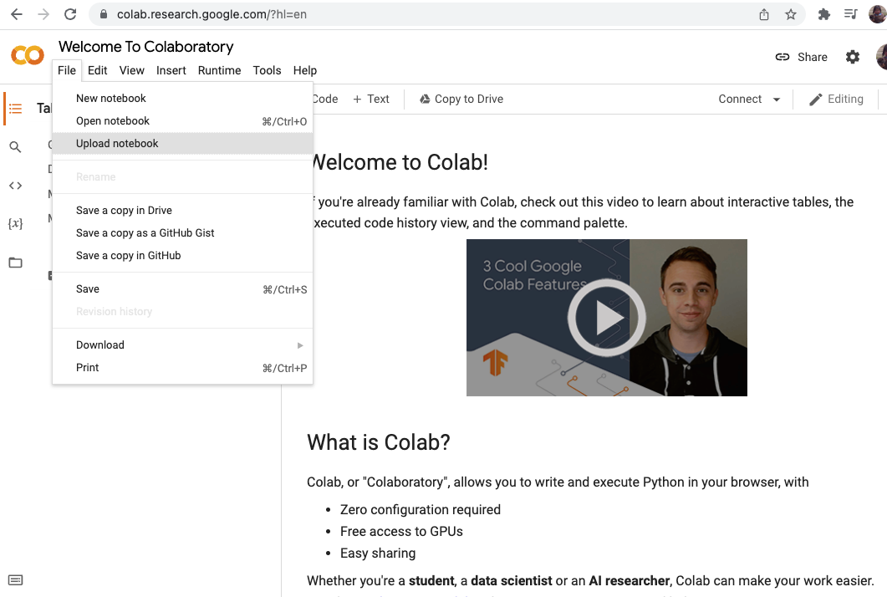
1. Upload your notebook

Slide 3
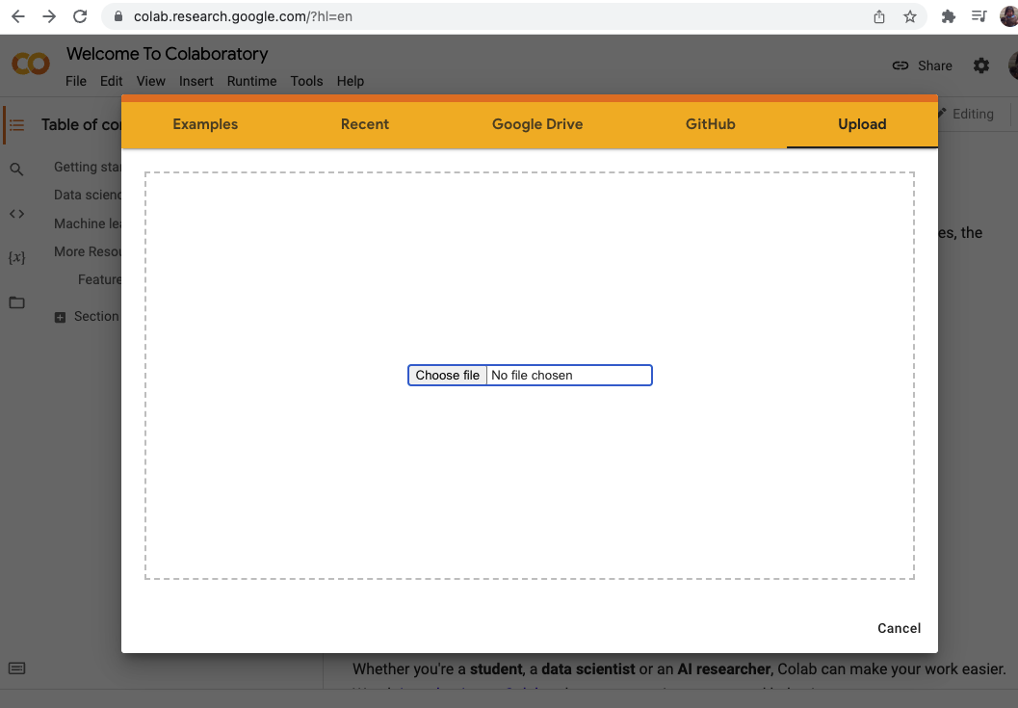
2. Choose file or drag & drop it to the upload window

Slide 4
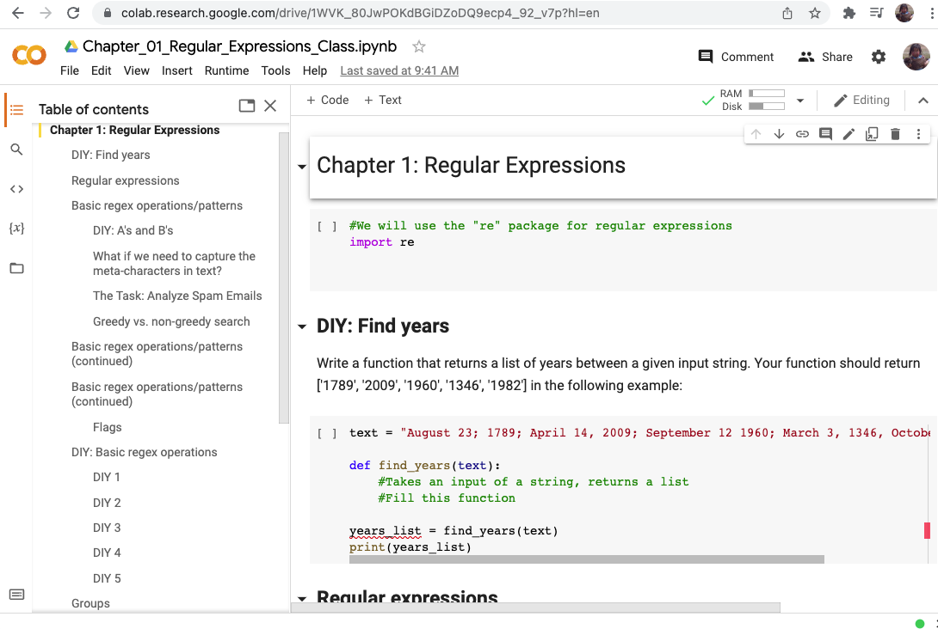
3. Structure of the notebook
Table of contents
Text cell
Files
Code cell

Slide 5
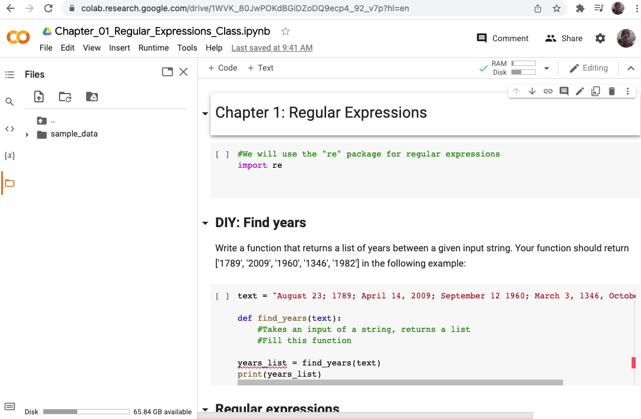
4. Upload text files to process
Go To ”Files”
Drag and drop text file to this box

Slide 6
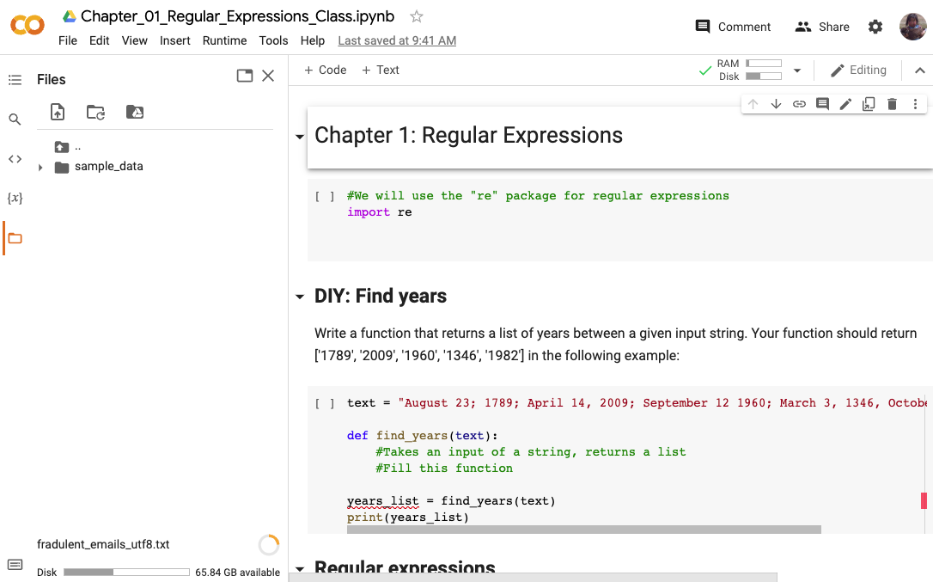
4. Upload text files to process
Upload progress bar

Slide 7
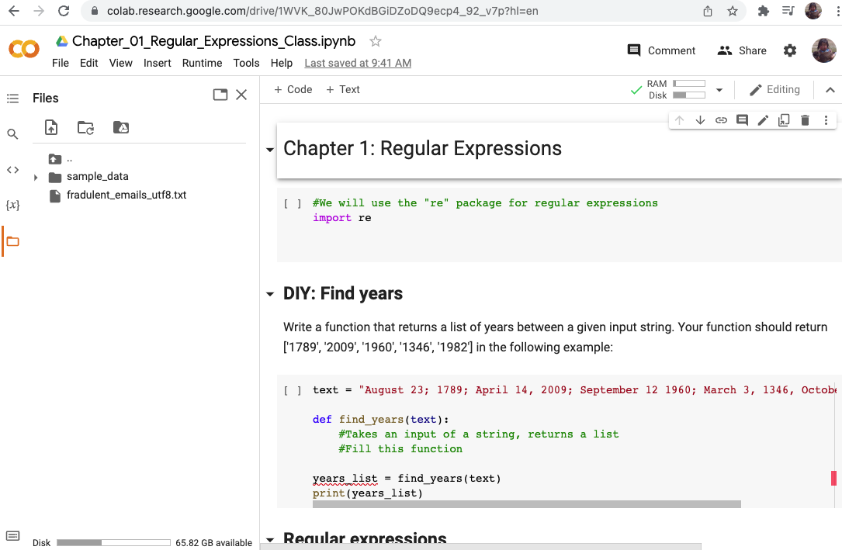
4. Upload text files to process
File is ready to be processed with your code

Slide 8
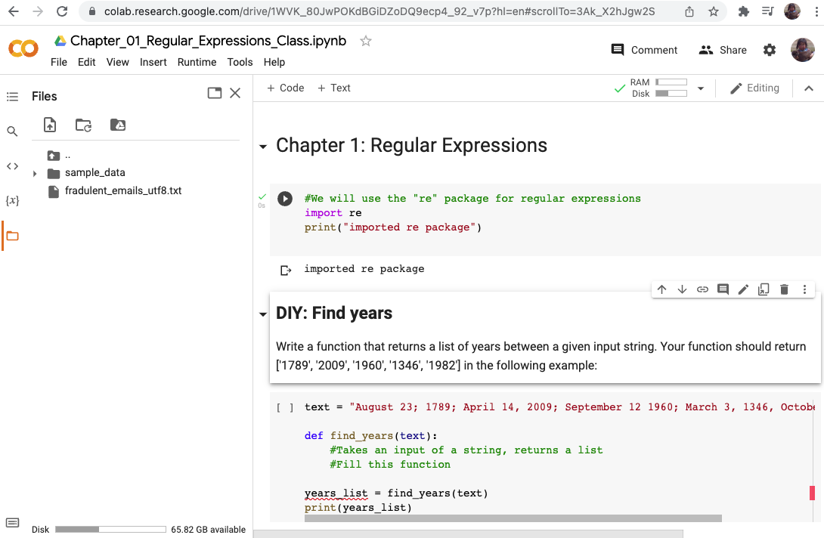
5. Running code
Run code cells:
Shift + Enter
or
Click the “Play” button
The output will be
displayed below the
code cell

