Slide 1
EMOTICONIZER
INSTRUMENTACION PARA LA VISION
ORION GARCÍA GALLARDO
MASTER EN VISIÓN ARTIFICIAL 2013
UNIVERSIDAD REY JUAN CARLOS

Slide 2
Index
Introduction
Architecture
Emoticon Selection
Algorithmic
Image Manager
Directories and Files
Project Improvements
Steps for deploying the application
Steps for using the application
Demo
Future work
Conclusions
Questions

Slide 3
Introduction
Face Emoticonizer: Facial Feature Detection and Changing on Android
Author: Kun Yi
Department of Electrical Engineering, Stanford University
Project for Spring 2012
Goal: Fast and robust facial feature changing to visualize emoticon
Challenge: Face feature replacement, stable tracking and performance

Slide 4
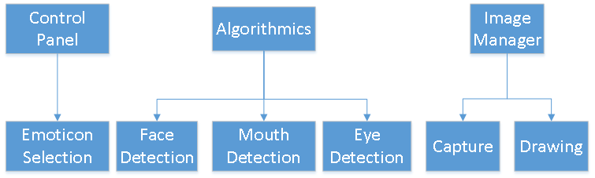
Architecture
Android version 3.0 (API 11)
3 Basic Modules:
Control Panel Module
Algorithmic Module
Image Manager Module

Slide 5


Emoticon Selection
Selection between predefined emoticons
Emoticon images will be placed in the ‘raw’ folder
Emoticons will have 2 images inside for: left eye, mouth and right eye.
A list with shown names (escaped with /) and the paths of the emoticons will be initialize at the beginning
kaomojiList.add(new Kaomoji("\u2267\u25BD\u2266", Utils.exportResource(context, R.raw.kaomoji1)))
A MenuItem List is initialized with the former list
Emtocions can be added including and image in ‘raw’ folder and including the name, that will be shown, in the first list

Slide 6
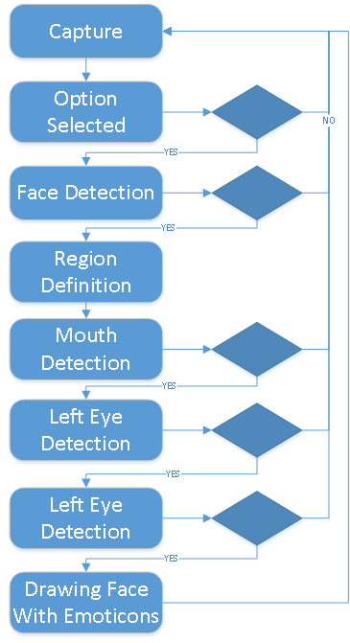
Algorithmic: Flow Diagram
Iterative Process
Critical Points:
Option Selection
Detections:
Face
Mouth
Eyes

Slide 7
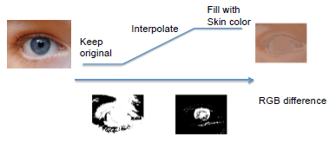
Algorithmic
Haar Detection:
Face
Eyes
Mouth
Xml for haar detection placed in ‘raw’ folder, with the previous features
Face detection more stable than feature detection
Use face detection as reference to make up for “lost” features in a frame
if (abs(center(feature) – center(old)) > threshold)
{
delta = center(face) – center(face_old)
center(feature) = center(old) + delta
}
Feature Fill with skin color (not used because bad performance)
Before drawing emoticons, need to remove feature and fill with skin color
Blend pixels close to skin color to avoid filling a “block” of solid color
Gaussian blurring for smoother result

Slide 8
Image Manager
Capture
AmdroidManifest .xml camera permisions:
<uses-permission android:name="android.permission.CAMERA"/>
<uses-feature android:name="android.hardware.camera" />
<uses-feature android:name="android.hardware.camera.autofocus" />
View: Class extended of ‘SurfaceView’
Gets the image from ‘VideoCapture’ of OpenCV
Drawing
Implemented in the ‘View’ class
VideoCapture is duplicated in two copies:
Color copy
Grayscale copy
Images are processed and modificated by the algorithm
Result image is copied to ‘Bitmap’ object
‘Bitmap’ object is drawn with a ‘Canvas’ object
Iterative process in a separate thread (avoiding hang the app)

Slide 9
Directories and Files
ee368.kaomoji folder:
BaseView.java (extend SurfaceView), View.java (extend BaseView.java ): Capture and draw images
Kaomoji.java: Draw emoticons over the image
FaceTracker.java: Main class of the algorithm with the iterative process
CotrolPanel.java (extends Activity), Options.java: Classes for manage the emoticon selection
Util.java: Methods to encapsulate operations
FpsMeter.java: Calculate frames per second and draw it in the output image
ee368.threads folder:
EyeRunnableThread.java (implements Runnable): Thread for detecting eyes
MouthRunnableThread.java (implements Runnable): Thread for detecting the mouth
ee368.tracking folder:
TrackedFeatured.java: Initial tracking for ‘low’ features
Camshifting.java .TrackedObj.java: Tracking for eyes using Camshift algorithm

Slide 10
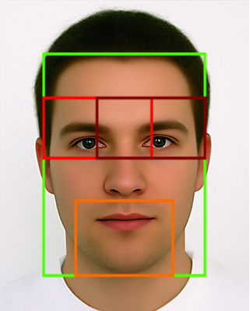
Project Improvements
Adapted project for version Android 2.3.3 (API 10)
Eyes detection:
Regions Distinction
between Left and Right
Camshift Eyes Detection
Option of running mouth and eyes detection process in parallel (multi-threading)
Improvement (approx 2x in Fps):
Initially: Max fps = 15, Min fps = 0,75
Finally: Max fps = 15, Min fps = 2

Slide 11
Camshift Eyes Detection
Camshift = Continuously Adaptive Mean Shift
G. Bradski. Computer Vision Face Tracking For Use in a Perceptual User Interface. Intel Technology Journal, Q2, 1998
Initially created for face tracking
Using functions calcHist, calcBackProject and CamShift in OpenCV
Initial histogram created with eye haar detection
Restricted to the region of the eye (Red rectangles)
Camshift faster then haar detection everytime

Slide 12
Steps for deploying the application
Extract .zip file
Download OpenCV-2.3.1 from http://sourceforge.net/projects/opencvlibrary/Diles/opencv--‐android/2.3.1/ in the ‘CODE’ folder
Open eclipse
File – Import...
Select - General - Existing Android Code Into Workspace - Next
Browse... - Select “CODE” folder
Check ControlPanel and OpenCV-2.3.1 projects - Finish
Connect USB Mobile.
Right Click in ControlPanel project - Run as - Android Application
Select Device
The application will be installed and running in the device

Slide 13
Steps for using the application
Initially no emoticon option is selected
Press menu button
The following panel will be shown
Select an emoticon
Point the camera to a face (in a photo or a real one)
Emoticon will be drawn over the face
Select another emoticon whenever you want

Slide 14
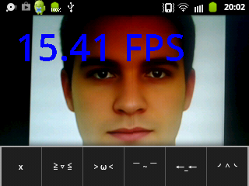
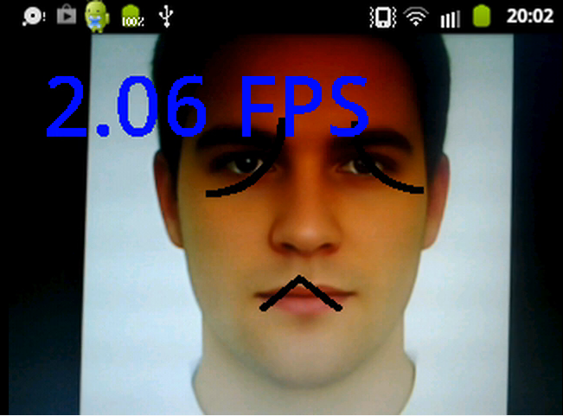
Demo
http://vimeo.com/66343546
http://vimeo.com/66383259

Slide 15
Future work
Implement haar algorithm and Camshift in native code
Extend Camshift for face detection (tested with bad results because features region definition)
Extend Camshift for mouth detection
Improve the emoticons drawing algorithm
Integrate with face expressions

Slide 16
Conclusions
Easy but powerful system
Robust and quite fast system
Portable to other mobile phones
Face limits in mobile phones:
Computational power
Camera quality, low fps

Slide 17
Questions
?

