Slide 1
EMOTICONIZER
INSTRUMENTACION PARA LA VISION
ORION GARCÍA GALLARDO
MASTER EN VISIÓN ARTIFICIAL 2013
UNIVERSIDAD REY JUAN CARLOS

Slide 2
Index
Introduction
Architecture
Emoticon Selection
Algorithmic
Image Manager
Project Improvements
Steps for deploying the application
Steps for using the application

Slide 3
Introduction
Face Emoticonizer: Facial Feature Detection and Changing on Android
Author: Kun Yi
Department of Electrical Engineering, Stanford University
Project for Spring 2012
Goal: Fast and robust facial feature changing to visualize emoticon
Challenge: Face feature replacement, stable tracking and performance

Slide 4
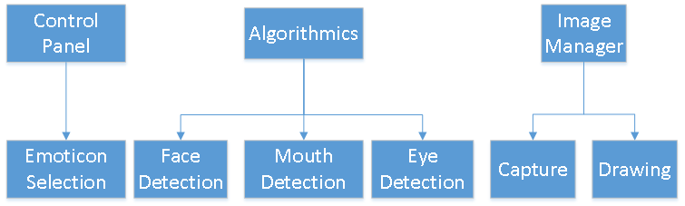
Architecture
Android version 3.0 (API 11)
3 Basic Modules:
Control Panel Module
Algorithmic Module
Image Manager Module

Slide 5


Emoticon Selection
Selection between predefined emoticons
Emoticon images will be placed in the ‘raw’ folder
Emoticons will have 2 images inside for: left eye, mouth and right eye.
A list with shown names (escaped with /) and the paths of the emoticons will be initialize at the beginning
kaomojiList.add(new Kaomoji("\u2267\u25BD\u2266", Utils.exportResource(context, R.raw.kaomoji1)))
A MenuItem List is initialized with the former list
Emtocions can be added including and image in ‘raw’ folder and including the name, that will be shown, in the first list

Slide 6
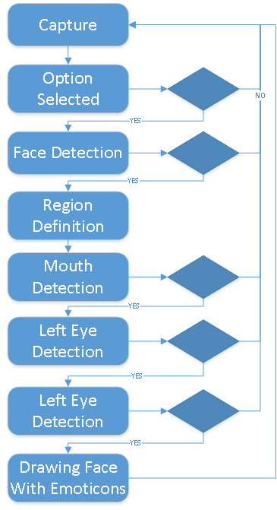
Flow Diagram
Iterative Process
Critical Points:
Option Selection
Detections:
Face
Mouth
Eyes

Slide 7
Algorithmic
Haar Detection:
Face
Eyes
Mouth
Xml for haar detection placed in ‘raw’ folder

Slide 8
Image Manager
Capture
AmdroidManifest .xml camera permisions:
<uses-permission android:name="android.permission.CAMERA"/>
<uses-feature android:name="android.hardware.camera" />
<uses-feature android:name="android.hardware.camera.autofocus" />
View: Class extended of ‘SurfaceView’
Gets the image from ‘VideoCapture’ of OpenCV
Iterative process in a separate thread (avoiding hang the app)
Drawing
Implemented in the ‘View’ class
VideoCapture is duplicated in two copies:
Color copy
Grayscale copy
Image is processed by the algorithm
Result image is copied to ‘Bitmap’ object
‘Bitmap’ object is drawn with a ‘Canvas’ object

Slide 9
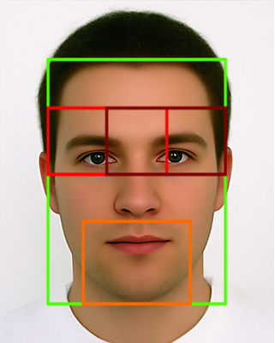
Project Improvements
Adapted project for version Android 2.3.3 (API 10)
Eyes detection:
Camshift
Regions Distinction
between Left and Right
Option of running mouth and eyes detection process in parallel (multi-threading)
Improvement: 2x in Fps

Slide 10
Tracking Mouth

Slide 11
Eye Camshift

Slide 12
Steps for deploying the application
Extract .zip file
Open eclipse
File – Import...
Select - General - Existing Android Code Into Workspace - Next
Browse... - Select “CODE” folder
Check ControlPanel and OpenCV-2.3.1 projects - Finish
Connect USB Mobile.
Right Click in ControlPanel project - Run as - Android Application
Select Device
The application will be installed and running in the device

Slide 13
Steps for using the application
Initially no emoticon option is selected
Press menu button
The following panel will be shown
Select an emoticon
Point the camera to a face (in a photo or a real one)
Emoticon will be drawn over the face
Select another emoticon whenever you want

