Slide 1
Comparison of different solution engines for size distribution method: sizes
2004-Dec-23
Regularization
Maximum Entropy
Regularization with NNLS
NNLS
Singular Value Decomposition

Slide 2
Model
# Calculated (bimodal) test distribution.
# created 31 January 1992 by Pete R. Jemian
#
# Model consists of a bimodal, log-normal volume fraction
# size distribution. Parameters are as follows:
# PARAMETER ( contrast = 100.0 ) ! * 10^20, 1/cm^4
# PARAMETER ( Background = 0.1 ) ! 1/cm^4
# PARAMETER ( sMult = 1000. ) ! counts per 1/cm (for shot noise)
# PARAMETER ( sNoise = 0.025 ) ! minimum level
#
# ! Vf rBar std. dev.
# PARAMETER ( a1 = 0.012, c1 = 75., s1 = 15. )
# PARAMETER ( a2 = 0.008, c2 = 180., s2 = 60. )
# ! a : volume fraction
# ! c : peak center (A)
# ! s : peak half-width (A)
#

Slide 3
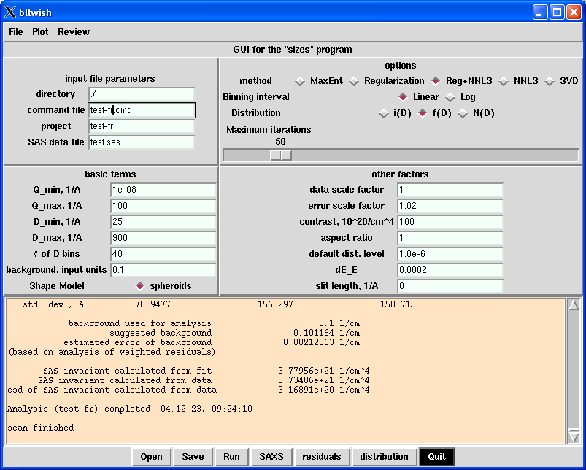
Parameters used

Slide 4
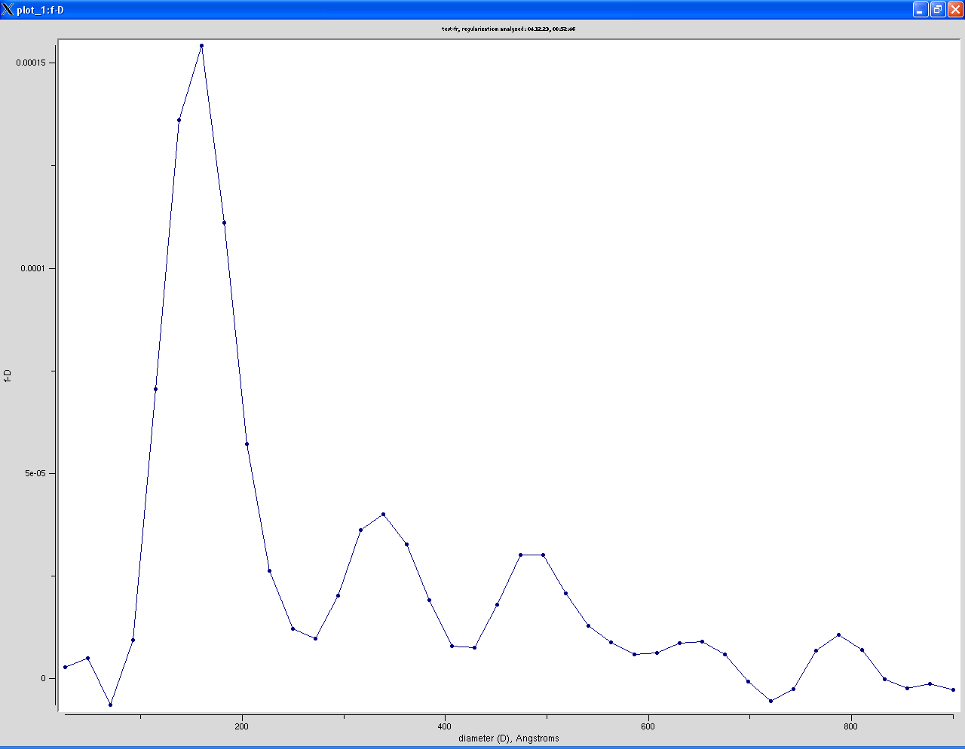
Regularization

Slide 5
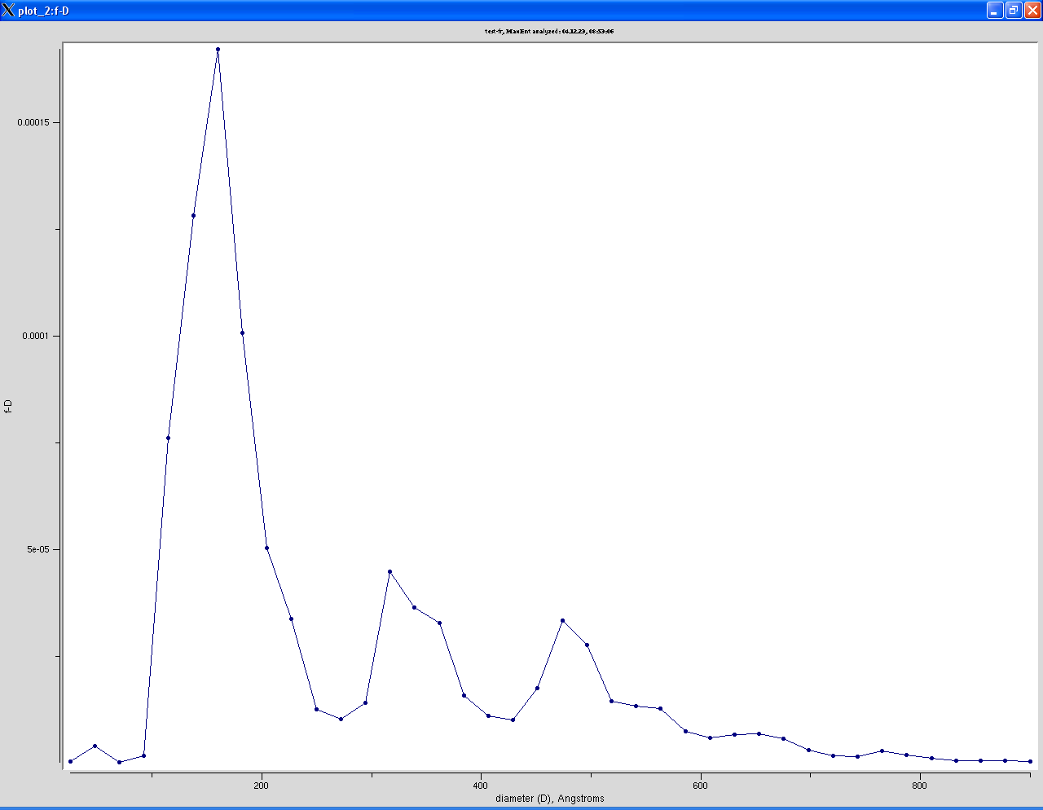
Maximum Entropy

Slide 6
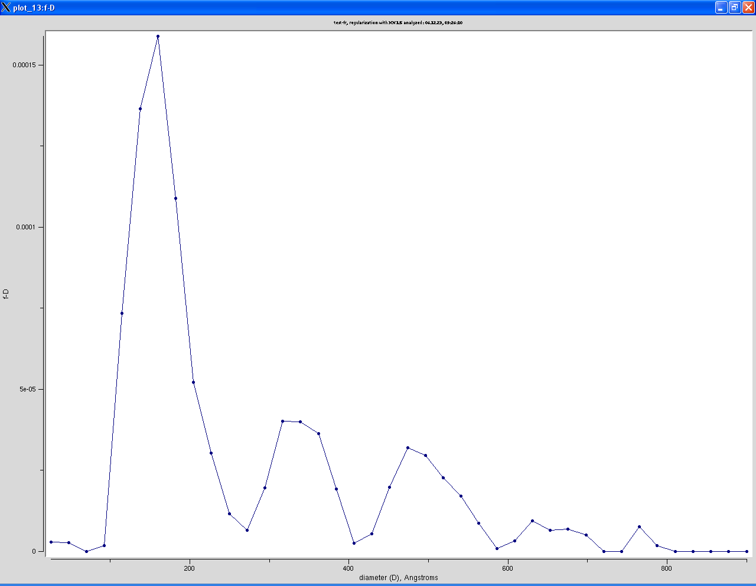
Regularization with NNLS

Slide 7
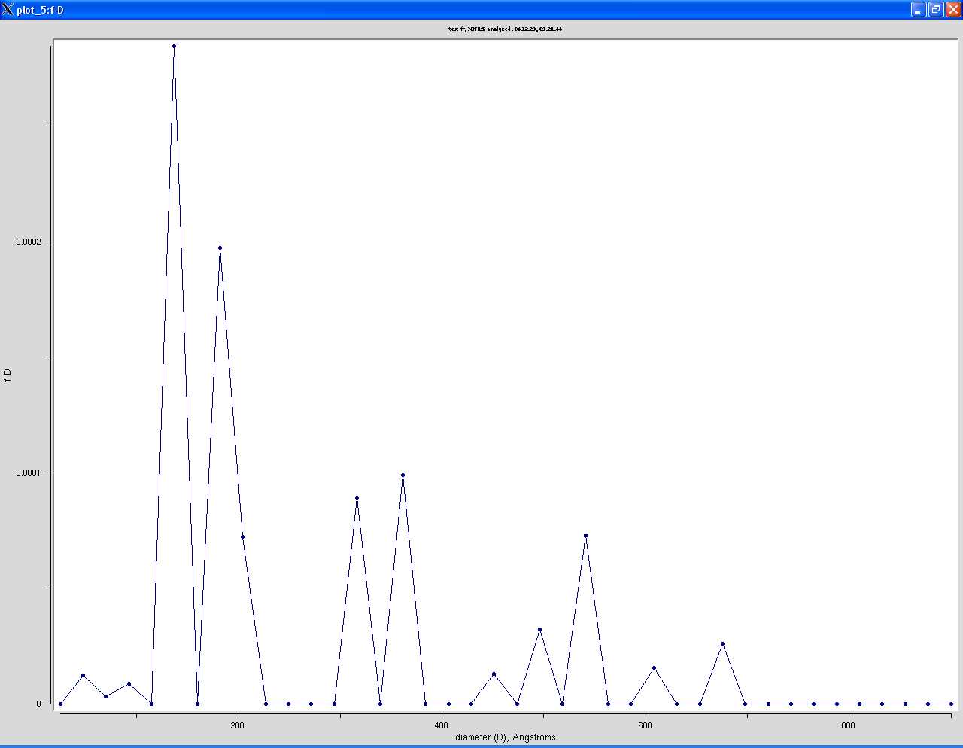
NNLS

Slide 8
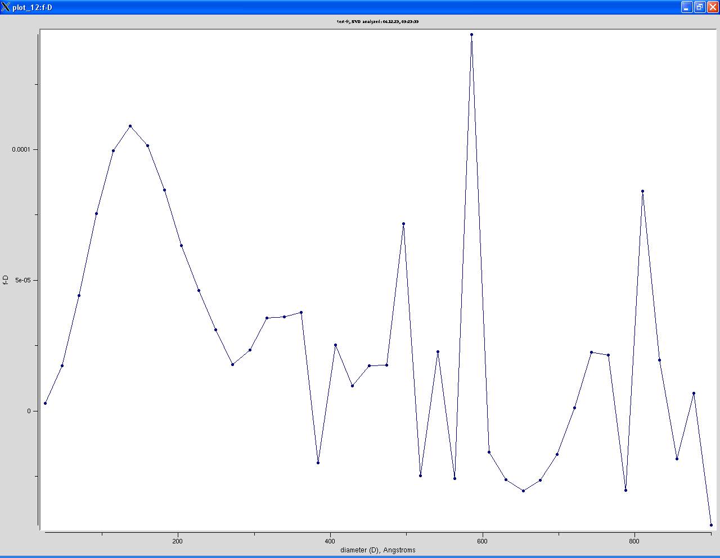
Singular Value Decomposition singular value cutoff = wMax*0.001

Slide 9
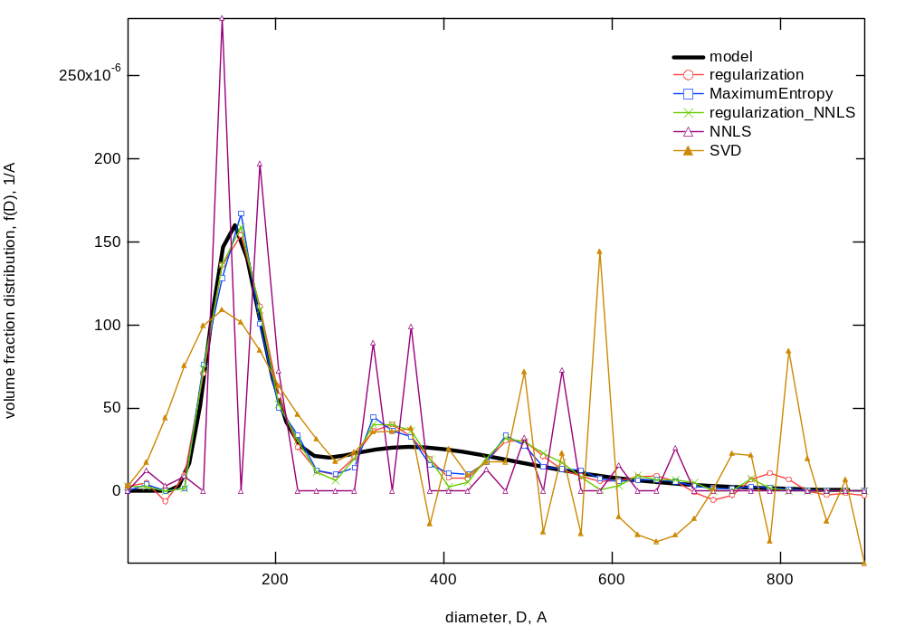
Comparison of distributions

