Slide 1
Strat EDITOR
version 0. 0. 1

Slide 2
Description:
Linux OS
GUI
Source code editor
C/ASM orientation
Division via Libraries
Independency inside sub-modules
Code auto-insertion
Full development cycle
Debugging
Minimal environment

Slide 3
Diagram
Menu
Open
Save
Compile
Store
file1
file2
file3
file4
file5
Browser
Serial drv
Memory drv
UserIface
Ethrnet drv
Interface
Interface
Heap Mngr
Interface
Console
Eth Mngr
Menu
UserIface
Review
Supervisor
Global definitions
App Entry
Initialization
Drivers Init
<<
W1
W2
W3
W4
>>
<<
S1
S2
S3
S4
>>
SSH1
SSH2
SSH3
SSH4

Slide 4
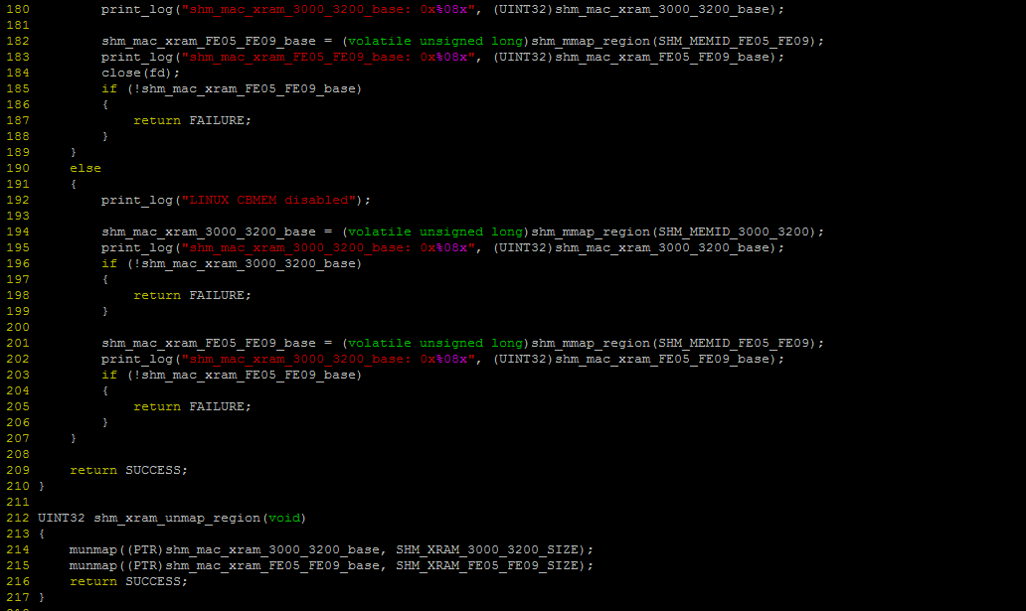
Editor window
Menu
Open
Save
Compile
Store
file1
file2
file3
file4
file5
<<
W1
W2
W3
W4
>>
<<
S1
S2
S3
S4
>>
SSH1
SSH2
SSH3
SSH4

Slide 5
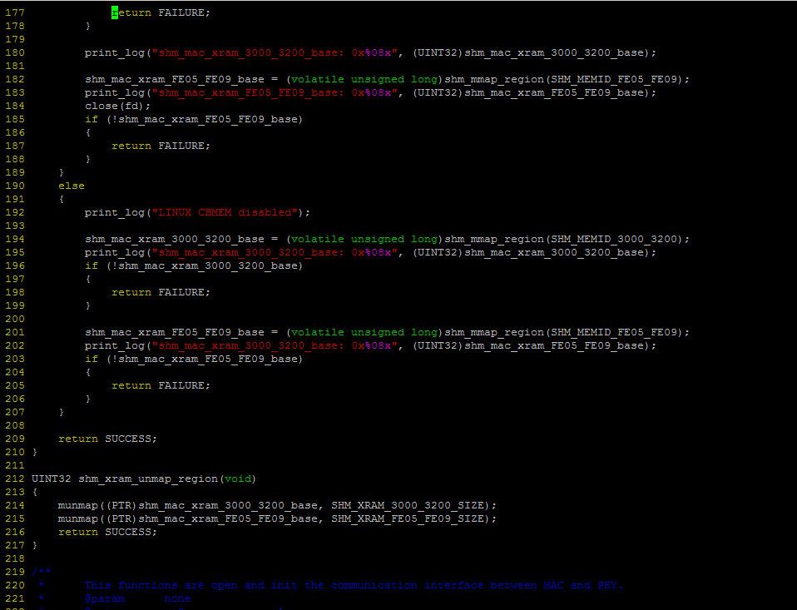
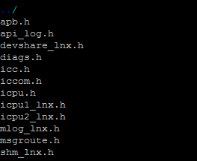
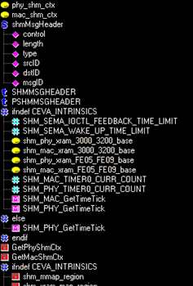
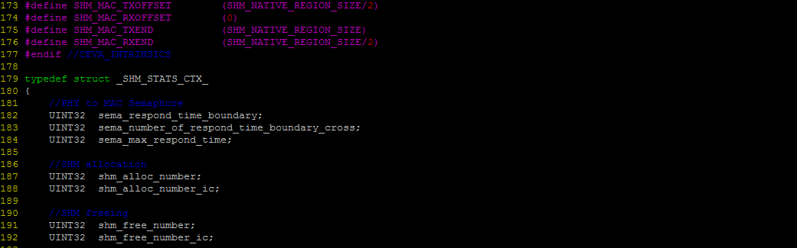
Workspace window
Menu
Open
Save
Color
Replace
Search
Browser
Description
Compile
Store
file1
file2
file3
file4
file5
Browser
Review
Dependency: file…
<<
W1
W2
W3
W4
>>
<<
S1
S2
S3
S4
>>
SSH1
SSH2
SSH3
SSH4

