Slide 1
Unequal Exposure and Stereotyping: Study 1 Design Overview
2026-03-06

Slide 2
Background & Research Question
Group bias can emerge from both motivational factors and simple exposure frequency.
A recent study using multi-agent reinforcement learning showed that exposure alone can produce group bias.
Specifically, differences in agents’ ability to correctly identify a negative individual in the ingroup versus the outgroup were correlated with the magnitude of outgroup bias.
Inspired by this finding, we ask:
Does differential learning about the individual characteristics of members from different groups, due to exposure difference, lead to group bias in humans?
Notes:
(optional) When people form a group-level belief, which individual-level information do they rely on?

Slide 3
Research Question
We will conduct a conceptual replication of Koster et al. (2025) by having participants play a game in which they can actively choose which social partners to interact with.
Demo https://despital.github.io/social-exposure-theory-demo/?demo=true

Slide 4
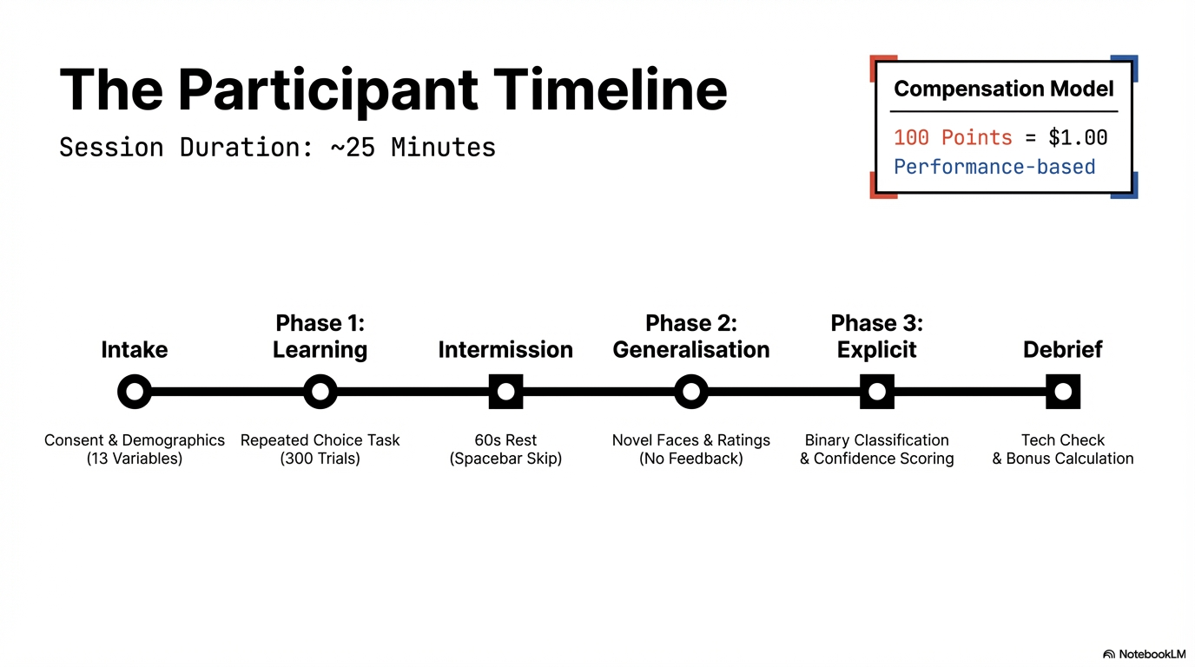

Slide 5
Participants Sampling
Age

Slide 6
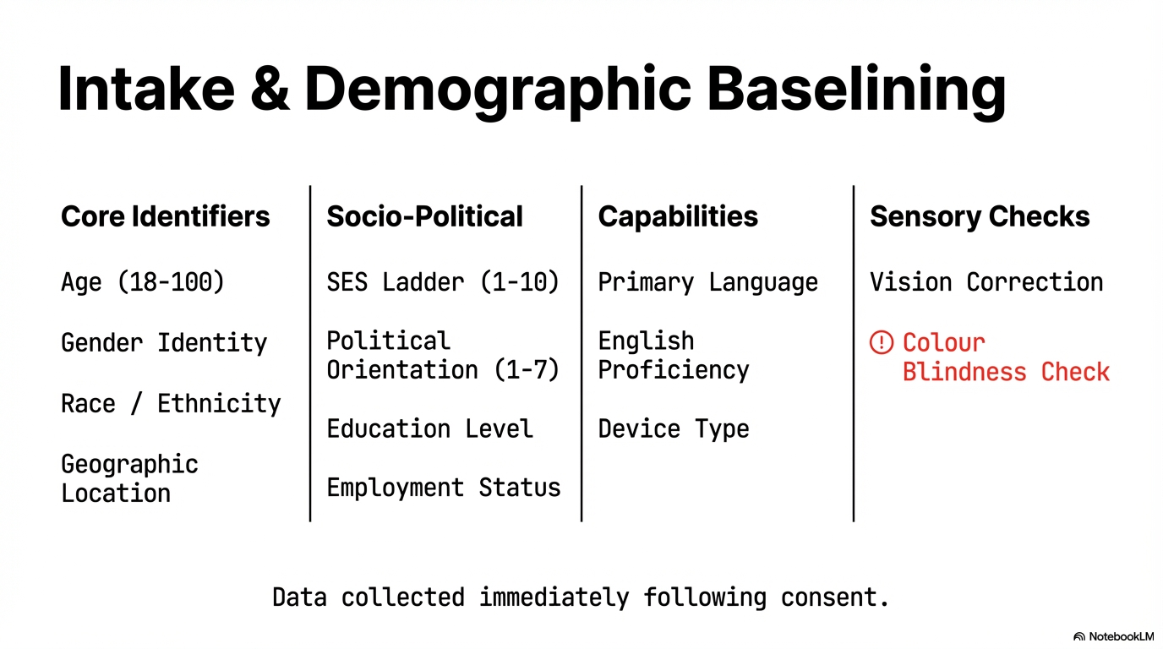

Slide 7
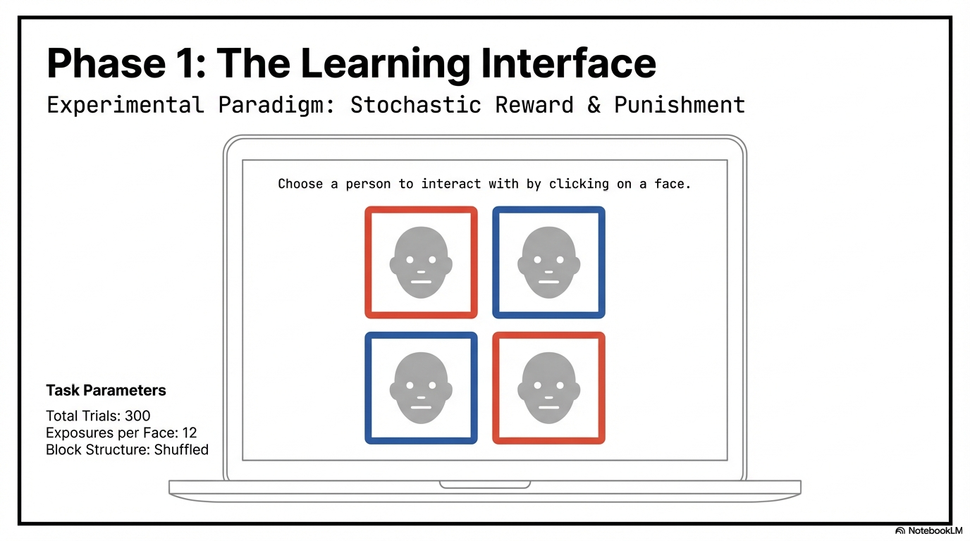
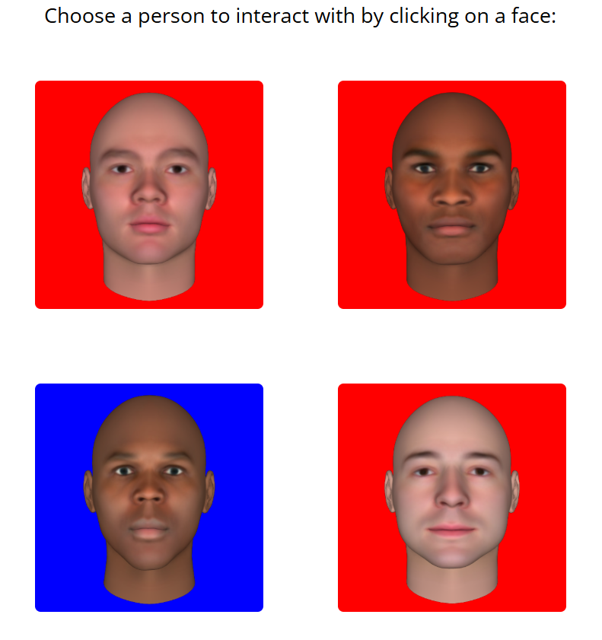

Slide 8
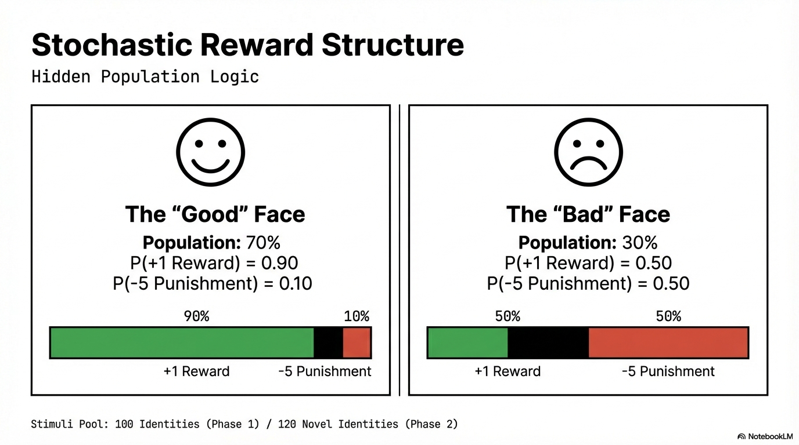
v
v

Slide 9
Sampling logic
How are the four faces sampled

Slide 10
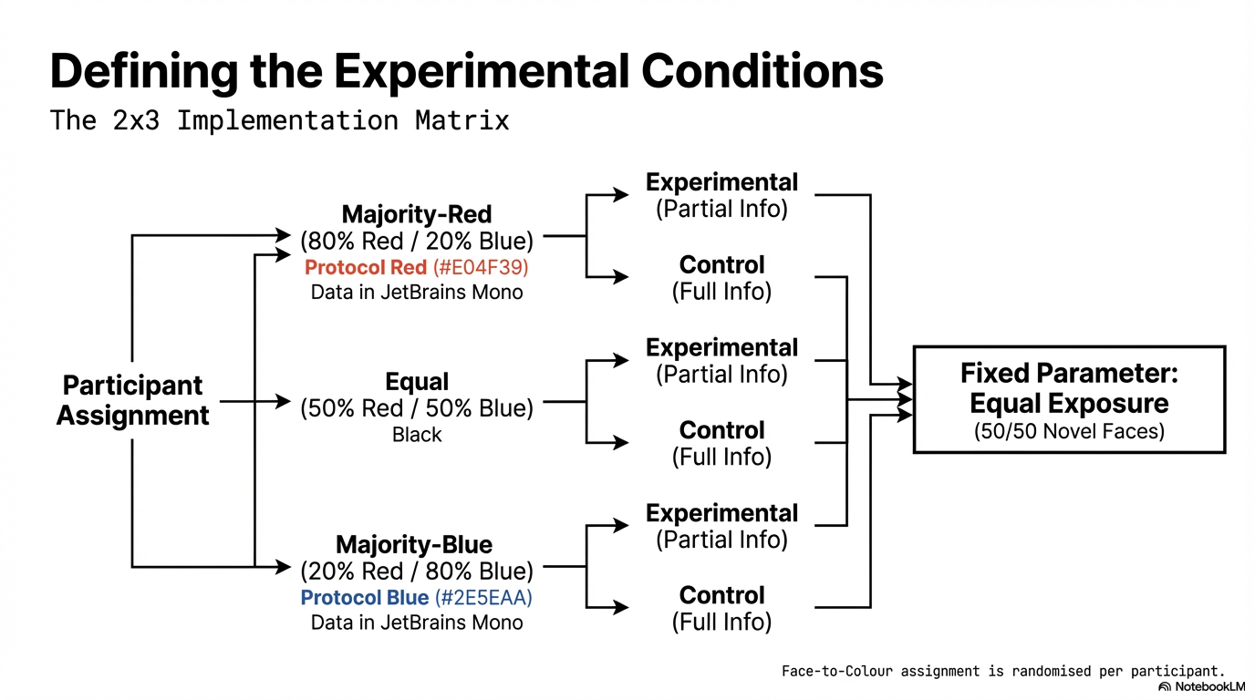
Phase 1 (Learning) Conditions

Slide 11
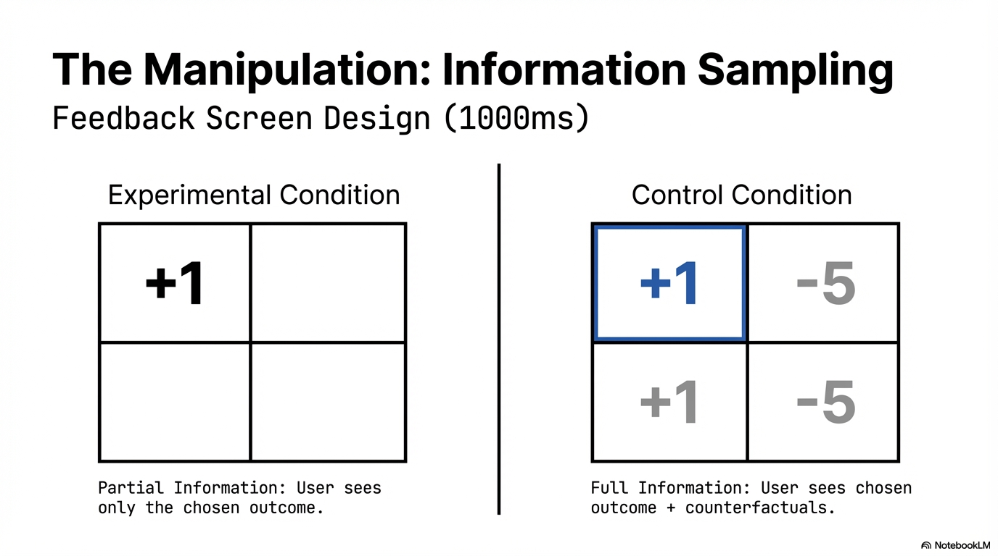

Slide 12
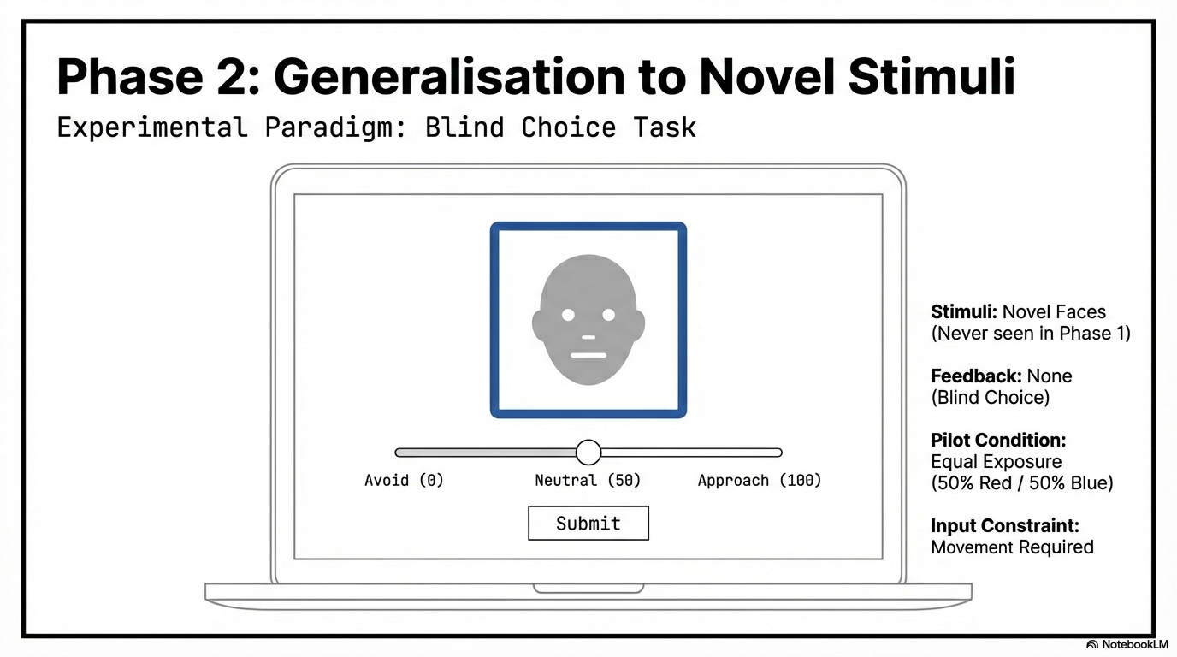
Red/Blue

Slide 13
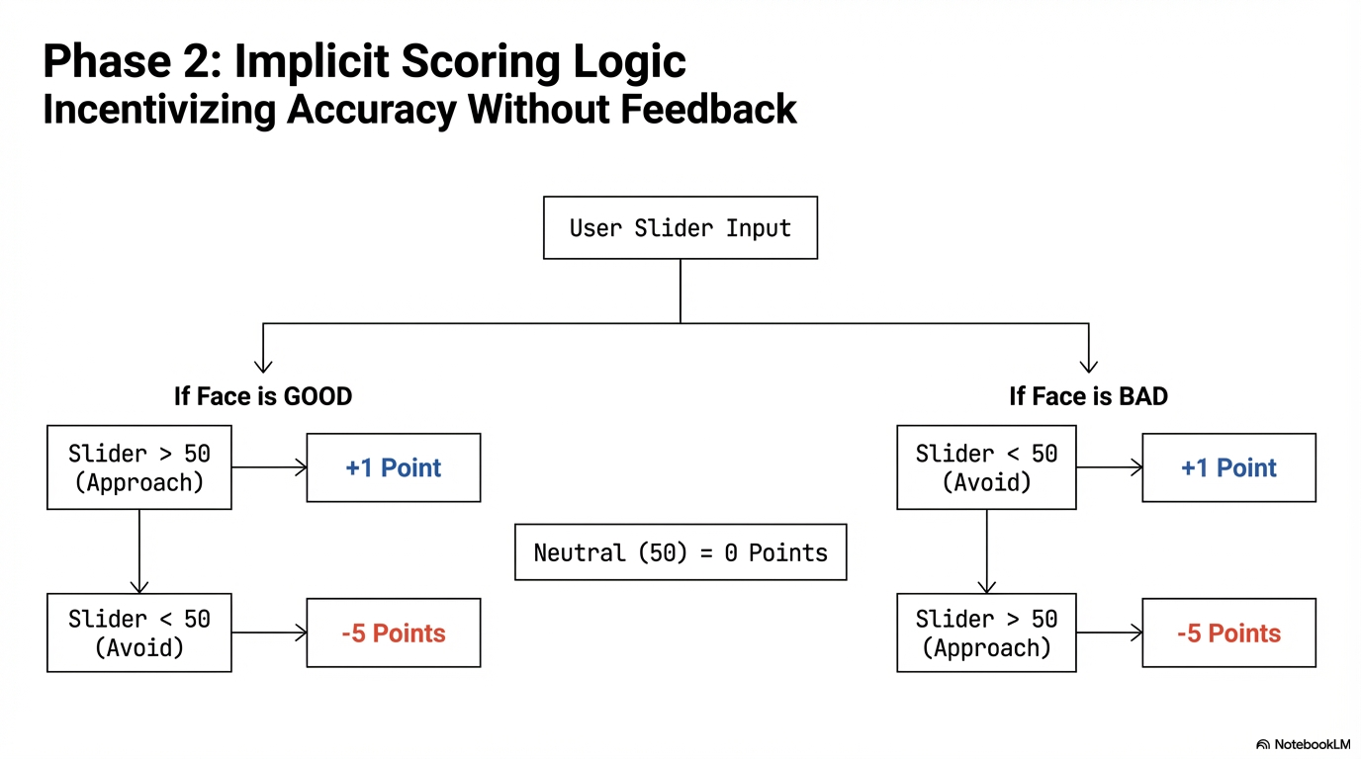

Slide 14
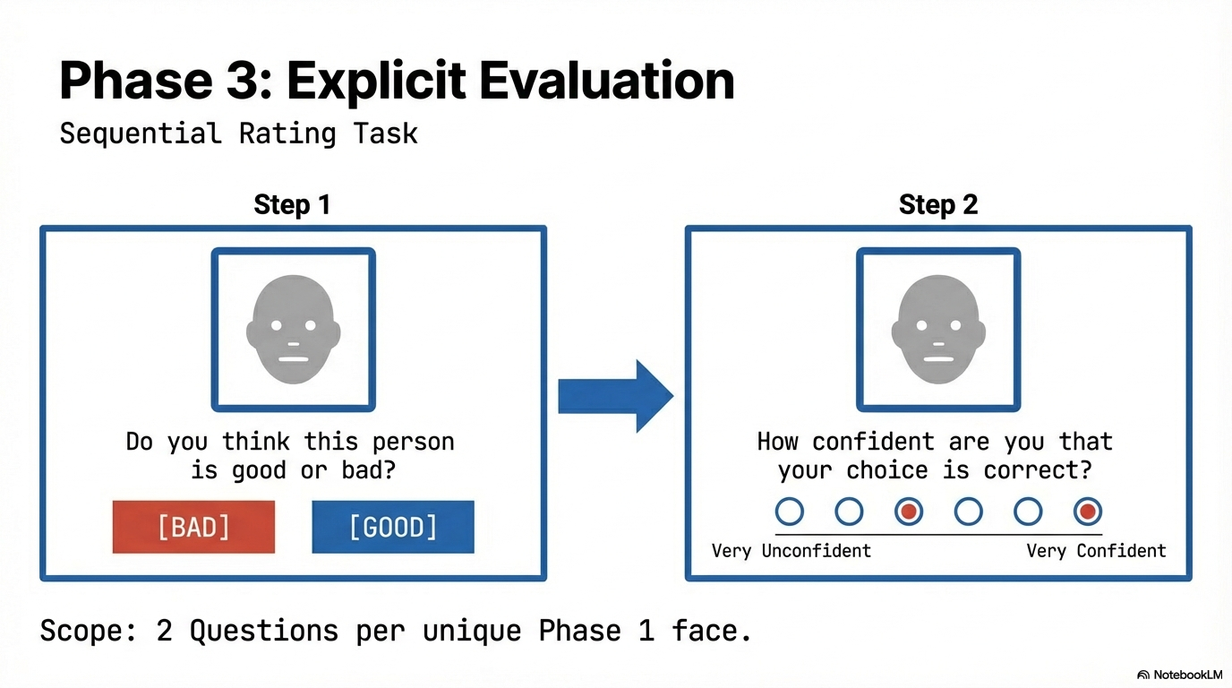
Red/Blue
Red/Blue
What is the likelihood that this target will punish you?

Slide 15
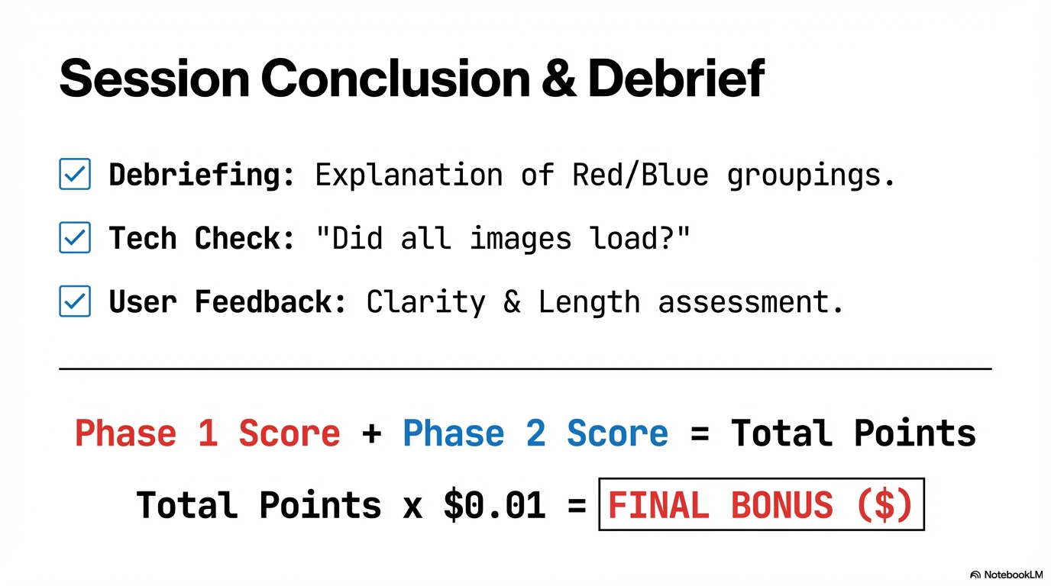

Slide 16
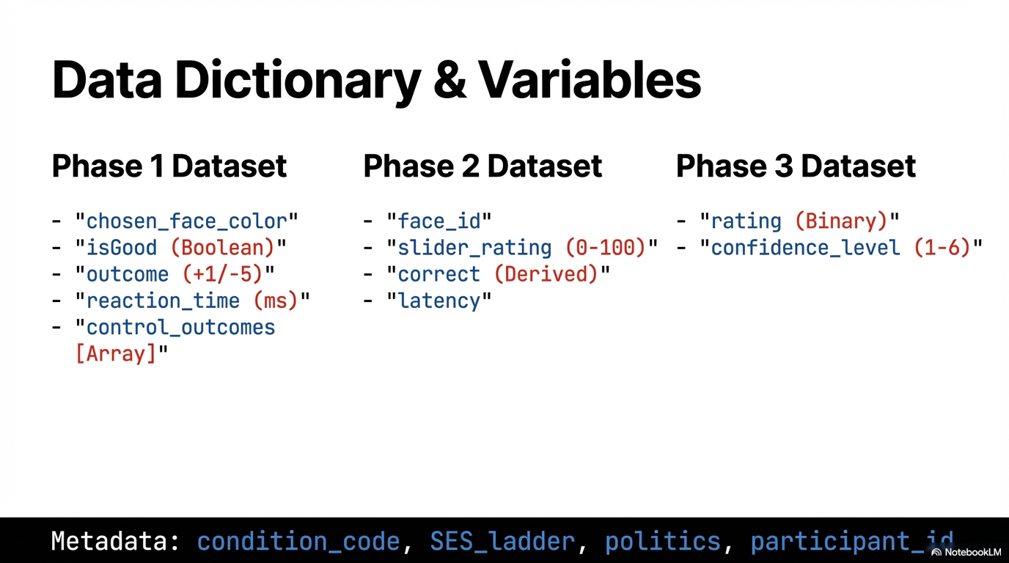

Slide 17
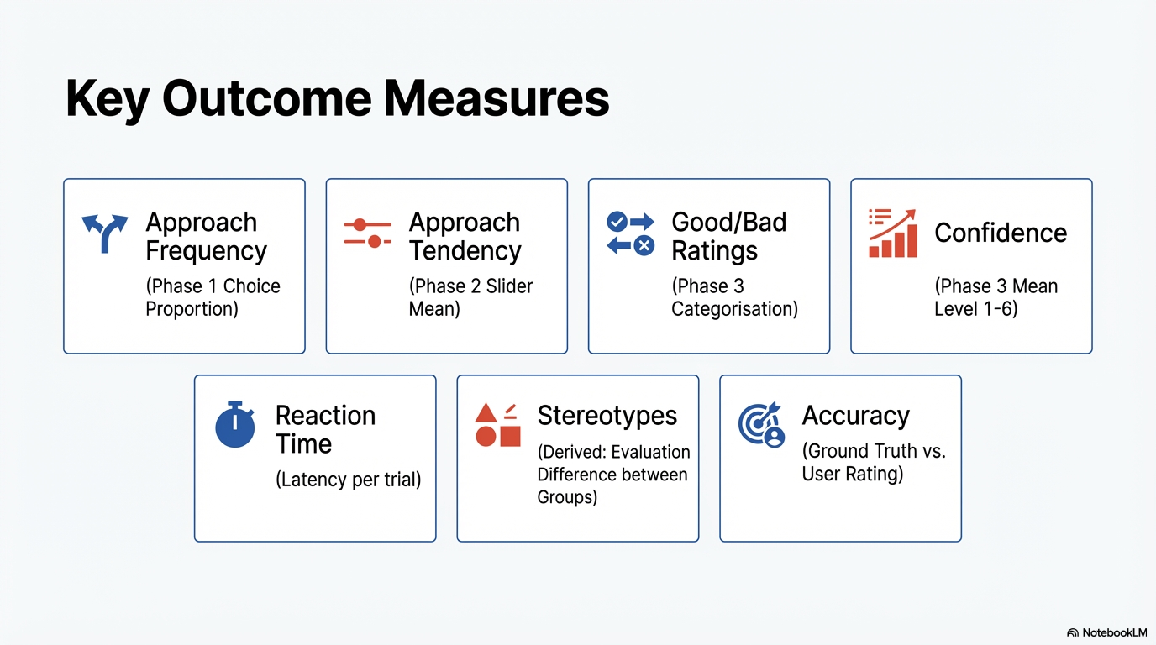

Slide 18
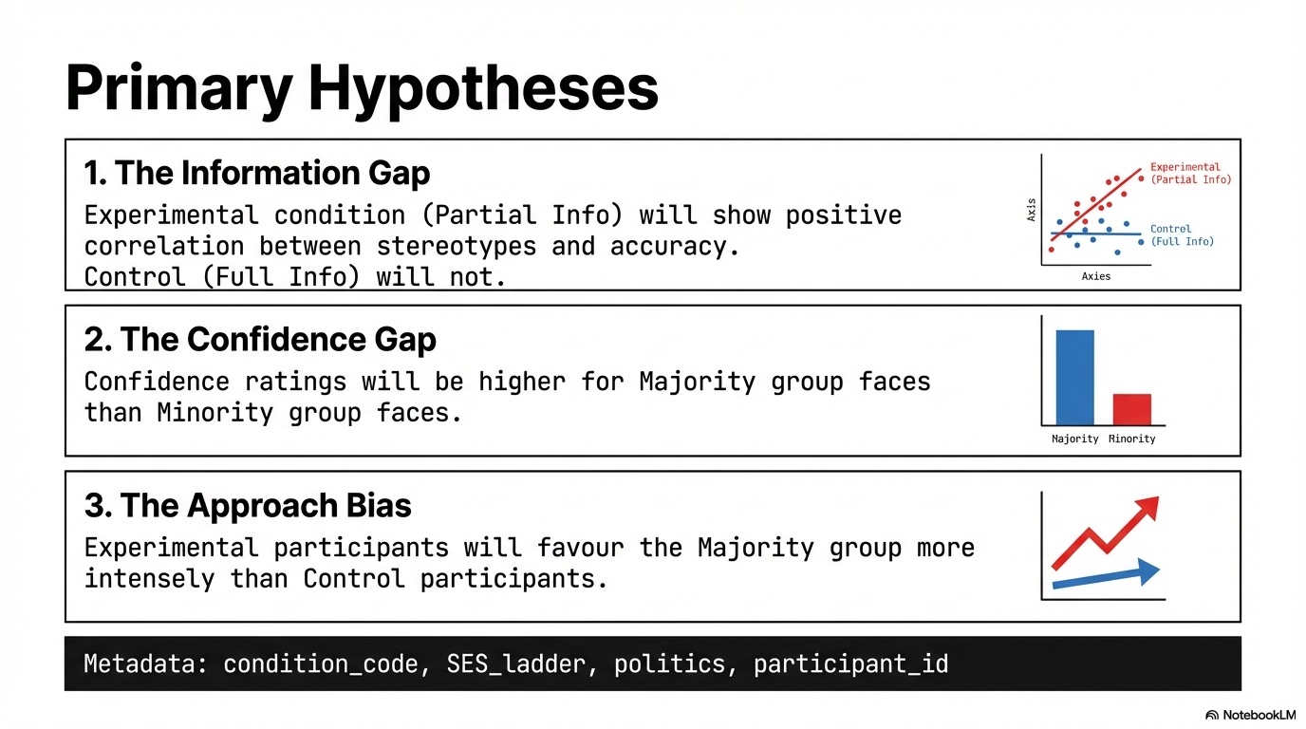

Slide 19
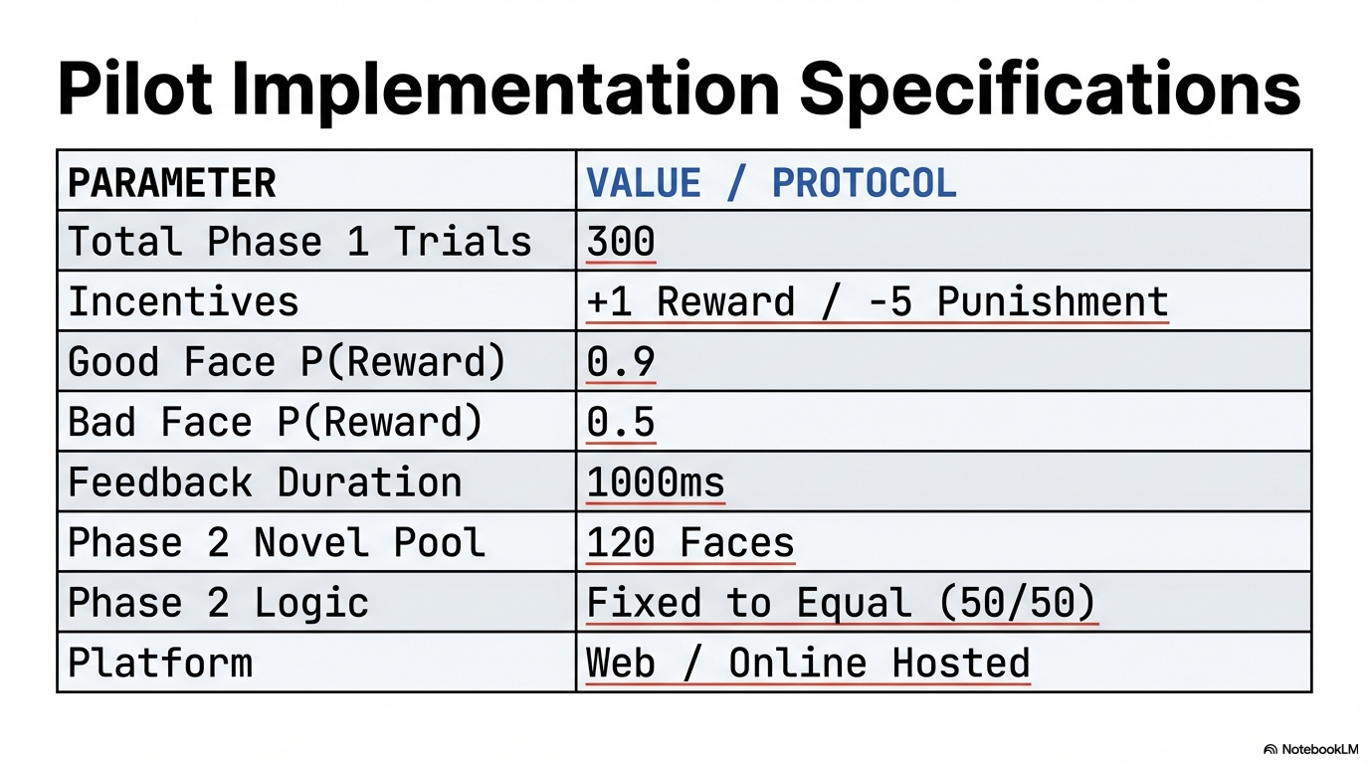

Slide 20
Key outcome measures
Discrimination: the differences in evaluation between the majority group and minority group
Approach tendency
Learned probability of the group members giving punishments
Learning about the individual characteristics of each member in the two groups
Whether a participant has learned the individual characteristic, specifically who the bad guys are, is operationalized as the difference between the estimated punishment probability & approach tendency of the bad guy and the mean of other good members.

Slide 21
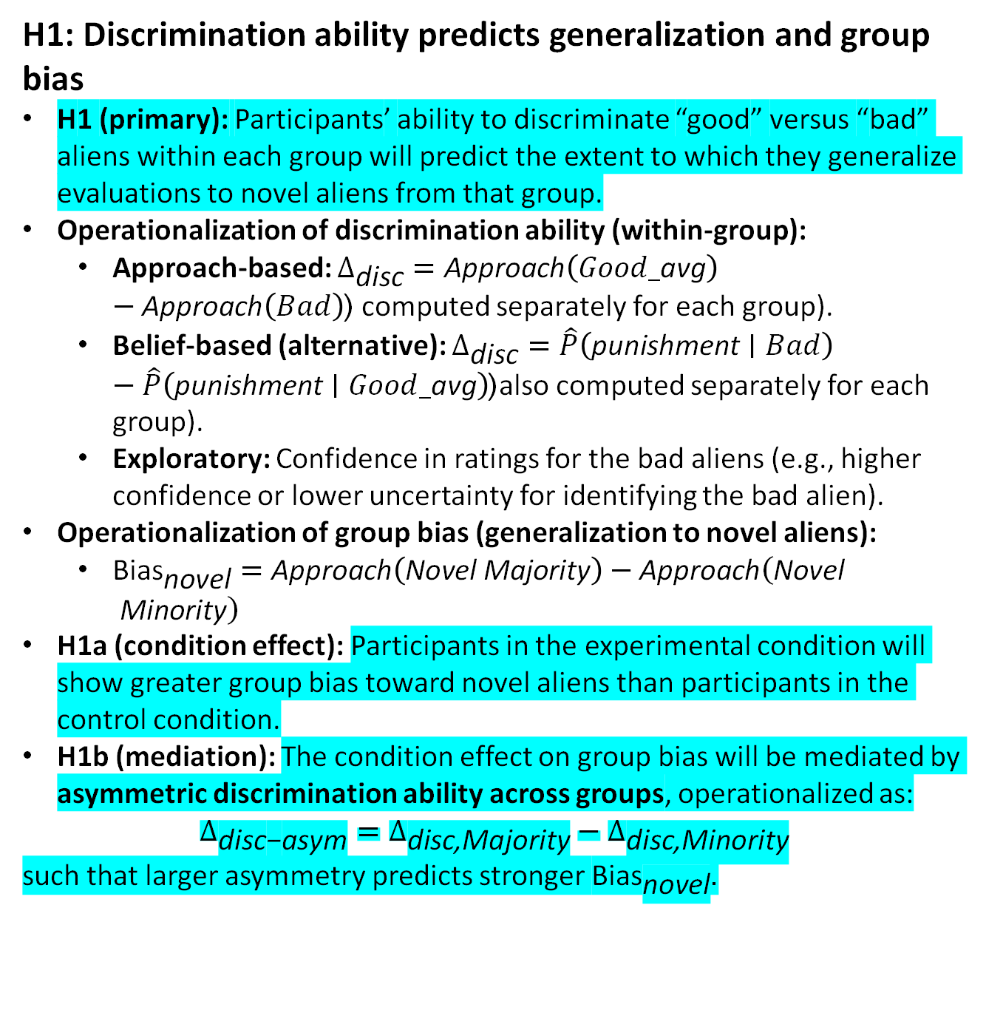
Hypotheses (from the original proposal)
H1: Discrimination ability predicts generalization and group bias
H1 (primary): Participants’ ability to discriminate “good” versus “bad” aliens within each group will predict the extent to which they generalize evaluations to novel aliens from that group.
Operationalization of discrimination ability (within-group):
Approach-based: $Δ_{\text{disc}}=\text{Approach}\left(Good_\text{avg}\right)−\text{Approach}\left(Bad\right)$( computed separately for each group).
Belief-based (alternative): $Δ_{\text{disc}}=\hat{P}\left(\text{punishment}∣Bad\right)−\hat{P}\left(\text{punishment}∣Good_\text{avg}\right)$(also computed separately for each group).
Exploratory: Confidence in ratings for the bad aliens (e.g., higher confidence or lower uncertainty for identifying the bad alien).
Operationalization of group bias (generalization to novel aliens):
${\text{Bias}}_{\text{novel}}=\text{Approach}\left(\text{Novel} \text{Majority}\right)−\text{Approach}\left(\text{Novel} \text{Minority}\right)$
H1a (condition effect): Participants in the experimental condition will show greater group bias toward novel aliens than participants in the control condition.
H1b (mediation): The condition effect on group bias will be mediated by asymmetric discrimination ability across groups, operationalized as:
$$Δ_{\text{disc}\text{−}\text{asym}}=Δ_{\text{disc}\text{,}\text{Majority}}−Δ_{\text{disc}\text{,}\text{Minority}}$$ such that larger asymmetry predicts stronger ${\text{Bias}}_{\text{novel}}$.

Slide 22
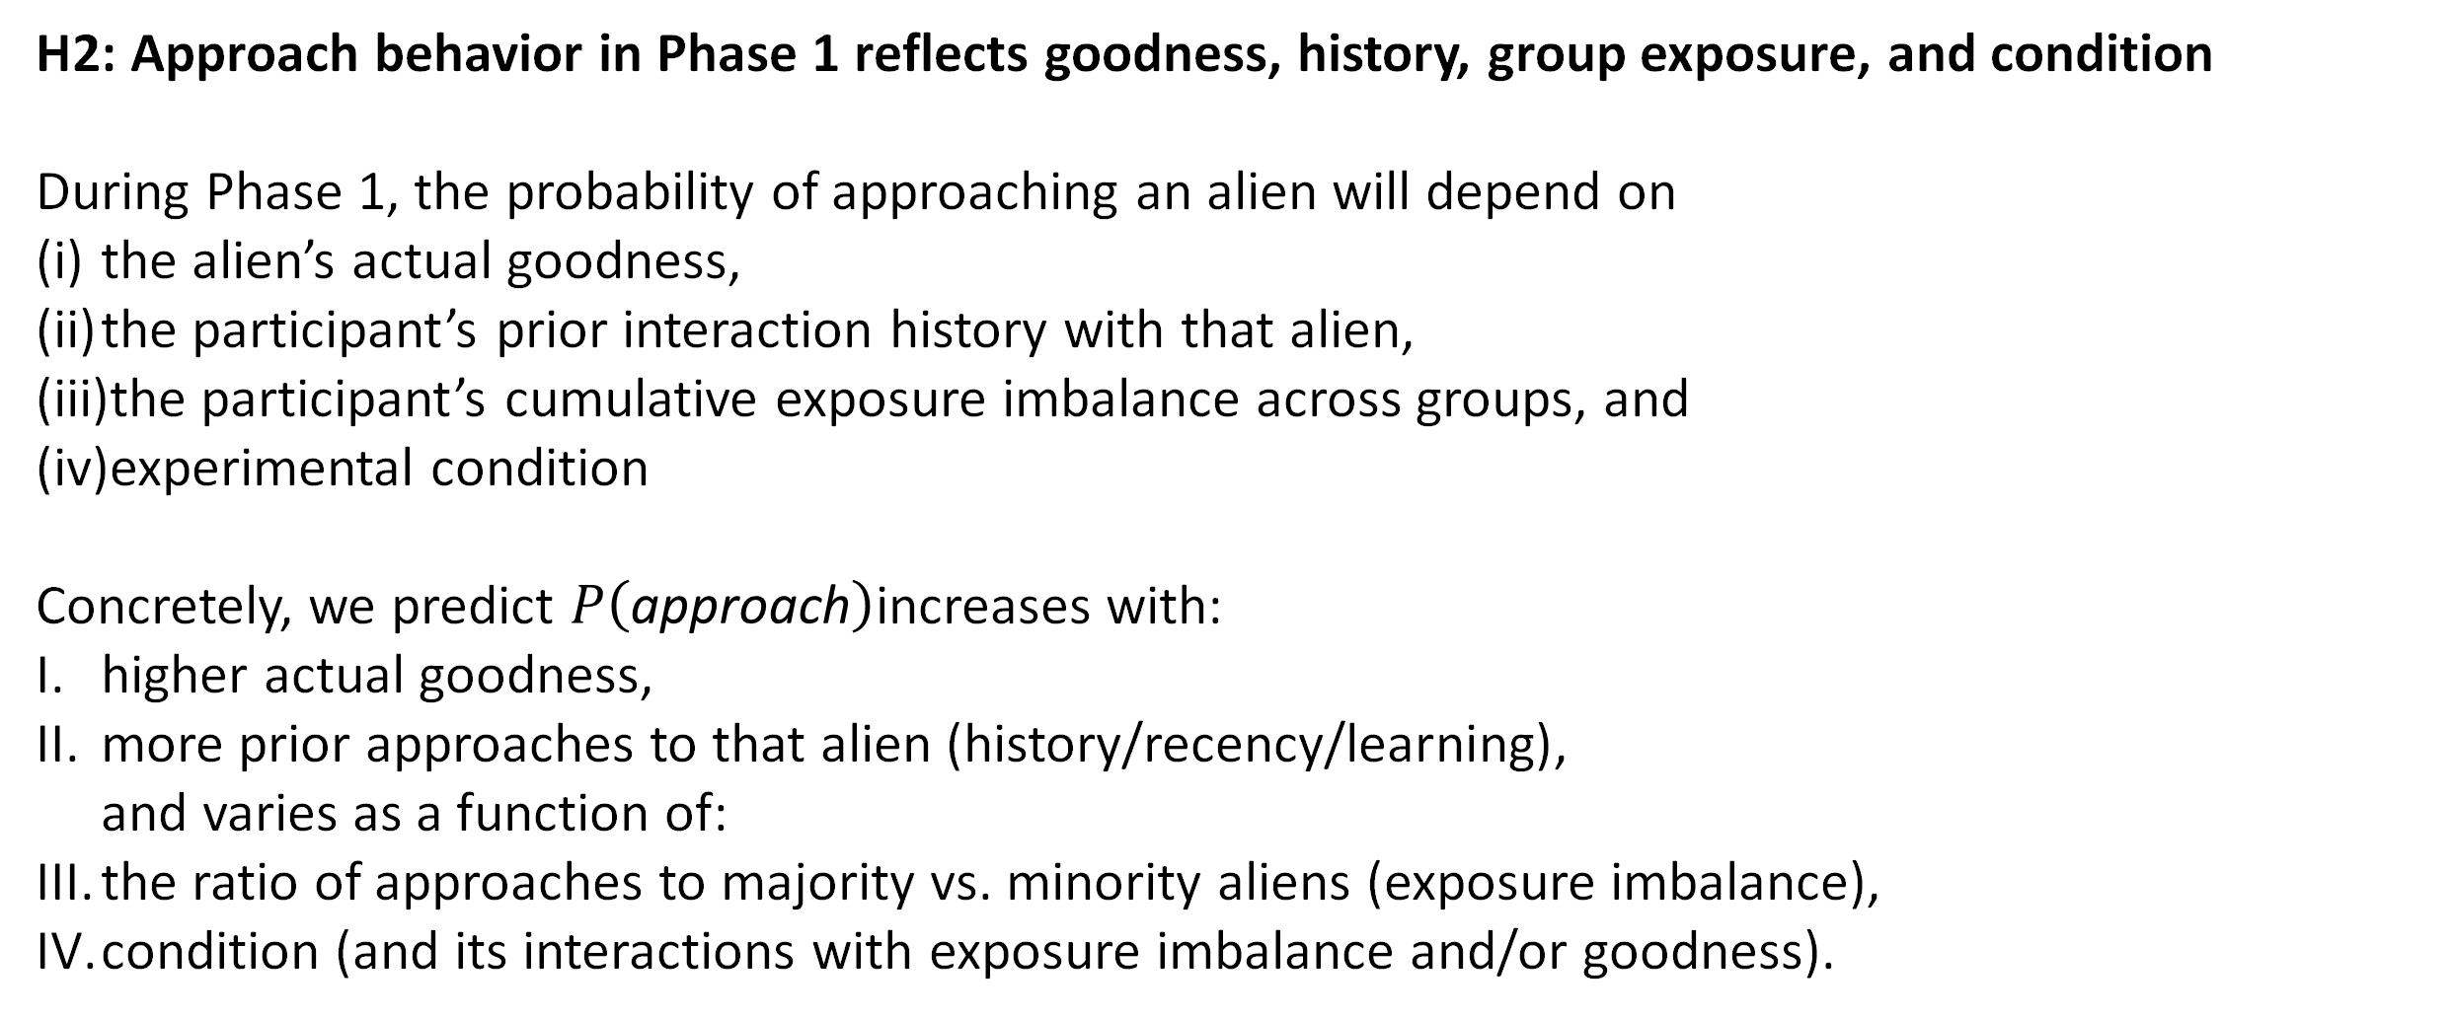
Hypotheses
H2: Approach behavior in Phase 1 reflects goodness, history, group exposure, and condition
During Phase 1, the probability of approaching an alien will depend on
the alien’s actual goodness,
the participant’s prior interaction history with that alien,
the participant’s cumulative exposure imbalance across groups, and
experimental condition
Concretely, we predict $P\left(\text{approach}\right)$increases with:
higher actual goodness,
more prior approaches to that alien (history/recency/learning), and varies as a function of:
the ratio of approaches to majority vs. minority aliens (exposure imbalance),
condition (and its interactions with exposure imbalance and/or goodness).

Slide 23
Hypotheses
Participants’ ability to accurately identify the “good” and “bad” aliens within each group will predict the extent to which they generalize evaluations to novel aliens from those groups.
Ability to discriminate good vs. bad would be operationalized as the difference between the approach tendency between the bad targets and average of good targets. Can also be operationalized using estimated punishment probability.
Unequal interaction opportunities would lead to discrimination towards majority group, because
If choose randomly every trial, the confidence for majority group would be higher, even with the same mean
When allowed to choose voluntarily, participants are more likely to develop reinforcing loop of majority bias because they have larger chance to encounter majority group members
approach Rate in phase 1: The discrimination will be higher in the selective exposure condition than in the full exposure condition, where the group proportions are not equal
Same for novel faces
Mediated by discriminative ability of the group members
Will be mediated by confidence
Mediated by exposure amount / selection amount
Total exposure amount may be correlated with the difference between true prob of punishmt
Prob and reported prob (for group [novel generalization] and encountered faces)
Compared to equal prop, full
Selective exposure may even extremify the reported punishment prob

