Slide 1

DE SRS Brundavan e.V. | Sri Raghavendra Aradhana Mahotsava 2026
Seva Registration Platform
Invitations · Registration · Payments · Check-in · Analytics
Concept and plan for discussion | free tools only

Slide 2
Agenda
1. Goal and constraints
2. Where we are today - prototype and problems found
3. Target system, free tools and roles
4. Flows - end-to-end, status, payment (UML), edit window, desk, waitlist
5. Data structure and analytics
6. Roadmap
7. Open questions and decisions
DE SRS Brundavan e.V. | Seva Registration Platform - Plan
2

Slide 3
Goal and constraints
What the tool must do
• Invite attendees and collect RSVPs
• Gather registration information in a structured way
• Take payments for sevas (online and at the desk)
• Let attendees update their registration - only during a window set by the admin
• Separate roles: Website Admin, Ticketing Admin, Registrar
• Backend structured for good data analysis
Constraints
• Free accounts only - no paid plans
• We own the UX, the payment flow and all the data
• Data stored in the EU (GDPR)
• Run by volunteers - simple to operate
• Only unavoidable cost: PayPal or card fees per payment
• Bank transfer and cash are fee-free
DE SRS Brundavan e.V. | Seva Registration Platform - Plan
3

Slide 4
01
Where we are today
The prototype and the problems found in its code

Slide 5
Current prototype
Page | Purpose today
index.html + app.js | Registration form and seva selection. A free darshan is confirmed straight away. A paid seva stays pending until payment is checked.
admin.html + admin.js | One admin login. Lists registrations, marks them paid and resends the confirmation email.
checkin.html + checkin.js | Read-only lookup page that the QR code opens.
Code.gs | Google Apps Script that sends the confirmation email with the QR code through Gmail.
firestore.rules | Database security rules: who can read and write what.
Area | Tool
Hosting | GitHub Pages
Database | Firebase Firestore
Admin login | Firebase Auth
Email | Apps Script and Gmail
Payment | A paypal.me link and bank transfer, checked by hand
QR codes | qrcode.min.js
DE SRS Brundavan e.V. | Seva Registration Platform - Plan
5

Slide 6
Problems found in the current code (1/2)
# | Problem | Where | Risk | Fix in phase
1 | Registration IDs are just timestamps (REG-<ms>), so they are easy to guess. The rules let anyone read a single registration by its ID, and that returns the full record, including email, phone and address. Anyone who guesses IDs can read personal data. | app.js completeRegistration, firestore.rules allow get | High (GDPR) | P0
2 | Someone can submit sevas with a total of €0 and a status of "no payment needed". They then get a confirmed QR code and email without paying. | firestore.rules allow create | High | P0
3 | The page shows success before the database save has finished. The free-darshan email can be rejected because the record isn't saved yet. | app.js saveRegistration | Medium | P0
4 | The check-in page expects the status confirmed, but the admin page writes paid. Paid registrations show the raw word "paid". | checkin.js STATUS_LABELS | Low | P0
5 | Only one admin, and it is a personal Gmail address written directly into the rules. | firestore.rules isAdmin() | Medium | P1
6 | A user can click "Confirm Registration" without actually paying. | app.js | Medium | P4
DE SRS Brundavan e.V. | Seva Registration Platform - Plan
6

Slide 7
Problems found in the current code (2/2)
# | Problem | Where | Risk | Fix in phase
7 | The QR image in the email is made by an outside service (api.qrserver.com). | Code.gs | Low–Medium (GDPR) | P4
8 | Check-in can't record that someone has arrived. | checkin.js | Missing feature | P5
9 | The PayPal link uses a personal account. | app.js PAYPAL_ME_USERNAME | Accounting | Decision
10 | The seva list and prices are written into the code. | app.js SEVAS | Changes need a developer | P1
11 | The setup guide says about 500 emails a day. A free Google account can probably only send to about 100 recipients a day through Apps Script – please check the current limit. | SETUP_INSTRUCTIONS.md | Invitations at scale | Decision
DE SRS Brundavan e.V. | Seva Registration Platform - Plan
7

Slide 8
02
Target system
Free tools, architecture and roles

Slide 9
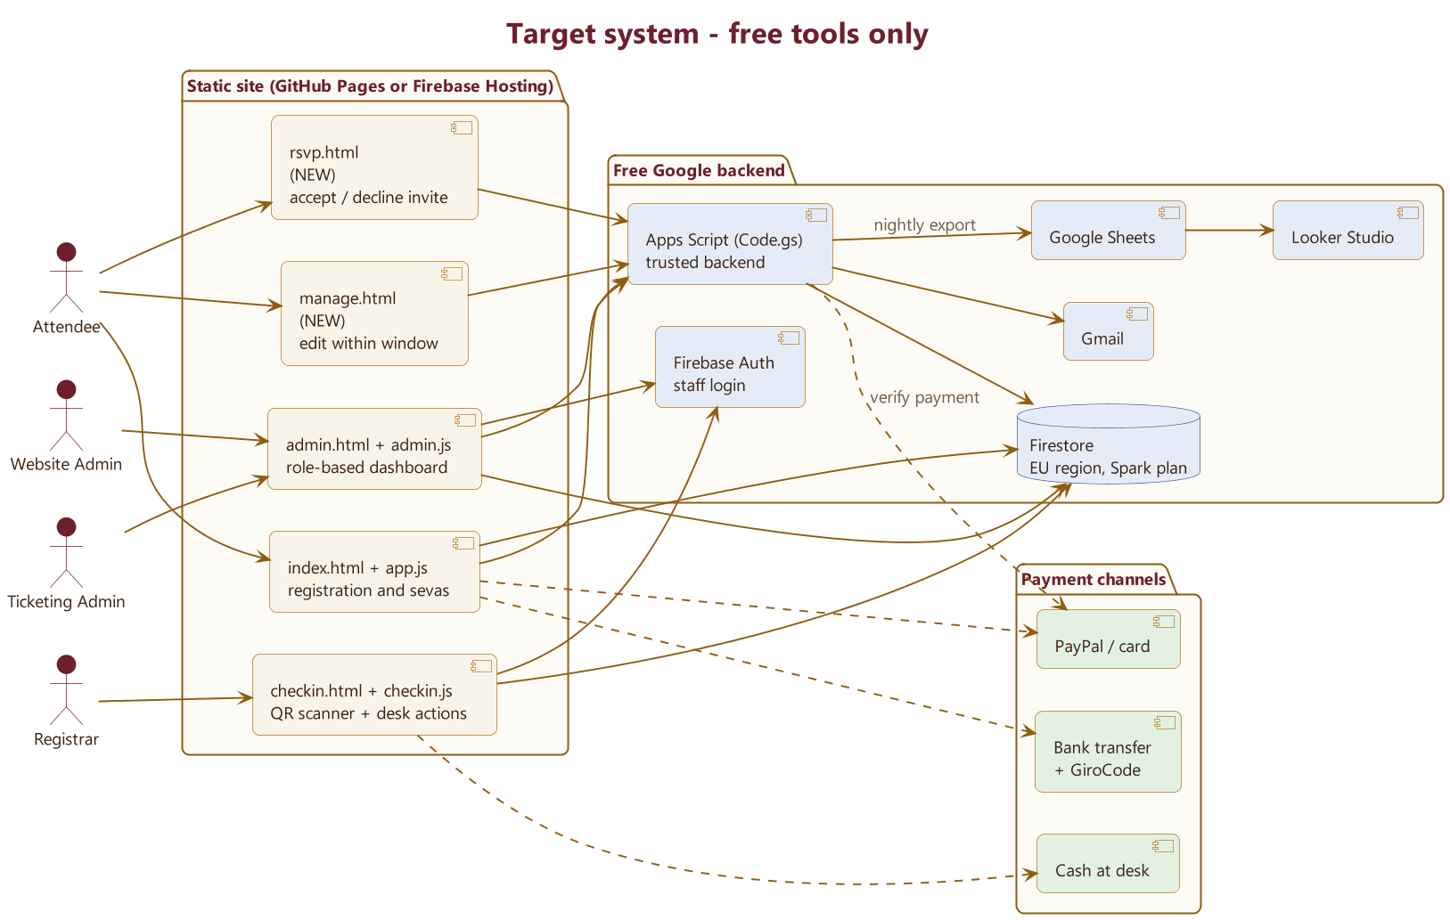
Target architecture - free tools only
DE SRS Brundavan e.V. | Seva Registration Platform - Plan
9
Notes:
Diagram source: diagrams/01_architecture.puml

Slide 10
Free tool stack and its limits (1/2)
Need | Free tool | Limit to watch | If you outgrow it
Hosting | GitHub Pages (current) or Firebase Hosting | Free tier | Custom domain
Database | Firestore free plan (Spark), EU region | About 50k reads and 20k writes a day, 1 GiB storage | Pay-as-you-go plan (Blaze), which needs a credit card
Staff login and roles | Firebase Auth plus a staff list that the security rules check | None | —
Server-side logic | Apps Script web app (Code.gs) | 6 minutes per run; about 90 minutes a day for scheduled jobs | Cloud Functions, which needs the paid plan
Email | Gmail through Apps Script | About 100 recipients a day on a normal Google account | Google Workspace for Nonprofits is free for registered non-profits (about 1,500 a day)
Online payment | PayPal checkout buttons (PayPal "Smart Buttons") | Fee on each payment; a lower charity rate is available | —
DE SRS Brundavan e.V. | Seva Registration Platform - Plan
10

Slide 11
Free tool stack and its limits (2/2)
Need | Free tool | Limit to watch | If you outgrow it
Bank payment | Bank transfer plus a GiroCode (a QR code that banking apps scan to fill in the transfer) | Free; payments are matched by hand or from a CSV export | —
Desk payment | Cash; optional card reader (for example SumUp) | Card fees | —
QR scanning | html5-qrcode (free in-browser scanner library) | — | —
Analytics | Apps Script scheduled export to Google Sheets, then Looker Studio dashboards | About 10 million cells per sheet | BigQuery, which needs the paid plan
Bot protection | reCAPTCHA check (Firebase App Check, already in app.js) plus a hidden trap field | Free tier | —
Testing | Firebase Emulator Suite (runs locally) | — | —
DE SRS Brundavan e.V. | Seva Registration Platform - Plan
11

Slide 12
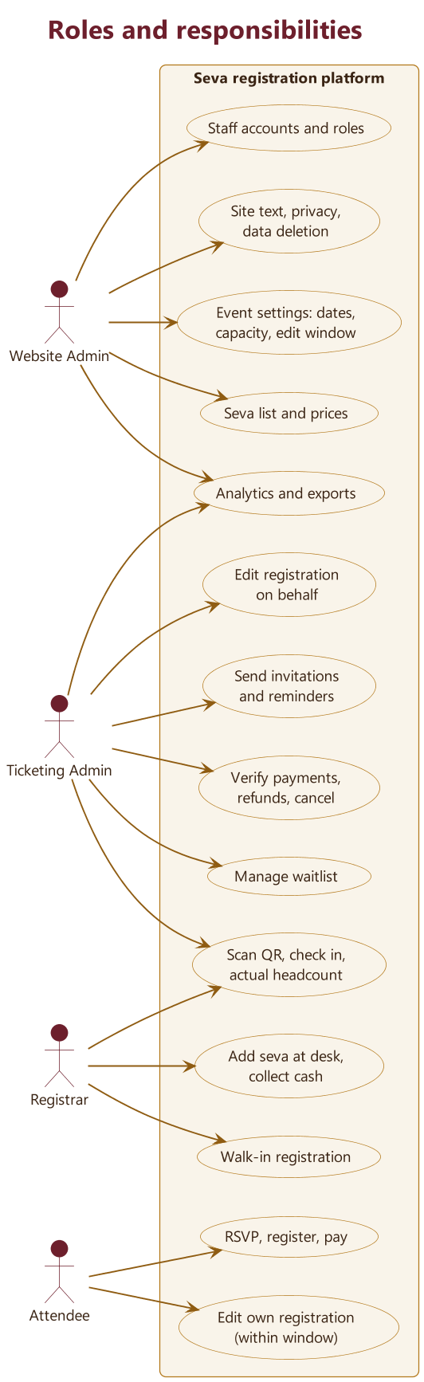
Roles and responsibilities
• Website Admin - event settings, sevas and prices, edit window, staff and roles, privacy
• Ticketing Admin - invitations, payments, refunds, waitlist, edits on behalf, exports
• Registrar - scan QR, check in with actual headcount, desk sevas and cash, walk-ins
• Attendee - RSVP, register, pay, edit own registration within the window
• Keep money tasks separate: whoever sets prices doesn't confirm payments
DE SRS Brundavan e.V. | Seva Registration Platform - Plan
12
Notes:
Diagram source: diagrams/11_roles.puml

Slide 13
Permission matrix
What | Website Admin | Ticketing Admin | Registrar | Attendee
Event settings: dates, capacity, edit window | Yes | View | — | —
Seva list and prices | Yes | View | View | View
Staff accounts and roles | Yes | — | — | —
Site text, privacy notice, data deletion requests | Yes | — | — | —
Send invitations and reminders | — | Yes | — | —
See all registrations | View | Yes | Search only, limited fields | Own only
Mark paid, refunds, cancel | — | Yes | — | —
Edit a registration | — | On behalf of attendee | Headcount and desk sevas | Own, within the window
Move people up from the waitlist | — | Yes, or automatic | — | —
Check-in and actual headcount | — | Yes | Yes | —
Add a seva at the desk and take cash | — | — | Yes | —
Walk-in registration | — | — | Yes, if allowed | —
Analytics and exports | Yes | Yes | — | —
DE SRS Brundavan e.V. | Seva Registration Platform - Plan
13

Slide 14
03
Flows
End-to-end, status, payment (UML), edit window, desk, waitlist

Slide 15
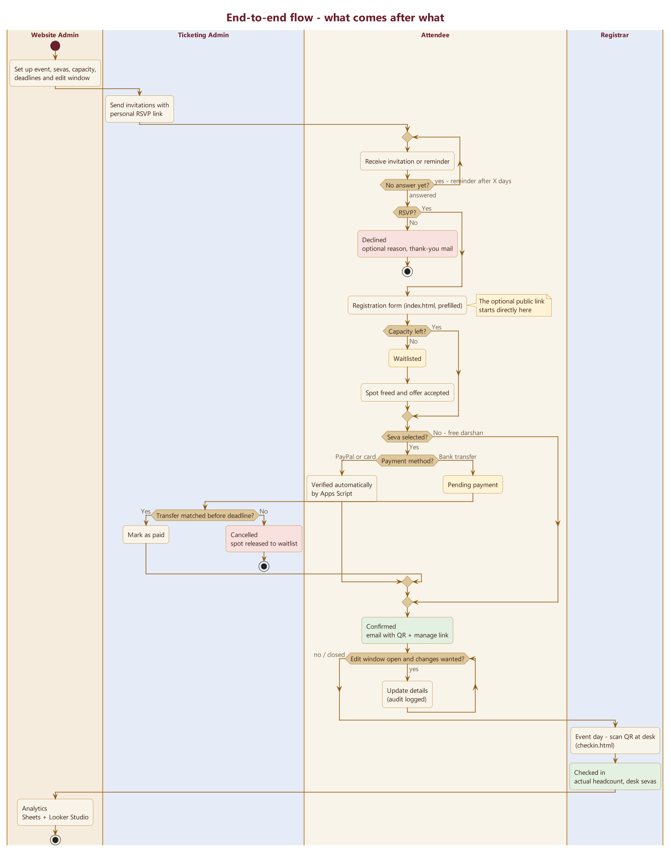
End-to-end flow - what comes after what
1. Website Admin sets up the event, sevas, capacity, deadlines and edit window
2. Ticketing Admin sends invitations with a personal RSVP link (reminders if no answer)
3. Decline: optional reason, thank-you email, end
4. Accept: prefilled registration form - waitlist if full
5. Free darshan is confirmed straight away; a seva needs payment by PayPal or bank transfer
6. Confirmation email with QR code and a manage link
7. Edits allowed only while the window is open (logged)
8. Event day: Registrar scans the QR code, records the actual headcount and any desk sevas
9. Analytics in Sheets + Looker Studio
DE SRS Brundavan e.V. | Seva Registration Platform - Plan
15
Notes:
Diagram source: diagrams/02_master_flow.puml

Slide 16
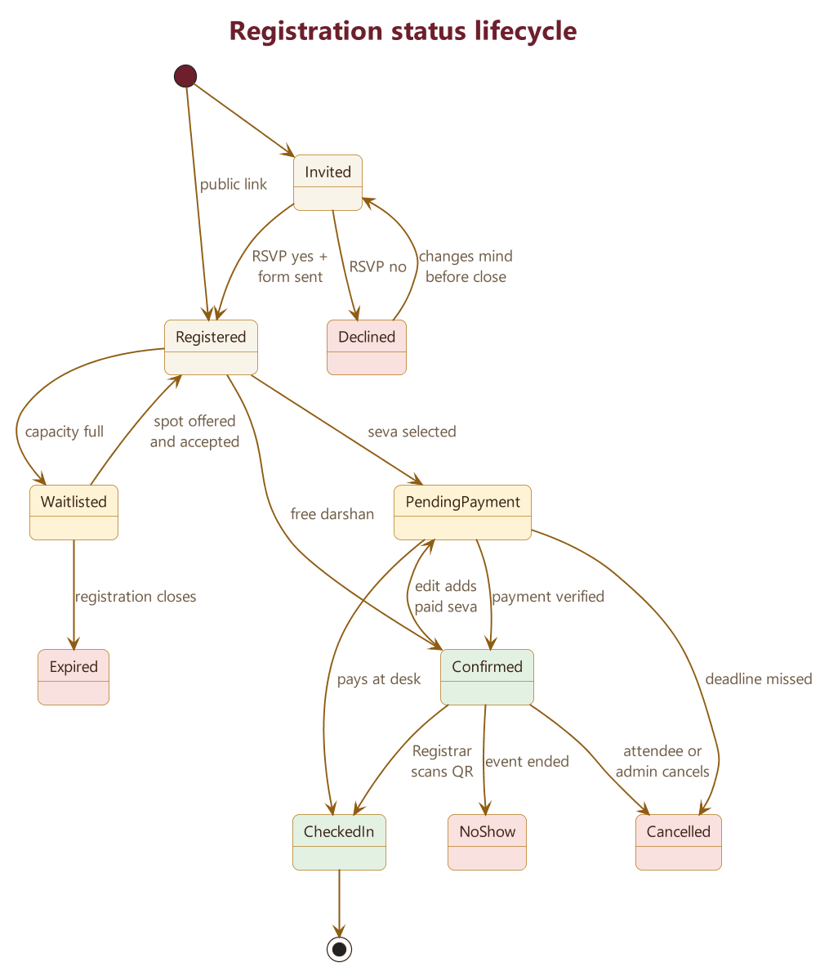
Registration status lifecycle
These states become the status values stored for analysis
DE SRS Brundavan e.V. | Seva Registration Platform - Plan
16
Notes:
Diagram source: diagrams/03_status_lifecycle.puml

Slide 17
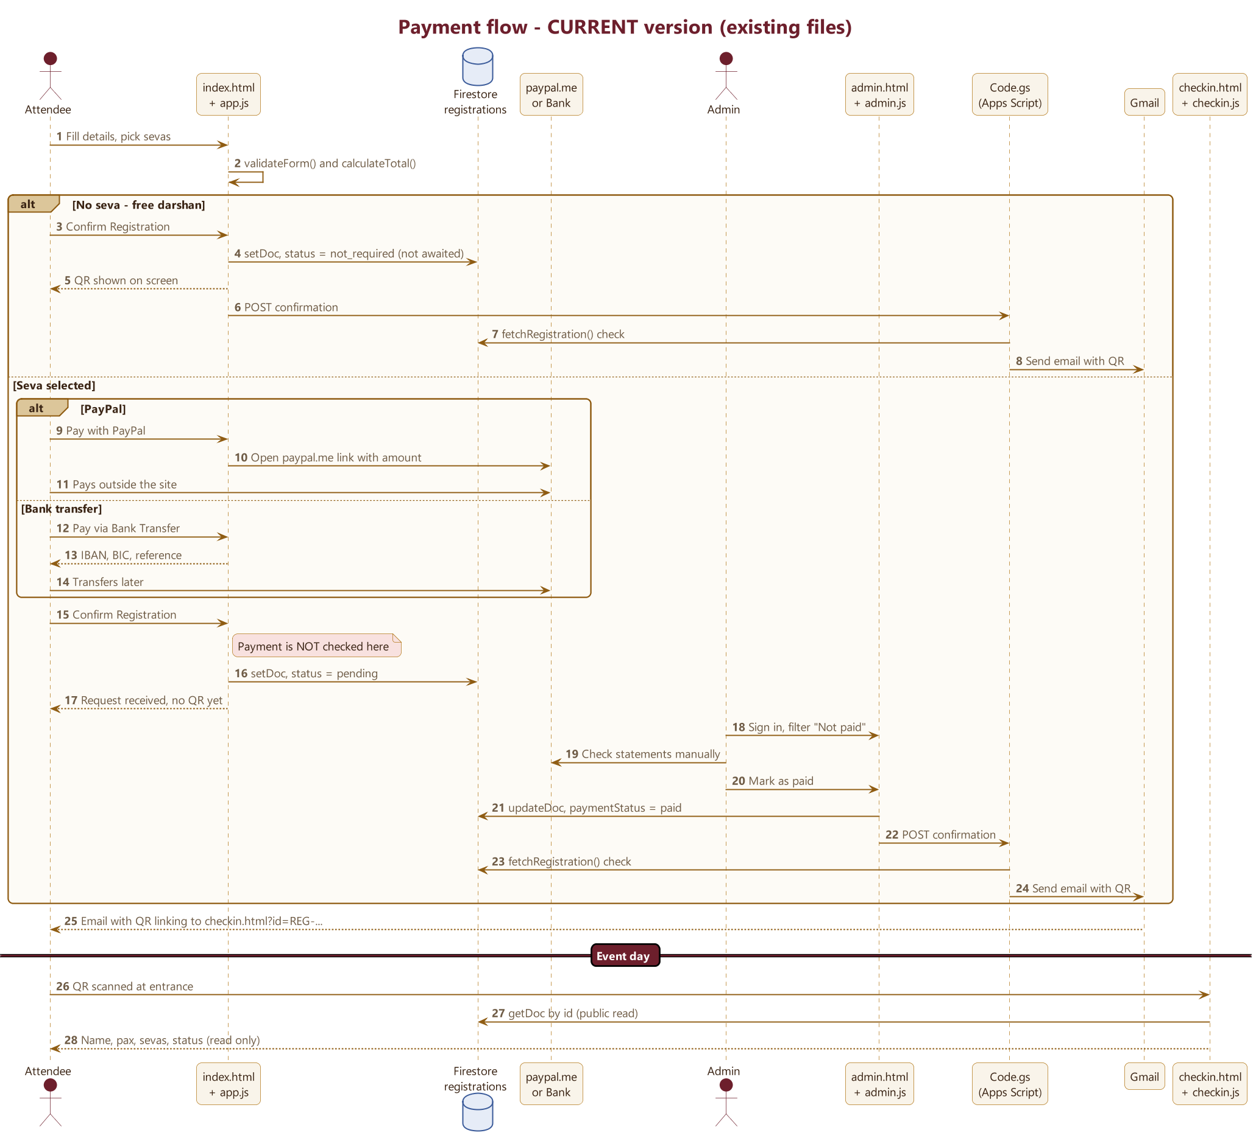
Payment flow - CURRENT (existing files)
DE SRS Brundavan e.V. | Seva Registration Platform - Plan
17
Notes:
Diagram source: diagrams/04_payment_as_is.puml

Slide 18
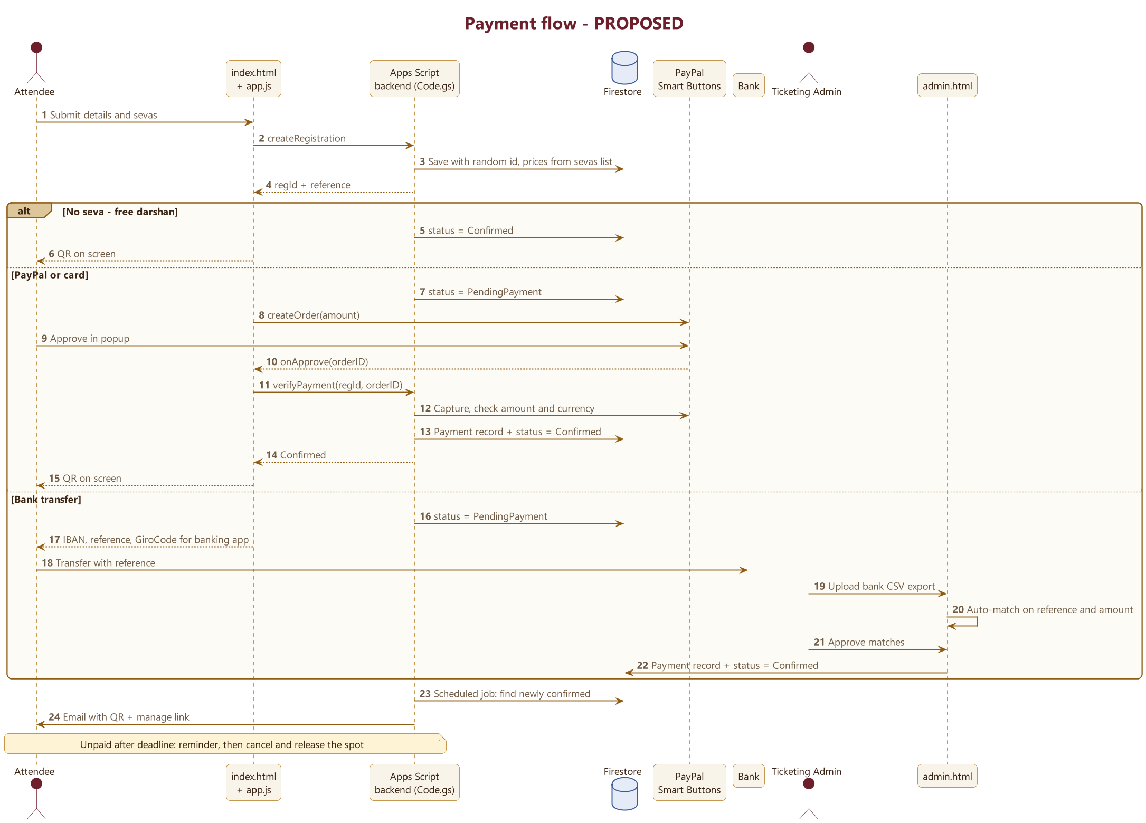
Payment flow - PROPOSED
DE SRS Brundavan e.V. | Seva Registration Platform - Plan
18
Notes:
Diagram source: diagrams/05_payment_to_be.puml

Slide 19
Payment - main changes from today
• Prices are calculated on the server. The Apps Script backend reads prices from the seva list, so totals can't be changed in the browser.
• PayPal payments are checked automatically. Apps Script asks PayPal to confirm the amount and currency before marking a registration confirmed.
• Bank transfers get a GiroCode that banking apps scan to fill in the details, so references are typed correctly.
• Bank payments are matched from a CSV export instead of by eye.
• Each payment gets its own record. This allows partial payments, extra payments after an edit, refunds and payments at the desk.
• Payment deadline: reminder emails, then automatic cancellation and the place goes to the waitlist.
DE SRS Brundavan e.V. | Seva Registration Platform - Plan
19

Slide 20
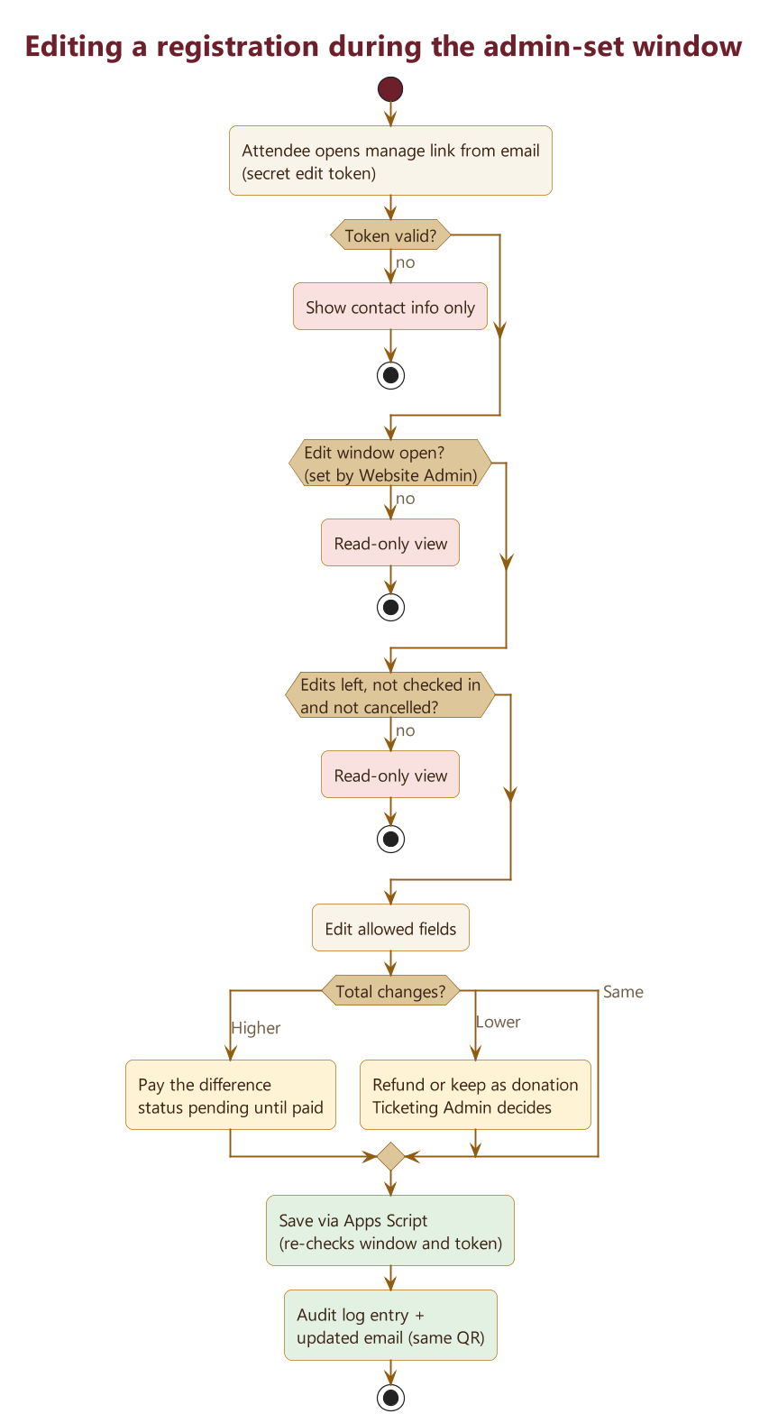
Editing during the admin-set window
• The edit link is a secret token sent in the email, so attendees don't need an account.
• Apps Script checks the token, the edit window (set by the Website Admin) and how many edits are left before saving. That keeps the rule on the server, where users can't bypass it.
• Every change is written to an audit log that records the old and new value, who made the change and when.
DE SRS Brundavan e.V. | Seva Registration Platform - Plan
20
Notes:
Diagram source: diagrams/06_edit_window.puml

Slide 21
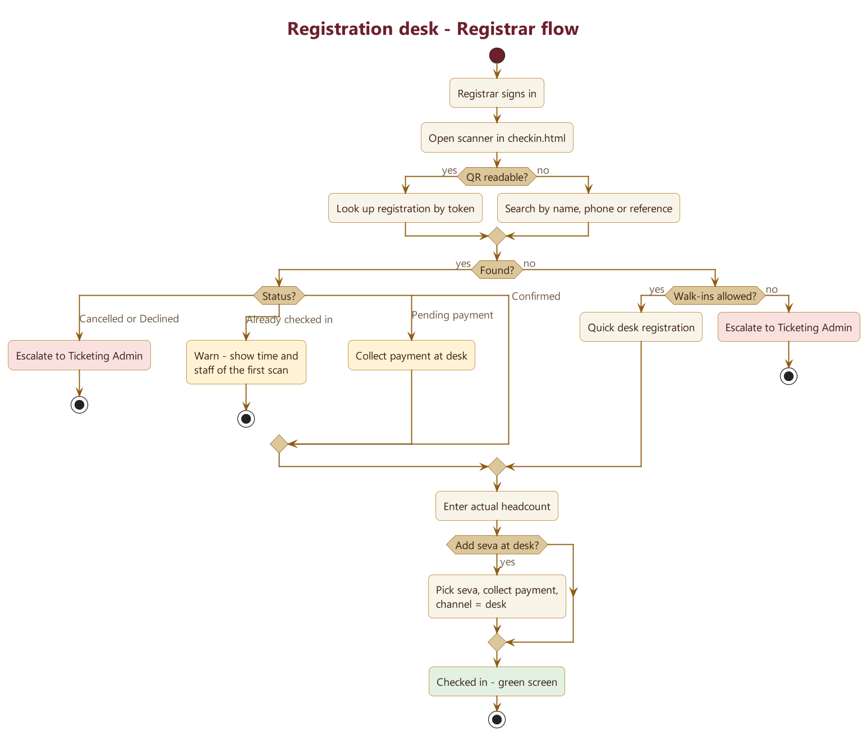
Registration desk - Registrar flow
DE SRS Brundavan e.V. | Seva Registration Platform - Plan
21
Notes:
Diagram source: diagrams/07_registrar_desk.puml

Slide 22
QR code logic
Step | Rule
Create | Each registration gets a random, unguessable ID. The QR code holds only a link to checkin.html?t=<that ID>, with no personal data.
Show | On screen using qrcode.min.js, and attached to the confirmation email.
Stability | The code stays the same after edits. It is cancelled only if the registration is cancelled or a new code is issued.
Scan, not signed in | Shows only "Show this at the entrance" – no data.
Scan, Registrar signed in | Shows name, headcount, sevas and status, plus the check-in actions.
Second scan | Shows a warning with the time and staff member of the first scan; a supervisor can override it.
No internet / no QR | Search by name, phone or reference; a printable list for each desk as a backup.
DE SRS Brundavan e.V. | Seva Registration Platform - Plan
22

Slide 23
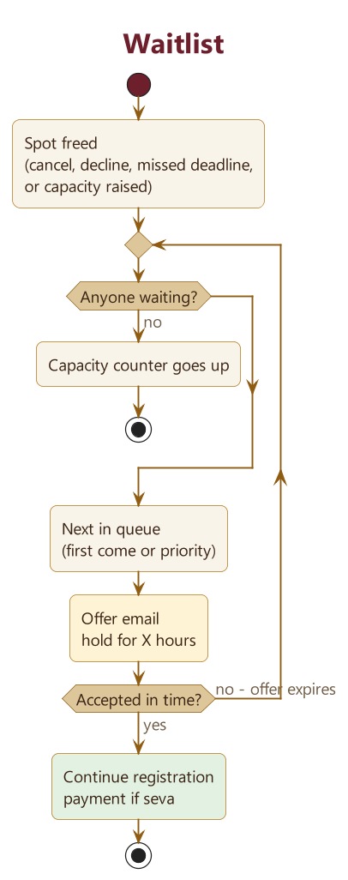
Waitlist
• A place frees up when someone cancels, declines or misses the payment deadline, or capacity goes up
• Next person in the queue gets an offer email with a time limit
• If they don't accept in time, the offer goes to the next person
• People on the waitlist pay only after they get a place
• Open: one waitlist per event or per seva? Priority rules?
DE SRS Brundavan e.V. | Seva Registration Platform - Plan
23
Notes:
Diagram source: diagrams/08_waitlist.puml

Slide 24
04
Data and analytics
Structured for analysis from day one

Slide 25
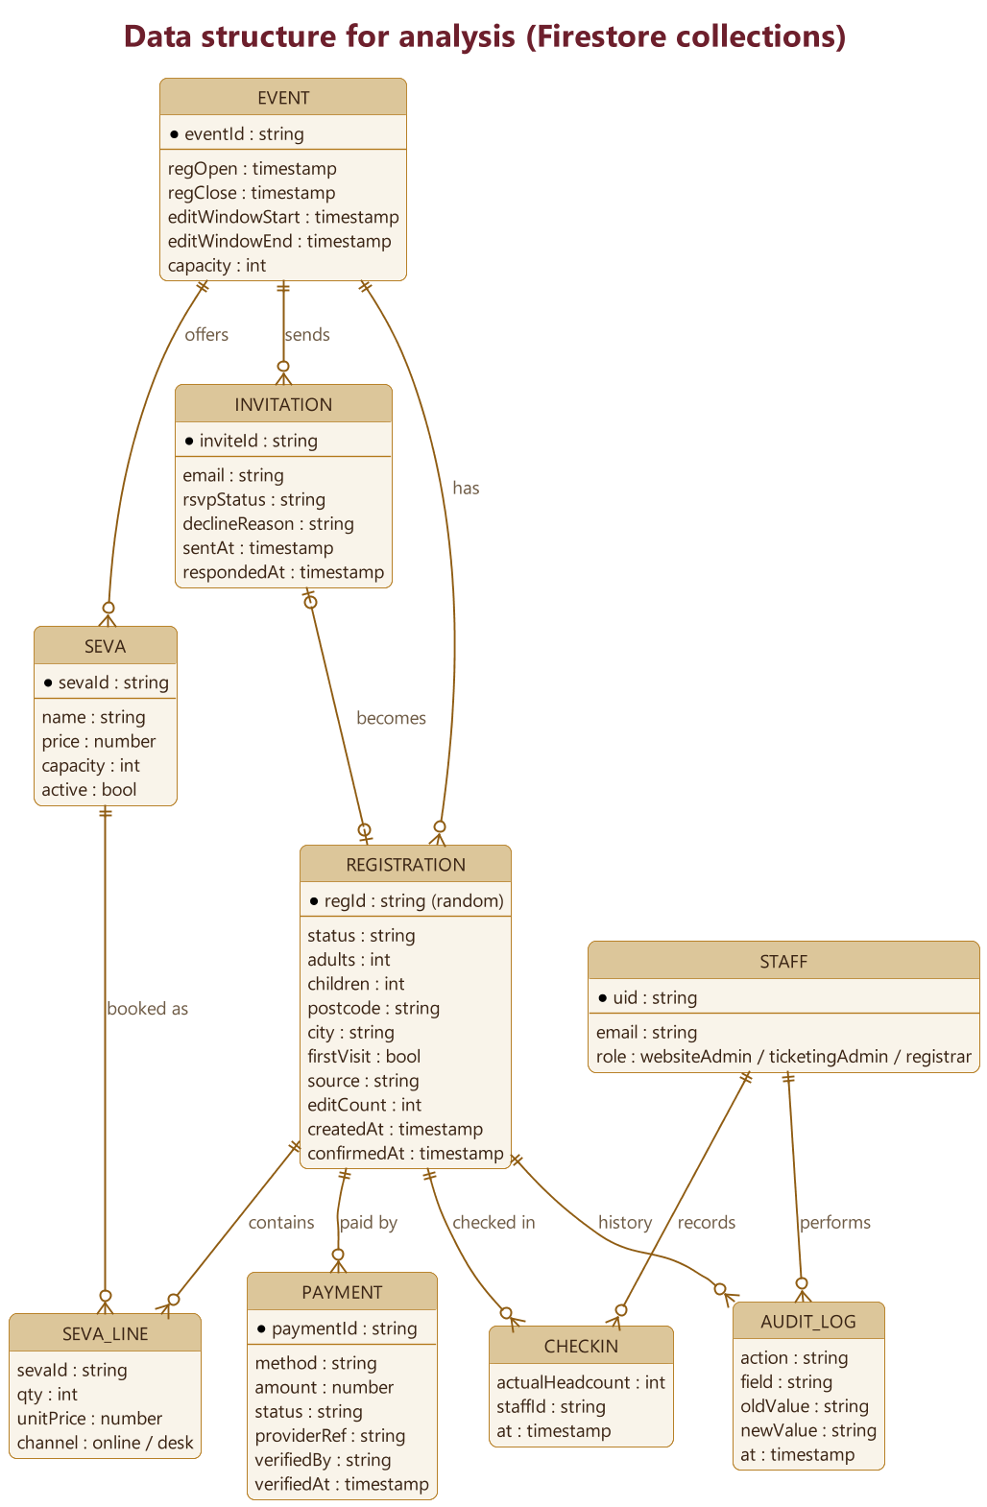
Data structure for analysis
Metrics this makes possible
• Funnel: invitation → RSVP → registration → payment → check-in
• Decline reasons
• Revenue by seva, by payment method, and online vs desk
• Time from registration to payment
• Registered vs actual headcount, and no-show rate
• First-time vs repeat visitors
• Where people come from, by postcode
• Registrations over time
• Waitlist conversion
• Number of edits per registration
• Pipeline: nightly Apps Script export, then Google Sheets, then Looker Studio (all free)
DE SRS Brundavan e.V. | Seva Registration Platform - Plan
25
Notes:
Diagram source: diagrams/09_data_model.puml

Slide 26
05
Roadmap
Phases and dependencies

Slide 27
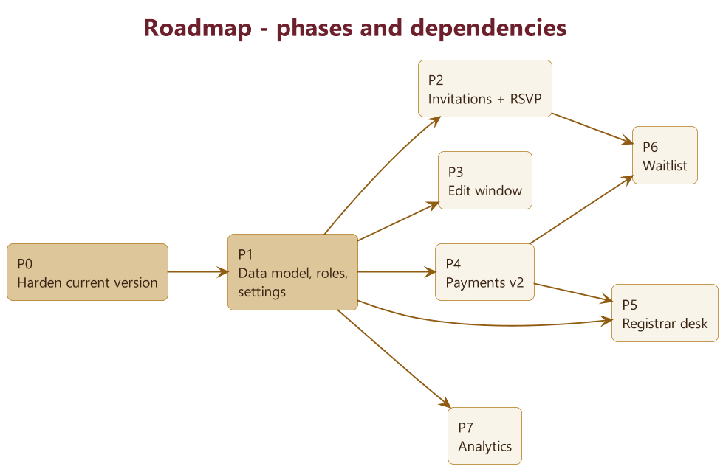
Roadmap - phases and dependencies
DE SRS Brundavan e.V. | Seva Registration Platform - Plan
27
Notes:
Diagram source: diagrams/10_roadmap.puml

Slide 28
Roadmap - phase content
Phase | Content | Depends on
P0 – Harden current version | Random IDs; tighter rules so total, sevas and status must match and only staff can read registrations; wait for the save before showing success; fix the status label; move the admin email into a staff list | — (do first)
P1 – Foundations | events, sevas and staff collections; move SEVAS out of app.js; audit log; status timestamps; rules for each role | P0
P2 – Invitations and RSVP | Guest list in Google Sheets → Apps Script sends personal invitation emails → new rsvp.html; decline flow; reminders | P1
P3 – Edit window | New manage.html plus an Apps Script edit endpoint; window and edit limit checked on the server | P1
P4 – Payments v2 | Payment records, GiroCode, verified PayPal checkout, bank CSV matching, deadlines and reminders | P1
P5 – Registrar desk | In-page scanner, check-in, actual headcount, desk sevas, walk-ins, cash summary | P1, P4
P6 – Waitlist | Queue, offers with a time limit, moving people up | P1, P2, P4
P7 – Analytics | Sheets export and Looker Studio dashboards | P1
DE SRS Brundavan e.V. | Seva Registration Platform - Plan
28

Slide 29
Files affected
File | Changes
app.js, index.html | Random IDs, waiting for the save, prefilled form, GiroCode, new fields
admin.html, admin.js | Tabs by role: Settings, Invitations, Payments, Waitlist, Analytics; bank CSV import
checkin.html, checkin.js | Scanner, staff login, check-in actions, status labels
Code.gs | Backend endpoints (create, verify payment, edit, invite, waitlist, export); secrets kept in Script Properties
firestore.rules | Roles, time windows, data checks
New: rsvp.html, manage.html | Each with its own JavaScript file
SETUP_INSTRUCTIONS.md, SITE_GUIDE.md | Update to match
DE SRS Brundavan e.V. | Seva Registration Platform - Plan
29

Slide 30
06
Open questions
Business rules to decide in the meeting

Slide 31
Open questions - What comes after what?
Question | Suggested default | Decision
Invite-only event, public link, or both? | Both, with a switch for the public link
Is RSVP a separate step before registration? | No – "Yes" opens a prefilled registration form
When is the QR code issued – on registration or after payment? | After confirmation; pending registrations get only a reference
Registration open and close dates?
Payment deadline – fixed date or relative? | 7 days after registering
Can someone sponsor a seva without attending?
DE SRS Brundavan e.V. | Seva Registration Platform - Plan
31

Slide 32
Open questions - General attendee flow
Question | Suggested default | Decision
Do we need the full postal address? | Only if donation receipts are issued; otherwise postcode and city
Should participants be split into adults and children? | Yes, for analysis and catering
Do we need the name of every participant? | No
One registration per email address? | Yes; duplicates are flagged to the Ticketing Admin
Which languages? | English first; Kannada and German later
Accounts for attendees? | No – the secret link in the email is enough
DE SRS Brundavan e.V. | Seva Registration Platform - Plan
32

Slide 33
Open questions - Attendee with a seva
Question | Suggested default | Decision
Does each seva have limited places or time slots?
Is the price per family or per person? | Per registration (family)
Partial payment, or pay at the venue? | Pay at the venue only if the Ticketing Admin allows it
Refund policy if the attendee or the organisers cancel?
What if the payment received is too low or too high? | Too low → status stays pending; too high → treat as a donation, with the attendee's agreement
Do we issue official donation receipts (Zuwendungsbestätigung)? Who issues them?
DE SRS Brundavan e.V. | Seva Registration Platform - Plan
33

Slide 34
Open questions - Attendee with a free darshan
Question | Suggested default | Decision
Is free darshan capacity-limited, or split into time slots?
Confirm straight away (as today), or reconfirm closer to the date? | Straight away, plus a reminder email a few days before
Add an optional voluntary donation field? | Yes
Can a free-darshan attendee add a seva later? | Yes – online during the edit window, or at the desk
DE SRS Brundavan e.V. | Seva Registration Platform - Plan
34

Slide 35
Open questions - Attendees who decline the RSVP
Question | Suggested default | Decision
Ask for a reason? | Optional, from a short list
Offer to keep them informed about future events? | Yes, as a separate opt-in
Can they change their mind later? | Yes, until registration closes
Does declining release a reserved place? | Yes
How long do we keep their data? | Delete after the event
How many reminders for people who don't answer, and when? | 2 reminders, 7 and 3 days before the deadline
DE SRS Brundavan e.V. | Seva Registration Platform - Plan
35

Slide 36
Open questions - Waitlist
Question | Suggested default | Decision
One waitlist for the whole event, or one per seva?
Order – first come first served, or priority (members, first-time visitors)? | First come, first served
Move people up automatically, or with admin approval? | Automatically, with the Ticketing Admin informed
How long does an offer stay open? | 48 hours
Do people on the waitlist pay up front? | No – only after they get a place
DE SRS Brundavan e.V. | Seva Registration Platform - Plan
36

Slide 37
Open questions - Admin flow
Question | Suggested default | Decision
Who holds each role (names, how many)? | 1 Website Admin, 2 Ticketing Admins, several Registrars
Can one person hold more than one role? | Yes, except Website Admin + Ticketing Admin
Should a second person confirm "Mark as paid"? | Only above an amount threshold
Can admins edit personal data? | Yes, recorded in the audit log
Who approves refunds? | Ticketing Admin plus the treasurer
Who may export personal data? | Website Admin only
Who controls the edit window? | Website Admin
DE SRS Brundavan e.V. | Seva Registration Platform - Plan
37

Slide 38
Open questions - Registrar at the desk
Question | Suggested default | Decision
How many desks and devices? Volunteers' own phones or provided tablets?
Is there internet at the venue (Wi-Fi or mobile data)?
Can registrars see phone numbers? | No – name, headcount, sevas and status only
More people arrive than registered – allowed? Charged? Checked against capacity?
Payment at the desk – cash only, or cards too? | Cash only for now
Who counts and reconciles the cash at the end of the day?
Allow walk-ins without a registration?
Can a family check in in two groups? | Yes – headcount can be added to
DE SRS Brundavan e.V. | Seva Registration Platform - Plan
38

Slide 39
Open questions - QR code generation
Question | Suggested default | Decision
One code per registration (family) or one per person? | Per registration
Issue codes to pending registrations too?
Does the code change after an edit? | No
Single entry, or can people leave and come back in?
Generate the email QR in-house instead of through a third-party service? | Yes, if it can be done for free
Apple / Google Wallet passes? | Out of scope
DE SRS Brundavan e.V. | Seva Registration Platform - Plan
39

Slide 40
Open questions - Reading QR codes at the desk
Question | Suggested default | Decision
Scanner inside the page, or the phone's camera app? | Scanner inside the page (faster, registrar stays signed in)
What does a member of the public see when they open the QR link? | Nothing personal
What happens on a second scan? | Warning with the option to override
Backup plan if the internet fails? | A printable list for each desk
Search when someone has no QR code? | By name, phone or reference
DE SRS Brundavan e.V. | Seva Registration Platform - Plan
40

Slide 41
Other open points
Topic | Question / action
Account ownership | Move Firebase, Apps Script and PayPal from personal accounts to an account owned by the Verein, with at least two owners.
PayPal account | Use a PayPal Business account in the Verein's name, and apply for the charity rate.
Bank details | Fill in the real IBAN and BIC (the current ones are placeholders).
Email limit | How many people will be invited? Compare with the free daily sending limit.
Media consent | Today it is required to register. GDPR expects consent to be freely given – make it optional and mark those attendees with a badge?
Privacy | Link a full privacy notice (Datenschutzerklärung), set a retention period, accept Google's data processing agreement in the console, and define a deletion process.
Expected numbers | Expected invitees, registrations and attendees, to check against the free limits.
Bookkeeping | What export does the treasurer (Kassenwart) need?
Domain | Use a custom domain (for example seva.<verein>.de) or keep github.io?
Languages | English only, or also Kannada and German?
DE SRS Brundavan e.V. | Seva Registration Platform - Plan
41

Slide 42
Suggestions
• Apply for Google for Nonprofits. Workspace is free for registered non-profits, which raises the email limit and gives shared ownership of accounts.
• Show a GiroCode on the bank-transfer screen. German banking apps scan it and fill in the amount and reference, so there are fewer typos and matching is easier.
• Import the bank's CSV export in the admin page and match payments automatically, instead of checking statements by hand.
• Make Apps Script the only trusted backend. Every sensitive write goes through it and the database rules block everything else. This avoids needing the paid Firebase plan.
• Keep the seva list and event settings in Firestore, so the Website Admin can change them without a developer.
• Make media consent optional, in line with GDPR.
• Use structured fields (postcode, adults and children, "how did you hear about us") for better analysis.
• Record a timestamp for every status change to enable funnel and timing analysis.
• Send a "Know before you go" email with the QR code a few days before the event, to reduce no-shows.
• Test every rules change in the Firebase Emulator before publishing.
• Keep a printable or CSV list for each desk as a backup if the internet fails.
• Keep money tasks separate: the person who sets prices doesn't confirm payments.
DE SRS Brundavan e.V. | Seva Registration Platform - Plan
42

Slide 43
Verification and scope
How we verify each phase
1. Rules tests in the Firebase Emulator. Each of these must be refused:
– reading a registration without a staff role
– submitting sevas with a €0 total
– editing outside the window
– a Registrar changing payment fields
2. Walk through each type of user:
– free darshan
– PayPal, using a free PayPal sandbox (test) account
– bank transfer, scanning the GiroCode with a banking app
– declining an RSVP
– moving up from the waitlist
– editing inside and outside the window
– a second scan of the same QR at the desk
3. Analytics check: Looker Studio totals match the admin dashboard summary (renderSummary in admin.js).
4. Test run at the venue with registrars on their own phones and the venue internet.
Assumptions and scope
• Free plans only, so no paid Firebase plan and no Cloud Functions; Apps Script is the backend.
• The site stays plain HTML and JavaScript (no framework), extending the current pages.
• Not included: a native mobile app, Apple/Google Wallet passes, an event platform for multiple organisations, automatic bank connections (bank APIs cost money).
DE SRS Brundavan e.V. | Seva Registration Platform - Plan
43

Slide 44
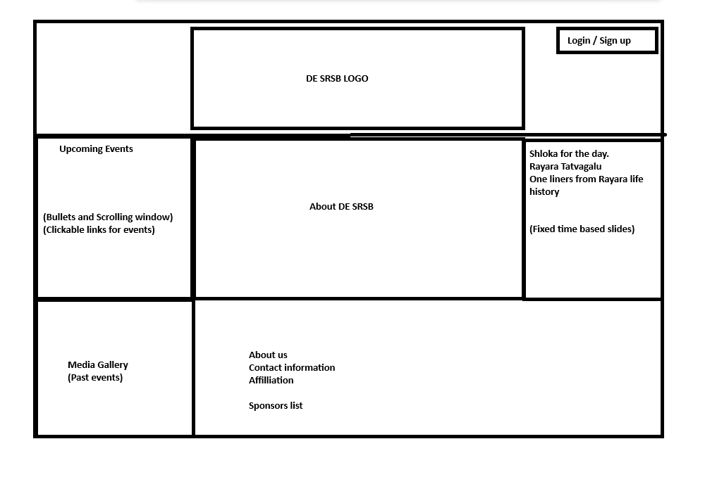
Sample website design
DE SRS Brundavan e.V. | Seva Registration Platform - Plan
45

Slide 45
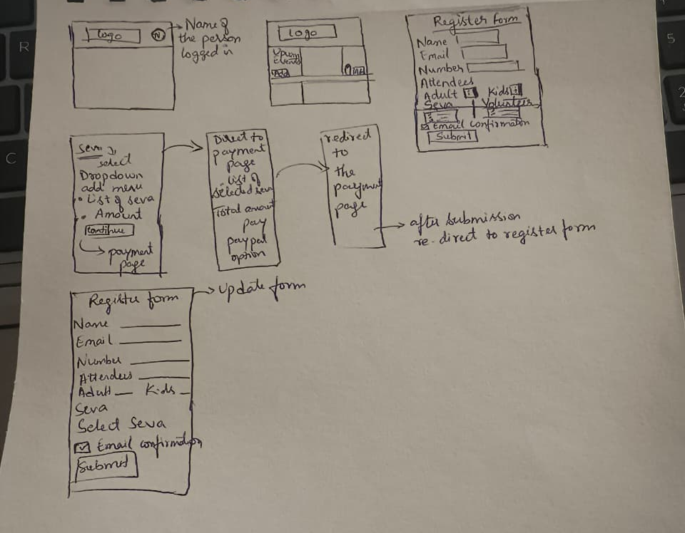
Sample website flow
DE SRS Brundavan e.V. | Seva Registration Platform - Plan
46

