Slide 1
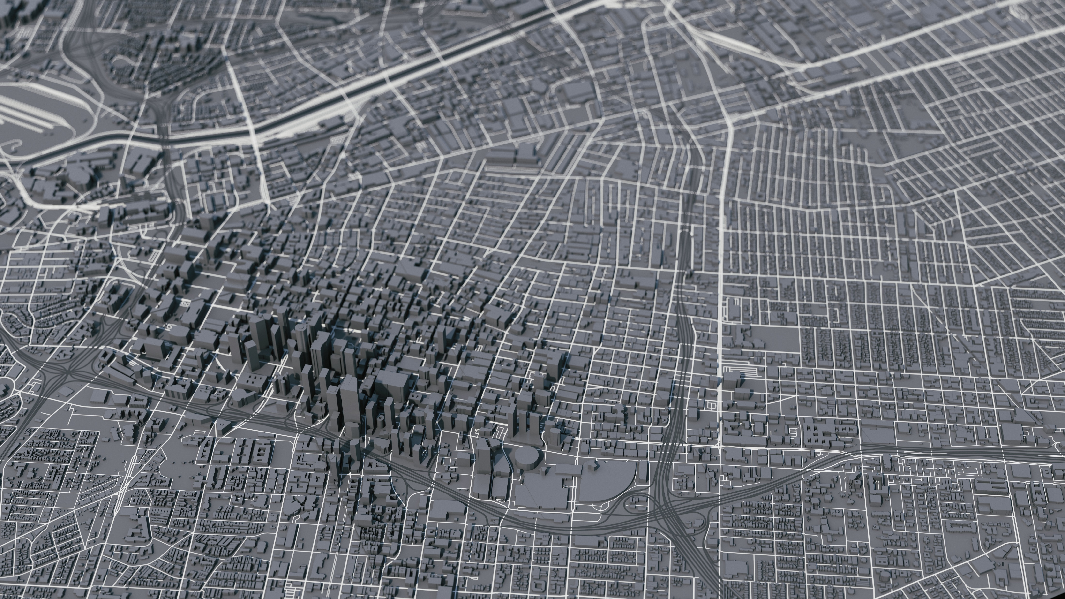
Comparing Air Pollution to Racial Demographics in the County of Los Angeles
Notes:
Greetings and welcome to my presentation: “Comparing Air Pollution to Racial Demographics in the County of Los Angeles

Slide 2
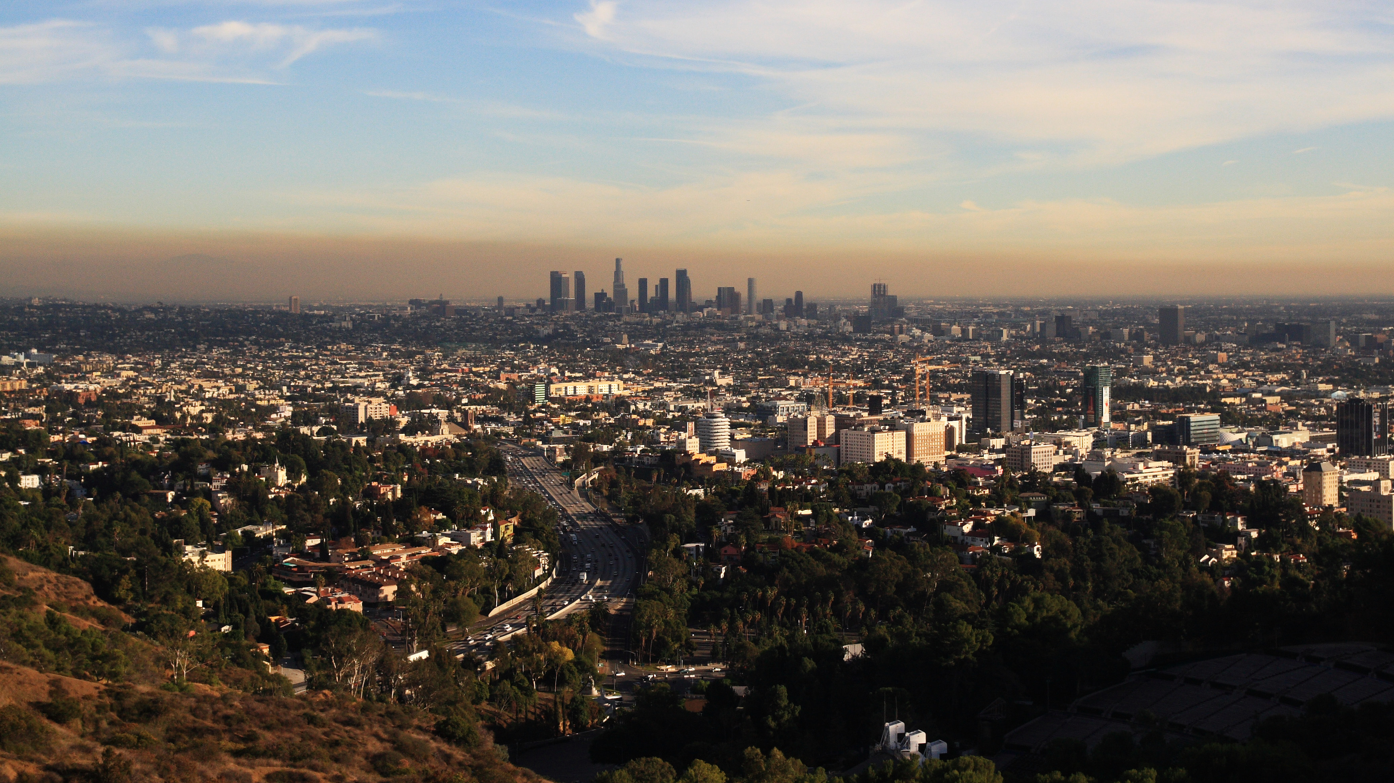
Is inventoried air pollution higher in areas with higher minority population?
Environmental Protection Agency Toxic Release Inventory tracks Escape and Stack point source air pollution
Census Bureau Tracts demographics in American Community Survey
Notes:
The question I will be investigating is if inventoried air pollution is higher in areas with higher minority population I used two datasets for this analysis. The EPA’s Toxic Release Inventory &
The Census Bureau’s American Community Survey

Slide 3
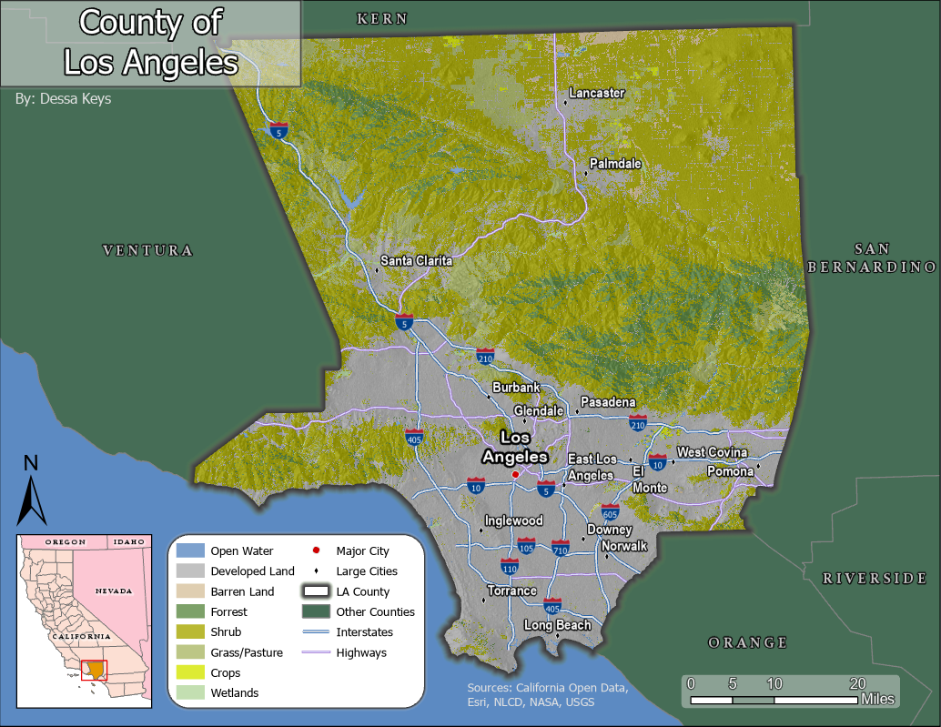
Study Area
Most Populous County in the United States
4,060 sq mi (10,515 km2)
2,496 Census Tracts including San Clemente and Santa Catalina Islands (Islands not included in analysis)
88 Incorporated Cities
Notes:
Los Angeles County, it has a lot of urban “spawl” While it is the most populous county, it is also very large at just over 4,000 sq mi making it much lower density than many other counties like San Francisco or counties on the east coast.
The large area and high population result in about 2,500 census tracts
Seen here are the City of Los Angeles and other highly populated suburbs
The city of Los Angeles itself is also very large and extends up into the San Fernando Valley

Slide 4
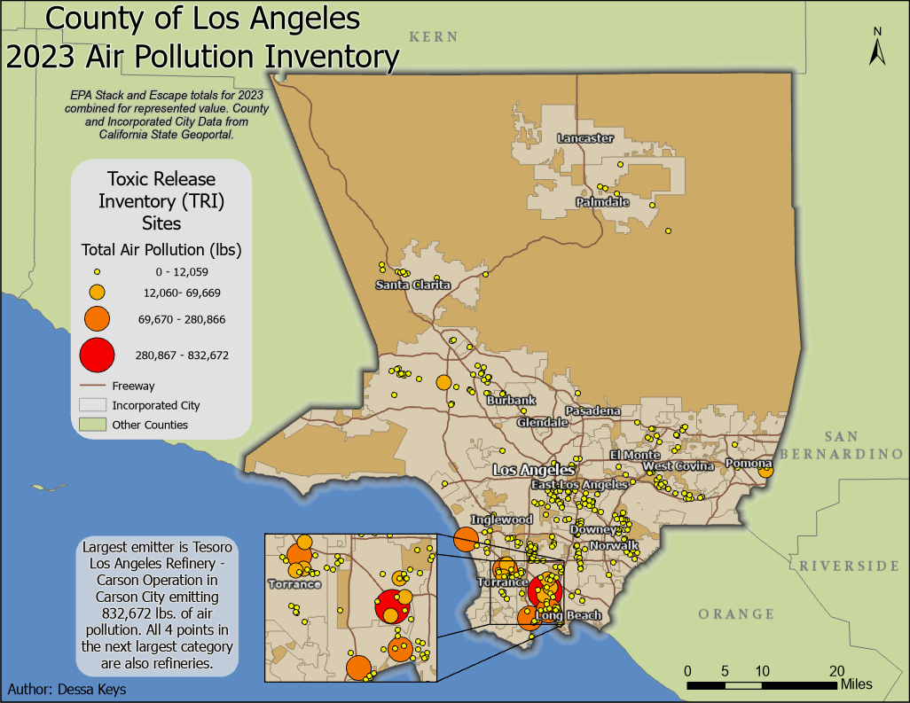
Inventoried Air Pollution
327 sites on mainland inventory air pollution
Values Represent the sum of Escape and Stack for each site.
Top 5 polluters are all refineries
Notes:
Well over 300 sites inventorying air pollution.
Represented here are the sum of stack emissions which are discharges that occur through confined air streams such as stacks, ducts or pipes – as well as escape or “fugitive” releases that include equipment leaks, building ventilation, and evaporative losses.
At 832,672 lbs in 2023, Tesoro Carson Refinery was the largest emitter. Refineries also accounted for the next top 4 emitters and several of the other larger emitters.

Slide 5
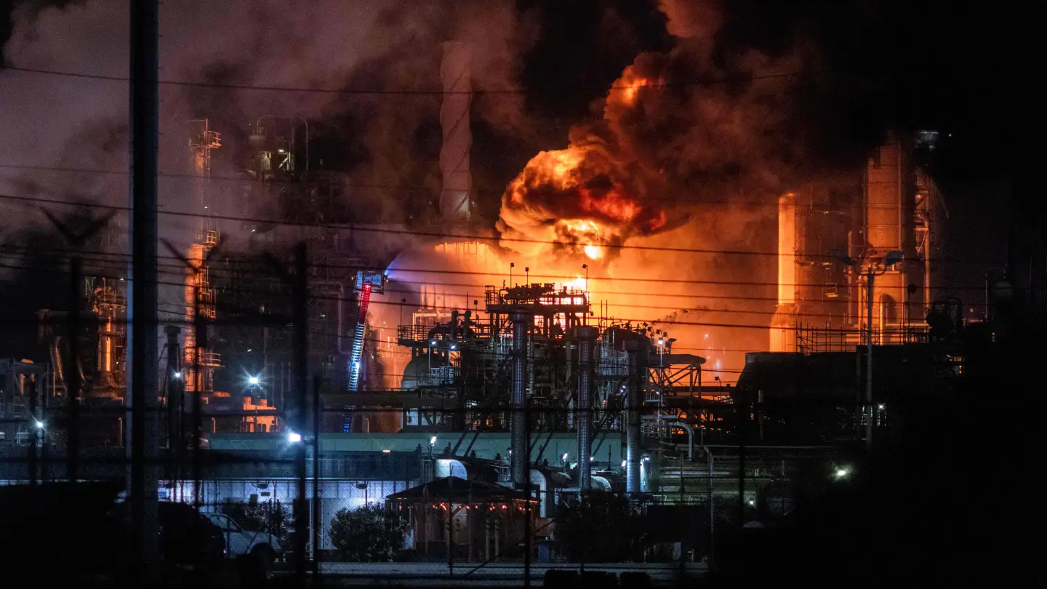
El Segundo Chevron Refinery Explosion
October 2nd, 2025
3rd largest source of inventoried air pollution prior to fire
Notes:
Just a quick current events regarding one of the inventory sites: [slide]
It also serves as a reminder that not all air pollution is inventoried such as those occurring through catastrophic events like these.

Slide 6
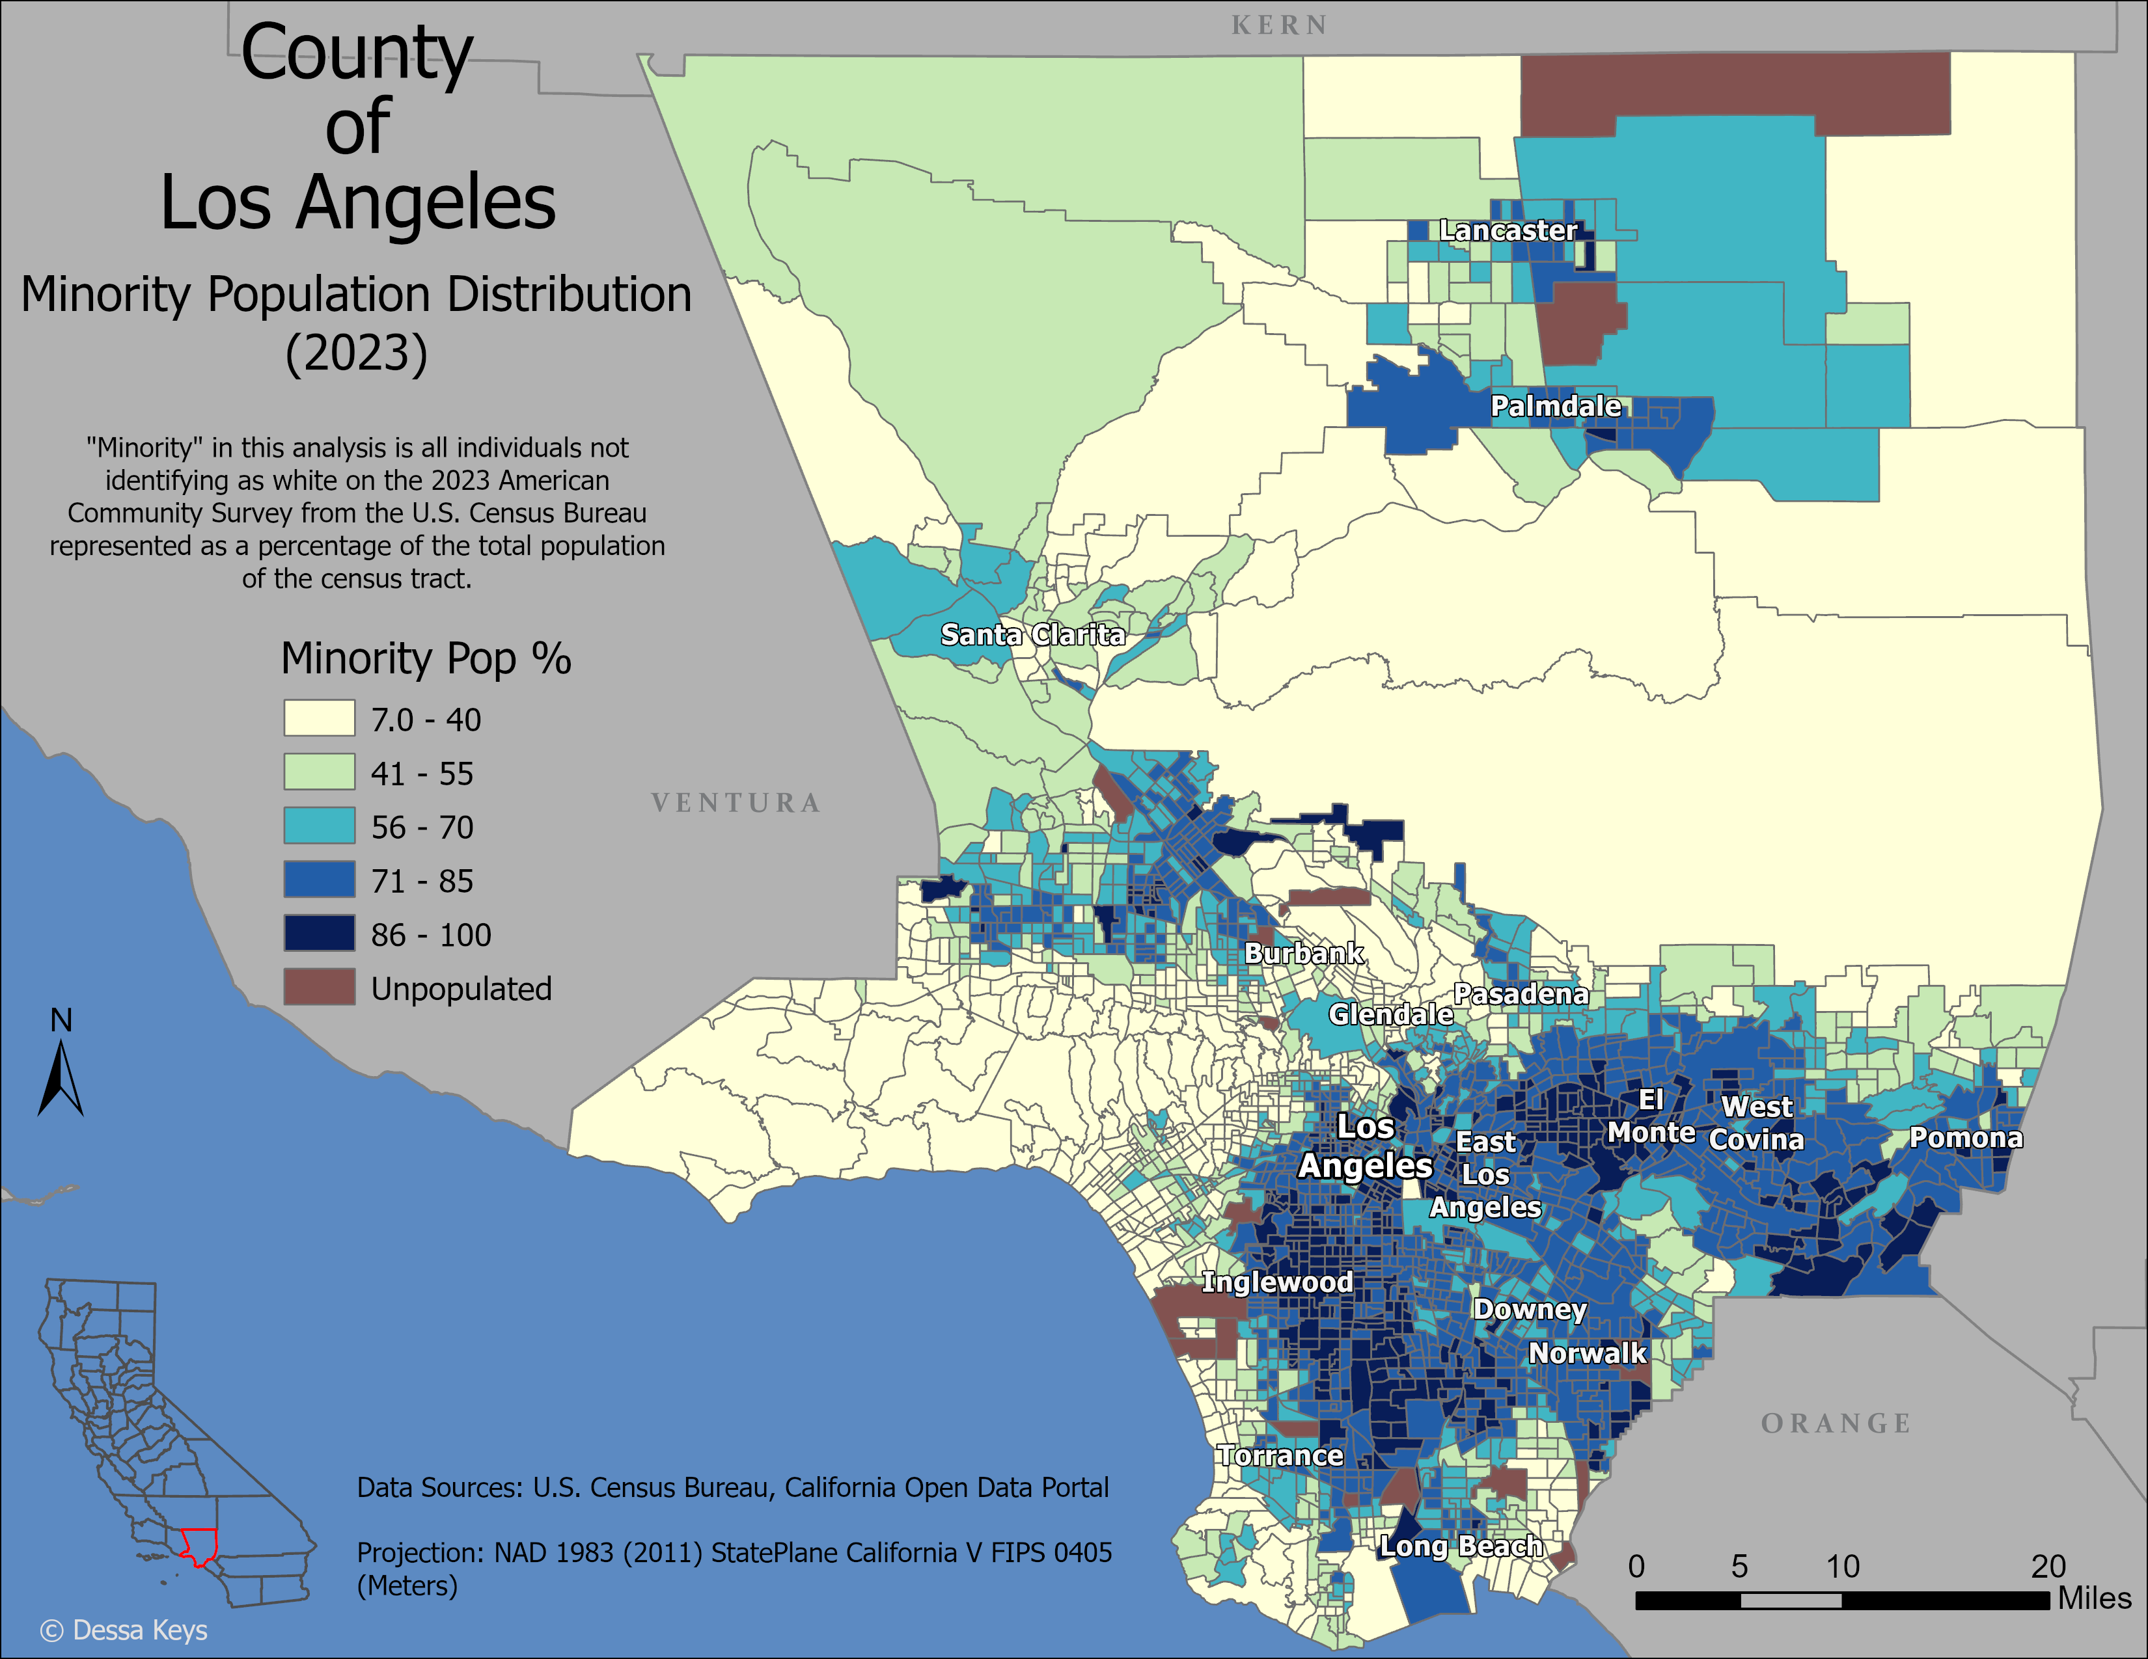

Racial Demographic Distribution
Individuals self-identify on American Community Survey
$\left(1−\frac{\text{White} \text{Population}}{\text{Total} \text{Population}}\right)×100$
Since “Hispanic” is an ethnic qualifier separate from the race selection, white includes both Hispanic and Non-Hispanic white-identifying individuals in this analysis
Notes:
For this analysis, “Minority” is all individuals not identifying as “white” on the race question on the ACS
This is the calculation to determine the percentage [slide]
Hispanic is an ethnic qualifier but White-Hispanics were not separated and not included in the “minority” designation in this analysis.
Hispanics of any race (including white) 4.7 million 49% Non-Hispanic Whites^{[26]} 2.4 25%
Highest Minority Populations south and east from downtown Los Angeles. Lowest areas along the coasts and hills and mountains

Slide 7
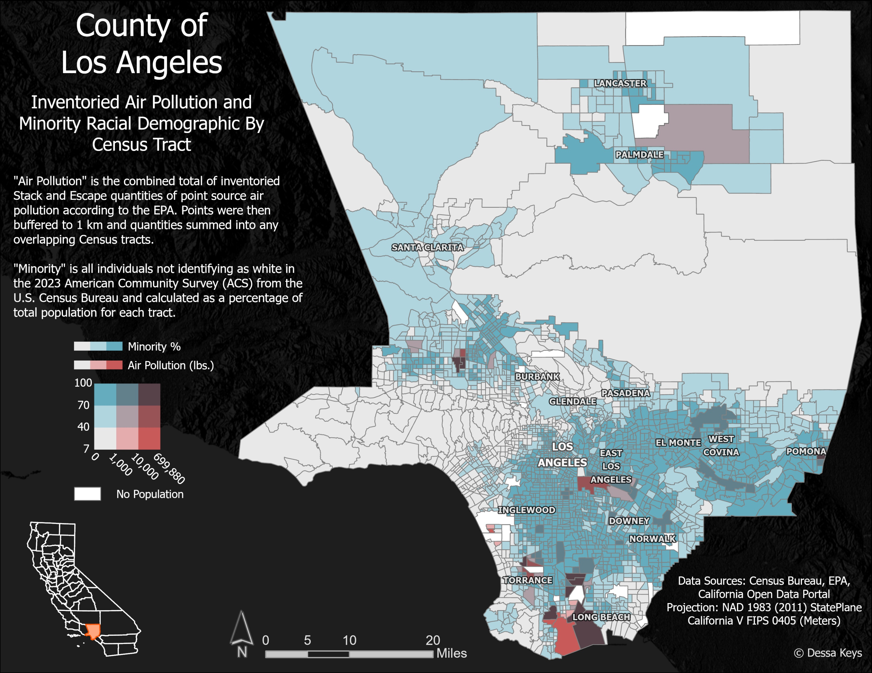

Pollution vs. Demographics Analysis
Significant percentage of Toxic Release Inventory locations are located within a census tract that is entirely comprised of an unpopulated industrial zone
$Air pollution is not static$
Prevailing winds not considered in this analysis
Notes:
Many emitters are located in unpopulated industrial zone tracts.
Air pollution is not static, 1 km buffer was used to determine affected census tracts. Fraction of buffer determined fraction of total value to include in census tract sum.
In depth analysis would require consultation with a subject matter expert about prevailing winds and overall effect area of each site

Slide 8
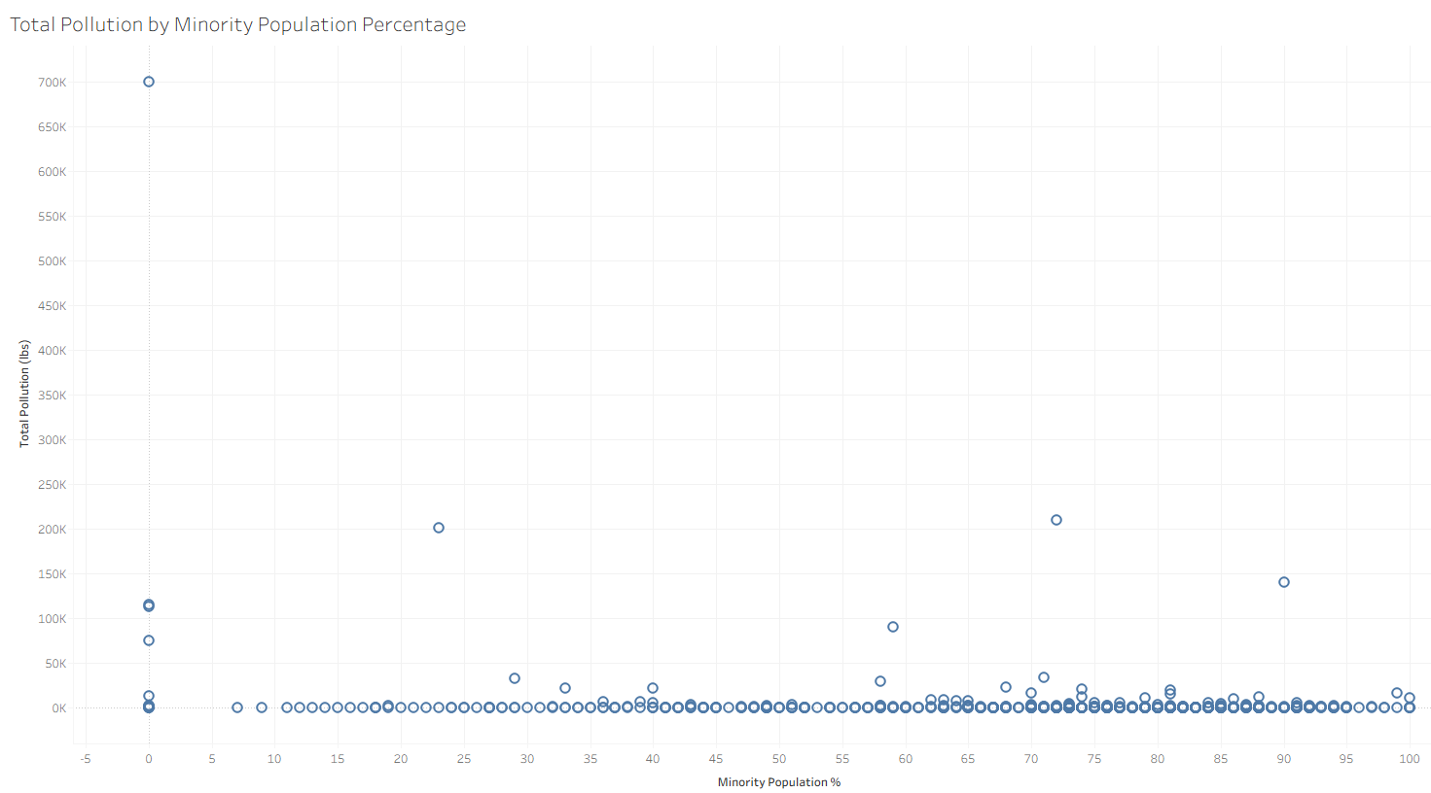
Further Analysis
Tableau will only display values for unpopulated tracts with a default “0” for the Minority Population %
No linear correlation apparent
Notes:
A different perspective – percentage minority population along the x and total pollution along the y.
Tableau will only display values with NULL in one of the axes if it is defaulted to “0”. Pollution in unpopulated tracts shown as “0% minority”
No linear correlation apparent though there may be more sites in total in areas with higher minority population.

Slide 9
Limitations
Does not include non-inventoried sources of air pollution like vehicular exhaust
Inclusion of wind-induced dispersal patterns would improve analysis
ACS includes sample-based estimations down to block group level, but decennial census includes racial demographics down to block level which may change results.
Analysis did not distinguish between white and white Hispanic
Notes:
This analysis only includes inventoried air pollution and does not include pollution from sources like vehicles or residential sources.
As mentioned before, wind dispersal patterns were not included in this analysis but would significantly improve accuracy of effect.
ACS census tract used for this analysis, decennial census gives information down to block level which would improve accuracy.
Should re-run analysis including white-Hispanics in “minority” group to see if effect changes.

Slide 10
Is inventoried air pollution higher in areas with higher minority population?
No apparent correlation found in this analysis.
Other confounding variables may be involved such as median income, rental vs. home-ownership, etc.
Notes:
I used two datasets for this analysis. The EPA’s Toxic Release Inventory &
The Census Bureau’s American Community Survey

