Slide 1
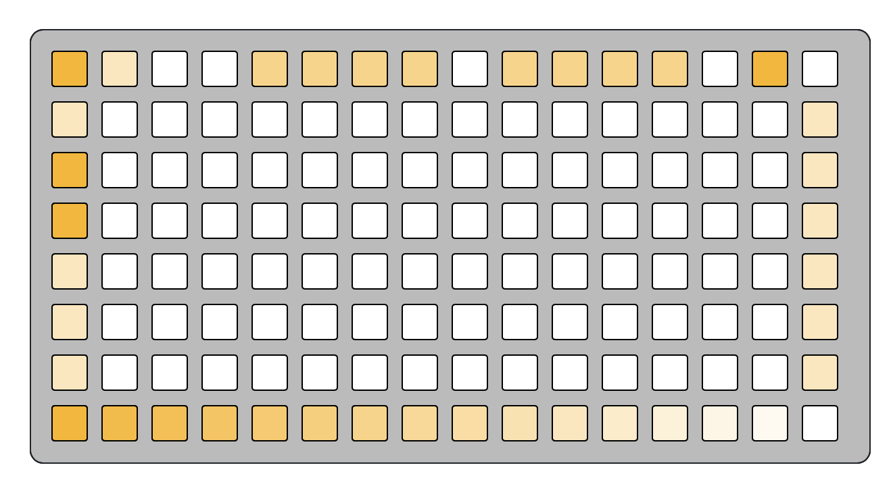
Chrome
Page select
Pattern looper
Scenes
Delete
Toggle playback (hold for gated playback)
Arm for recording
Master volume

Slide 2
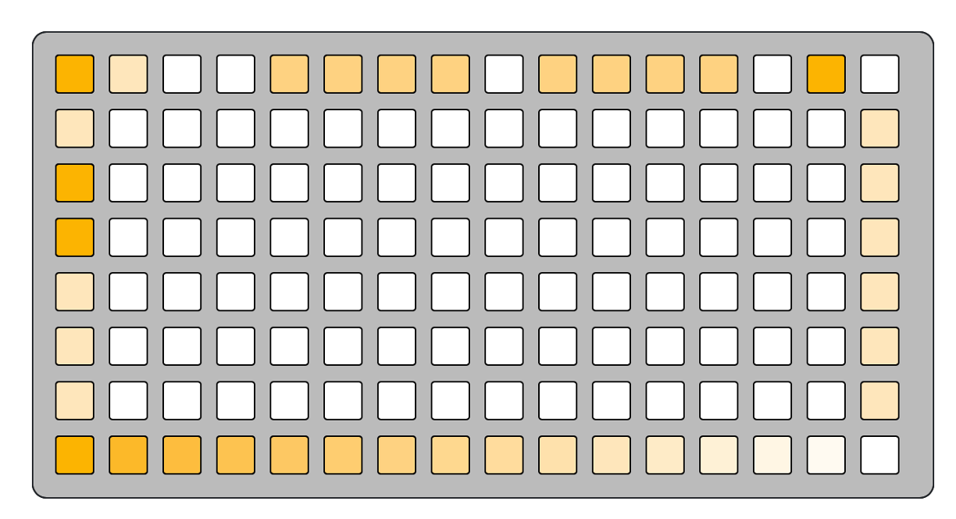
Tracks
Track 1
Track 2
Track 3
Track 4
Track 5
Track 6

Slide 3
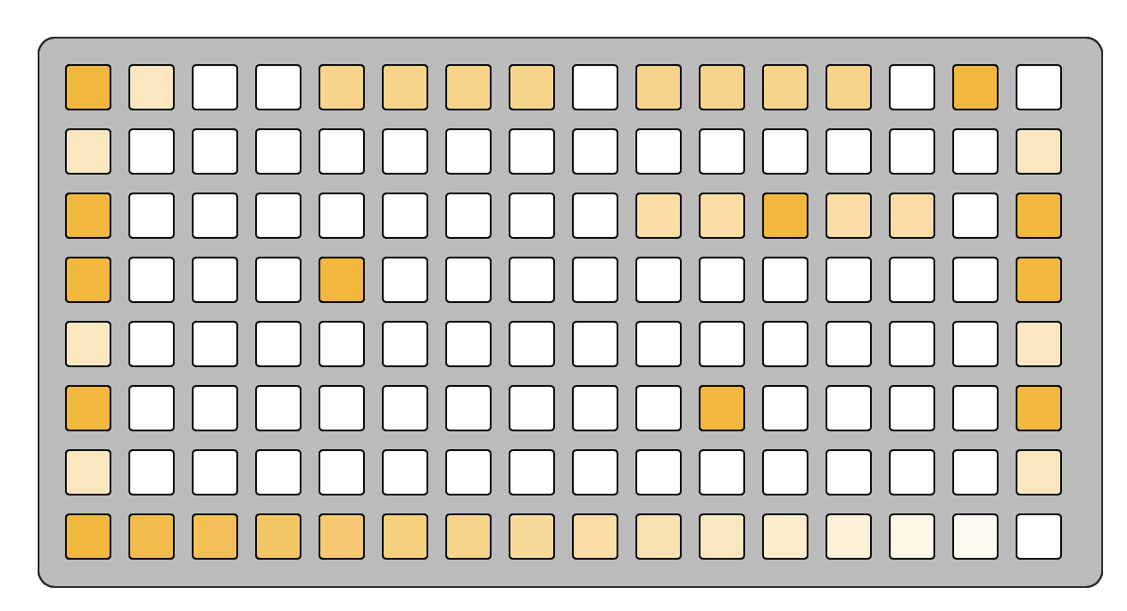
CUT page
Page 1: CUT
Looping playhead
Playheads

Slide 4
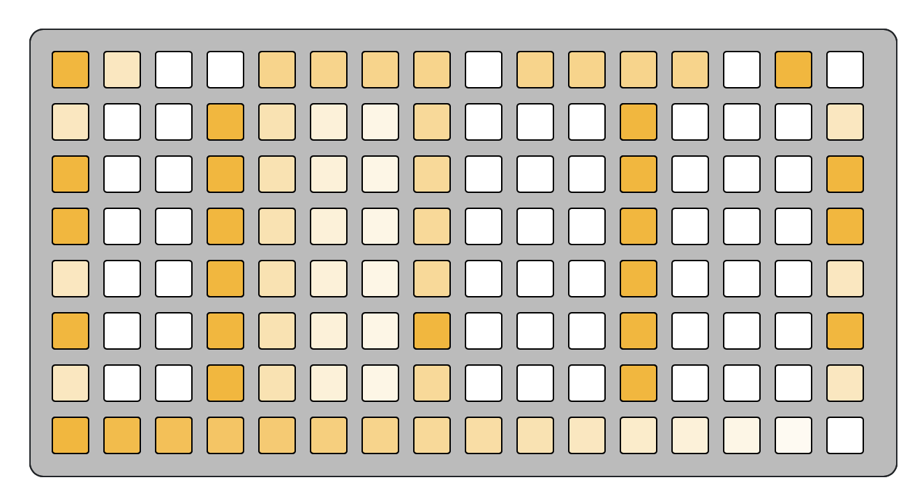

REC page
Page 2: REC/MIX

Slide 5
REC page
Mixer
Max
Unity
Min

Slide 6
REC page
Toggle reverse

Slide 7
REC page
Recording/playback speed
Speed options:
1/4x 1/2x 2/3x 1x 3/2x 2x 4x

