Slide 1
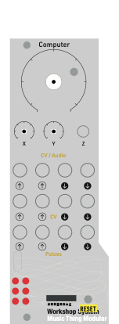
Main Vol
Silence
Max
Input gain
Record armed track
Playback only
Record armed track
Mono or stereo based on UF2 installed
CHAN 1
CHAN 2
Input L/mono
Input R
Output L/mono
Output R

