Slide 1
Trueskill Overview
By: William Li
Date: 7-6-2020

Slide 2
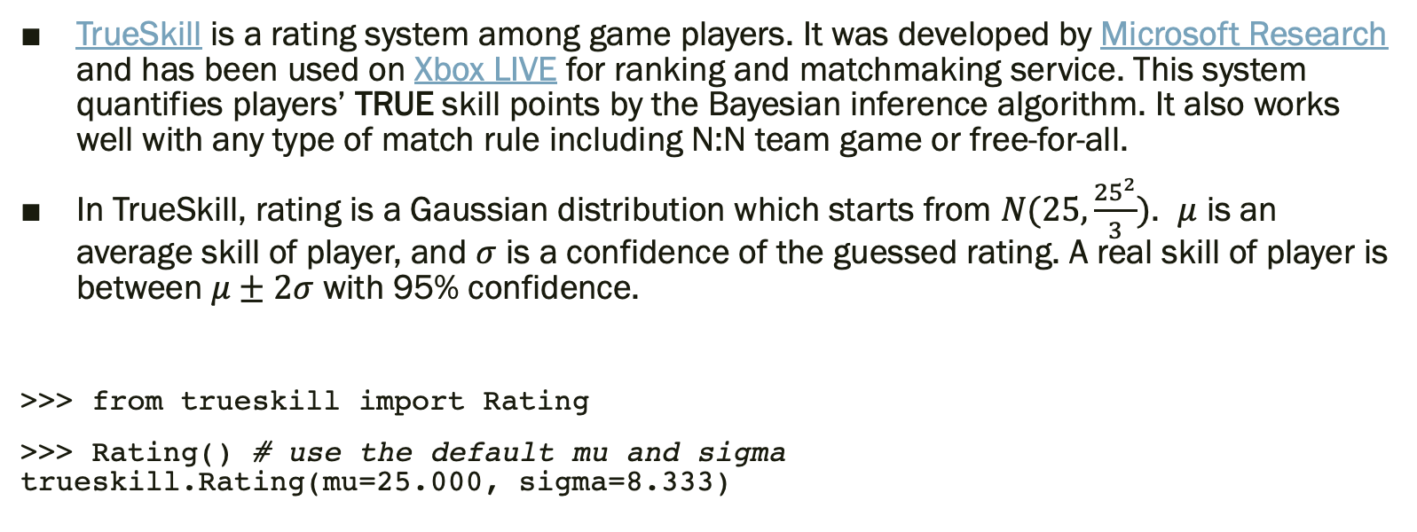
Trueskill Description
TrueSkill is a rating system among game players. It was developed by Microsoft Research and has been used on Xbox LIVE for ranking and matchmaking service. This system quantifies players’ TRUE skill points by the Bayesian inference algorithm. It also works well with any type of match rule including N:N team game or free-for-all.
In TrueSkill, rating is a Gaussian distribution which starts from $N(25, \frac{{25}^{2}}{3})$. $μ$ is an average skill of player, and $σ$ is a confidence of the guessed rating. A real skill of player is between $μ±2σ$ with 95% confidence.
>>> from trueskill import Rating
>>> Rating() # use the default mu and sigma trueskill.Rating(mu=25.000, sigma=8.333)

Slide 3
Installation
The package is available in PyPI:
$ pip install trueskill

Slide 4
Setup
Most competition games follows 1:1 match rule. If your game does, just use _1vs1 shortcuts containing rate_1vs1() and quality_1vs1(). These are very easy to use.
First of all, we need 2 Rating objects:
>>> r1 = Rating() # 1P's skill
>>> r2 = Rating() # 2P's skill

Slide 5
Before Game Info Example
Then we can guess match quality which is equivalent with draw probability of this match using quality_1vs1():
>>> print('{:.1%} chance to draw'.format(quality_1vs1(r1, r2))) 44.7% chance to draw

Slide 6
After Game Info Example
After the game, TrueSkill recalculates their ratings by the game result. For example, if 1P beat 2P:
>>> new_r1, new_r2 = rate_1vs1(r1, r2) # winner in first slot
>>> print(new_r1) trueskill.Rating(mu=29.396, sigma=7.171) # mean and variance updated
>>> print(new_r2) trueskill.Rating(mu=20.604, sigma=7.171) # mean and variance updated
If the game was a tie:
>>> new_r1, new_r2 = rate_1vs1(r1, r2, drawn=True)

Slide 7
Team Game Example
>>> r1 = Rating() # 1P's skill
>>> r2 = Rating() # 2P's skill
>>> r3 = Rating() # 3P's skill
>>> t1 = [r1] # Team A contains just 1P
>>> t2 = [r2, r3] # Team B contains 2P and 3P
>>> print('{:.1%} chance to draw'.format(quality([t1, t2]))) 13.5% chance to draw
>>> (new_r1,), (new_r2, new_r3) = rate([t1, t2], ranks=[0, 1]) # lower rank means winner
>>> print(new_r1) trueskill.Rating(mu=33.731, sigma=7.317)
>>> print(new_r2) trueskill.Rating(mu=16.269, sigma=7.317)
>>> print(new_r3) trueskill.Rating(mu=16.269, sigma=7.317)

Slide 8
All Team Games Possible
N:N team match – rate( [ (r1, r2, r3), (r4, r5, r6) ] )
N:N:N multiple team match – rate( [ (r1, r2), (r3, r4), (r5, r6) ] )
N:M unbalanced match – rate( [ (r1,), (r2, r3, r4) ] )
Free-for-all – rate( [ (r1,), (r2,), (r3,), (r4,) ] )

Slide 9
Win Probability
TrueSkill provides a function (quality()) to calculate a draw probability between arbitrary ratings. But there’s no function for a win probability.
Anyway, if you need to calculate a win probability between only 2 teams, this code snippet will help you:
import itertools
import math
BETA = trueskill.BETA = 4.16 # Default distance that guarantees about 76% chance of winning.
def win_probability(team1, team2):
delta_mu = sum(r.mu for r in team1) - sum(r.mu for r in team2)
sum_sigma = sum(r.sigma ** 2 for r in itertools.chain(team1, team2))
size = len(team1) + len(team2)
denom = math.sqrt(size * (BETA * BETA) + sum_sigma)
ts = trueskill.global_env()
return ts.cdf(delta_mu / denom)

Slide 10
Problems
Trueskill with high variance will have difficulty assessing the skill of the agent
It is not possible to assess the skill of an individual agent unless it switches teams
A team’s skill is simply the sum of skill levels of its individual agents’ skills
Trueskill is designed to predict the probability of drawing between opponents (not win probability!)
Skill levels on the top and bottom of the ladder have more inherent uncertainty.

