Slide 1
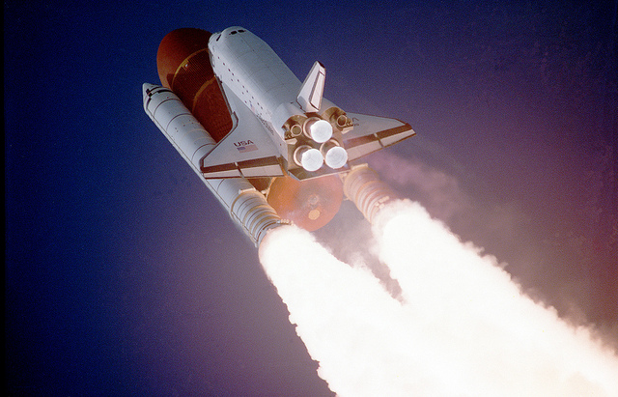
Be proud of your code - Software Design Workshop
Dawid Pytel

Slide 2
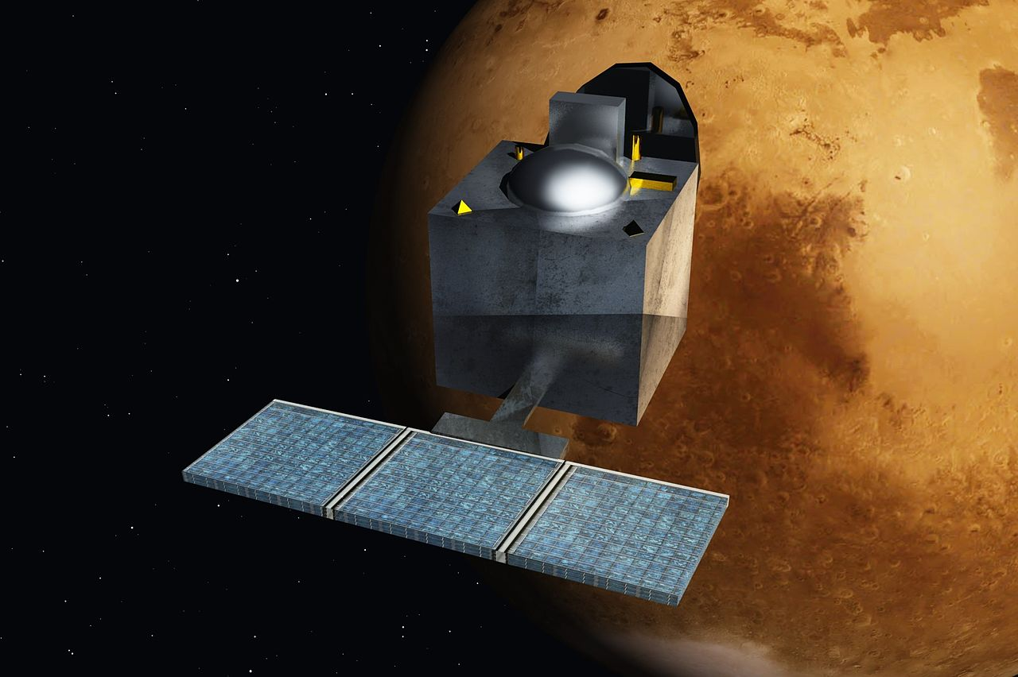
MOM: 73M $
Windows Vista:
6000M $
Nesnad
https://commons.wikimedia.org/wiki/File:Mars_Orbiter_Mission_-_India_-_ArtistsConcept.jpg

Slide 3

82x

Slide 4
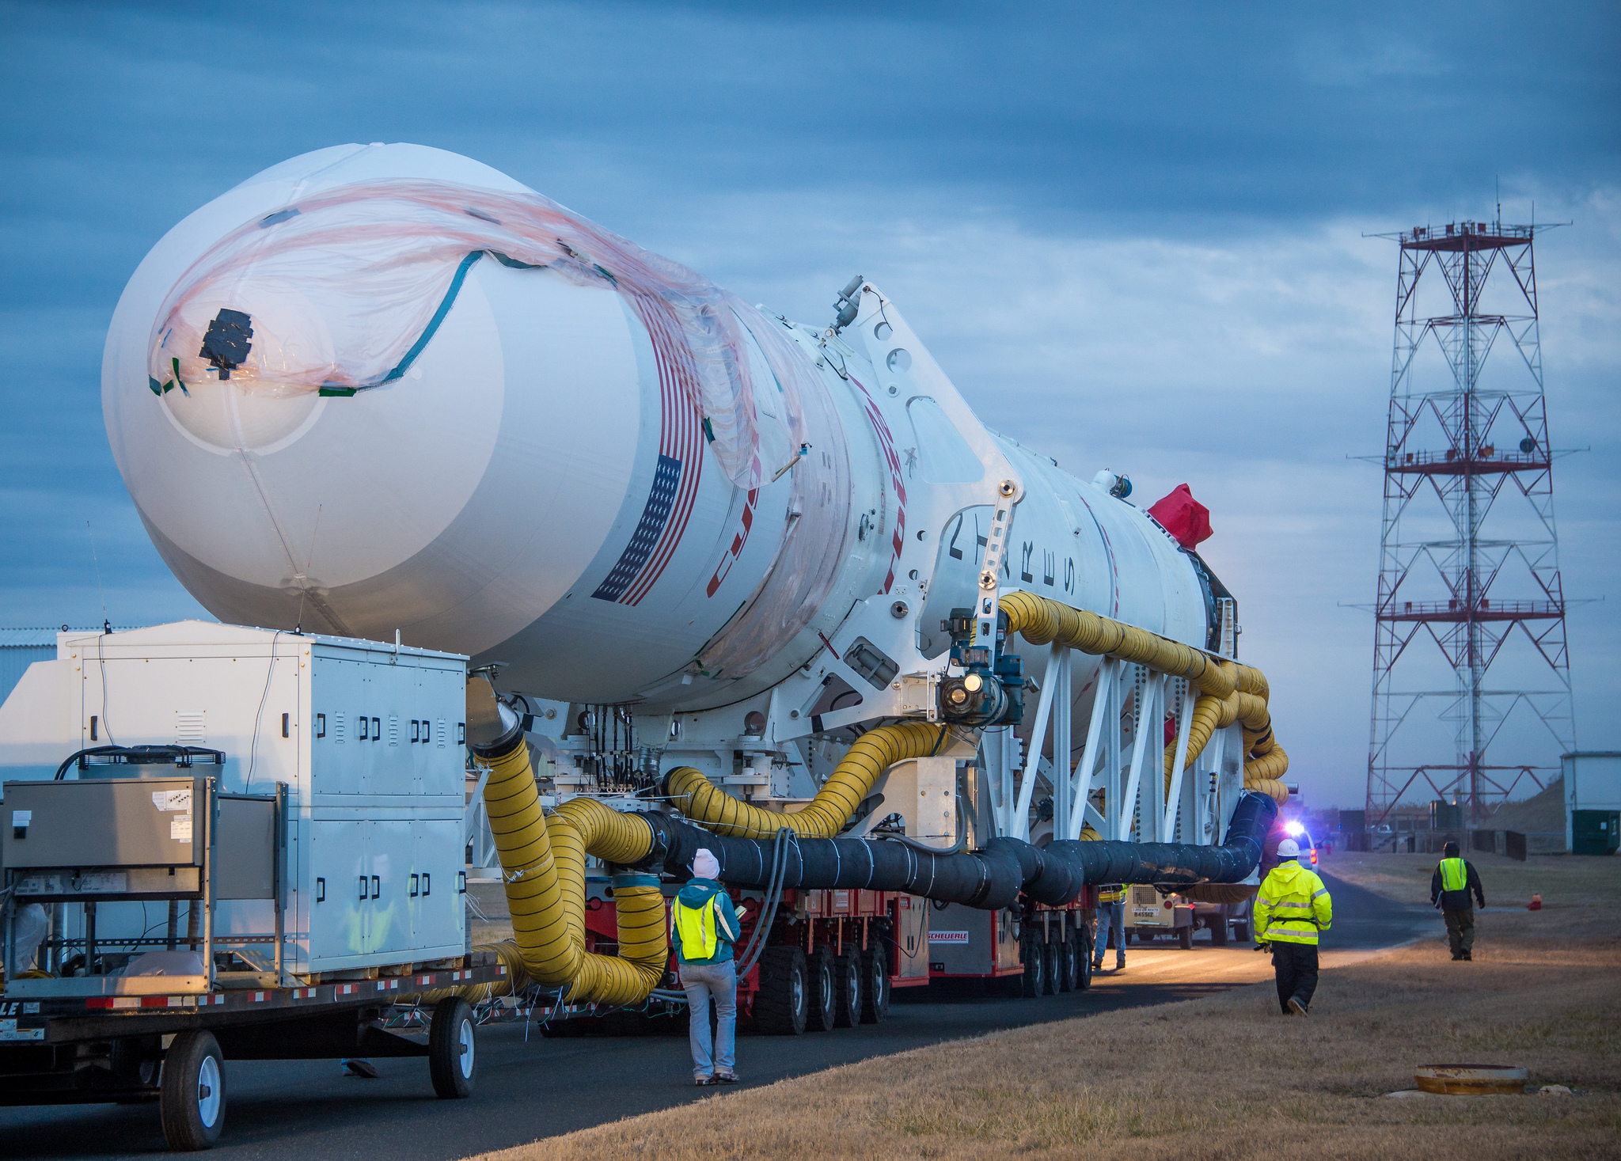
Project starts ...
NASA/Bill Ingalls
https://www.flickr.com/photos/gsfc/11827827413/
Notes:
Ambitious plan – we are going to reach the Moon
This time it will be different
And management gives you a deadline…
Nevertheless, you do your best and you deliver something
The result is not as remarkable ->

Slide 5
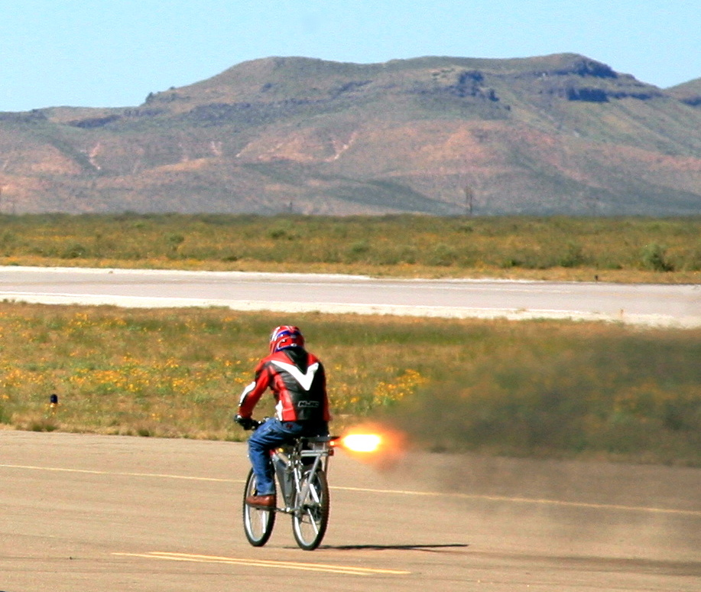
After some time...
Steve Jurvetson “Rocket Bike”
https://www.flickr.com/photos/jurvetson/280651657/
Notes:
The Moon – in version 2.0
Time flies – many bugfixes and CRs later…
After 2-3 years people start using L-word to describe the system. Word that every programmer is afraid of

Slide 6

LEGACY
Magnus Manske “Ken Thompson (sitting)-&-Dennis Ritchie at PDP-11”
https://en.wikipedia.org/wiki/File:Ken_Thompson_%28sitting%29_and_Dennis_Ritchie_at_PDP-11_%282876612463%29.jpg

Slide 7
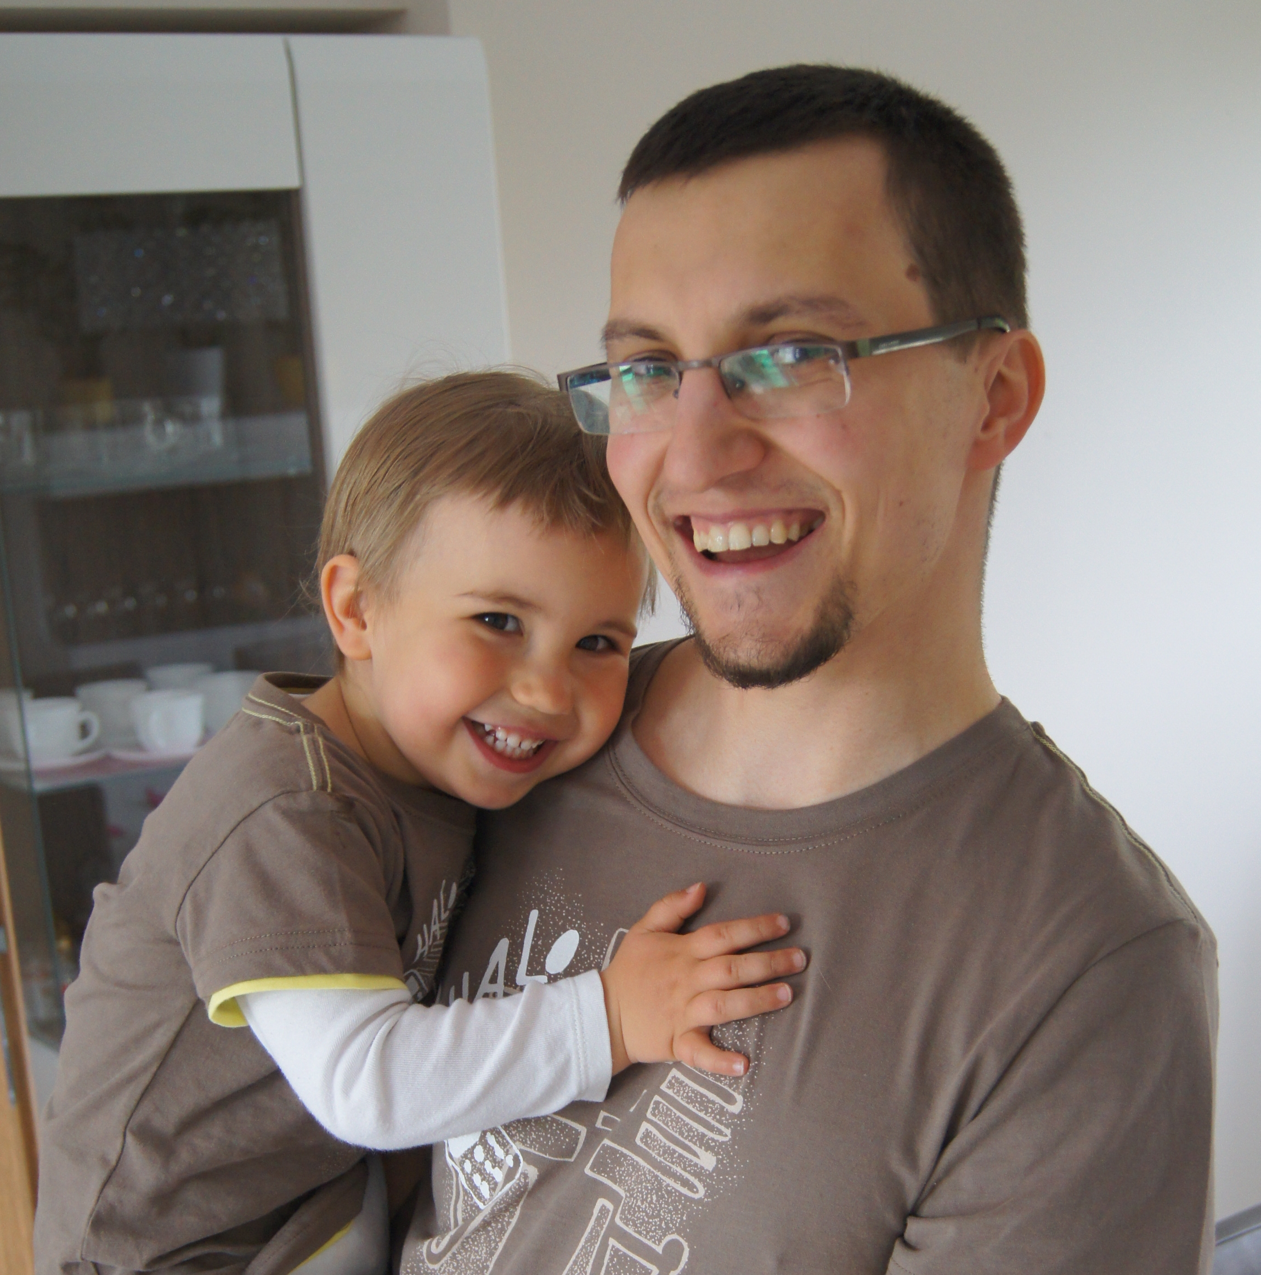
Be Proud
Notes:
Let's put an end to it! Let's be proud of our code. I'm sure it's worth it. Why should we allow our code to rot?
Wouldn't it be nice to hear “I extended your code, it was great. I reused your code to do this and that...”

Slide 8
How to achieve it?
Refactoring
Better
tests
Better design
Notes:
These are well known ways to achieve that.
This is not complete list but this is what we as software developers could do.

Slide 9
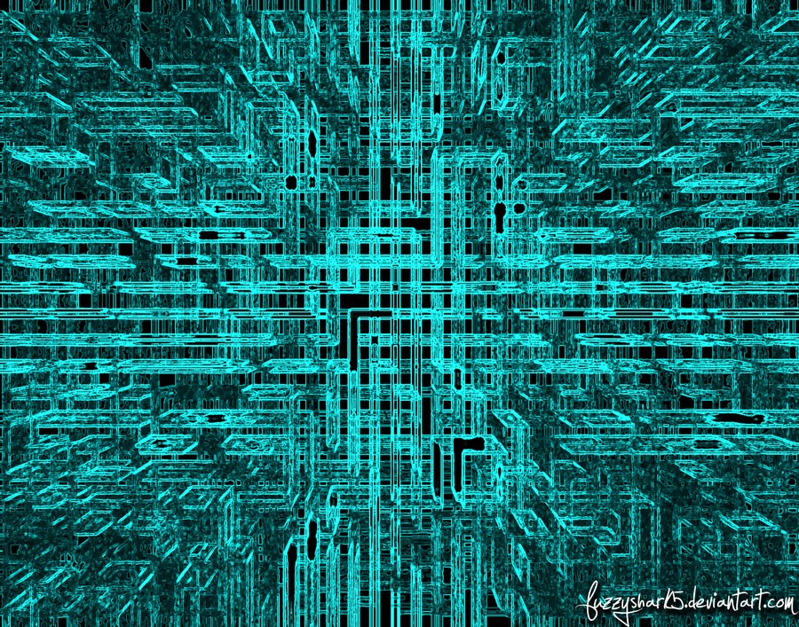
Where is a design?
IN CODE
fuzzyshark5 “Matrix-y Background”
http://fuzzyshark5.deviantart.com/art/Matrix-y-Background-204791408

Slide 10
What is a good design?
Passes tests
Reveals intention
No duplication
Fewest elements

Slide 11
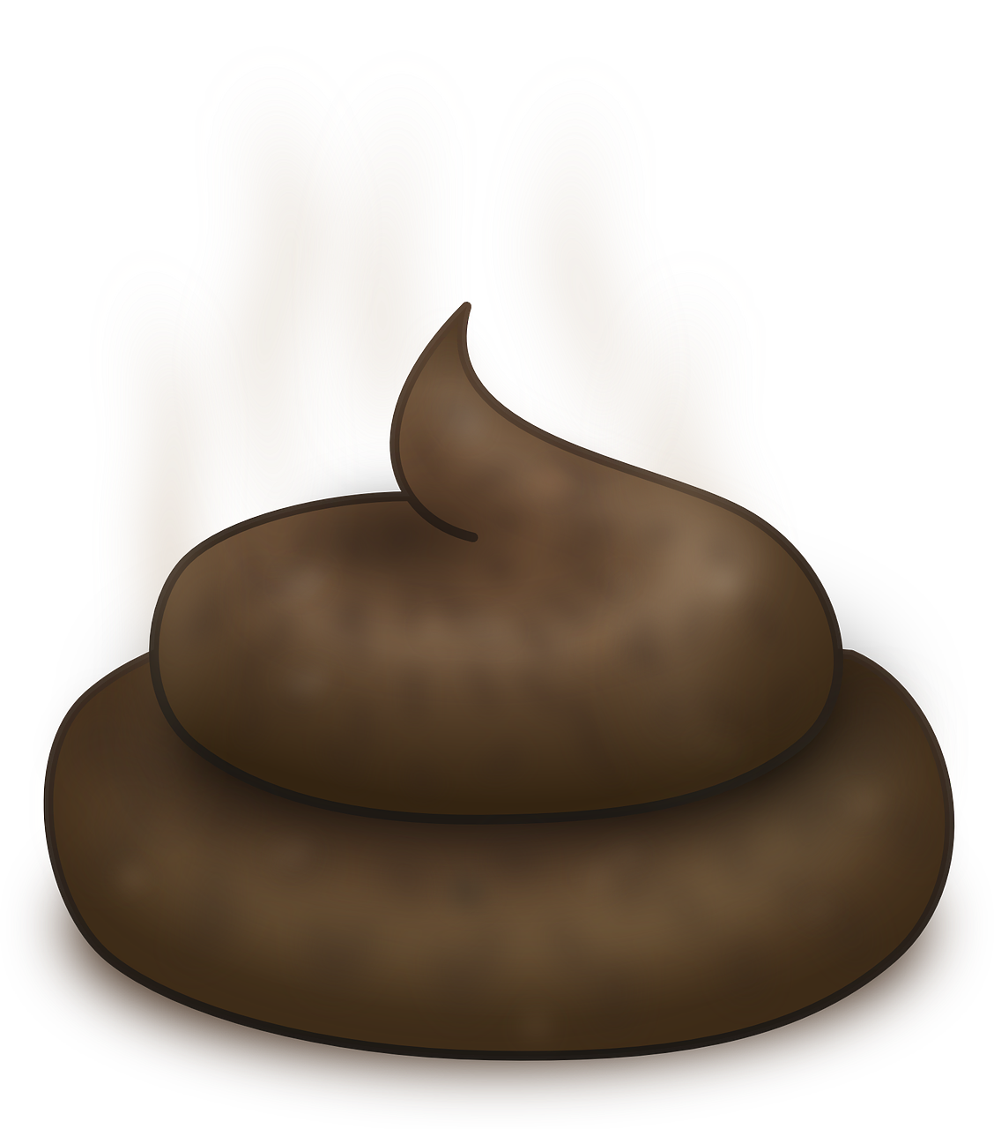
Symptoms of bad design

Slide 12
Exercises
Problem
Discussion in 5 person groups
Few words on communication
Presentation of solutions by group members
Discussion on presented solution
Notes:
Problem presented by me and described on handouts
Problem from banking industry

Slide 13
Problem 1
Payment templates
Notes:
Frontend system for banks (like mBank, Intelligo etc.)

Slide 14
Problem 1 – payment template attributes
Payment template attributes:
  template title
  addressee account number (optional)
  amount (optional)
  is international payment (mandatory)
  country (only for international)
  bank code (only for international)

Slide 15
Problem 1 - goal
void createTemplate(long userId,
String title,
String addresseeAccountNumber,
Decimal amount,
boolean internationalPayment,
String countryCode,
String bankCode)
List<?> listTemplates(long userId)
Payment createPaymentFromTemplate(long templateId)

Slide 16
Intentionally empty slide

Slide 17
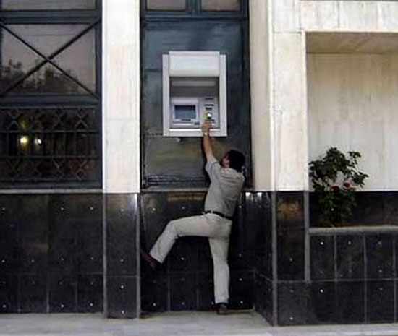
Why we are so hopeless at communicating?
http://iliketowastemytime.com/epic-construction-fails
Notes:
Reason for such failures is communication:
Someone used meters, someone feet

Slide 18
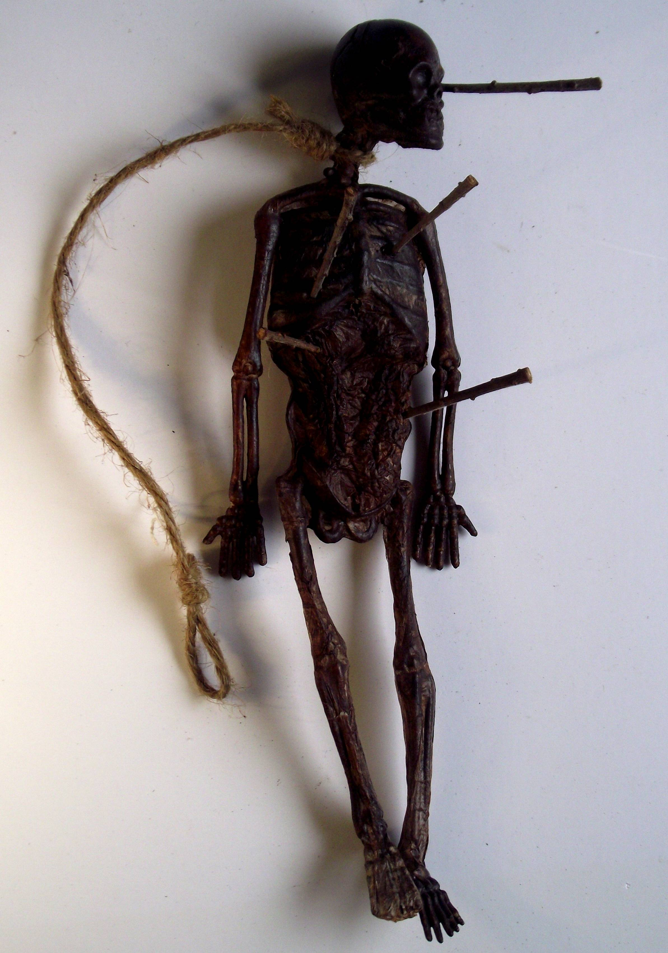
Curse of Knowledge
Malcolm Lidbury (aka Pinkpasty)
https://commons.wikimedia.org/wiki/File:Witch_Doll_Curse.jpg
Notes:
We who know something cannot imagine how it is to be someone who doesn't know what we know.
Again, curse of knowledge.
I know something. You don't.

Slide 19
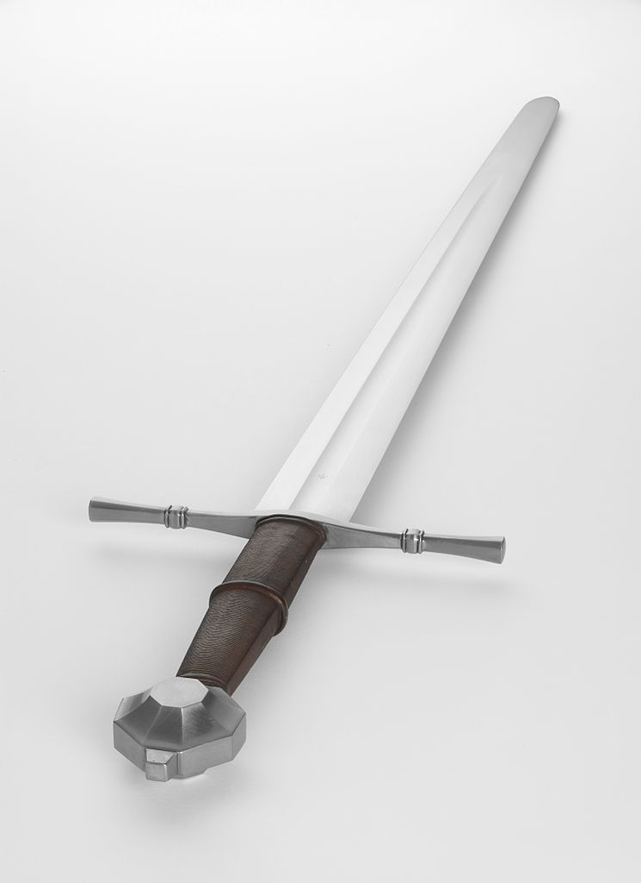
Simple message
Søren Niedziella “The Count Limited Edition Medieval War Sword”
https://commons.wikimedia.org/wiki/File:Albion_Count_Medieval_Sword_13_%287310805628%29.jpg
Notes:
Simple like a sword. Simple and deadly. Used successfully for centuries.

Slide 20
7 ± 2

Slide 21
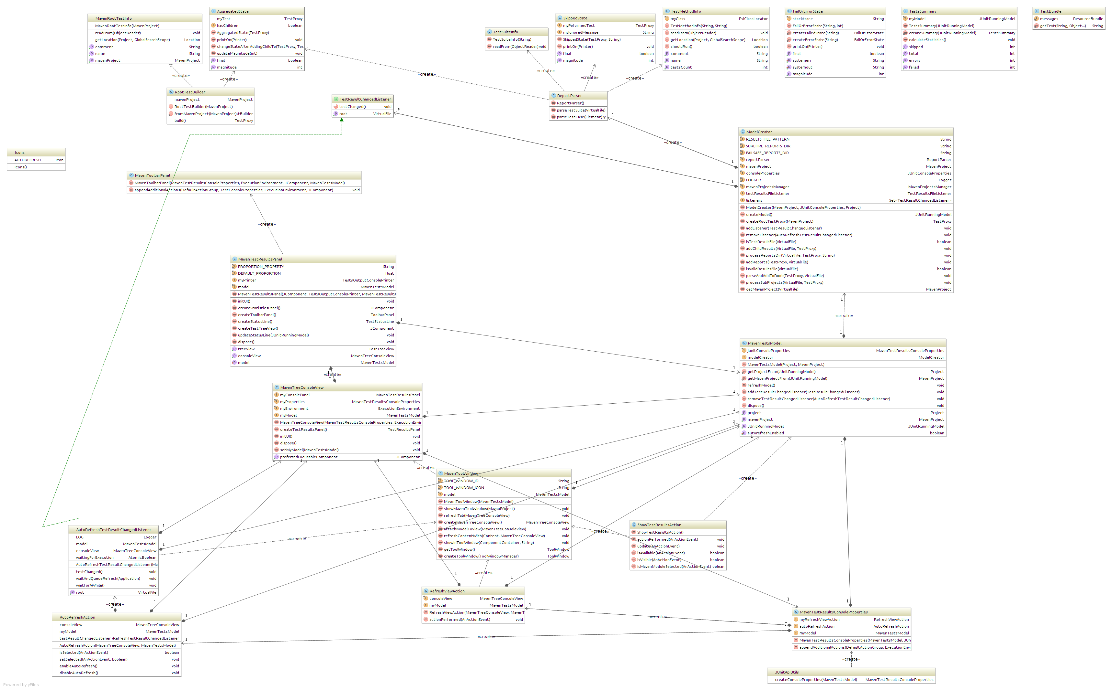
Multiple perspectives

Slide 22
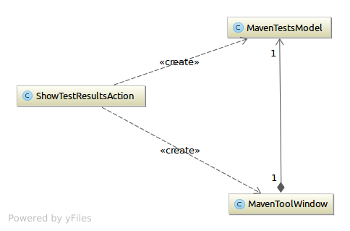

Slide 23
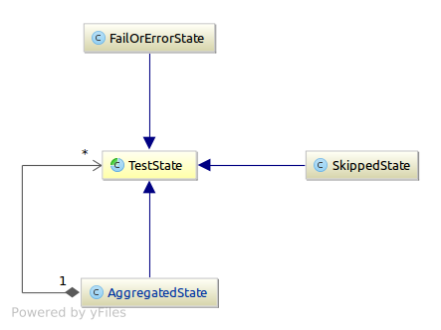

Slide 24
Problem 1 - Solutions

Slide 25
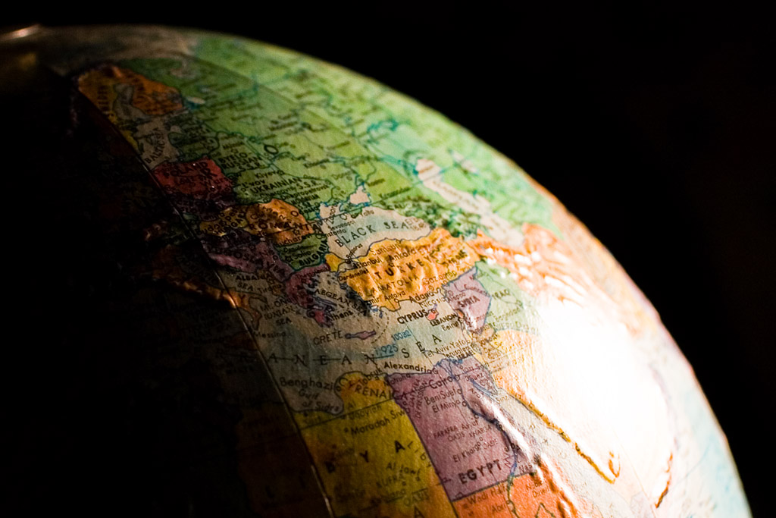
Model real world
Kenneth Lu “Old Globe”
https://www.flickr.com/photos/toasty/1540997910/
Notes:
Helped:
Understand world around
Explore
Convey information
Same in software. Question:
Is it exposed and maintained
Is it scattered around and incidental

Slide 26
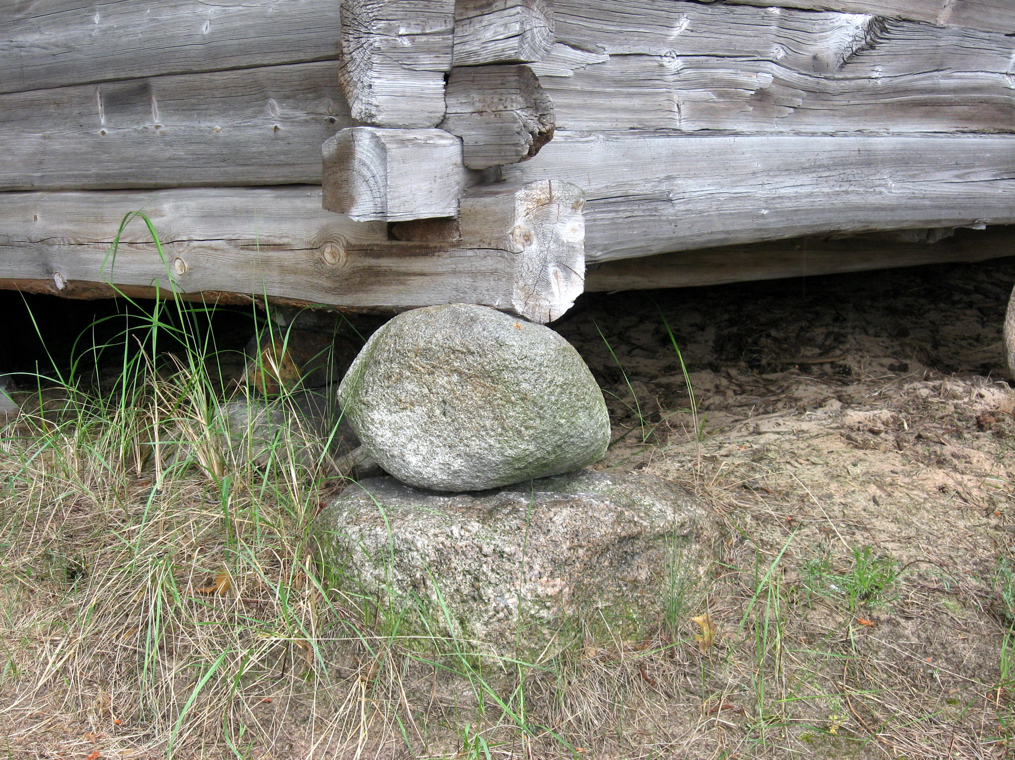
Why to separate?
Dezidor "Čeština: Lotyšské etnografické muzeum v přírodě" https://en.wikipedia.org/wiki/File:Lotyšské etnografické muzeum v přírodě (91).jpg
Notes:
Tak będzie wyglądał model domeny na początku

Slide 27
Dependency direction?
Application rules
Domain model
Domain model
?

Slide 28
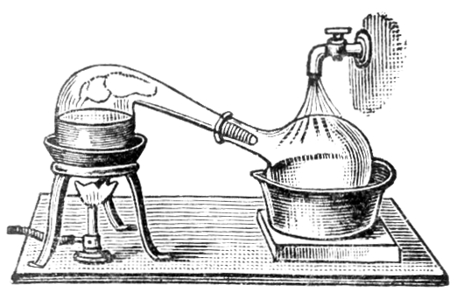
Mind your language
Milling, Mashing, Fermentation, Distillation, Ageing, Blending
Distillation by Alembic 1910
https://en.wikipedia.org/wiki/File:Distillation_by_Retort.png
Notes:
Imagine you are building alcohol distillation system
Fermentation, not conversion of sugars into alcohol

Slide 29
Problem 2
Bank accounts creation
Notes:
Frontend system for banks (like mBank, Intelligo etc.)

Slide 30
Problem 2 – kinds of bank accounts
Local account:
  Created by bank administrators
  attributes: name, IBAN, BIC, isSavingsAccount (all required)
Addressee account:
  Created by bank customers
  attributes: name (optional), IBAN, BIC (both mandatory)

Slide 31
Problem 2 – BIC & IBAN
BIC: BREXPLPWKRA
IBAN (N – digit, X – character or digit)
  Poland
  PLNN NNNN NNNN NNNN NNNN NNNN NNNN
  Germany
  DENN NNNN NNNN NNNN NNNN NN
  France
  FRNN NNNN NNNN NNXX XXXX XXXX XNN

Slide 32
Problem 2 – BIC & IBAN rules
Bank has database of known BICs (but not all)
IBAN and BIC country might not match → show warning

Slide 33
Problem 2 - Task
CreationResponse createLocalAccount(
String name, String bic, String iban,
boolean isSavingsAccount)
CreationResponse createAddresseeAccount(
String name, String bic, String iban)
public class CreationResponse {
boolean success;
List<String> errorKeys;
boolean isBicIbanCountryMismatch;
}

Slide 34
Problem 2 - What to expect?
Support for new countries
Some banks might not want to allow for IBAN/BIC country mismatch

Slide 35
Intentionally empty slide

Slide 36

Concrete message
F2=F1
F2=F1
VS
F1
Sara Fasullo “grandmother”
https://www.flickr.com/photos/sarasculli/7206443606/
Attribution-NonCommercial-NoDerivs 2.0 Generic

Slide 37
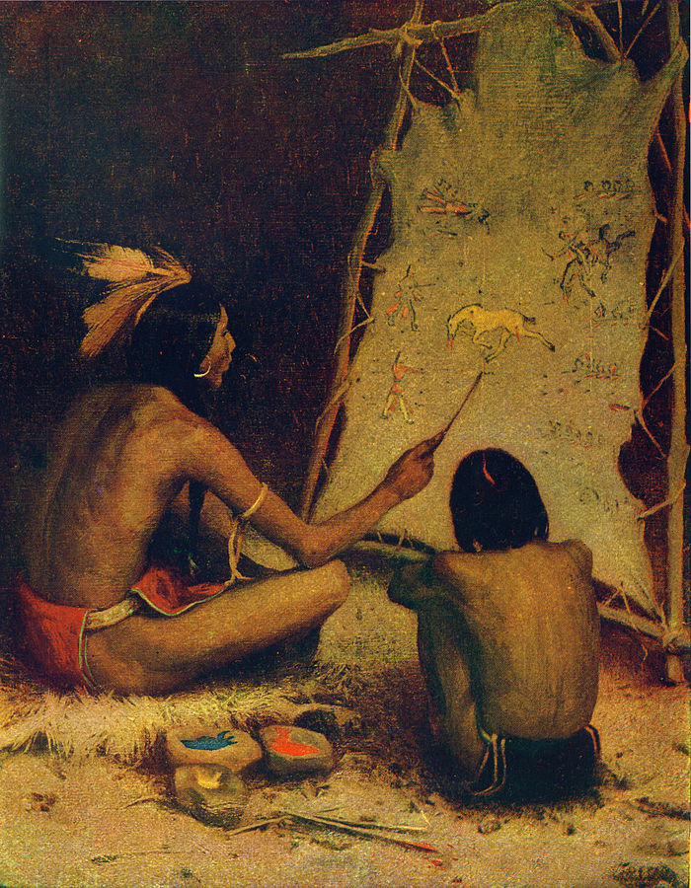
Storytelling
E. Irving Couse
https://en.wikipedia.org/wiki/Storytelling#/media/File:The_Historian_%28The_How_and_Why_Library%29.jpg

Slide 38
Problem 2 - solutions

Slide 39
BankAccount
transferMoneyTo(
anotherAccount, amount)
isIbanValid()
save()
delete()

Slide 40
BankAccount
transferMoneyTo(
anotherAccount, amount)
isIbanValid()
save()
delete()

Slide 41
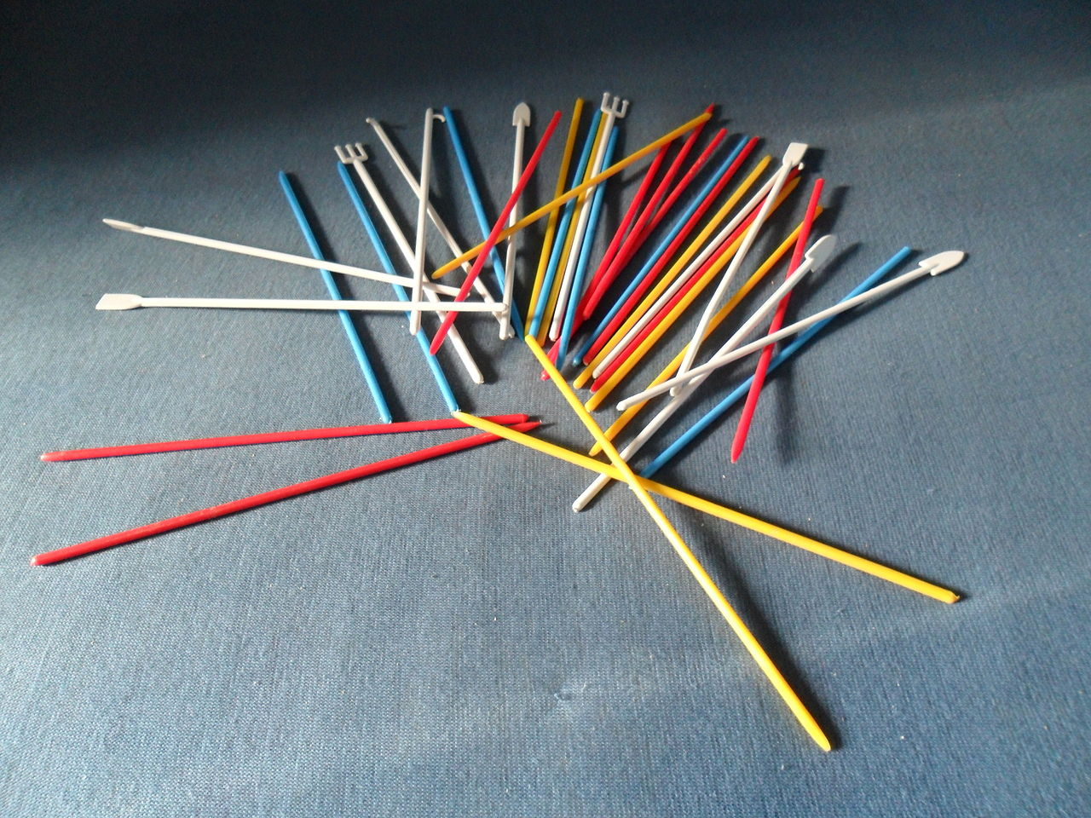
SRP – why?
Olos88 “Bierki”
https://pl.wikipedia.org/wiki/Bierki#/media/File:Bierki.JPG

Slide 42

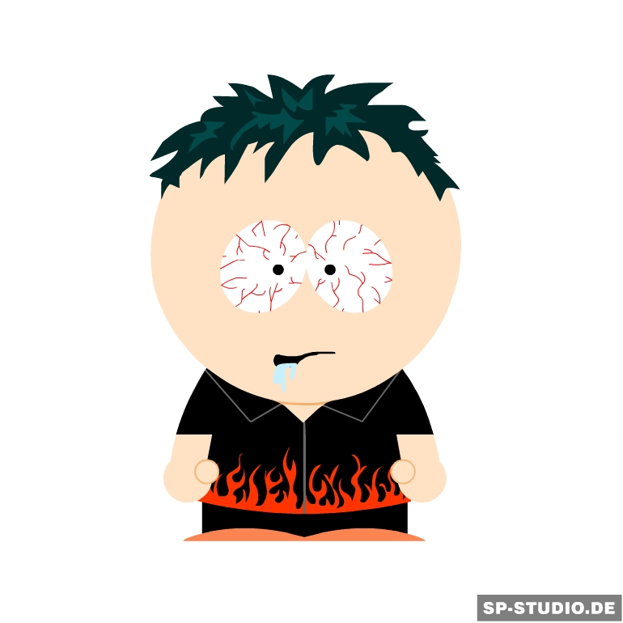
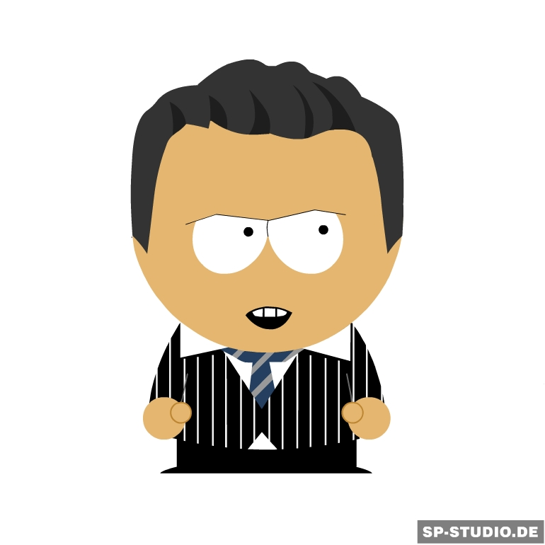
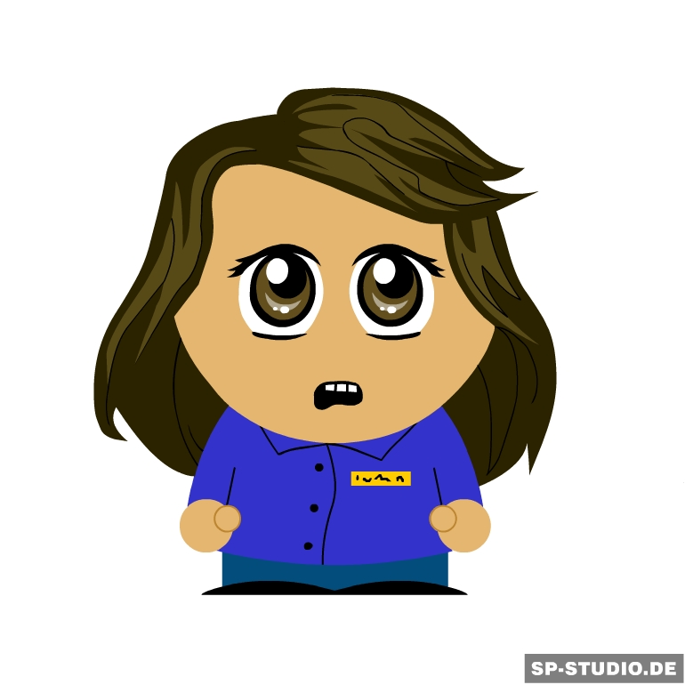
Responsibility = Users

Slide 43
Problem 3
Mass payments
Notes:
Frontend system for banks (like mBank, Intelligo etc.)

Slide 44
Problem 3 – Mass payments
User uses CSV file (e.g. exported from external application) to create multiple payments

Slide 45
Problem 3
System creates payments by combining data from:
CSV file
payment template specified by user (optional)
addressee accounts table (matched by addressee account)

Slide 46
Problem 3 – example 1
Payment template
title: “Instalment payment”
addressee: “Example Bank Inc.”
addressee account: “SA03 8000 0000 6080 1016 7519”
Amount | Execution date
444 | 2015-08-28
442 | 2015-09-28
... | …

Slide 47
Problem 3 – example 2
Payment template
title: “Salary”
amount: 1286,16 zł
Addressee account | Execution date
PL 1… …… …… | 2015-08-28
PL 2… …… …… | 2015-08-28
... | …

Slide 48
Intentionally empty slide

Slide 49
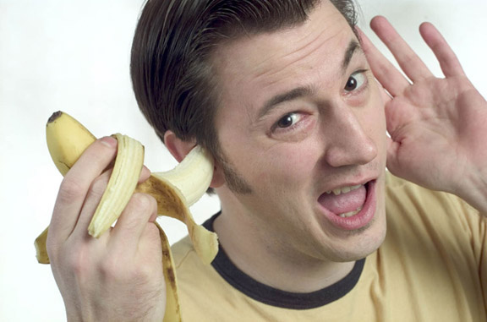
Listen first,
show respect for their opinion
Gabe Palmer “banana in my ear”
https://www.flickr.com/photos/gp3301/4134094086

Slide 50
You are wrong!
Notes:
Not: “You are wrong”
Use questions
Look for agreement

Slide 51
assert !mistake;
Notes:
Fail fast in programming – raise an error before it gets nasty
Why don't we do this in our professional life?

Slide 52
Problem 3 - solutions

Slide 53
Good design is NOT rocket science
Notes:
This is what I want you to remember
It is about conscious choices
You can learn that

Slide 54




