Slide 1
URBAN SQUARE
HIGH RESOLUTION AIR QUALITY MEASUREMENTS
Camille Lainé

Slide 2
URBAN SQUARE
User stories
User story | State
Map of neighborhood-level air quality | Done
Download neighborhood-level air quality | Done
User-friendly interface | On-going
Time-series for a particular pixel | Done
Air quality profiles based on weather conditions | To Do

Slide 3
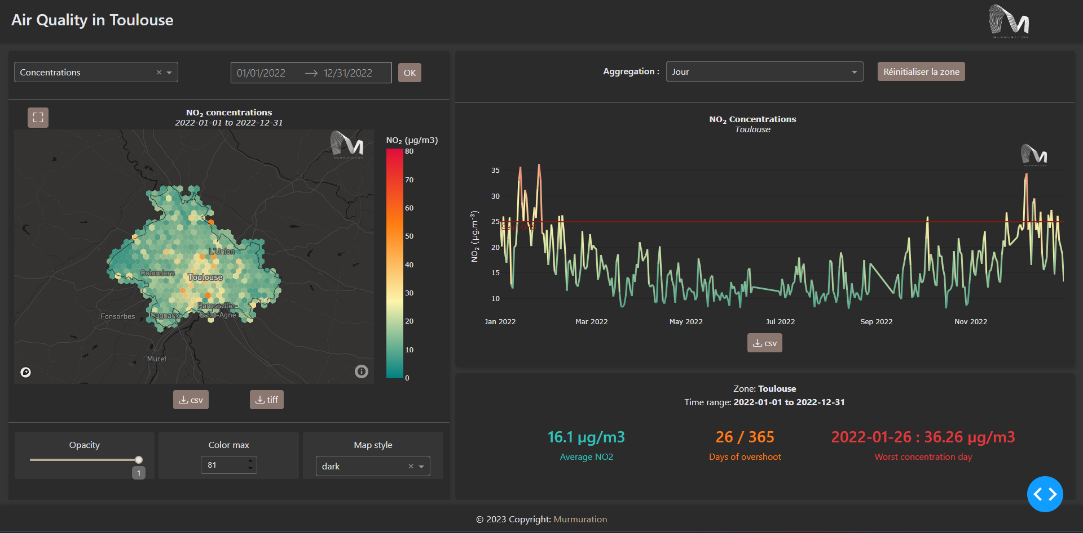
URBAN SQUARE
Dashboard V1
https://services.murmureo.com/dash/dev/urban-square/air-quality/

Slide 4
URBAN SQUARE
Next steps
Work on the scheduled flow to retrieve up-to-date data (5 days ago)
Add explainability :
SHAP graphs to explain the model’s decision-making process (highlight which variables were responsible for increasing concentration levels)
Add relationship between pollution and weather
Improve UX design

Slide 5
Contact us :
Fabien Castel
fabien.castel@murmuration-sas.com
Camille Lainé
camille.laine@murmuration-sas.com

