Slide 1
Individual Digital Story: Personal Contribution to iSuperviz
S H A R I N G U N I Q U E E X P E R I E N C E S A N D R O L E S I N
D I G I T A L P R O J E C T S

Slide 2
INTRODUCTION AND PROJECT CONTEXT

Slide 3

Personal Introduction and Purpose of the Digital Story
Individual Role in Team Project
Focus on personal involvement and specific contributions to the iSuperviz project within a team environment.
Project Purpose and Scope
iSuperviz is a full-stack web app helping researchers manage papers and AI-
assisted workflows effectively.
Alignment with Course Requirements
Highlights tasks like reference organization and project evaluation to meet academic honesty and documentation standards.
Learning Outcomes and Ethics
Demonstrates understanding of non-coding tasks' importance and adherence to
ethical standards in web projects.

Slide 4
OVERVIEW OF THE ISUPERVIZ PROJECT

Slide 5

System Overview and Full-Stack Design Rationale
Integrated Research Workflow
iSuperviz supports discovery, reading, reflection, idea generation, and evaluation within one unified platform.
Frontend Technologies
The frontend uses React, TypeScript, Ant Design, and React
Flow for modular, typed, and responsive design.
Backend Architecture
Node.js, Express, and SQLite form the backend, providing authentication, data persistence, and APIs.
Deployment Design Decision
A client-side mock API adapter replicates backend functions to
enable deployment on GitHub Pages.

Slide 6
INDIVIDUAL ROLE AND RESPONSIBILITIES

Slide 7

Assigned Contributions and Academic Support Role
Citation and Reference Management
Organized APA-style citations ensuring academic honesty and transparency in documenting external technologies and resources.
Project Evaluation Contribution
Explained success criteria such as functionality, deployment, responsiveness, accessibility, and documentation completeness during team presentation.
Understanding Hallucination Audit Workflow
Studied AI review processes to connect citation consistency and
writing polish with academic integrity concerns.

Slide 8
EVALUATION AND CRITERIA OF SUCCESS

Slide 9
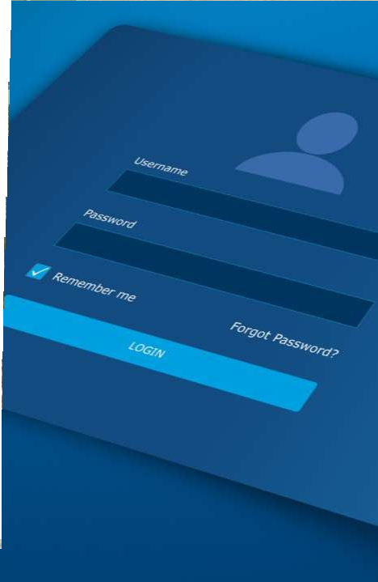
Defining and Applying Project Success Criteria
Functional Success
Ensures all essential services like signup, login, dashboard, and orders are testable and visible to users.
Peculiar-Service Success
Incorporates advanced team-defined features such as AI Paper Chat and Idea
Graph beyond basic templates.
Deployment Success
Requires a publicly accessible URL to allow easy testing without local installation or setup.
Responsive and Documentation Success
Verifies interface usability across devices and ensures complete, clear
documentation and installation instructions.

Slide 10
CONNECTING SLIDES TO SYSTEM DEMONSTRATION

Slide 11

Planned Demo Flow and Its Relevance to My Role
Demo Flow Overview
The demo begins with the home page introducing project identity and features, setting a clear context.
Dashboard Core Features
Post-login dashboard highlights user profile, credit tracking, search history, cart,
and order management.
Research Workflow Display
Paper list and detail pages demonstrate structured notes and AI-assisted interactions for research.
Hallucination Audit Feature
Feature reviews AI-generated content for citation accuracy, writing quality, and
hallucination detection.

Slide 12
INDIVIDUAL LEARNING OUTCOMES

Slide 13

Citation Management Importance
Proper citation of frameworks and libraries supports academic honesty and prevents plagiarism in technical projects.
Evaluation Criteria Usage
Evaluation criteria systematically verify if projects meet functional and non-functional requirements effectively.
Deployment Documentation
Clear deployment evidence like screenshots, URLs, and explanations are essential for validating project functionality.
Learning from Documentation, Evaluation, and AI Ethics
AI Ethics Awareness
Studying AI content audits highlights the need for assessing AI-generated content reliability and proper citations.

Slide 14
SUBMISSION AND
ASSESSMENT READINESS

Slide 15

Individual Digital Story Submission Evidence
Video File Requirements
The digital story must be an MP4 video between 10 and 15 minutes long and under 200 MB in size.
File Naming Convention
Use course code, team number, and student ID in the file name for clear
identification.
Submission Platforms
Submit the video via Moodle and create a forum post with viewing links on platforms like YouTube or OneDrive.
Documentation and Compliance
Clearly document personal involvement and evaluation steps to comply with
submission requirements and avoid grading issues.

Slide 16
CONCLUSION AND REFLECTION

Slide 17

Personal Reflection and Closing Remarks
Academic Integrity and Documentation
Organized APA references and improved documentation quality to enhance project transparency and professionalism.
Evaluation and Ethical Reflection
Supported evaluation criteria and reflected on AI workflows to
ensure responsible and ethical project development.
Team Contribution and Learning
Recognized the importance of non-coding roles in team success and the impact of clear communication and responsibility.

