Slide 1
Meteorite landings prediction analysis.
Presented by-
Team “Kuch Bhi”(Chitkara University)

Slide 2
Synopsis
Scientists predict over 44,0000 tonnes of meteoritic mass falls on the earth daily. As the earth is being bombarded with astronomical debris. We were provided with the dataset containing Information on the geographic location as well as structure of the meteorite.
We conducted an analysis on the data, visualizing it and predict areas with the highest showers.
The dataset was provided by the organization, which we presumed to be cleaned and ready for use beforehand.

Slide 3
Elements used for analysis and prediction
Dataset used:
https://tinyurl.com/yc553x2z
Technologies used:
Microsoft Excel
Python
Kaggle
Plotly
Pandas
Matplotlib
Numpy
GeoPy
Scatter plots
Heatmaps

Slide 4
About the Dataset
The Meteoritical Society collects data on meteorites that have fallen to Earth from outer space. This dataset includes the location, mass, composition, and fall year for over 45,000 meteorites that have struck our planet.
Notes on missing or incorrect data points:
a few entries here contain date information that was incorrectly parsed into the NASA database. As a spot check: any date that is before 860 CE or after 2016 are incorrect; these should actually be BCE years. There may be other errors and we are looking for a way to identify them.
a few entries have latitude and longitude of 0N/0E (off the western coast of Africa, where it would be quite difficult to recover meteorites). Many of these were actually discovered in Antarctica, but exact coordinates were not given. 0N/0E locations should probably be treated as NA.

Slide 5
About the Dataset (cont.)
The dataset contains the following variables:
name: the name of the meteorite (typically a location, often modified with a number, year, composition, etc)
id: a unique identifier for the meteorite
nametype: one of: -- valid: a typical meteorite -- relict: a meteorite that has been highly degraded by weather on Earth
recclass: the class of the meteorite; one of a large number of classes based on physical, chemical, and other characteristics (see the Wikipedia article on meteorite classification for a primer)
mass: the mass of the meteorite, in grams

Slide 6
About the Dataset(cont.)
fall: whether the meteorite was seen falling, or was discovered after its impact; one of: -- Fell: the meteorite's fall was observed -- Found: the meteorite's fall was not observed
year: the year the meteorite fell, or the year it was found (depending on the value of fell)
reclat: the latitude of the meteorite's landing
reclong: the longitude of the meteorite's landing
GeoLocation: a parentheses-enclose, comma-separated tuple that combines reclat and reclong

Slide 7
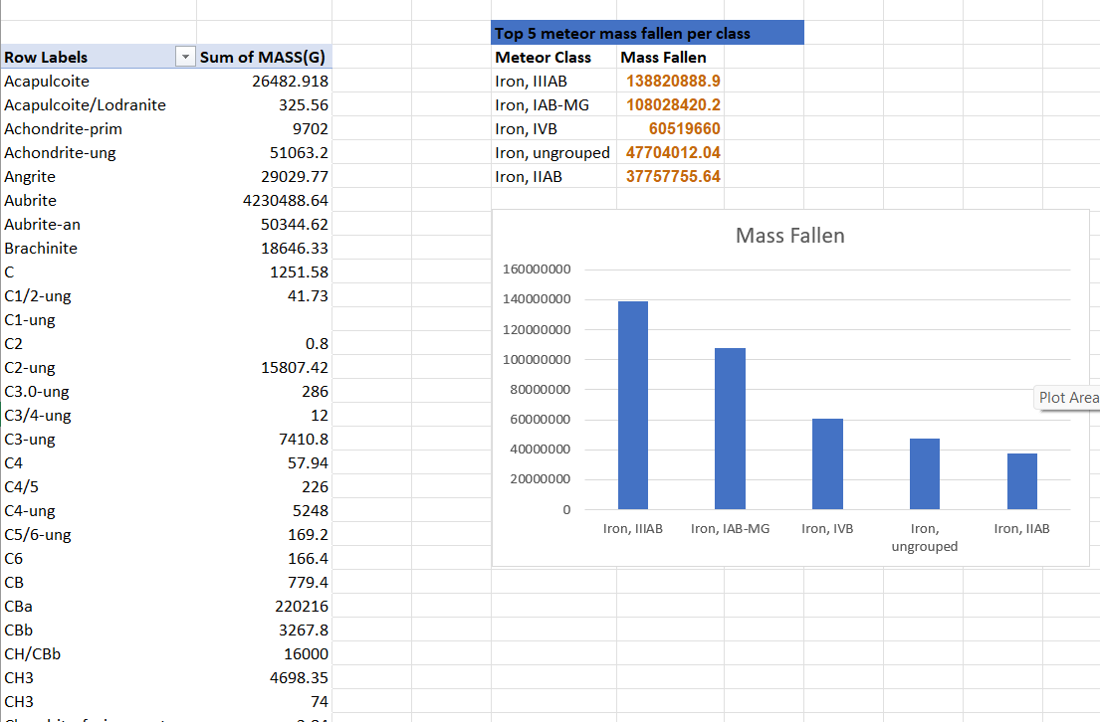
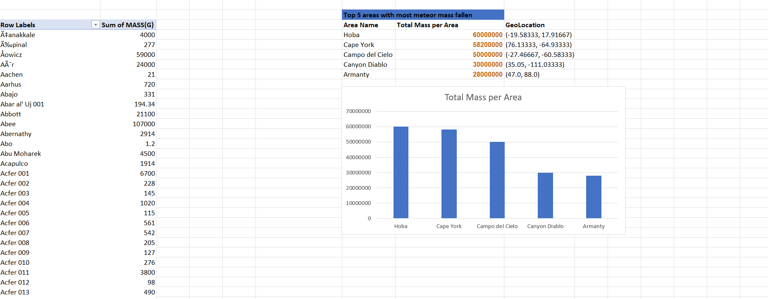
Approach to analysis.
The team first condensed the 45,717 record data into usable pivot tables using Excel.

Slide 8
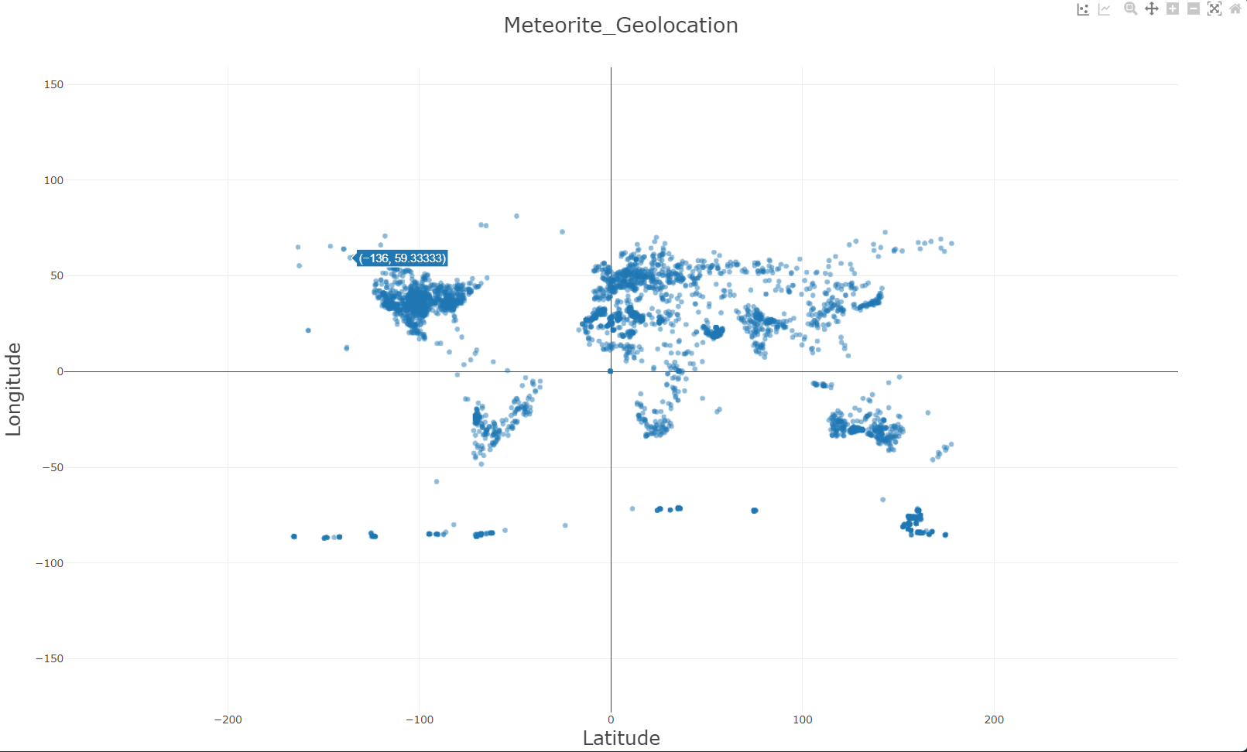
Approach to analysis(cont.)
Afterwards, the team considered the geolocation coordinates provided within the dataset to plot a density scatter plot

Slide 9
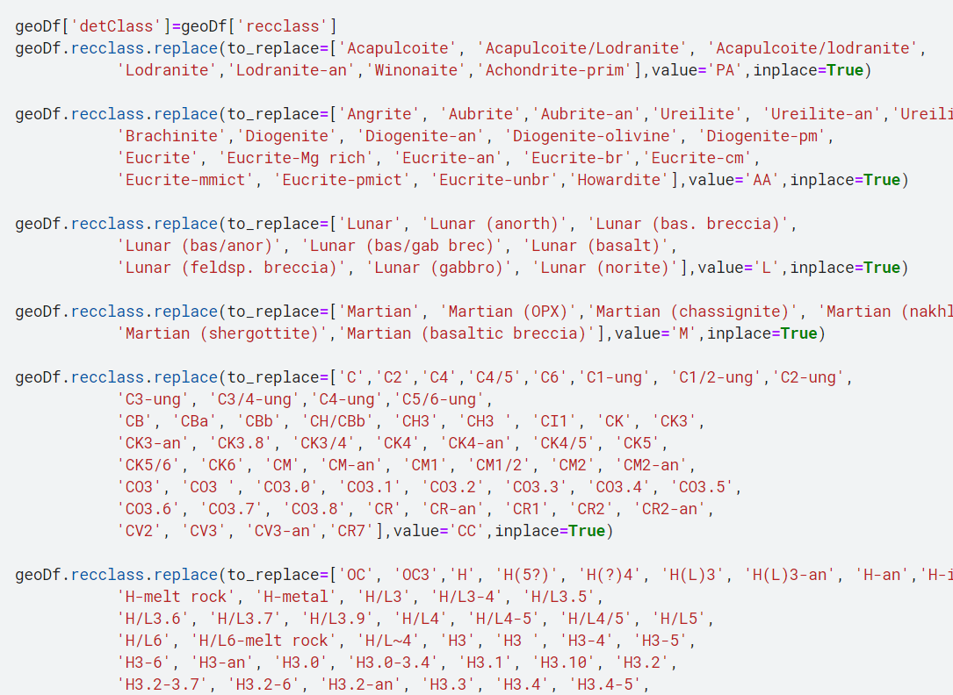
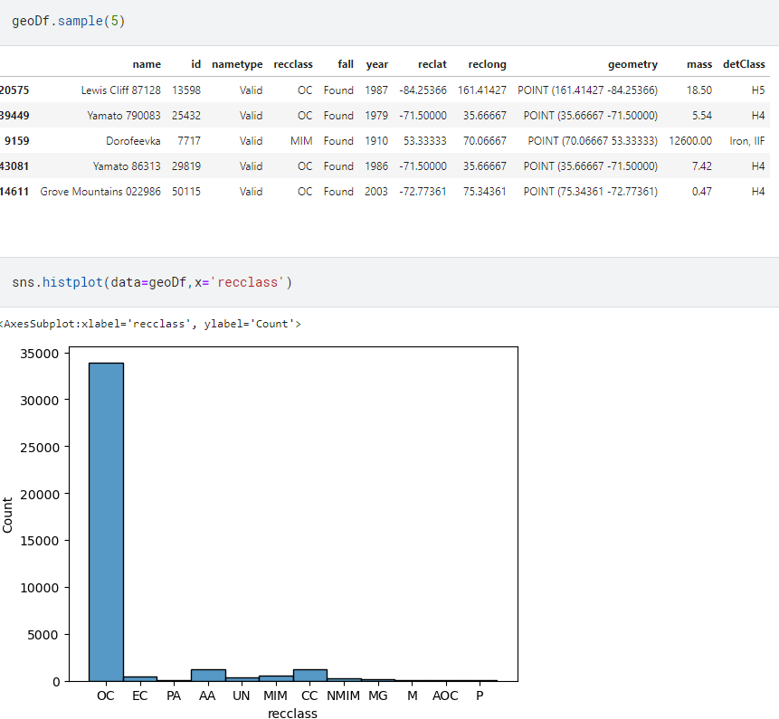
Approach to analysis(cont.)
The dataset contained meteorite classes, which were in a very high degree of detail. Since this would’ve hindered our approach and not result in any significant analytical results, we decide to further classify the classes into major categories. Here, python libraries such as pandas and numPy were used. Wikipedia as reference was used(reference link here).

Slide 10
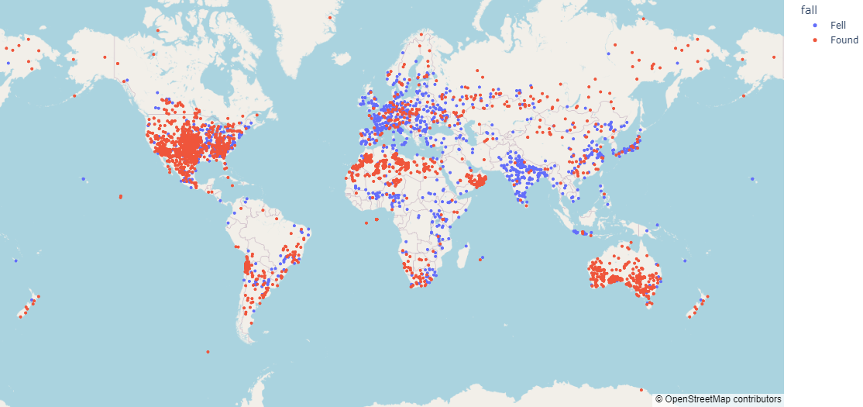
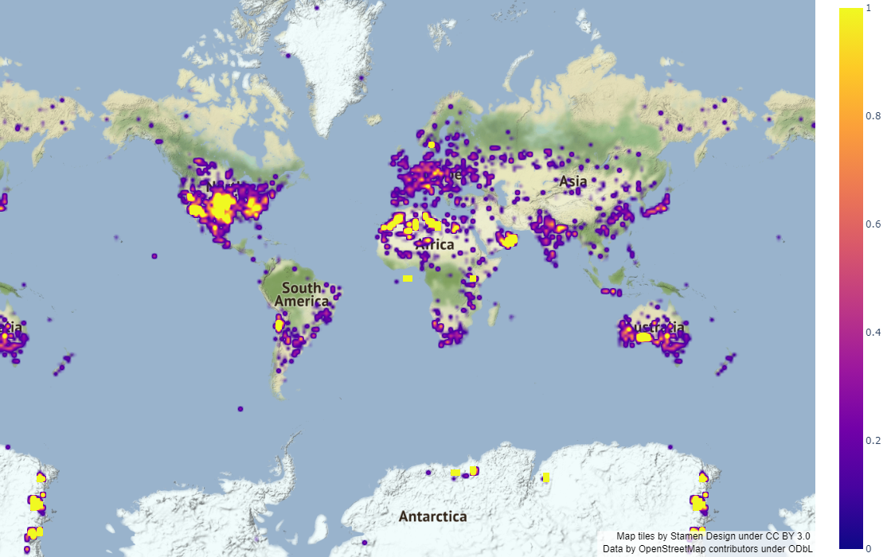
Approach to analysis(cont.)
Using plotly and matplotlib, python libraries to visualize data we created two unique maps based on the geolocation frequency of the fallen meteorites.

Slide 11
Approach to Analysis(cont.)
The first map was a geolocation frequency map that showed us the frequency of meteorites fallen in regards to the metrics of fell and found properties of the meteorites(for information on fell and found refer here).

Slide 12
Approach to Analysis(cont.)
The second map that was generated was frequency based heatmap, that allowed us to better understand which areas receive the most amount of Astro-debris.

Slide 13
Analysis and conclusions
After generating various pivot tables, dataframes, plots and maps, the team felt confident in the refined information produced from the data provided to now commence with the Exploratory Data Analysis and draw conclusions.
This was done by a visual analysis by the members of the team first, then cross referencing it with more data in the database, primarily year and frequency based data.

Slide 14
Analysis and conclusions(cont.)
Through visual analysis of both the fall-category based maps and frequency heatmap based maps we concluded with confidence that areas with the most meteor showers were as follows:
The United States of America
Oman
Northern Africa
Southern Australia
All of the above listed areas had the most concentrated areas of data points generated by the maps.

Slide 15
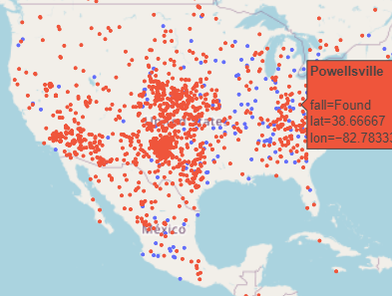
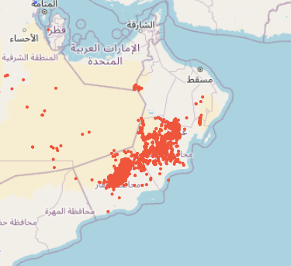
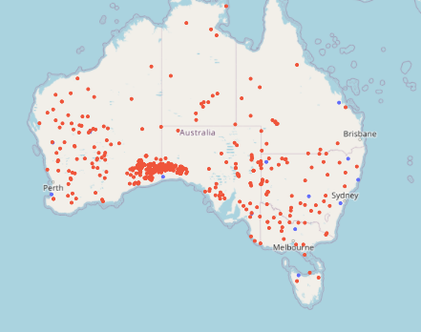
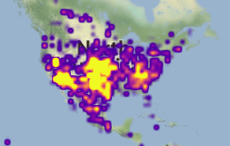
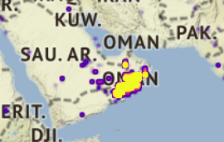
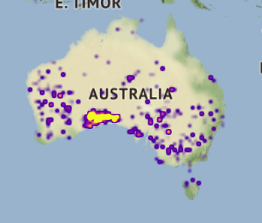
Analysis and conclusions(cont.)
USA
Oman
Southern Australia

Slide 16
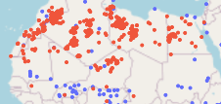
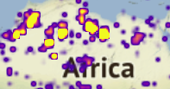
Analysis and conclusions(cont.)
Northern Africa

Slide 17
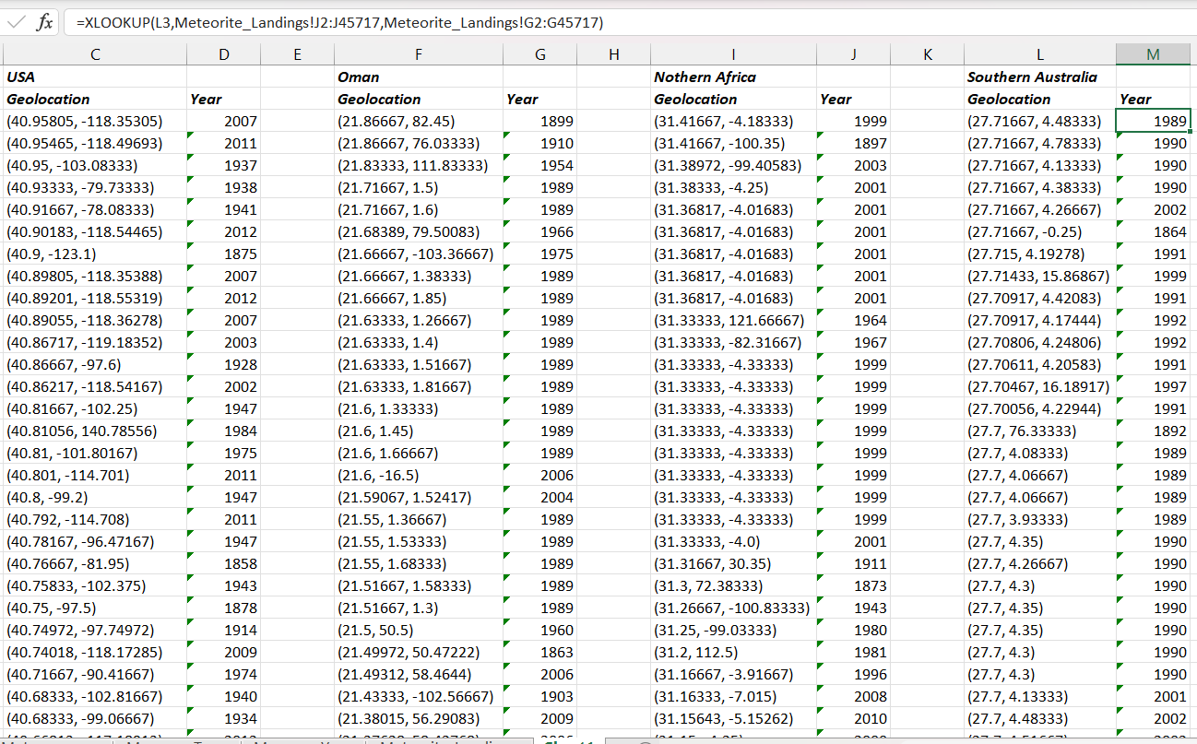
Analysis and conclusions(cont.)
After the visual analysis and location confirmation, we then proceeded to cross reference each major geolocation coordinate with the year it fell to find out the recency of the meteorites fallen.

Slide 18
Analysis and conclusions (cont.)
After some more fine tuning of the data and a significant amount of data analysis, we have concluded the following.
The areas which received the most amount of meteorite showers are
The USA, Oman, Northern Africa, Southern Australia, and European Continent.
The areas which received Astro-debris most recently were
The USA, Oman, Northern Africa, Southern Australia
Keeping in mind the frequency of meteorite showers and the recent time frame, we can confidently predict that The USA, Oman, Southern Australia and Northern Africa will be the areas which will receive the most amount of meteorite showers.
The European Continent, while receiving a significant amount of showers as well, has majority of its Astro-debris in a fell state and hasn’t received any showers in recent times as well. Therefore, we can conclude that it is not a hot zone for meteoric showers.

Slide 19
Analysis attributes
This analysis and prediction project was a hybrid of machine accuracy and human intuition, drawing the best properties of both sides and delivering a result that the team is confident in.
We estimate a prediction accuracy of 90 percent with this analysis, keeping in mind the random erratic nature of Astro-debris and acts of God.
No particular Machine Learning model or algorithm was implemented as, given the dataset, there were far too many differentiating variables for any particular ML model or algorithm to accurately process and give satisfactory results.
We have confidence that this hybrid we have taken is one of the better approaches to this particular problem case.

Slide 20
Conclusion
The meteorite landings analysis and prediction project aims to provide a significantly accurate model that can analyze past trends in meteorite showers and predict the areas which have the most amount of showers.
The team has worked rigorously and have delivered results that are accurate and can be implemented with fair confidence.
TEAM “Kuch Bhi”(Chitkara University)
Members-
Shubhanker Mehta
Shaurya Vashisht
Aseespreet Singh
Aakash Dixit

